Slide 1
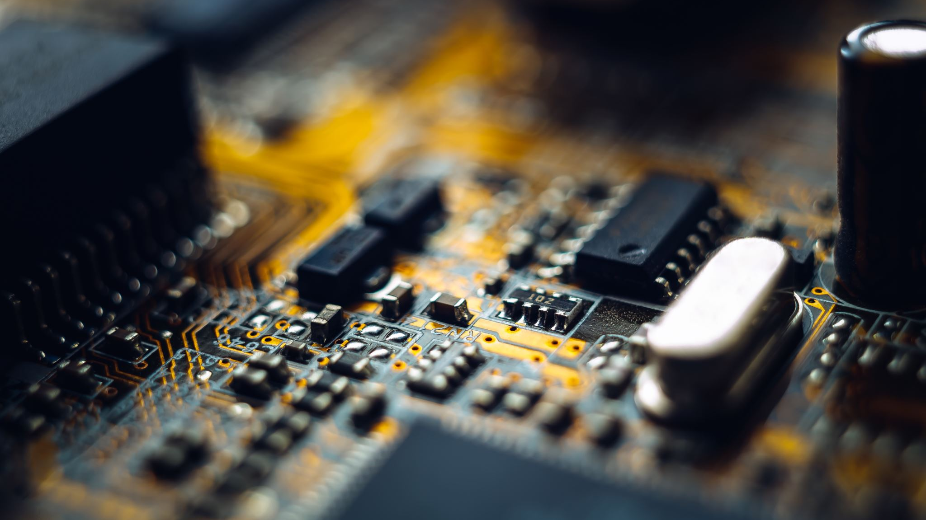
From Transistor to Silicon: How a Chip Is Born
IEEE Invited Student Lecture
Srinivas Rahul Sapireddy
Illinois State University
Notes:
Good morning everyone. Today I want to show you something fascinating: how the tiny chips inside your phone, laptop, smartwatch, and even AI systems are actually built.
We’ll start from a single transistor, which behaves like a tiny switch, and by the end of this talk, you’ll see how engineers transform that tiny switch into a real silicon chip.
Transition
So before we talk about design, let’s first understand why chips matter so much in our daily lives.

Slide 2
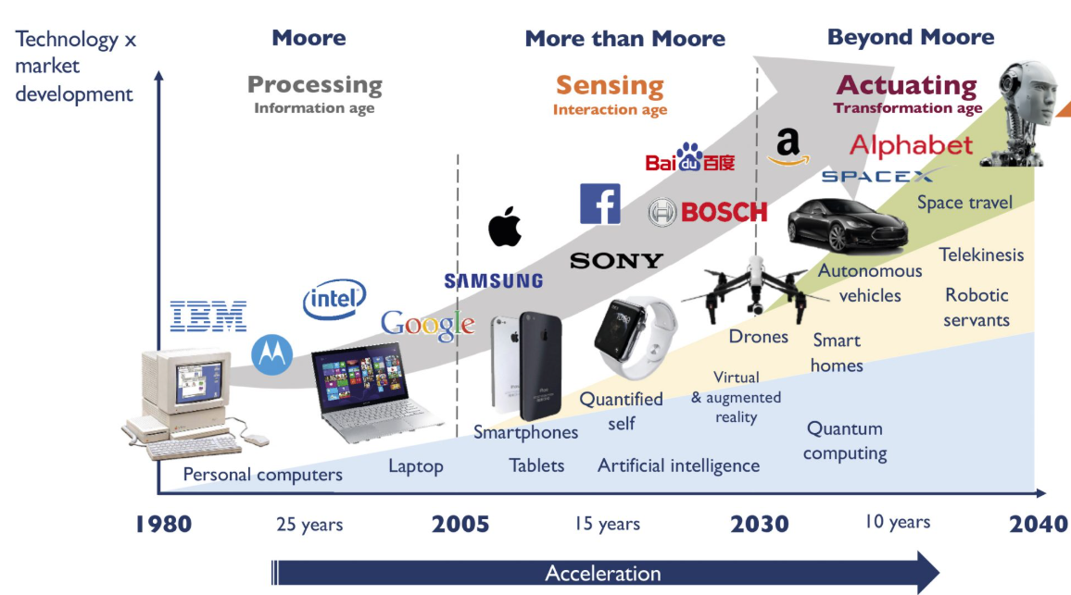
Why Chips Matter The Invisible Technology Around Us
Every smart device runs on chips.
From PCs to AI robots, every revolution is powered by silicon chips.
Notes:
What to say
Every smart device around us depends on chips. Your phone camera, laptop, Wi-Fi router, smartwatch, car sensors, and even AI tools all run because of silicon chips.
Earlier, chips were mainly used for faster computing in desktops and laptops. But today chips are everywhere:
smartphones
medical devices
autonomous cars
drones
AI robots
satellites
Chips are no longer just calculating numbers. They are making decisions, sensing the world, and enabling intelligence.
Good audience question
Can anyone guess how many chips are inside a smartphone?
Transition
As chips became more useful, engineers kept making them smaller and more powerful. That leads us to Moore’s Law.

Slide 3
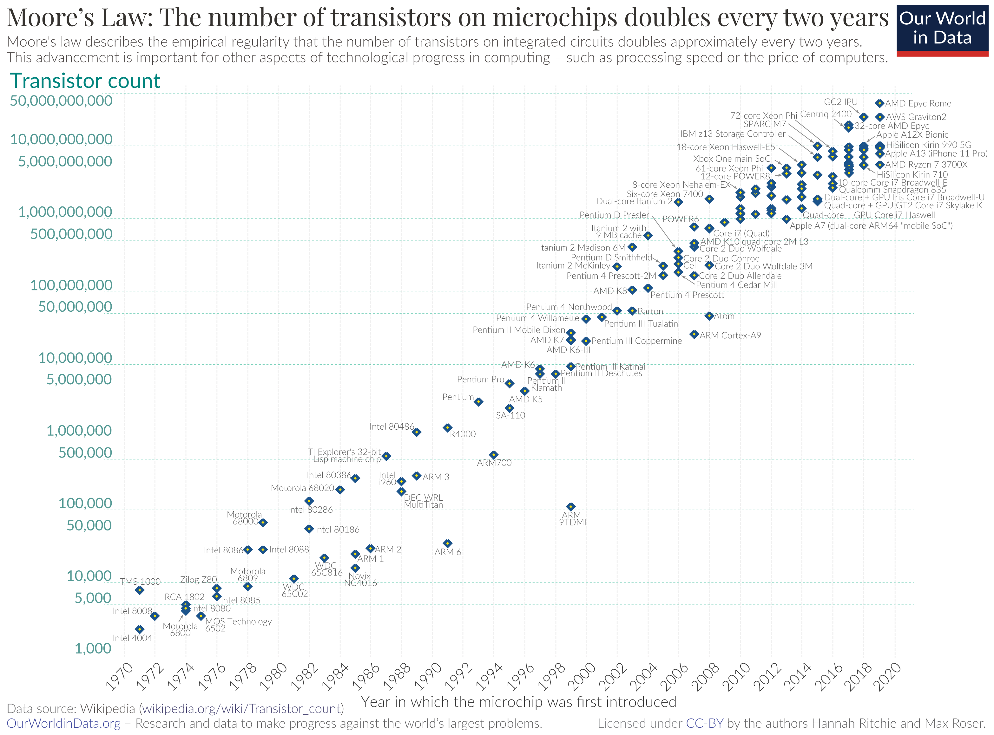
Moore’s Law
Notes:
What to say
Moore’s Law is the observation that the number of transistors on a chip roughly doubles every couple of years.
More transistors means:
more speed
more functionality
lower cost per operation
more AI capability
This is why your laptop today is far more powerful than a supercomputer from decades ago.
Nice line
The reason this is possible is because the transistor itself became unbelievably small.
Transition
So what exactly is this transistor that made the digital world possible?

Slide 4
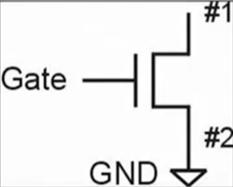


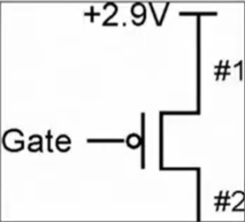


The Smallest Building Block
A transistor is an electronic switch.
n-type MOS Transistor
If the Gate = 1 (positive voltage), current can flow from source to drain → switch ON (closed)
If the Gate = 0 (zero voltage), current cannot flow → switch OFF (open)
p-type MOS Transistor
Gate = 0 → ON → switch closed
Gate = 1 → OFF → switch open
Gate = 1
Gate = 0
Gate = 0
Gate = 1
n-type MOS Transistor
p-type MOS Transistor
Notes:
What to say
A transistor is simply an electronic switch controlled by voltage.
Think of it like a water tap:
when the tap is open → water flows
when closed → no flow
In electronics:
Gate voltage controls the switch
current flows from source to drain
For NMOS:
Gate = 1 → ON
Gate = 0 → OFF
For PMOS:
Gate = 0 → ON
Gate = 1 → OFF
Simple memorable line
Every chip in the world is ultimately built from billions of these tiny voltage-controlled switches.
Transition
Once we have switches, the next question is: how do we make them perform computation?

Slide 5
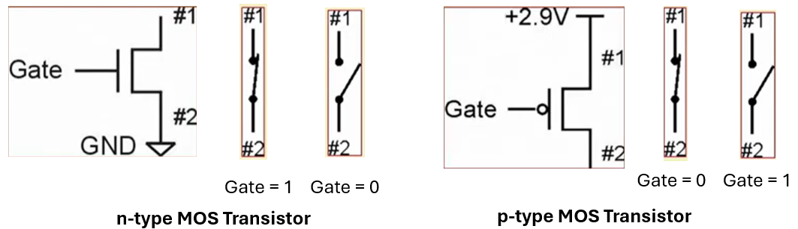
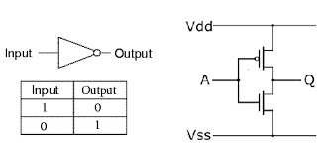
Basic Logic Gates
Digital logic gates typically operate on binary logic.
Two distinct values in binary logic, denoted by 0 and 1.
Why binary logic?
It is easy to design electronic circuits with two distinct states.
Examples:
An electronic switch is either open or closed.
Input A = 0 → Output Q = 1
Input A = 1 → Output Q = 0
PMOS on top, NMOS on bottom
One transistor ON, the other OFF
How Transistors Build an NOT Gate (Inverter)
Notes:
What to say
Here we combine one PMOS and one NMOS transistor to build the simplest logic gate: the NOT gate, also called an inverter.
If input is 0, output becomes 1. If input is 1, output becomes 0.
So this circuit flips the input.
This is the first step from physics to logic.
Key line
This is where transistors stop being just switches and start becoming computation.
Transition
Once we can build one logic gate, we can combine many gates into useful digital circuits.

Slide 6
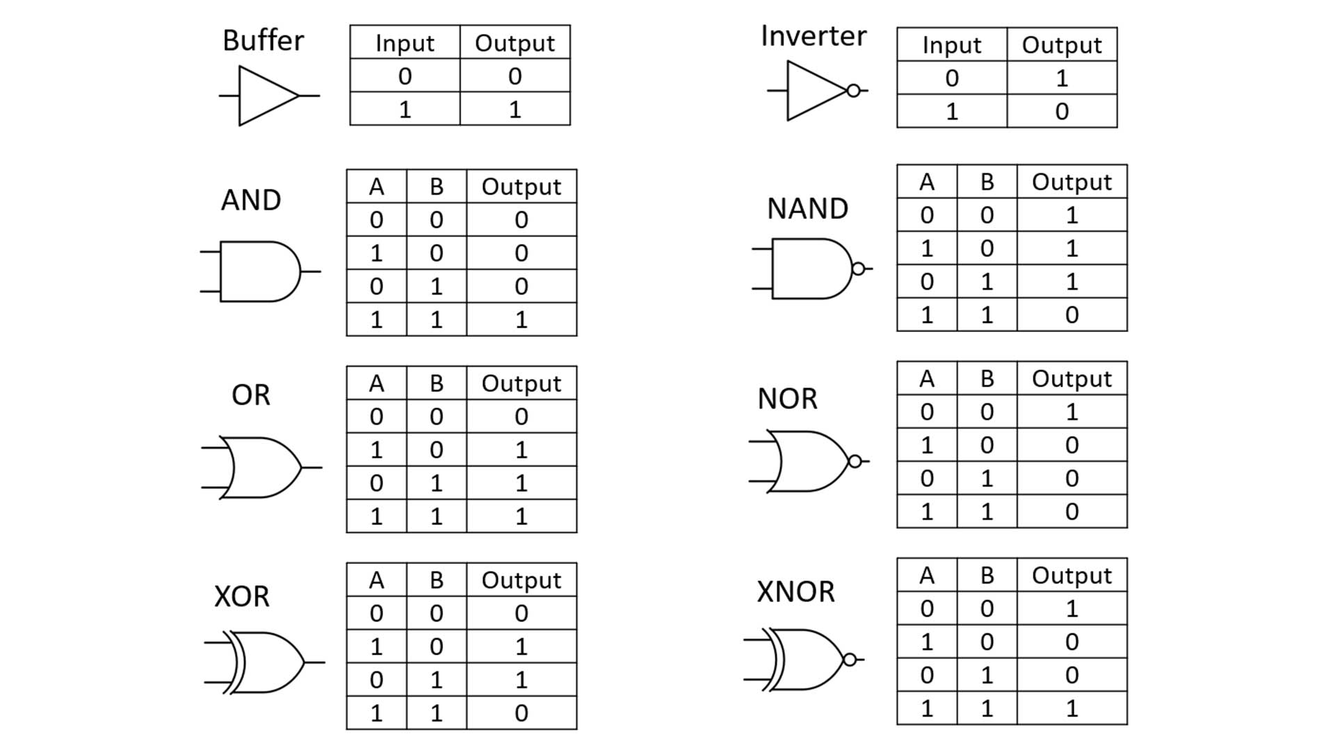
Basic Logic Gates
Notes:
What to say
By combining transistors in different ways, we can build:
AND
OR
NAND
NOR
XOR
These are the alphabet of digital design. Every processor, GPU, and AI accelerator is built from these basic logic blocks.
Nice line
Just like letters form words, gates form circuits.
Transition
Let’s now combine these gates into a simple arithmetic circuit.

Slide 7
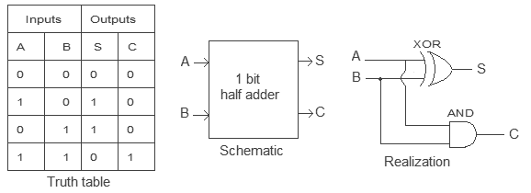
From Gates to Circuits
Half Adder Circuit Realization
Notes:
What to say
Here we use logic gates to build a half adder, which adds two binary numbers.
This is the beginning of arithmetic hardware. The same idea scales into:
ALUs
CPUs
DSPs
AI accelerators
Powerful line
Your laptop’s processor is essentially a very advanced version of this idea.
Transition
But engineers do not manually draw every gate in modern chips. Instead, we describe hardware using code.

Slide 8
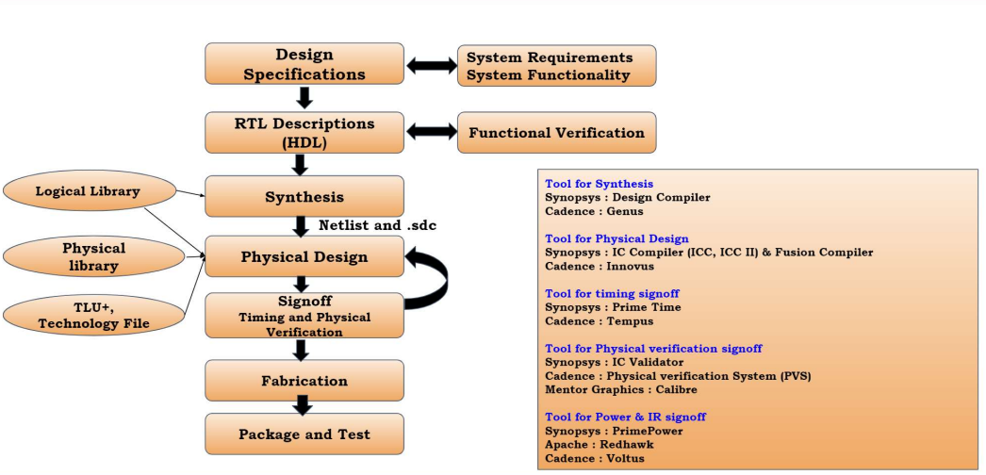
ASIC Design Flow
Notes:
What to say
Instead of drawing gates by hand, we write hardware in languages like:
Verilog
VHDL
SystemVerilog
This level is called RTL: Register Transfer Level.
RTL describes:
data movement
registers
combinational logic
timing behavior
Example line
So hardware engineers write code, but this code describes circuits, not software execution.
Transition
Once RTL is ready, software tools convert it into actual gates.

Slide 9
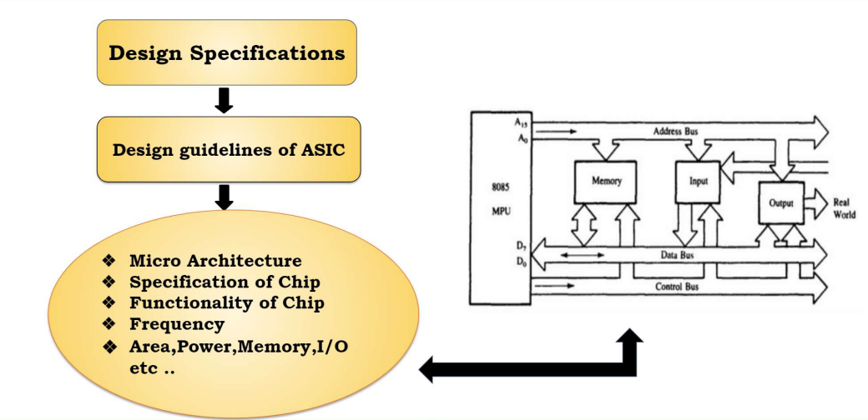
Design Specifications
Notes:
What to say
Synthesis converts RTL code into a gate-level netlist.
Think of this as translating:
human-readable hardware code into
real logic gates and standard cells
Nice line
This is where your Verilog becomes physically realizable hardware.
Transition
But gates alone are not enough. They must now be arranged on silicon.

Slide 10
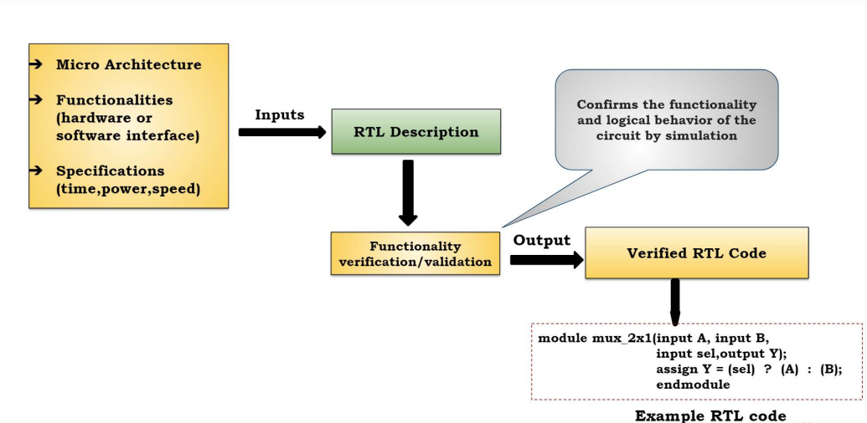
RTL Description (HDL)

Slide 11
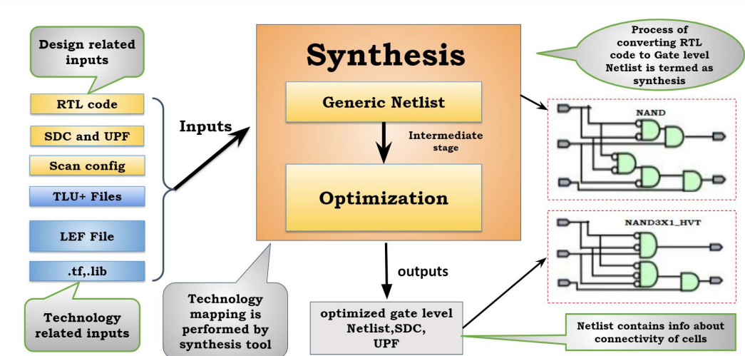
Synthesis

Slide 12
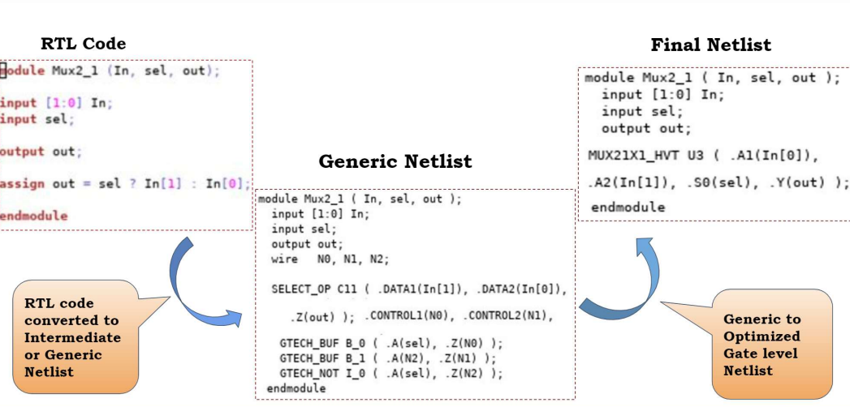
RTL Code to Optimized Netlist

Slide 13
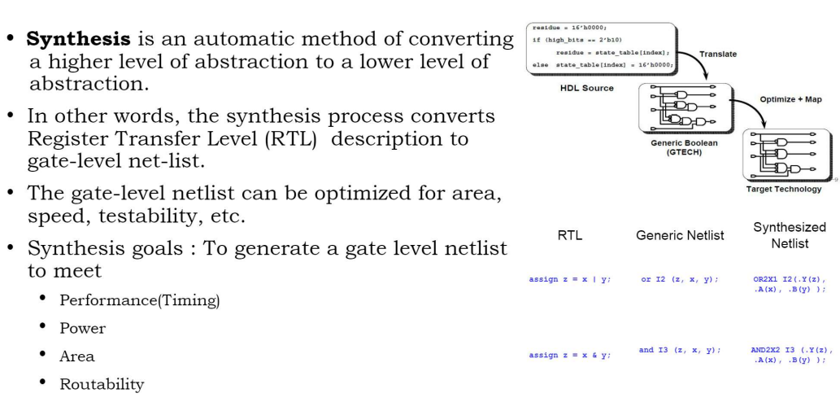
Logic Synthesis

Slide 14
PD FLOW and Terminology

Slide 15
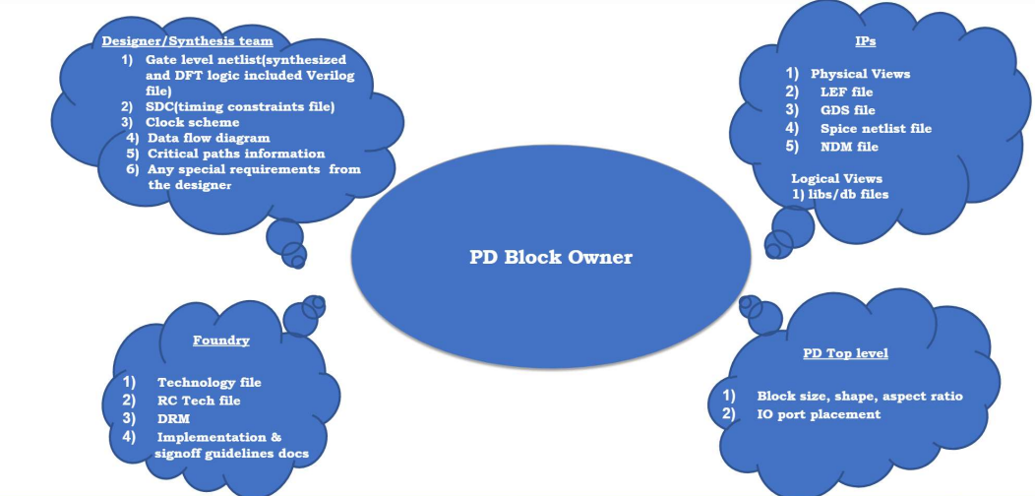
Inputs to PD Block Implementation

Slide 16
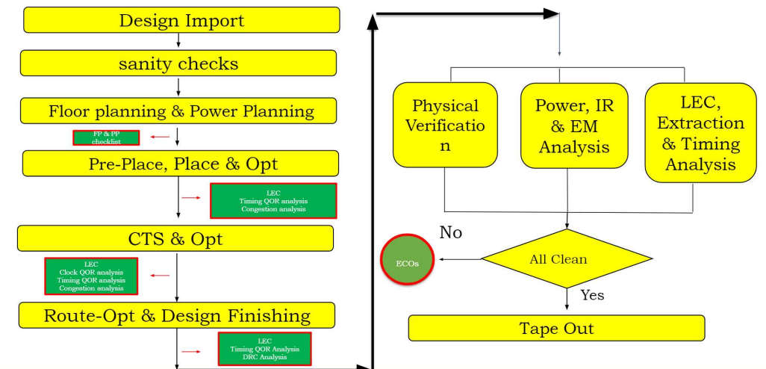
ASIC Block-level PD Flow

Slide 17
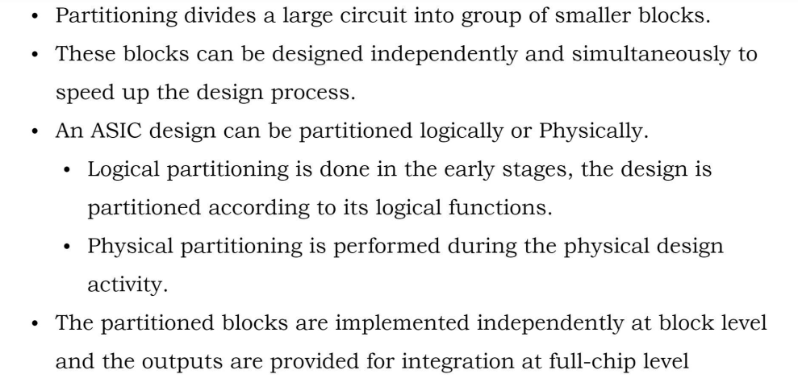
Full Chip Partitioning

Slide 18
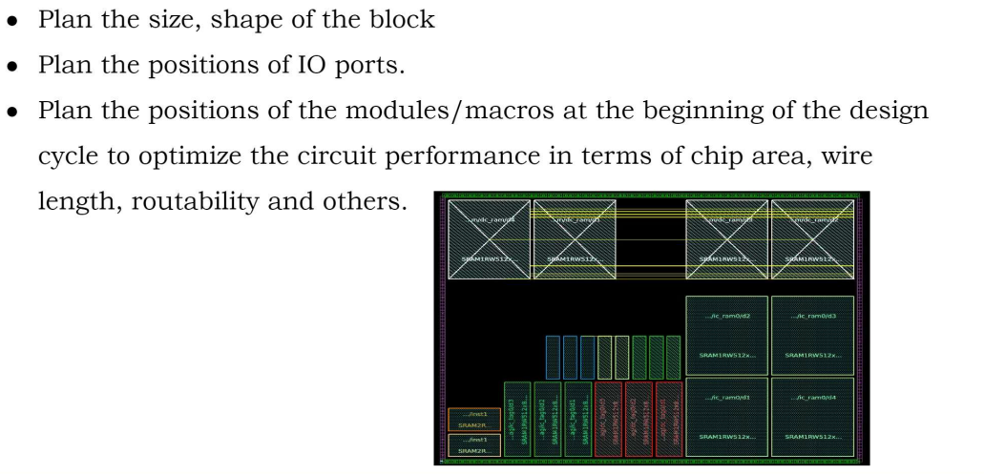
Floorplan
Notes:
ere we decide where major blocks go on the chip. Similar to planning rooms in a building:
CPU block
memory
IO
clock blocks

Slide 19
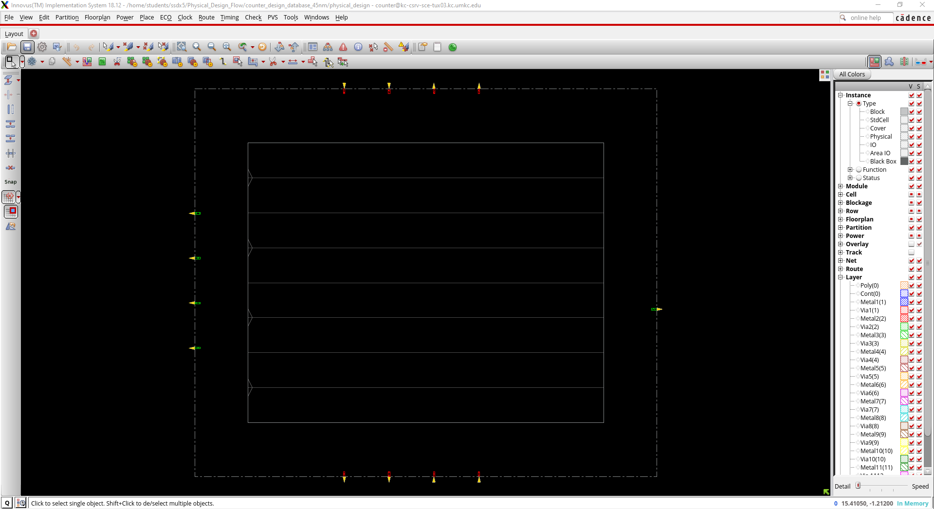
Floorplan

Slide 20
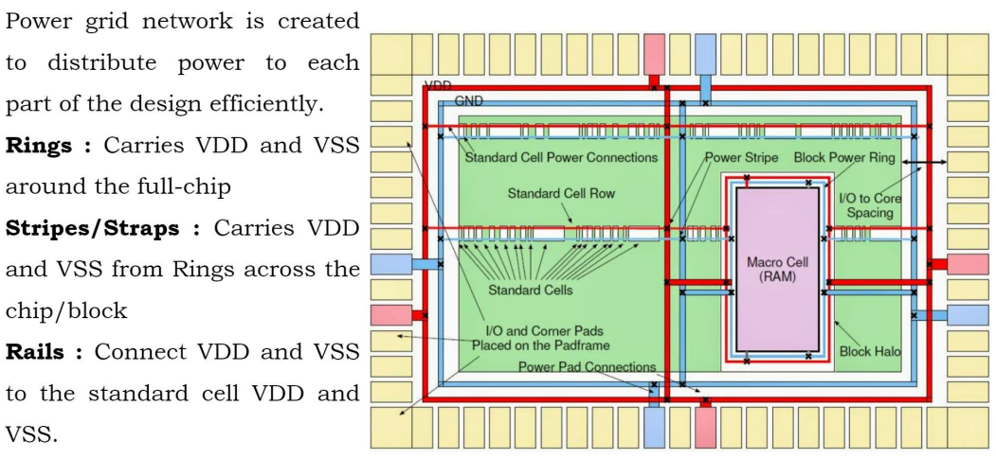
Power plan
Notes:
Just like buildings need electrical wiring, chips need power networks. We distribute VDD and ground safely across the chip.

Slide 21
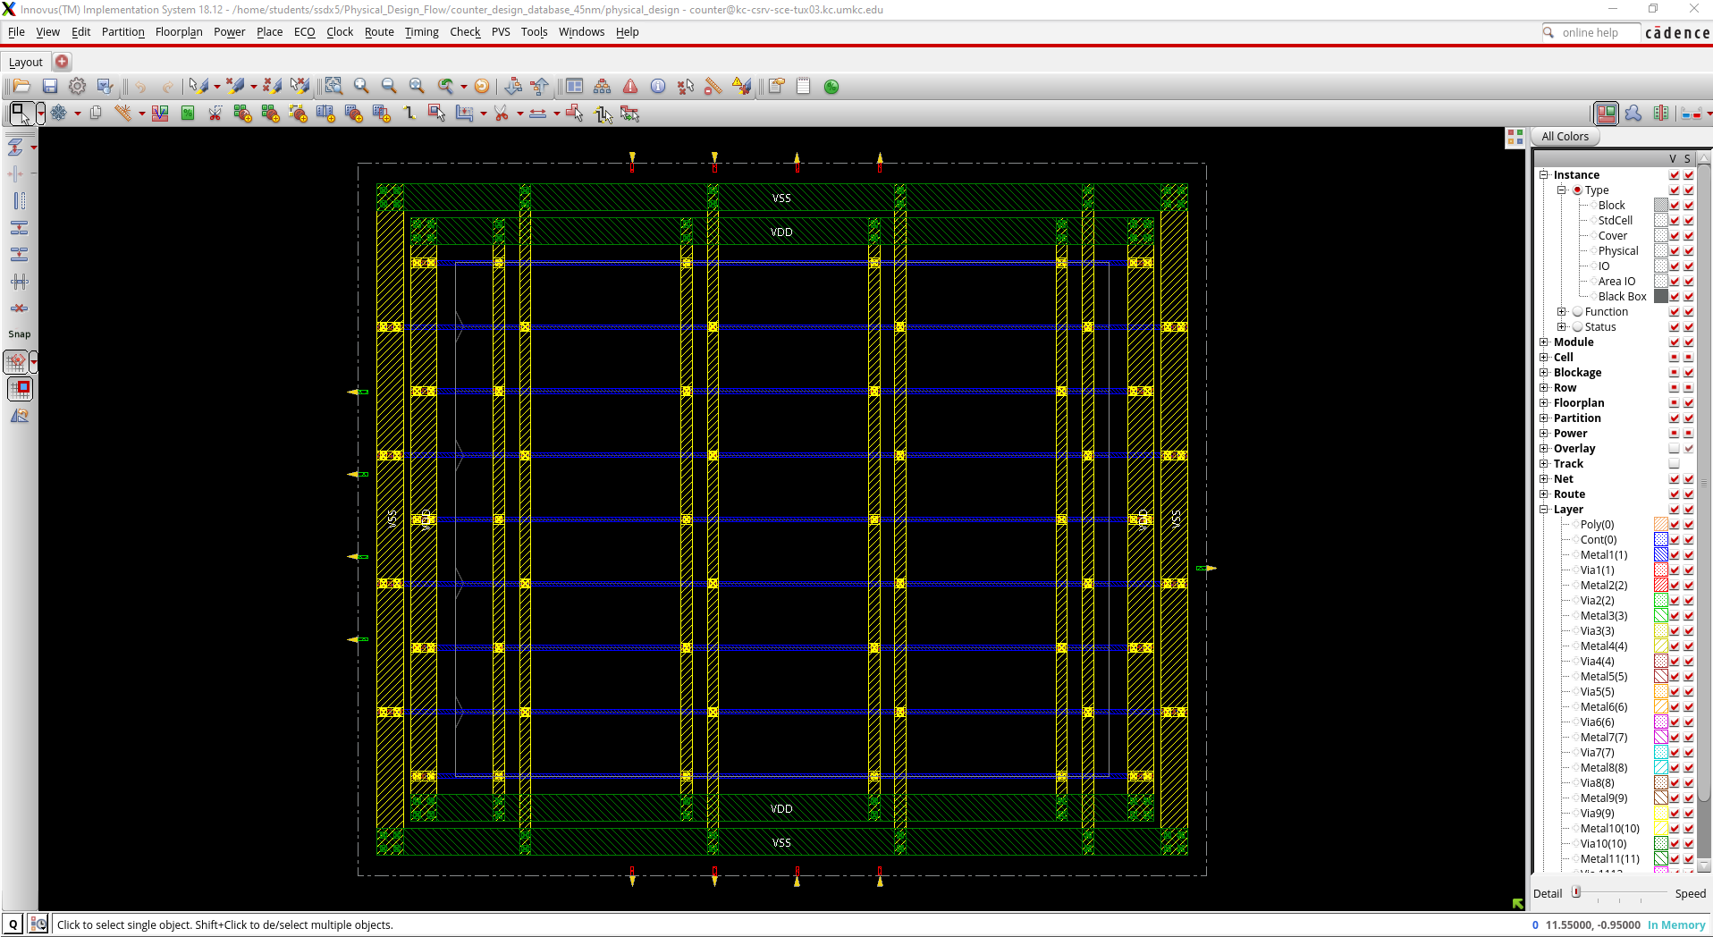
Power plan

Slide 22
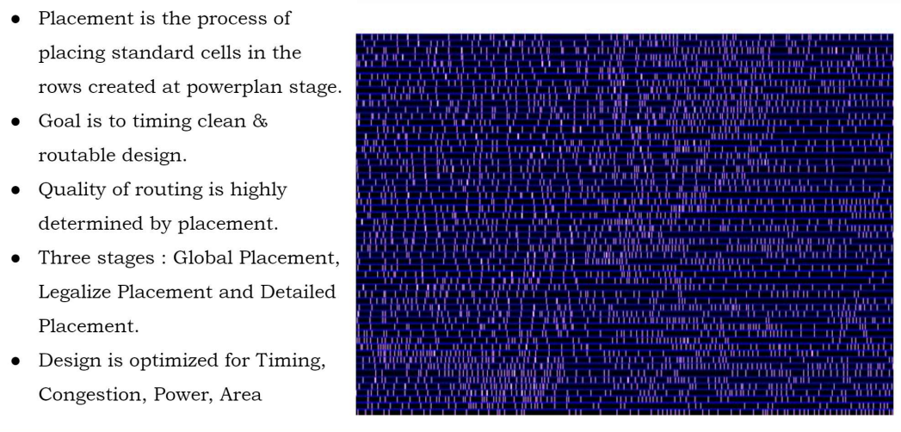
Placement and Optimization
Notes:
Now every standard cell is placed automatically by EDA tools. The goal is:
minimal delay
low congestion
low power

Slide 23
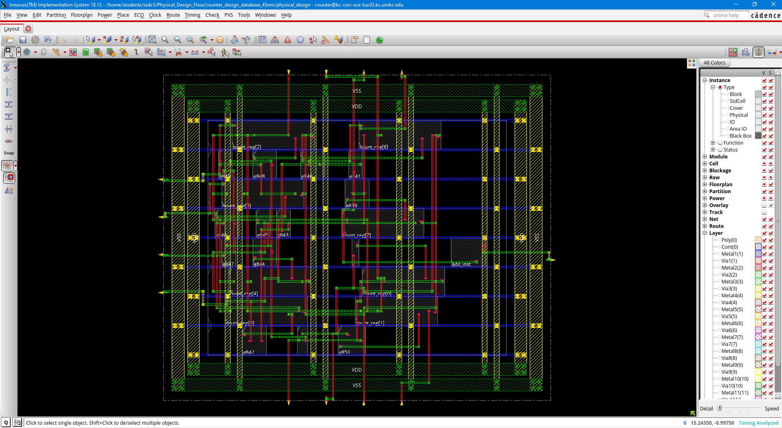
Placement and Optimization

Slide 24
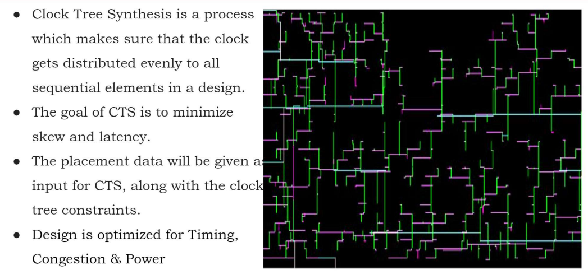
CTS and Optimization
Notes:
CTS means Clock Tree Synthesis. The clock must reach millions of flip-flops almost simultaneously. Otherwise timing errors happen.
Use analogy:
Like making sure every student in the room hears the bell at the same time.

Slide 25
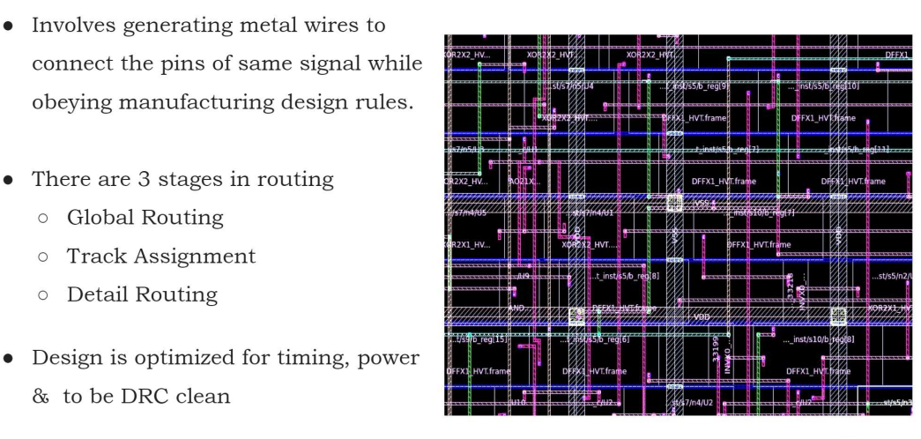
Routing and Optimization
Notes:
uting
After placement, we connect everything with metal wires. This is like building roads between houses in a city.
Great analogy
Placement decides where houses are. Routing builds the roads.

Slide 26
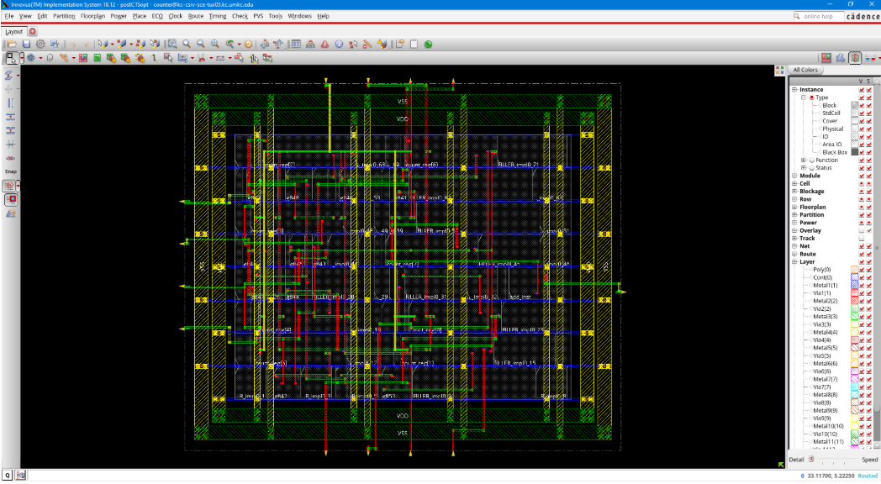
Routing and Optimization

Slide 27
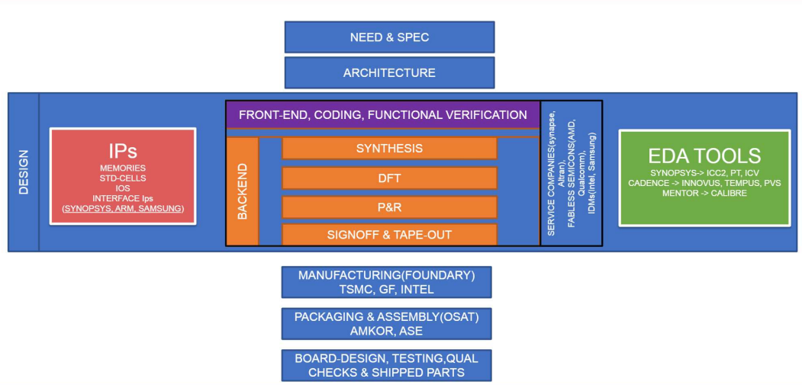
ASIC Design ECOSYSTEM

Slide 28

Questions?
Notes:
Now the circuit is doing logic, not just switching

