Slide 1

Introduction to Operating Systems
Smruti R Sarangi
IIT Delhi

Slide 2

What is an Operating Systems (OS)?
It is a special program
Can control other programs
Exercises control over hardware

Slide 3
Background Required
C/C++ programming proficiency
Computer Architecture
Data Structures

Slide 4
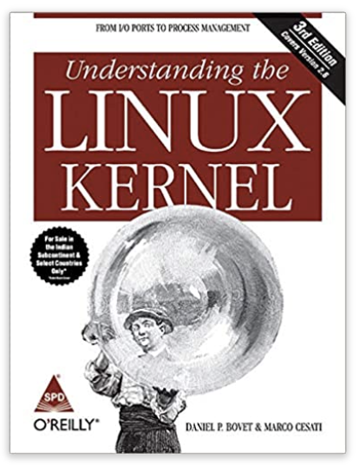
Textbook
Generic 0S concepts
Based on the latest Linux Kernel : Ver 5
Some understanding of kernel code
Homework Assignments : xv6
6.1810 / Fall 2022 (mit.edu)

Slide 5

Key Components
Who manages these?
CPU
Memory
Hard
Disk
I/0 devices

Slide 6

Place of the 0S
Programs
P1
P2
P3
Operating System
CPUs
Hardware
Memory
I/O & Storage

Slide 7
Why do we need a special program, the 0S?
Many programs share common hardware
The access to common hardware needs to be regulated
Hardware: CPU, memory, I/0 and storage
Schedule the CPU
Interface with devices
Manage storage
Manage memory
Security
Make it easy to build distributed systems
Makes it easy to work with HW

Slide 8

Basic Idea
Arbitration
A process is an instance of a running program
At any point of time multiple processes are active
The processes have different HW requirements
The 0S arbitrates between the processes
Accessing HW is very complex
Elaborate protocols
Same code needs to run on multiple machines
Provide a common interface: device derivers in the 0S
Access

Slide 9
Space of operating Systems
HPC and server
Desktop/laptop
Mobile

Slide 10
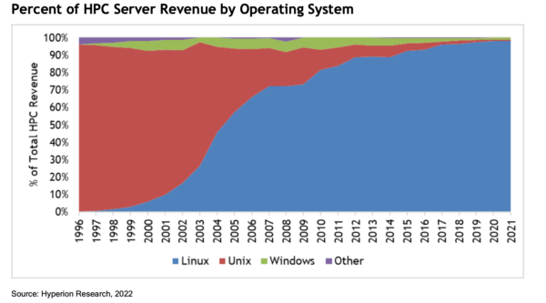

HPC 0S market share
Only Linux
now

Slide 11
History of Linux : milestones
1991
Linus Torvalds started extending the MINIX 0S
1992
Released under the GPL license. Available on the web.
2000 – 2010
Takes over the server and HPC market
Android (Linux-based) becomes the most popular mobile Operating System
2012 – 2020

Slide 12



Why teach a real –world 0S?
Conveys a realistic picture
Provides real-world skills
We will learn generic concepts in the context of Linux

Slide 13

Open Source Design
Freely available source code
www.kernel.org
https://elixir.bootlin.com/linux/latest/source/kernel
Version 6

Slide 14
Some Kernel Source Code Statistics
Roughly 25 million lines of source code
Per version, 250k lines of code change
Current version: 6.0.12
x
y
z
-rc<num>
rc → release candidate (test release)
Major version number
Patch number
Minor version number
Even numbers: production
Odd numbers: development

Slide 15
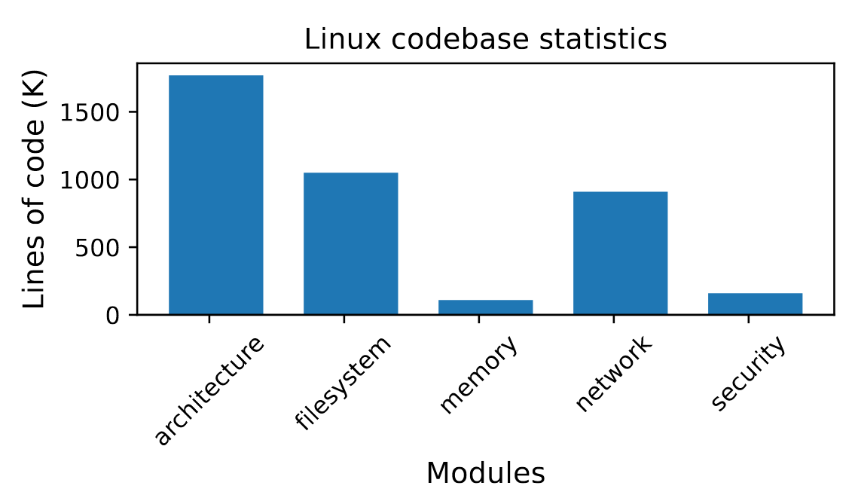
70% of the code is in drivers, rest in →

Slide 16
Major Subsystems in Linux (Directory-wise)
All the code
init: boot code
Process manager
HW-dependent code
Memory
and I/O
kernel: process scheduler, synchronization, time management, event management, debugging
mm: physical and virtual memory manager
arch: All the assembly code that is architecture dependent
fs: file systems
virt: Support for running a guest OS as a regular program.
drivers: All the kernel routines that run the devices. Translate generic OS calls to HW-specific instructions.
block: generic layer for all block-based storage
devices like hard disks
io_uring: data structures for I/O support

Slide 17

Factoid
Android, Chrome OS, Tizen (Samsung), Web OS (LG) are all based on Linux.

Slide 18


srsarangi@cse.iitd.ac.in

Slide 19
















Slide 20














Answer:

