Slide 1
CSL211
Computer Architecture
Processor design -
Introduction
30th August, 2011

Slide 2

MIPS subset for implementation
Arithmetic - logic instructions
  add, sub, and, or, slt
Memory reference instructions
  lw, sw
Control flow instructions
  beq, j
Incremental changes in the design to include other instructions will be discussed later

Slide 3
Format of instructions
lw, sw, beq I - format
op rs rt 16 bit number
j J - format
op 26 bit number
add, sub, and, or, slt R - format
op rs rt rd shamt funct

Slide 4
Generic Implementation
use the program counter (PC) to supply instruction address
get the instruction from memory
read registers
use the instruction to decide exactly what to do

Slide 5
Design overview
D
a
t
a
R
e
g
i
s
t
e
r
#
P
C
A
d
d
r
e
s
s
I
n
s
t
r
u
c
t
i
o
n
R
e
g
i
s
t
e
r
s
A
L
U
A
d
d
r
e
s
s
I
n
s
t
r
u
c
t
i
o
n
R
e
g
i
s
t
e
r
#
m
e
m
o
r
y
D
a
t
a
R
e
g
i
s
t
e
r
#
m
e
m
o
r
y
D
a
t
a

Slide 6
Division into data path and control
DATA PATH
control
signals
status
signals
CONTROLLER

Slide 7
Building block types
Two types of functional units:
elements that operate on data values (combinational)
  output is function of current input
  no memory
elements that contain state (sequential)
  output is function of current and previous inputs
  state = memory

Slide 8
Combinational circuit examples
gates: and, or, nand, nor, xor, inverter
multiplexer
decoder
adder, subtractor, comparator
ALU
array multipliers

Slide 9
Sequential circuit examples
flip-flops
counters
registers
register files
memories

Slide 10
Clocked vs. unclocked circuit
Clocked state element
  state changes only with clock edge
Unclocked state element
  state changes can occur with changes in other inputs
falling edge
cycle time
rising edge

Slide 11
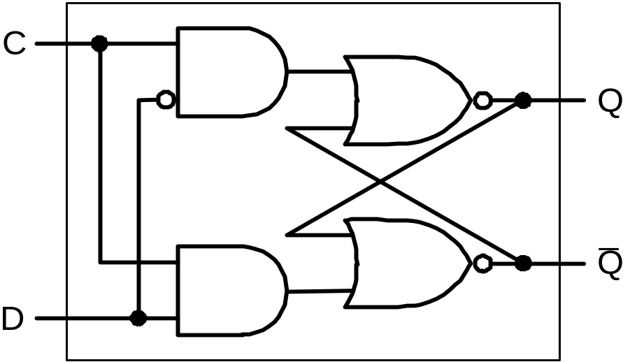
Unclocked state elements
R
Q
_
Q
S
D
C
Q

Slide 12
Clocked state elements
D
D
Q
D
Q
Q
D
D
l
a
t
c
h
l
a
t
c
h
_
_
C
C
Q
Q
C
D
C
Q

Slide 13
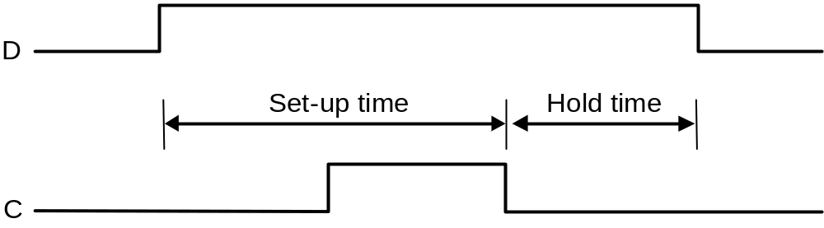
Clock and timings
S
t
a
t
e
S
t
a
t
e
e
l
e
m
e
n
t
C
o
m
b
i
n
a
t
i
o
n
a
l
l
o
g
i
c
e
l
e
m
e
n
t
1
2
C
l
o
c
k
c
y
c
l
e

Slide 14
Components for MIPS subset
Register
Adder
ALU
Multiplexer
Register file
Program memory
Data memory
Bit manipulation components

Slide 15
MIPS components - register
PC
32
32
clock

Slide 16
MIPS components - adder
PC
PC+4
32
32
+
+
32
32
4
offset
32
32

Slide 17
MIPS components - ALU
operation
a=b
a
overflow
32
ALU
result
32
b
32

Slide 18
MIPS components - multiplexers
PC+4
0
mux
1
32
PC+4+offset
32
32
select

Slide 19
MIPS components - register file
5
R
e
a
d
r
e
g
i
s
t
e
r
1
R
e
a
d
R
e
g
i
s
t
e
r
5
d
a
t
a
1
R
e
a
d
n
u
m
b
e
r
s
r
e
g
i
s
t
e
r
2
R
e
g
i
s
t
e
r
s
D
a
t
a
5
W
r
i
t
e
r
e
g
i
s
t
e
r
R
e
a
d
d
a
t
a
2
W
r
i
t
e
D
a
t
a
d
a
t
a
R
e
g
W
r
i
t
e

Slide 20
MIPS components - program memory
I
n
s
t
r
u
c
t
i
o
n
a
d
d
r
e
s
s
I
n
s
t
r
u
c
t
i
o
n
I
n
s
t
r
u
c
t
i
o
n
m
e
m
o
r
y

Slide 21
MIPS components - data memory
M
e
m
W
r
i
t
e
A
d
d
r
e
s
s
R
e
a
d
d
a
t
a
W
r
i
t
e
D
a
t
a
d
a
t
a
m
e
m
o
r
y
M
e
m
R
e
a
d

Slide 22
MIPS components - bit manipulation circuits
sign
xtend
MSB
16
32
LSB
shift
MSB
32
32
0
LSB

Slide 23
Datapath for add,sub,and,or,slt
fetch instruction
address the register file
pass operands to ALU actions
pass result to register file required
increment PC
Format: add $t0, $s1, $s2
000000 10001 10010 01000 00000 100000
op rs rt rd shamt funct

Slide 24
Fetching instruction
IM
PC
ad
ins

Slide 25
Addressing RF
ins[25-21]
rad1
IM
RF
PC
ad
ins[20-16]
rd1
ins
rad2
wad
rd2
wd

Slide 26
Passing operands to ALU
ins[25-21]
rad1
IM
RF
PC
ad
ins[20-16]
rd1
ins
rad2
ALU
wad
rd2
wd

Slide 27
Passing the result to RF
ins[25-21]
rad1
IM
RF
PC
ad
ins[20-16]
rd1
ins
rad2
ALU
wad
rd2
ins[15-11]
wd

Slide 28
Incrementing PC
+
4
ins[25-21]
rad1
IM
RF
PC
ad
ins[20-16]
rd1
ins
rad2
ALU
wad
rd2
ins[15-11]
wd

Slide 29
Load and Store instructions
format : I
Example: lw $t0, 32($s2)
35 18 9 32
op rs rt 16 bit number

Slide 30
Adding “sw” instruction
+
4
ins[25-21]
rad1
IM
RF
PC
ad
ins[20-16]
rd1
ins
rad2
ALU
DM
wad
rd2
0
1
ad
rd
ins[15-11]
wd
wd
16
sx
ins[15-0]

Slide 31
Adding “lw” instruction
+
4
ins[25-21]
rad1
IM
RF
PC
ad
ins[20-16]
rd1
ins
rad2
ALU
DM
0
1
wad
rd2
0
1
ad
rd
1
0
ins[15-11]
wd
wd
16
sx
ins[15-0]

Slide 32
Format of beq instruction
beq I - format
op rs rt 16 bit number

Slide 33
Adding “beq” instruction
0
1
+
+
4
s2
ins[25-21]
rad1
IM
RF
PC
ad
ins[20-16]
rd1
ins
rad2
ALU
DM
0
1
wad
rd2
0
1
ad
rd
1
0
ins[15-11]
wd
wd
16
sx
ins[15-0]

Slide 34
MIPS components - bit manipulation circuits
sign
xtend
MSB
16
32
LSB
shift
MSB
32
32
0
LSB

Slide 35
Format of jump instruction
j J - format
op 26 bit number

Slide 36
Adding “j” instruction
ins[25-0]
28
s2
ja[31-0]
1
0
0
1
PC+4[31-28]
+
+
4
s2
ins[25-21]
rad1
IM
RF
PC
ad
ins[20-16]
rd1
ins
rad2
ALU
DM
0
1
wad
rd2
0
1
ad
rd
1
0
ins[15-11]
wd
wd
16
sx
ins[15-0]

Slide 37
Control signals
jmp
ins[25-0]
28
s2
ja[31-0]
1
0
0
1
PC+4[31-28]
+
+
4
s2
Psrc
ins[25-21]
RW
rad1
MW
IM
RF
Z
PC
ad
ins[20-16]
rd1
M2R
ins
rad2
ALU
DM
0
1
rd2
Asrc
ad
rd
wad
0
1
1
0
ins[15-11]
wd
3
op
wd
Rdst
16
sx
ins[15-0]
MR

Slide 38
Datapath + Control
jmp
ins[25-0]
28
s2
ja[31-0]
1
0
0
1
PC+4[31-28]
+
+
4
s2
brn
Psrc
ins[31-26]
control
ins[25-21]
RW
rad1
MW
IM
RF
Z
PC
ad
ins[20-16]
rd1
M2R
ins
rad2
ALU
DM
0
1
rd2
Asrc
ad
rd
wad
0
1
1
0
ins[15-11]
wd
3
op
wd
Rdst
16
sx
Actrl
ins[15-0]
MR
ins[5-0]
2
opc

Slide 39
Summary
Processor designed for {add, sub, and, or, slt, lw, sw, beq, j}
Step by step approach
Started with {add, sub, and, or, slt}
Added {sw, lw}, then added {beq, j}
Identified control signals and connected to a controller (black box).

