Slide 1
Course Policies
COL 216

Slide 2
Structure of the Course
Component | Marks
Minor 1 (1.5 hours) | 20
Minor 2 (1.5 hours) | 20
Major (2 hours) | 30
Assignment 1 | 9
Assignment 2 | 9
Assignment 3 | 12

Slide 3

Textbook
Details given on the website.
Published by McGrawHill
E-book also available
Amazon and Flipkart

Slide 4
Grading Scheme
Grade | Range
A | 80-100
A- | 72-80
B | 64-72
B- | 56-64
C | 48-56
C- | 40-48
D | 30-40
E | 25-30
F | 0-25

Slide 5
Phased Assignments
Assume Assignment 1 has a deadline of February 1st
Not able to submit on Feb 1st.
Reasons: Late (even by 1 ns), wrong format, assignment lost, any other issue
Submit assignment 1a on Feb. 10th
Little more work
If there are problems with 1a, submit 1b on 20th.
No penalties. You just keep on doing additional work.

Slide 6
Self Proposed Assignments
You can propose to do something advanced, and get credit for it.
It should be in the scope of the course, and should be more complicated than the existing assignments.
It should be pre-approved by the instructor
If your idea is promising, then we can also fuse two assignments into one.
Beware: It might be risky, if your idea does not work

Slide 7
Extra Minor
Missed a minor due to an illness
Need to submit a medical certificate within a week after returning
We will have 1 reminor after the major for only those students who have submitted valid medical certificates
Will be 2X more difficult than a regular minor

Slide 8

Passing Criterion
Theory: >= 20/70
Lab: >= 10/30

Slide 9

Rescue Assignment
After minor 2, we will release a rescue assignment (10 marks)
Marks will be added to the total
It can be used to convert E/F to a D

Slide 10
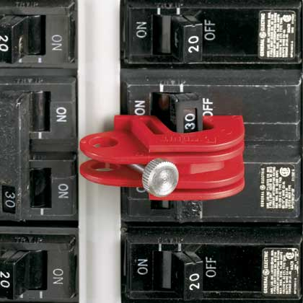
Circuit Breakers
If less than three students get an A, then the total marks will be scaled such that the third student gets 80
If more than 15 students get an A, then the total marks will be scaled such that the 15th student gets 80
If more than 15 students fail the course after considering the rescue assignment, then these students will be asked to write an extra quiz (10 marks) after additional study. The maximum grade that they can get is a D.
Upper
Lower

Slide 11

Academic Misconduct
Student caught cheating …
All parties: 0 in assignment (no resubmissions)
Not eligible for the rescue assignment
Not eligible for the lower circuit breaker
Additionally: -10 from the overall total.

