Slide 1
Introduction to Computer
Architecture
Smruti Ranjan Sarangi, IIT Delhi

Slide 2
What is Computer Architecture ?
Answer : It is the study of computers ?
Computer Architecture
  The view of a computer as presented to software designers
Computer Organization
  The actual implementation of a computer in hardware.

Slide 3


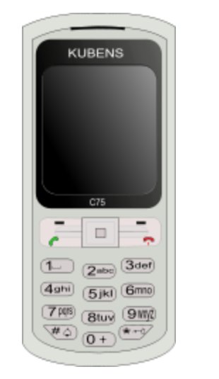
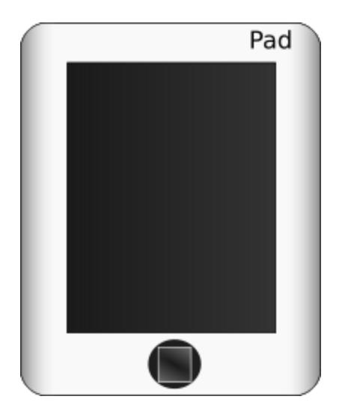
What is a Computer ?
A computer is a general purpose device that can be programmed to process
information, and yield meaningful results.

Slide 4
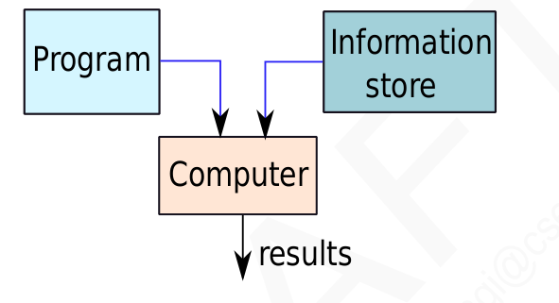
How does it work ?
Program – List of instructions to the computer
Information store – data, images, files, videos
Computer – Process the information store according to the instructions in the program

Slide 5
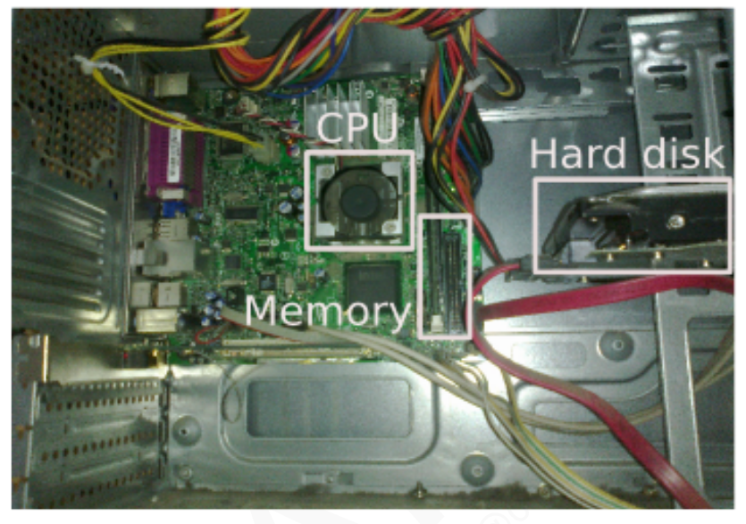
What does a Computer Look Like ?
Let us take the lid off a desktop computer

Slide 6
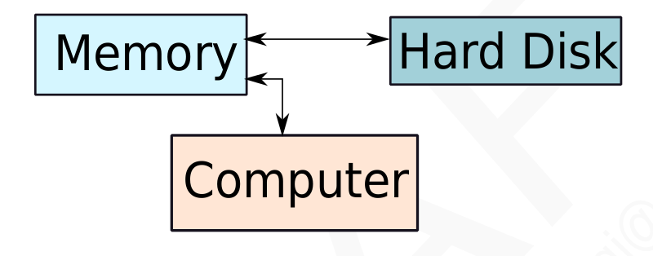
Memory – stores programs and data. Gets destroyed when the computer is powered off
Hard disk – stores programs/data permanently

Slide 7
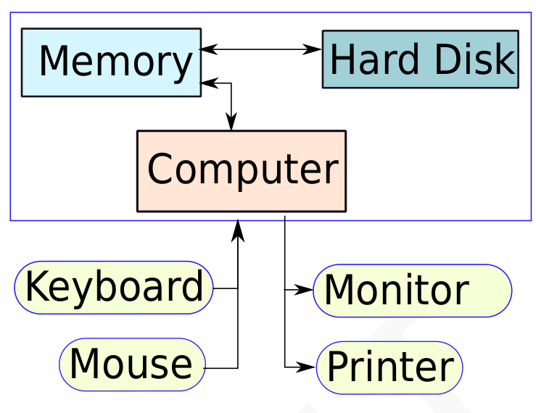
Let us make it a full system ...

Slide 8

Food for Thought...
What is the most intelligent computer ?

Slide 9
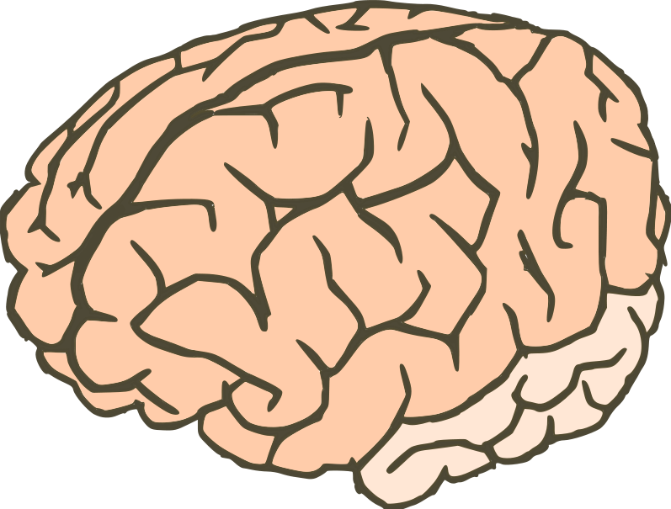
Answer ...
Our brilliant brains

Slide 10
Outline
Language of Instructions
  Instruction Set Architecture
  Features of an ISA – Complete, Concise, Generic, Simple
Completeness of an ISA
  Turing Machines
  Universal Machines
  Single Instruction/Multi-Instruction ISA
Design of Practical Machines
  Harvard/ Von Neumann Machines
  Registers
Road Ahead

Slide 11
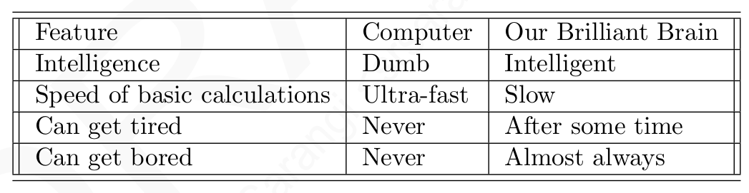
How does an Electronic Computer
Differ from our Brain ?
Computers are ultra-fast and ultra-dumb

Slide 12
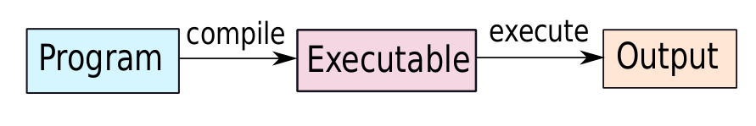
How to Instruct a Computer ?
Write a program in a high level language – C, C++, Java
Compile it into a format that the computer understands
Execute the program

Slide 13
What Can a Computer Understand ?
Computer can clearly NOT understand instructions of the form
  Multiply two matrices
  Compute the determinant of a matrix
  Find the shortest path between Mumbai and Delhi
They understand :
  Add a + b to get c
  Multiply a + b to get c

Slide 14
The Language of Instructions
Humans can understand
  Complicated sentences
    English, French, Spanish
Computers can understand
  Very simple instructions
The semantics of all the instructions supported by a processor is known
as the instruction set architecture (ISA). This includes the semantics of
the instructions themselves, along with their operands, and interfaces with
peripheral devices.

Slide 15
Features of an ISA
Example of instructions in an ISA
  Arithmetic instructions : add, sub, mul, div
  Logical instructions : and, or, not
  Data transfer/movement instructions
Complete
  It should be able to implement all the programs that users may write.

Slide 16
Features of an ISA- II
Concise
  The instruction set should have a limited size. Typically an ISA contains 32-1000 instruction.
Generic
  Instructions should not be too speicalized, e.g. add14 (adds a number with 14)
Simple
  Should not be very complicated.

Slide 17
Designing an ISA
Important questions that need to be answered :
  How many instructions should we have ?
  What should they do ?
  How complicated should they be ?
Two different paradigms : RISC and CISC
RISC
(Reduced Instruction Set
Computer)
CISC
(Complex Instruction
Set Computer)

Slide 18
RISC vs CISC
A reduced instruction set computer (RISC) implements simple instructions
that have a simple and regular structure. The number of instructions is
typically a small number (64 to 128). Examples: ARM, IBM PowerPC,
HP PA-RISC
A complex instruction set computer (CISC) implements complex instruc-
tions that are highly irregular, take multiple operands, and implement com-
plex functionalities. Secondly, the number of instructions is large (typically
500+). Examples: Intel x86, VAX

Slide 19
Summary Uptil Now ...
Computers are dumb yet ultra-fast machines.
Instructions are basic rudimentary commands used to communicate with the processor. A computer can execut billions of instructions per second.
The compiler transforms a user program written in a high level language such as C to a program consisting of basic machine instructions.
The instruction set architecture(ISA) refers to the semantics of all the instructions supported by a processor.
The instruction set needs to be complete. It is desirable if it is also concise, generic, and simple.

Slide 20
Outline
Language of Instructions
  Instruction Set Architecture
  Features of an ISA – Complete, Concise, Generic, Simple
Completeness of an ISA
  Turing Machines
  Universal Machines
  Single Instruction/Multi-Instruction ISA
Design of Practical Machines
  Harvard/ Von Neumann Machines
  Registers
Road Ahead

Slide 21


Completeness of an ISA
How can we ensure that an
ISA is complete ?
Complete means :
  Can implement all types of programs
  For example, if we just have add instructions, we cannot subtract

Slide 22
Completeness of an ISA – II
How to ensure that we have just enough instructions such that we can implement every possible program that we might want to write ?

Slide 23
Answer
Let us look at results in theoretical computer science
Is there an universal ISA ?
Universal ISA
Universal Machine
The universal machine has a set of basic actions, and each such
action can be interpreted as an instruction.

Slide 24
The Turing Machine – Alan Turing
Facts about Alan Turing
  Known as the father of computer science
  Discovered the Turing machine that is the most powerful computing device known to man
  Indian connection : His father worked with the Indian Civil Service at the time he was born. He was posted in Chhatrapur, Odisha.

Slide 25
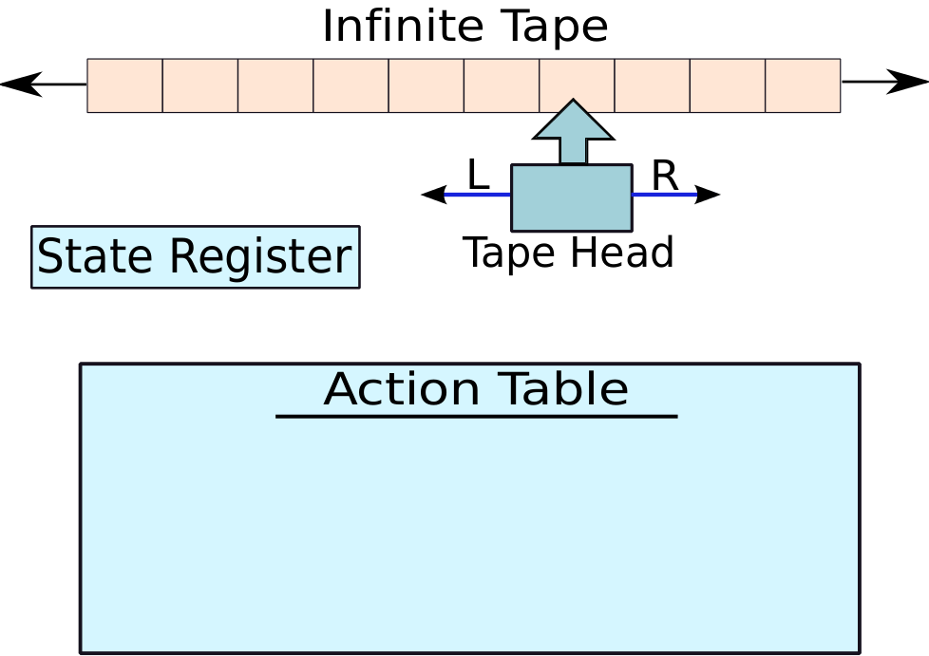
Turing Machine
(old state, old symbol) -> (new state, new symbol, left/right)

Slide 26
Operation of a Turing Machine
There is an inifinite tape that extends to the left and right. It consists of an infinite number of cells.
The tape head points to a cell, and can either move 1 cell to the left or right
Based on the symbol in the cell, and its current state, the Turing machine computes the transition :
  Computes the next state
  Overwrites the symbol in the cell (or keeps it the same)
  Move to the left or right by 1 cell
The action table records the rules for the transitions.

Slide 27
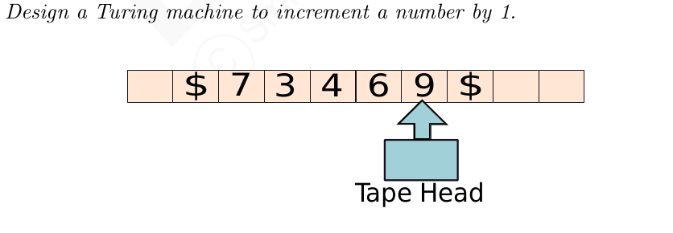
Example of a Turing Machine
Start from the rightmost position. (state = 1)
If (state = 1), replace a number x, by x+1
The new state is equal to the value of the carry
Keep going left till the '$' sign

Slide 28
More about the Turing Machine
This machine is extremely simple, and extremely powerful
  We can solve all kinds of problems – mathematical problems, engineering analyses, protein folding, computer games, …
  Try to use the Turing machine to solve many more types of problems (TODO)

Slide 29
Church-Turing Thesis
Church-Turing thesis: Any real-world computation can be translated
into an equivalent computation involving a Turing machine. (source: Wolfram Mathworld)
Note : It is a thesis, not a theorem
For the last 60 years, nobody has found a couter-example
Definition:
Any computing system that is equivalent to a Turing machine is said to be
Turing complete.

Slide 30
Universal Turing Machine
For every problem in the world, we can design a Turing Machine (Church-Turing thesis)
Can we design a universal Turing machine that can simulate any Turing machine. This will make it a universal machine (UTM)
Why not : The logic of a Turing machine is really simple. We need to move the tape head left, or right, and update the symbol and state based on the action table. A UTM can easily do this.
A UTM needs to have an action table, state register, and tape that can simulate any arbitrary Turing machine.

Slide 31
Universal Turing Machine
Prog. 1
Prog. 2
Prog. 3
Turing Machine 1
Turing Machine 2
Turing Machine 3
Universal Turing Machine

Slide 32
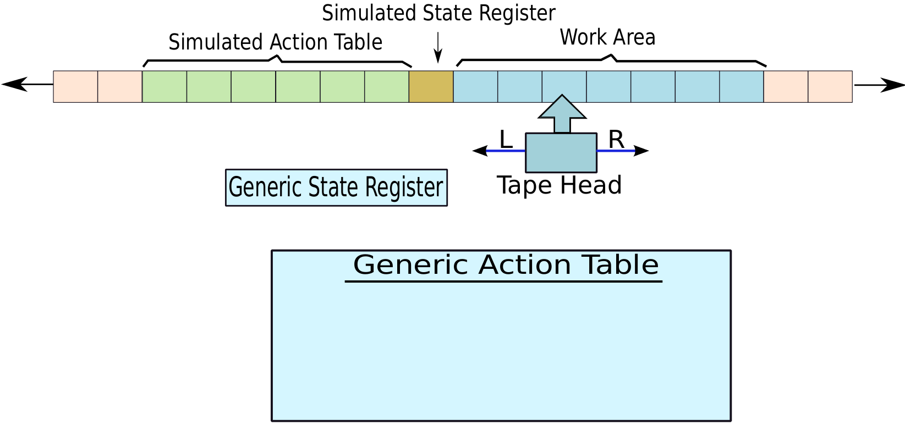
A Universal Turing Machine

Slide 33
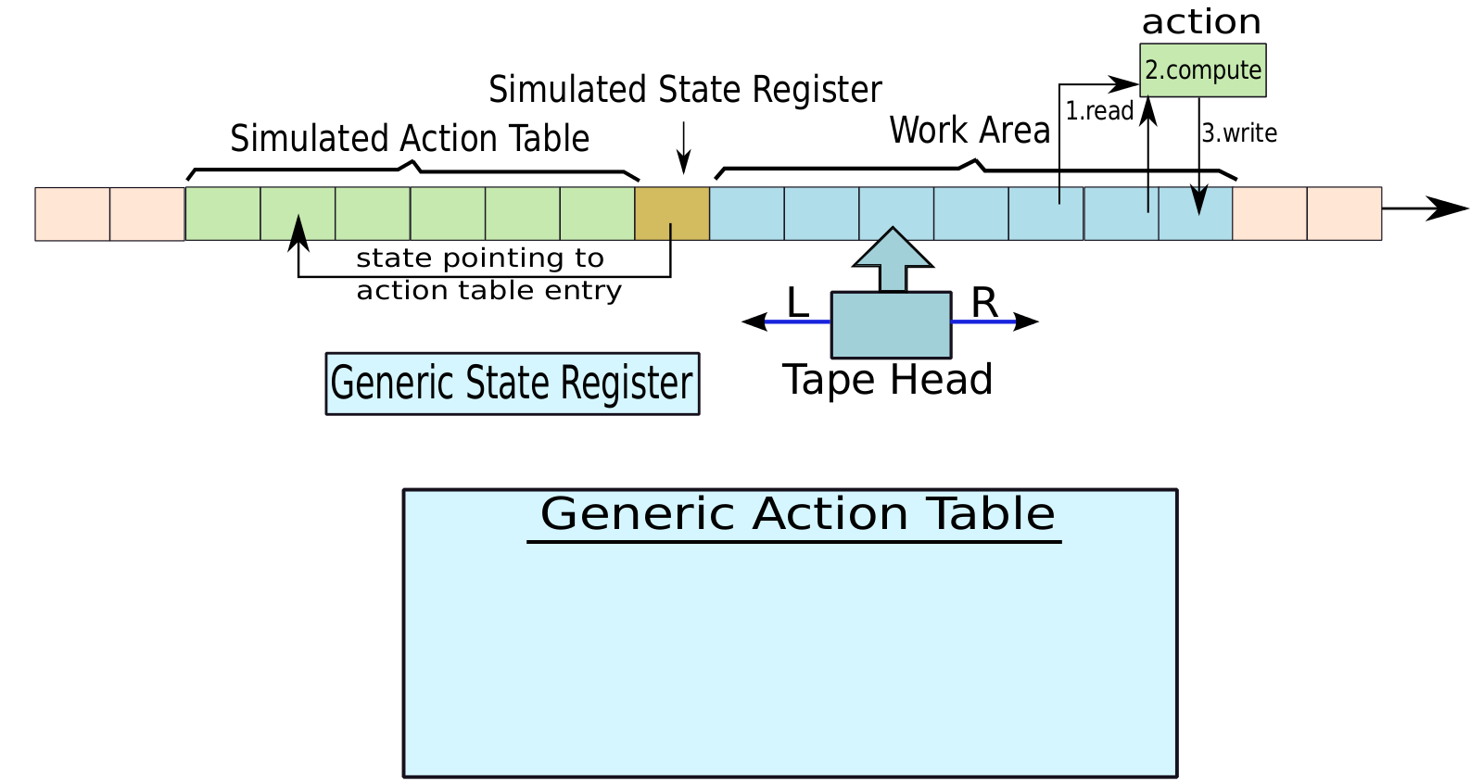

Universal Turing Machine - II
Program Counter
(Intruction Pointer)
Instruction Memory
Data Memory
CPU
(central processing unit)

Slide 34
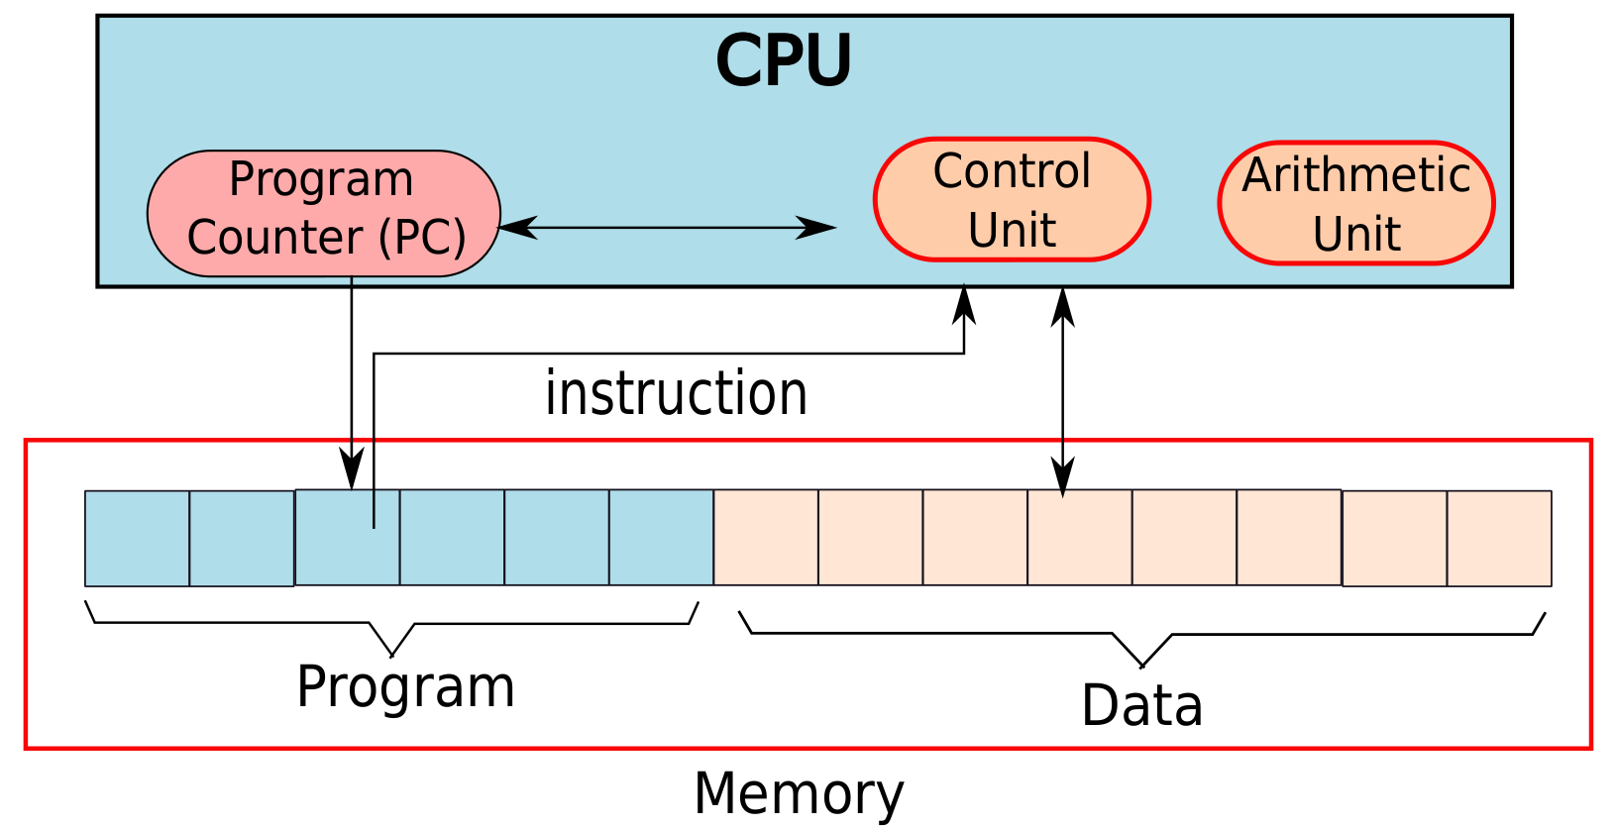
Computer Inspired from the Turing Machine

Slide 35
Elements of a Computer
Memory (array of bytes) contains
  The program, which is a sequence of instructions
  The program data → variables, and constants
The program counter(PC) points to an instruction in a program
  After executing an instruction, it points to the next instruction by default
  A branch instruction makes the PC point to another instruction (not in sequence)
CPU (Central Processing Unit) contains the
  Program counter, instruction execution units

Slide 36
Let us now design an ISA ...
Single Instruction ISA
  sbn – subtract and branch if negative
Add (a + b) (assume temp = 0)
1: sbn temp, b, 2
2: sbn a, temp, exit

Slide 37
Single Instruction ISA - II
Add the numbers – 1 … 10
Initialization:
one = 1
index = 10
sum = 0
1: sbn temp, temp, 2 // temp = 0
2: sbn temp, index, 3 // temp = -1 * index
3: sbn sum, temp, 4 // sum += index
4: sbn index, one, exit // index -= 1
5: sbn temp, temp, 6 // temp = 0
6: sbn temp, one, 1 // (0 - 1 < 0), hence goto 1
exit

Slide 38
Multiple Instruction ISA
Arithmetic Instructions
  add, subtract, multiply, divide
Logical Instructions
  or, and, not
Move instructions
  transfer values between memory locations
Branch instructions
  Move to a new program location, based on the values of some memory locations

Slide 39
Outline
Language of Instructions
  Instruction Set Architecture
  Features of an ISA – Complete, Concise, Generic, Simple
Completeness of an ISA
  Turing Machines
  Universal Machines
  Single Instruction/Multi-Instruction ISA
Design of Practical Machines
  Harvard/ Von Neumann Machines
  Registers
Road Ahead

Slide 40
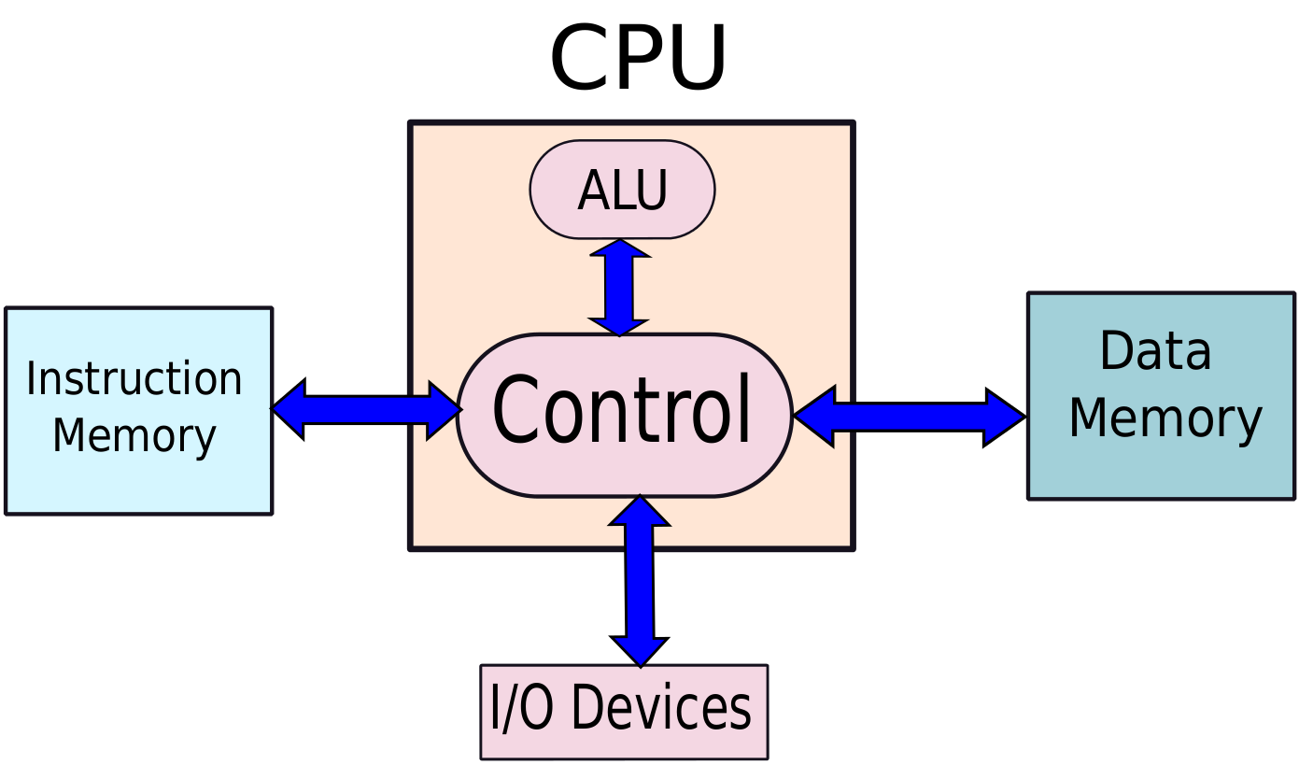
Designing Practical Machines
Harvard Architecture

Slide 41
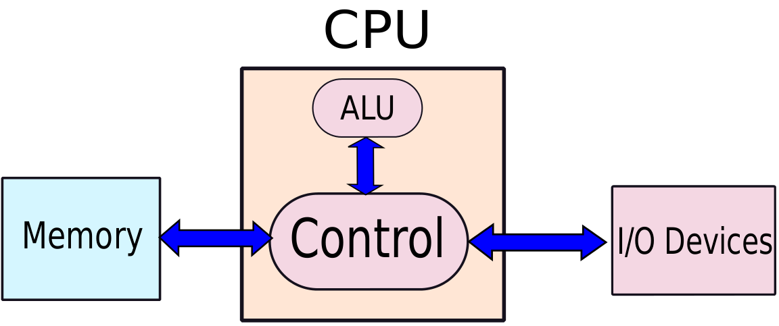
Von-Neumann Architecture

Slide 42


Problems with Harvard/ Von-Neumann
Architectures
The memory is assumed to be one large array of bytes
  It is very very slow
  Solution:
    Have a small array of named locations (registers) that can be used by instructions
    This small array is very fast
General Rule: Larger is a structure, slower it is
Insight: Accesses exhibit locality (tend to use the same
variables frequently in the same window of time)

Slide 43
Uses of Registers
A CPU (Processor) contains set of registers (16-64)
These are named storage locations.
Typically values are loaded from memory to registers.
Arithmetic/logical instructions use registers as input operands
Finally, data is stored back into their memory locations.

Slide 44
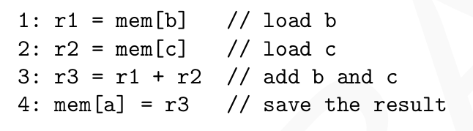
Example of a Program in Machine Language with Registers
r1, r2, and r3, are registers
mem → array of bytes representing memory

Slide 45
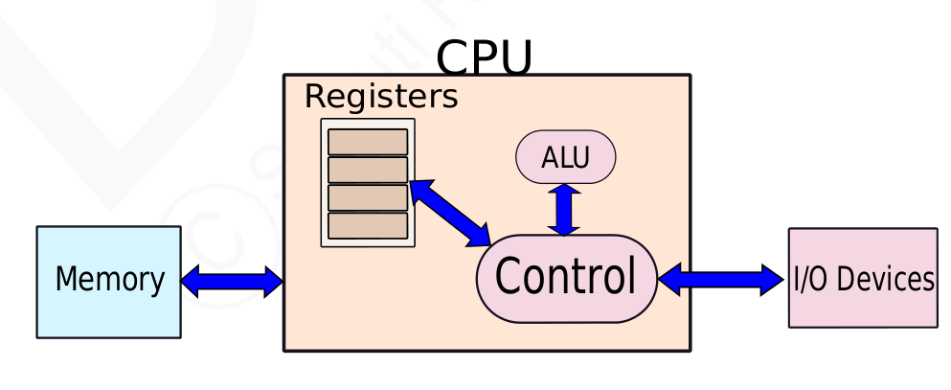
Machine with Registers

Slide 46
Outline
Language of Instructions
  Instruction Set Architecture
  Features of an ISA – Complete, Concise, Generic, Simple
Completeness of an ISA
  Turing Machines
  Universal Machines
  Single Instruction/Multi-Instruction ISA
Design of Practical Machines
  Harvard/ Von Neumann Machines
  Registers
Road Ahead

Slide 47

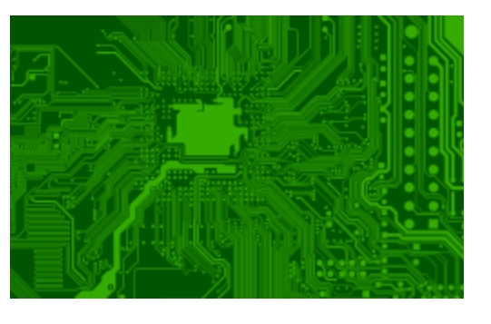
Where are we ...
We have derived the structure of a computer from theoretical fundamentals.
It has a CPU with a program counter & registers, memory, and peripherals.
The Instruction Set Architecture (ISA) is the link between hardware and software.
Instruction
Set
Architecture

Slide 48
Instruction Set Architecture
Interface between software and hardware
  A compiler converts a program into machine instructions in the given ISA
  The processor executes the instructions in the ISA
We shall first look at the software aspect of the ISA (assembly programs)
Then look at implementing the ISA by designing the processor
Then, we shall make the computer more efficient by designing fast memory/ storage systems
At the end, we will look at multiprocessors

Slide 49
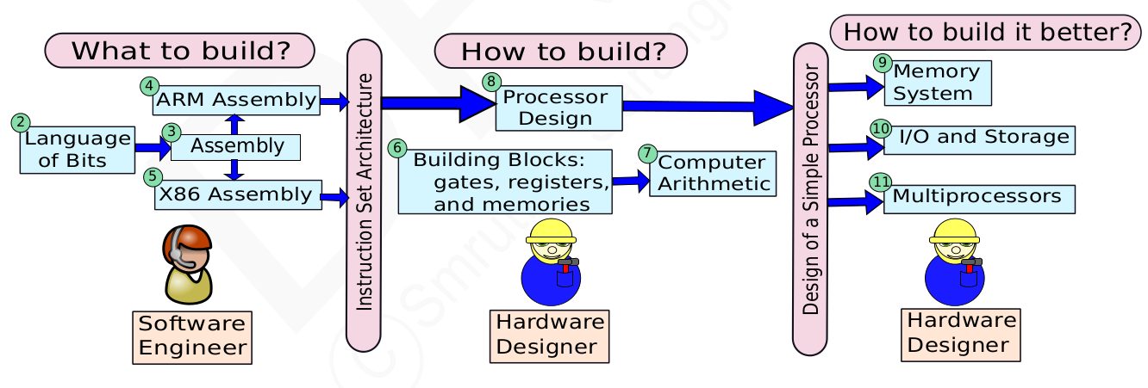
Roadmap of the Course

Slide 50
THE END

