Slide 1
Radiation-Induced Soft Errors:
An Architectural Perspective
Shubu Mukherjee¹, Joel Emer², & Steven. K Reinhardt^{1,3}
¹Fault Aware Computing Technology (FACT) Group, Intel
²VSSAD, Intel
³University of Michigan, Ann Arbor
11th International Symposium on High-Performance Computer
Architecture (HPCA), 2005
“If a problem has no solution, it may not be a problem, but a FACT, not to be solved, but to be coped with over time,” Shimon Peres, Nobel Laureate 1994.
Notes:
Transition: Will explain the physics and details of this area, but first I would like to show a few instances where we have seen the problem of cosmic ray strikes.

Slide 2
Evidence of Cosmic Ray Strikes
Documented strikes in large servers found in error logs
  Normand, “Single Event Upset at Ground Level,” IEEE Transactions on Nuclear Science, Vol. 43, No. 6, December 1996.
Sun Microsystems, 2000 (R. Baumann, Workshop talk)
  Cosmic ray strikes on L2 cache with defective error protection
    caused Sun’s flagship servers to suddenly and mysteriously crash!
  Companies affected
    Baby Bell (Atlanta), America Online, Ebay, & dozens of other corporations
    Verisign moved to IBM Unix servers (for the most part)
Notes:
Transition: where are we headed?

Slide 3
Reactions from Companies
Typical server system data corruption target around 1000 years MTBF
  very hard to achieve this goal in a cost-effective way
  Bossen, 2002 IRPS Workshop Talk
Fujitsu SPARC in 130 nm technology (2003)
  80% of 200k latches protected with parity
  compare with very few latches protected in Mckinley
  ISSCC, 2003
Notes:
Transition: before we delve into this area, I will walk you through the basics.

Slide 4
Evolution of a Product’s Team’s Psyche
Shock
  “SER is the crabgrass in the lawn of computer design”
Denial
  “We will do the SER work two months before tapeout”
Anger
  “Our reliability target is too ambitious”
Acceptance
  “You can deny physics only for so long”

Slide 5
Outline
Faults from Cosmic Rays
Terminology
Computing a chip’s Soft Error Rate
The Soft Error Opportunity
Summary
Notes:
Transition: What is the basic model? We have a storage cell containing a value, say zero, which …

Slide 6
Strike Changes State of a Single Bit
0
1
Notes:
Transition: The physics of this is, of course, a little more involved

Slide 7
Impact of Neutron Strike on a Si Device
neutron strike
source
Strikes release electron & hole pairs that can be absorbed by source & drain to alter the state of the device
drain
+
+
-
+
-
+
-
-
Transistor Device
Secondary source of upsets: alpha particles from packaging

Slide 8
Cosmic Rays Come From Deep Space
p
n
p
n
p
n
n
p
n
p
n
Earth’s Surface
Neutron flux is higher in higher altitudes

Slide 9
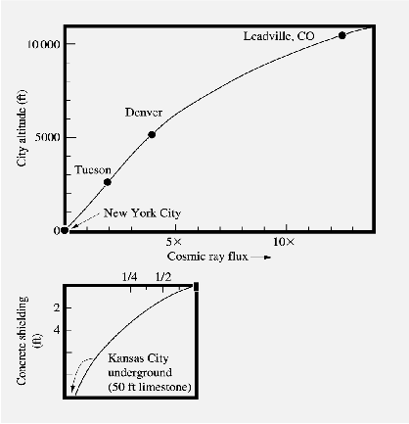
Impact of Elevation
Figure 8, Ziegler, et al., “IBM experiments in soft fails in computer electronics (1978 - 1994),” IBM J. of R. & D., Vol. 40, No. 1, Jan. 1996.
3x - 5x increase in Denver at 5,000 feet
100x increase in airplanes at 30,000+ feet
Notes:
Transition: Underground we can slow down the neutrons to almost completely mitigate the effect, so the question is does shielding work?

Slide 10
Physical Solutions are hard
Shielding?
  No practical absorbent (e.g., approximately > 10 ft of concrete)
  unlike Alpha particles
Technology solution: SOI?
  Partially-depleted SOI of some help, effect on logic unclear
  Fully-depleted SOI may help, hard to manufacture in high volumes
Radiation-hardened cells?
  10x improvement possible with significant penalty in performance, area, cost
  2-4x improvement may be possible with less penalty
We think some of these techniques will help alleviate the impact of Soft Errors, but not completely remove it

Slide 11
Outline
Faults from Cosmic Rays
Terminology
Computing a chip’s Soft Error Rate
The Soft Error Opportunity
Summary
Notes:
Transition: What is the basic model? We have a storage cell containing a value, say zero, which …

Slide 12
Strike Changes State of a Single Bit
0
1
Notes:
Transition: Based on this flip, we can categorize the different kinds of errors

Slide 13
Strike on state bit (e.g., in register file)
Bit
Read
yes
no
Bit has error protection
benign fault
no error
yes
no
yes
Error
is only detected
(e.g., parity +
no recovery)
Does bit matter?
Error can be
corrected
(e.g, ECC)
yes
no
Silent Data Corruption (SDC)
benign fault
no error
Detected, but unrecoverable error (DUE)
no error
Notes:
Transition: Based on this figure, here are our definitions …
Talk about “Does bit matter” as a forward pointer for ACE later
Bit flip in quicksort … often doesn’t matter!

Slide 14
Definitions 1
SDC = Silent Data Corruption
DUE = Detected & unrecoverable error
SER = Soft Error Rate = Total of SDC & DUE

Slide 15
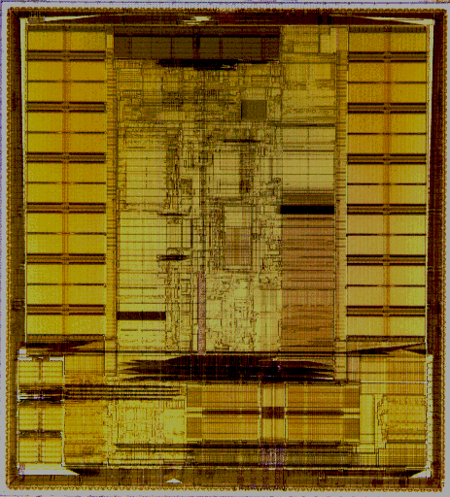
Definitions 2
Interval-based
  MTTF = Mean Time to Failure
  MTTR = Mean Time to Repair
  MTBF = Mean Time Between Failures = MTTF + MTTR
  Availability = MTTF / MTBF
Rate-based
  FIT = Failure in Time = 1 failure in a billion hours
  1 year MTTF = 10⁹ / (24 * 365) FIT = 114,155 FIT
  SER FIT = SDC FIT + DUE FIT
Hypothetical Example
Cache: 0 FIT
+
IQ: 100K FIT
+
FU: 58K FIT
Total of 158K FIT
Notes:
Interval-based: one event is an interval, e.g., MTTF …
Transition within bullets: Engineers use FIT because FIT is additive.

Slide 16
Typical Server System Reliability Goals
(D.C.Bossen, 2002 IRPS Tutorial Reliability Notes)
Error Type | System MTBF Goal
SDC (Silent Data Corruption) | 1000 years (114 FIT)
DUE for system crash | 25 years
DUE for application crash | 10 years
Notes:
Transition: Now we will see how our rates match up against these goals and requirements.

Slide 17
Outline
Faults from Cosmic Rays
Terminology
Computing a chip’s Soft Error Rate
The Soft Error Opportunity
Summary
Notes:
Transition: What is the basic model? We have a storage cell containing a value, say zero, which …

Slide 18
Measuring a Chip’s FIT
Chip | Physically bombard with neutrons in neutron accelerators Expose to alpha particles in radioactive foils
Chip | Study error logs of running machines
Circuit Models + RTL | Obtain raw error rate Statistical fault injection
Circuit Models + Performance Model | Obtain raw error rate Work in progress in FACT group
Like performance measurement
Notes:
Transition: The second and third methods require a FIT equation model …

Slide 19
Computing FIT rate of a Chip
FIT Rate Law: FIT rate of a system is the sum of the FIT rates of its individual components
Vulnerable Bit Law: FIT rate of a chip is the sum of the FIT rate of vulnerable bits in that chip!
Total Soft Error FIT =
  ∑_{(for each vulnerable device i)} (intrinsic error rate_{i} * vulnerability factor_{i})
  Vulnerability Factor = fraction of faults that become errors
  Vulnerability Factor is also known as “derating factor” and “soft error sensitivity (SES).”
Notes:
Transition: now we will examine each of the components of the FIT equation

Slide 20
FIT Equation: Raw Soft Error Rate
FIT = ∑_{(for each vulnerable device i)} (intrinsic error rate_{i} * vulnerability factor_{i})
SRAM cells
  FIT/bit decreasing slightly across generations w/ usu. voltage scaling
  FIT/chip increasing overall
Latch cells
  FIT/bit constant across generations w/ usu. voltage scaling
Static Logic Gates
  see later
Dynamic Logic
  keeper similar to latches, but extra reduction due to specific function implemented
Notes:
Transition: now lets look at VF

Slide 21
FIT Equation: Vulnerability Factors
FIT = ∑_{(for each vulnerable device i)} (intrinsic error rate_{i} * vulnerability factor_{i})
Vulnerability Factor =
Timing Vulnerability Factor * Architectural Vulnerability Factor
Timing Vulnerability Factor
  fraction of time bit is vulnerable
Architectural Vulnerability Factor (AVF)
  fraction of time bit matters for final output of a program
Notes:
Transition: lets look at Timing and AVF separately now

Slide 22
Timing Vulnerability Factor
SRAM cells
  100%
Latch cells
  ~ 50%
  depends on min. delay of signal propagation through logic chain (ref: Norbert Seifert, Intel)
Static Logic Gates
  Shivakumar, et al. (DSN 2002) predict near zero today
  signal attenuation, latch window, & logical masking
  may be a problem in future
Dynamic Logic
  same as latches
Notes:
Static Gates: Timing VF -> electrical masking (signal attenuation), latch window masking (setup/hold time)
Transition: So, this is timing, lets look at AVF now

Slide 23
Architectural Vulnerability Factor
Does a bit matter?
Branch Predictor
  Doesn’t matter at all (AVF = 0%)
Program Counter
  Almost always matters (AVF ~ 100%)
Computing AVF for complex structures
  Statistical Fault Injection
  ACE Analysis (next)
  Other methods being researched
Notes:
Transition: However most structures will lie between these two extremes. So we introduce a new concept we call ‘architecturally correct execution’…

Slide 24



Architecturally Correct Execution (ACE)
Program Input
Program Outputs
ACE path requires only a subset of values to flow correctly through the program’s data flow graph (and the machine)
Anything else (un-ACE path) can be derated away
Notes:
ace instructions are ace cards
Transition: If we look at this leaf node that has no outputs…the any strike that hits it will not change the program outputs. So that instructions is ‘un-ACE’

Slide 25

Example of un-ACE instruction:
Dynamically Dead Instruction
Dynamically
Dead
Instruction
Most bits of an un-ACE instruction do not affect program output
Notes:
– unnecessary for architecturally correct execution…
Transition: So let’s look at a breakdown of the dynamic execution of a program so that we can see which instruction are ACE and which are un-ACE .
Define: un-ACE: this instruction is unnecessary to get correct for ACE

Slide 26
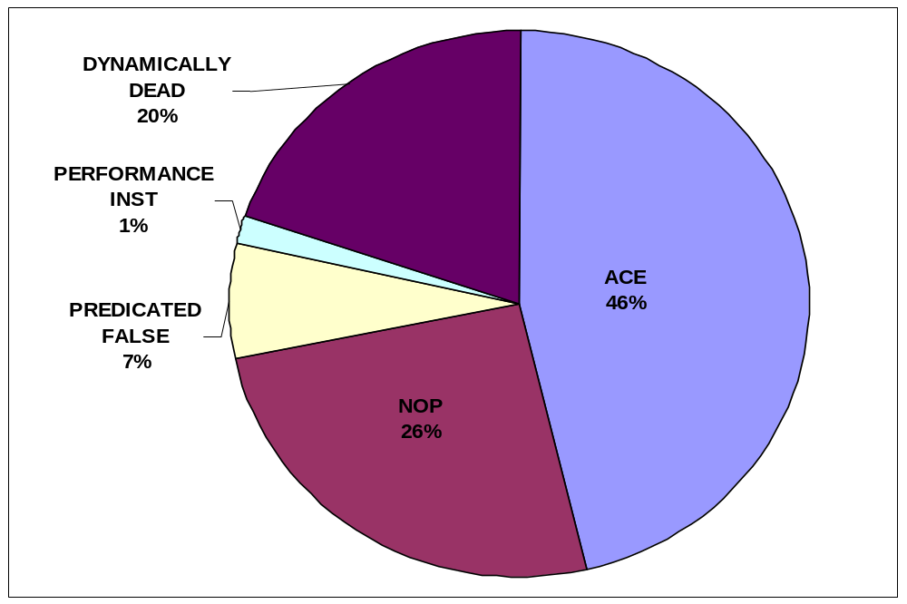
Dynamic Instruction Breakdown
Average across Spec2K slices
Notes:
Note that less than 50% of the instructions are ACE, so we would except a significant AVF decrease…
Transition: So we are going to use this ACE concept to do an analysis of a particular structure…
Give an example of Performance Instruction: e.g. prefetch

Slide 27




Mapping ACE & un-ACE Instructions to the Instruction Queue
NOP
Prefetch
ACE
Inst
ACE
Inst
Wrong-
Path
Inst
Idle
Ex-ACE
Inst
Architectural un-ACE
Micro-architectural un-ACE
Notes:
Examples of un-ACE arch and microarchitectural state residing in the IQ
There are two reasons why instructions are un-ACE: architectural and micro-architectural.
Transition: So given this categorization of the states of instructions in the IQ, how do we calculate the AVF…

Slide 28
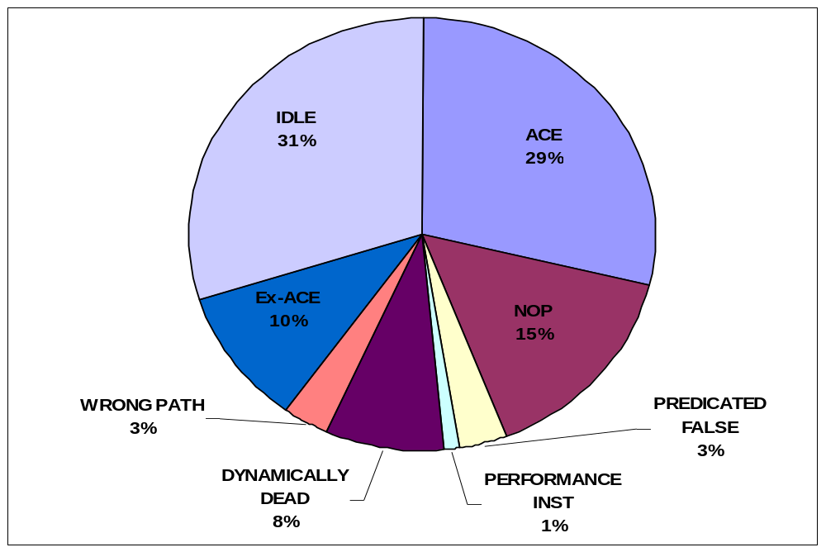
Instruction Queue
ACE percentage = AVF = 29%
Notes:
Transition: and the results we got for the functional units…
Average across all the dynamic slices of SPEC 2K benchmarks

Slide 29
Punchline: Simple Conceptual Model
FIT rate = sum of FIT rate of “vulnerable” bits
Vulnerable bits (RAM & latch cells)
  for SDC, this means unprotected bits
Rule of thumb: vulnerability factor
  architectural vulnerability factor ~= 20%
  timing vulnerability factor = 50% for latches & 13% dynamic
Rule of thumb: raw FIT rate
  0.001 – 0.010 FIT/bit (Normand 1996, Tosaka 1996)
Notes:
Transition: Using this rough model, we can project into the future …

Slide 30
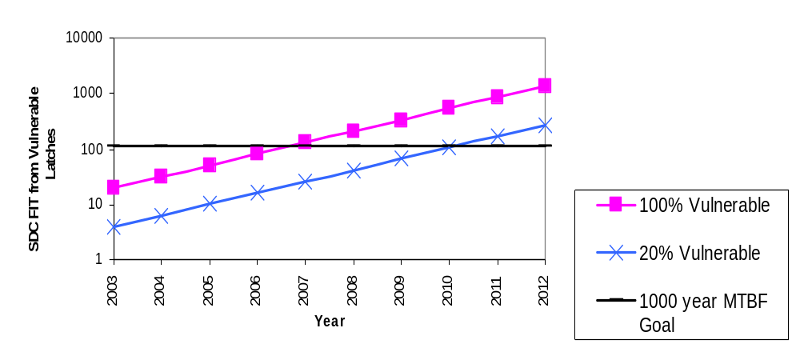
# Vulnerable Bits Growing with Moore’s Law
12x GAP
Fujitsu SPARC has 20% of 200k latches vulnerable in 2003
  aggressive designs have significantly higher number of vulnerable latches
Additional SDC FIT from RAM cells, static logic, & dynamic logic
Higher SDC FIT in multiprocessor systems
  Gap ~= 100x for 8 processor system!
  A data center with 300 such systems will encounter a data corruption almost every week
Notes:
Transition: so, how do we solve this problem?
Mention that the DUE rate is 10 years, so it would get a machine crash every day

Slide 31
Outline
Faults from Cosmic Rays
Terminology
Computing a chip’s Soft Error Rate
The Soft Error Opportunity
Summary
Notes:
Transition: What is the basic model? We have a storage cell containing a value, say zero, which …

Slide 32
The Soft Error Opportunity
Key differences with classical fault tolerance
  FIT budget 100x – 1000x more than Tandem-style machines
  Traditional “big hammer” solutions too expensive for volume market & can be an overkill
Why architecture plays a critical role?
  error often defined in architecture & microarchitecture
    e.g., strike on a branch predictor doesn’t cause an error
  architectural solutions are often more cost-effective
    one bit of parity can protect 64 bits, overhead < 2%
    radiation-hardened cells can have overhead around 20-40%

Slide 33
Research Directions
AVF characterization of processor structures
  architectural abstraction for soft errors
AVF reduction techniques & tradeoff with performance
  reduce exposure
  reduce false errors
  fault detection & recovery techniques
Protecting un-core components
  data flows unchanged
  microarchitectural state changes
Software solutions
  e.g., the Princeton CRAFT approach
  but, software doesn’t have full visibility into hardware
AVF vs. AF (activity factor) tradeoff
  structures with high AF and low AVF may require a closer look
Other sources of soft errors, definitions carry over
  timing errors, Vcc reduction errors, etc.

Slide 34
Summary
Soft Errors: real problem today
  Primary culprit: neutrons from deep space
  Industry seeing this now
Major problem in next few technology generations
  Problem scales with Moore’s Law, die size, & system size
  Industry will have a hard time making chips reliable
SER effort across Intel
  number of projects aimed at modeling, measuring, detecting, and correcting soft errors
Notes:
Transition: Ack

Slide 35
BACKUPS FOLLOW

Slide 36
Faults, Errors, Failures
(From Pradhan, “Fault-Tolerant Computer System Design”)
Fault
  defect in hardware or software component
  defect for cosmic ray = upset from high-energy neutron strike
Error
  manifestation of a fault, resulting in deviation from accuracy
  faults cause errors (but, not vice versa)
  a masked fault is not an error!
  vulnerability factor = fraction of faults that cause errors (Intel term)
Failure
  non-performance of expected action
  errors cause failures (but not vice versa)
  a corrected error doesn’t cause a failure

Slide 37
References
Documented Strikes
  (Sun Microsystems) R. Baumann, “Soft Errors in Commercial Semiconductor Technology,” 2002 IRPS Tutorial Notes
  Normand, “Single Event Upset at Ground Level,” IEEE Transactions on Nuclear Science, Vol. 43, No. 6, December 1996.
Raw soft error rate: 0.001 – 0.010 FIT/bit
  Y.Tosaka, S.Satoh, K.Suzuki, T.Suguii, H.Ehara, G.A.Woffinden, and S.A.Wender, “Impact of Cosmic Ray Neutron Induced Soft Errors, on Advanced Submicron CMOS circuits,” VLSI Symposium on VLSI Technology Digest of Technical Papers, 1996.
  Normand, “Single Event Upset at Ground Level,” IEEE Transactions on Nuclear Science, Vol. 43, No. 6, December 1996.
Typical Server System Goals
  D.C.Bossen, “CMOS Soft Errors and Server Design,” IEEE 2002 Reliability Physics Tutorial Notes, Reliability Fundamentals, pp. 121_07.1 – 121_07.6, April 7, 2002.

Slide 38
FIT/bit for SRAM Cells decreasing
Shivakumar, et al., “Modeling the Effect of Technology Trends on the Soft Error Rate of Combinatorial Logic,” DSN, 2002.
  FIT/bit decreasing, FIT/chip increasing
Hareland, et al., “Impact of CMOS Process Scaling and SOI on the soft error rates of logic processes,” 2001 Symposium on VLSI Technlogy Digest of Technical papers
  FIT/bit decreasing
R.Baumann, 2002 IRPS Tutorial Notes
  FIT/bit decreasing because of voltage saturation
  FIT/bit increasing in products with B10

Slide 39
FIT/bit for Latches Constant
Shivakumar, et al., “Modeling the Effect of Technology Trends on the Soft Error Rate of Combinatorial Logic,” DSN, 2002.
  prediction using models
  FIT/bit constant (within 2x error range)
Karnik, et al., “Scaling Trends of Cosmic Rays induced Soft Errors in Static Latches beyond 0.18μ,” 2001 Symposium on VLSI Circuits Digest of Technical Papers
  Neutron beam experiment
  FIT/bit constant

Slide 40
Raw FIT Equation
Raw Neutron FIT rate
  ∝ Neutron Flux * Area * e ^{-(Qcrit/Qs)}
When Qcrit >> Qs
  exponential dominates
  we are still in this region
When Qcrit <= Qs
  reached saturation
  area dominates, so FIT/bit will continue to decrease with area

Slide 41
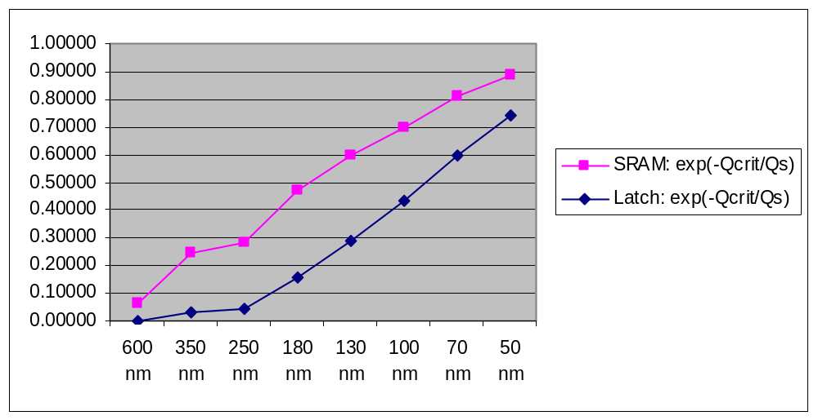
e^{-Qcrit/Qs} trends (Shivakumar et al., DSN 2002)
exp(-Qcrit/Qs) increasing
area decreasing quadratically

Slide 42
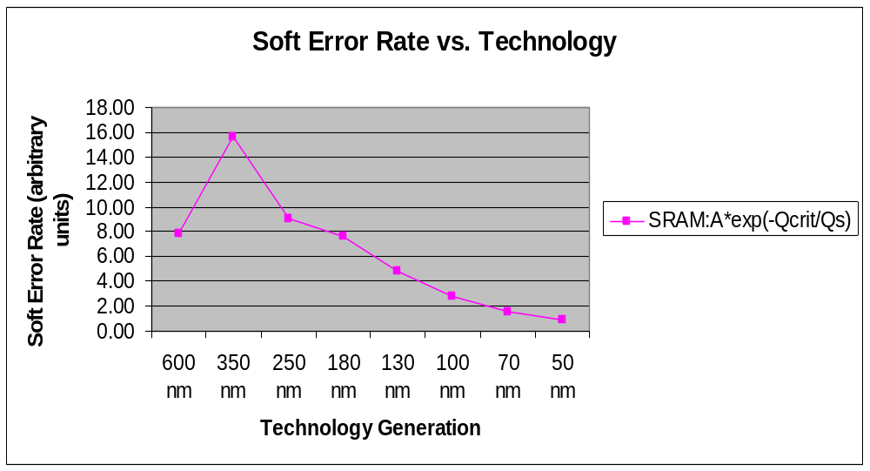
SRAM: FIT/bit decreasing
Source: Shivakumar, et al., DSN 2002

Slide 43
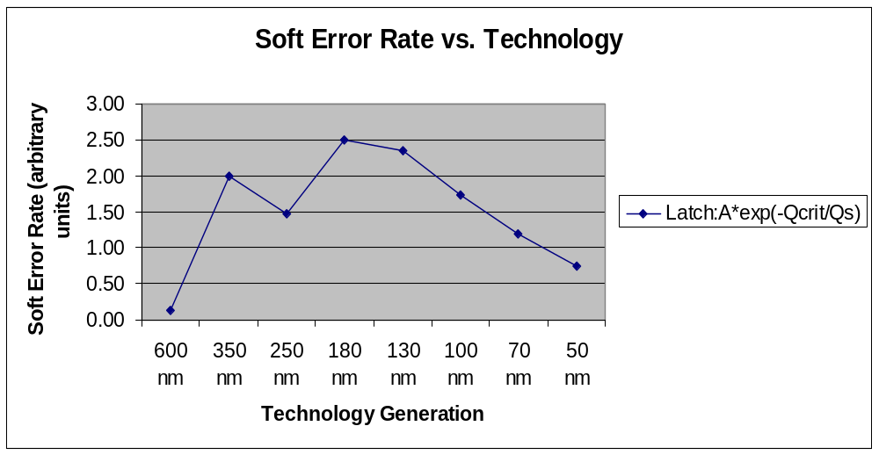
Latch: FIT/bit roughly constant
Source: Shivakumar, et al., DSN 2002

Slide 44
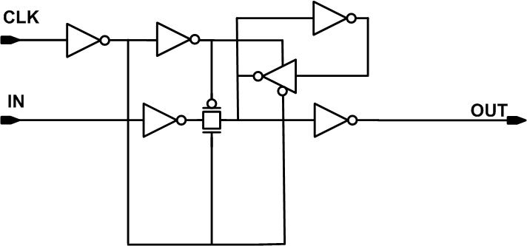
Timing vulnerability Factor for latches
flow-through
setup time
hold time
latch data
Timing vulnerability factor = latch time / clock time ~= 50%

Slide 45
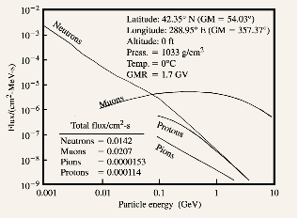
Energy Spectrum of Cosmic Ray Particles
Figure 4, Ziegler, et al., “Terrestrial Cosmic Rays,” IBM J. of R. & D., Vol. 40, No. 1, Jan. 1996.
Neutrons constitute > 96% of cosmic ray particles at sea level
Higher # of lower energy particles (significant)

Slide 46
SFI vs. ACE analysis
 | SFI | ACE
Accuracy of Microarchitectural un-ACE | Better than ACE analysis | Conservative
Accuracy of Architectural un-ACE | Conservative | Better than SFI (e.g., covers dynamically dead instructions)
Insight | Per-structure insights harder | Little’s Law & per-structure breakdown easier
# of experiments | Large # required to be statistically significant | Small # of experiments can give good accuracy

