Slide 1
Temperature and Power Management
Smruti R. Sarangi

Slide 2
Outline
Dynamic Power Management
DVFS
Clock gating
big.LITTLE approach
Fetch throttling
Leakage Power Management
Temperature Reduction

Slide 3
DVFS Scaling
DVFS is one of the the most popular method of reducing power in processors.
Every processor has a DVFS table:
Pairs of: voltage and frequency
It is possible to choose one among several discrete DVFS settings
Internal Operation
The processor gets cues from software (user or OS) regarding changing the DVFS settings
The processor also might decide on its own

Slide 4
Chip’s Power Grid and Frequency Control System
Power Supply
3.3V
Voltage Regulator
0.8-1.2V
Chip
PLLs
Quartz clock
The quartz clock generates a fixed 133 MHz signal
PLL → phase locked loop
It helps generate a clock signal that is synchronized with the quartz clock
The frequency is a multiple of 133 MHz
For example, we can use it to generate a frequency of 133MHz * 16 = 2.13 GHz
The PLL takes 10s of micro-seconds to lock to a new frequency. During that time there is no usable clock signal.

Slide 5
Changing Voltage and Frequency
frequency
PLL lock time
PLL lock time
Voltage
V1
V0
Voltage conversion
Voltage conversion

Slide 6
Hardware based DVFS
Estimate the amount of CPU activity
If it is low → reduce the frequency
If it is high → increase the frequency (if you need performance)
Estimating CPU activity
Average L2 misses per instruction
Commit(retirement) rate
We essentially need a model to correlate frequency and performance
Option 1: Get it by profiling. Run small phases of the program, and record the IPC.
Option 2: Method of stall rates: assumes that the stall cycles due to LLC misses is proportional to the frequency. Decrease the frequency till the LLC miss stalls are below a certain threshold.

Slide 7
Software based DVFS
Each frame needs to be processed in 33 ms
If we can do it in 20 ms
Reduce the frequency till we process it in 33 ms
Need a model to relate processing time and frequency
Video Codecs
Regular programs
Classify them: hard real time, soft real time, interactive, periodic, batch
Real time tasks → set DVFS settings based on performance and deadlines
Interactive → Take the user’s perception into account
Periodic jobs → Take the periodicity into account
Batch → Take the user’s requirements into account

Slide 8
Linux Speed Governors
Use the cpufreq utility
Performance → maximum possible frequency
Powersave → always run at minimum frequency
Ondemand → Tries to maintain a constant rate of CPU utilization. Uses a set of thresholds for each DVFS setting.
Conservative → Much more conservative than ondemand
Interactive → Similar to Ondemand, but does not use thresholds. Uses a formula that relates CPU utilization to frequency.

Slide 9
Clock Gating
Recall
Dynamic power is only consumed during a transition.
Block 16
Block 1
32
31
30
29
4
3
2
1
G,P
G,P
G,P
G,P
Carry lookahead adder
32-31
30-29
4-3
2-1
G,P
G,P
32-29
4-1
G,P
G,P
G,P
G,P
Assume bit #4 changes
Only the small part of the circuit shown in red is affected
The rest of the elements do not dissipate any dnamic power
32-25
24-17
16-9
8-1
G,P
G,P
32-17
16-1
G,P
32-1

Slide 10
Typical Structure of a Circuit
clock
Pipeline Register
Pipeline Register
Logic
What if the clock signal is 0?
The output of the registers do not change
There are no state transitions in the logic
No current flow and thus no dynamic power dissipation

Slide 11
Circuit with clock gating
clock
S
Pipeline Register
Pipeline Register
Logic
If S = 0, the inputs to the logic circuit don’t change. The circuit is clock gated.
If S = 1, normal operation

Slide 12
Clock Gating
Present in almost all architectures
Guess/predict/deduce if a unit is off
For example, an add instruction will not use the divider
Clock-gate the divider
Note that the divider will still have leakage
In processors such as Pentium 4
They try to ensure that there is absolutely no deviation in timing by enabling clock gating
Some times, we can aggressively clock gate. Instructions will have to wait till the unit is enabled.

Slide 13
Other Architectural Techniques
ARM big.LITTLE Architecture, or Samsung’s dual quad processor
Have N big cores, and M small cores
Depending on the nature of the task and its priority, choose:
a big core → if it is important
a little core → if it is not important, and power needs to be saved.
Fetch throttling
Dynamically adjust the fetch/issue/commit rate → Based on power constraints
Idea 1: After fetching low-confidence branches, reduce the fetch rate (decreases the number of potential wrong-path instructions)
Idea 2: Reduce the fetch rate in the shadow of an L2 miss

Slide 14
Outline
Dynamic Power Management
DVFS
Clock gating
big.LITTLE approach
Fetch throttling
Leakage Power Management
Temperature Reduction

Slide 15
Power Gating
Brute force method: Just turn off the power
Easier said than done
Power Grid
Power controllers
Functional Unit
Need to have power switches at each connection to the power grid

Slide 16
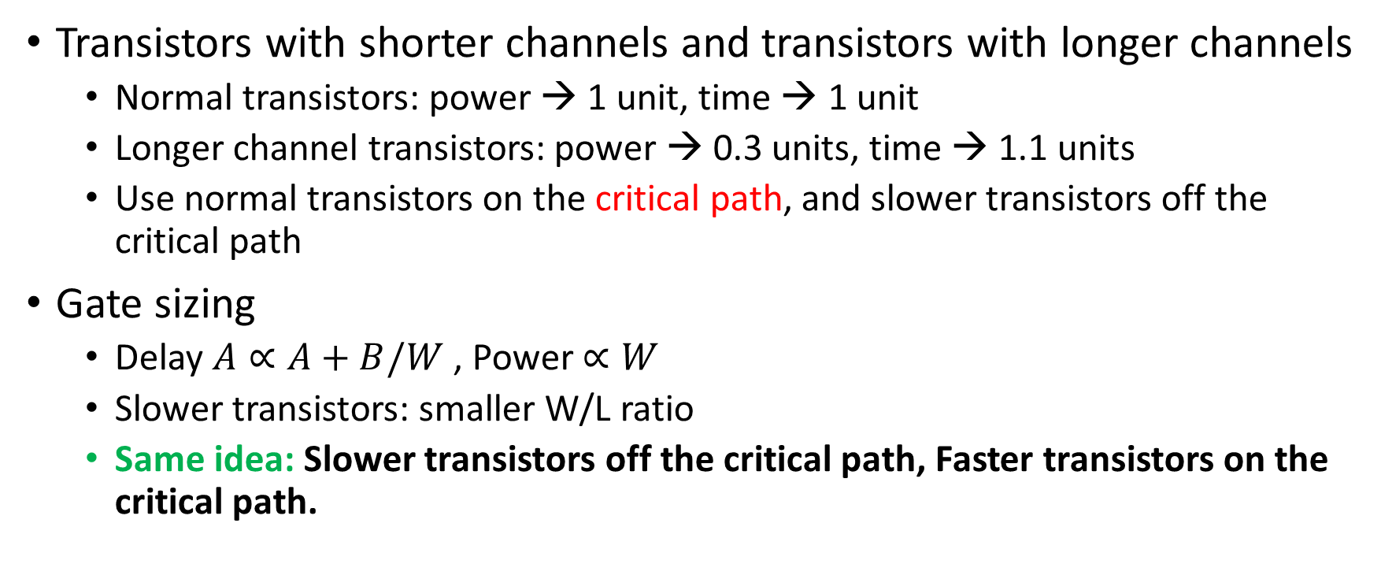
Multiple Transistor Sizes
Transistors with shorter channels and transistors with longer channels
Normal transistors: power → 1 unit, time → 1 unit
Longer channel transistors: power → 0.3 units, time → 1.1 units
Use normal transistors on the critical path, and slower transistors off the critical path
Gate sizing
Delay $A∝A+B/W$ , Power $∝W$
Slower transistors: smaller W/L ratio
Same idea: Slower transistors off the critical path, Faster transistors on the critical path.

Slide 17
Adaptive Body Biasing
V_{th} = V_{th1} – K1 ⋅ V_{dd} – K2 ⋅ V_{bs}
Forward body biasing → Increase V_{bs}
Reduce V_{th}
Increase power, increase performance
Reverse body biasing → Decrease V_{bs} (even –ve)
Increase V_{th}
Decrease power, decrease performance
Same idea: forward body biasing in the critical path, reverse body biasing off the critical path

Slide 18

Drowsy Caches
drowsy mode
Allows read/writes
Maintain the value, accesses not allowed
V_{dd} = 1V
V_{dd} = 0.3 V
row of SRAM cells
row of SRAM cells
Drowsy mode → Runs at 0.3 V. Maintains the value. Access it not allowed
Takes 1-2 cycles to enter/exit drowsy mode
Treat a set of lines as 1 unit
Turn it on/off as 1 unit
Once a set is turned on → Keep it on 1000-2000 cycles
Take temporal and spatial locality into account

Slide 19
Outline
Dynamic Power Management
DVFS
Clock gating
big.LITTLE approach
Fetch throttling
Leakage Power Management
Temperature Reduction

Slide 20
Dynamic Thermal Management
Place thermal sensors all over the chip
Once a temperature hot-spot forms
Traditional mechanisms: DVFS, power reduction, fetch throttling
Many new techniques for CMP (multicore) processors
Stop-n-go
Temporarily stop a core (let it cool down)
Heat and run thread assignment
Don’t allow hot cores to be close to each other
If a thread’s activity increases, migrate it to a colder region of the chip

