Slide 1
Fundamentals of Memory Consistency
Smruti R. Sarangi
Prereq: Slides for Chapter 11 (Multiprocessor Systems), Computer Organisation and Architecture, Smruti R. Sarangi, McGrawHill, 2015

Slide 2

Contents
Basic Terminology
Program Order Relaxations
Healthiness Conditions

Slide 3
Sequential Consistency
Leslie Lamport’s definition
The result of any execution is the same as if the operations of all the processors were executed in some sequential order, and the operations of each individual processor appear in this sequence in the order specified by its program.
SC is intuitive
SC is slow
Weak models enable many processor optimizations
Weak memory models can reorder insructions

Slide 4
Operational vs. Axiomatic Models
Operational Model of SC
P1
P2
Pn
Pick one processor at a time
Memory
Axiomatic Model of SC
Allowed Behaviors
Disallowed behaviors

Slide 5
Terminology
Global view
A set of memory events that are totally ordered. All processors agree with the same total order. (recapitulate total ordering)
Local view
Order of memory events from the point of view of one processor only. Other processors might not agree with this view.
A memory request, m, has the following properties
loc(m) → its location
val(m) → its value
proc(m) → its processor
M_{l} → memory events to location, l
R_{l} → Reads to l
W_{l} → Writes to l

Slide 6
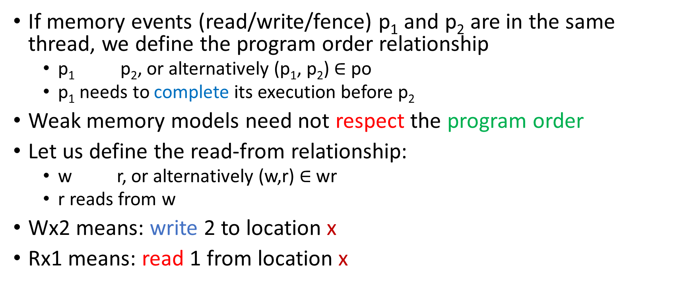
Some more terminology
If memory events (read/write/fence) p₁ and p₂ are in the same thread, we define the program order relationship
p₁ p₂, or alternatively (p₁, p₂) $∈$ po
p₁ needs to complete its execution before p₂
Weak memory models need not respect the program order
Let us define the read-from relationship:
w r, or alternatively (w,r) $∈$ wr
r reads from w
Wx2 means: write 2 to location x
Rx1 means: read 1 from location x
po
rf

Slide 7
Well formedness conditions
In the rf relationship
A read reads its data from only one write
Let us define a function: wf-rf (rf)
It is true if the relationship, rf, is well formed
Meaning: A read gets its data from only one write
Let us now add some coherence conditions
Every location has a globally visible order of writes
Let us call this the coherence order
ws = union of coherence orders for all locations
ws is well formed (wf-ws(ws) = true)
Meaning: The coherence order is well defined for all memory locations

Slide 8
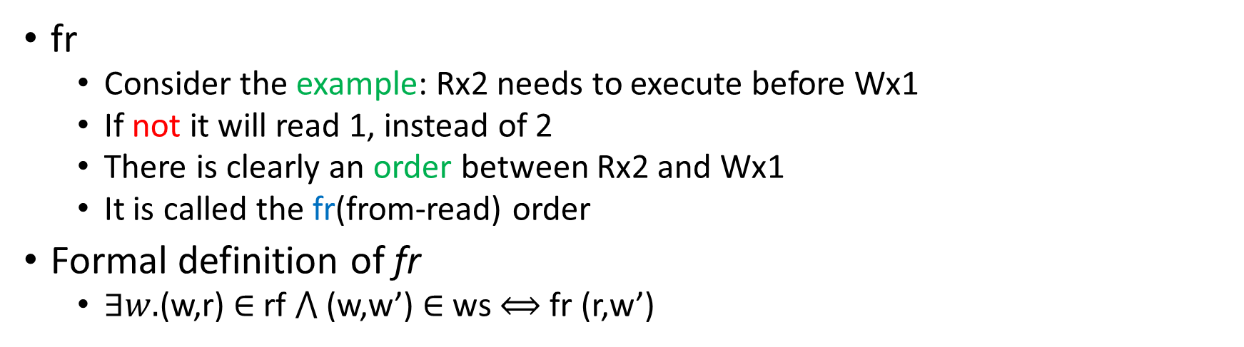
From-read map (fr)
Execution Witness
P0 | P1
(a) x = 1 | (b) x = 2 (c) r1 = x
Wx2
rf, po
ws
Rx2
r1=2, x = 1
fr
Wx1
fr
Consider the example: Rx2 needs to execute before Wx1
If not it will read 1, instead of 2
There is clearly an order between Rx2 and Wx1
It is called the fr(from-read) order
Formal definition of fr
$∃w.$(w,r) $∈$ rf $⋀$ (w,w’) $∈$ ws $⟺$ fr (r,w’)

Slide 9
Relationships between memory accesses
ws
coherence (write → write, same loc)
rf
write → read, dependence (same loc)
fr
read → write, dependence (same location)
po
program order

Slide 10
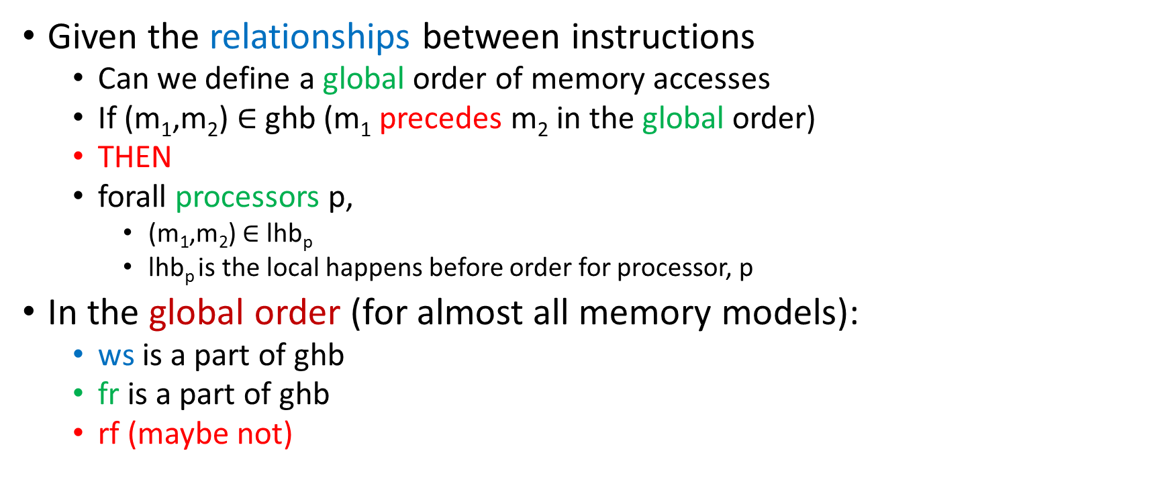
Global happens before (ghb)
Given the relationships between instructions
Can we define a global order of memory accesses
If (m₁,m₂) $∈$ ghb (m₁ precedes m₂ in the global order)
THEN
forall processors p,
(m₁,m₂) $∈$ lhb_{p}
lhb_{p} is the local happens before order for processor, p
In the global order (for almost all memory models):
ws is a part of ghb
fr is a part of ghb
rf (maybe not)

Slide 11


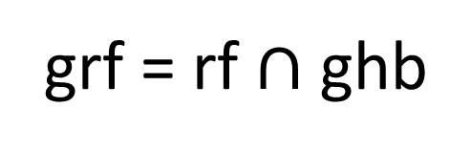
Let us divide rf into two parts
rf
rfe
rfi
(w,r) $∈$ rf $⋀$ proc(w) ≠ proc(r)
(w,r) $∈$ rf $⋀$ proc(w) = proc(r)
rf across processors
rf same processor
grf = rf $∩$ ghb
rf relations that are part of the global order

Slide 12
Local vs Global Order
Execution Witness
(d) Wy1
P0 | P1
x = 1 r1 = x r2 = y | (d) y = 1 (e) r3=y (f) r4 = x
fr
rfi
Core
reads/writes
(c) Ry0
(e) Ry1
po
po
reads
write
buffer
(b) Rx1
(f) Rx0
r1 = 1, r2= 0, r3 = 1, r4 = 0
rfi
fr
(a) Wx1
L1
writes
The global order cannot have a cycle
This means that rfi is not global if we respect po
The local order of P0 contains Wx1 → Rx1, but does not contain Wy1 → Ry1 and vice-versa
The local order can be different from the global order

Slide 13
Contents
Basic Terminology
Program Order Relaxations
Healthiness Conditions

Slide 14
Program Order
Types of memory instructions
Read
Write
Fence
All memory models respect
Read → Fence, Fence → Read, Write → Fence, Fence → Write
The order between Reads and Writes to different addresses might or might not be ensured.

Slide 15


Summary of Memory Models
location not updated atomically
with write buffers
Relaxation | W → R | W → W | R → RW | Read other’s write early | Read own write early
SC
TSO (Intel)
Processor consistency
PSO
Weak Ordering
IBM PowerPC
ARM
Ordering that is
relaxed
Let the program order relationships that are guaranteed to be preserved by a memory model be ppo
ppo $⊑$ po

Slide 16
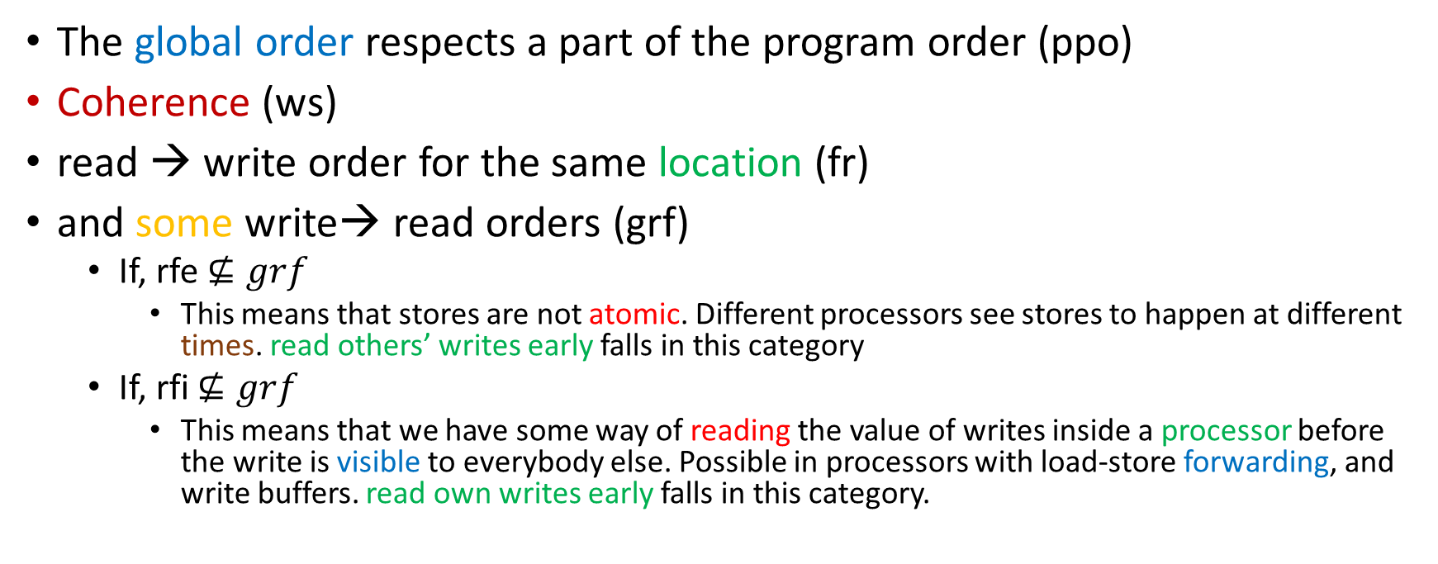
Putting it All Together
$$ghb=ppo ∪ws ∪fr ∪grf$$
The global order respects a part of the program order (ppo)
Coherence (ws)
read → write order for the same location (fr)
and some write→ read orders (grf)
If, rfe $⊈grf$
This means that stores are not atomic. Different processors see stores to happen at different times. read others’ writes early falls in this category
If, rfi $⊈grf$
This means that we have some way of reading the value of writes inside a processor before the write is visible to everybody else. Possible in processors with load-store forwarding, and write buffers. read own writes early falls in this category.

Slide 17
Deeper look at the global order
$$ghb=ppo ∪ws ∪fr ∪grf$$
always need to hold
Only the ppo and the grf can be changed by memory models
ws and fr are fundamentally properties of coherence. They always need to hold.
Any memory model is defined by:
ppo and grf
All global orders have to be acyclic
You can never have a cycle in a happens before relationship
For a memory model to be sound
The global order being acyclic is only one condition
We will see more later ...

Slide 18
Examples: Load-load or Store-store reordering
Execution Witness
P0 | P1
x = 1 y = 1 | (c) r3 = y (d) r4 = x
(a) Wx1
po
(b) Wy1
rfe
fr
r3 = 1, r4 = 0
(c) Ry1
po
(d) Rx0
To allow this outcome either load-load or store-store does not hold
IBM PowerPC and ARM allow this behavior
How can this happen? ANS: Messages get reordered in the NoC

Slide 19
Example: Load → Store reordering
Execution Witness
P0 | P1
r1 = x y = 1 | (c) r2 = y (d) x = 1
(a) Rx1
po
(b) Wy1
rfe
rfe
r1 = r2 = 1
(c) Ry1
po
(d) Wx1
The load → store reordering must cease to hold here
IBM and ARM allow this (message reordering in the NoC)

Slide 20
Example: Store atomicity relaxation (rfe)
Execution Witness
(c) Ry2
P0 | P1 | P2 | P3
r1 = x r3 = y | (c) r2 = y (d) r4 = x | (e) x = 1 | (f) y = 2
rfe
po
(f) Wy2
(d) Rx0
fr
fr
(b) Ry0
(e) Wx1
r1 = 1, r3 = 0, r2 = 2, r4 =0
po
rfe
(a) Rx1
If we assume that the read-read ordering is a part of ppo (like Intel TSO)
The only way this can happen if rfe is not global
How can this happen?
Assume P3 and P1 share a cache bank. P1 has a mechanism to read the new cache contents in this bank before (P0,P2) can read it. Same with P0 and P2.

Slide 21
Contents
Basic Terminology
Program Order Relaxations
Healthiness Conditions

Slide 22
Healthiness Conditions
We have up till now talked only about multiprocessors
What about uniprocessors?
ANS: All the programs running on uniprocessors should have the same output irrespective of the memory model.
How do we formalize this?
$$\left(m1, m2\right)ε poloc≡\left(m1, m2\right)ε po∧\left(loc\left(m1\right)=loc\left(m2\right)\right)$$
Uniprocessor Condition
$$\text{u}\text{niproc}\text{(}\text{E}\text{, }\text{rf}\text{, }\text{ws}\text{) }≡acyclic( rf ∪ws ∪fr ∪po_{loc})$$

Slide 23
What does the uniproc Condition Mean?
For a single processor:
Consider an execution, E
Create a graph of events with the following relations
rf → data dependence via memory
ws → coherence write order
fr → (read → write) order for the same memory location
po_{loc} → program order for memory accesses to the same memory location
Create a graph: Should be acyclic
Alternatively this condition also guarantees
per location, SC holds
All memory models need to obey the uniproc criterion also

Slide 24
Example: Invalid executions as per uniproc
Execution Witness
P0 | P1
x = 1 | (b) r1 = x (c) x = 2
(a) Wx1
rfe
(b) Rx1
ws
po_loc
x = 1, r1 = 1
(c) Wx2

Slide 25
Example 2: Invalid executions as per uniproc
Execution Witness
P0 | P1
x = 1 r1 = x r2 = x | (d) x = 2
(c) Rx1
po_loc
fr
(b) Rx2
(d) Wx2
rfe
r1 = 2, r2 = 1, x = 2
po_loc
ws
(a) Wx1

Slide 26
Thin Air Reads
Execution Witness
P0 | P1
r1 = x r9 = r1 XOR r1 (b) y = 1 + r9 | (c) r4 = y r9 = r4 xor r4 (d) x = 1 + r9
(c) Ry1
rfe
dp
(b) Wy1
(d) Wx1
r1 = 1, r4 = 1
dp
rfe
(a) Rx1
Let us add a new kind of edge: dp (data dependence)
One thing is for certain:
You cannot write to y before reading x
AND you cannot write to x before reading y
This should be forbidden because r1 and r4 actually seen either 0, or a junk value
How can this happen?
Ans: If you predict the load values for r1 and r4 (result of aggressive speculation, compiler opts)

Slide 27
Formalizing the Thin Air Read Constraint
$$thin \left(E, ws, rf\right) ≡acyclic (rf ∪dp\left(E\right))$$
rf → represents data dependences across processors
dp → data dependences in the same core
Data dependences cannot form a cycle, also means you cannot read junk data as valid

Slide 28
When is an execution valid?
$$valid \left(E,ws, rf\right)=wfrf\left(rf\right) ∧wfws\left(ws\right)$$
$∧thin\left(E,ws,rf\right) ∧uniproc \left(E, ws, rf\right)∧acyclic(ghb\left(E,ws,rf\right))$
When is an execution valid under a memory model?
rf and ws are well formed
No thin air reads
Uniprocessor constraints need to be met
No cycles in the global happens before relationship

Slide 29


