Slide 1
Operating Systems (COL 331)
Smruti R. Sarangi

Slide 2
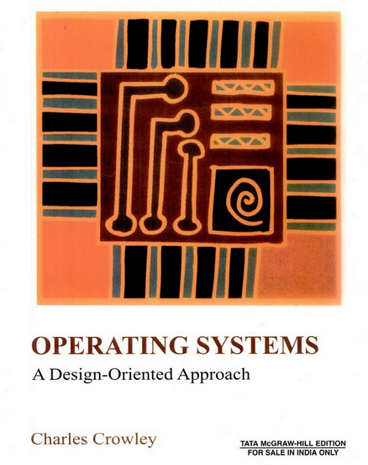

Slide 3
Outline of Topics
Introduction
The Hardware Interface
The Operating System Interface
Design Techniques I
Implementing Processes
Parallel Systems
Interprocess Communication
Processes
Design Techniques II
Memory Management

Slide 4
Outline of Topics - II
Virtual Memory
Virtual Memory Systems
Design Techniques III
IO Devices
IO Systems
File Systems
File System Organization
Design Techniques IV
Resource Management
The Client/Server Model

Slide 5
Few more things (self study mode)
Case studies:
Windows 7/10
Linux
Questions in the major from this.
Aims (to be achieved by the end of the course)
Understand the basic components of an OS
Understand the implementation
Appreciate theoretical issues concerning advanced OSes
Case studies: Windows and Linux

Slide 6
Class Policies
2 Minors + 1 Major
1 Extra minor to be held between Minor 2 and Major, for those who missed on health grounds. Will be significantly harder than the minor that was missed. Medical certificate required.
3 Assignments
Passing criteria: 30% in theory, and 30% in practicals (pass both separately)
Breakup of marks:
Assignment: 45 (indiv. assignment 1 and 2 (12.5), final assignment team of 2 assignment (20))
Theory: 55
Minor 1 (15) + Minor 2 (15) + Major (25)

