Slide 1

Chapter 5: Synchronization and Scheduling
Smruti R Sarangi
IIT Delhi

Slide 2
Outline of this Chapter
Synchronization Basics (User Space)
Synchronization in the Kernel
Scheduling
Real Time Scheduling with Dependences

Slide 3




Consider a Multicore CPU
Do something as simple as
count++
Assume there are multiple threads.
Each line corresponds to one line of assembly code. count is a global variable stored in memory and t1 is a register.
Will this work correctly?
t1 = count
t1 = t1 + 1
count = t1

Slide 4



Consider 2 Threads
count = 0
Thread 1
Thread 2
t1 = count
t1 = t1 + 1
count = t1
t1 = count
t1 = t1 + 1
count = t1
The delay between any two instructions can be indefinite
What can this cause?

Slide 5

Problematic Executions
count = 0
t1 = count
There is no synchronization between threads here
Arbitrary overlaps are possible
t1 = count
t1 = t1 + 1
t1 = t1 + 1
count = t1
count = 1
count = t1
count = 1
Should be 2

Slide 6


Concurrently incrementing count is hard
What is the main issue?
The instruction sequences are overlapping.
We need synchronization.
Acquire a lock. Only one thread can get in
t1 = count
t1 = t1 + 1
count = t1
Unlock.

Slide 7


What will the code look with locks …
Thread 1
Thread 2
t1 = count
t1 = t1 + 1
count = t1
t1 = count
t1 = t1 + 1
count = t1

Slide 8


What is a lock anyway?
Implementation of a lock
You lock a memory address A
Test if the memory address contains a 1, else loop
Atomically set the value to 0
Some other thread was successful in setting the location to 0
If successful

Slide 9


Unlocking
Set the contents of the location to 1
Critical section

Slide 10
Notion of Data Races
Why does this piece of code not work in the first place.
We have a data race
Conflicting accesses by two threads
At least one of the threads writes to the shared variable
Concurrent accesses
Both the accesses are happening roughly at the same time. There is a more precise definition that uses the notion of happens-before relationships and lock-unlock relationships. Let A and B be memory access events. A happens before B, if A is a memory access in a critical section, then its lock is released and reacquired by the critical section that B is a part of.

Slide 11


Properly Labelled Programs
Ensure that all your shared variables (shared across threads) are always accessed in the context of a critical section and there are no data races.
This program has a data race.
Lock (X)
Lock (Y)
Access locations A, B, and C
Access locations D, E, and C
A shared variable always has to be protected by the same lock.

Slide 12

Locks can lead to deadlocks ....
Thread 1
Thread 2
Lock X
Lock Y
Lock Y
Lock X

Slide 13
Four Conditions for a Deadlock
Hold and Wait
No preemption
Mutual exclusion
A thread is holding on to a lock and waiting for the other one.
The lock cannot be taken away from a thread.
A lock can be held by only a single thread.
Circular wait

Slide 14


Solutions for Preventing Deadlocks
Hold and Wait
No preemption
Mutual exclusion
If a thread is waiting for a resources for too long, release the resources that it holds.
Resources can be taken away from threads by the OS.
This is a basic property of a lock. This cannot be tampered with.
Circular wait
Acquire locks in a given order

Slide 15
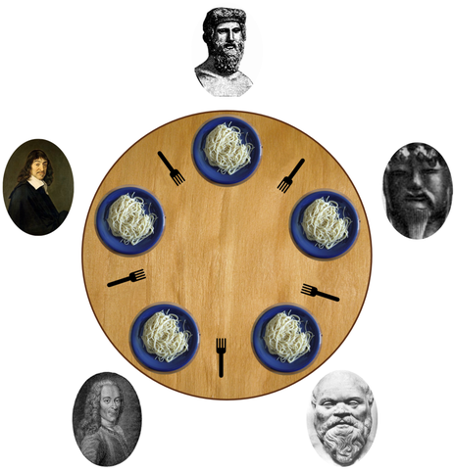

Dining Philosopher’s Problem
A philosopher needs to pick up both the forks to eat. He can pick up only one fork at a time.
Avoid deadlocks.

Slide 16
Livelocks, Deadlocks, and Starvation
Deadlocks
Starvation
Livelocks
All the threads are waiting on each other.
A thread waits indefinitely to get access to the resource. Starvation freedom implies deadlock freedom (not the other way).
Threads keep executing instructions but nothing productive gets done.

Slide 17
#include<stdio.h>
#include<pthread.h>
#include<stdlib.h>
#include<unistd.h>
pthread_t tid[2];
int counter;
void* func(void *arg)
{
int *ptr = (int *) arg;
printf("Thread %d \n", *ptr);
}
int main(void)
{
int errcode, i = 0; int *ptr;
for (i=0; i < 2; i++)
{
ptr = (int *) malloc (sizeof(int));
*ptr = i;
errcode = pthread_create(&(tid[i]), NULL,
&func, ptr);
if (errcode)
printf("Error in creating pthreads \n");
}
pthread_join(tid[0], NULL);
pthread_join(tid[1], NULL);
}
gcc <prog_name> -lpthread

Slide 18

The same code with locks for incrementing a counter
int counter = 0;
pthread_mutex_t cntlock;
void* func(void *arg)
{
pthread_mutex_lock(&cntlock);
counter++;
pthread_mutex_unlock(&cntlock);
}
int main () {
...
...
printf (“The final value of counter is %d \n”, counter);
}

Slide 19

Code without locks (lock-free programming)
#include <stdatomic.h>
atomic_int counter = 0;
void * fetch_and_increment (void *arg) {
atomic_fetch_add (&counter, 1);
}
Also known as non-blocking algorithms

Slide 20
Same Example with Compare_and_Exchange
Increment using the compare_and_swap primitive
atomic_int counter = 0;
#define CAS atomic_compare_exchange_strong
void* fetch_and_increment (void *arg){
int oldval, newval;
do {
oldval = atomic_load (&counter);
newval = oldval + 1;
printf (“old = %d, new = %d \n”, oldval, newval);
while (! CAS (&counter, &oldval, newval)) {}
}

Slide 21



Output
old = 0, new = 1
old = 0, new = 1
old = 1, new = 2
The final value of counter is 2
In this case, there is the possibility of many failed attempts at performing the CAS.
If threads are allowed to call this function repeatedly, then it is possible that a few threads may starve forever.

Slide 22
Obstruction-free vs Lock-free vs Wait-free
Assuming a thread that is holding a lock goes off to sleep or is swapped out
Then this means that the rest of the threads will not be able to make any progress
This is unfair.
We thus need algorithms with better progress guarantees
Obstruction-free
If n-1 threads stop, then the n^{th} thread can finish in a bounded number of steps
Lock-free
At any point of time, there is at least one thread that is going to complete in a bounded number of steps.
Wait-free
All threads complete within a bounded number of steps.

Slide 23

What does all of this mean?
In an obstruction-free algorithm, no thread can hold a lock and go off to sleep
It should be possible to finish one thread’s operation by putting the rest of the threads to sleep all the time
Using locks is thus precluded unless locks can be released on a context switch
Lock-free algorithms are more difficult to write
They are fast in practice
They guarantee system wide progress, but individual threads can starve
Use wait-free algorithms
They are slower than lock-free algorithms in practice but have much stronger progress guarantees.

Slide 24
Case of Bounded Queues
Producers
Consumers
The bounded queue is an important data structure
It is used in a large number of kernel subsystems
Device drivers use such structures a lot for communicating with other processes and devices
There are multiple producer threads and multiple consumer threads
This needs to be a concurrent queue.

Slide 25


Codes
E.g. 1
Bounded wait-free queue – single producer and single consumer
E.g. 2
Bounded queue with locks – pthread mutexes
E.g. 3
Bounded queue with semaphores
E.g. 4
Bounded queue with semaphores – no busy waiting
E.g. 5
Bounded queue with semaphores and reader-writer locks

Slide 26
Atomics
Example 1
<stdatomic.h> contains a library of atomic integers and characters
atomic_load and atomic_store operations are used to read and write these atomic variables
A few atomic operations are supported:
atomic_fetch_add
atomic_flag_test_and_set
atomic_compare_exchange_strong
For the sake of simplicity, let us assume that atomic operations are globally (sequentially) ordered.
We cannot say the same about regular memory accesses
This is the crux of lock-free programming

Slide 27

How do you prove the correctness of lock-free programs?
Linearizability
The operation needs to be atomic
It needs to “appear” to execute instantaneously (single instant of time)
Either the entire operation executes or it appears to not have execute at all
Atomicity vs Linearizability
Atomicity basically says that the entire operation (like enqueue/dequeue) appears to execute at any one instant of time
However, it does not say that this execution point needs to lie between the start and end of the operation
This is where we have linearizability – a stronger criterion
It says that if the end time of an operation is before the start time of another operation, then their execution (linearization) points follow the same order
With regards to concurrent operations (they can be ordered in any way)

Slide 28
More about the Correctness of such Algorithms
Linearization point
Start
End
The linearization point needs to lie between the start and end
It corresponds to a specific instruction within the function
Proving that a certain instruction is a linearization point is a very well established area of research, and it is often quite difficult to do so
This makes it quite difficult to write such programs

Slide 29

Wait-free Queue → Queue with Locks
Example 2
Wait-free queue → It is easy to construct one for a single enqueuer and dequeuer. One thread enqueues and the other dequeues.
However, it is quite hard to design a wait-free algorithm with multiple enqueuers and dequeuers
Easier to use locks
Mutex
Spin-lock of busy-wait loop: Keep looping on the lock variable until it is locked
Futex
Do busy waiting for some time. Then, request the kernel to put the process into sleep and put it in a wait queue.
Release the CPU to do useful work

Slide 30
Semaphores
Example 3
count
Semaphore
waiting queue
A semaphore maintains a count
+ a kernel-level wait queue
sem_wait
if (count == 0)
insert_into_wait_queue();
else
count --;

Slide 31
Semaphores – II
Example 4
sem_post
if ( (count == 0) && process_waiting())
wake_from_wait_queue();
else
count ++;
A binary semaphore (Boolean count) is equivalent to a lock
A non-binary semaphore uses a count larger than 1
Quite useful while implementing a bounded queue

Slide 32

Reader-Writer Lock
Example 5
Let us now add a new function.
int peak() {
/* This is the read function */
int val = (head == tail)? -1 : queue[head];
printf ("Queue head = %d\n",val);
return val;
}
Just read the head of the queue
If you have multiple readers at a time, they can be allowed to read the head of the queue concurrently.

Slide 33

Key Idea: Either one thread writes or multiple threads read
Read
Write
Read-write lock
Read lock
Have two modes:
1. A write mode that allows a single writer
2. A read mode that allows multiple readers but no writer
Switch between them

Slide 34



Read and Write Locks
Basic Idea:
The enqueue and dequeue function need the read_write lock: rwlock
Writing always involves reading
void get_write_lock(){
WAIT(rwlock);
}
void release_write_lock(){
POST(rwlock);
}
void get_read_lock(){
WAIT(read_lock);
if (readers == 0) WAIT(rwlock);
readers++; POST(read_lock); }
void release_read_lock(){
WAIT(read_lock);
readers--;
if (readers == 0)
POST (rwlock);
POST(read_lock);
}
For acquiring the read lock, we need to ensure that there are no current writers. Hence, acquire rwlock if there are no other readers
Fairness is an issue
Update the number of readers, by locking the read lock

Slide 35
Other kinds of synchronization

Slide 36
Condition Variables
Semaphores are a generic OS mechanism
pthreads have a lightweight version – condition variables
pthread_mutex_t mlock;
pthread_cond_t count;
pthread_cond_init (&count, NULL);
/* wait on the condition variable*/
pthread_mutex_lock (&mlock);
pthread_cond_wait (&count, &mlock);
pthread_mutex_unlock (&mlock);
pthread_mutex_lock (&mlock);
pthread_cond_signal (&count);
pthread_mutex_unlock (&mlock);
A conditional variable is always associated with a mutex
The wait call releases the mutex while waiting and reacquires it once woken up
The pthread_cond_signal and pthread_cond_broadcast functions wake up waiting threads

Slide 37
Barriers
Wait for all the threads to reach the barrier
Then release all at once
A barrier acts as a synchronization point
All the threads wait at the barrier for the slowest thread to arrive
Then all of them are released and begin to execute

Slide 38
Phasers
Wait for all the threads to reach Point 1 before allowing them to proceed past Point 2
Point 1
Point 2
Then release all at once
A phaser is a more complex synchronization point
All the threads wait at Point 2 till the slowest thread reaches Point 1
Then all of them are released and can proceed past Point 2

Slide 39
Outline of this Chapter
Synchronization Basics (User Space)
Synchronization in the Kernel
Scheduling
Real Time Scheduling with Dependences

Slide 40


Questions regarding Concurrency in the Kernel
If we have multiple threads in the kernel (as is normally the case), then a data structure can be accessed in parallel
We need to support concurrency
Either use locks
Some variant of lock-free programming
The other source of concurrency is the interrupt and scheduling process
Kernel code can be interrupted in the middle. Then, the scheduler can schedule other threads, which can modify the state of the data structure.

Slide 41
Spinlocks
It is the most basic type of lock
They run a “busy wait” lock. Unlike other locks, the thread does not go off to sleep.
They can be used in the interrupt context where blocking is not permitted
After acquiring a spinlock, the kernel turns off pre-emption
Otherwise, a new thread can run and that can try to acquire the lock. It will block yet the system will not make progress.
The spinlock can also be visualized as a lock on the CPU. We don’t want to migrate the thread to a different CPU.

Slide 42


How to enable/disable pre-emption?
The kernel maintains a per CPU variable that indicates whether pre-emption is allowed or not
If it is 0, pre-emption is allowed
Else, it is disallowed
/include/linux/preempt.h
#define preempt_disable() \
do { \
preempt_count_inc(); \
barrier(); \
} while (0)
Not the same barrier we studied before. A different one
Stop memory reordering

Slide 43
Enable Preemption
#define preempt_enable() \
do { \
barrier(); \
if (unlikely(preempt_count_dec_and_test())) \
__preempt_schedule(); \
} while (0)
If the count reaches 0
Run the schedule function

Slide 44

Some Memory Consistency Concepts
Thread 1
Thread 2
x = 1
t1 = y
y = 1
t2 = x
Consider two threads that access two global variables: x and y
They are initialized to 0
t1 and t2 are temporary variables stored in registers
Is the outcome <t1,t2> = <0,0> possible?
If you assume sequential consistency: statements execute one by one.

Slide 45



Non-Sequentially Consistent Machines
Owing to performance reasons, all modern machines will allow this behavior. Their memory models not sequentially consistent.
How do you write parallel code then?
Take a computer architecture class.
Accesses to global atomic variables can have data races → concurrent and conflicting accesses
A fence or a memory barrier instruction forces sequentiality
All instructions before it need to complete before an instruction after it can begin.
For all accesses to regular (non-atomic) variables, just wrap them in critical sections

Slide 46
Spinlocks
/include/linux/spinlock.h
/include/linux/spinlock_types_raw.h
typedef struct raw_spinlock {
arch_spinlock_t raw_lock;
#ifdef CONFIG_DEBUG_LOCK_ALLOC
struct lockdep_map dep_map;
#endif
} raw_spinlock_t;
The raw_spinlock_t type is just a wrapper on the architecture defined spin lock → This structure wraps an atomic/volatile integer
It also has a lockdep_map structure to find deadlocks

Slide 47
Inner Workings of the Spinlock
Ticket lock
/include/asm-generic/spin-lock.h
Ticket id
To be served
void arch_spin_lock(arch_spinlock_t *lock)
{
u32 val = atomic_fetch_add (1<<16, lock);
u16 ticket = val >> 16; /* upper 16 bits of lock */
if (ticket == (u16) val) /* Ticket id == ticket next in line */
return;
atomic_cond_read_acquire(lock, ticket == (u16)VAL);
smp_mb(); /* barrier instruction*/
}
The spin lock function

Slide 48

The actual spin loop (keeping the memory model into account)
#define smp_cond_load_relaxed(ptr, cond_expr) ({ \
typeof(ptr) __PTR = (ptr); \
__unqual_scalar_typeof(*ptr) VAL; \
for (;;) { \
VAL = READ_ONCE(*__PTR); \
if (cond_expr) \
break; \
cpu_relax(); /* insert a delay*/ \
} \
(typeof(*ptr)) VAL; \
})

Slide 49
The unlock Function
Ticket id
To be served
void arch_spin_unlock(arch_spinlock_t *lock)
{
u16 *ptr = (u16 *)lock + IS_ENABLED(CONFIG_CPU_BIG_ENDIAN);
u32 val = atomic_read(lock);
smp_store_release(ptr, (u16)val + 1); /* store following release semantics */
}
Increment the “to be served” part
The acquire and release keywords are the same as the ones used in the Release Consistency (RC) literature
All memory operations after the acquire can complete only after it completes
The release needs to complete only after all the memory operations before it have completed

Slide 50

A Fast Path: Trylock function
static __always_inline bool arch_spin_trylock(arch_spinlock_t *lock)
{
u32 old = atomic_read(lock);
if ((old >> 16) != (old & 0xffff))
return false;
return atomic_try_cmpxchg(lock, &old, old + (1<<16));
}
The lock is held
Attempt to get the lock quickly
The fast path/ slow path approach is a standard technique. If the lock is unlikely to be held, attempt the fast path, otherwise fall back to the slow(er) path.

Slide 51
Spin locks and Interrupts
Interrupts can still be processed on the CPU that is waiting on a spin lock
What if the interrupt handler tries to acquire the same spinlock
We have a deadlock
Hence, we use the “_irq” variant of the function. It enables and disables interrupts in the critical section.
raw_spin_lock_irq and raw_spin_unlock_irq
Sadly raw_spin_unlock_irq will enable all interrupts (not in your best interest)
Hence, use the _irqsave and _irqrestore versions that save and restore the interrupt state.

Slide 52

Kernel Mutexes
/include/linux/mutex.h
mutex_lock(struct mutex *lock)
mutex_unlock(struct mutex *lock)
mutex_trylock(struct mutex *lock)
A spinlock is held by a CPU, a mutex is held by a task
The task can go off to sleep
struct mutex {
atomic_long_t owner;
raw_spinlock_t wait_lock;
struct list_head wait_list;
#ifdef CONFIG_DEBUG_LOCK_ALLOC
struct lockdep_map dep_map;
#endif
};
struct task_struct*
The spin lock protecting the wait_list
Contending processes

Slide 53

Mutex Locking
/kernel/locking/mutex.c
void mutex_lock(struct mutex *lock)
{
might_sleep(); /* prints a stacktrace if called in an atomic context (sleeping not allowed */
if (!__mutex_trylock_fast(lock)) /* cmpxchg on owner */
__mutex_lock_slowpath(lock);
}
Supports the slow path/ fast path concept
Fast path: Compare and exchange (acquire) as we have seen earlier
Slow path: We need to try to acquire the spinlock. However, if that does not seem to be possible, make the process sleep. Lock the task in the UNINTERRUPTIBLE state.

Slide 54
Slow Path
First, attempt a fast path lock
cmpxchg on the owner field
If that works, well and good
Acquire a lock on the wait_list
Lock wait_lock using a spinlock
Insert the current task to the wait_list
Set the state of the current task to a sleeping state: UNINTERRUPTIBLE or INTERRUPTIBLE (in some cases)
Call the scheduler to schedule ready processes

Slide 55
Different Kinds of Locks in the Kernel
/kernel/locking/…
Queued Spinlock or MCS lock (qspinlock.c)
Create a linked list of nodes
Insert the given node (consisting of the current task) atomically to the end of this list
Uses complex lock-free programming
It is far more scalable than a regular spinlock.
It eliminates cache line bouncing: When we try to read/write the lock a copy of it needs to be brought into the local cache. When another core needs it, the entire cache line’s contents needs to be transferred to it.
osq_lock.c → A variant of the MCS lock (useful with mutexes)
qrwlock.c → A reader writer lock that gives priority to readers

Slide 56
Semaphores in the Kernel
/kernel/locking/semaphore.c
struct semaphore {
raw_spinlock_t lock;
unsigned int count;
struct list_head wait_list;
};
/include/linux/ semaphore.h
Waiting list of processes
There are two key functions: up and down
Very similar to user-level semaphores
For down, set the current state to UNINTERRUPTIBLE and call the scheduler
For up, set the current state to RUNNING and call the scheduler

Slide 57
The Lockdep Mechanism

Slide 58

The lockdep mechanism
/kernel/locking/lockdep.c
It is the kernel lock validator
There could be different issues with locks
We might have circular waiting that leads to deadlocks
The base function that is called whenever a lock is acquired is lock_acquire in lockdep.c
This makes a call to __lock_acquire that does the bulk of the processing
It verifies that the lock depth (number of locks that the current task has acquired) is below a maximum number.
Next, it needs to validate the chain of locks that have been acquired including the lock that is about to be acquired. Makes a call to validate_chain
Validate spin locks
Validate mutexes
Validate reader writer locks

Slide 59

validate_chain
https://www.kernel.org/doc/Documentation/locking/lockdep-design.rst
We define four types of states: softirq-safe, softirq-unsafe, hardirq-safe, hardirq-unsafe
A softirq-safe lock means it was acquired in a softirq context. At that point, irqs would have been disabled.
On the other hand, a softirq-unsafe lock would have been acquired with irq interrupts turned on. This potentially allows the interrupt handler to try to reacquire the lock.
A softirq-unsafe is also hardirq-unsafe
First, check for deadlocks. Cannot have the A → B, and B → A problem (trivial deadlock). A and B are locks. → is a path
No path can contain a hardirq-unsafe and then a hardirq-safe lock. The latter may have interrupted the former. May lead to lock inversion. Same for softirq locks.
Lock inversion problem

Slide 60


Why validate_chain not validate_graph?
Find the cycle in a graph using breadth first search (algorithm used in lockdep.c) requires O(N²) steps
This is very slow.
Consider a chain of locks
A long sequence of lock operations possibly acquired by different threads.
Acts as a cache for chains of locks. No need to compute again and again
hash
status
chain hash

Slide 61
The RCU Mechanism

Slide 62

The RCU Mechanism
A smart reader-writer lock
Allocating and freeing data structures in the kernel is a tricky issue
Especially, when multiple threads are involved.
This is where the read-copy-update (RCU) mechanism is handy
Deactivate pointers to a data structure. Cannot be accessed subsequently
Wait for all the readers to complete their reads.
Reclaim the space using the kfree function call.

Slide 63



Example of a Linked List
Delete this
Synchronize and reclaim the space
Readers may be reading this
Final state

Slide 64


The Key Idea
/include/linux/rcupdate.h
Decouple the write(update), read, and memory reclamation steps.
Call | Explanation | Action
rcu_read_lock() | Enter a read-side critical section | Disable preemptions
rcu_read_unlock() | Exit a read-side critical section | Enable preemptions
synchronize_rcu() | Marks the end of the reading phase | Wait until all readers finish
rcu_assign_pointer() | Assign a value to an RCU-protected pointer | Assignment + checks + memory barrier
rcu_dereference() | Read the value of an RCU-protected pointer | Read → memory barrier

Slide 65
Using an RCU
https://lwn.net/Articles/262464/
rcu_read_lock();
list_for_each_entry_rcu(p, head, list) {
t1 = p->a;
t2 = p->b;
}
rcu_read_unlock();
Reads the list between RCU calls
list_replace_rcu(&p->list, &q->list);
synchronize_rcu();
kfree(p);
Write to the list,
synchronize, and then free
Blocking and non-blocking versions (with callbacks) are available for the synchronize_rcu operation

Slide 66

Assign an RCU-protected pointer
/include/linux/rcupdate.h
#define rcu_assign_pointer(p, v)
do { \
uintptr_t _r_a_p__v = (uintptr_t)(v); \
/* do some checking */ \
if (__builtin_constant_p(v) && (_r_a_p__v) == (uintptr_t)NULL) \
WRITE_ONCE((p), (typeof(p))(_r_a_p__v)); \
else \
smp_store_release(&p, RCU_INITIALIZER((typeof(p))_r_a_p__v)); \
} while (0)
This is a regular assignment to a pointer + some checks + memory barrier

Slide 67

Get the value of an RCU-protected Pointer
#define __rcu_dereference_check(p, local, c, space) \
({ \
/* Dependency order vs. p above. */ \
typeof(*p) *local = (typeof(*p) *__force) READ_ONCE(p); \
rcu_check_sparse(p, space); \
((typeof(*p) __force __kernel *)(local)); \
})
Do some checks, read the value of the pointer, typecast and return
Read → memory barrier

Slide 68

Example of rcu_assign_pointer
/include/linux/rculist.h
static inline void list_replace_rcu(struct list_head *old,
struct list_head *new)
{
new->next = old->next;
new->prev = old->prev;
rcu_assign_pointer(list_next_rcu(new->prev), new); /* new->prev->next = new */
new->next->prev = new;
old->prev = LIST_POISON2;
}

Slide 69
Example of rcu_dereference
#define __hlist_for_each_rcu(pos, head) \
for (pos = rcu_dereference(hlist_first_rcu(head)); \
pos; \
pos = rcu_dereference(hlist_next_rcu(pos)))
An hlist is a non-circular doubly-linked list

Slide 70


Mystery behind synchronize_rcu
rcu_read_lock and rcu_read_unlock pretty much do nothing other than disabling and enabling pre-emption
How does synchronize_rcu know that all readers are done?
Insight: If you are able to run a thread on a CPU, then it means that it is in a preemptable state. This means that it has exited the “read critical section” → The reader is not active anymore → The pointer can be reclaimed
foreach_cpu (cpu)
run_curr_task_on_cpu (cpu);
Too simple and too slow

Slide 71



RCU in all its glory …
https://docs.kernel.org/RCU/index.html
Tree RCU (/kernel/rcu/tree.c)
RCU has two implementations
Tiny RCU (/kernel/rcu/tiny.c)
Tree RCU is the default implementation for kernels in servers
Grace periods in RCUs
It is the time between the read+update and the reclamation. It must be long enough for all the readers to have dropped the references to the object.

Slide 72
When does the “Grace Period” end?
Four conditions
When a thread blocks (you know it is out of the read lock-unlock phase)
Switches to user-mode execution
Enters an idle loop
Switch the context to run a kernel thread
There are preemptible variants of RCU
However, they do not rely on indirect mechanisms
They require read_lock operations to increment per-CPU counters
synchronize_rcu provides a strict ordering between threads. Acts like a barrier (waits for all readers to finish) and a barrier (a memory barrier where all the writes that happen in the read block are visible later)

Slide 73

Removal and Reclamation
https://lwn.net/Articles/305782/
Quiescent state: A point of time after the read block ends
Reader
Reader
Reader
Reader
Reader
Removal
Reclamation
Let’s say that a CPU sets/resets a bit at the end of a grace period

Slide 74

Tree RCU
Manage these bits as an Emde Boas tree
struct rcu_state
struct rcu_node
Underlying storage structure is an array in the rcu_state structure. Allows efficient storage and traversal.v
struct rcu_node
struct rcu_node
struct rcu_node
CPU 0
CPU 1
CPU 2
CPU 3
CPU 4
CPU 5

Slide 75
RCUs and callbacks
When all the CPUs pass through a quiescent state, the grace period ends
struct rcu_state
struct rcu_node
Register a callback function with a CPU. Called when the grace period ends.
struct rcu_node
struct rcu_node
struct rcu_node
struct rcu_data
struct rcu_data
per-CPU
struct rcu_data

Slide 76
Expedited Grace Periods
Assume that a CPU is not entering a quiescent state
A quiescent state can be forced by sending an IPI to it
Non-preemptable read block
The IPI will be serviced after the read block has finished. Its interrupt handler runs in the quiescent state.
If the read block is preemptable (real-time kernel), then register a callback function that is called once the target CPU reaches a quiescent state
Preemptible RCU-protected regions cause problems
We need to add reference counters and state variables to the rcu_read_lock and rcu_read_unlock functions. They don’t remain ZERO overhead anymore.

Slide 77
Outline of this Chapter
Synchronization Basics (User Space)
Synchronization in the Kernel
Scheduling
Real Time Scheduling with Dependences

Slide 78


The Problem of Scheduling
Simple variant
Assume that there is no preemption
Single CPU
Set of tasks/jobs model
T1
T2
T3
T4
A bunch of tasks that arrive at the beginning. Each one has a fixed duration, which is known in advance (somewhat impractical assumption).
Find different ways of sequencing them.

Slide 79
Metric: Minimize the Mean Completion Time
T1
T2
T3
T4
t₁
t₂
t₃
t₄
In this case the completion times are t₁, t₂, t₃, and t₄
It is a more convenient tool to create a formal model

Slide 80
Example
J1
J2
J3
J4
3
2
4
1
Shortest job first (SJF) algorithm
J4
J2
J1
J3
1
2
3
4

Slide 81

A More Formal Way of Thinking
The Karger-Stein-Wein Model (KSW model) [1]
KSW Model
$α:$There are n jobs, $1 …n$. The processing time of the j^{th} job is p_{j}. This parameter characterizes the machine: #cores.
𝜶: There are n jobs, 1 …n. The processing time of the j^{th} job is p_{j}. This parameter characterizes the machine: #cores.
$β:$Constraints: pre-emption, arrival (release) times of jobs, dependence between jobs, deadlines
𝜷: Constraints: pre-emption, arrival (release) times of jobs, dependence between jobs, deadlines
$γ:$Optimality criteria: Mean completion time, Max. completion time, weighted completion time
𝜸:Optimality criteria: Mean completion time, Max. completion time, weighted completion time
$$α\left|β\right|γ$$

Slide 82

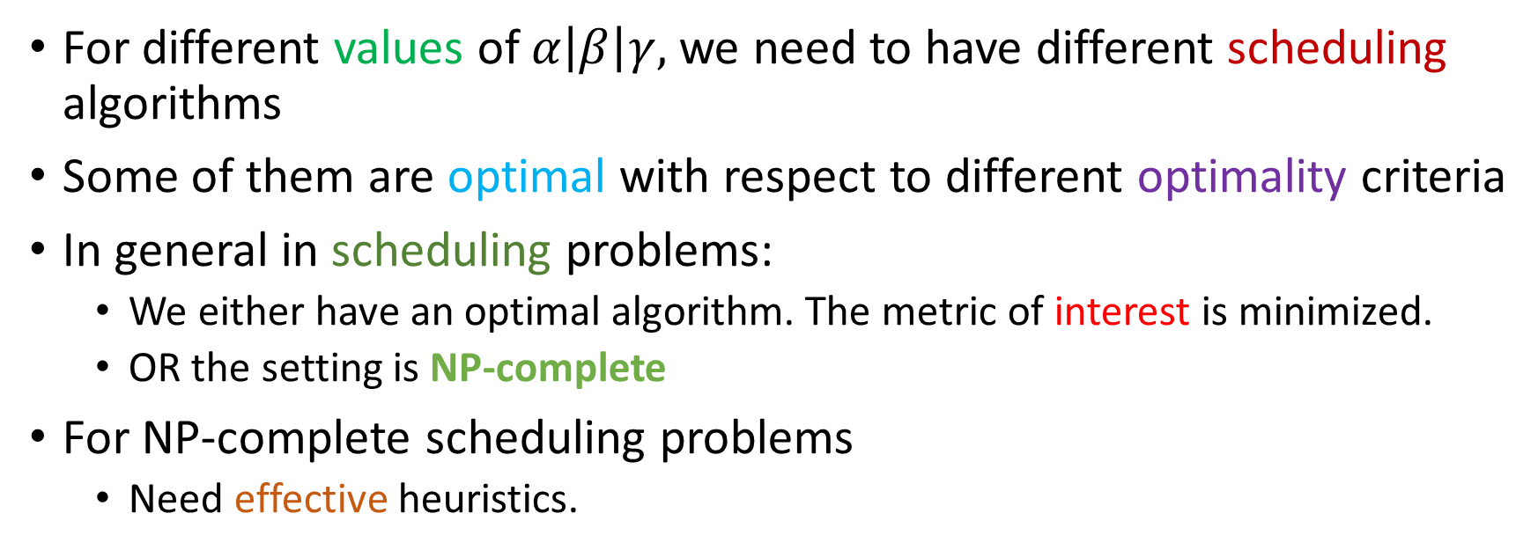
Class of Scheduling Problems
For different values of $α\left|β\right|γ,$we need to have different scheduling algorithms
Some of them are optimal with respect to different optimality criteria
In general in scheduling problems:
We either have an optimal algorithm. The metric of interest is minimized.
OR the setting is NP-complete
For NP-complete scheduling problems
Need effective heuristics.
Mostly either very easy or NP-Complete

Slide 83



How do you prove that a scheduling algorithm A is optimal?
Set up the problem
Assume it is not
Then there must be another optimal algorithm A’
Let it take the same decisions till a certain point
Prove by contradiction
Find the first point of divergence
Prove that an algorithm A’’ is better than A’ because of the decision that it took.
Hence, A’ cannot be optimal.

Slide 84


Proof that SJF is Optimal for $1||Σ C_{j}$
For the Algorithm A’ (supposedly optimal) there must be a pair of jobs
j and k such that
j immediately precedes k
p_{j} > p_{k} (this will not happen in the optimal algorithm)
p_{j} started at time t
Now exchange them (result of algorithm A’’)
Contribution to the completion time of j and k in A’: (t+p_{j}) + (t+p_{j}+p_{k})
Contribution to the completion time of j and k in A’’: (t+p_{k}) + (t+p_{j}+p_{k})
Given that p_{k} < p_{j}, A’’ has a lower completion time
Thus A’ cannot be optimal.
Contradiction

Slide 85
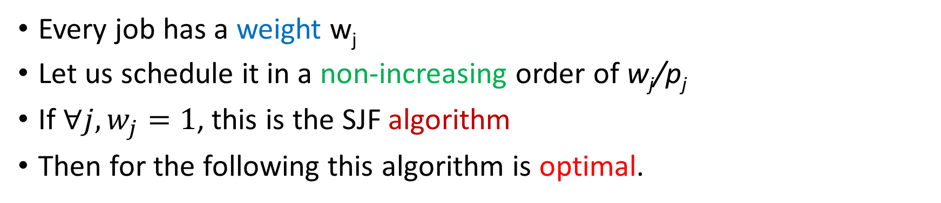

Weighted Jobs
Every job has a weight w_{j}
Let us schedule it in a non-increasing order of w_{j}/p_{j}
If $∀j, w_{j}=1$, this is the SJF algorithm
Then for the following this algorithm is optimal.
$$1||{Σw}_{j}C_{j}$$
Same exchange-based argument

Slide 86

Lateness and the Earliest Due Date (EDD) Algorithm/ Earliest Deadline First (EDF) Algorithm
Assume that jobs are associated with deadlines
Let us define lateness as <completion time> - <deadline>
Let us now solve the problem:
$$1||L_{max}$$
EDF algorithm: Order jobs by non-decreasing deadlines
Schedule in that order; break ties arbitrarily.
It is an exact algorithm for this problem
Same exchange-based argument

Slide 87


Preemption and Release Dates
$$1\left|r_{i}, pmtn\right|ΣC_{i}$$
Jobs arrive at different times. Job i arrives at time r_{i}.
Preemption is allowed
The most optimal algorithm is SRTF → Shortest Remaining Time First algorithm
Same exchange-based argument
EDF is an exact algorithm for
$$1\left|r_{i}, pmtn\right|L_{max}$$

Slide 88

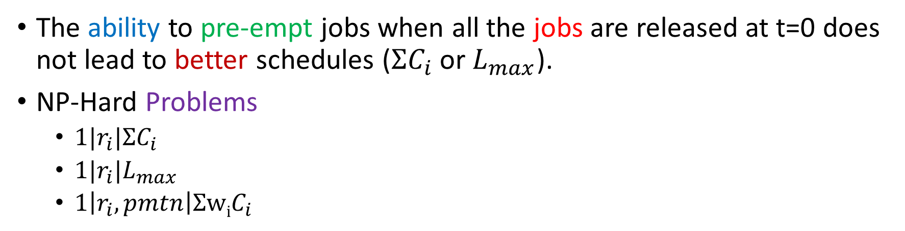
Some NP-Complete and Impossibility Results
The ability to pre-empt jobs when all the jobs are released at t=0 does not lead to better schedules ($ΣC_{i}$ or $L_{max}$).
NP-Hard Problems
$1|r_{i}|ΣC_{i}$
$1|r_{i}|L_{max}$
$1\left|r_{i}, pmtn\right|ΣwiC_{i}$
Look up other variants

Slide 89




What about the fact that it is impractical?
You normally don’t know how long a job will take to execute.
However, you can approximate.
CPU burst
I/O burst
CPU burst
I/O burst
You just need to predict CPU bursts. Let t_{n} be the size of the n^{th} burst. Predict it using a time-series model.
$t_{n}=αt_{n−1}+βt_{n−2}+γt_{n−3}$

Slide 90
Other Algorithms
FIFO
Maintain a queue of all processes
At every point, choose the process at the head of the queue
Problems with FIFO
A long job might delay a lot of small jobs: convoy effect
Fairness is an issue
Round robin
Run each job for one time quanta
Then preempt the task and run a new job in round robin order

Slide 91

Priority-based Scheduling
At any point of time, the highest-priority task should be running
If a task with a higher priority arrives, then swap out the currently running task
We can think of SRTF and FIFO as subsets of this class
For SRTF, the priority is the reciprocal of the remaining time
For FIFO, the priority is the reciprocal of the job arrival time
Recall Linux priorities …
Priority
Fairness

Slide 92
Priority Classes
Linux has 140 different priority levels. It is the job of the system administrator and OS to assign priorities to running tasks
The sys admin. can also change the priorities dynamically
Other OSes have different priority classes
Real time
Interactive
Regular
Batch
Windows gives a 3X priority boost to foreground processes

Slide 93
Queue-based Scheduling
Multi-level Feedback Queue
Queue: Level 1
Queue: Level 2
Queue: Level 3
Different queues have different priorities. They could have different scheduling policies as well.
Choose the queue with the highest priority that is non-empty
Schedule a process from it
Move processes between queues based on factors such as interactivity and age

Slide 94
Multi-Processor Scheduling
Dispatcher
CPU 1
CPU 2
CPU 3
Different CPUs maintain their queues.
The dispatcher also has a central queue. It picks a task from the queue and sends it to a CPU-specific queue.

Slide 95

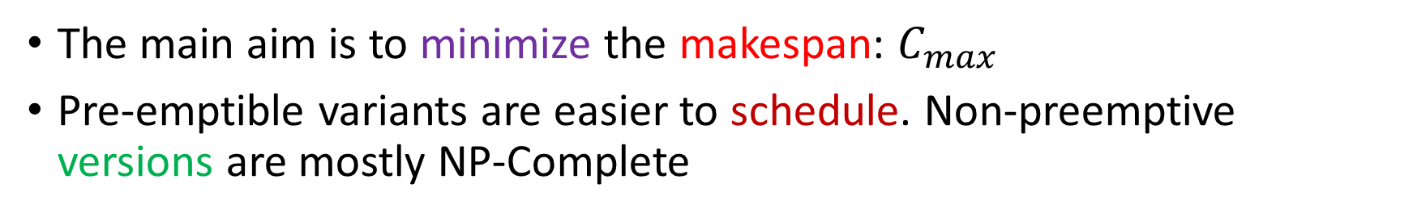

Some Theoretical Definitions
The main aim is to minimize the makespan: $C_{max}$
Pre-emptible variants are easier to schedule. Non-preemptive versions are mostly NP-Complete
Examples
$$P\left|pmtn\right|C_{max}$$
Evenly divide the work among the CPUs
$$P||C_{max}$$
NP-Hard

Slide 96



The Bin Packing and Partition Problems
These are some common NP-Complete problems that are used to prove the NP hardness of scheduling problems
Bin Packing
Each item is a job and each bin is a CPU
We have a finite number of bins
Each bin has a fixed capacity
There are n items, where each item’s size is n_{i}
We need to pack items into bins without exceeding their capacity
OR

Slide 97
Partition Problem
Consider a set S that contains a set of numbers
Find a subset whose sum is equal to a given number A (if it exists)
This is an NP-Complete problem
In a non-preemptive setting, this indicates that it is computationally hard to schedule exactly a certain amount of work on a given CPU.

Slide 98
Heuristics for Multiprocessor Scheduling
List Scheduling
Maintain a list of ready jobs
Order them according to some priority scheme
Choose the first job, assign it to a free CPU. So on and so forth until there are no more free CPUs.
Once a job finishes executing, check if there are any ready jobs.
Add the ready jobs to the queue. Keep executing.

Slide 99

Different List Scheduling Strategies
Order them in descending order of processing times
Find the critical path (longest path) in the graph of jobs. Choose jobs on the longest path first.
Order the jobs in descending order of out-degree
It is often near-optimal. The computed makespan is often less than 2 times the optimal makespan.

Slide 100




Banker’s Algorithm to Create Schedules and Avoid Deadlocks
We now have a complex schedule with the following attributes:
Task arrival times
Preemption or no preemption
Deadlines
Priorities
Dependences: pre-defined or dynamic (created by lock usage)
CPU affinities
$$ΣC_{i}$$
Metrics
$$L_{max}$$
$$C_{max}$$
What about the correctness of the schedule? Need to avoid deadlocks.
Checking for circular waits is not enough when there are multiple copies of each resource.

Slide 101
Data Structures in the Banker’s Algorithm
n processes
m types of resources
Data structures | Remarks
avlbl [0 … (m-1)] | avlbl[i] = #copies of the resource i
max [0 … (n-1)][0 … (m-1)] | Process i can request at the most max[i][j] copies of resource j (maximum allocation)
acq [0 … (n-1)][0 … (m-1)] | Process i has acquired acq [i][j] copies of resource j (resources acquired)
need [0 … (n-1)][0 … (m-1)] | Process i may request req [i][j] copies of resource j. acq + need = max

Slide 102

Check if the system is in a safe state
Complexity: O(mn²)
Initialize
Find an i such that
cur_cnt = avlbl
done[i] = false (0 … n-1)
(done[i] == false) && (need[i][…] $≤$cur_cnt)
If such an i cannot be found, jump to the last step
(done[i] == false) && (need[i][…] ≤ cur_cnt)
If such an i cannot be found, jump to the last step
Update
cur_cnt += acq[i][…]
done[i] = true
Safety check
If $∀i, done\left[i\right]==true$→ Safe
Else Unsafe
If ∀𝑖, 𝑑𝑜𝑛𝑒[𝑖]==𝑡𝑟𝑢𝑒 → Safe
Else Unsafe
requirement ≤ availability
Assume the process finishes and releases its resources. Increment cur_cnt accordingly. Elementwise array addition.
All the requests can be satisfied

Slide 103
Resource Request Algorithm
Initialize
The req[] array is an array of resource requests for array i . If req[j] = k, then it means that process i needs k copies of resource j.
If req > need[i][…], then the requirements cannot be satisfied.
If req > avlbl, wait until resources are available
Dummy Allocation
avlbl = avlbl - req
acq[i][…] = acq[i][…] + req
need[i][…] = need[i][…] – req
Basic check
Then check if the state is safe or not. If it is not safe, undo the current allocation and wait

Slide 104
Deadlock Detection Algorithm
reqs is an nxm matrix that stores resource requests (for each process)
Initialize
Find an i such that
cur_cnt = avlbl
$∀i,$done[i] = false if acq[i][…] ≠ 0, else true
cur_cnt = avlbl
∀𝑖, done[i] = false if acq[i][…] ≠ 0, else true
(done[i] == false) && (r$eqs\left[i\right][…]≤$cur_cnt)
If such an i cannot be found, jump to the last step
(done[i] == false) && (reqs[i][…]≤ cur_cnt)
If such an i cannot be found, jump to the last step
Update
cur_cnt = cur_cnt + acq[i][…]
done[i] = true
Deadlock check
If $∀i, done\left[i\right]==true$→ NO deadlock
Else Deadlock
If ∀𝑖, 𝑑𝑜𝑛𝑒[𝑖]==𝑡𝑟𝑢𝑒 → NO deadlock
Else Deadlock
Can satisfy

Slide 105

What happens if you find a deadlock?
Don’t allow a deadlock to perform by delaying a request or kill one of the processes involved in a circular wait.
Don’t enter an unsafe state
If we have entered an unsafe state, then perform a deadlock check when the system does not appear to make any progress
Kill one of the processes in the deadlock. Choose a process that has not executed for a very long time.

Slide 106
Scheduling in Linux

Slide 107

The schedule function
/kernel/sched/core.c
https://www.mail-archive.com/linux-kernel@vger.kernel.org/msg1740572.html
void schedule(void)
{
struct task_struct *tsk = current;
sched_submit_work(tsk);
do {
preempt_disable();
__schedule(SM_NONE);
sched_preempt_enable_no_resched();
} while (need_resched());
sched_update_worker(tsk);
}
To avoid deadlocks, dispatch work to other kernel threads
Update the status of the worker threads.

Slide 108
The main scheduler function: __schedule
There are several ways that one can enter the schedule function
A blocking call to a mutex, semaphore, etc.
The TIF_NEED_RESCHED flag is set while returning from an interrupt or system call.
One process pre-empts another one
Every CPU has a runqueue, which is the main data structure that queues tasks
struct rq
Encapsulates three different run queues (one for each scheduler): completely fair scheduler, real time, deadline driven
/kernel/sched/sched.h

Slide 109

The runqueue
struct rq {
raw_spinlock_t __lock;
unsigned int nr_running;
u64 nr_switches;
int cpu;
struct cfs_rq cfs;
struct rt_rq rt;
struct dl_rq dl;
struct task_struct __rcu *curr;
struct task_struct *idle;
struct mm_struct *prev_mm;
struct task_struct *core_pick;
};
Lock the runqueue for all operations
Basic stats about the CPU
All three runqueues: one for each scheduling class
Pointers to the current task, idle task, and mm_struct
The task selected for running

Slide 110
Notion of Scheduling Classes
Descending order of priority
STOP TASK → Stops everything and runs (like a kernel panic)
DL (Deadline Scheduling)
Tasks that need to finish before a deadline.
Audio and video encoding
RT (Real Time)
SoftIRQ threads
Custom software with mission critical requirements
Fair (CFS – completely fair scheduler)
Default
Idle
Idle process (nothing running basically)

Slide 111
struct sched_class
Defines a bunch of function pointers
All scheduling classes need to provide an implementation for these functions
Examples
enqueue_task
dequeue_task
pick_task
pick_next_task
migrate_task_rq
update_curr
Object-oriented languages define child classes.
This is C’s way of doing the same.
Just call the function pointer

Slide 112

Each Scheduler Class corresponds to a Scheduler
Mapping between sched_classes and files that implement the corresponding schedulers.
All expose the same API
Scheduler | File
Stop Task Scheduler | stop_task.c
Deadline Scheduler | deadline.c
Real-Time Scheduler | rt.c
Completely Fair Scheduler (CFS) | cfs.c
Idle | idle.c

Slide 113
schedule → pick_next_task → __pick_next_task
Regular non-real time processes
If the currently executing task is in the CFS class or above and there are no tasks in any other higher classes
Find the next fair task (as per CFS)
Else, iterate through the classes in descending order
Find the first eligible task and schedule.
Select the current core
Add to the runqueue
Run the scheduling algorithm of the appropriate scheduling class
Effect context switches (back to user mode or another task)

Slide 114
Relevant fields in task_struct
struct sched_entity se;
struct sched_rt_entity rt;
struct sched_dl_entity dl;
const struct sched_class *sched_class;
struct rb_node core_node;
unsigned long core_cookie;
Scheduling statistics
Node in an RB tree
Uniquely identifies a group of jobs

Slide 115

Completely Fair Scheduler
struct sched_entity {
struct load_weight load; /* load balancing*/
struct rb_node run_node;
u64 exec_start;
u64 sum_exec_runtime;
u64 vruntime;
u64 prev_sum_exec_runtime;
u64 nr_migrations;
struct cfs_rq *cfs_rq;
struct sched_avg avg; /* statistics */
};
Key concept: Virtual runtime of a process. Lower it is, higher the priority

Slide 116


pick_next_task_fair (for CFS Scheduling)
/kernel/sched/fair.c
Update the current task
Update the scheduling statistics
Update the virtual runtime of the task
Consider the current execution interval (current time – when the task started executing last) (= δ)
Let it be delta (δ)
$δ_{vruntime}=δ∗ \frac{weight (nice=0)}{weight (nice)}$
The increment to the virtual runtime is a function of the priority
$curr→vruntime+=δ_{vruntime}$

Slide 117
Priority (nice value) → Weight
const int sched_prio_to_weight[40] = {
/* -20 */ 88761, 71755, 56483, 46273, 36291,
/* -15 */ 29154, 23254, 18705, 14949, 11916,
/* -10 */ 9548, 7620, 6100, 4904, 3906,
/* -5 */ 3121, 2501, 1991, 1586, 1277,
/* 0 */ 1024, 820, 655, 526, 423,
/* 5 */ 335, 272, 215, 172, 137,
/* 10 */ 110, 87, 70, 56, 45,
/* 15 */ 36, 29, 23, 18, 15,
};

Slide 118
Next Steps …
Update the vruntime
Red-black tree indexed by the vruntime
Reduce the virtual executed time of the entire cfs_rq
A red-black tree stores a list of tasks indexed by the vruntime.
The leftmost entry stores the task with the least vruntime
Store the current minimum in cfs_rq->vruntime (u64)

Slide 119
pick_next_entity
This is called by pick_next_task_fair
Default: Choose the leftmost entity that has the least vruntime
Otherwise: If the current task has executed for more than a quantum, then try a pre-emption
Choose the second leftmost entity
Each group of processes is treated as a single unit for the purposes of allocation of vruntime

Slide 120
Fairness Aspects of CFS
sysctl_sched_latency: A period of task when all ready tasks run at least once. Referred to as a scheduling period.
sched_nr_latency: maximum number of runnable tasks that should be able to execute once
sysctl_sched_min_granularity: The minimum amount of time that a task needs to run in a scheduling period.

Slide 121
More about the scheduling slice
sched_nr_latency = sysctl_sched_latency/ sysctl_sched_min_granuarlity
u64 __sched_period(unsigned long nr_running)
{
if (unlikely(nr_running > sched_nr_latency))
return nr_running * sysctl_sched_min_granularity;
else
return sysctl_sched_latency;
}
Every task gets the minimum
$$Scheduling Slice=sched_{period} ∗ \frac{weight of the task}{Sum of weights}$$

Slide 122

Updating vruntime
The vruntime will keep on increasing. Wouldn’t that heavily prioritize new tasks?
The cfs_rq maintains a variable called min_vruntime (lowest vruntime of all processes)
Let se be the sched_entity that is being enqueued to the run queue
If an old task is being restored or a new task is being added, then set: se->vruntime += cfs_rq->min_vruntime
This ensures that other tasks have a fair chance of getting scheduled
Always ensure that the all vruntimes monotonically increase (in the cfs_rq and sched_entity structures)
When a child process is created, it inherits the vruntime of the parent
Upon a task migration or block/unblock, subtract cfs_rq->vruntime from the source rq and add the corresponding number for the destination rq (while enqueueing back again in the same or a different rq)

Slide 123


Load Averages and Decaying
/kernel/sched/pelt.c
Computing the load average is important for taking decisions such as allocating CPUs and modulating the CPU frequency.
Solution:
Divide the timeline into 1 ms intervals
Let the intervals be p₀, p₁, p₂, ...
Let u_{i} denote the fraction of time p_{i} was runnable
$$Load_{avg}=u_{0}+u_{1}∗y+u_{2}∗y^{2}+ …$$
$$y^{32}=0.5$$

Slide 124
Deadline Scheduler
/kernel/sched/deadline.c
We have an analogous function: pick_next_task_dl
Maintain a red-black tree
The task with the earliest (smallest) deadline is the leftmost
Maintain sched_dl_entity structures indexed by their deadline
#define rb_entry(ptr, type, member) container_of(ptr, type, member)
Find the sched_dl_entity for a given rb_node using this macro and return it. Find the task_struct from sched_dl_entity using the same method.

Slide 125
Realtime Scheduler
/kernel/sched/rt.c
Maintain a queue for each priority level
Maintain a bitmap: one bit for each queue.
Find the highest priority queue that has an entry.
Pick the first task and run it.
Two policies: FIFO and RR
RR
FIFO
If a task has executed for more than its time slice
Put it at the end of its queue
Find the next task and mark it ready. Set the re-schedule flag to true.
Tasks are queued in FIFO order
We scan every queue in FIFO order
The FIFO ordering is always maintained

Slide 126
Outline of this Chapter
Synchronization Basics (User Space)
Synchronization in the Kernel
Scheduling
Real Time Scheduling with Dependences

Slide 127
Real-Time Systems
Every task has an associated deadline
Soft real-time system
If a task misses its deadline, its utility reduces, does not become zero.
Firm real-time system
Missing a few deadlines is acceptable. Even though the utility is zero, we will not have a total failure.
Hard real-time system
No task can miss its deadline

Slide 128


The Notion of Schedulability
In real-time systems such as rockets or avionics
The tasks are known
They are often periodic
The maximum processing time is also (more or less) known
The deadlines are known
Set of jobs
Is it schedulable?
This makes the process of scheduling easier and it is also easier to provide guarantees.
A set of jobs is schedulable with an algorithm A, if no job misses its deadline in the final schedule.

Slide 129




EDF (Earliest Deadline First)
Uniprocessors
Priority $∝1$ / <time till deadline>
We already know that
EDF minimizes $L_{max}$
This means that if we have a set of tasks and associated deadlines, if it is schedulable, we have L_{max} ≤ 0
Furthermore, if it is schedulable, EDF will always be able to find a feasible schedule.
If pre-emption is enabled, EDF is optimal, and furthermore it provides the test of schedulability

Slide 130
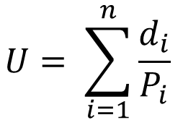
A Stronger Result for EDF on Uniprocessor Machines and Periodic Jobs
Zero overheads for preemption and scheduling
Let the duration of a job be d_{i}
Let its period be P_{i}
Let its deadline be same as the period (needs to complete before the next instance of the job arrives).
$$U= \sum_{i=1}^{n}{\frac{d_{i}}{P_{i}}}$$
If $U≤1,$we can always find a feasible schedule for it using EDF
The scheduler computes U and if $U≤1$, it reports that the set of jobs are not schedulable. The same algorithm is followed if new tasks arrive in the middle of the execution.

Slide 131
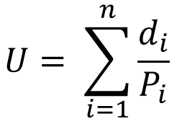
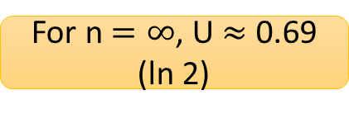

Rate-monotonic Scheduling (RMS Scheduling)
Uniprocessors
[2]
In EDF, priorities are decided dynamically.
If a new job arrives with an earlier deadline, then it gets a higher priority.
Consider a system with periodic jobs where
All the priorities are assigned statically (at start-up time)
The priority is inversely proportional to the job’s period
A periodic task i has two attributes: P_{i} (time period) and d_{i} (execution duration)
For each periodic task, the deadline is the time period
$$U= \sum_{i=1}^{n}{\frac{d_{i}}{P_{i}}}$$
Total utilization
Liu and Layland ‘73
A set of n jobs is RMS-schedulable if $U≤n(2^{\frac{1}{n}}−1)$
For n=2, U $≈$ 0.83
For n $=∞$, U $≈$ 0.69 (ln 2)

Slide 132

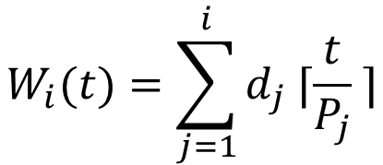



More about RMS [3]
The Liu-Layland bound is a very conservative bound. Often, we can do better.
It can be proven that the worst case occurs when all the tasks are in phase (start together).
Lehoczky Test
Assume the worst case (zero phasings)
Check whether every task is meeting its first deadline
Then, the we have schedulability (even if U exceeds the Liu-Layland bound)
Arrange the tasks in descending order of RMS priority
$$W_{i}(t)=\sum_{j=1}^{i}{d_{j} ⌈\frac{t}{P_{j}} ⌉}$$
Find the number of periods within a time interval and account for all the tasks’ execution. This is the total load of the first i tasks.
$$L_{i}\left(t\right)=\frac{W_{i}\left(t\right)}{t}$$
Necessary and sufficient condition
$$L_{i}=\min_{\left\{0<t≤P_{i}\right\}}{L_{i}(t)}$$
$$L=\max_{\left\{1≤i≤n\right\}}{L_{i }≤1}$$
i^{th} task is schedulable if and only if $L_{i}≤1$
All tasks are schedulable

Slide 133






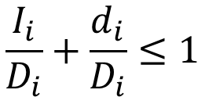
DMS: Deadline Monotonic Scheduling [4]
Uniprocessors
RMS
$$deadline=period$$
$$Priority∝\frac{1}{deadline}$$
DMS
$$deadline≤period$$
Every task should be schedulable
$$\frac{I_{i}}{D_{i}}+\frac{d_{i}}{D_{i}}≤1$$
D_{i} is the deadline for task i
I_{i} is the interference that it suffers because of other tasks
Not enough

Slide 134

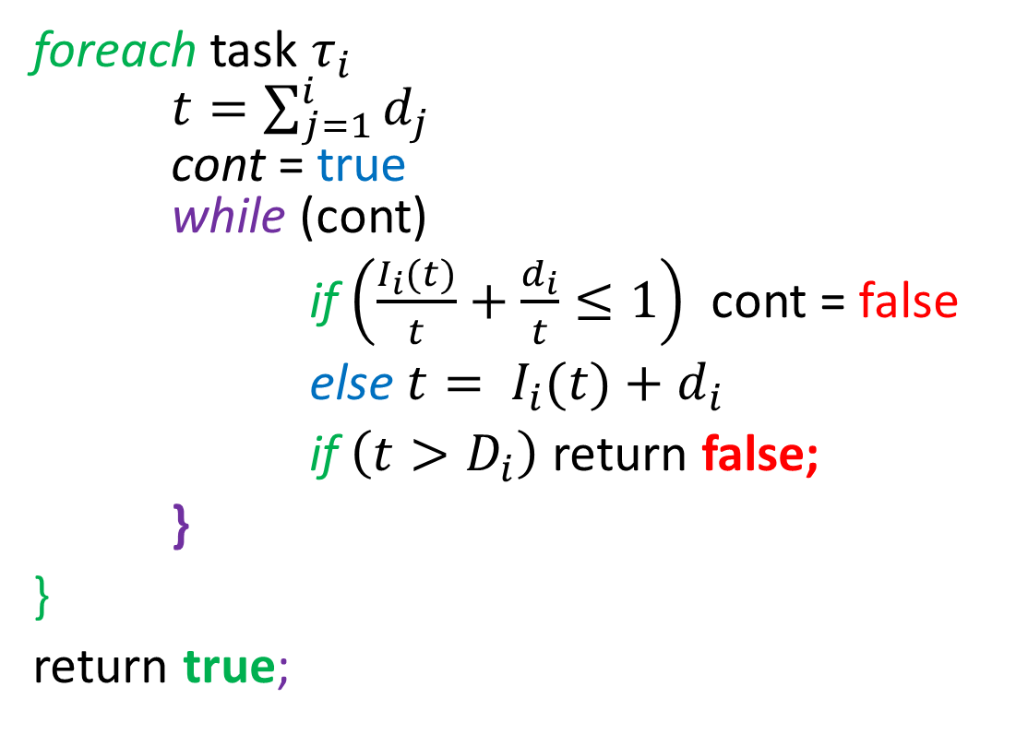
Exact Algorithm
Interference
foreach task $τ_{i}$ $t=\sum_{j=1}^{i}{d_{j}}$ cont = true while (cont)
if $\left(\frac{I_{i}(t)}{t}+\frac{d_{i}}{t}≤1\right)$ cont = false
else $t= I_{i}(t)+d_{i}$
if $\left(t>D_{i}\right)$ return false;
}
}
return true;
$$I_{i}(t)= \sum_{j=1}^{i−1}{\left\lceil \frac{t}{P_{j}}\right\rceil ∗d_{j}}$$
Schedulable
Iterate
Not schedulable

Slide 135

Priority Inheritance Protocol (PIP) [5]
What happens if a low-priority process holds a resource, and this stops high priority processes from making progress? Priority inversion
A high priority process could be blocked for a long time if a medium priority process decides to run.
Solution:
Raise the priority of the lock-holding low-priority task to that of the high-priority task (until it holds the resource).
Chain blocking
There is a problem if a high-priority process needs many resources and this process has to be carried out for every resource.

Slide 136


Highest Locker Protocol (HLP)
For Uniprocessors
Let us assume some facts are known a priori
Let ceil(resource) be the priority of the highest-priority process that can possibly acquire the resource.
Once a process acquires a resource, raise its priority to ceil(resource)
The moment a process acquires a resource, it cannot be blocked any more by a low-priority process.
We cannot have any deadlocks.
Quite unfair for intermediate priority tasks that can’t run now.
Inheritance blocking

Slide 137
Priority Ceiling Protocol (PCP)
Uni and multi-processors
Each resource has a highest ceiling priority
Don’t allocate a resource, even if it is free 🤚
System ceiling (CSC) = max (ceilings of all resources that are in use)
Resource grant clause
Either a task holds a resource that set the current system ceiling
OR its priority needs to be higher than the CSC (also set the new CSC in this case)
Inheritance clause
The process holding a resource inherits the priority of the blocked task, if its priority is lower
⛔Does not change the priority
Changes the priority
Revert the priority accordingly on a resource release.

Slide 138
Brief Note about PCP
No deadlocks and chain blocking
Once a task acquires a resource, it does not undergo any more priority inversions.
Controlled priority inheritance
We look at the actual pattern of resource usage.
This breaks the symmetry and thus deadlocks are not possible.
We don’t design a protocol assuming the theoretical worst-case.

Slide 139
Bibliography
[1] Karger, David, Cliff Stein, and Joel Wein. "Scheduling algorithms." Algorithms and Theory of Computation Handbook: special topics and techniques. 2010. 20-20.
[2] Scheduling Algorithms for Multiprogramming in a Hard-Real-Time Environment, Liu and Layland, Journal of the ACM, 1973
[3] The Rate Monotonic Scheduling Algorithm: Event Characterization and Average Case Behavior, Lehoczky, Sha, and Ding. IEEE Real Time Systems Symposium, 1989
[4] Deadline Monotonic Scheduling, Audsley, 1990
[5] Real-Time Systems: Theory and Practice, Rajib Mall, 2006. Pearson Publishers.

Slide 140


srsarangi@cse.iitd.ac.in

