Slide 1
Ethereum
Prof. Smruti R. Sarangi
IIT Delhi

Slide 2

History of Ethereum
Dwork and Naor proposed the idea of “proof of work” way back in 1992
Vishnumurthy et al. [2003] used PoW to secure a currency. The basic idea is to make it very hard to generate fake currency.
Bitcoin came in 2008 [Satoshi Nakamoto]
We have seen a deluge of cryptocurrencies after that
Ethereum came in 2013 (first proposed by Vitalik Buterin)
It is much more than a digital currency. It allows users to run arbitrary code on a shared global state (allows all kinds of financial instruments)
Second largest cryptocurrency in terms of market cap in 2018 (just behind Bitcoin)
Extremely popular as of 2022. Adopted to create a large number of financial products. Also used to create Non Fungible Tokens (NFTs) for managing digital art and collectibles.
Smart contracts

Slide 3



Machine State and World State
World state
Machines
All the machines (nodes) are share a common world state. It is a shared
state that is modified by transactions. Every machine has a private machine state.

Slide 4
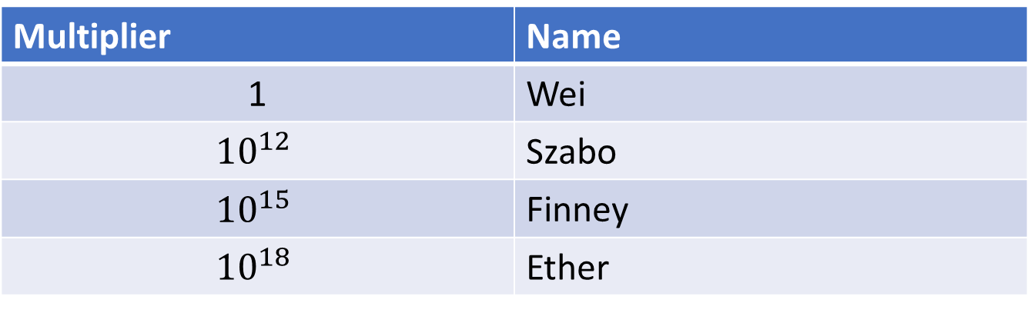
Basic Concepts
The blockchain starts with a genesis block.
There are two kinds of functions applied to the world state
State transition functions (transfer from account A to account B)
Account creation transactions
The built-in currency is in Ether (Ξ). The lowest denomination is a Wei.
Multiplier | Name
1 | Wei
$${10}^{12}$$ | Szabo
$${10}^{15}$$ | Finney
$${10}^{18}$$ | Ether

Slide 5
World State
Addresses
(160-bit ids)
Account state
The account states need to be maintained by each machine
Preferably in a Merkle Patricia tree (MPT)
This is the state database
The contents of the root node are dependent on the state of the entire tree

Slide 6

What is a Merkle Patricia Tree (or Trie)?
What is a Patricia trie?
A prefix tree
d
a
t
d
a
s
o
as
t
do
o
e
to
te

Slide 7
Merkle Tree
A tree of hashes
The root represents the state of the entire tree.
hash (hash(A), hash (B,C))
hash(A)
hash (B,C)
A
B
C

Slide 8
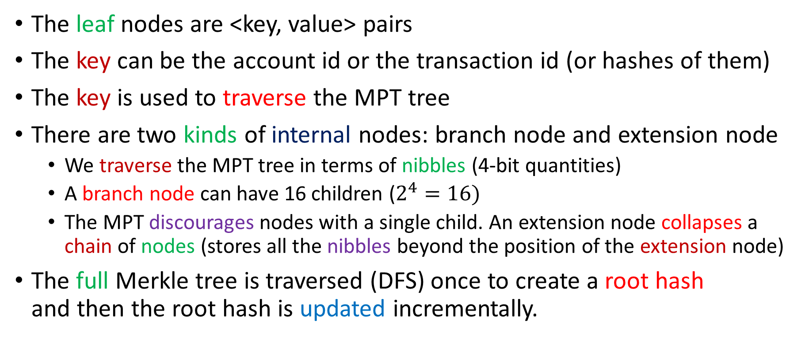
Merkle Patricia Tree
The leaf nodes are <key, value> pairs
The key can be the account id or the transaction id (or hashes of them)
The key is used to traverse the MPT tree
There are two kinds of internal nodes: branch node and extension node
We traverse the MPT tree in terms of nibbles (4-bit quantities)
A branch node can have 16 children ($2^{4}=16)$
The MPT discourages nodes with a single child. An extension node collapses a chain of nodes (stores all the nibbles beyond the position of the extension node)
The full Merkle tree is traversed (DFS) once to create a root hash and then the root hash is updated incrementally.

Slide 9
Parts of the Account State
Nonce
#contract creations made or #transactions sent to an address
Balance
#Wei owned by an account
storageRoot
codeHash
Root hash (256 bits) of the contents of the account.
Hash of the EVM (Ethereum Virtual Machine) code

Slide 10
Transactions
Message transfer
data (input byte array)
Creation of a new account (contract creation)
body
Code that when a message is received
Common Fields
Nonce → #transactions sent by the sender
gasPrice → #Wei per unit of gas (computational effort)
gasLimit → Maximum gas that can be spent for this transaction (paid up front)
to → Recipient of the message
value → Value to be transferred

Slide 11
The Block
Contains a list of transactions + other information
Concept of an ommer block
Grand parent
Parent
Ommer
Block

Slide 12
List of Fields in a Block
Field | Meaning
parentHash | Hash of the parent’s block header
ommersHash | Hash of the list of ommers
beneficiary | Who gets the fees for successfully mining this block
stateRoot | Root hash of the account state trie
transactionsRoot | Root hash of the trie (that stores all the transactions in the block)
receiptsRoot | Root hash of the trie that has all transaction receipts
logsBloom | Bloom filter for all the log topics in the transaction logs

Slide 13
List of Fields in a Block – II
Field | Meaning
difficulty | mining difficulty level of the block (function of the timestamp and difficulty of the previous block)
number | Depth of the block (starting from the genesis block)
gasLimit, gasUsed | Total allowed gas and the amount of gas used
timestamp | Unix time() value at the block’s inception
extraData | Max. 32 bytes of additional meta-data
mixHash | 32 bytes of pseudorandom data (used for mining)
nonce | A 8-byte quantity (used for mining)

Slide 14

Transaction Receipts
Every transaction modifies the world state and (optionally) produces an output
The transaction outputs (receipts) are stored in a trie. The root hash is stored in the block.
Post-transaction state
Set of logs created
Gas used
Bloom filter (logs)
Transaction Receipt
The hash of the world state acts as the key in the trie.

Slide 15
Log Entry
Logger’s address
List of log topics
Data
2048-bit hash
Set to 1
Bloom filter

Slide 16
Gas and Payment
gasPrice
gasLimit
The entire amount – gasPrice x gasLimit + value – is deducted at the beginning of a transaction
The unused amount is later refunded
Increasing the gasPrice provides a higher incentive to mine
It will get added to the blockchain sooner

Slide 17
Transaction Execution
Transaction Substate
Self-destruct set
Set of logs
Refund balance
Self-destruct set: Set of accounts that will be destroyed after the transaction completes
Why have the notion of gas?
Answer:
This places a limit on the computation that miners need to do. It ensures that they don’t enter an infinite loop or become unresponsive. If a transaction
runs out of gas, it stops, and the state is reverted back, refunds are issued.

Slide 18

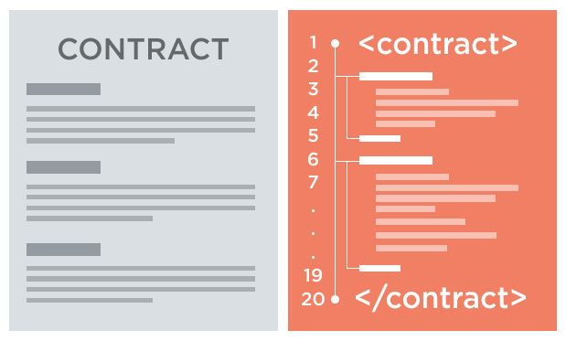
Message Calls
Message: sender, tx originator, recipient,
account, available gas, value, gas price,
inputs and call stack
account
associated code (smart contract)

Slide 19
Execution Model
The Ethereum Virtual Machine (EVM) is a Turing-complete machine. However, the number of computations is bounded by the amount of available gas.
Word size: 32 bytes
Maximum stack size: 1024
Independent word array (for storage)
Code stored in a ROM (read-only memory) region

Slide 20
When is Gas Charged?
Fees intrinsic to the operation (different operations need different amounts of gas)
Payment for message calls and contract creation
Increase in the usage of memory
Note: storage usage fees are refunded (once storage is freed)

Slide 21
Overview of Execution
The EVM is a regular sandboxed execution environment, which is isolated from the host.
It stops upon an exception including when the gas used exceeds the gas limit
Machine state → (gas available, program counter, memory contents, active number of words in memory, stack contents)

Slide 22

Block Tree to Blockchain
Unlike Bitcoin, Ethereum maintains a tree (DAG) of blocks
The list of ommers is maintained
There is no confusion about the chain (real block chain)
It is the path with the maximum cumulative difficulty
This is the hardest to mine
Rewards
A block’s reward is 5 Ether (credited to the beneficiary address)
Two ommers are maintained (credited 1/32th of the block reward)

Slide 23
Proof of Work (PoW) in Ethereum
Should be accessible to as many people as possible
Should not be easily solvable using a custom ASIC
Should not be possible to write an efficient parallel program to compute the PoW
A general-purpose computation is “ASIC hard”
PoW algorithm
Ethash

Slide 24

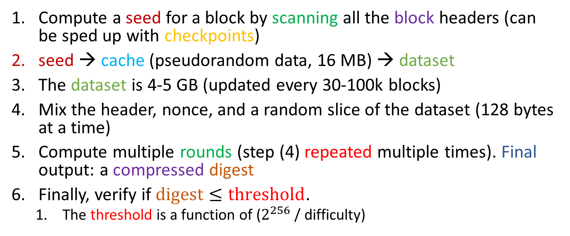
Ethash algorithm
Compute a seed for a block by scanning all the block headers (can be sped up with checkpoints)
seed → cache (pseudorandom data, 16 MB) → dataset
The dataset is 4-5 GB (updated every 30-100k blocks)
Mix the header, nonce, and a random slice of the dataset (128 bytes at a time)
Compute multiple rounds (step (4) repeated multiple times). Final output: a compressed digest
Finally, verify if $digest≤threshold$.
The threshold is a function of ($2^{256}$ / difficulty)
A nonce that leads to condition (6) getting satisfied is the PoW.

Slide 25
Types of Smart Contracts
Data Feed
Access to the external world within the Ethereum ecosystem
News feeds, current time, etc.
Random Numbers
Use the internal PoW mechanisms to generate pseudorandom numbers
Cryptocurrency
Unlike Bitcoin, Ethereum has built-in support for accounts
This makes it a default choice for cryptocurrency and other kinds of financial instruments

Slide 26
Scalability
We can maintain periodic checkpoints
There is no need to store all the blocks and all the transactions within a block
Periodically checkpoint the world state trie
Inactive nodes could be thrown out
Create a hierarchical structure
Smaller light-weight chains (sharding)
Support parallel blockchains (subject to limits)

Slide 27
References
Wood, Gavin. "Ethereum: A secure decentralised generalised transaction ledger." Ethereum project yellow paper 151.2014 (2014): 1-32.
Dameron, Micah. "Beigepaper: an ethereum technical specification." Ethereum Project Beige Paper (2018). Dameron, M. (2018). Beigepaper: an ethereum technical report

Slide 28
Thank you

Slide 29















Slide 30
















Answer:

