Slide 1
Stellar Consensus Protocol
Prof. Smruti R. Sarangi
IIT Delhi

Slide 2
Types of Blockchains
There are two kinds of blockchains
Permissioned
Permissionless
Permissioned systems like Hyperledger
All the participants are known.
They can all be authenticated.
Not suitable for open membership (any body can join)
Permissionless systems
Bitcoin and Ethereum
Can implement cryptocurrencies

Slide 3

Notion of Quorums
Fault model
Byzantine faults
Nodes can behave arbitrarily and maliciously
Malicious nodes can also collaborate with each other
Classic fault tolerance result with Byzantine faults
With 3f+1 nodes, we can tolerate at the most f Byzantine failures.
In this case, at least 2f+1 nodes make a quorum (all need to be correct)

Slide 4
New Ideas: Stellar and Ripple
Federated Byzantine Quorum System (FBQS)
The participants are not known
There is no need for all the nodes to participate in a consensus protocol
Every node chooses whom to trust (think of it as a private quorum)
Such protocols are very modular and scalable

Slide 5
Background and Assumptions
The universe of nodes: V
A correct node executes as per specifications
If a node is either correct or just fails (without sending any malicious messages), then it is dubbed as honest
The rest of the nodes are faulty
Partially Synchronous Network:
After a global stabilization time (GST), all messages have a bounded delay
The clock skew is bounded.

Slide 6

The key idea: Quorum slice
Every node has a set of quorum slices (associated with it)
A quorum slice is a set of nodes that the node trusts
A node is a member of all of its quorum slices.
A quorum is a set of nodes. Every node that is a part of a quorum also has at least one quorum slice in it (in the quorum).
Assume that for the time being all the faulty nodes do not lie about their quorum slices.

Slide 7
Example of Quorums and Quorum Slices
Node | Quorum Slices
v1 | {v1, v2}
v2 | {v1,v2}, {v2,v3}
v3 | v3
v4 | v4
We can have many quorums
{v1, v2}, {v3}, {v4}, {v1,v2,v3,v4}, ....

Slide 8

Some Basic Requirements
Every two quorums must intersect at a correct node.
This correct node will ensure that there is common agreement (consensus) across all quora.
Few more definitions:
Two nodes, v1 and v2, are said to be intertwined, if they are both correct
and every quorum containing v1 intersects every quorum containing v2 in at least one correct node.

Slide 9
Intact Set
Projection of the FBQS S to set I
$$S\left|I ⇒ S\right|I\left(v\right)=\left\{q∩I \right|q∈S(v)\}$$
Projects all the slices to a given set S
A set I is an intact set if
I is a quorum in S
All pairs in I are intertwined in S|I.

Slide 10




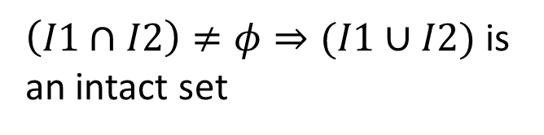
Let us understand a little bit more.
I
Intact sets can reach a consensus
U1
U2
$$\left(U1∩U2\right)∩I≠φ$$
All intersecting intact sets are closed under union.
$\left(I1∩I2\right)≠φ⇒(I1∪I2)$ is
an intact set

Slide 11
Non-Blocking Byzantine Consensus for Intact Sets
Given a maximal intact set I
Integrity → No correct node decides twice
Agreement → No two nodes decide differently
Weak validity → If all nodes are honest, then the value that is decided is one of the proposed values
Non-blocking → If all malicious nodes stop, then all the nodes ultimately come to a consensus.
By the FLP result, we cannot guarantee termination if malicious/faulty nodes are active.

Slide 12
Key part of the algorithm: Federated Voting
Properties
Vote (a)
Deliver (a’)
For correct nodes
No duplication → Every correct node delivers at most one voted value
Totality → If a node in I delivers a voted value, every node in I delivers a voted value
Consistency → If two intertwined nodes deliver a and a’ resp., a = a’
Validity → If all nodes vote for a, they eventually deliver a
Reliable Byzantine voting

Slide 13
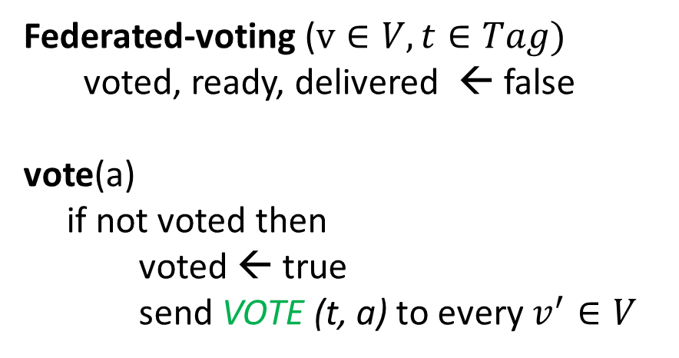
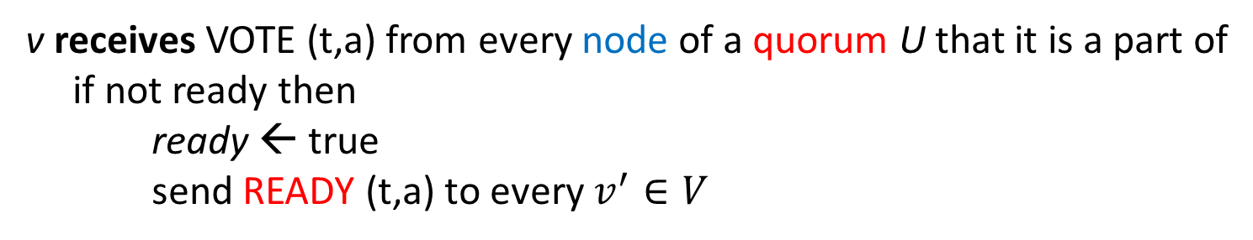
One Round of the Federated Voting Protocol
Federated-voting ($v∈V, t∈Tag)$
voted, ready, delivered ← false
vote(a)
if not voted then
voted ← true send VOTE (t, a) to every $v^{′}∈V$
A tag indicates a round
v receives VOTE (t,a) from every node of a quorum U that it is a part of
if not ready then
ready ← true
send READY (t,a) to every $v^{′}∈V$

Slide 14
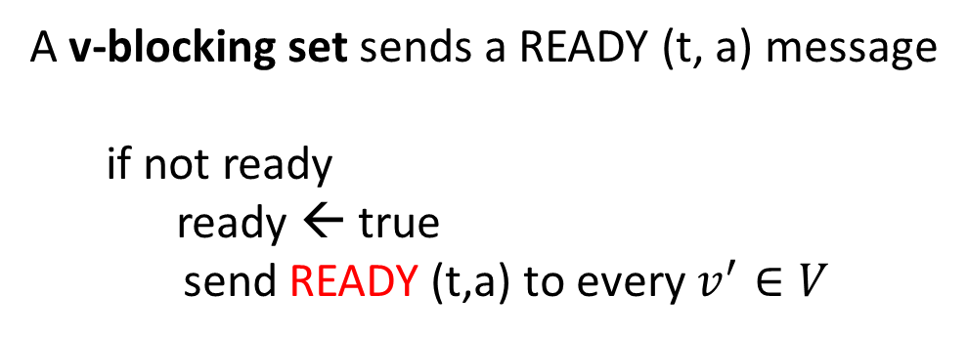
FV Protocol (Part II)
A v-blocking set sends a READY (t, a) message
if not ready
ready ← true
send READY (t,a) to every $v^{′}∈V$
A set is v-blocking if it overlaps with every quorum slice of v
Can send a READY message for value that it has not voted for
Received READY (t, a) from a quorum U that v is a part of
if not delivered
delivered ← true
deliver (a)
Similar to 2-phase commit

Slide 15
Insights
The first READY message is received, only after the same VOTE message is received from the entire quorum
Then it is propagated (a v-blocking set is enough)
Termination is not guaranteed:
Otherwise, it will violate the FLP result
However, once one message is delivered
The rest get delivered in finite time (for correct nodes), if we assume bounded clock skew

Slide 16
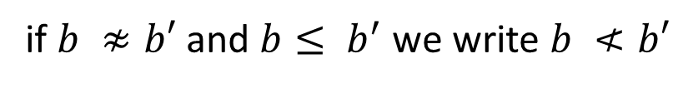
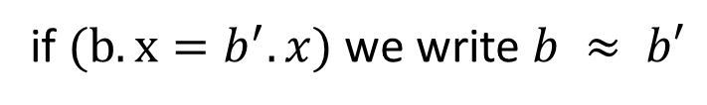
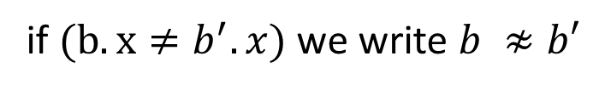
Some More Terminology
Ballot
<n, x>
Value
Positive number
Total ordering: b < b’ → (b.n < b’.n) or ((b.n = b’.n) and (b.x < b’.x))
Compatibility
if $(b.x=b^{′}.x)$ we write $b ≈ b′$
if $(b.x≠b^{′}.x)$ we write $b ≉b′$
if $b ≉b′$ and $b≤ b^{′}$ we write $b ≮b′$

Slide 17
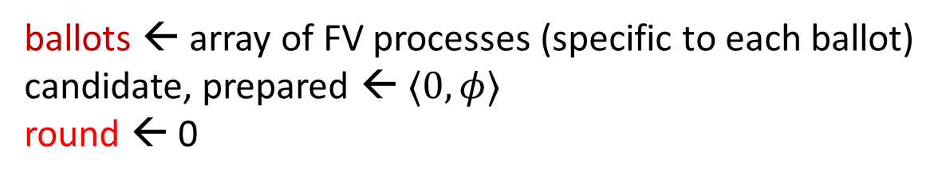
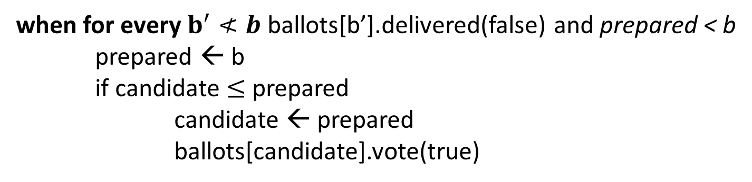
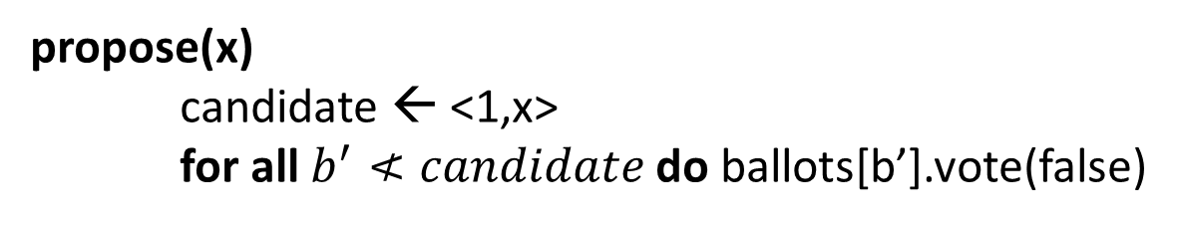
Abstract Consensus Algorithm for node v
ballots ← array of FV processes (specific to each ballot)
candidate, prepared ← $⟨0, φ⟩$
round ← 0
propose(x)
candidate ← <1,x>
for all $b^{′}≮candidate$ do ballots[b’].vote(false)
Ensure all incompatible ballots with a lower number are voted out
when for every $b^{′}≮b$ ballots[b’].delivered(false) and prepared < b
prepared ← b
if candidate $≤$ prepared
candidate ← prepared
ballots[candidate].vote(true)
Ensure that the candidate ballot is accepted by all

Slide 18
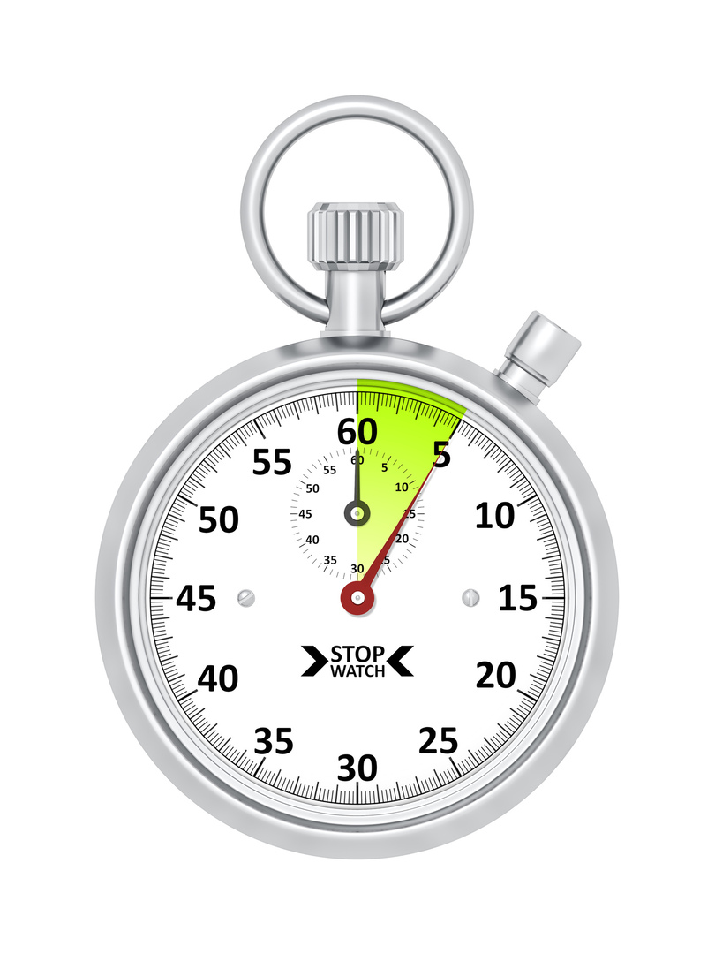
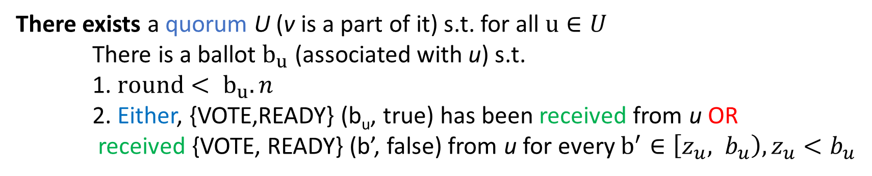
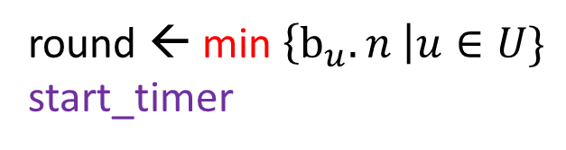
Consensus Algorithm – II
when ballots[b].delivered (true)
decide (true)
Once, one true message is delivered, we know that the rest will also be delivered (property of intact sets). Declare victory
A quorum is pretty much deciding for another round.
There exists a quorum U (v is a part of it) s.t. for all $u∈U$
There is a ballot $b_{u}$ (associated with u) s.t.
1. ${round< b}_{u}.n$
2. Either, {VOTE,READY} (b_{u}, true) has been received from u OR
received {VOTE, READY} (b’, false) from u for every $b^{′}∈\left[z_{u}, b_{u}\right), z_{u}<b_{u}$
round ← min $\left\{b_{u}. n \right|u∈U\}$
start_timer
Upgrade the round to be in sync with the quorum

Slide 19
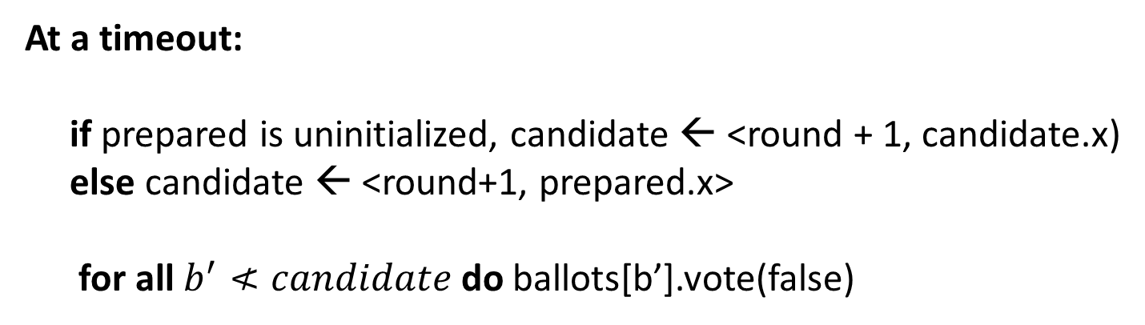
Consensus Algorithm – III
Quite similar to propose(x)
At a timeout:
if prepared is uninitialized, candidate ← <round + 1, candidate.x) else candidate ← <round+1, prepared.x>
for all $b^{′}≮candidate$ do ballots[b’].vote(false)

Slide 20
Some Basic Properties
If some node decided on a ballot, some node must have prepared it
If a node has prepared a ballot, some node must have proposed the value
All nodes in the intact set decide the same value (if the protocol terminates)
If quorum intersection holds, this is obvious.
We need infinite state because the state of all the ballots and tags (rounds) has to be maintained.

Slide 21

Finite Version of the Protocol
The main idea is that we cannot maintain an unbounded amount of state: all tags (rounds) and all ballots
We need to do some garbage collection (dynamic removal basically)
We need to maintain a subset of all messages (and throw out of messages that are beyond the range)
New Terminology
instead of vote and deliver
prepare
commit

Slide 22
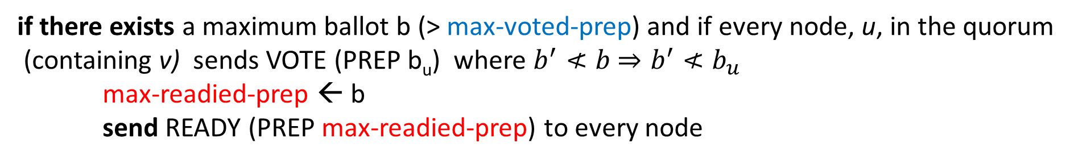
New FV Algorithm
prepare (b)
if (max-voted-prep < b) then
max-voted-prep ← b
send VOTE (PREP max-voted-prep) to all the nodes
If not voted for the current ballot (or later ones), then vote
if there exists a maximum ballot b (> max-voted-prep) and if every node, u, in the quorum (containing v) sends VOTE (PREP b_{u}) where $b^{′}≮b$ $⇒b^{′}≮b_{u}$
max-readied-prep ← b
send READY (PREP max-readied-prep) to every node
If it receives a b_{u} where lower and incompatible ballots are alive, it waits
Always consider the maximum ballot

Slide 23
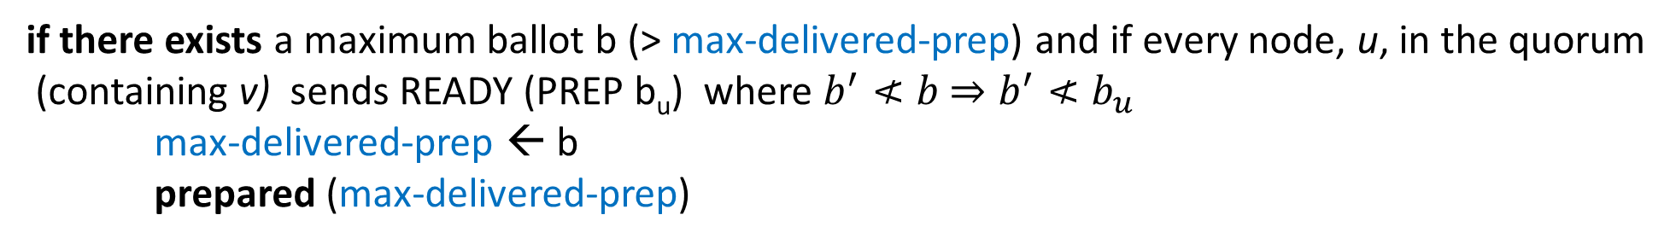
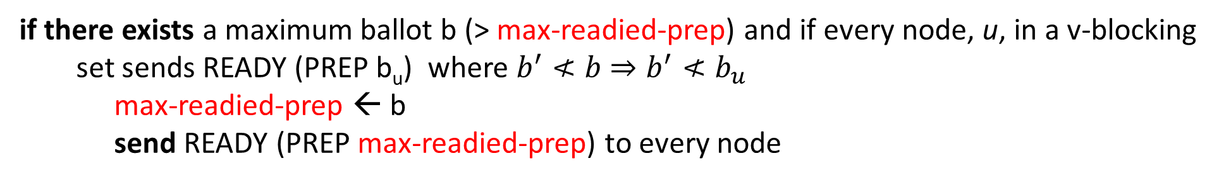
Finite Version of the FV Algorithm – II
if there exists a maximum ballot b (> max-readied-prep) and if every node, u, in a v-blocking set sends READY (PREP b_{u}) where $b^{′}≮b$ $⇒b^{′}≮b_{u}$
max-readied-prep ← b
send READY (PREP max-readied-prep) to every node
Just propagate READY messages
if there exists a maximum ballot b (> max-delivered-prep) and if every node, u, in the quorum (containing v) sends READY (PREP b_{u}) where $b^{′}≮b$ $⇒b^{′}≮b_{u}$
max-delivered-prep ← b
prepared (max-delivered-prep)
Finally deliver the prepare message

Slide 24
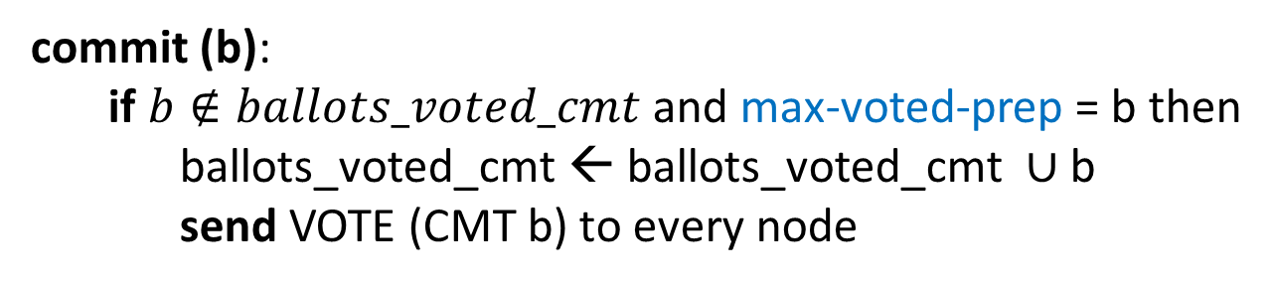
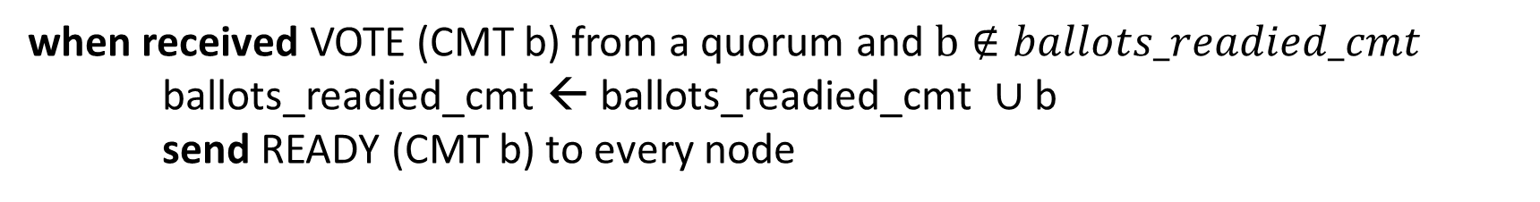
The Commit Function
commit (b):
if $b∉ballots_voted_cmt$ and max-voted-prep = b then
ballots_voted_cmt ← ballots_voted_cmt $∪$b
send VOTE (CMT b) to every node
A prepared ballot is committed (done only once)
when received VOTE (CMT b) from a quorum and $b∉ballots_readied_cmt$
ballots_readied_cmt ← ballots_readied_cmt $∪$b
send READY (CMT b) to every node
Send READY messages after a quorum votes

Slide 25
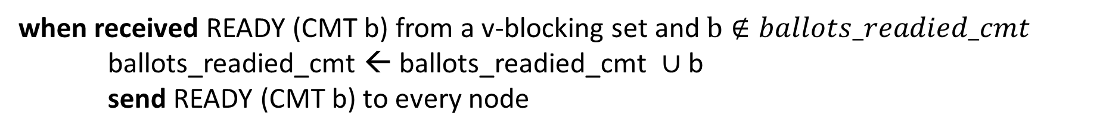
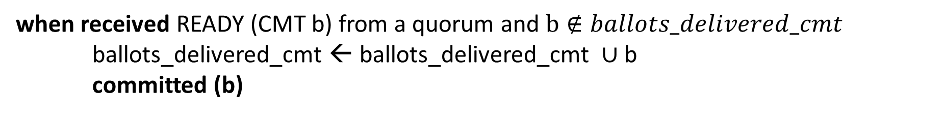
Commit Function – II
when received READY (CMT b) from a v-blocking set and $b∉ballots_readied_cmt$
ballots_readied_cmt ← ballots_readied_cmt $∪$b
send READY (CMT b) to every node
Propagate READY messages
when received READY (CMT b) from a quorum and $b∉ballots_delivered_cmt$
ballots_delivered_cmt ← ballots_delivered_cmt $∪$b
committed (b)
Finally commit the message (like prepare)

Slide 26
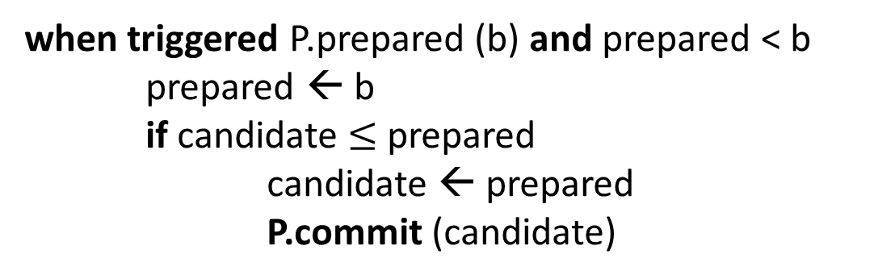
Consensus Protocol
candidate, prepared, and round are initialized
P ← voting process
propose (x)
candidate ← <1, x>
P.prepare (candidate)
Prepare phase
when triggered P.prepared (b) and prepared < b
prepared ← b
if candidate $≤$ prepared
candidate ← prepared
P.commit (candidate)
Commit phase
When committed, decide (b.x)

Slide 27
Timeout
Both the algorithms are equivalent
Same as the algorithm with infinite resources
If a node receive messages for later rounds (from the entire quorum)
Set the round to the minimum value of b_{u}.n in the quorum.
Start a timer
After a timeout
Increment the round and prepare again

Slide 28
Lying about Quorum Slices
We do not make any assumptions about faulty nodes
As long as we have an intact set that guarantees a non-empty quorum intersection comprising correct nodes, there is no problem
All these protocols are obstruction free
This means that if the faulty nodes stop
Consensus is achieved (subject to bounded clock skew)

Slide 29
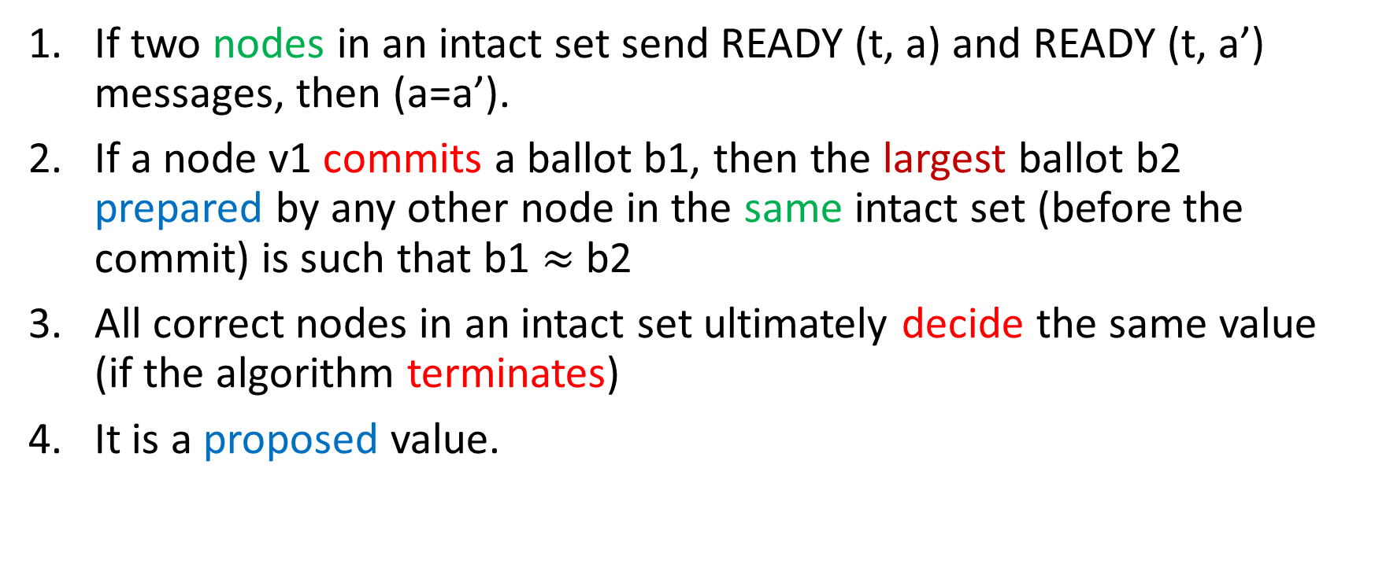
Key Lemmas in the Proof Sketch
If two nodes in an intact set send READY (t, a) and READY (t, a’) messages, then (a=a’).
If a node v1 commits a ballot b1, then the largest ballot b2 prepared by any other node in the same intact set (before the commit) is such that b1 $≈$b2
All correct nodes in an intact set ultimately decide the same value (if the algorithm terminates)
It is a proposed value.

Slide 30
Conclusion
The notion of quorums and quorum slices is the most important. They need to be constructed wisely.
Practical implementations are very fast.
Some guarantees regarding the reliability of intersecting nodes and partial synchrony need to be made.

Slide 31
References
[Main reference] García-Pérez, Álvaro, and Maria A. Schett. "Deconstructing stellar consensus (extended version)." arXiv preprint arXiv:1911.05145 (2019).
[Original paper] Mazieres, David. "The stellar consensus protocol: A federated model for internet-level consensus." Stellar Development Foundation 32 (2015): 1-45.

Slide 32
Thank you

