Slide 1

Chapter 1: Introduction to Operating Systems
Smruti R Sarangi
IIT Delhi

Slide 2

What is an Operating Systems (OS)?
It is a special program
Can control other programs
Exercises control over hardware

Slide 3
Background Required for the Course
C/C++ programming proficiency
Computer Architecture
Data Structures

Slide 4

Key Components
Who manages these?
CPU
Memory
Hard
Disk
I/0 devices

Slide 5

Place of the 0S
Programs
P1
P2
P3
Between application software and hardware
Operating System
CPUs
Hardware
Memory
I/O & Storage

Slide 6

Why do we need a special program, the 0S?
Many programs share common hardware (HW)
The access to common hardware needs to be regulated
Hardware: CPU, memory, I/0 and storage
Schedule the CPU
Interface with devices
Manage storage
Manage memory
Security
Make it easy to build distributed systems
Makes it easy to work with HW
Power, temperature and security concerns

Slide 7

Basic Idea: Arbitration and Regulating Accesses
Arbitration
A process is an instance of a running program
At any point of time multiple processes are active
The processes have different requirements
The 0S arbitrates between the processes
Accessing HW is very complex
Elaborate protocols
Same code needs to run on multiple machines
Provide a common interface: device derivers in the 0S
Access

Slide 8

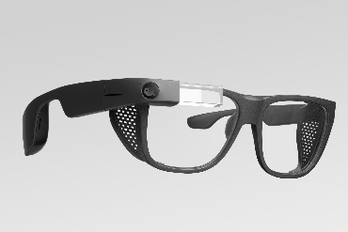
Space of operating Systems
HPC and server
Desktop/laptop
Mobile
Even wearables

Slide 9
History of Linux : Milestones
1991
Linus Torvalds started extending the MINIX 0S
1992
Released under the GPL license. Available on the web.
2000 – 2010
Takes over the server and HPC market
2012 – 2020
Android (Linux-based) becomes the most popular mobile Operating System

Slide 10



Why teach a real world 0S?
Conveys a realistic picture
Provides real-world skills
We will learn generic concepts in the context of Linux

Slide 11

Open Source Design
Freely available source code
www.kernel.org
https://elixir.bootlin.com/linux/v6.2.12/source/kernel
Version 6.2.12

Slide 12


Bane and Boon of the GPL License
Freedom to use, modify and distribute
All derivative works are also under GPL
Fosters collaboration
Prohibits tivoization: cannot restrict hardware to a given piece of GPL-protected software that is protected with a key
Quite restrictive in nature
Need to disclose all modifications
Cannot build appliances (HW+SW) combos that involve kernel modifications

Slide 13

Some Kernel Source Code Statistics
Roughly 25 million lines of source code
Per version, 250k lines of code change
Current version: 6.2.12
x
y
z
-rc<num>
rc → release candidate (test release)
Major version number
Patch number
Minor version number

Slide 14
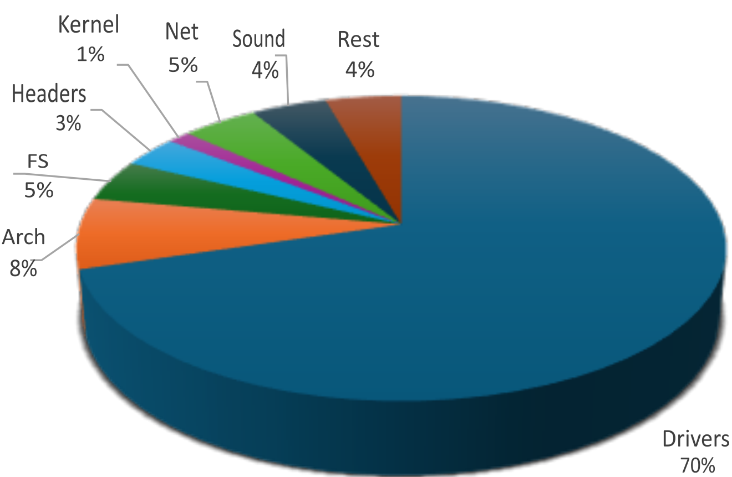

Details of the Linux Code Base
Most of the code is drivers

Slide 15
Major Subsystems in Linux (Directory-wise)
All the code
init: boot code
Process manager
HW-dependent code
Memory
and I/O
kernel: process scheduler, synchronization, time management, event management, debugging
mm: physical and virtual memory manager
arch: All the assembly code that is architecture dependent
fs: file systems
virt: Support for running a guest OS as a regular program.
drivers: All the kernel routines that run the devices. Translate generic OS calls to HW-specific instructions.
block: generic layer for all block-based storage
devices like hard disks
io_uring: data structures for I/O support

Slide 16
The arch Folder
The Linux codebase has two parts: machine dependent and machine independent
Most of the code is machine independent. Otherwise, it will become impossible to manage such a large codebase.
We need a layer to abstract out details of the underlying machine.
This is the job of the arch folder (machine dependent part) that:
The kernel uses generic data types such as u32 or u64. They are defined within files of the arch folder (for each architecture)
Map high-level primitives to assembly-level code snippets (arch. specific)
Provide other low-level services: booting the system, managing the memory system, power management, etc.

Slide 17

Factoid
Android, Chrome OS, Tizen (Samsung), Web OS (LG) are all based on Linux.

Slide 18
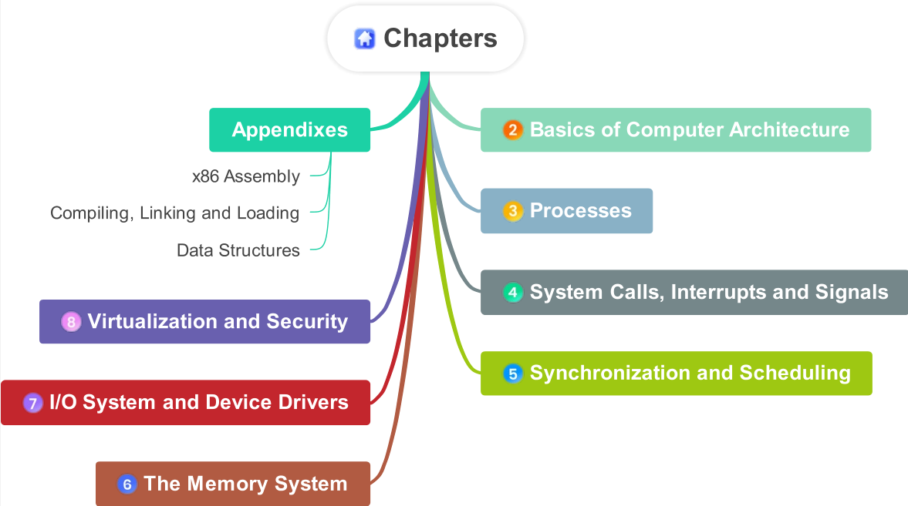

Slide 19
OS
Fundamentals: cores, registers, interrupts, virtual memory, I/O
Processes, synchronization, scheduling
Communication: interrupts, system calls + I/O system and device drivers
Memory system, virtualization, security

Slide 20



srsarangi@cse.iitd.ac.in

