Slide 1

X4Rate: A Scene-Adaptive Extrapolation Framework for 4× Frame Rate Upsampling
Akanksha Dixit and Smruti R. Sarangi
Department of Electrical Engineering
Indian Institute of Technology Delhi
New Delhi, India
21st International Conference on Computer Graphics, Interaction, Visualization Theory and Applications (GRIVAPP) 2026
Notes:
I am Shruti Pandey from IIT Delhi, India. I am going to present my paper titled HybMT: Hybrid Meta-Predictor based ML Algorithm for Fast Test Vector Generation. This paper is done under the supervision of Prof. Jayadeva and prof. Smruti Ranjan Sarangi from IIT Delhi.

Slide 2
Outline
Introduction
Background
Implementation
Results
Conclusion

Slide 3

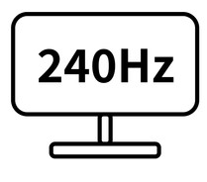
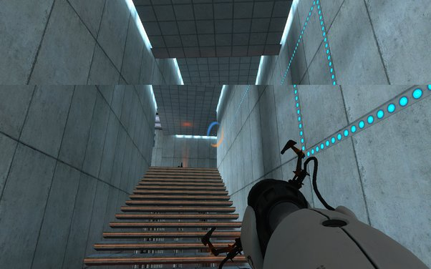
Introduction
GPU is the bottleneck
Case 1:
T_{render} = T_{refresh}
Time
Case 2
Rendering F1
Rendering F2
Rendering F3
T_{refresh}
F1
F1
F2
RD0
RD1
RD2
RD3
Display
Frame Generation
Need to fill in frames missed by the GPU
Interpolation
Case 2: T_{render} > T_{refresh}
Rendering time: T_{render}
Extrapolation
Refresh interval: T_{refresh}
Screen tearing
Notes:
having high-frequency displays alone may not always guarantee smooth performance, it should get the frames to display at the same high rate. If we briefly look at how these systems work, first the gpu renders a frame, then when the display is refreshed, the rendered frame is displayed. This is the case 1, where rendering time is equal to the refresh interval. This is the ideal case. and does not happen always. as have shown this as case 2, the rendering time is greater than the refresh interval. This results in visual artifacts such as screen tearing and screen stuttering etc. here, the conclusion is that here the GPU is the bottleneck. And we need to Upsample the rendering rate. Temporal supersampling is an approach that does this, it fill in frames missed by the gpu. It predicts frames using information from the next and previously rendered frames.. This boosts the frame rate and achieves rate matching. In the field of temporal supersampling, two primary methodologies exist: interpolation and extrapolation. Next we look at the pros and cons of these two technologies.

Slide 4
Background
Interpolation
High quality
High latency
Rendering F_{i}
F_{i-0.5}
Rendering F_{i+1}
F_{i+0.5}
Rendering F_{i+2}
F_{i+1.5}
Rendering F_{i+3}
F_{i+2.5}
F_{i-0.5}
F_{i}
F_{i+0.5}
F_{i+1}
F_{i+1.5}
F_{i+2}
R_{i}
Display latency for F_{i} = 3D – R_{i}
D
D
D
Extrapolation
Low latency
Low quality
Rendering F_{i}
F_{i+0.5}
Rendering F_{i+1}
F_{i+1.5}
Rendering F_{i+2}
F_{i+2.5}
Rendering F_{i+3}
F_{i+3.5}
F_{i}
F_{i+0.5}
F_{i+1}
F_{i+1.5}
F_{i+2}
F_{i+2.5}
R_{i}
R_{i}
Display latency for F_{i} = R_{i} – R_{i} = 0
∀i, R_{i} > D
R_{i} + I ≤ 2D | Interpolation
R_{i+1} + E ≤ 2D | Extrapolation
Assumptions:

Slide 5
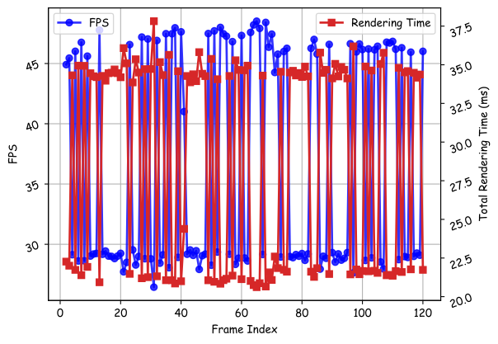
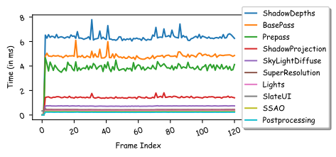
Background
Highly variable frame rate
Steps responsible for this variation
Hence, we need temporal supersampling to ensure a stable frame rate.
5

Slide 6
Experimental Setup
Abbr. | Name
PR | City Park
WT | Western Town
RF | Redwood Forest
CM | Cemetery
BR | Bridge
DW | Downtown West
TC | Tennis Court
LB | Lab
BK | Bunker
Parameter |  | Type/ Value
CPU | Intel®Xeon®Gold 6226R | Intel®Xeon®Gold 6226R
GPU | NVIDIA RTX 4080 | NVIDIA RTX A4000
VRAM | 16 GB | 16 GB
Game Engine | Unreal Engine v5.1 | Oculus Quest 2
Animations | Mixamo
3D Objects | Blender
System configuration
List of benchmarks
Notes:
Now, we have run these applications on our setup. Some of these applications are used for benhmarking the GPU whereas some the applications are VR based games.

Slide 7
Problem Formulation
Goal
Increase the frame rate by 4×
Generate three intermediate frames at 𝑡 + 0.25, 𝑡 + 0.5, and 𝑡 + 0.75 b/w input frames F_{t} and F_{t+1}.
Algo. | Runtime (ms)
ExtraNet (EN) | 8.06
ExtraSS (ES) | 5.63
Mob-FGSR (M) | 1.92
GFFE (G) | 3.66
Algo. | F_{t+0.25} | F_{t+0.5} | F_{t+0.75}
M | M(F_{t}) | M(M(F_{t})) | M(M(M(F_{t})))
G | G(F_{t}) | G(G(F_{t})) | G(G(G(F_{t})))
EN | F_{t} (old frame) | EN(F_{t} ) | EN(F_{t} )(old frame)
ES | F_{t} (old frame) | ES(F_{t} ) | ES(F_{t} )(old frame)
Possible scenarios based on the predictions

Slide 8
Related Work
Year | Work | Type | ML- based | Real- time | US Domain | US Factor
2020 | SS | I | ✓ | × | Temporal | up to 2×
2021 | ExtraNet | E | ✓ | ✓ | Temporal | up to 2×
2022 | DLSS 3 | I | ✓ | ✓ | Temporal | up to 4×
2023 | EMA-VFI | I | ✓ | × | Temporal | 2×
2023 | ExtraSS | E | ✓ | ✓ | Spatio-temporal | up to 2×
2024 | STSS | E | ✓ | ✓ | Spatio-temporal | 2×
2024 | Mob-FGSR | E | × | ✓ | Spatio-temporal | 2×
2024 | GFFE | E | ✓ | ✓ | Spatio-temporal | 2×
2025 | X4Rate | E | ✓ | ✓ | Temporal | 4×
I: Interpolation, E: Extrapolation, US: Upsampling
Notes:
This table shows several state-of-the-art works in the area of frame rate upsampling. Among these works, we have implemented two interpolation methods “EM_VFI” and Softmax splatting (SS) and two extrapolation methods. We then compared their performance with our proposed method.

Slide 9
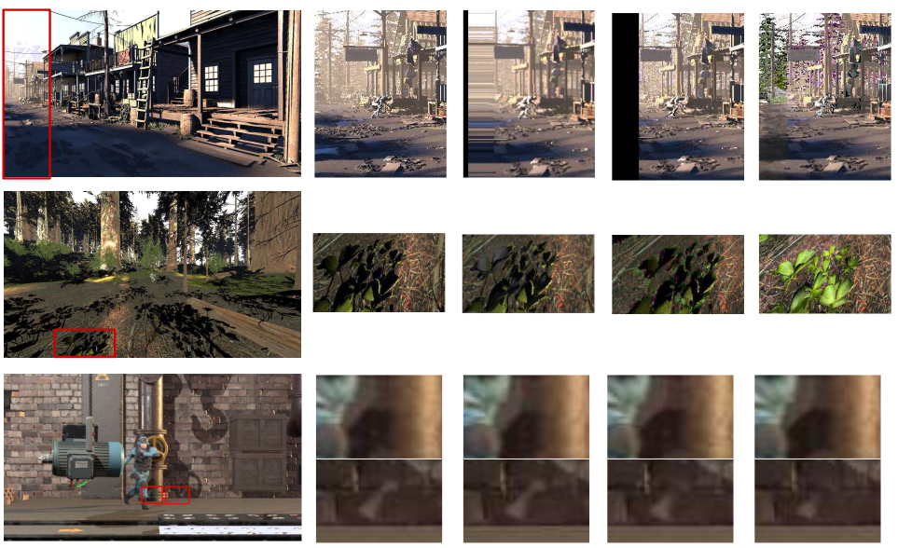
Qualitative Comparison
Frame F_{t}
G
ES
EN
M
No single sol^{n} fits all cases
Identify features that impact models’ performance
Meta-learner driven selection
Adapt in real-time

Slide 10
Feature | Description | Type
𝑁𝑑 | #dynamic objects | SP
𝑁𝑠 | #movable shadow-casting lights | SP
𝑉 | Variance in motion of dynamic objects | ST
𝑉𝑐 | Camera velocity | SP
𝑁𝑑𝑐 | #draw calls | SP
𝑀 | Average metallic value | ST
𝐼 | Total intensity of the Directional Light and Sky Light | IT
𝑉𝑟 and 𝑉𝑤 | VRAM read and write bandwidth (Throughput%) | HL
𝑃𝑟 and 𝑃𝑤 | PCIe read and write bandwidth (Throughput%) | HL
𝑆𝑜 | SM warp occupancy (Throughput%) | HL
𝐶𝑖 | Compute (#instructions) in flight (Throughput%) | HL
𝑅 | PCIe to BAR requests | HL
𝑇 | Runtime latency | ML
NG: Nsight Graphics, SP: Simple, ST: Statistical, IT: Information-theoretic, HL: Hardware-based Landmarking, ML: Model-based
List of identified features for choosing the best extrapolation algorithm

Slide 11
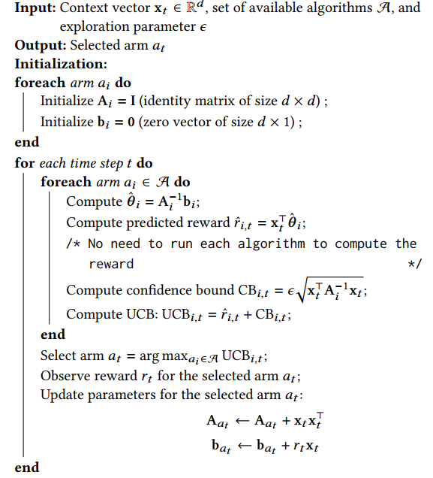
Workflow of X4Rate
Initialization
Selection
Update

Slide 12
Results
Scenes | Mob-FGSR | ExtraSS | GFFE | ExtraNet | X4Rate
PR | 20.30 | 23.32 | 24.80 | 25.82 | 27.01
BK | 21.53 | 24.43 | 26.25 | 20.14 | 29.91
WT | 25.23 | 27.97 | 29.25 | 29.14 | 31.24
RF | 21.15 | 18.38 | 18.98 | 17.47 | 21.24
CM | 28.37 | 27.21 | 28.99 | 26.58 | 34.89
BR | 30.93 | 24.24 | 28.02 | 28.29 | 33.25
DW | 28.01 | 26.37 | 28.42 | 26.78 | 32.04
TC | 23.09 | 24.17 | 25.09 | 21.04 | 27.36
VL | 29.65 | 25.21 | 27.38 | 22.25 | 31.07
TN | 27.65 | 30.53 | 29.01 | 30.14 | 34.48
PSNR (in dB)
Performance comparison against state-of-the-art Extrapolation algorithms
Notes:
This table shows a quantitative comparison among our work i.e, PatchEX, and the other state-of the art works. Here we have shown only the PSNR values due to space constraints. However, we have used two more performance metrics SSIM, and LPIPS. As we can see here that Our method performs better than extrapolation-based methods (ExtraNet and ExtraSS) across all benchmarks. However, the psnr values for interpolation-based approaches (EMA-VFI and SS) are higher. But the difference is not significant. Considering the fact that extrapolation methods have significantly lower latency compared to interpolation methods..

Slide 13
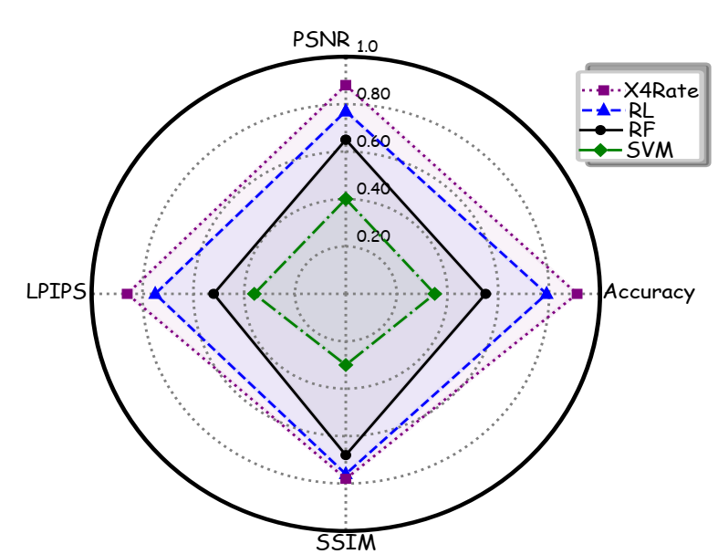
Results
X4Rate delivers the highest accuracy (0.92) along with superior results across all other performance metrics.
The second-highest accuracy is attained by RL.
Performance comparison of various meta-learners

Slide 14
Results
Algo. | Mob-FGSR | ExtraSS | GFFE | ExtraNet
PR | 05.1 | 26.5 | 28.2 | 40.2
BK | 18.1 | 35.2 | 36.3 | 10.4
WT | 12.7 | 22.0 | 35.5 | 29.8
RF | 50.4 | 18.2 | 21.1 | 10.3
CM | 24.3 | 22.0 | 28.7 | 25.0
BR | 36.4 | 15.4 | 19.1 | 29.1
DW | 33.5 | 16.7 | 36.5 | 13.3
TC | 27.2 | 21.7 | 34.8 | 16.3
VL | 34.5 | 23.1 | 23.6 | 15.8
TN | 07.1 | 44.1 | 10.6 | 38.2
GFFE is the most frequently selected method, with Mob-FGSR as the second-best.
Breakup of predictions (in %)

Slide 15
Conclusion
Most GPUs cannot provide a consistently high frame rate at an HD/4K resolution.
X4Rate, a temporal super-sampling method designed to maximize visual quality while increasing frame rates.
We propose a dynamic run-time predictor to select the optimal algorithm per frame.
Our approach achieves up to 4× frame rate improvement (~240 Hz) while maintaining best-in-class visual quality.
Notes:
In conclusion, our work highlights that the GPU is the bottleneck. To address this, we propose an extrapolation method that predicts high-quality images with minimal latency.
Our method achieves a 48.46% improvement in quality (PSNR) and 2× better latency compared to the nearest competitor.

Slide 16

THANK YOU
Contact:
akanksha.dixit@ee.iitd.ac.in
Questions

