Slide 1
Virtual Synchrony and Commit Protocols
Prof. Smruti R. Sarangi
Computer Science and Engineering
IIT Delhi
Adapted from the original slides of Prof. Martin Steen with consent.

Slide 2
Virtual Synchrony

Slide 3
One-to-one Communication: Unicasting
Client
Server
Client-server
Messages can get lost.
There is a need to resend messages.
Two commonly used semantics
At-least-once semantics: The operation will be carried out by the server at least once.
At-most-once semantics: The operation will be carried out at most once.

Slide 4
Notion of Process Groups: Multicasting
Processes can exhibit all kinds of failures
Fail-silent: Just fails without any intimation.
Fail-stop: The failure can be detected.
Fail-safe: The failure is benign.
Create a group of processes to service the client’s request
Replicate the state across processes
Give the same user input to all the processes, collate the outputs, and decide the result based on voting
Failure tolerance
To tolerate k fail-stop failures, we need k+1 processes.
If processes produce arbitrary outputs, we need 2k+1 processes (use voting)
If the process sending the input is malicious, we need 3k+1 processes (Byzantine)

Slide 5
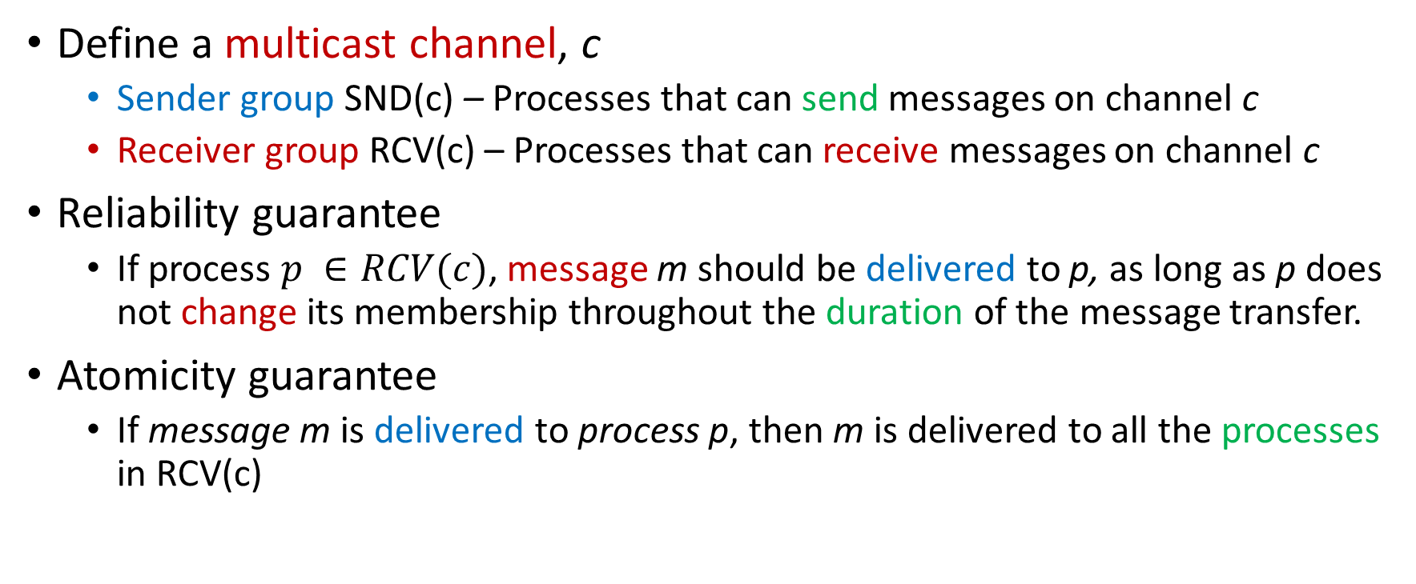
Reliable Multicasting
Define a multicast channel, c
Sender group SND(c) – Processes that can send messages on channel c
Receiver group RCV(c) – Processes that can receive messages on channel c
Reliability guarantee
If process $p ∈RCV(c)$, message m should be delivered to p, as long as p does not change its membership throughout the duration of the message transfer.
Atomicity guarantee
If message m is delivered to process p, then m is delivered to all the processes in RCV(c)

Slide 6
Implementation in a LAN
Sender
Receiver
Receiver
Receiver
ACK
The sender sends a message to a set of receivers
One of them sends an acknowledgement (ACK) on a shared channel
The rest snoop the message
If any receiver hasn’t gotten the original message, it requests for a re-transmission

Slide 7
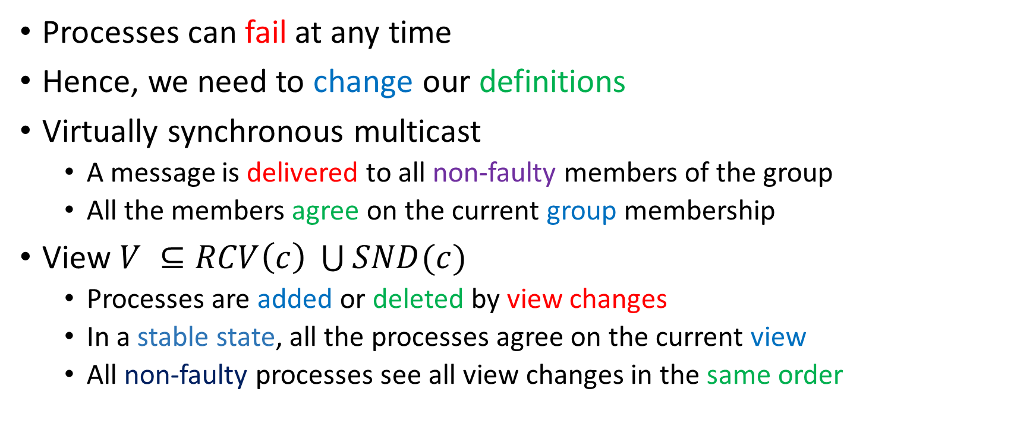
Virtually Synchronous Multicast
Processes can fail at any time
Hence, we need to change our definitions
Virtually synchronous multicast
A message is delivered to all non-faulty members of the group
All the members agree on the current group membership
View $V ⊆RCV\left(c\right) \bigcup{SND(c)}$
Processes are added or deleted by view changes
In a stable state, all the processes agree on the current view
All non-faulty processes see all view changes in the same order

Slide 8
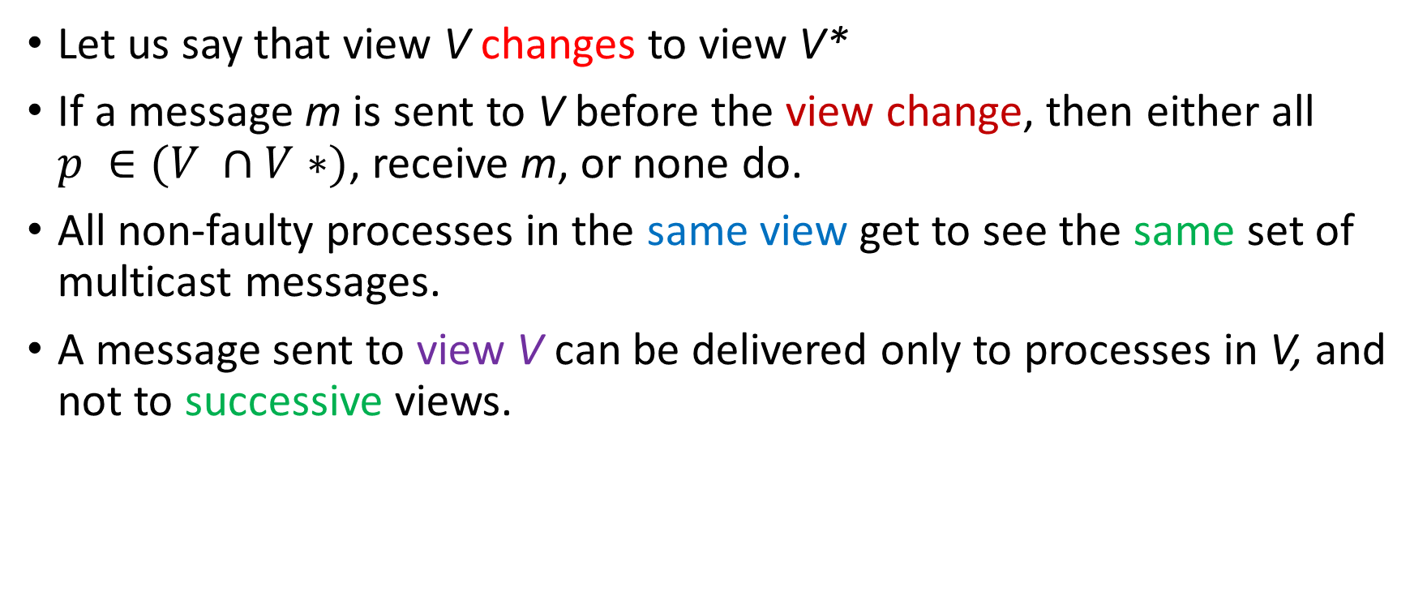
Virtually Synchronous Multicast – View Changes
Let us say that view V changes to view V*
If a message m is sent to V before the view change, then either all $p ∈(V ∩V∗)$, receive m, or none do.
All non-faulty processes in the same view get to see the same set of multicast messages.
A message sent to view V can be delivered only to processes in V, and not to successive views.

Slide 9


Example of Virtual Synchrony
P1
P2
P3
P4
G = {P1, P2, P3, P4}
G = {P1, P3, P4}
G = {P1, P2, P4}
G = {P1, P2, P3, P4}

Slide 10

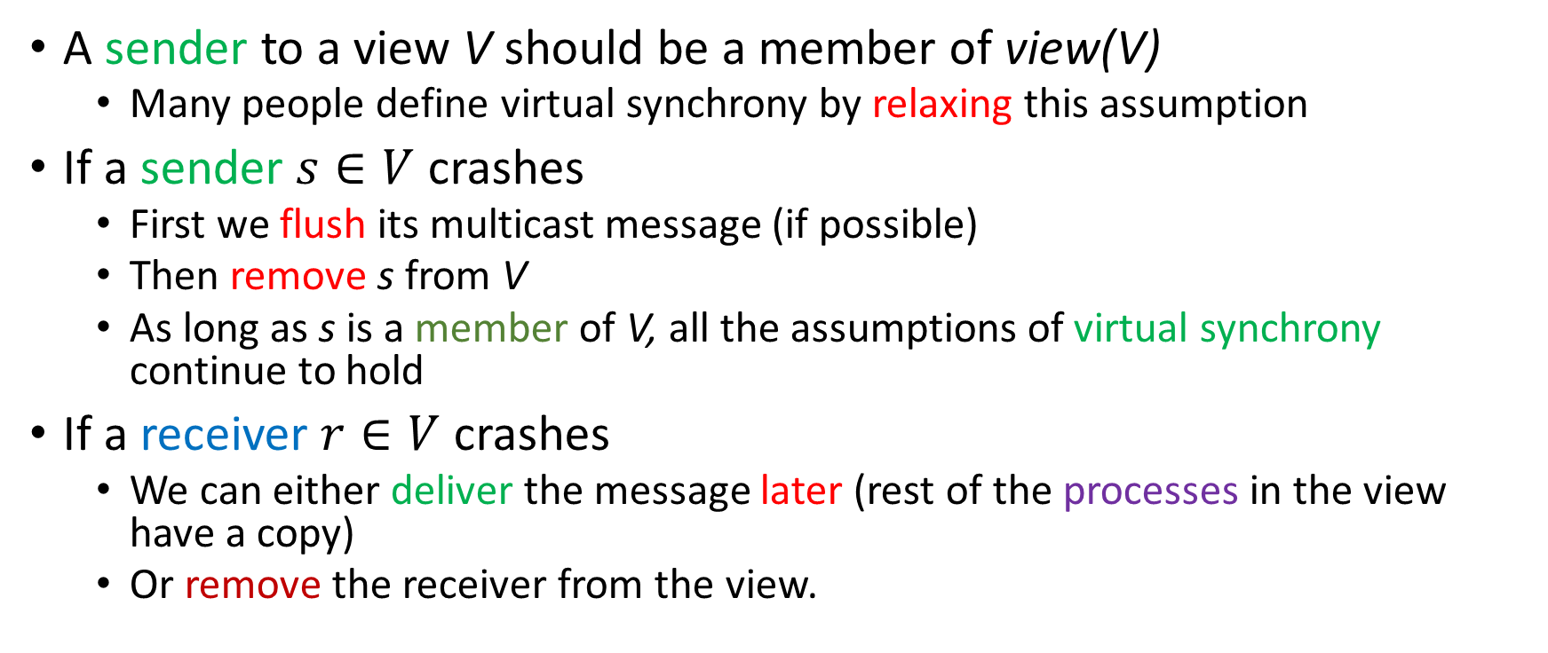
Few more assumptions
A sender to a view V should be a member of view(V)
Many people define virtual synchrony by relaxing this assumption
If a sender $s∈V$ crashes
First we flush its multicast message (if possible)
Then remove s from V
As long as s is a member of V, all the assumptions of virtual synchrony continue to hold
If a receiver $r∈V$ crashes
We can either deliver the message later (rest of the processes in the view have a copy)
Or remove the receiver from the view.
Virtual synchrony is independent of the order of message delivery.

Slide 11
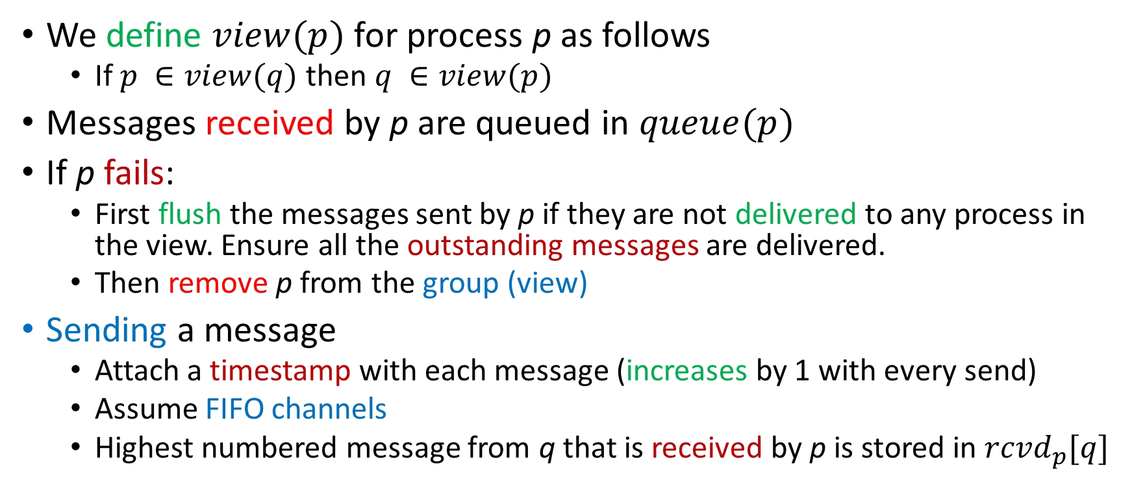
Implementation
We define $view(p)$ for process p as follows
If $p ∈view(q)$ then $q ∈view(p)$
Messages received by p are queued in $queue(p)$
If p fails:
First flush the messages sent by p if they are not delivered to any process in the view. Ensure all the outstanding messages are delivered.
Then remove p from the group (view)
Sending a message
Attach a timestamp with each message (increases by 1 with every send)
Assume FIFO channels
Highest numbered message from q that is received by p is stored in $rcvd_{p}[q]$

Slide 12
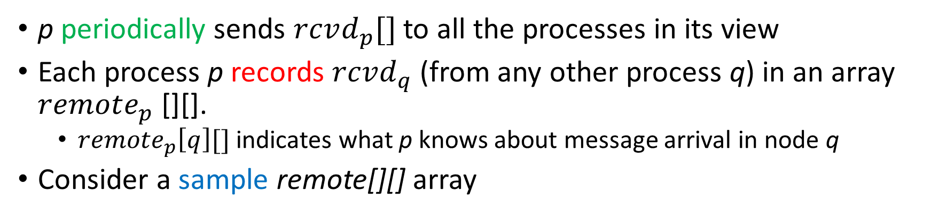
Implementation - II
p periodically sends $rcvd_{p}[]$ to all the processes in its view
Each process p records $rcvd_{q}$ (from any other process q) in an array $remote_{p}$[][].
$remote_{p}\left[q\right][]$ indicates what p knows about message arrival in node q
Consider a sample remote[][] array
P1
2 3 1 3
P2
2 3 1 4
Find the minimum in each column
P3
1 1 1 5
P4
2 2 1 5
min
1 1 1 4

Slide 13
Stability and Flushing of Messages [Details]
A message is stable if it has been received by all the processes in the view (refer to the min. vector)
The message can be delivered to the process’s next layer
To remove a process a failure-detecting process needs to multicast a flush message to all the processes in the view.
All the processes stop sending new messages.
Processes send their rcvd arrays to other processes.
They also elect a leader (coordinator). Once a process finds that its messages have all been received, and it has received all the messages it sends a flush_ok message to the coordinator. Otherwise, after a timeout it sends its list of unstable messages.
If the coordinator does not get all the flush_ok messages in a given interval, it collects all the unstable messages, and multicasts them again.
After getting acknowledgements, it sends a view_change message.

Slide 14
Commit Protocols

Slide 15



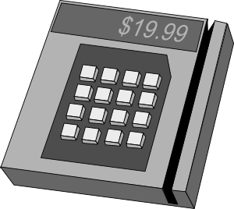



Commit Protocols
Either all of them commit or abort.
Bank
Agreement
Data center
Credit card
machine
Airline
User

Slide 16
2-Phase Commit
The nodes elect a coordinator
Phase 1a: Coordinator sends a Vote-request message to all participants.
Phase 1b: A participant returns either Vote-commit or Vote-abort
Phase 2a: Coordinator collects all the votes. If all are Vote-commit it sends a Global-commit message, otherwise it sends a Global-abort message to all.
Phase 2b: Each participant waits for the messages from Phase 2a. It acts accordingly.

Slide 17
2-Phase Commit
Vote-Request
Vote-Abort
INIT
INIT
-
Vote Request
Vote-Request
Vote-Commit
WAIT
READY
Vote-Abort
Global-abort
Vote-Commit
Global-commit
Global-abort
ACK
Global-commit
ACK
ABORT
COMMIT
ABORT
COMMIT
Coordinator
Participant

Slide 18
Analysis of 2-Phase Commit
Let’s say a participant fails, recovers and then restores its old state.
INIT state: No problem. It just aborts.
READY state: It needs to know the global decision (commit or abort) after it recovers. Ask the coordinator or other participants.
This is very problematic.
The coordinator might have failed. Other processes might have committed or aborted. They might have erased all the history of the transaction.
We will never know what decision the coordinator took.
ABORT state: Complete the abort process.
COMMIT state: Complete the commit process.

Slide 19
3-Phase Commit
The nodes elect a coordinator
Phase 1a: Coordinator sends a Vote-request message to all participants.
Phase 1b: A participant returns either Vote-commit or Vote-abort
Phase 2a: Coordinator collects all the votes. If all are Vote-commit it sends a Prepare-commit message, otherwise it sends a Global-abort message to all.
Phase 2b: Each participant waits for the messages from Phase 2a. If it gets a Prepare-commit message, it proceeds to send a Ready-commit message, else it aborts.
Phase 3a: After the coordinator gets all the Ready-commit messages it sends a Global-commit message to all the participants.
Phase 3b: The participants wait for the Global-commit message.

Slide 20
3-Phase Commit
Vote-Request
Vote-Abort
INIT
INIT
-
Vote Request
Vote-Request
Vote-Commit
WAIT
READY
Vote-Abort
Global-abort
Vote-Commit
Prepare-Commit
Global-abort
ACK
Prepare-Commit
Ready-Commit
ABORT
PRECOMMIT
ABORT
PRECOMMIT
Ready-Commit
Global-commit
Global-commit
ACK
COMMIT
COMMIT
Coordinator
Participant

Slide 21
Analysis
Consider the READY and PRECOMMIT states.
If a participant fails in the
READY state: It can ask the coordinator. If the coordinator has failed, then we can elect a new coordinator. If any process has gotten a PRECOMMIT message, then they proceed towards a global commit. Else all processes abort.
PRECOMMIT state: Elect a new coordinator that will send a Global-commit message.
Coordinator fails in the
WAIT state: Participants time out in the READY state
PRECOMMIT state: Participants time out in the PRECOMMIT state

Slide 22
References
Tanenbaum, Andrew S., and Maarten Van Steen. Distributed systems: principles and paradigms. Prentice-Hall, 2007. [Thanks to Prof. Martin Steen for allowing us to adapt his original slides. ] https://www.distributed-systems.net/index.php/books/ds2/

Slide 23
Thank you

