Slide 1
Basics Of X86 Architecture
Prathmesh Kallurkar
Teaching Assistant,
Computer Architecture (CSL211)
Instructor :
Dr. Smruti Sarangi
Notes:
<number>

Slide 2
<number>
Key Points
What is x86 ?
Chronology
Overview
Notes:
<number>

Slide 3
<number>
Overview
X86 is a series of instruction set architectures based on Intel 8086 CPU.
Original ISA was 16 bit. Term x86 derived from the ISA names ending with "86". 32 and 64 -bit implementations are known as x86-32 and x86-64 respectively.
X86 ISA is complex and requires complex decoders. Relatively uncommon in small and low-power applications in embedded market.
Who uses it : Intel, AMD, VIA

Slide 4
<number>
Chronology (History : Boring Huh ..)
8086: 16-bit, all internal registers 16 bits wide; no general purpose registers; ’78
8087: + 60 Fl. Pt. instructions, (Prof. Kahan) adds 80-bit-wide stack, but no registers; ’80
80286: adds elaborate protection model; ’82
80386: 32-bit; converts 8 16-bit registers into 8 32-bit general purpose registers; new addressing modes; adds paging; ’85

Slide 5
<number>
Chronology (Contd.)
MMX: + 57 instructions for multimedia; ‘97
AMD64 - First 64-bit CPU in x86 family, 2003
2006: Core 2
Multicore, SSE4
2008: Atom
Deep pipeline, very low power

Slide 6
<number>
Basic Properties
Key Points
Design of x86
What is CISC ?
Pros and Cons
Notes:
<number>

Slide 7
<number>
Design of X86
Primarily two-address architecture
ARM : add r1, r2, r3 -> r1 = r2 + r3
X86 : add rax, rbx -> rax += rab
Fewer instruction vs Compact representation
Assumption : Often true in C, C++ : x+=y
Register Memory architecture
Load-Store architecture : simple decoder and pipeline Only load/store access memory
RM : ALU operation can involve a memory and register operand
Add 12 (%rsp), rbx - Requires less registers
Assumption : Most of the accesses on array variables

Slide 8
<number>
Design Of X86 (Contd..)
Little endian
What about ARM ??
Java ??
Allow unaligned memory-address access for 16 and 32 bits.
Advantages : Memory-intensive
Problems : Performance.
Assumption : Most compilers will access aligned content.
Variable length operation : operand-size can be byte(8), word(16), double-word(32) or quad-word(64)

Slide 9
<number>
CISC vs RISC Philosophy
Instruction length
RISC – fixed instruction. Easy fetch
CISC – Intelligent fetch. Optimized icache
Memory architecture
RISC – Load/Store Architecture
CISC – Register Memory Architecture
Type of instructions
x86 – enter : push and set combined
Intel – Keep main core RISC. Add additional complex decoder

Slide 10
<number>
Register & Addressing Modes
Key Points
Quiet obvious, isn’t it
Notes:
<number>

Slide 11
<number>
Register Set (Integer - GPR)
Accumulator : Arithmetic operations, System call
Base for address operations
Counter : Loop, String operations
IO operations
Notes:
<number>

Slide 12
<number>
Floating Point Registers
The FPU has 8 registers, st0 to st7, formed into a FP stack.
Build in the processor and has access speed same as register
Stack instruction format :
Pop arg1. Pop arg2
Apply operation
Push solution
Problem : Low instruction level parallelism
Intel’s answer : vector operations

Slide 13
<number>
Addressing Modes
Direct : R1 <- R1 + M[1001]
Global variable. Static data
C : x = global variable
Register Deferred : R4 <- R4 + M[R1]
Pointer
C : a = *b
Indexed : R3 <- R3 + M[R1+R2]
Local variable
Scaled : R1<-R1+M[100+R2+R3*d]
Used to index arrays.
May be applied to any base addressing mode in some machines.

Slide 14
<number>
Key Points
Function
Prologue
Epilogue
Variables
Local variable
Function Parameter
Global variable
Hello World !!
Assembly Programming
Notes:
<number>

Slide 15
<number>
Stack Convention
Stack grows downwards
Caller convention
Pass arguments on the stack
Foo( arg1, arg2, arg3 )
Push arg3, arg2, arg1
Call callee
Callee convention
Maintain local variables on stack
Int local1, local2
Sub esp, 08h

Slide 16
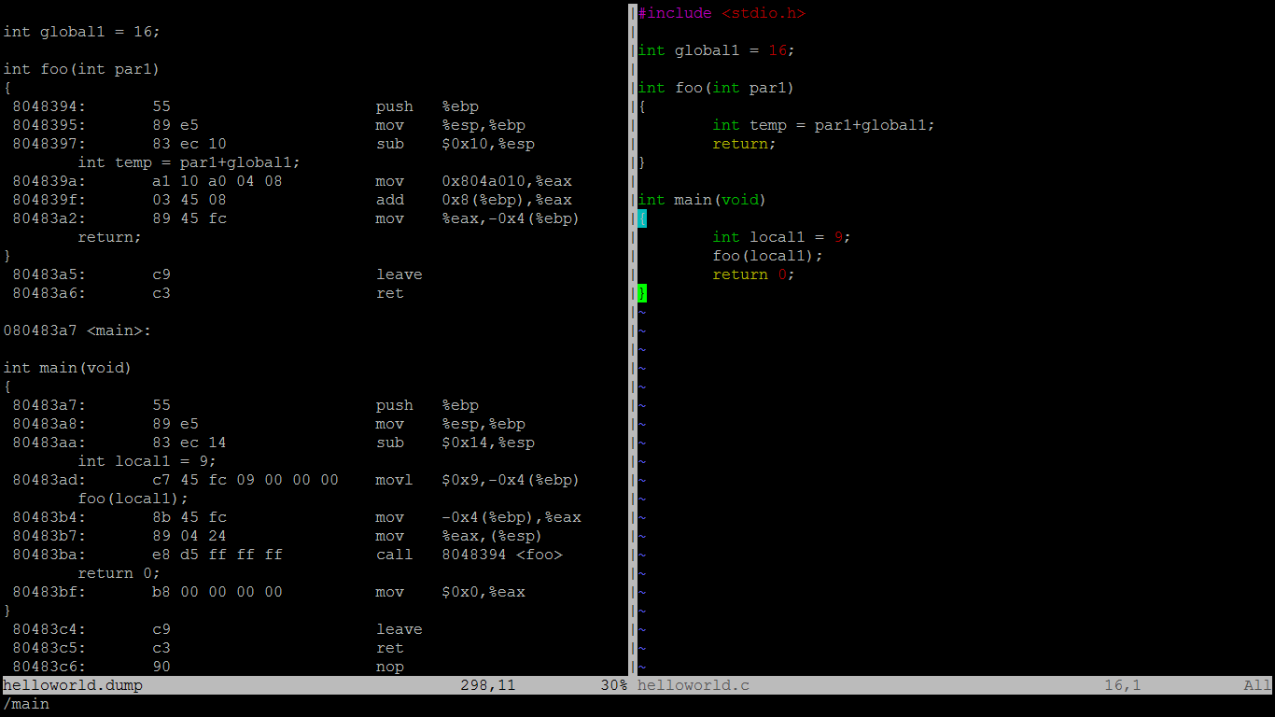
<number>
Global Variable
Function Prologue
Local Variable
Function Epilogue

Slide 17
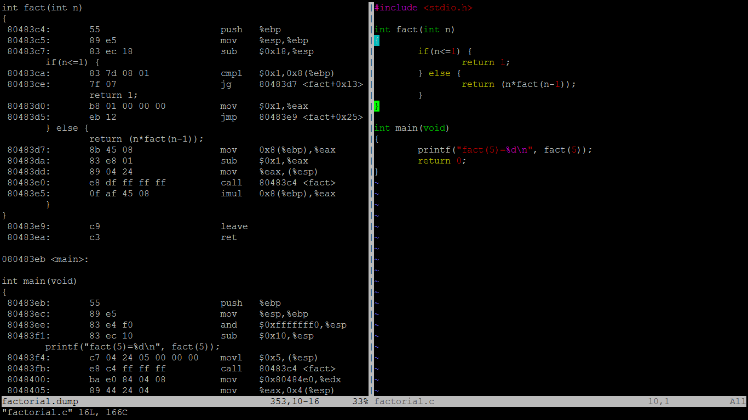
<number>
Manage recursion.
Intelligent use of eax register

Slide 18
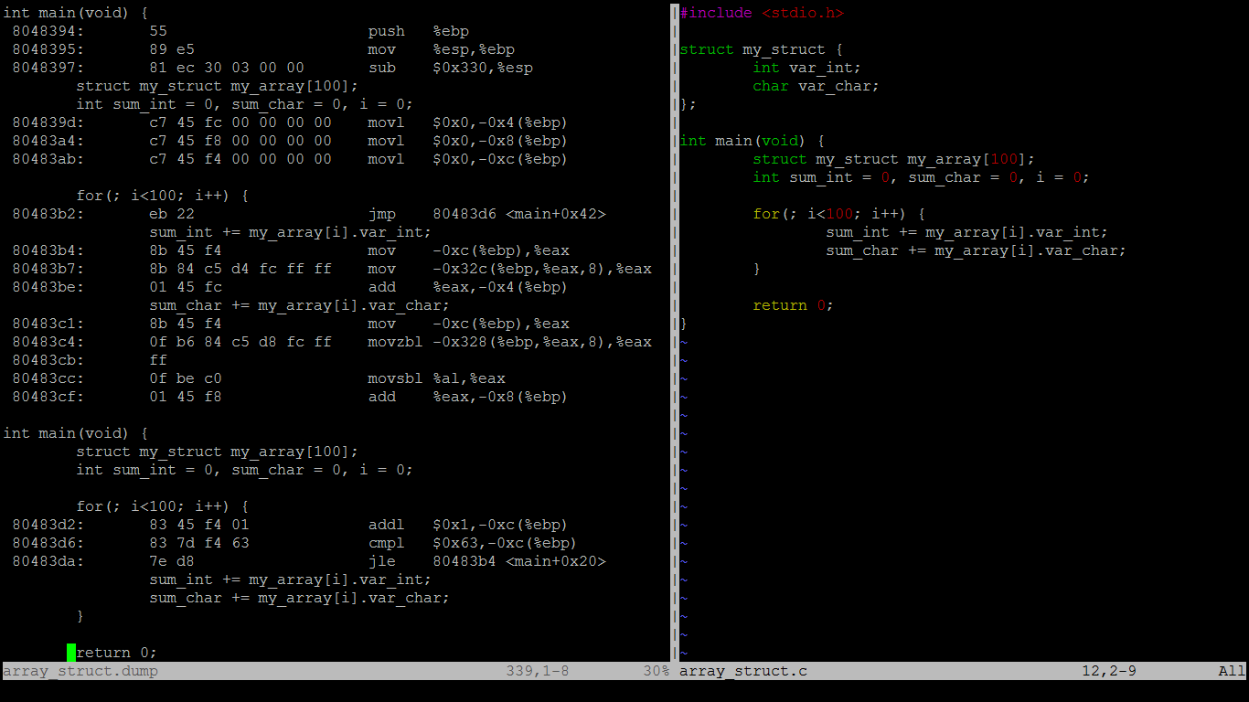
<number>
Addressing mode for accessing
Structure elements
Looping

Slide 19
<number>
References
http://www.cs.virginia.edu/~evans/cs216/guides/x86.html
Patterson - http://www-inst.eecs.berkeley.edu/~cs61c/
http://www.cs.rice.edu/~gw4314/lectures/x86-assembly.ppt
http://www.cs.sjsu.edu/~lee/cs147/28FCS147L20RISC%20Architecture.ppt
Stacks, Frames, and Calling Conventions by David Kyle
http://www.cs.iastate.edu/~prabhu/Tutorial/PIPELINE/addressMode.html

