Slide 1
Project Voldemort
Distributed Key-value Storage
Alex Feinberg
http://project-voldemort.com/

Slide 2
The Plan
What is it?
  Motivation
  Inspiration
Design
  Core Concepts
  Trade-offs
Implementation
In production
  Use cases and challenges
What’s next

Slide 3
What is it?

Slide 4
Distributed Key-value Storage
The Basics:
  Simple APIs:
    get(key)
    put(key,value)
    getAll(key1…keyN)
    delete()
  Distributed
    Single namespace, transparent partitioning
    Symmetric
    Scalable
  Stable storage
    Shared nothing disk persistence
    Adequate performance even when data doesn’t fit entirely into RAM
Open sourced January 2009
  Spread beyond LinkedIn: job listings mentioning Voldemort!

Slide 5
Motivation
LinkedIn’s Search, Networks and Analytics Team
  Search
  Recommendation Engine
  Data intensive features
    People you may know
    Who’s viewed my profile
    History Service
Services and functional/vertical partitioning
Simple queries
  Side effect of the modular architecture
  Necessity when federation is impossible

Slide 6
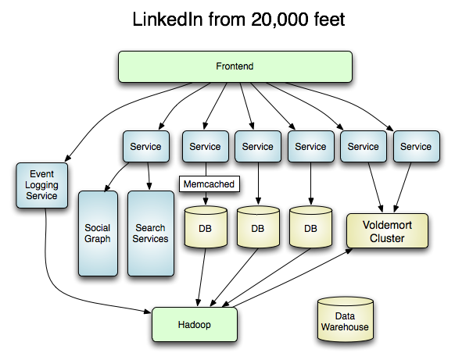

Slide 7
Inspiration: Specialized Systems
Specialized systems within the SNA group
  Search Infrastructure
    Real time
    Distributed
  Social Graph
  Data Infrastructure
    Publish/subscribe
    Offline systems

Slide 8
Inspiration: Fast Key-value Storage
Memcached
  Scalable
  High throughput, low latency
  Proven to work well
Amazon’s Dynamo
  Multiple datacenters
  Commodity hardware
  Eventual consistency
  Variable SLAs
  Feasible to implement

Slide 9
Design
(So you want to build a distributed key/value store?)

Slide 10
Design
Key-value data model
Consistent hashing for data distribution
Fault tolerance through replication
Versioning
Variable SLAs

Slide 11
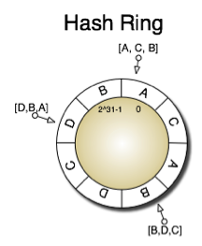
Request Routing with Consistent Hashing
Calculate “master”
partition for a key
Preference list
  Next N adjacent partitions
  in the ring belonging to
  different nodes
Assign nodes to
multiples places on the
hash ring
  Load balancing
  Ability to migrate partitions

Slide 12
Replication
Replication
  Fault tolerance and high availability
  Disaster Recovery
  Multiple datacenters
Operation transfer
  Each node starts in the same state
  If each node receives the same operations, all nodes will end in the same state (consistent with each other)
  How do you send the same operations?

Slide 13
Consistency
Strong consistency
  2PC
  3PC
Eventual Consistency
  Weak Eventual Consistency
  “Read-your-writes” consistency
Other eventually consistent systems
  DNS
  Usenet (“writes-follow-reads” consistency)
  Email
  See: “Optimistic Replication.”, Saito and Shapiro [2003]
  In other words: very common, not a new or unique concept!

Slide 14
Trade-offs
CAP theorem
  Consistency, Availability, (Network) Partition Tolerance
    Network partitions – splits
    Can only guarantee two out of three
  Tunable knobs, not binary switches
  Decrease one to increase the other two
Why eventual consistency (i.e., “AP”)
  Allows multi-datacenter operation
  Network partitions may occur even within the same datacenter
  Good performance for both reads and writes
  Easier to implement

Slide 15
Versioning
Timestamps
  Clock skew
Logical clock
  Establishes a “happened-before” relation
  Lamport Timestamps
  “X caused Y implies X happened before Y”
  Vector Clocks
    Partial ordering

Slide 16
Quorums and SLAs
Quorums
  N replicas total (the preference list)
  Quorum reads
    Read from the first R available replicas in the preference list
    Return the latest version, repair the obsolete versions
    Allow for client side reconciliation if causality can’t be determined
  Quorum writes
    Synchronously write to W replicas in the preference list.
    Asynchronously write to the rest
  If a quorum for an operation isn’t met, operation is considered a failure
  If R + W > N, then we have “read-your-writes” consistency
SLAs
  Different applications have different requirements
  Allow different R, W, N per application

Slide 17
An observation
Distribution model vs. the query model
  Consistency, versioning, quorums aren’t specific to key-value storage
  Other systems with state can be built upon the Dynamo model!
  Think of scalability, availability and consistency requirements
  Adjust the application to the query model

Slide 18
Implementation

Slide 19
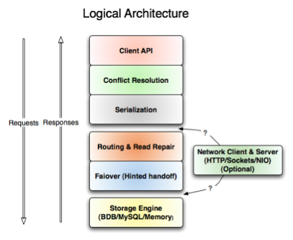
Architecture
Layered design
One interface
down all the layers
Four APIs
  get
  put
  delete
  getall

Slide 20
Storage Basics
Cluster may serve multiple stores
Each store has a unique key space, store definition
Store Definition
  Serialization: method and schema
  SLA parameters (R, W, N, preferred-reads, preferred-writes)
  Storage engine used
  Compression (gzip, lzf)
Serialization
  Can be separate for keys and values
  Pluggable: binary JSON, Protobufs, (new!) Avro

Slide 21
Storage Engines
Pluggable
One size doesn’t fit all
  Is the load write heavy? Read heavy?
  Is the amount of data per node significantly larger than the node’s memory?
BerkeleyDB JE is most popular
  Log-structured B+Tree (great write performance)
  Many configuration options
MySQL Storage Engine is available
  Hasn’t been extensively tested/tuned, potential for great performance

Slide 22
Read Only Stores
Data cycle at LinkedIn
  Events gathered from multiple sources
  Offline computation (Hadoop/MapReduce)
  Results are used in data intensive applications
  How do you make the data available for real time serving?
Read Only Storage Engine
  Heavily optimized for read-only data
  Build the stores using MapReduce
  Parallel fetch the pre-built stores from HDFS
  Transfers are throttled to protect live serving
  Atomically swap the stores

Slide 23
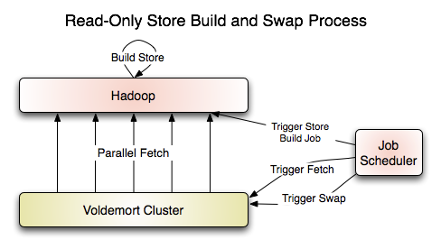
Read Only Store Swap Process

Slide 24
Store Server
Socket Server
  Most frequently used
  Multiple wire protocols (different versions of a native protocol, protocol buffers)
  Blocking I/O, thread pool implementation
  Event-driven, non-blocking I/O (NIO) implementation
    Tricky to get high performance
    Multiple threads available to parallelize CPU tasks (e.g., to take advantage of multiple cores)
HTTP server available
  Performance lower than the Socket Server
  Doesn’t implement REST

Slide 25
Store Client
“Thick Client”
  Performs routing and failure detection
  Available in the Java and C++ implementations
“Thin Client”
  Delegated routing to the server
  Designed for easy implementation
    E.g., if failure detection algorithm is changed in the thick clients, thin clients do not need to update theirs
  Python and Ruby implementations
HTTP client also available

Slide 26
Monitoring/Operations
JMX
  Easy to create new metrics and operations
  Widely used standard
  Exposed both on the server and on the (Java) client
Metrics exposed
  Per/store performance statistics
  Aggregate performance statistics
  Failure detector statistics
  Storage Engine statistics
Operations available
  Recovering from replicas
  Stopping/starting services
  Manage asynchronous operations

Slide 27
Failure Detection
Based on requests rather than heart beats
Recently overhauled
Pluggable, configurable layer
Two implementations
  Bannage period failure detector (older option)
    If we see a certain number of failures, ban a node for a time period
    Once the time period expired, assume healthy, try again
  Threshold failure detector (new!)
    Looks at the number of successes and failures within a time interval
    If a node responds very slowly, don’t count is a success
    When a node is marked down, keep retrying it asynchronously. Mark as available when it has been successfully reached.

Slide 28
Admin Client
Needed functionality, shouldn’t be used by applications
  Streaming data to and from a node
  Manipulating metadata
  Asynchronous operations
Uses
  Migrating partitions between nodes
  Retrieving, deleting, updating partitions on a node
  Extraction, transformation, loading
  Changing cluster membership information

Slide 29
Rebalancing
Dynamic node addition and removal
Live requests (including writes) can be served as rebalancing proceeds
Introduced in release 0.70 (January 2010)
Procedure:
  Initially, new nodes have no partitions assigned to them
  Create a new cluster configuration, invoke command line tool

Slide 30
Rebalancing
Algorithm
  Node (“stealer”) receives a command to rebalance to a specified cluster layout
  Cluster metadata is updated
  Fetches the partitions from the “donor” node
  If data is not yet migrated, proxy the requests to the donor
  If a rebalancing task fails, cluster metadata is reverted
  If any nodes did not receive the updated metadata, they may synchronize the metadata via the gossip protocol

Slide 31
(Experimental) Views
Inspired by CouchDB
Moves computation close to the data (to the server)
Example:
  We’re storing a list as a value, want to append a new element
  Regular way:
    Retrieves, de-serialize, mutate, serialize, store
  Problem: unnecessary transfers
  With views:
    Client sends only the element they wish to append

Slide 32
Client/Server Performance
Single node max (1 client/1 server) throughput
  19,384 reads/second
  16,556 writes/second
  (Mostly in-memory dataset)
Larger value performance test
  6 nodes, ~50,000,000 keys, 8192 value
  Production-like key request distribution
  Two clients
  ~6,000 queries/second per client
In Production (“Data platform” cluster)
  7,000 client operations/second
  14,000 server operations/second
  Peak Monday morning load, on six servers

Slide 33
Open Source!
Open Sourced in January 2009
Enthusiastic community
  Mailing list
Equal amount contributed inside and outside LinkedIn
Available on Github
  http://github.com/voldemort/voldemort

Slide 34
Testing and Release Cycle
Regular release cycle established
  So far monthly, ~15th of the month
Extensive unit testing
Continuous integration through Hudson
  Snapshot builds available
Automated testing of complex features on EC2
  Distributed systems require tests that test the entire cluster
  EC2 allows nodes to be provisioned, deployed and started programmatically
  Easy to simulate failures programmatically: shutting down and rebooting the instances

Slide 35
In Production

Slide 36
In Production
At LinkedIn: multiple clusters, multiple teams
  32 gb of RAM, 8 cores (very low CPU usage)
SNA team
  Read/write cluster (12 nodes, to be expanded soon)
  Read/only cluster
  Recommendation engine cluster
Other clusters
Some uses
  Data driven features: people you may know, who viewed my profile
  Recommendation engine
  Rate limiting, crawler detection
  News processing
  Email system
  UI settings
  Some communications features
  More coming

Slide 37
Challenges of Production Use
Putting a custom storage system in production
  Different from a stateless service
  Backup and restore
  Monitoring
  Capacity planning
Performance tuning
  Performance is deceitfully high when data is in RAM
  Need realistic tests: production-like data and load
Operational advantages
  No single point of failure
  Predictable query performance

Slide 38

Case Study: KaChing
Personal investment start-up
Using Voldemort for
six months
Stock market data, user history, analytics
Six node cluster
Challenges: high traffic volume, large data sets on low-end hardware
Experiments with SSDs: “Voldemort In the Wild”, http://eng.kaching.com/2010/01/voldemort-in-wild.html

Slide 39

Case Study: eHarmony
Online match-making
Using Voldemort since April 2009
Data keyed off a unique id, doesn’t require ACID
Three production clusters: ten, seven and three nodes
Challenges: identifying SLA outliers

Slide 40

Case study: Gilt Groupe
Premium shopping site
Using Voldemort since August 2009
Load spikes during sales events
  Have to remain up and responsive during the
  load spikes
  Have to remain transitionally healthy even if machines die
Uses:
  Shopping cart
  Two separate stores for order processing
Three clusters, four nodes each. More coming.
“Last Thursday we lost a server and no-one noticed”

Slide 41

Nokia
Contributing to Voldemort
Plans involve 10+ TB (not counting replication) of data
  Many nodes
  MySQL Storage Engine
Evaluated other options
  Found Voldemort best fit for environment, performance profile

Slide 42
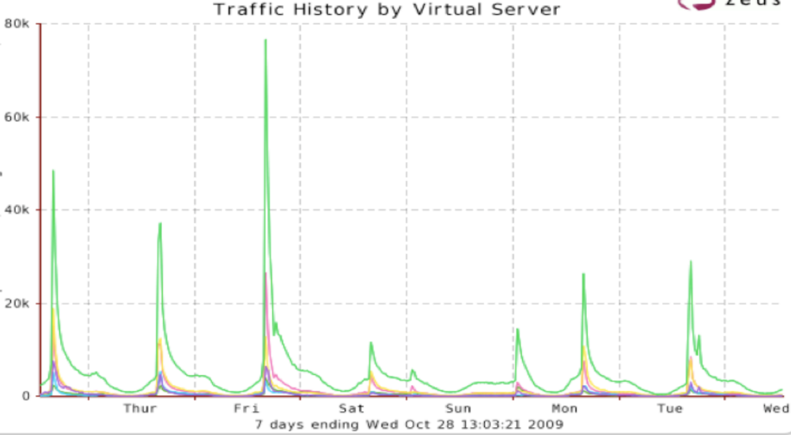
Gilt: Load Spikes

Slide 43
What’s Next

Slide 44
The roadmap
Performance investigation
Multiple datacenter support
Additional consistency mechanisms
  Merkle Trees
  Finishing Hinted Handoff
Publish/subscribe mechanism
NIO client
Storage engine work?

Slide 45
Shameless plug
All contributions are welcome
  http://project-voldemort.com,
  http://github.com/voldemort/voldemort
  Not just code:
    Documentation
    Bug reports
We’re hiring!
  Open Source Projects
    More than just Voldemort: http://sna-projects.com
    Search: real time search, elastic search, faceted search
    Cluster management (Norbert)
    More…
  Positions and technologies
    Search relevance, machine learning and data products
    Distributed systems
      Distributed social graph
      Data infrastructure (Voldemort, Hadoop, pub/sub)
    Hadoop, Lucene, ZooKeeper, Netty, Scala and more…
Q&A

