Slide 1
COL 100: Introduction to Programming
Smruti R. Sarangi
Dept. of Computer Science & Engineering

Slide 2
Course Materials
Books:
Programming with C (Second Edition)
Byron Gottfried, Third Edition, Schaum’s Outlines Series,
The C Programming Language
Brian W Kernighan, Dennis M Ritchie

Slide 3
Attendance REALLY matters
Important for understanding the course
Any student with low attendance may be deregistered from the course
Leave due to medical reasons must be certified by the IIT Hospital

Slide 4
Introduction

Slide 5


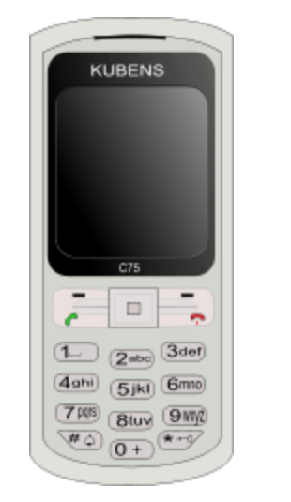
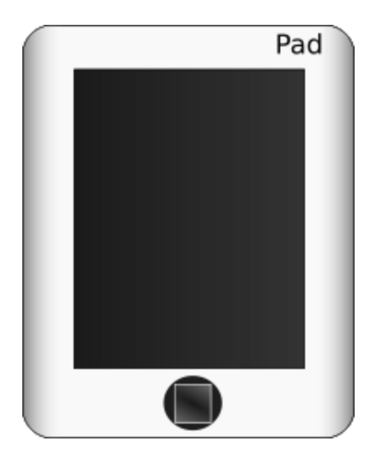

What is a Computer ?
A computer is a general purpose device that can be programmed to process
information, and yield meaningful results.
5

Slide 6
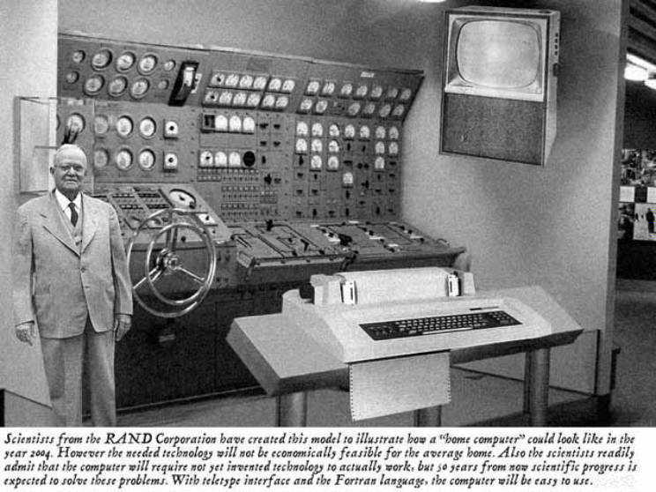
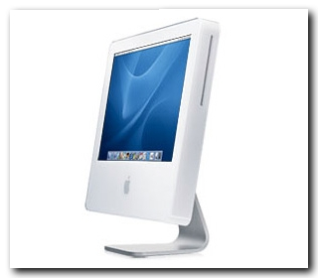
Predicted in 1954
Reality

Slide 7
How does it work ?
Information
store
Program
Computer
results
Program – List of instructions given to the computer
Information store – data, images, files, videos
Computer – Process the information store according to the instructions in the program
7

Slide 8
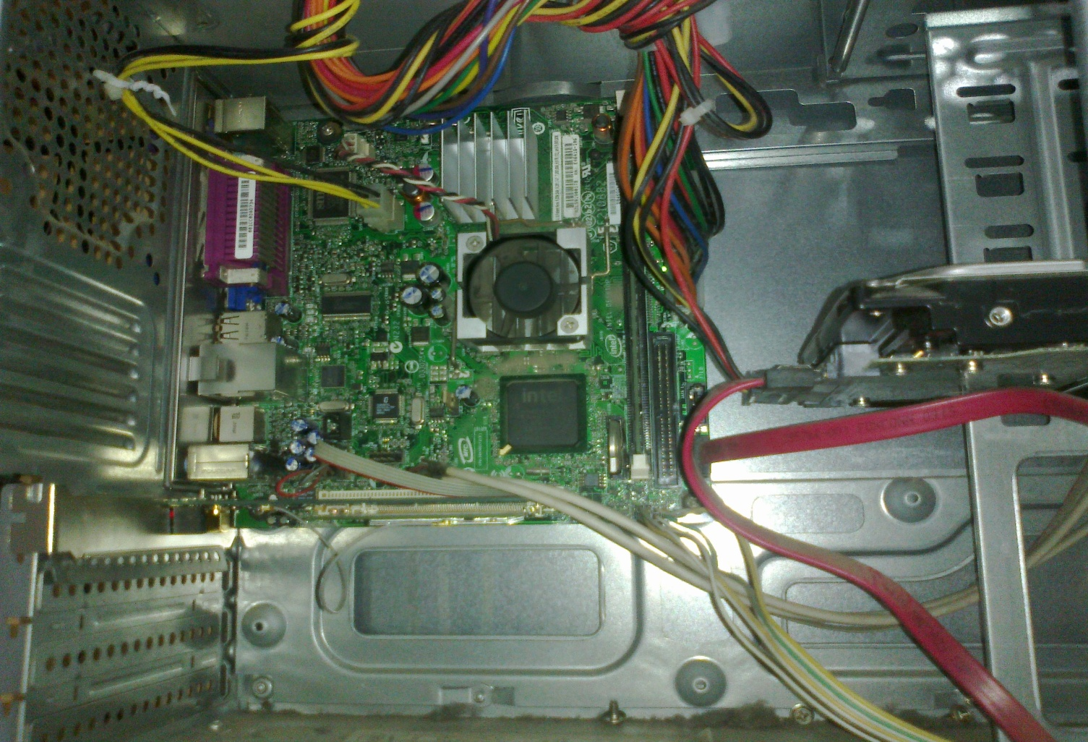
What does a computer look like ?
Let us take the lid off a desktop computer
CPU
Hard disk
Memory
8

Slide 9
Memory
Hard disk
Computer
Memory – Stores programs and data. Gets destroyed when the computer is powered off
Hard disk – stores programs/data permanently
9

Slide 10
Let us make it a full system ...
Memory
Hard disk
Computer
Keyboard
Monitor
Mouse
Printer
10

Slide 11
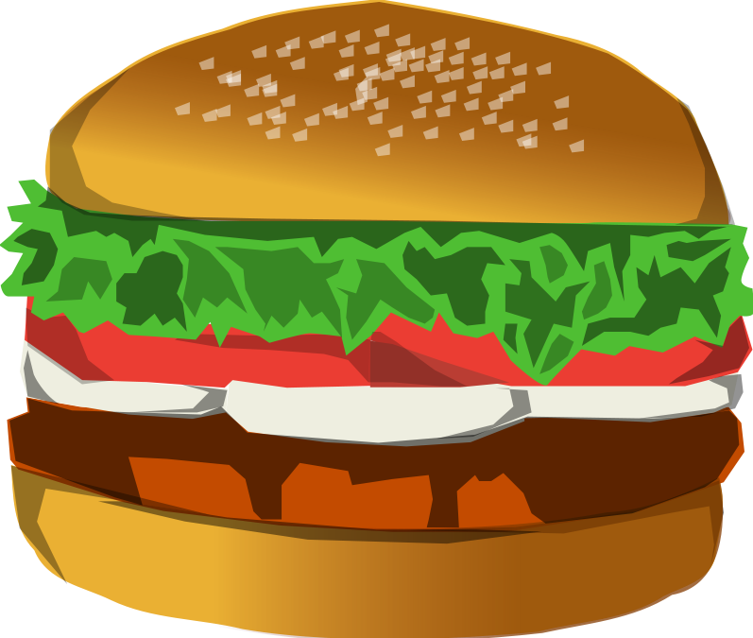
Food for Thought...
What is the most intelligent computer ?
11

Slide 12
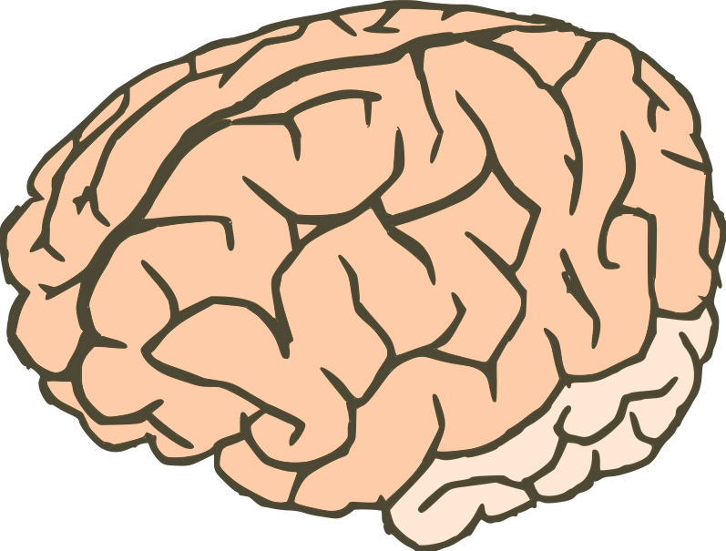
Answer ...
Our brilliant brains
12

Slide 13
How does an Electronic Computer Differ from our Brain ?
Feature
Computer
Our Brilliant Brain
Intelligence
Dumb
Intelligent
Speed of basic calculations
Ultra-fast
Slow
Can get tired
Never
After sometime
Can get bored
Never
Almost always
Computers are ultra-fast and ultra-dumb
13

Slide 14
How to Instruct a Computer ?
compile
execute
Program
Executable
Output
Write a program in a high level language – C, C++, Java
Compile it into a format that the computer understands
Execute the program
14

Slide 15
What Can a Computer Understand ?
Computer can clearly NOT understand instructions of the form
Multiply two matrices
Compute the determinant of a matrix
Find the shortest path between Mumbai and Delhi
They understand :
Add a + b to get c
Multiply a + b to get c
15

Slide 16
The Language of Instructions
Humans can understand
Complicated sentences
English, French, Spanish
Computers can understand
Very simple instructions
The semantics of all the instructions supported by a processor is known
as its instruction set architecture (ISA). This includes the semantics of
the instructions themselves, along with their operands, and interfaces
with peripheral devices.
16

Slide 17

Features of an ISA
Example of instructions in an ISA
Arithmetic instructions : add, sub, mul, div
Logical instructions : and, or, not
Data transfer/movement instructions
Also called low level instructions …
Most programmers avoid writing programs in low level instructions. Very complicated, and difficult.
17

Slide 18
Problems with programming using instruction sets directly
Instruction sets of different types of CPUs are different
Need to write different programs for computers with different types of CPUs even to do the same thing
Solution: High level languages (C, C++, Java,…)
CPU neutral, one program for many
Compiler to convert from high-level program to low level program that CPU understands
Easy to write programs

Slide 19
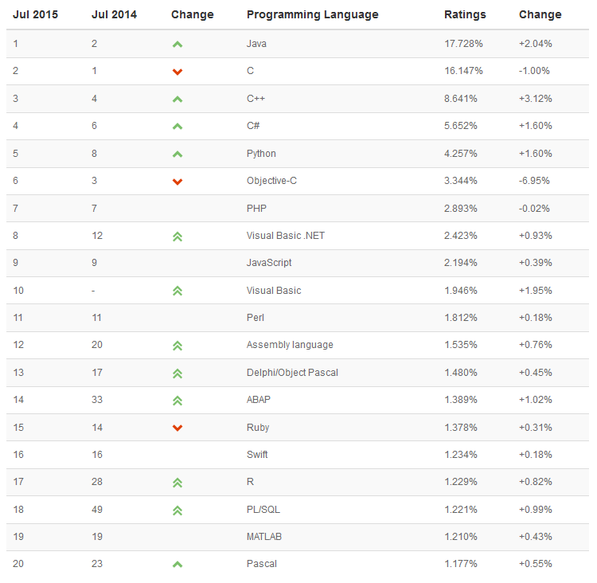

Slide 20
Fundamentals: Binary Numbers

Slide 21
Representing Positive Integers
Ancient Roman System
Issues :
There was no notion of 0
Very difficult to represent large numbers
Addition, and subtraction (very difficult)
Symbol | I | V | X | L | C | D | M
Value | 1 | 5 | 10 | 50 | 100 | 500 | 1000
21

Slide 22
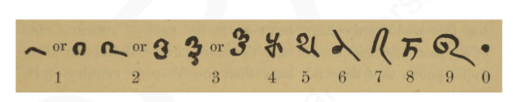
Indian System
Bakshali numerals, 7th century AD
Uses the place value system
5301 = 5 * 10³ + 3 * 10² + 0 * 10¹ + 1*10⁰
Example in base 10
22

Slide 23

Number Systems in Other Bases
Why do we use base 10 ?
because ...
23

Slide 24

What if we had a world in which ...
People had only two fingers.
24

Slide 25
Representing Numbers
1023₁₀ = 1 * 10³ + 0 * 10² + 2 * 10¹ + 3 * 10⁰
Decimal
base
Binary
17₁₀ = 1 * 2⁴ + 0 * 2³ + 0 * 2² + 0 * 2¹ + 1 * 2⁰ = 10001₂
Base = 2

Slide 26
Binary Number System
They would use a number system with base 2.
Number in decimal
Number in binary
5
101
100
1100100
500
111110100
1024
10000000000
26

Slide 27
MSB and LSB
MSB (Most Significant Bit) → The leftmost bit of a binary number. E.g., MSB of 1110 is 1
LSB (Least Significant Bit) → The rightmost bit of a binary number. E.g., LSB of 1110 is 0
27

Slide 28
Hexadecimal and Octal Numbers
Hexadecimal numbers
Base 16 numbers – 0,1,2,3,4,5,6,7,8,9,A,B,C,D,E,F
Start with 0x
Octal Numbers
Base 8 numbers – 0,1,2,3,4,5,6,7
Start with 0
28

Slide 29

Examples
Decimal | Binary | Octal | Hexadecimal
9 | 1001 | 0 11 | 0x 9
12 | 1100 | 0 14 | 0x C
17 | 10001 | 0 21 | 0x 11
28 | 11100 | 0 34 | 0x 1C
Convert 110010111 to the octal format : $\underbrace{110}\underbrace{010}\underbrace{111}$ = 0612
Convert 111000101111 to the hex format : $\underbrace{1110}\underbrace{0010}\underbrace{1111}$ = 0xC2F

Slide 30
Bits and Bytes
Computers do not understand natural human languages, nor programming languages
They only understand the language of bits
Bit
Bit
0 or 1
0 or 1
0 or 1
0 or 1
0 or 1
0 or 1
0 or 1
Byte
8 bits
0 or 1
0 or 1
0 or 1
Word
4 bytes
1024 bytes
0 or 1
0 or 1
kiloByte
0 or 1
0 or 1
10⁶ bytes
megaByte
0 or 1
30

Slide 31
Fundamentals of C

Slide 32
First C program – print on screen
#include <stdio.h>
void main()
{
printf ("Hello, World! \n") ;
}

Slide 33
More printing … (code and see)
#include <stdio.h>
void main()
{
printf ("Hello, World! ") ;
printf ("Hello \n World! \n") ;
}

Slide 34
Some more printing
#include <stdio.h>
void main()
{
printf ("Hello, World! \n") ;
printf ("Hello \n World! \n") ;
printf ("Hell\no \t World! \n") ;
}

Slide 35
Reading values from keyboard
#include <stdio.h> void main() { int num ; scanf ("%d", &num) ; printf (“No. of students is %d\n”, num) ; }

Slide 36
Centigrade to Fahrenheit
#include <stdio.h> void main() { float cent, fahr; scanf(“%f”,&cent);
fahr = cent*(9.0/5.0) + 32; printf( “%f C equals %f F\n”, cent, fahr); }

Slide 37
Largest of two numbers
#include <stdio.h> void main() { int x, y; scanf(“%d%d”,&x,&y); if (x>y) printf(“Largest is %d\n”,x);
else printf(“Largest is %d\n”,y);
}
largest-1.c

Slide 38
What does this do?
#include <stdio.h> void main() { int x, y; scanf(“%d%d”,&x,&y); if (x>y) printf(“Largest is %d\n”,x);
printf(“Largest is %d\n”,y);
}
largest-2.c

Slide 39
The C Character Set
The C language alphabet
Uppercase letters ‘A’ to ‘Z’
Lowercase letters ‘a’ to ‘z’
Digits ‘0’ to ‘9’
Certain special characters:
A C program should not contain anything else
! # % ^ & * ( )
_ + = ~ [ ] \
| ; : ‘ “ { } ,
. < > / ? blank

Slide 40
Structure of a C program
A collection of functions (we will see what they are later)
Exactly one special function named main must be present. Program always starts from there
Each function has statements (instructions) for declaration, assignment, condition check, looping etc.
Statements are executed one by one

Slide 41
Variables
Very important concept for programming
An entity that has a value and is known to the program by a name
Can store any temporary result while executing a program
Can have only one value assigned to it at any given time during the execution of the program
The value of a variable can be changed during the execution of the program

Slide 42
Contd.
Variables stored in memory
Remember that memory is a list of storage locations, each having a unique address
A variable is like a bin
The contents of the bin is the value of the variable
The variable name is used to refer to the value of the variable
A variable is mapped to a location of the memory, called its address

Slide 43
Example
#include <stdio.h>
void main( )
{
int x;
int y;
x=1;
y=3;
printf("x = %d, y= %d\n", x, y);
}

Slide 44
Variables in Memory
Instruction executed
Memory location allocated to a variable X
X = 10
T
i
m
e
10
X = 20
X = X +1
X = X*5

Slide 45
Variables in Memory
Instruction executed
Memory location allocated to a variable X
X = 10
T
i
m
e
20
X = 20
X = X +1
X = X*5

Slide 46
Variables in Memory
Instruction executed
Memory location allocated to a variable X
X = 10
T
i
m
e
21
X = 20
X = X +1
X = X*5

Slide 47
Variables in Memory
Instruction executed
Memory location allocated to a variable X
X = 10
T
i
m
e
105
X = 20
X = X +1
X = X*5

Slide 48
Variables (contd.)
X = 20
20
X
Y=15
X = Y+3
?
Y
Y=X/6

Slide 49
Variables (contd.)
X = 20
20
X
Y=15
X = Y+3
15
Y
Y=X/6

Slide 50
Variables (contd.)
X = 20
18
X
Y=15
X = Y+3
15
Y
Y=X/6

Slide 51
Variables (contd.)
X = 20
18
X
Y=15
X = Y+3
3
Y
Y=X/6

Slide 52
Data Types
Each variable has a type, indicates what type of values the variable can hold
Four common data types in C
int - can store integers (usually 4 bytes)
float - can store single-precision floating point numbers (usually 4 bytes)
double - can store double-precision floating point numbers (usually 8 bytes)
char - can store a character (1 byte)

Slide 53
Contd.
Must declare a variable (specify its type and name) before using it anywhere in your program
All variable declarations should be at the beginning of the main() or other functions
A value can also be assigned to a variable at the time the variable is declared.
int speed = 30;
char flag = ‘y’;

Slide 54
Variable Names
Sequence of letters and digits
First character must be a letter or ‘_’
No special characters other than ‘_’
No blank in between
Names are case-sensitive (max and Max are two different names)
Examples of valid names:
i rank1 MAX max Min class_rank
Examples of invalid names:
a’s fact rec 2sqroot class,rank

Slide 55
More Valid and Invalid Identifiers
Valid identifiers
X
abc
simple_interest
a123
LIST
stud_name
Empl_1
Empl_2
avg_empl_salary
Invalid identifiers
10abc
my-name
“hello”
simple interest
(area)
%rate

Slide 56
C Keywords
Used by the C language, cannot be used as variable names
Examples:
int, float, char, double, main, if else, for, while. do, struct, union, typedef, enum, void, return, signed, unsigned, case, break, sizeof,….
There are others, see textbook…

Slide 57
Example 1
#include <stdio.h> void main() { int x, y, sum; scanf(“%d%d”,&x,&y); sum = x + y;
printf( “%d plus %d is %d\n”, x, y, sum ); }
Three int type variables declared
Values assigned

Slide 58
Example - 2
#include <stdio.h> void main() { float x, y; int d1, d2 = 10;
scanf(“%f%f%d”,&x, &y, &d1); printf( “%f plus %f is %f\n”, x, y, x+y); printf( “%d minus %d is %d\n”, d1, d2, d1-d2);
}
Assigns an initial value to d2,
can be changed later

Slide 59
Read-only variables
Variables whose values can be initialized during declaration, but cannot be changed after that
Declared by putting the const keyword in front of the declaration
Storage allocated just like any variable
Used for variables whose values need not be changed
Prevents accidental change of the value

Slide 60
Correct
void main() {
const int LIMIT = 10;
int n;
scanf(“%d”, &n);
if (n > LIMIT)
printf(“Out of limit”);
}
Incorrect: Limit changed
void main() {
const int Limit = 10;
int n;
scanf(“%d”, &n);
Limit = Limit + n;
printf(“New limit is %d”, Limit);
}

Slide 61
Constants
Integer constants
Consists of a sequence of digits, with possibly a plus or a minus sign before it
Embedded spaces, commas and non-digit characters are not permitted between digits
Floating point constants
Two different notations:
Decimal notation: 25.0, 0.0034, .84, -2.234
Exponential (scientific) notation
3.45e23, 0.123e-12, 123e2
e means “10 to the power of”

Slide 62
Contd.
Character constants
Contains a single character enclosed within a pair of single quote marks.
Examples :: ‘2’, ‘+’, ‘Z’
Some special backslash characters
‘\n’ new line
‘\t’ horizontal tab
‘\’’ single quote
‘\”’ double quote
‘\\’ backslash
‘\0’ null

Slide 63
Input: scanf function
Performs input from keyboard
It requires a format string and a list of variables into which the value received from the keyboard will be stored
format string = individual groups of characters (usually ‘%’ sign, followed by a conversion character), with one character group for each variable in the list
int a, b;
float c;
scanf(“%d %d %f”, &a, &b, &c);
Variable list (note the & before a variable name)
Format string

Slide 64
Commonly used conversion characters
c for char type variable
d for int type variable
f for float type variable
lf for double type variable
Examples
scanf ("%d", &size) ;
scanf ("%c", &nextchar) ;
scanf ("%f", &length) ;
scanf (“%d%d”, &a, &b);

Slide 65
Reading a single character
A single character can be read using scanf with %c
It can also be read using the getchar() function
char c;
c = getchar();
Program waits at the getchar() line until a character is typed, and then reads it and stores it in c

Slide 66
Output: printf function
Performs output to the standard output device (typically defined to be the screen)
It requires a format string in which we can specify:
The text to be printed out
Specifications on how to print the values
printf ("The number is %d\n", num);
The format specification %d causes the value listed after the format string to be embedded in the output as a decimal number in place of %d
Output will appear as: The number is 125

Slide 67
Contd.
General syntax:
printf (format string, arg1, arg2, …, argn);
format string refers to a string containing formatting information and data types of the arguments to be output
the arguments arg1, arg2, … represent list of variables/expressions whose values are to be printed
The conversion characters are the same as in scanf

Slide 68
Examples:
printf (“Average of %d and %d is %f”, a, b, avg);
printf (“Hello \nGood \nMorning \n”);
printf (“%3d %3d %5d”, a, b, a*b+2);
printf (“%7.2f %5.1f”, x, y);
Many more options are available for both printf and scanf
Read from the book
Practice them in the lab

