Slide 1
Phoenix: Detecting and Recovering from Permanent Processor Design Bugs with Programmable Hardware
Smruti R. Sarangi
Abhishek Tiwari
Josep Torrellas
University of Illinois at Urbana-Champaign
http://iacoma.cs.uiuc.edu

Slide 2


Can a Processor have a Design Defect ?
No Way !!!
Yes, it is a major challenge.

Slide 3

A Major Challenge ???
50-70% effort spent on debugging
1-2 year verification times
Massive computational resources
Some defects still slip through
to production silicon

Slide 4

Defects slip through ???
1994
Pentium defect costs Intel $475 million
1999
Defect leads to stoppage in shipping Pentium III servers
2004
AMD Opteron defect leads to data loss
2005
A version of Itanium 2 recalled
Increasing features on chip
Conventional approaches are ineffective
Micro-code patching
Compiler workarounds
OS hacks
Firmware
Does not look like it will stop

Slide 5
Vision
Processors include programmable
HW for patching design defects
Vendor discovers a new defect
Vendor characterizes the conditions
that exercise the defect
Vendor sends a defect signature
to processors in the field
Customers patch the HW defect

Slide 6
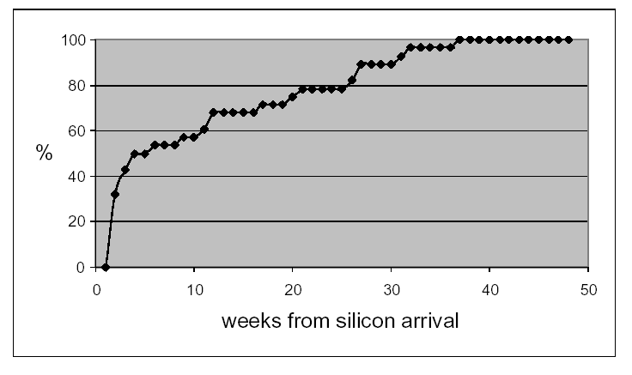
Additional Advantage: Reduced Time to Market
Pentium-M, Silas et al., 2003
% of defects detected
8 weeks
Reduced time to market → Vital ingredient of profitability

Slide 7
Outline
Analysis and Characterization
Architecture for Hardware Patching
Evaluation

Slide 8
Defects in Deployed Systems
100%
50
% of defects detected
We studied public domain errata documents for 10 current processors
  Intel Pentium III, IV, M, and Itanium I and II
  AMD K6, Athlon, Athlon 64
  IBM G3 (PPC 750 FX), MOT G4 (MPC 7457)

Slide 9
Dissecting a Defect – from Errata doc.
Module
L1, ALU, Memory, etc.
Defect
Type of Error
Hang, data corruption
IO failure, wrong data
Condition
A ∪ (B∩C∩D)
Snoop
L1 hit
IO request
Low power mode
Signal

Slide 10
Types of Defects
Design Defect
Non-Critical
Critical
Performance counters
Error reporting registers
Breakpoint support
Defects in memory, IO, etc.
Concurrent
Complex
All signals – same time
Different times

Slide 11
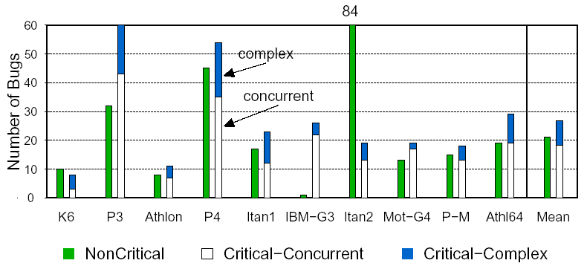
Characterization
31%
69%

Slide 12
When can the defects be detected ?
Post Defect (37%)
Condition
Detector
Local
Pipeline
Other
Signals
Defect
Pre Defect (63%)
ALU
time
Memory, IO

Slide 13
Outline
Analysis and Characterization
Architecture for Hardware Patching
Evaluation

Slide 14
Phoenix Conceptual Design
Store defect signatures
obtained from vendor
Program the on-chip
reconfigurable logic
Signature Buffer
Signal Selection Unit
(SSU)
Tap signals from units
Select a subset
Reconfigurable
Logic
Bug Detection Unit
(BDU)
Collect signals from SSUs
Compute defect conditions
Initiate recovery if a
defect condition is true
Global Recovery Unit

Slide 15
Distributed Design of Phoenix
Neighborhood
Subsystem
Subsystem
To Recovery
Unit
To Recovery
Unit
BDU
SSU
HUB
SSU
BDU
Examples of Subsystems
Inst. Cache | FP ALU | Virtual Mem.
Fetch Unit | L1 Cache | IO Cntrl.

Slide 16
Overall Design
Chip Boundary
Global Recovery
Unit
Neighborhood
Neighborhood
HUB
HUB
HUB
HUB
Neighborhood
Neighborhood

Slide 17
Software Recovery Handler
Flush Pipeline
Rest of Post
Checkpointing
Support
Local Post
Type of
Defect
Yes
No
Reset Module
Pipeline Post
+
Rollback
Interrupt to
OS
Pre
Turn condition off
continue

Slide 18
Designing Phoenix for a New Processor
New Processor
List of Signals
Sizes of Structures
Training
Data
Generic
Specific
Learn from other
processors
Processor
data sheets
Scatter plot of sizes
vs. # of signals in unit
Derive rules of thumb
Training
Data

Slide 19
Designing Phoenix for a New Proc. – II
Generate list of signals to tap
Decide on breakdown of
subsystems and neighborhoods
Place BDUs, SSUs, and HUBs
Size structures using the
rules of thumb
Route all signals and realize
the logic function of defects

Slide 20
Outline
Analysis and Characterization
Architecture for Hardware Patching
Evaluation

Slide 21
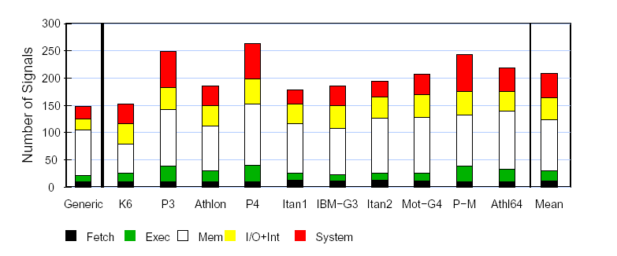
Signals Tapped
Generic+Specific
150-270
Generic Signals
Specific Signals
L2 hit, low power mode
ALU access, etc.
A20 pin set in Pentium 4
BAT mode in IBM 750FX
Notes:
annotate 150-270 , last thing

Slide 22
Defect Coverage Results
Training Set:
Intel P3, P4, P-M
Itanium I & II
AMD K6, K7
AMD Opteron
IBM G3
Motorola G4
Recover
All Defects
Concurrent
Complex
63%
Pre
Post
Detect
37%
69%
31%
Test Set:
UltraSparc II
Intel IXP 1200
Intel PXA 270
PPC 970
Pentium D
Detection Coverage
65%
Test Processors
Recovery Coverage
60%

Slide 23

Overheads
Overheads
Area
Wiring
Timing
Programmable logic
(PLA & interconnect)
Estimated using PLA
layouts (Khatri et al.)
Wires to route signals
Estimated using Rent’s rule
None
0.05%
0.48%

Slide 24
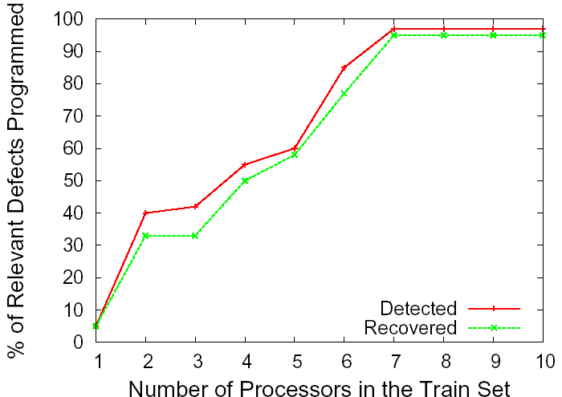
Impact of Training Set Size
Train set only needs to have 7 processors
Coverage in new processors is very high

Slide 25

Conclusion
We analyzed the defects in 10 processors
Phoenix novel on-chip programmable HW
Evaluated impact:
  150 – 270 signals tapped
  Negligible area, wiring, and performance overhead
  Defect coverage: 69% detected, 63% recovered
  Algorithm to automatically size Phoenix for new procs
We can now live with defects !!!

Slide 26
Phoenix: Detecting and Recovering from Permanent Processor Design Bugs with Programmable Hardware
Smruti R. Sarangi
Abhishek Tiwari
Josep Torrellas
University of Illinois at Urbana-Champaign
http://iacoma.cs.uiuc.edu

Slide 27
Backup

Slide 28
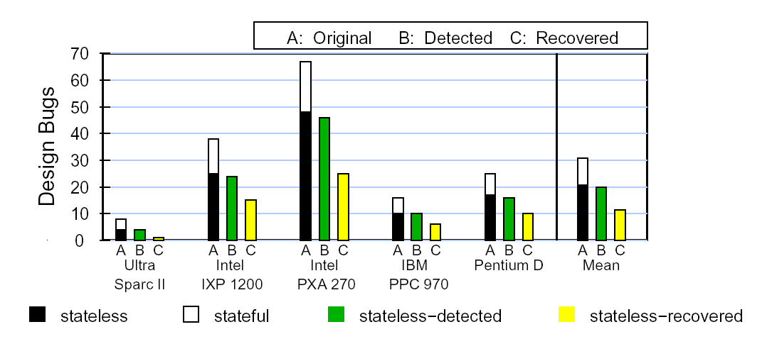
Phoenix Algorithm for New Processors
Generate Signal List
Defect Coverage for New Processors
Place a SSU-BDU pair
in each subsystem
Use k-means clustering to
group subsystems in nbrhoods
Size hardware using the
thumb-rules
Similar results obtained for 9 Sun processors – UltraSparc III, III+, III++, IIIi, IIIe, IV, IV+, Niagara I and II
Map signals in errata to
signals in the list
Route all signals and realize
the logic function

Slide 29
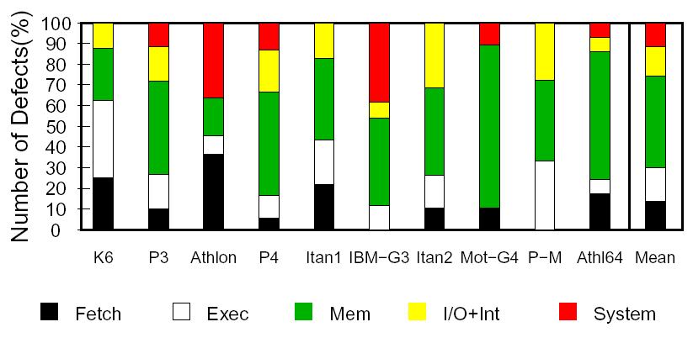
Where are the Critical defects ?
The core is well debugged
Most of the defects are in the mem. system

