Slide 1
Power and Temperature
Smruti R. Sarangi
IIT Delhi

Slide 2
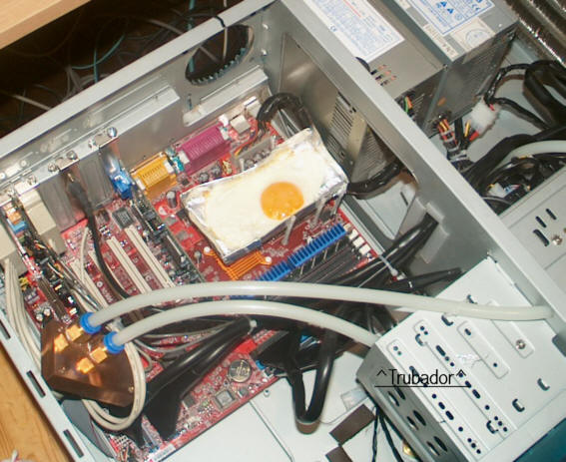
Why is power consumption important?

Slide 3
Scientific Reasons
High Power
High Temperature
Low Reliability

Slide 4

Sources of Power Consumption

Slide 5
Types of Power Dissipation
Dynamic power
Power lost due to current flowing across resistors in the chip’s circuit
Leakage power
Power that is lost in transistors when they are in the off state
Short circuit power
Power lost when both the PMOS and NMOS transistors are on (during a logic transition)

Slide 6
Dynamic Power

Slide 7










Dynamic Power
Any electronic circuit can be decomposed (at any point in time), to an equivalent circuit with resistances, capacitances, current and voltage sources
Equivalent Circuit of an NMOS transistor
$$C_{gd}$$
$$i_{d}$$
gate
drain
+
$$V_{gs}$$
$$C_{gs}$$
$$C_{gb}$$
$$g_{m}V_{gs}$$
$$g_{mb}V_{bs}$$
-
source
-
$$V_{bs}$$
$$C_{sb}$$
$$C_{db}$$
+
body

Slide 8

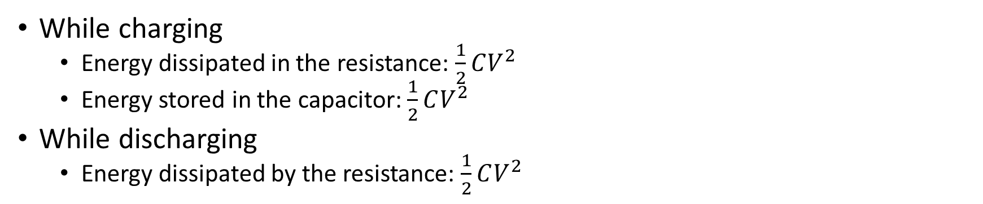
Consider a simple case
Charging
Discharging
R
R
V
C
C
While charging
Energy dissipated in the resistance: $\frac{1}{2}CV^{2}$
Energy stored in the capacitor: $\frac{1}{2}CV^{2}$
While discharging
Energy dissipated by the resistance: $\frac{1}{2}CV^{2}$
Total energy dissipated in one charge-discharge cycle: $CV^{2}$

Slide 9
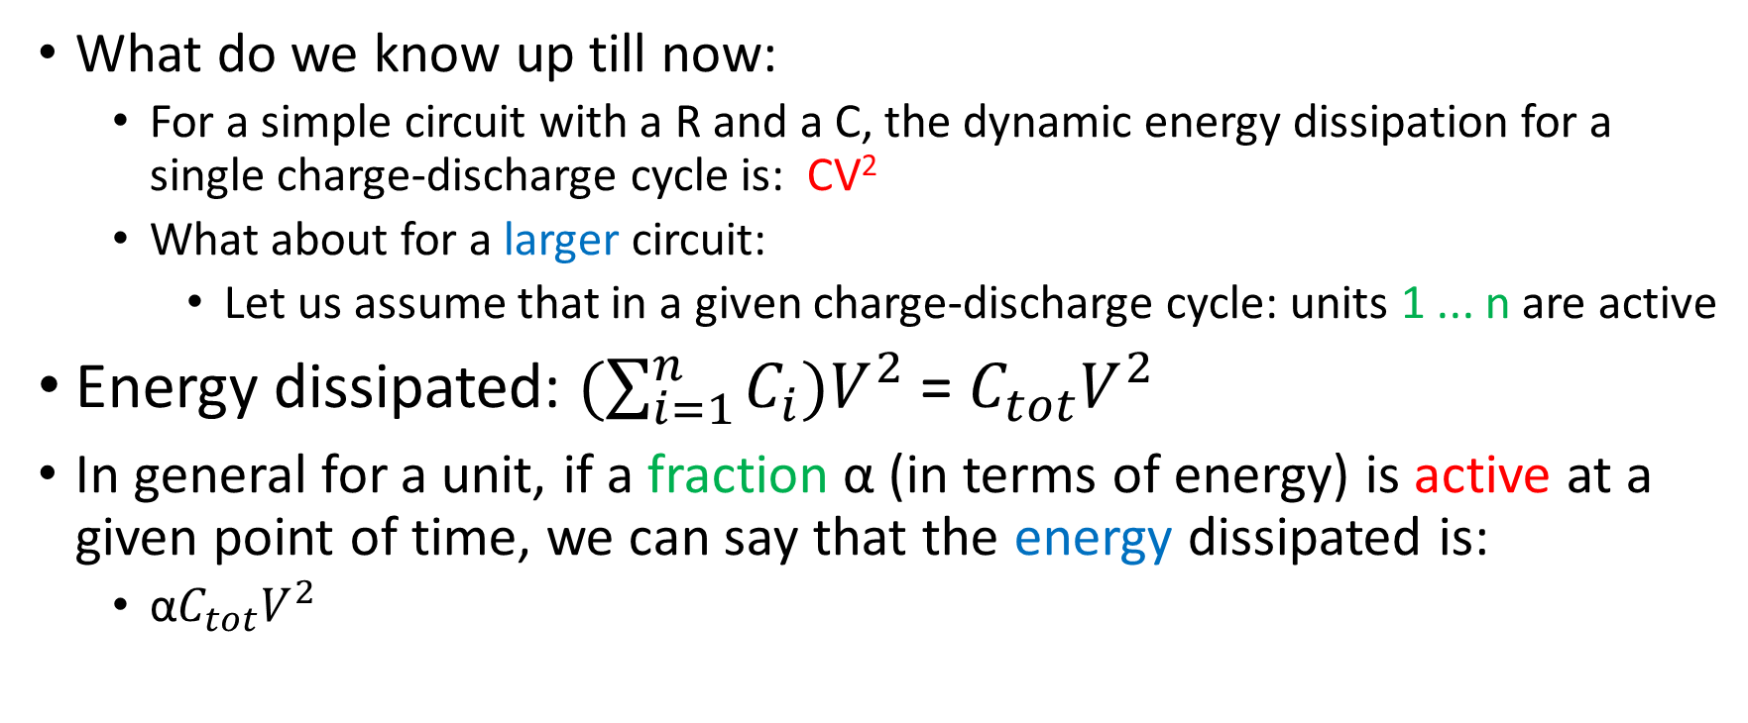
Dynamic Power Analysis
What do we know up till now:
For a simple circuit with a R and a C, the dynamic energy dissipation for a single charge-discharge cycle is: CV²
What about for a larger circuit:
Let us assume that in a given charge-discharge cycle: units 1 ... n are active
Energy dissipated: $(\sum_{i=1}^{n}{C_{i}})V^{2}$ = $C_{tot}V^{2}$
In general for a unit, if a fraction α (in terms of energy) is active at a given point of time, we can say that the energy dissipated is:
α$C_{tot}V^{2}$

Slide 10
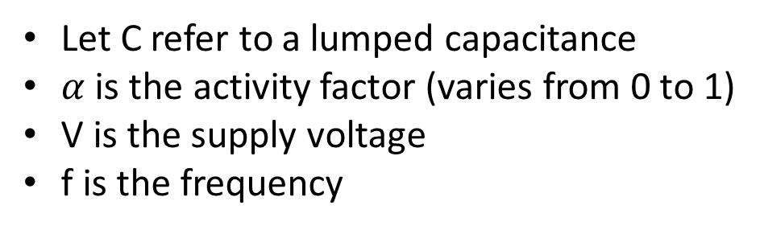
Energy vs Power
Power = Energy per unit time
For a given clock cycle
$$P= \frac{Energy}{Cycle Time}=Energy ∗frequency ∝αCV^{2}f$$
Let C refer to a lumped capacitance
$α$ is the activity factor (varies from 0 to 1)
V is the supply voltage
f is the frequency

Slide 11
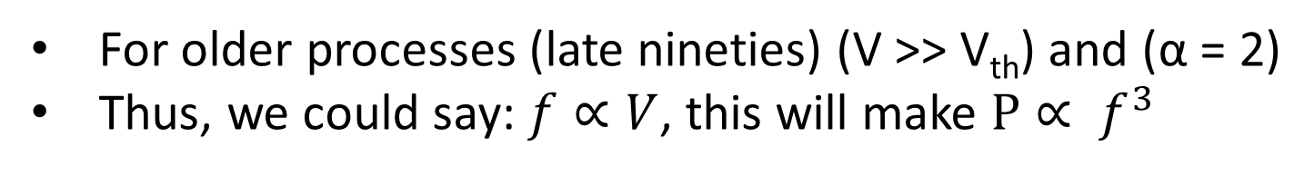
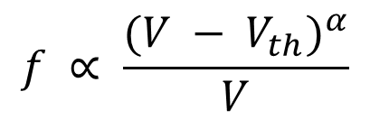
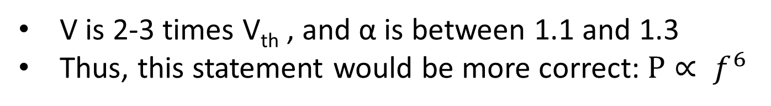
Are V and f related?
Let us look at some textbook results.
Alpha Power Law
$$f ∝ \frac{(V − V_{th})^{α}}{V}$$
Olden Days
For older processes (late nineties) (V >> V_{th}) and (α = 2)
Thus, we could say: $f∝V$, this will make $P∝ f^{3}$
Nowadays
V is 2-3 times V_{th} , and α is between 1.1 and 1.3
Thus, this statement would be more correct: $P∝ f^{6}$

Slide 12
Voltage-Frequency Scaling
What happens if we increase the voltage
We can also increase the frequency
The power will also increase significantly
We already know the relation between V and f
Quad-core AMD Opteron scaling levels:
Voltage | Frequency
1.25 V | 2.6 GHz
1.15 V | 1.9 GHz
1.05 V | 1.4 GHz
0.9 V | 0.8 GHz

Slide 13
Leakage Power

Slide 14
Leakage Power: Sources of Leakage Current
gate
source
drain
n
n
3. Gate oxide tunneling
2. Drain induced barrier lowering
1. subthreshold current
4. GIDL
bulk

Slide 15
Leakage Power: Sources of Leakage Current
gate
6. hot carrier injection
source
drain
n
n
5. p-n junction current
bulk

Slide 16
Description of the Mechanisms
Sub-threshold leakage
When a transistor is turned off, there should be no current flowing between the source and drain
This is the ideal case, and life is never ideal
Little bit of leakage is there even in the off state
input
output
small amount of current flow even if the transistor is off

Slide 17
DIBL and Gate Tunneling
DIBL (drain induced barrier lower)
As the drain voltage increases, the threshold voltage decreases (V_{th})
Lower the V_{th}, more is the leakage
The current flows between the drain-to-source terminals
Thin-oxide Gate Tuneling
The gate oxide is very thin (<2 nm)
Since the oxide layer is so thin, current tunnels from the gate to the body of the transistor
NMOS leakage is much more than PMOS leakage (3-10X more)

Slide 18
Other Mechanisms
Gate-Induced Drain Leakage (GIDL)
Current flows from the drain terminal into the body of the transistor
Can happen when the gate voltage is high (in NMOS)
A high gate voltage increases the charge concentration in the areas near the gate.
P-N Junction Leakage
Current flowing between the source-and-body and drain-and-body
Hot Carrier Injection
Hot carriers are fast electrons that get trapped in the gate oxide
This causes a shift in the threshold voltage, V_{th}
Affects leakage current

Slide 19
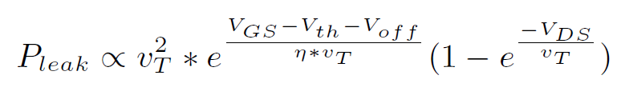
Some Equations
Most commonly used equation for leakage current (mainly sub-threshold leakage)
v_{T} → kT/q (k → Boltzmann’s constant, q → Coulomb’s constant, T → Temperature)
V_{th} has a temperature dependence
Typically reduces by 2.5 mV for every degree C rise in temperature
Conclusion: Leakage power is superlinearly dependent on temperature

Slide 20
Short Circuit Power

Slide 21
Consider a CMOS Inverter
T2
T1
When the input is 0: T1 is off, and T1 is on
When the input is 1: T1 is on, and T2 is off
During the transition: For a brief period, both are on

Slide 22
Ballpark Figures
Dynamic Power
40-60%
Short Circuit Power
5-10 %
Leakage Power
20-40 %

Slide 23
Temperature

Slide 24

Power and Temperature
Methods of heat transfer
Conduction
Heat transferred between two objects when they are in contact
Convection
Heat transferred between an object and a flowing fluid
Radiation (Not relevant)
Rate of change of temperature (u) is proportional to the second derivative of temperature over space

Slide 25
Chip’s Package
Fan
Thermal interface material
Heat sink
Heat spreader
Silicon die
PCB
The spreader helps to avoid temperature hot spots
The fan blows air over the heat sink

Slide 26

source: www.alamy.com

Slide 27
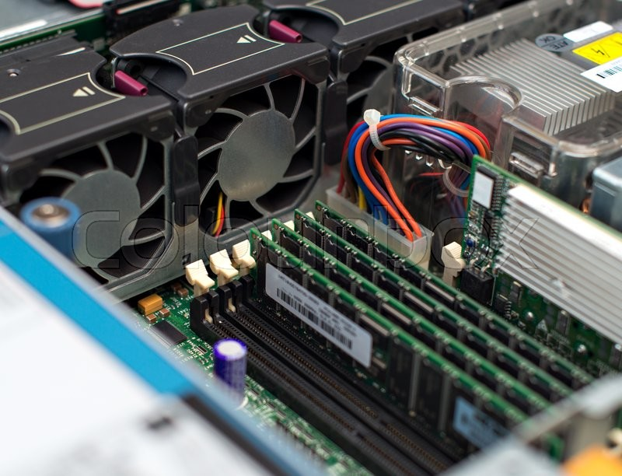

Slide 28

Some Maths
T= AP
Let us divide the surface of the die into a M * M grid
Let N = M²
Let the vector P be a N*1 vector.
P[i] is the power dissipated at the i^{th} grid point
Similarly, let T be a N*1 vector for temperature
Let A be a N*N matrix that linearly relates power and temperature
As simple as that ....

Slide 29
Leakage Temperature Feedback Loop
Needs several iterations to converge
Dynamic + Short Circuit Power
Total Power
Temperature
Leakage Power

Slide 30


