Slide 1
Advanced Caches
Smruti R. Sarangi

Slide 2
Time to go deeper into the memory system
Processor
Let us mainly focus on the L2 cache
L1
L2
Main Memory

Slide 3

Outline
Modeling and simulating caches
Structure of a large L2 Cache
Non-uniform Caches
S-NUCA
D-NUCA
R-NUCA

Slide 4
Modeling and Simulating Caches
Should I use a 4KB, 2-way assoc cache or 8KB, 1-way assoc cache?
First, we need to find the access times of both caches
Convert access time into clock cycles
Simulate both the configurations: find the faster one
To find the time it takes to access a cache
We need to use a simulation tool
Most popular simulation tool → Cacti (designed by HP labs)
Along with that
We need power and area data as well
Cacti 6.0 provides all of these
It has a web interface also: http://quid.hpl.hp.com:9081/cacti/

Slide 5
Structure of a Cache
SRAM cell
Address
Tag Array
Data Array
wordlines
Decoder
column muxes
sense amps
output drivers
Output driver
Comparators
mux drivers
data output
valid output

Slide 6
Usage
cacti C B A
C → cache size in bytes
B → block size in bytes
A → associativity
Number of sub-banks (a bank is a sub-cache) (more later ..., assume 1 for now)
Hidden inputs
b_{o} → output width (differs for 32/64 bit machines)
b_{width} → input address width (differs for 32/64 bit machines)
Cacti
area,time,power
inputs

Slide 7
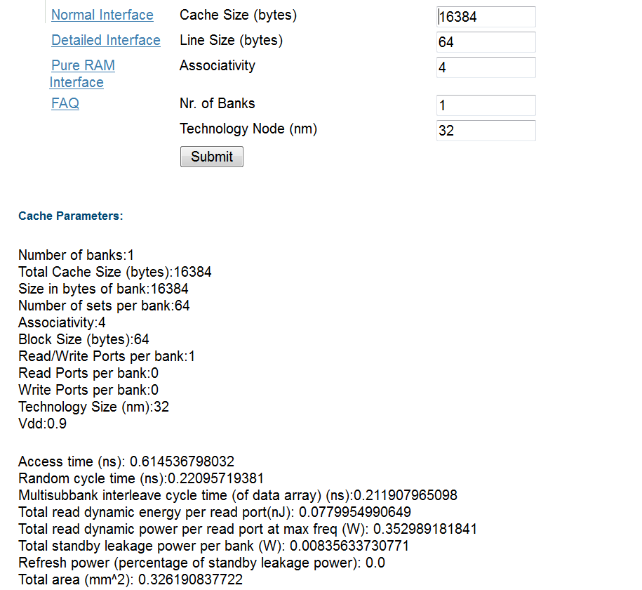
Sample input and output

Slide 8
How does Cacti work?
Given the inputs it tries to create the most optimal (often fastest) cache
What can happen?
Caches can get very asymmetric. rows >> columns, or columns >> rows (>> → significantly more than)
slow design
fast design

Slide 9
How to make it fast?
Create sub-arrays of SRAM cells
N_{dwl} → Number of vertical cut lines
N_{dbl} → Number of horizontal cut lines
Total number of subarrays created → N_{dwl} * N_{dbl}
Also to improve the aspect ratio, map more sets per wordline
It will increase the number of column multiplexers → slowdown
Will decrease the number of rows, and thus the size of the address decoder → speedup
Number of sets mapped to a wordline → N_{spd}
The optimal values of N_{dwl} , N_{dbl,} and N_{spd} are found out by Cacti

Slide 10
Banks and Sub-arrays
A large cache can be split into multiple banks
A bank is a cache in its own right. It has its own tag and data array.
Different banks can be accessed simultaneously
Given an address, we first need to map it to a bank, and then access that specific bank
Advantage of banking → faster banks and more parallel access
Disadvantage of banking → Higher area, and additional delay in deciding the bank
Each bank can then be split into sub-arrays
Subarrays do not allow parallel(concurrent) access
Multilevel hierarchical organizations are also possible (Cacti 5.0 +)
Bank → sub-banks →Mats → 4 sub-arrays
Wire routing delay and SRAM array access delay determine the degree of hierarchy

Slide 11
Multi-Ported Structures
Approach 1: Change the SRAM Cell → Area intensive & slow
Approach 2: Use banking
Better → faster, and does not need more area.

Slide 12
Examples: (2-way assoc, 64B line size, 1 array, 32 nm) Access Time vs Cache Size

Slide 13
Area vs Cache Size

Slide 14
Cache Size vs Power

Slide 15
Outline
Modeling and simulating caches
Structure of a large L2 cache
Non-uniform Caches
S-NUCA
D-NUCA
R-NUCA

Slide 16
Structure of a Modern Processor
Typical L2 caches in a chip are fairly large: order of MBs
It is thus necessary to divide them into many banks
We thus have an array of banks
A lot of modern chips have many cores (OOO pipelines) also (more later)
There are many ways to organize cores and cache banks
Checkerboard Layout
Rim Layout
Core
Cache bank

Slide 17
How do you pass messages in such a system?
Need an on-chip network
Also called Network-on-chip (NoC)
First create groups of co-located cores and cache banks
Called a tile
Associate a network element (router) with each tile. Elements in each tile are connected to each other using regular electrical links. All of them are also connected to the router (one per each tile).
Communication Element
Router

Slide 18

Passing Messages - II
Connect all the routers with an on-chip network
Routers are connected by electrical links (or hops)
Destination
Sending a message
Source

Slide 19
A Network Router
Router
Local Tile
Router
Router
Router
Router

Slide 20
Network Delays
Two routers are connected with a set of wires
We cannot have many wires in parallel
We typically cannot have more than 64-128 wires in parallel
Means, we cannot send more than 64-128 bits at a time
64-128 bits → 8-16 bytes
Each such packet is also called a flit in an NoC
If we are reading a 64 byte cache line
We need to break it into 4-8 flits
Send one flit after the other
A lot of networks typically a head flit and a tail flit also
Head flit
Body flit
Body flit
Tail flit

Slide 21
Network Delays
Flits typically 1 cycle to traverse a hop
Sending delay by the transmitter
Signal propagation time
Receiving delay
What does the router do?
If the flit belongs to the local time → send it to the local tile
Figure out the next router to send the packet to
Take congestion and deadlocks into account
Router has a delay of 2-3 cycles
Total delay: at least 3-4 cycles

Slide 22
Network Delays
How long will it take to go from one end to the other in this network?
6 hops, assume 4 cycles per hop → 24 cycles

Slide 23
Non Uniform Caches
L2/L3 caches are large.
If you find data in a nearby bank → a couple of cycles
If it is a remote bank → 20-50 cycles (depending on the size of the network and the degree of congestion)
Cache access times can be very variable depending on where the data is
This is called a non-uniform cache (NUCA cache)
Can we take advantage of this non-uniformity?
ANSWER: Place frequently used data closer

Slide 24
Outline
Modeling and simulating caches
Structure of a large L2 cache
Non-uniform Caches
S-NUCA
D-NUCA
R-NUCA

Slide 25
S-NUCA (static NUCA)
Simplest scheme:
Map cache lines to cache banks
Give a cache line → we know which cache bank it maps to
How to do the mapping
Solution 1:
Solution 2:
Tradeoffs: Bank locality vs homogenizing bank accesses
Tag
Bank id
Set id
Byte within a block
Tag
Set id
Bank id
Byte within a block

Slide 26
D-NUCA (Dynamic NUCA)
Let us now look at a method of bringing frequently used data closer
Bank set → sets of banks
Bank set 1
Bank set 8

Slide 27
Operation of the Protocol
Given an address → Map it to a bank set
Search the bank set
If you find the line, declare a cache hit
Otherwise declare a miss and fetch it from the lower level
Three search strategies
Sequential
Two-way
Broadcast
Tag
Bank set id
Set id
Byte within a block

Slide 28
Search Strategies: Start from the home bank (closest to the core in the bank set)
Sequential Search
Two-way Search
start from home bank
Broadcast Search

Slide 29
After a Hit/Miss Decision
Hit decision
Send the block to the requesting core
Promote the block → Move it closer to the home bank (Migration)
Bring it to a nearer bank (closer to the home bank)
If there is an empty block in the set in the new bank → no problem
Otherwise swap the blocks
Bringing blocks closer to the home bank (consistent with temporal locality)
Miss decision
Fetch the block from the lower level
Either insert it into the nearest bank or the farthest bank (depends on the strategy)

Slide 30
Eviction and Migration
Assume that a block needs to be evicted
Solution 1: Move it to the lower level
Solution 2: Move it away from the home bank. Need to tag each line with the id of the requesting core
Advantages
Keeps data close to requesting cores
Brings data closer depending upon usage
Gives a block multiple chances → Upon an eviction move it to block slightly further away
Search policy, location, migration and eviction are important design decisions

Slide 31
R-NUCA
Break down accesses into three types
Instructions (read only)
Data-private
Data-shared
Since instructions are read-only, thus they can be replicated
Data cannot be replicated (very complex)
Use OS mechanisms to map pages as: instruction, data-private, and data-shared
Save this information in the TLBs

Slide 32
Instructions
Overlapping clusters
Create small clusters of 4 tiles
Can be overlapping or non-overlapping
If they are overlapping
A tile can be a part of multiple clusters
Search protocol
Consider the 2 bits in the block address above the set index bits
2 bits → 4 combinations
For each combination store the id of the tile that we need to search
Note that a tile can be a part of multiple clusters
Ensure that for all the tiles in the cluster that we search → all the blocks with the same value of the 2 bits map to the same cluster
If there is a miss in the cluster search in a designated remote bank (SNUCA)

Slide 33
Mapping Clusters in R-NUCA – Rotational Interleaving
11
00
01
10
01
10
11
00
Cluster
11
00
01
10
Randomly assign a RID of 00 to a tile
01
10
11
00
RIDs are contiguous along each row
Differ by n/2 (for n = 4) across a column
Let A = (a1, a2) be 2 bits in the block address to the left (more significant) of the set index
Compute ( RID - A )
Result: 0 (current), -1 (right), 1 (left), 2 or -2 (down)
Access the bank. This is where the instruction line should be kept.

Slide 34
Data
Private data → Store it only within the bank in the tile
Shared data → Use SNUCA
Advantages:
Limited replication ensures good instruction hit rates
Does not add the complexity of maintaining replicas for read-write data

Slide 35
THE END

