Slide 1
Byzantine Fault Tolerance
Prof. Smruti R. Sarangi
Computer Science and Engineering
IIT Delhi

Slide 2
Byzantine Faults
Normal faults
Crash faults → The process just stops
Crash faults with intimation → The process stops working and some entity lets other processes know.
We have been dealing with such easy-to-manage faults up till now.
Byzantine faults
Everything is fair for nodes with Byzantine faults (lying, colluding, etc.)
They can
Show up as crash failures
Fake and forge messages
Even get together with other faulty nodes and create confusion

Slide 3


Byzantine General’s Problem
Orders
Commander
General

Slide 4
Byzantine Generals Problem – II
The commander or any of the lieutenant generals can be disloyal
Can have Byzantine failures.
You cannot trust them at all.
Consider a synchronous algorithm.
The commander sends an order to n-1 lieutenant generals.
Condition IC1: All loyal lieutenant generals obey the same order.
Condition IC2: If the commander is loyal, every loyal general obeys the order that the commander issues.

Slide 5
Impossibility Results

Slide 6
Impossibility result for 3 generals.
Assume 1 commander and 2 lieutenant generals. Assume at the most one Byzantine failure – at the most one general (including the commander) is disloyal.
No solution is possible.
Traitor
Commander
Commander
Attack
Retreat
Attack
Attack
General 1
General 2
General 1
General 2
Retreat
[Commander said]
Retreat
[Commander said]
No way to distinguish between these scenarios. General 1 chooses Attack (IC2). Similar argument can be used to prove that General 2 chooses RETREAT, when both are loyal.

Slide 7
General Result
Assume there are m traitors and <= 3m generals
No solution is possible
Approach
Let these generals be Albanian generals
We will prove that if Albanian generals can solve this problem, then 3 Byzantine generals can also solve this problem for 1 traitor
The latter is impossible!
Divide the set of Albanian generals into 3 groups, let each Byzantine general simulate m Albanian generals
The Byzantine commander simulates the Albanian commander + at the most (m-1) Albanian generals
Each of the rest of the Byzantine generals simulate at the most m Albanian generals
Since at most 1 Byzantine general can be a traitor, at most m Albanian generals can be traitors

Slide 8
Contradiction
We assume we have a solution to the Albanian Generals problem
Means we have ensured IC1 and IC2
Simulation assumption: Byzantine general loyal ↔Albanian general loyal
IC1: This means that all loyal Albanian generals obey the same order
The two Byzantine generals simulating them also obey the same order
This ensures condition IC1 for the Byzantine generals as well
If the Byzantine command is loyal, then the Albanian commander is loyal
All the loyal Albanian generals obey this order (assumption)
Their simulating Byzantine generals also obey the same order. (IC2)
Means we have a solution for 3 Byzantine generals. This is impossible!

Slide 9
Byzantine Agreement Algorithm

Slide 10
Assumptions
A1
Every message is delivered correctly. Message integrity is maintained.
A2
The receiver of a message knows the identity of the sender.
A3
The absence of a message can be detected.
Majority
A majority function (v₁ … v_{n}) that returns the majority value. If the majority does not exist, return RETREAT.

Slide 11
Algorithm: Step 1
OM(0)
The commander sends its value to each lieutenant
Each lieutenant accepts the value or accepts RETREAT if no message was sent.
Commander
Just accept the value
General 1
General 2
General n

Slide 12
Step 2
OM(m), m > 0, total n generals including the commander
The commander sends his value to every lieutenant
Let lieutenant i, receive value v_{i} from the commander.
How does it know that the same value was sent to other lieutenants?
It acts as a commander in an algorithm with the rest of the n-2 lieutenants OM(m-1): Sends them value v_{i}, and tries to arrive at an agreement
The loyal generals in OM(m-1) come to an agreement about the value received by lieutenant i
It does not matter if lieutenant i is loyal or not. The rest of the loyal generals agree on the value that i got from its commander after OM(m-1).
(n-1) lieutenants run their instance of OM(m-1)

Slide 13
Step 2: Visualization
Commander
1. Don’t accept the value that the commander sends
General 1
General 2
General n
OM(m-1)
2. Ask the rest of the lieutenants and come to an agreement regarding the value sent by the commander

Slide 14

Step 3:
In step OM(m-1) general i receives a total of (n-1) values
From (n-2) lieutenant generals (result of their OM(m-1) → after Byzantine agreement)
One value from its commander
It computes the majority of the (n-1) values (= v)
It uses this value v as the output of OM(m)
This is a recursive algorithm
Since generals don’t trust their commander, they do not accept an order at face value.
They inquire with the rest of the generals, and ask them what they have gotten.
Each general collects (n-2) responses from other lieutenants, and 1 from its commander.
It can be proven that all loyal generals will compute the same majority value subsequently.
Notes

Slide 15
Example: General 3 is the traitor
Commander
v
v
v
General 1
General 2
General 3
v
x
General 1 and General 2 compute majority (v,v,x) = v

Slide 16
Example: Commander is the traitor
Commander
x
y
z
General 1
General 2
General 3
x
z
y
y
x
z
Each general computes the same value: majority (x,y,z)

Slide 17
Proof

Slide 18
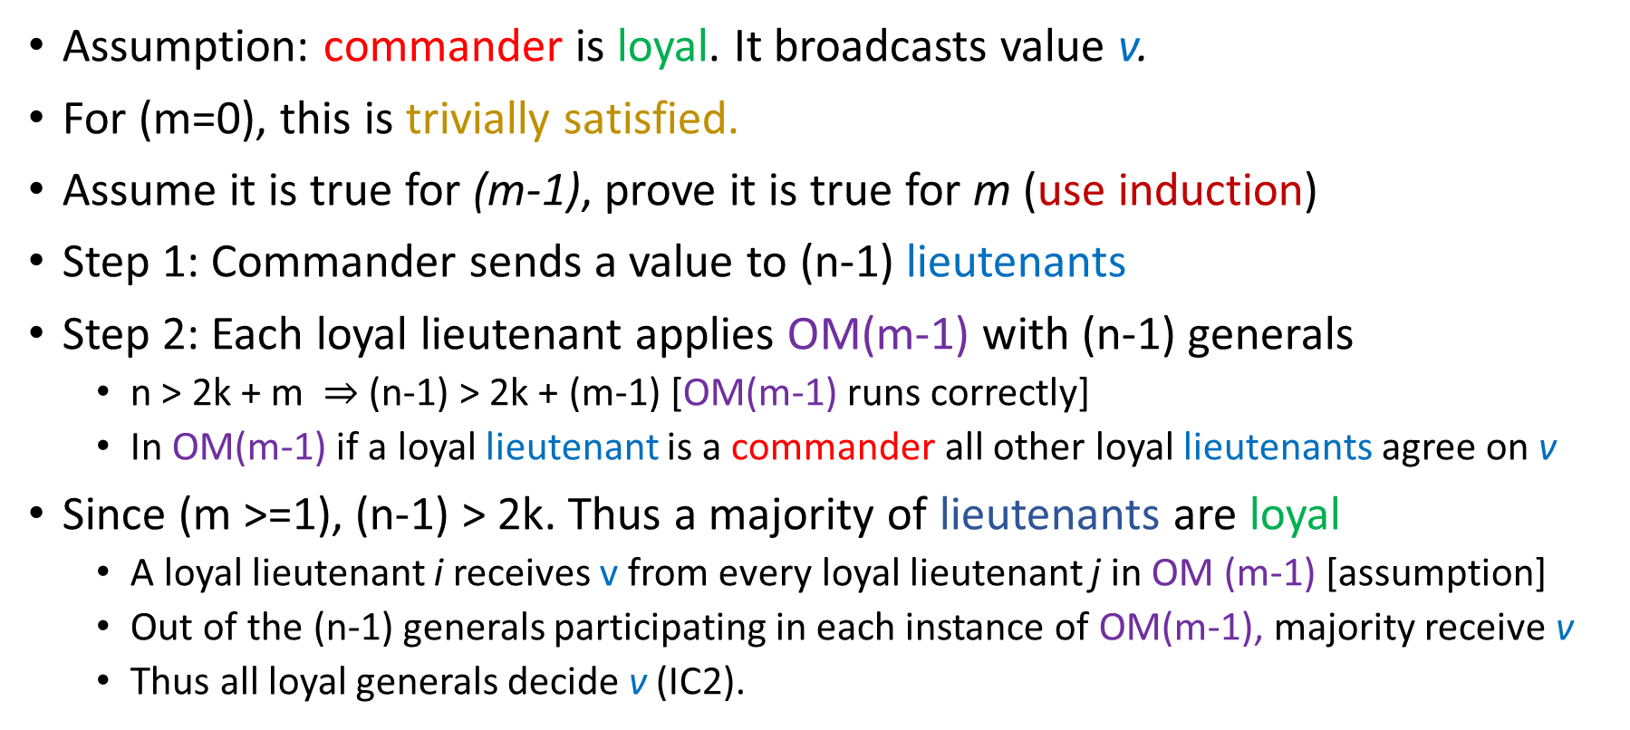
Lemma 1
For any m and k, OM(m) satisfies IC2 if there are more than 2k+m generals and at most k traitors. Let n = #generals. n > 2k + m
Proof
Assumption: commander is loyal. It broadcasts value v.
For (m=0), this is trivially satisfied.
Assume it is true for (m-1), prove it is true for m (use induction)
Step 1: Commander sends a value to (n-1) lieutenants
Step 2: Each loyal lieutenant applies OM(m-1) with (n-1) generals
n > 2k + m $⇒$ (n-1) > 2k + (m-1) [OM(m-1) runs correctly]
In OM(m-1) if a loyal lieutenant is a commander all other loyal lieutenants agree on v
Since (m >=1), (n-1) > 2k. Thus a majority of lieutenants are loyal
A loyal lieutenant i receives v from every loyal lieutenant j in OM (m-1) [assumption]
Out of the (n-1) generals participating in each instance of OM(m-1), majority receive v
Thus all loyal generals decide v (IC2).

Slide 19
Theorem 1
With at most m traitors, and with more than 3m generals, OM(m) satisfies conditions IC1 and IC2.
Proof
If (m= 0), this is trivially true
Assume it is true for OM(m-1), prove for OM(m)
Assume the commander is loyal
Take (k = m), and use Lemma 1 to prove that OM(m) satisfies IC2
It trivially satisfies IC1
Commander is not loyal
At most (m-1) lieutenants are traitors
OM(m-1) runs on more than (3m -1) generals
3m -1 > 3 (m-1). Induction hypothesis can be applied to OM(m-1)
All instances of OM(m-1) thus satisfy both IC1 and IC2

Slide 20
Proof - II
This means that in Step 3, any two loyal lieutenants get the same values for each instance of OM(m-1)
If the vector of values is (v₁, … v_{n-1}), then all loyal lieutenants get the same vector
They compute the same majority value.
We thus have an agreement.
With m traitors, we need at least (3m+1) generals.

Slide 21
Solution with Signed Messages

Slide 22
New assumptions
Let us add the notion of signed messages
This will be useful when we discuss cryptocurrencies
Assumption A4:
A loyal general’s signature cannot be forged. Any alteration can be detected.
Anybody can verify the authenticity of a general’s signature.
If we have m traitors, we can have a solution for any number of generals
Let the commander be General 0.
The notation x:i means the value x is signed by general i
The notation x:i:j means that first i signed the message and then j
Signatures are always appended

Slide 23
Assumptions - II
Let the set V_{i} be the set of properly signed orders received by process i
Initially V_{i} = φ. Assume a maximum of m traitors.
Assume a function: choice(V). V is a set of values.
If V contains a single element, v : choice(V) = v
choice(φ) = <default_value>
choice(V) is fixed for a given V. It does not depend upon the order of elements within V.

Slide 24
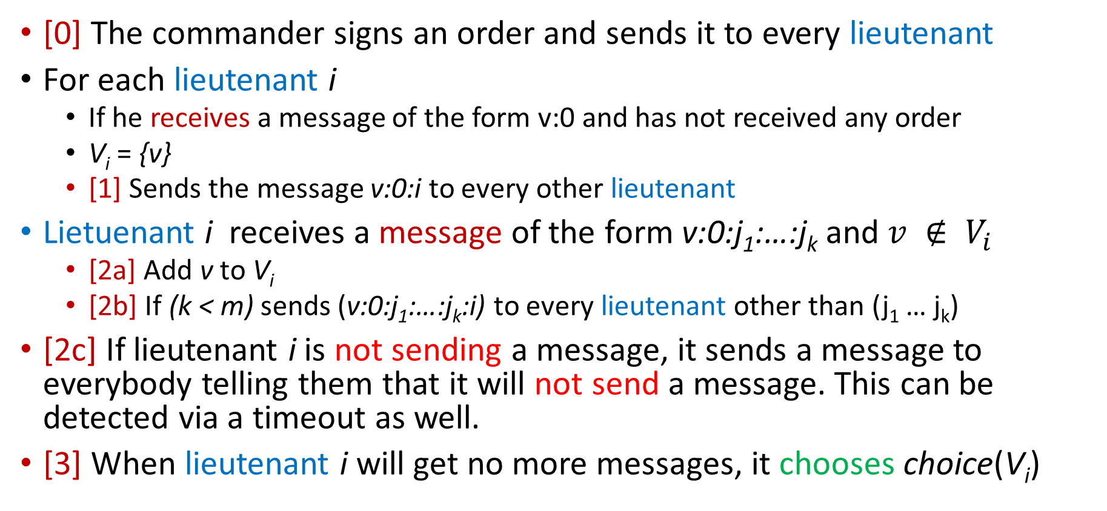
Algorithm
[0] The commander signs an order and sends it to every lieutenant
For each lieutenant i
If he receives a message of the form v:0 and has not received any order
V_{i} = {v}
[1] Sends the message v:0:i to every other lieutenant
Lietuenant i receives a message of the form v:0:j₁:…:j_{k} and $v ∉ V_{i}$
[2a] Add v to V_{i}
[2b] If (k < m) sends (v:0:j₁:…:j_{k}:i) to every lieutenant other than (j₁ … j_{k})
[2c] If lieutenant i is not sending a message, it sends a message to everybody telling them that it will not send a message. This can be detected via a timeout as well.
[3] When lieutenant i will get no more messages, it chooses choice(V_{i})

Slide 25
Clarification
How will a lieutenant know that it will not get any more messages?
In round k every lieutenant gets a message with k signatures.
The lack of a message can be detected.
By the end of round k every loyal lieutenant is sure that it has seen all the messages with k signatures
We will have at most m rounds (needs to be proven)
Thus the algorithm will terminate.

Slide 26
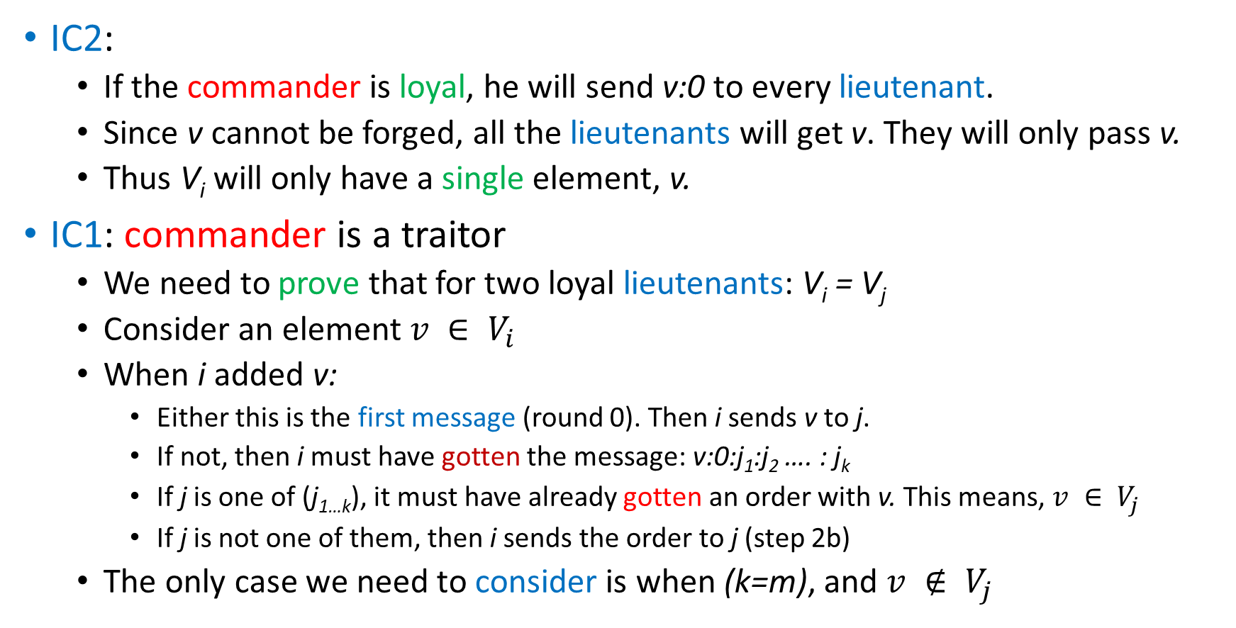
Proof
IC2:
If the commander is loyal, he will send v:0 to every lieutenant.
Since v cannot be forged, all the lieutenants will get v. They will only pass v.
Thus V_{i} will only have a single element, v.
IC1: commander is a traitor
We need to prove that for two loyal lieutenants: V_{i} = V_{j}
Consider an element $v ∈ V_{i}$
When i added v:
Either this is the first message (round 0). Then i sends v to j.
If not, then i must have gotten the message: v:0:j₁:j₂ …. : j_{k}
If j is one of (j_{1…k}), it must have already gotten an order with v. This means, $v ∈ V_{j}$
If j is not one of them, then i sends the order to j (step 2b)
The only case we need to consider is when (k=m), and $v ∉ V_{j}$

Slide 27
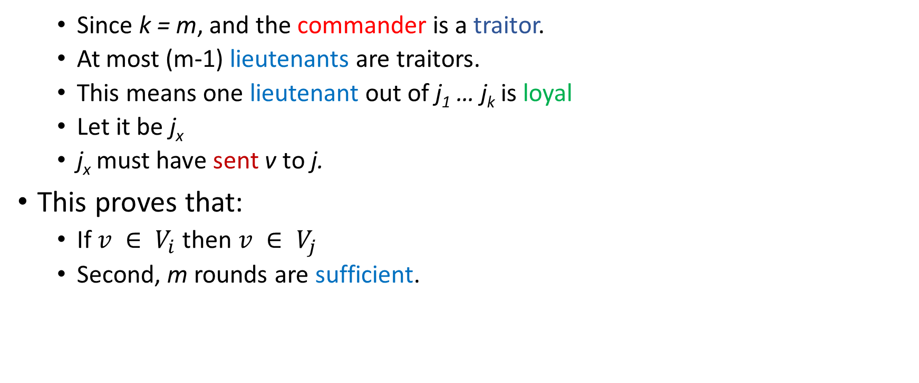
Proof - II
Since k = m, and the commander is a traitor.
At most (m-1) lieutenants are traitors.
This means one lieutenant out of j₁ … j_{k} is loyal
Let it be j_{x}
j_{x} must have sent v to j.
This proves that:
If $v ∈ V_{i}$then $v ∈ V_{j}$
Second, m rounds are sufficient.

Slide 28
References
Lamport, Leslie, Robert Shostak, and Marshall Pease. "The Byzantine generals problem." Concurrency: the Works of Leslie Lamport. 2019. 203-226.

Slide 29
Thank you

