Slide 1
Bitcoin and Blockchains
Prof. Smruti R. Sarangi
Computer Science and Engineering
IIT Delhi

Slide 2
Hashcash

Slide 3
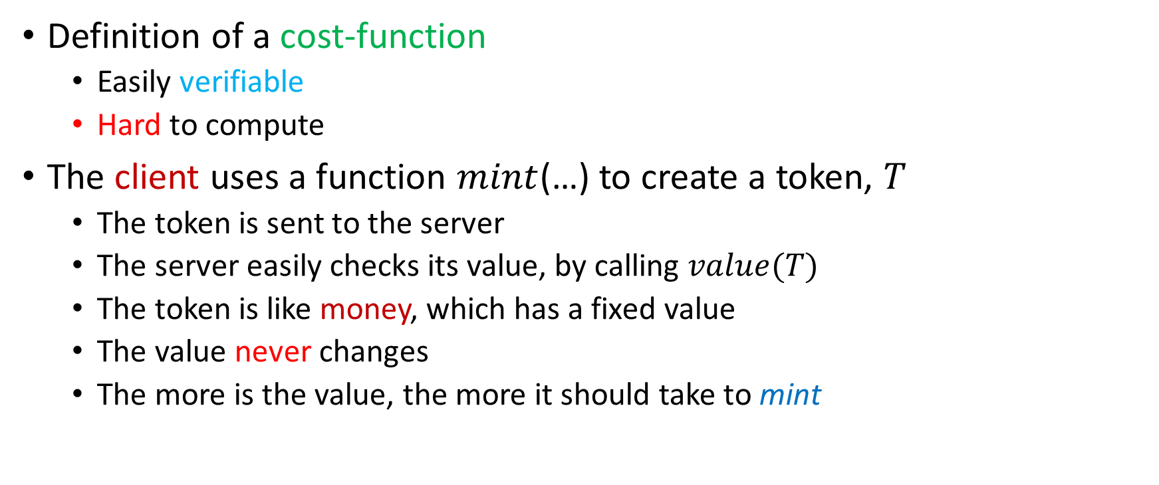
Cost-functions
Definition of a cost-function
Easily verifiable
Hard to compute
The client uses a function $mint$(…) to create a token, $T$
The token is sent to the server
The server easily checks its value, by calling $value(T)$
The token is like money, which has a fixed value
The value never changes
The more is the value, the more it should take to mint

Slide 4
Properties of a Good Cost-function
Publicly auditable
Anybody can verify its value rather easily
A fixed cost-function takes a fixed amount of time to compute
A probabilistic cost-function
Takes a varying amount of time to compute.
The time can either be bounded or unbounded
The function should be trapdoor-free
Server derives no advantage by minting tokens

Slide 5
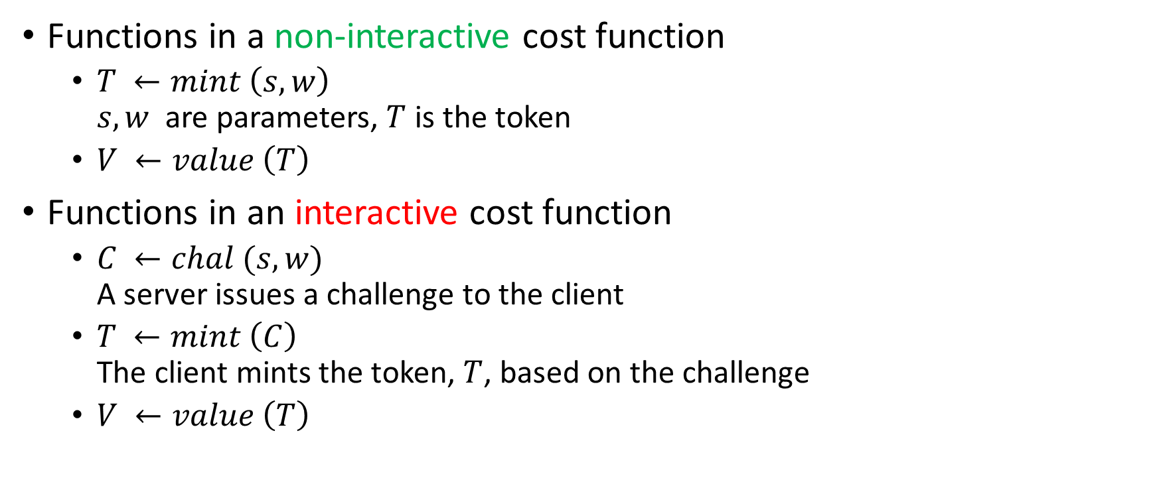
Interactive and Non-interactive Cost Functions
Functions in a non-interactive cost function
$T ←mint \left(s,w\right)$ $s,w$ are parameters, $T$ is the token
$V ←value \left(T\right)$
Functions in an interactive cost function
$C ←chal (s,w)$ A server issues a challenge to the client
$T ←mint \left(C\right)$ The client mints the token, $T$, based on the challenge
$V ←value \left(T\right)$

Slide 6
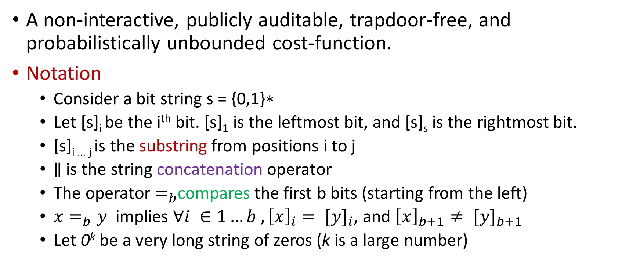
Hashcash
A non-interactive, publicly auditable, trapdoor-free, and probabilistically unbounded cost-function.
Notation
Consider a bit string $\text{s}\text{ = \{0,1\}∗}$
Let [s]_{i} be the i^{th} bit. [s]₁ is the leftmost bit, and [s]_{s} is the rightmost bit.
[s]_{i … j} is the substring from positions i to j
$∥$ is the string concatenation operator
The operator $=_{b}$compares the first b bits (starting from the left)
${x=}_{b}y$ implies $∀i ∈1…b , {\left[x\right]}_{i}= {[y]}_{i}$, and ${\left[x\right]}_{b+1}≠ {[y]}_{b+1}$
Let 0^{k} be a very long string of zeros (k is a large number)

Slide 7
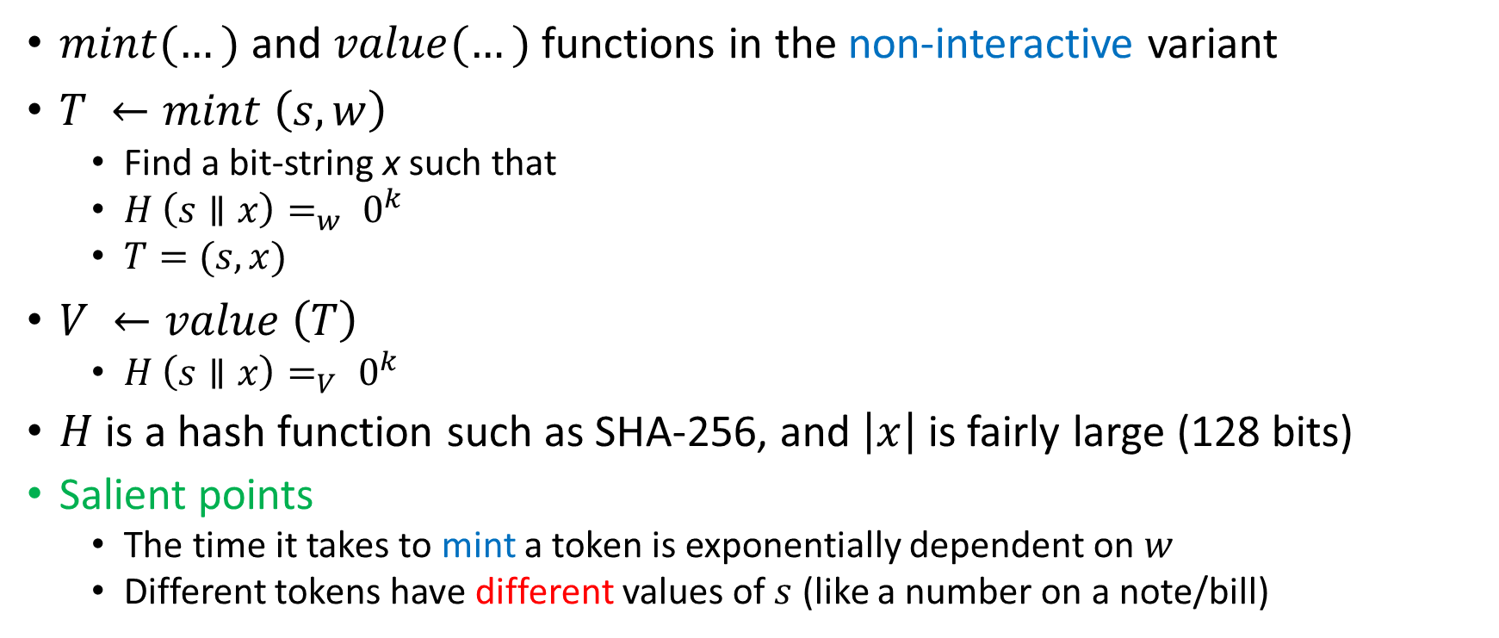
Hashcash-II
$mint(…)$and $value(…)$ functions in the non-interactive variant
$T ←mint \left(s,w\right)$
Find a bit-string x such that
$H \left(s∥x\right)=_{w} 0^{k}$
$T=(s,x)$
$V ←value \left(T\right)$
$H \left(s∥x\right)=_{V} 0^{k}$
$H$ is a hash function such as SHA-256, and $\left|x\right|$is fairly large (128 bits)
Salient points
The time it takes to mint a token is exponentially dependent on $w$
Different tokens have different values of $s$ (like a number on a note/bill)

Slide 8
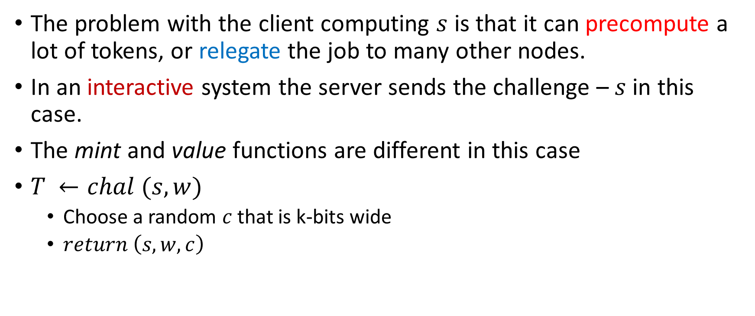
Interactive Hashcash
The problem with the client computing $s$ is that it can precompute a lot of tokens, or relegate the job to many other nodes.
In an interactive system the server sends the challenge – $s$ in this case.
The mint and value functions are different in this case
$T ←chal (s,w)$
Choose a random $c$that is k-bits wide
$return \left(s,w,c\right)$

Slide 9
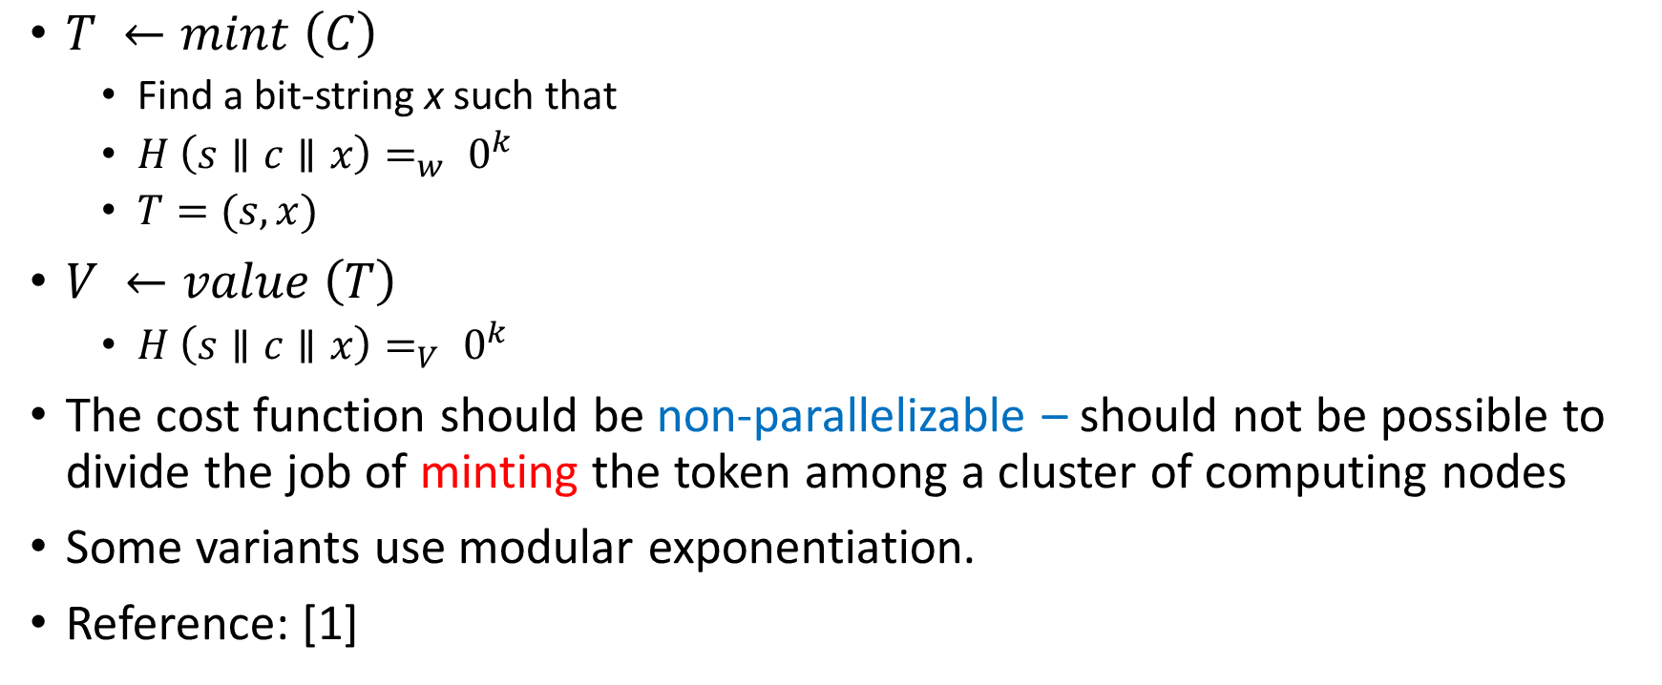
Interactive Hashcash-II
$T ←mint \left(C\right)$
Find a bit-string x such that
$H \left(s∥c∥x\right)=_{w} 0^{k}$
$T=(s,x)$
$V ←value \left(T\right)$
$H \left(s∥c∥x\right)=_{V} 0^{k}$
The cost function should be non-parallelizable – should not be possible to divide the job of minting the token among a cluster of computing nodes
Some variants use modular exponentiation.
Reference: [1]

Slide 10
Bitcoin and Blockchains

Slide 11


Bitcoin – Key Ideas
Can we create a digital currency?
We can then mint money and transfer it between parties to buy services. Let us call them Bitcoins.
The main issue is the double-spending problem. Digital currency can be stolen like regular currency, and that too very easily.
We need a trusted third party that records each transaction. This is slow and not scalable.
Bitcoin solves this problem.
Before moving on, study public key encryption, and digital signatures.

Slide 12
A chain of hashes
Tx → Transaction
Transaction
P1 → P2
Transaction
P2 → P3
Transaction
P3 → P4
P2’s public key
+ Tx Details
P3’s public key
+ Tx details
P4’s public key
+ Tx details
Previous
Transaction
Hash
Hash
Hash
Signed with P1’s private key
Signed with P2’s private key
Signed with P3’s private key

Slide 13
Chain of Transactions
We create a transaction (P1 → P2) with the following elements
Hash of the previous transaction.
Public key of P2 → This establishes the identity of the next element on the chain.
Note that processes in bitcoin are anonymous. They are only known by their public key.
Details of the transaction: amount of money, time, etc.
We compute a hash of these elements.
This hash is signed with P1’s digital signature (private key) and stored within the transaction.
This means that at a later point in time, P1 cannot say that it hasn’t created this transaction (non-repudiation)
Other processes can also verify that the transaction is correct and P1 has signed it.

Slide 14
Idea of a Distributed Ledger
A ledger is a list of transactions → organized as a linked list.
We simply maintain a list of transactions where we record each and every transaction.
The only requirement is that all the nodes agree on the ledger. It does not have multiple versions.
The ledger can at any point give us the instantaneous state of the system. Every node has a copy of the ledger.
In Bitcoin we use cryptographic mechanisms to establish consensus regarding adding new items to the shared ledger.

Slide 15


Double-spending Problem
Let us say that using this mechanism Alice transfers some money to Bob
At a later point in time Alice, might fork the chain and create another chain of transactions where she diverts the money to a proxy account of her cousin Carlos.
Alice → Bob
This is what happened
to Bob
Alice → Carlos
Carlos is Alice’s cousin.

Slide 16
Notion of a Blockchain
It is unwieldy to deal at the level of transactions.
The overheads are prohibitive.
We thus group transactions into blocks.
Transactions can be linked together linearly within a block as we have just seen.
More efficient ways exist.
We then create a chain of blocks, known as a blockchain. The first block is known as the genesis block.
We will still have the same double-spending problem with blocks. Can be solved. [we will see later]
In this case we are using it to record Bitcoin transactions. It can be used to record anything that is normally recorded in a ledger or log book.

Slide 17
Architecture of the Blockchain
Block
Block
Prev. hash
Nonce
Prev. hash
Nonce
Tx
Tx
Tx
Tx
Tx
Tx
Tx
Tx
Trivial idea:
Just group transactions into blocks and chain the blocks. Block i has a hash of block (i-1) to establish the chain.
We need to make it hard to generate a block. This will somehow reduce (?) the probability of mounting a double-spending attack.
Use proof-of-work (remember Hashcash)

Slide 18
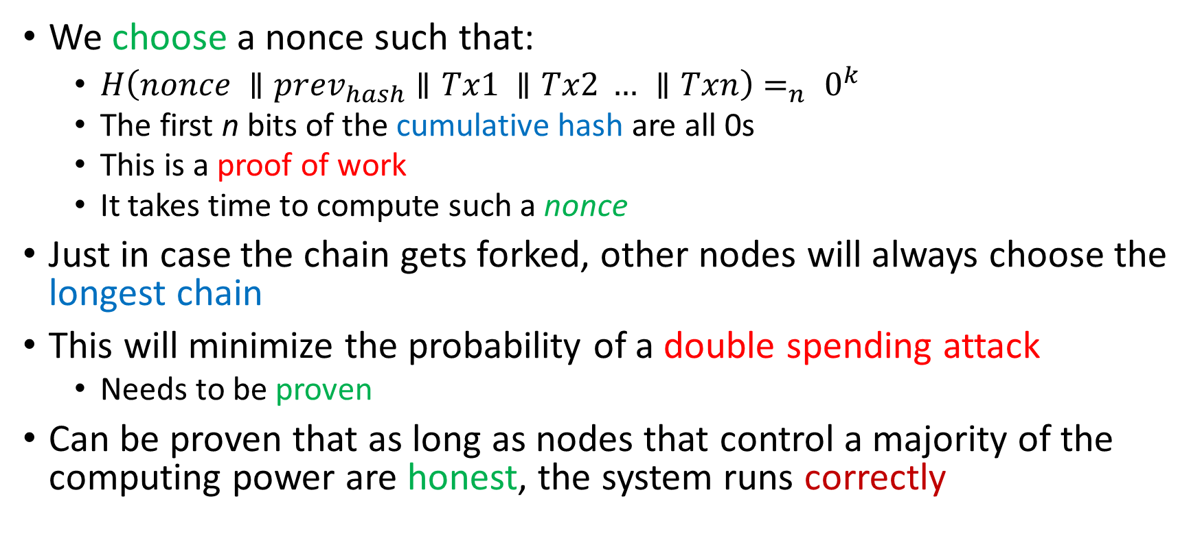
Proof-of-work (PoW)
We choose a nonce such that:
$H\left(nonce ∥prev_{hash}∥Tx1 ∥Tx2 … ∥Txn\right)=_{n} 0^{k}$
The first n bits of the cumulative hash are all 0s
This is a proof of work
It takes time to compute such a nonce
Just in case the chain gets forked, other nodes will always choose the longest chain
This will minimize the probability of a double spending attack
Needs to be proven
Can be proven that as long as nodes that control a majority of the computing power are honest, the system runs correctly

Slide 19
Blockchain Protocol
New transactions are broadcast to all the nodes
Each node collects transactions sent to it.
It checks each transaction, and validates the cryptographic keys.
If the transaction is illegal (for some reason), drops it.
It groups a set of transactions into blocks (Bitcoin does it once every 10 minutes). Computes a proof-of-work (PoW)
Then it broadcasts the block (along with the PoW) to all the nodes
Nodes accept the block only if it contains valid transactions and they can verify the PoW.
This is where we need to solve a consensus problem:
Nodes need to agree to add only one block to the blockchain.
In the basic Bitcoin protocol, a node chooses the first block sent to it, and saves other versions of the block, in case it needs to choose a different chain.

Slide 20
The Consensus Problem
It is possible that different nodes compute different proofs-of-work for the same block.
It is further possible that different nodes group different transactions into the next block.
Hence, blocks with different versions will be broadcasted in the network.
Each of the other nodes save all the versions and choose one of them (first one that they get), and grow the chain.
Some localized chain-forking will be seen.
Since each node ultimately chooses the longest chain, such forks will die out over time.
Note that here consensus is done by purely cryptographic means
Known as Nakamoto consensus
This is an unpermissioned blockchain → Nodes do not know/trust each other.

Slide 21
Increasing the Space Efficiency of a Blockchain

Slide 22

Incentives
What is the incentive for third-party nodes to verify transactions, and create blocks
Every creator of a block gets to embed a special transaction at the beginning, paying herself a fixed number of coins.
This is known as Bitcoin mining
Bitcoin miners get paid (Bitcoin money at first, which can be exchanged for real money in a Bitcoin exchange)!

Slide 23
Saving Space
Is it necessary to store all past transactions?
We can change the format of a block to enable compression later.
Block
Store the blocks as a Merkle tree
The parent contains the hash of its children
It is easy to compress this later on.
Just get rid of transactions (leaves). The internal nodes anyway contain the hashes.
Prev. hash
Nonce
Root hash
H
H
Tx
Tx
Tx
Tx

Slide 24
Combining and Splitting Value
To reduce the number of transactions, we typically combine them.
We can create a complex multi-input multi-output transaction.
Alice’s Transaction
Money transfer to Bob
Previous Txs
that credited
money to Alice
(identified by their hash)
Transfer to Alice
[Keeping the change]

Slide 25
Nakamoto Consensus

Slide 26
Analysis of Nakamoto Consensus
Alice → Bob
Alice → Carlos
Consider the altered sequence of events.
Alice waits to add z more blocks before attempting to make an illegal transaction to Carlos.
Other nodes have no idea about Alice’s intent: Bob or Carlos
They simply need to use the longer chain.

Slide 27

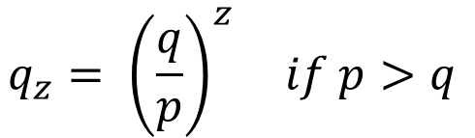
Probability that a Dishonest Chain will Catch up with an Honest Chain?
Attacker is starting at a position that is z blocks behind
p ← probability an honest node adds the next block
q ← probability an attacker adds the next block
q_{z} ← probability that an attacker’s chain will catch up, if it starts z blocks behind
Using results from the classic Gambler’s Ruin problem
$$q_{z}=1 if p ≤q$$
$$q_{z}= {\left(\frac{q}{p}\right)}^{z} if p>q$$

Slide 28
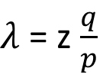
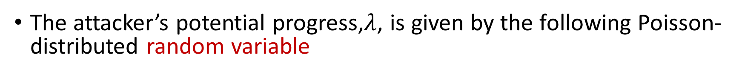
Analysis - II
The attacker’s potential progress,$λ$, is given by the following Poisson-distributed random variable
$λ$ = z $\frac{q}{p}$
We can sum up the cumulative probability to find the attacker’s probability of success, P (See reference [2])

Slide 29
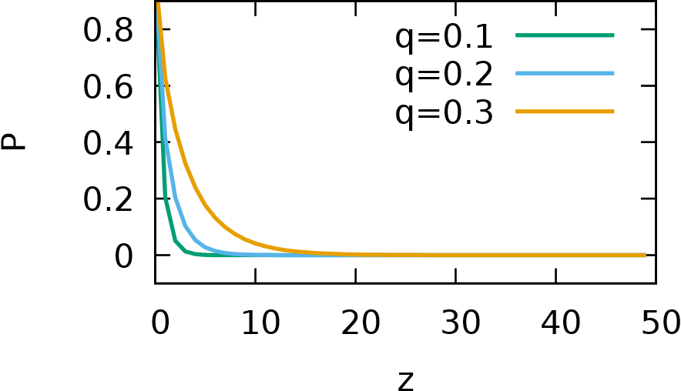
Probability of the attacker’s success (P) versus z
Very low
In Bitcoin, we generate blocks every 10 minutes. We can be sure of a transaction (probabilistically) after 10*z minutes. Typically, z = 6 (total: 1 hour)

Slide 30
Hyperledger

Slide 31
Hyperledger Framework
Collaborative effort to provide a usable blockchain platform.
Has several simplifying assumptions
It is a permissioned blockchain
Nodes join the blockchain after getting prior permission
It does not use a proof-of-work based consensus
It uses a regular consensus protocol such as RAFT for the consensus operation
Smart contract
The transaction is an example of a smart contract
Most blockchain frameworks allow users to code such smart contracts that the blockchain can technically enforce.

Slide 32
References
Back, Adam. "Hashcash-a denial of service counter-measure." (2002).
Nakamoto, Satoshi. "A peer-to-peer electronic cash system." Bitcoin.–URL: https://bitcoin. org/bitcoin. pdf (2008).
Cachin, Christian. "Architecture of the hyperledger blockchain fabric." Workshop on distributed cryptocurrencies and consensus ledgers. Vol. 310. 2016.
Valenta, Martin, and Philipp Sandner. "Comparison of ethereum, hyperledger fabric and corda.[ebook] Frankfurt School." Blockchain Center (2017).
Narayanan, Arvind, et al. "Bitcoin and cryptocurrency technologies." (2015)

Slide 33
Thank you

