Slide 1
The CAP Theorem
Prof. Smruti R. Sarangi
IIT Delhi

Slide 2
Basic Idea of the CAP Theorem
At the PODC conference in 2000, Eric Brewer made the following conjecture
We cannot design a protocol (web service) that simultaneously guarantees
Consistency
Availability
Partition Tolerance

Slide 3

How do we understand them?
Background
Basic ACID semantics of databases
Atomicity → Operations either fully complete (commit) or fail in entirety
Consistency → The result of any execution is consistent. There are different definitions for the word ``consistent’’. Need to discuss …
Isolated → Uncommitted transactions are isolated from each other (cannot see each others updates)
Durable → Once committed, a transaction’s changes are permanent
Distributed system services need a different model

Slide 4
Let us discuss consistency
The dictionary meaning is that the execution’s outcomes should satisfy some intuitive notion of correctness
Atomicity
All operations appear to take place instantaneously.
No intermediate state is ever visible.
Example
Terminology | Meaning
Wx1 | Set x = 1
Rx1 | Read x = 1
P1, P2 | Processes P1 and P2
x,y | Global variables (initialized to 0)
P1
P2
Wx1
Wy1
Ry1
Rx1

Slide 5

Why does this example have atomic writes?
P1
P2
Wx1
Wy1
Ry1
Rx1
We can lay the operations out in a sequence
Wx1
Wy1
Ry1
Rx1
This sequence is legal → Every read fetches the value of the latest write
This is a sequence with atomic events (operations) that is also legal
What else ???

Slide 6

Sequential Consistency (SC)
P1
P2
Equivalent global order
Wx1
Wy1
Wx1
Wy1
Ry1
Rx1
Ry1
Rx1
Note the order of operations within each thread
They have the same relative order in the equivalent global order
Sequential consistency
We can reduce a parallel multi-process execution to a sequential execution, where each operation is atomic, the sequence is legal, and the intra-thread
(program) order is respected. The operations are basically interleaved to get the equivalent global order.

Slide 7
Can we have a non-atomic execution?
P1
P2
P3
Wx1
Rx1
Ry1
Wy1
Rx0
If the program order is respected, we expect P3 to read (x=1)
However, it reads (x=0)
This means that the write to x (Wx1) is not atomic
An intermediate state is visible

Slide 8

What is the problem with sequential consistency (SC)?
P1
P2
Equivalent global order
1. Wx1
3. Wy1
Wx1
Wy1
Ry1
Rx1
2. Ry1
4. Rx1
We only talk about relative orders.
What if the real time order is like this: (1) → (2) → (3) → (4)
We should have seen the following outcome
P1
P2
1. Wx1
3. Wy1
2. Ry0
4. Rx1

Slide 9
SC vs Linearizability
SC is fine as a theoretical model (preserves relative orders, read-write relationships, and atomicity)
However, can we ignore real-time constraints?
operation
Additional constraints in Linearizability
start
end
Every operation takes effect instantaneously at some point of time between its start and finish.
If operation B starts after operation A ends, then in the equivalent global sequential order, B appears after A
No such requirement in SC

Slide 10
Other Types of Consistency
Causal consistency
Causally related writes (ordered by read-write and program order relationships) have to be seen in the same order by all processes
Writes without causal relationships can be seen in any order
Continuous consistency
We maintain different replicas of variable x
The replicas are loosely synchronized
While reading a replica, we may get an inaccurate value (stale value)
The error is bounded

Slide 11


Client-Centric Models
Data center containing
many servers
Monotonic reads
If a certain value for a variable was read, subsequent reads by the same process (possibly connected to a different server) yield the same (or a more recent result).
Otherwise, we may find new emails while connecting to one server, and later when we connect to another server, we may find the mails missing
Monotonic writes
Write operations by the same process happen in order.
Otherwise, the user’s tweets will be read in a different order (2/2 first and 1/2 later)

Slide 12
Client-Centric Models – II
Read your Writes
If a write operation is done on a process on item x, any subsequent read operation by the same process will see the same write (or something newer)
Otherwise, a process will not be able to see its own updates
Writes follow Reads
A write operation that overwrites a variable will overwrite (fully or partially) the version that was read.
See reactions to tweets, only after the original tweet has been read

Slide 13

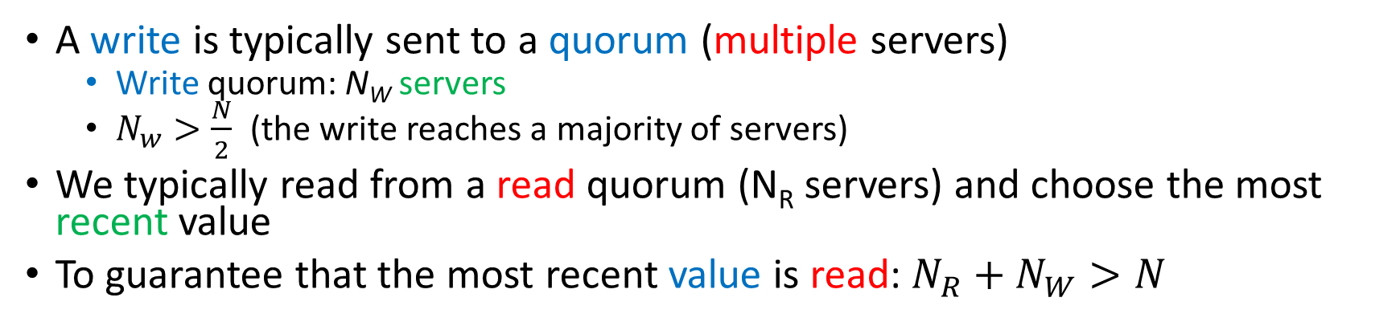
Read and Write Quorums
A write is typically sent to a quorum (multiple servers)
Write quorum: N_{W} servers
$N_{w}>\frac{N}{2}$ (the write reaches a majority of servers)
We typically read from a read quorum (N_{R} servers) and choose the most recent value
To guarantee that the most recent value is read: $N_{R}+N_{W}>N$

Slide 14

What is the final word on consistency, then?
Sequential consistency or other similar variants
Atomicity

Slide 15
Availability and Partition Tolerance
Availability → Every request received by a correct node must result in a response. Requests must terminate.
Partition tolerance → A partition means that all messages sent from one partition to nodes in the other partition are lost.

Slide 16
Asynchronous Network Model
Theorem
We cannot guarantee both availability and atomic consistency for a read/write object in an asynchronous setting where messages can be lost.
Proof
Assume the network is divided into disjoint non-empty sets: G₁ and G₂
All messages between G₁ and G₂ are lost
If a write occurs in G₁ and later there is a read in G₂, a stale value will be returned (atomicity violation ×)
Note, a node in G₂ is bound to return a value by the availability requirement.

Slide 17
Asynchronous Network Model
Corrollary
We cannot guarantee both availability and atomic consistency for a read/write object in an asynchronous setting where no messages are lost.
Proof
Same argument as FLP: A node does not know if a message is lost or the sender is just slow.
Another argument: Assume the earlier case where messages can be lost. Don’t lose them, just keep them in cold storage. At some point, we will see a non-atomic execution (will happen for some example). At that point, release all the messages in the cold storage. Now, no messages are lost, yet the execution is non-atomic.

Slide 18
Guarantee two out of three
Atomic and partition tolerant
Don’t return responses of partitions that are unreachable from a central node
The central node maintains up-to-date state
Atomic and available
A centralized node for a single partition solves the problem
Since we are not partition tolerant, unreachable partitions can be ignored
Available and partition tolerant
Provide stale values

Slide 19

Partially Synchronous Model
Clocks are loosely synchronized (bounded clock skew)
All network messages are either delivered within t_{msg} time units or are lost
Theorem
We still cannot guarantee availability, atomicity and partition tolerance.
Proof
Same approach as before: divide the network into two disjoint partitions -- G₁ and G₂
A read happens in one component after a write happens in the other
Atomicity is still violated: there is no way for a write to go from G₁ → G₂

Slide 20
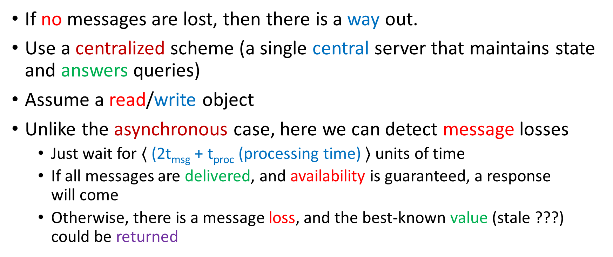
Partially Synchronous Model (no messages lost)
If no messages are lost, then there is a way out.
Use a centralized scheme (a single central server that maintains state and answers queries)
Assume a read/write object
Unlike the asynchronous case, here we can detect message losses
Just wait for $⟨$ (2t_{msg} + t_{proc} (processing time) $⟩$ units of time
If all messages are delivered, and availability is guaranteed, a response will come
Otherwise, there is a message loss, and the best-known value (stale ???) could be returned

Slide 21
Conclusions and Extensions
The CAP theorem limits what can be done in a distributed system.
It has been extended in 2010
PACELC Theorem
If the network is partitioned (P), a tradeoff exists between availability (A) and consistency (C)
Else (E)
Without partitions, we need to choose between latency (L) and consistency (C)

Slide 22
References
Gilbert, Seth, and Nancy Lynch. "Brewer's conjecture and the feasibility of consistent, available, partition-tolerant web services." Acm Sigact News 33.2 (2002): 51-59.
Golab, Wojciech. "Proving PACELC" ACM SIGACT News 49.1 (2018): 73-81.

