Slide 1
The Raft Consensus Protocol
Prof. Smruti R. Sarangi
Computer Science and Engineering
IIT Delhi

Slide 2

Motivation
Paxos is too complex
Paxos is optimized for agreeing upon a single value
If we want to agree upon a list of values (in the same order) such as a log
It becomes even more complicated
Practical implementations are unwieldy
Main advantages of Raft
Understandability
Naturally tailored towards a list of values.
Easy to implement

Slide 3
Overview

Slide 4
Key Idea
Replicated state machine model
Each server maintains a state machine
Clients send requests to the servers
All the servers need to apply the requests to their state machines in the same order (consensus order)
This means that all the servers need to agree on the sequence of events (requests)
Elect a leader
It accepts requests from clients.
Replicates them at the servers.
Informs the servers when they can process the message (in consensus order)
Divides time into terms: Each term has a unique leader and an increasing sequence number.

Slide 5
Safety Properties
Election Safety
At most one leader can be elected at a given point in time (term).
Leader Append-Only
It never overwrites or deletes entry in the log.
Only appends new entries.
Log Matching
If two logs contain the same entry at a given index and term.
Logs are identical till that index.
Leader Completeness
If an entry is committed in a given term, it will be present in the logs of leaders of successive terms.
State Machine Safety
If a server has applied a log entry to a state machine, then all servers will apply the same entry at the same log index.

Slide 6
A Raft Cluster
Times out
new election
Receives votes from a
majority of servers
Times out, starts election
Starts up
Follower
Candidate
Leader
Discovers the leader
or a new term
Discovers server
with higher term
A Raft cluster typically contains 5 servers
A server has three states
Leader, follower, and candidate
Followers become candidates. Any candidate receiving a majority vote becomes a leader.
If the leader finds another leader or a server with a higher term id, it becomes a follower again.

Slide 7
Dividing Time into Terms
Term 1
Term 2
Term 3
Term 4
Leader
election
Normal
operation
Failed leader
election
Each server stores a current term number
The term number is attached to every message
If a server with a lower term number sends a message to a server with a higher term number, the latter rejects the message
In the reverse case, the server with the lower term number upgrades its term num.
If a candidate or leader discover that their term is stale, they move to the follower state.

Slide 8
Details

Slide 9
Leader Election
All servers start in the follower state
They periodically get messages from the leader
Heartbeat messages
If a server does not get a heartbeat for a pre-specified duration
It times out
Begins the process of electing a new leader
Beginning an election
Increments its current term
Transitions to the candidate state
Votes for itself. Sends a <RequestVote> message to rest of the servers.
Three possible outcomes.

Slide 10
Three possible scenarios
Wins the election
Each server votes for only one candidate in a given term.
Receives an <AppendEntries> message from a server
If the term is greater than or equal to the current term. Recognize the other server as the leader. Transition to the follower state.
No leader is elected. Split votes.
Each candidate times out and starts a new election.
The leader needs to get a vote from the majority of servers.
It begins its term, and sends heartbeat messages to the rest of the servers.
Otherwise, ignore the message.
The timeout period is randomized.
This minimizes the chances of having split votes.

Slide 11
Log Replication
After a leader has been elected
Clients send it requests.
It sends <AppendEntries> messages to all the servers
Structure of a log
A list of entries
Each entry stores a term number, and a command
Each entry has an index (integer) to indicate its position in the log
Committing an entry
A log entry is committed once the leader has replicated it on a majority of servers.
This commits all preceding entries as well.
The leader includes the highest committed index in all its messages
Once followers see the message, they commit their corresponding entries one after the other (in the order in which they are stored in the log)

Slide 12

Log Matching Property - I
Key safety properties (Log matching property)
S1: If two entries in different logs have the same index and term, they store the same command.
S2: If two separate logs have the same index and term, all the preceding entries of the logs are identical
Log index
1
2
3
4
5
6
7
Matched logs
1
x ← 1
1
y ← 3
2
z ← 1
2
x ← 3
3
y ← 5
3
x ← 2
3
z ← 3
Leader
1
x ← 1
1
y ← 3
2
z ← 1
2
x ← 3
3
y ← 5
Follower
1
x ← 1
1
y ← 3
2
z ← 1
2
x ← 3
2
z ← 3
Unmatched log

Slide 13
Log Matching Property - II
Ensuring property S1 (same <index,term> → same command)
The leader creates at most one entry at a given index in a term
This is sent to all the followers
Property S2: (same <index,term> → All previous entries match)
Along with an <AppendEntries> message, the leader sends the <index,term> of the previous entry in its log.
If the follower does not find the previous entry with a matching <index,term>, it refuses to accept the message
Ensures the Log Matching property by induction
It is possible that because of crashes, the follower’s logs will diverge
Raft forces followers to replicate the leader’s logs.

Slide 14
Reconciling the Log Entries
nextIndex = 8
Log index
1
2
3
4
5
6
7
1
x ← 1
1
y ← 3
2
z ← 1
2
x ← 3
3
y ← 5
3
x ← 2
3
z ← 3
The leader maintains a nextIndex pointer for each follower
It is initialized to be equal to the index of the last entry in its log + 1 [Assuming the logs are consistent]
Followers might indicate a divergence after receiving a message from the leader. The entries at (nextIndex – 1) do not match.
The leader decrements the nextIndex pointer and tries again
Ultimately the logs match. The follower appends all the remaining entries from the leader’s log.
The leader never overwrites or deletes entries in its own log. It only appends.

Slide 15
Safety Properties

Slide 16
Leader Completeness Property
Leaders will keep changing because of process crashes
However, the new leader should have all the log entries of the old leader
Election restriction
A candidate cannot win an election unless its log contains all committed entries
The <RequestVote> message includes information about the candidate’s log
The candidate’s log should at least be as up to date as the log of the voter.
Up to date check
Check the last entries. The log with the higher term is more up to date.
If the terms are the same, the log with more entries is more up to date.

Slide 17

Committing Entries from Previous Terms
Assume a leader crashes
Let’s say it crashes before committing an entry, e, that is stored in a majority of servers.
A new leader will be elected
This leader’s log has to be at least as up to date as a majority of the servers
Let us say it has e in its log
In the normal course of operation it will send e to the rest of the servers that do not have it.
What about an entry from a previous term that is uncommitted?
Should the current leader overwrite it, or commit it?
Prefer simplicity: Do not commit entries from previous terms.

Slide 18
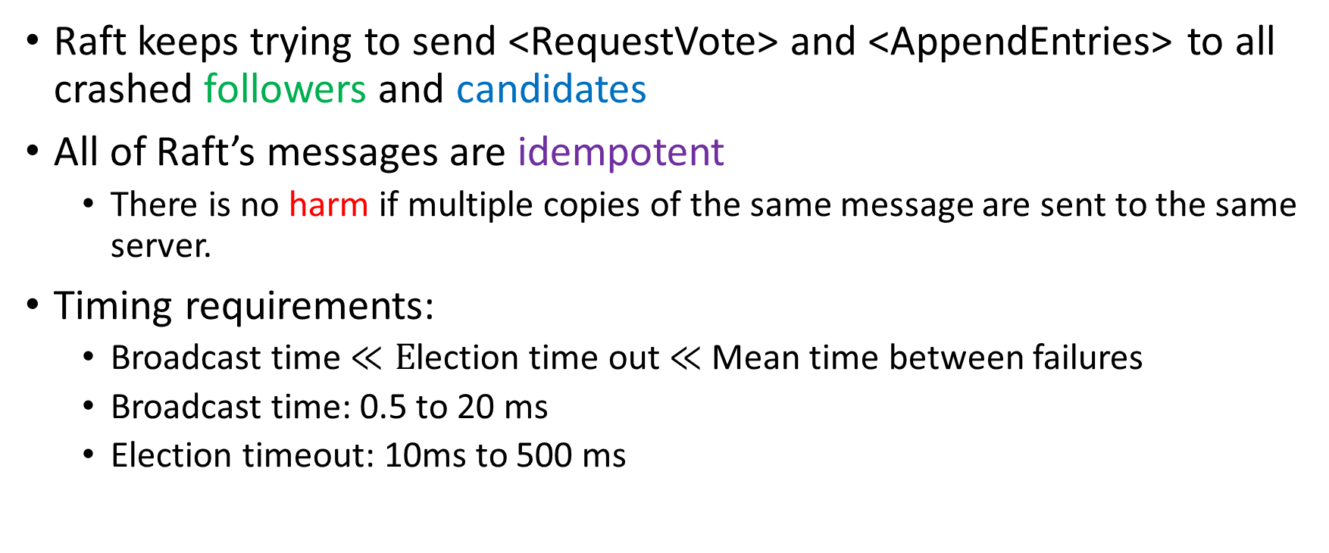
Follower and Candidate Crashes
Raft keeps trying to send <RequestVote> and <AppendEntries> to all crashed followers and candidates
All of Raft’s messages are idempotent
There is no harm if multiple copies of the same message are sent to the same server.
Timing requirements:
Broadcast time $≪E$lection time out $≪$ Mean time between failures
Broadcast time: 0.5 to 20 ms
Election timeout: 10ms to 500 ms

Slide 19
Proof of Safety (Leader Completeness Property)
Say that in term T, leader_{T} commits an entry, e
At a later term U, leader_{U} does not store the entry
Consider the smallest such U. U > T
e must have been absent from U’s logs at the time of its election
There must be some server, S, that accepted e (sent by leader_{T}) and also voted for leader_{U}.
S still had e, when it voted for leader_{U}. This is because all the intervening leaders had e in their logs (assumption, we chose the smallest U).
At the time of voting, leader_{U}’s log must have been up to date
If they had the same last term, then the log of leader_{U} must have been longer. It must have contained e.

Slide 20
Proof of Safety - II
Otherwise, leader_{U}’s last log term must have been larger than the voter’s.
The earlier leader that created leader_{U}’s last log entry must have had e in its log (assumption). By the Log Matching property , leader_{U}’s log must also contain e.
Hence, the Leader Completeness Property holds.

Slide 21
Miscellaneous Issues

Slide 22
Cluster Membership Changes
Servers can get added or deleted from the Raft cluster.
The traditional approach is to stall the system.
Copy the logs to the new configuration.
Restart the system.
Raft does this without any down time.
Leader receives a request to change the configuration: C_{old} → C_{new}
It creates a joint consensus mechanism
Creates a new configuration C_{old,new}. It broadcasts this message to all the servers.
Once the C_{old,new} entry has been committed, all the servers have to respect this joint configuration.

Slide 23
Joint Consensus Mechanism
C_{old}
C_{old,new}
C_{new}
During this period, the servers act in a special way
Log entries are replicated in all the servers.
Any server (from C_{new} or C_{old}) can be elected as a leader
We need separate majorities (election and entry commitment) in both the old and new configurations.
This ensures that the new servers in C_{new} can get all the logs. New servers can also join as non-voting members.
After this the leader sends a message to all the servers describing C_{new}
After this message is committed, a server from C_{new} needs to start an election and win. This will happen because all the logs till this message are committed.

Slide 24
Log Compaction
Logs will keep growing over time.
When a log reaches a fixed size, take a snapshot.
Store a snapshot of the entire follower server in stable storage
Record the index, and term of the latest entry in the last snapshot
Then discard the stored logs from the servers
Servers take snapshots independently by the leader and followers
The leader may send snapshots to followers that are far behind

Slide 25
Client Interaction
Clients first contact a randomly chosen server, that directs them towards the leader
Linearizability consistency condition:
Each request appears to execute in a single instant at some point between its invocation and response
Every command is assigned a unique serial number by the client. Servers keep a record of it. If they see a command once again, they simply respond to it without re-executing the request.
Read-only operations
Can be handled without writing anything to the log
Before executing a read-only operation, the leader needs to ensure that it has at least committed a single message in the current term, and it is still the leader.

Slide 26
References
Ongaro, D., & Ousterhout, J. (2014). In search of an understandable consensus algorithm. In 2014 {USENIX} Annual Technical Conference ({USENIX}{ATC} 14) (pp. 305-319).

Slide 27
Thank you

