Slide 1

Chapter 12:
Reliability

Slide 2

Background Required to Understand this Chapter
OOO Processors
Probability and Statistics
Basic Semiconductor Physics
Chapter 4

Slide 3


Are processors always reliable?
Transient faults
Design faults
Ageing and wear-out

Slide 4

Some Definitions
Fault
A defect in the system (software or hardware).
Error
An incorrect internal state.
Failure
An externally visible event: deviation from ideal execution.

Slide 5
Some Points
A fault simply represents a problem in the system. It may or may not manifest into an error.
An error is an incorrect internal state that may or may not manifest into a failure.
Failures can be of several types:
Erroneous output
Fail-stop failures: the system just stops
Byzantine failures: the processor behaves maliciously and sends confusing signals to other elements

Slide 6

How do we mathematically analyze the reliability of a system?
FIT
FIT (failures in time). 1 FIT = 1 failure/ billion hours
MTTF
Mean time to failure
MTBF
Mean time between failures
MTTR
Mean time to repair

Slide 7

Outline
1.
Soft Errors
2.
Inductive Noise
3.
Faults due to Nondeterminism
4.
Design Faults
5.
Parameter Variation
6.
Hard Errors and Ageing

Slide 8
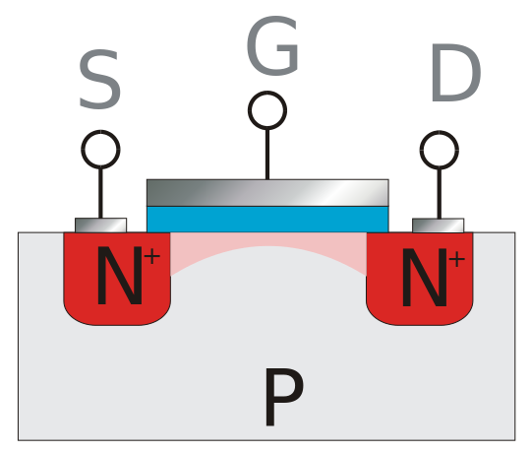
History of Soft Errors
Definition of soft errors
In the 60s and 70s scientists noticed a strange phenomenon.
A lot of electronic devices in the vicinity of nuclear sites started failing
High energy particles (neutrons and alpha particles) were striking transistors and creating spurious current pulses
In the 80s, this became a problem with DRAM memory as well
Alpha particle
(2 protons + 2 neutrons)
or neutron strike

Slide 9
Sources of Radiation
Trace uranium and thorium impurities
4-9 MeV (energy), 100 $μm$(penetration range)
4-9 MeV (energy), 100 𝜇𝑚 (penetration range)
²¹⁰Pb decay
Decays into ²¹⁰Pb → ²⁰⁶Pb
Emits an alpha particle
Decay of ¹⁰B
Part of a dielectric: boron phosposilicate glass (BPSG)
Neutrons

Slide 10
Dynamics of a Particle Strike
Linear Energy Transfer rate (LET) = energy lost per unit distance / the density of the target material
Typical an LET of 20 MeV-cm²/mg is sufficient to generate a current pulse that is large enough to propagate to a latch and change its stored value.
Logic
Latch
current pulse

Slide 11
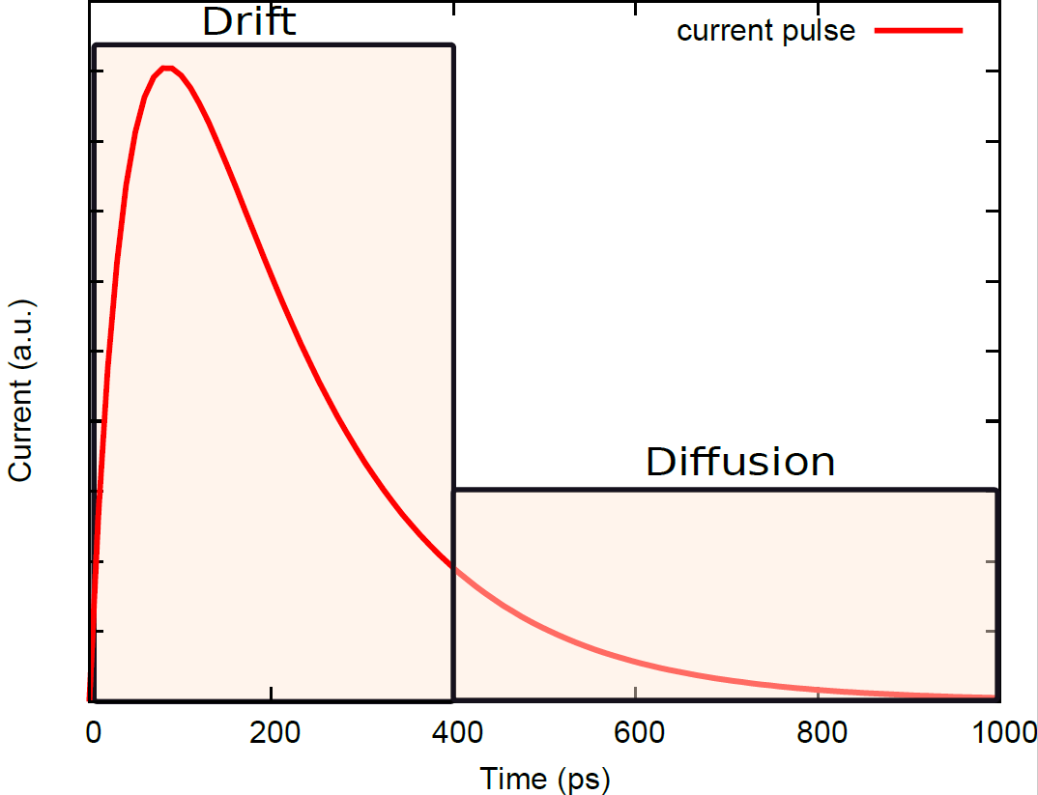
Steps
A particle displaces charge: creates a lot of electron-hole pairs
More effective if the particle hits the depletion region
For tens of picoseconds, charge is vigorously collected
Starts with drift and ends with diffusion
This creates a current pulse
200-600 ps

Slide 12
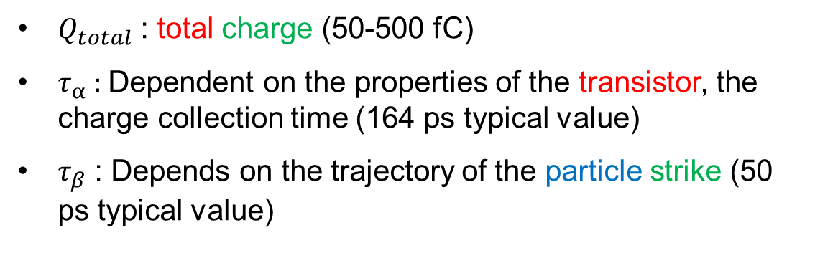
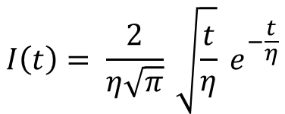
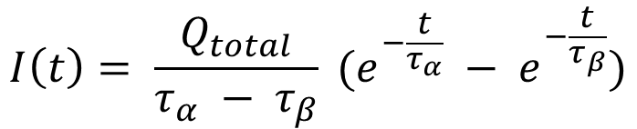
Approximate Equations for the Current Pulse
$$I\left(t\right)= \frac{Q_{total}}{τ_{α} − τ_{β}} (e^{−\frac{t}{τ_{α}}} − e^{−\frac{t}{τ_{β}}})$$
$Q_{total}$ : total charge (50-500 fC)
$τ_{α}$ : Dependent on the properties of the transistor, the charge collection time (164 ps typical value)
$τ_{β}$ : Depends on the trajectory of the particle strike (50 ps typical value)
Hazucha Svensson 1-parameter model
$$I\left(t\right)= \frac{2}{η\sqrt{π}} \sqrt{\frac{t}{η}} e^{−\frac{t}{η}}$$

Slide 13

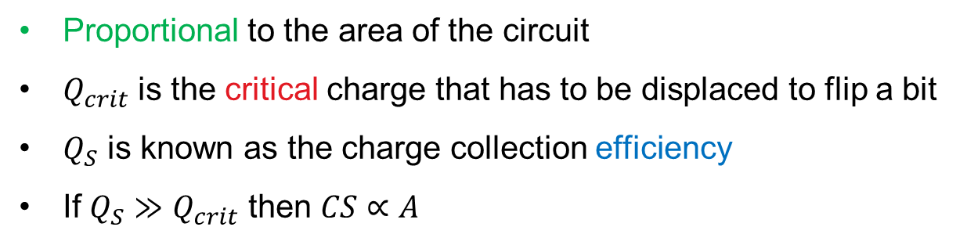

The Full Hazucha-Svensson Model
$$SER=F ×CS$$
SER is the soft error rate
F is the particle flux
CS is the critical section (area susceptible to particle strikes)
$$CS ∝A × e^{−\frac{Q_{crit}}{Q_{S}}}$$
Proportional to the area of the circuit
$Q_{crit}$ is the critical charge that has to be displaced to flip a bit
$Q_{S}$ is known as the charge collection efficiency
If $Q_{S}≫Q_{crit}$ then $CS∝A$

Slide 14
Methods to Mitigate Soft Errors
Device level
Circuit level
Arch. level
Device level
Use sophisticated manufacturing processes that avoid uranium, thorium, ¹⁰B, and ²¹⁰Pb impurities.
Do not use BPSG as a dielectric.
To increase Q_{crit} we can opt for larger transistors, larger supply voltages, and larger output capacitance

Slide 15
Two Methods to Reduce Q_{S}
Triple well process
SoI process
n
n
n
n
p
p
Buried n well
Insulating layer
(a)
(b)
Use a triple well or an SoI (silicon on insulator) process

Slide 16
Circuit-Level Techniques: Masking
Electrical masking
The pulse gets attenuated as it
passes through gates.
Logical masking
The other input, 0, sets the output
to 0. The pulse is ineffectual.
0 → 1
0
0

Slide 17



Circuit-Level Techniques – II
The pulse needs to reach the latch only during the critical window (setup time, hold time)
Otherwise, it does not have any effect
Timing window
masking
Latch
logic
Latch
Critical
window
Hence, the actual bit flip probability reduces quite a bit.
Clock
edge
Add ECC bits to detect and correct soft errors. DRAM already has such bits. We can add them to SRAM and latches (to secure them).
Identify sensitive paths in the circuit that have less masking. Increase the size of transistors on such paths.

Slide 18
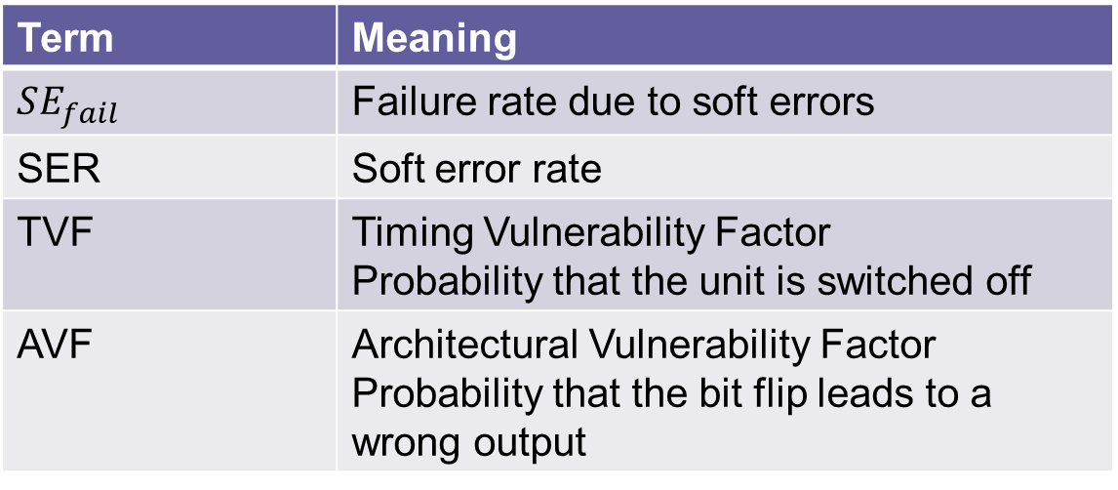

Architectural Techniques
$$SE_{fail}=SER ×TVF ×AVF$$
Term | Meaning
$$SE_{fail}$$ | Failure rate due to soft errors
SER | Soft error rate
TVF | Timing Vulnerability Factor Probability that the unit is switched off
AVF | Architectural Vulnerability Factor Probability that the bit flip leads to a wrong output

Slide 19

Components of the AVF
Bit read?
Yes
No
Is it protected?
No error
Yes
No
Is the error only
detected?
Does the bit
matter?
No, also
corrected
Yes
Yes
No
Detected but
unrecoverable
error (DUE)
No error
Silent data
corruption (SDC)
No error

Slide 20
Discussion of AVF
SDC and DUE errors are of consequence.
DUE errors are quite rare because we typically use error correction code (ECC) bits that detect and correct errors.
Multiple bit flips (at the same time) are very unlikely
SDC errors are way more important. Many structures are not protected keeping in mind time and performance overheads.
AVF
0 for branch predictors
0 for performance counters
Between 0 and 1 for most of the other structures
Use architectural state checkers for SDC and DUE errors

Slide 21
Design Space of Checkers
Complete
The execution of the entire thread is checked
Subset
Checks a subset of instructions
Invariant
Checks if certain properties hold for internal signals and outputs
Symptom
Checks if something went wrong.

Slide 22
Complete Checker: Multi Master Systems
Dual modular redundancy (DMR)
Pipeline 1
Checker
Triple modular redundancy (TMR)
Pipeline n
There are multiple pipelines that run the same code – could be different HW threads, SW threads or cores
The results produced by them are compared (once every cycle or once every epoch)
If the results don’t match: go back to a previous checkpoint or use voting
IBM G5: Two parallel pipelines.
If there is a mismatch, flush the pipeline
HP NonStop server: Only check I/O. Can run loosely synchronized threads across address spaces.

Slide 23

SingleSlave Systems: DIVA Architecture
DIVA core
2-stage pipeline
Pipeline
COMM
Commit
Out-of-order
COMP
core
Queue of
Checker
unverified
L0 cache
Store
RF
instructions
queue
Verifying is easier than computing.
The COMM stage maintains a shadow register file. It checks the register file values and re-reads values from memory.
The COMP stage: A dedicated ALU performs the operations once again (recomputation); the results are tallied.

Slide 24


Optimizations in the DIVA Pipeline
L0 cache: Used to reduce pressure on the L1 cache. It caches the most frequently read/written values.
We need a larger ROB and store queue. Values can be sent to the memory only after the checker verifies them.
Give the checker its dedicated store queue (small buffer for uncommitted values) and register file.
The peak IPC of the DIVA checker is 2. If the IPC of the OOO core > 2, the checker cannot keep up.
The queue of unverified instructions is used to smooth the rate of instruction commits.

Slide 25
MultiSlave System
Unverified execution
A
B
C
D
Master
A
B
Checker 1
B
C
Checker 2
C
D
Checker 1
Single master, multiple slaves
Needed to keep up with a master that has a high IPC
We can use multiple checkers.
The logic gets more complicated.

Slide 26
Outline
1.
Soft Errors
2.
Inductive Noise
3.
Faults due to Nondeterminism
4.
Design Faults
5.
Parameter Variation
6.
Hard Errors and Ageing

Slide 27
Physics of On-Chip Power Grids
Power grid
External pins of the chip
connected to voltage regulators
The voltage source is not ideal – it has an internal resistance
The power grid has an inductance. It opposes an abrupt change in current (Lenz’s law).
Traditional solution: use decoupling capacitors
It acts like an RLC circuit: it has a resonating frequency ω
The impedance reaches an extrema
This can cause large voltage spikes

Slide 28

Stay Off Resonance → Avoid Voltage Spikes
The resonant frequency is between 10-100 MHz
We could have code snippets (running in a loop) that produce current fluctuations at the resonant frequency
Pipeline damping → homogenize the computation by reducing the rate of computation at some points. Deliberately throttle the computation.
Maintain a count of the events in the CPU backend (issue, select, execute commit)
Correlate it with actual current (developer-supplied models)
Throttle and issue dummy instructions (if required)

Slide 29
Outline
1.
Soft Errors
2.
Inductive Noise
3.
Faults due to Nondeterminism
4.
Design Faults
5.
Parameter Variation
6.
Hard Errors and Ageing

Slide 30

Nondeterminism
Does a CPU produce the same output all the time and take exactly the same amount of time for doing so?
Subtle sources of nondeterminism make it hard to debug a CPU and motherboard.
Determinism allows for bug reproducibility
We can accurately diagnose the cause of faults during post-silicon validation
Easier to specify and verify HW-level protocols

Slide 31
Sources of Nondeterminism
CPUs and caches
Random replacement policies in caches, random choices made by bus arbiters
Uninitialized state elements in the processor
Power-gating and clock-gating events, DVFS
Faults and recovery due to inductive noise and soft errors
DRAM Memory, Buses and I/O
DRAM refresh operations and ECC scrubbing
Hard disks rely on mechanical components that do not have exact timing
Clock drift, jitter in transmission

Slide 32


Methods to Enforce Determinism
Deterministic CPUs
Set the internal state to a given state
Most CPUs have mechanisms to reset the state of all flip-flops and state elements
There are special motherboards for recording the precise timing of events and replaying them later
Deterministic Buses
t_{s}+ $θ_{1}$
t_{s}+ $θ_{2}$
Process all messages at this time
Local time
Local time
t_{s}
Send
Receive

Slide 33
Outline
1.
Soft Errors
2.
Inductive Noise
3.
Faults due to Nondeterminism
4.
Design Faults
5.
Parameter Variation
6.
Hard Errors and Ageing

Slide 34



Design Faults
Can a processor have design faults? Errors in the RTL code ….
In 1995, Intel Pentium had a serious bug in its division unit. Loss of 475 million dollars
AMD’s Barcelona and Phenom processors had a bug in the TLB that caused the processor to hang
Rare but still exist

Slide 35
The Fault-Checking Process
Try to avoid them as much as possible.
Formally verify a few
Decide the architecture
Divide into different units and design them
Exhaustively test the rest of the designs
Two methods for formal verification
Automated theorem proving → Start with basic axioms and try to prove a theorem (the output is correct) based on the design of the circuit. See if the theorem can be proven.
Model checking → Create a model of the system in a formal language. Then verify if the implemented system is equivalent to the model.

Slide 36
Validation
Validation
After the chip has been manufactured, it needs to be tested for manufacturing defects.
Burn-in testing
Attach probes to wafers and perform exhaustive testing.
Scan chain based testing
A scan chain is a serial bus that is connected to a large number of flip-flops. Set their state, run the processor, and again read them via the scan chain. Test the values.
Iddq testing
Verify the current in the quiescent stage. Finds short circuits.
Shmooing
Run the chip at different voltages and frequencies. Create its DVFS table.
Functional testing
Set the chip to a deterministic state and then apply test vectors.

Slide 37
Examples of Faults
 | Processor | Defect
Fault 1 | IBM G3 | If the L1 cache suffers a miss, at the same time the processor is using the L2 cache, and power management is turned on, then some L2 lines may get corrupted.
Fault 2 | Pentium 4 | If the following conditions are simultaneously true – there is a cache hit on a line in the M state, a snoop access is going on, there are pending requests to reinitialize the bus – then this can lead to a deadlock.
Fault 3 | AMD Athlon 64 | If within a window of 4 instructions, we have two adjust-after-multiply (AAM) instructions or within a window of 7 instructions, we have a DIV instruction and a following AAM instruction, the ALU might produce incorrect results.

Slide 38

Types of Faults
Type of fault | Definition | Examples
Non-critical | Do not affect the correctness of the program | Bugs in performance counters and debug registers
Critical-concurrent | All the conditions for triggering the bug need to exist in the same cycle | Faults 1 and 2 in the table
Critical-complex | Not purely combinational. There is a dependence in terms of time. | Fault 3
Critical-concurrent bugs are of special interest. It is possible to predict and detect them.

Slide 39

Alternative Classification of Faults
Type of fault | Description
Logic design faults | Errors in the RTL code
Algorithmic faults | Major algorithmic deviations from ideal specifications
Timing faults | Timing paths are not analyzed properly. Some signals do not reach the target latches on time.
These are congenital faults. We need to live with them.

Slide 40
Workarounds
Use compiler or BIOS level solutions to avoid error-prone configurations. For example, if DVFS causes errors, disable it entirely.
Approach based on tapping signals
Tap signals from the chip (common architectural events, DVFS status, prefetching status, cache misses, etc.)
Pre-characterize bugs in terms of these signals.
Whenever a combinational condition is true, notify a hardware unit about the impending error and take remedial action
Design for Debug (DfD hardware):
Create debug buffers (trace buffers) to store certain signals
Analyze the trace buffers to find the conditions associated with the bug
Summarize (compress) the traces to store more information
Filter a single trace (spatial)
Filter a set of traces arranged in the order of timestamps (temporal)

Slide 41
Outline
1.
Soft Errors
2.
Inductive Noise
3.
Faults due to Nondeterminism
4.
Design Faults
5.
Parameter Variation
6.
Hard Errors and Ageing

Slide 42
VLSI Design Process
Coat the silicon wafer (200-300 mm diameter) with a photoresist
Place a photomask in front of a light source and illuminate the photoresist
Let the structures of the VLSI circuit form
Apply a solvent to the areas that were not exposed (known as etching)
Spray dopants (n type or p type). Allow them to permeate.
Repeat this process several times to create a multi-layered chip
This is a process of patterning using light and chemical solvents

Slide 43



Some Basic Questions
Can you make a fine engraving with a blunt knife?
How can you make a 10 nm feature with 193 nm light?
There are bound to be imperfections. We need to manage them.
One atom is roughly 1 angstrom (0.1 nm). A 10 nm feature is only 100 atoms (placed side by side). Can we ever be this accurate?
Process variation → imperfections in the fabrication process

Slide 44
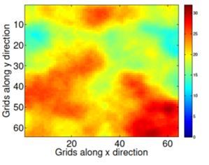
Parameter Variation
Parameter Variation
Because of imperfections in the fabrication process and variation in runtime conditions, different transistors will have different physical and electrical characteristics.
Process variation
Supply voltage variation
Temperature variation
Within die variation
IR drops
Systematic
Random
Die to die variation
di/dt drops

Slide 45
Systematic Variation
Leakage power variation map of a die. Note the systematic nature of the variation (focus on the squares)

Slide 46
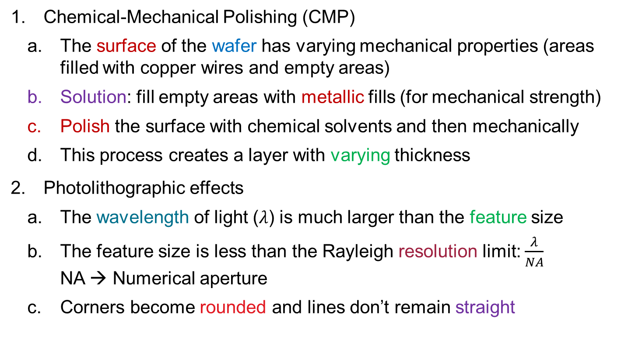
Sources of Systematic Variation
Chemical-Mechanical Polishing (CMP)
The surface of the wafer has varying mechanical properties (areas filled with copper wires and empty areas)
Solution: fill empty areas with metallic fills (for mechanical strength)
Polish the surface with chemical solvents and then mechanically
This process creates a layer with varying thickness
Photolithographic effects
The wavelength of light ($λ$) is much larger than the feature size
The feature size is less than the Rayleigh resolution limit: $\frac{λ}{NA}$ NA → Numerical aperture
Corners become rounded and lines don’t remain straight

Slide 47
Random Variation
Light has a particle nature as well. It is hard to fabricate a smooth line. The edges will be rough at the nanometer scale.
Varying photon flux and degrees of exposure
“Line edge roughness” can also arise after the etching process
Consider a 5 nm feature
It is just 50 atoms placed side by side
Can we ever achieve this level of accuracy?
There will be fluctuations in the dopant density or the gate thickness

Slide 48
Effects of Process Variation
Examples
Edge shortening and
rounded corners
Line edge roughness
Additive nature of process variation
$ΔP=ΔP_{D2D}+ ΔP_{WID}=ΔP_{D2D}$ + $ΔP_{rand}+ΔP_{sys}$

Slide 49
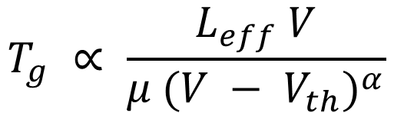
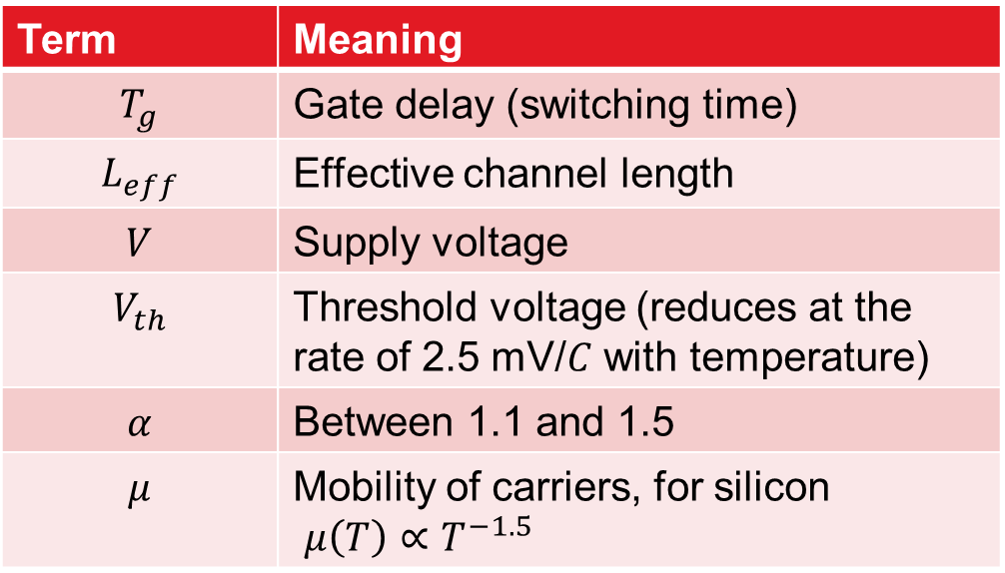
The Varius Mathematical Model
In older technologies, transistors always slowed down with increasing temperature
Alpha power law for gate delay
$$T_{g} ∝ \frac{L_{eff} V}{μ (V − V_{th})^{α}}$$
Term | Meaning
$$T_{g}$$ | Gate delay (switching time)
$$L_{eff}$$ | Effective channel length
$$V$$ | Supply voltage
$$V_{th}$$ | Threshold voltage (reduces at the rate of 2.5 mV/$C$ with temperature)
$$α$$ | Between 1.1 and 1.5
$$μ$$ | Mobility of carriers, for silicon $μ\left(T\right)∝T^{−1.5}$

Slide 50
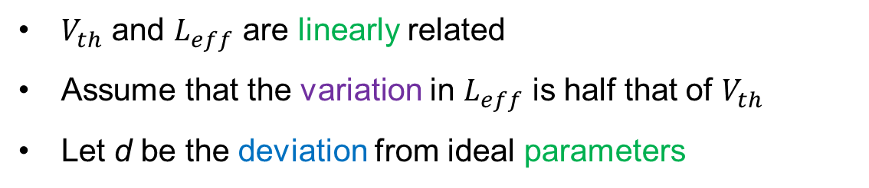
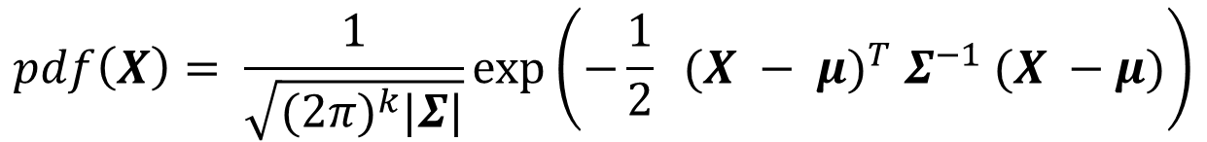

Systematic Variation
$V_{th}$ and $L_{eff}$ are linearly related
Assume that the variation in $L_{eff}$ is half that of $V_{th}$
Let d be the deviation from ideal parameters
$$V_{th}= V_{th0}+d × V_{th0}$$
Discretize the die’s surface into a 2D grid
Let X be a vector that contains the deviation for each grid cell.
$$pdf\left(X\right)= \frac{1}{\sqrt{({2π)}^{k}|Σ|}}\exp\left(−\frac{1}{2} (X − {μ)}^{T} Σ^{−1} (X −μ)\right)$$
Modelled as a multivariate normal distribution

Slide 51
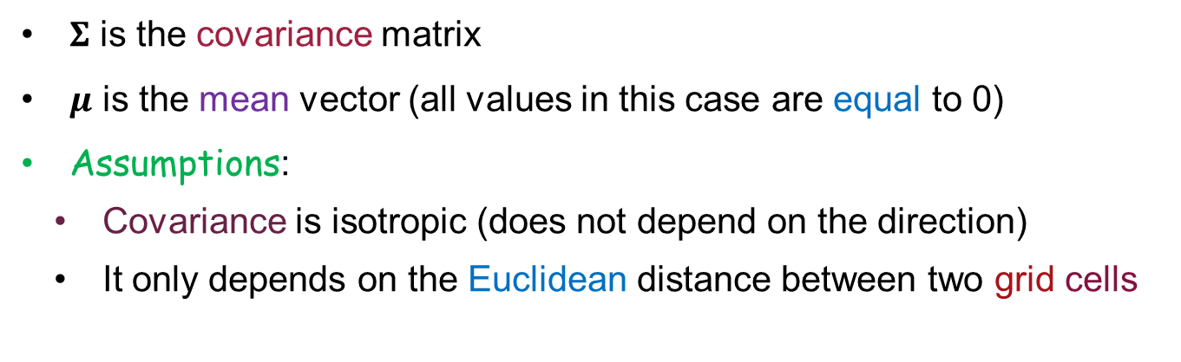
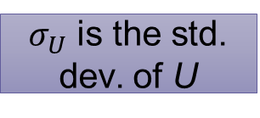
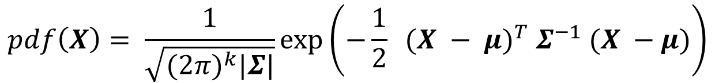
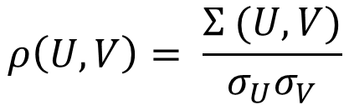
Spherical Correlation
$$pdf\left(X\right)= \frac{1}{\sqrt{({2π)}^{k}|Σ|}}\exp\left(−\frac{1}{2} (X − {μ)}^{T} Σ^{−1} (X −μ)\right)$$
$Σ$ is the covariance matrix
$μ$ is the mean vector (all values in this case are equal to 0)
Assumptions:
Covariance is isotropic (does not depend on the direction)
It only depends on the Euclidean distance between two grid cells
$$ρ\left(U,V\right)= \frac{Σ (U,V)}{σ_{U}σ_{V}}$$
$σ_{U}$ is the std. dev. of U
General relationship between the covariance and correlation of two variables U and V

Slide 52
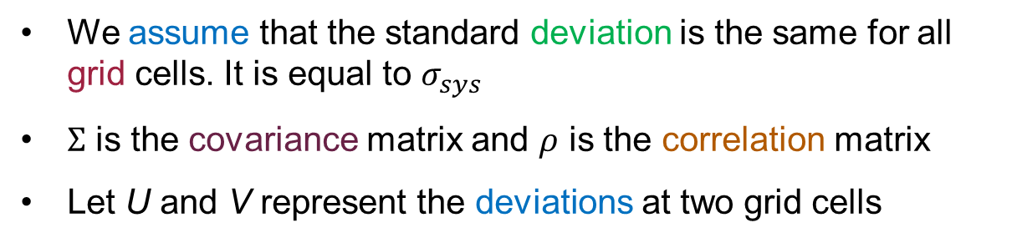
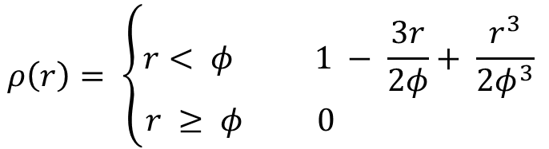

Structure of the Correlation Matrix
We assume that the standard deviation is the same for all grid cells. It is equal to $σ_{sys}$
$Σ$ is the covariance matrix and $ρ$ is the correlation matrix
Let U and V represent the deviations at two grid cells
$$Σ\left(U,V\right)= σ_{sys}^{2} ρ (U,V)$$
Varius models the correlation matrix using the spherical function that is only a function of the inter-cell distance, r
$$ρ\left(r\right)= \left\{\begin{aligned}r< φ 1 − \frac{3r}{2φ}+ \frac{r^{3}}{2φ^{3}} \\ r ≥ φ 0 \end{aligned}\right.$$

Slide 53

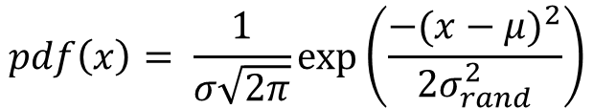

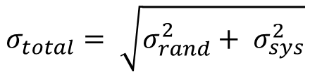
Random Variation
$L_{eff}$ and $V_{th}$ are no more linearly related
Both are modelled as univariate normal distributions
$$pdf\left(x\right)= \frac{1}{σ\sqrt{2π}}\exp\left(\frac{−({x−μ)}^{2}}{2σ_{rand}^{2}}\right)$$
Combine systematic and random variation
$$σ_{total}= \sqrt{σ_{rand}^{2}+ σ_{sys}^{2}}$$

Slide 54
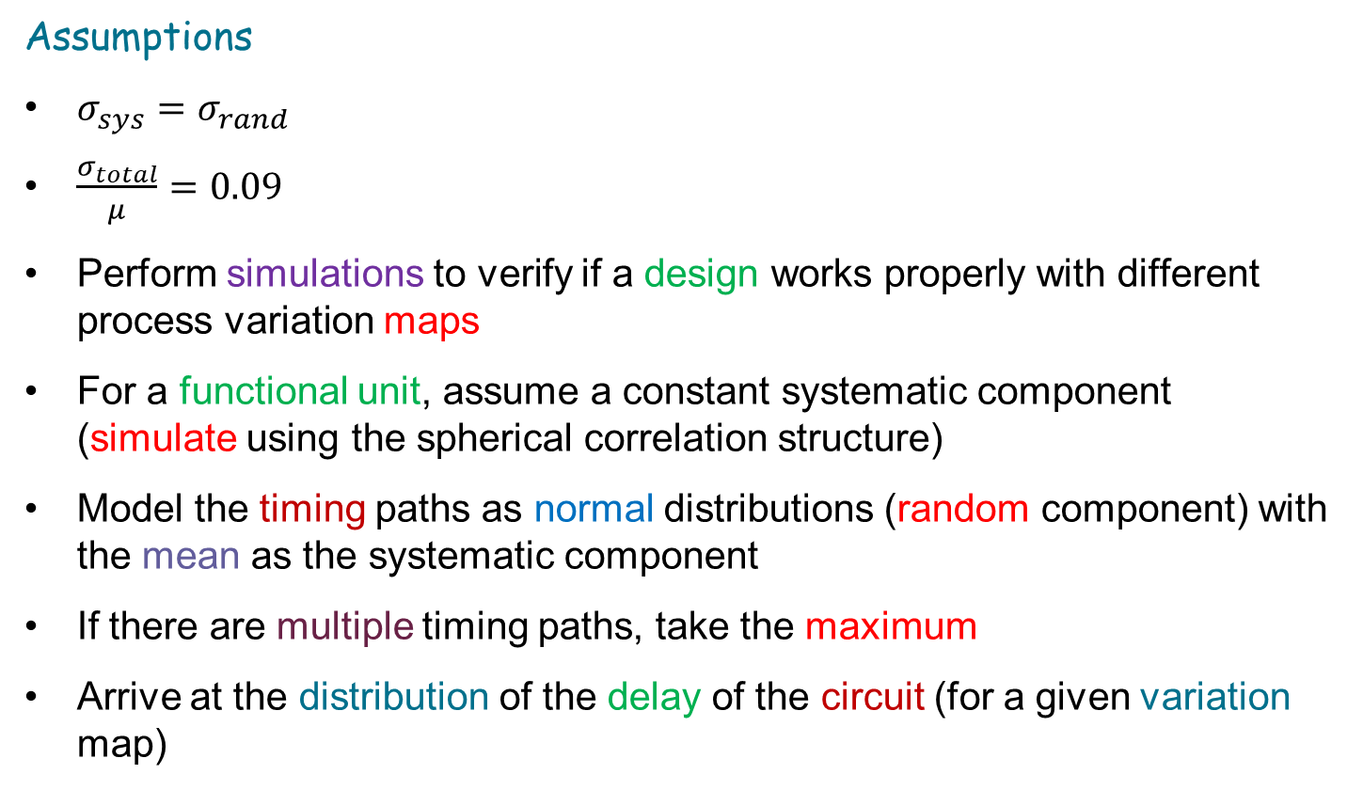
Using Varius for Statistical Timing Analysis
Assumptions
$σ_{sys}=σ_{rand}$
$\frac{σ_{total}}{μ}=0.09$
Perform simulations to verify if a design works properly with different process variation maps
For a functional unit, assume a constant systematic component (simulate using the spherical correlation structure)
Model the timing paths as normal distributions (random component) with the mean as the systematic component
If there are multiple timing paths, take the maximum
Arrive at the distribution of the delay of the circuit (for a given variation map)

Slide 55

Methods to Mitigate the Effects of Process Variation
Perform statistical timing analysis for a large number of variation maps. Add a margin and set the clock frequency accordingly.
Random variation
Systematic variation
Pre-distort the shape (on the mask) such that the desired structure is printed on silicon.
Optical proximity correction (OPC)

Slide 56


Off-Axis Illumination and Assist Features
Light source
Tilt the axis of the incident waves on the mask. Higher diffraction orders strike the surface of the silicon wafer.
Mask
Lens
Wafer
Off-axis Illumination
Small features that themselves do not get printed. However, the change the nature of the incident field on the main structure. This enhances the overall accuracy.
Assist features
Sub-resolution assist features (SRAFs)

Slide 57

Phase Shift Masking
Light
Phase-shifting
regions
Opaque regions
Lens
Phase-shift masking
Change the phase of light in the intervening regions (between structures) such that there is destructive interference and no structure is printed there. Enhances the contrast.

Slide 58
Architectural Solutions
Different regions of the chip have different degrees of variation
Frequency binning
Assign different frequencies to different dies on the wafer
Create specific DVFS tables (depending on the die)
Create voltage-frequency islands within the chip

Slide 59
Outline
1.
Soft Errors
2.
Inductive Noise
3.
Faults due to Nondeterminism
4.
Design Faults
5.
Parameter Variation
6.
Hard Errors and Ageing

Slide 60

Processors Age Over Time
Negative Bias Temperature Instability (NBTI)
Hydrogen is extensively used in semiconductor fabrication processes
Silicon atoms at the surface of the substrate have a few dangling bonds. Si-H bonds form there.
In PMOS transistors:
Protons move towards the surface and combine with the atoms in the Si-H bonds
SiO₂ layer
H₂
H₂
H₂
Si substrate
H₂
protons
This leaves a net positive charge on the silicon surface.

Slide 61

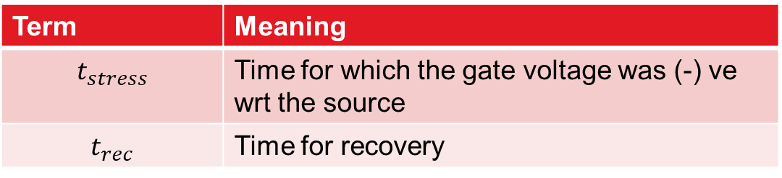
NBTI – II
Leaves a net positive charge on the silicon atoms
This raises the effective threshold voltage (stress phase)
Once, the gate voltage is removed, some part of this effect can be reversed
Some damage is unfortunately permanent
Term | Meaning
$$t_{stress}$$ | Time for which the gate voltage was (-) ve wrt the source
$$t_{rec}$$ | Time for recovery
$$ΔV_{th}∝t_{stress}^{0.25}$$
Stress phase
$$ΔV_{th}∝ \left(1 − \sqrt{η × t_{rec} /(t_{rec}+ t_{stress})}\right)$$
Recovery phase

Slide 62

Hot Carrier Injection (HCI)
Definition: It is a leakage current. Carriers gain sufficient kinetic energy to jump the channel-gate boundary.
Electrons can get permanently lodged in the SiO2 layer (within the gate)
Additionally, they collide with Si-H bonds at the channel-gate interface and change the chemical structure
This raises the threshold voltage (makes the transistor slower)
There is hardly no recovery
$$ΔV_{th}∝t^{1.5}$$
t is the time for which the transistor was actively switching

Slide 63
Permanent Faults: Hard Errors
RAMP model
Electromigration
Stress migration
Thermal cycling
Dielectric breakdown

Slide 64
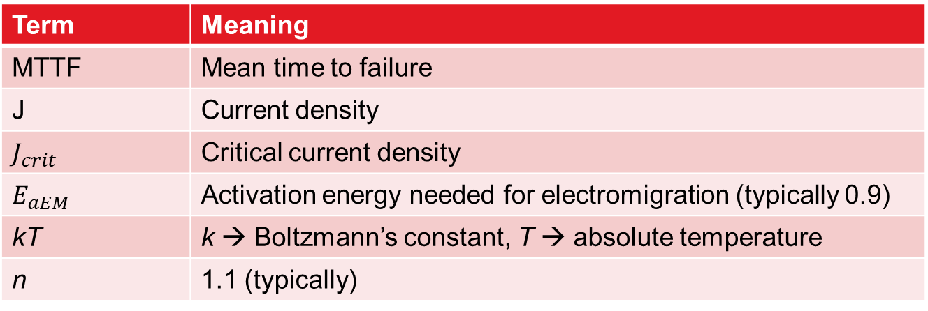

Electromigration
$${MTTF}_{em}∝(J− J_{crit})^{−n}e^{\frac{E_{aEM}}{kT}}$$
Term | Meaning
MTTF | Mean time to failure
J | Current density
$$J_{crit}$$ | Critical current density
$$E_{aEM}$$ | Activation energy needed for electromigration (typically 0.9)
kT | k → Boltzmann’s constant, T → absolute temperature
n | 1.1 (typically)
As electrons flow along a wire, they drag a few metal atoms along with them
Over time, one end of the wire becomes fat; the other end becomes thin
The thin end can snap and the fat end can extrude (create short circuits)

Slide 65

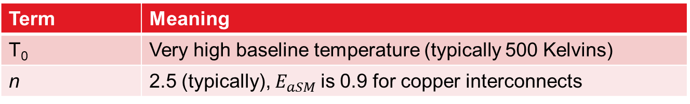
Stress Migration
$${MTTF}_{sm}∝ {\left|T_{0}−T\right|}^{−n}e^{\frac{E_{aSM}}{kT}}$$
Term | Meaning
T₀ | Very high baseline temperature (typically 500 Kelvins)
n | 2.5 (typically), $E_{aSM}$is 0.9 for copper interconnects
Interconnect contacts have different expansion rates due to varying material properties and temperatures
Stresses accumulate through the body of the interconnect
Causes a migration of metal atoms (similar to electromigration)
As the temperature increases, the MTTF reduces

Slide 66
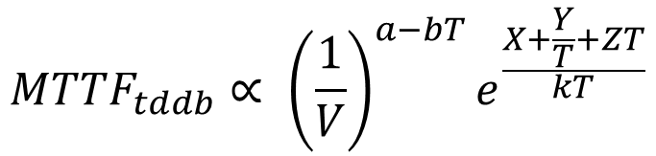
Time-dependent Dielectric Breakdown (TDDB)
$${MTTF}_{tddb}∝ {\left(\frac{1}{V}\right)}^{a−bT}e^{\frac{X+\frac{Y}{T}+ZT}{kT}}$$
Term | Meaning
V | The supply voltage
Constants | a = 78, b = -0.081, X = 0.759 eV, Y = -66.8 eV K, Z = -8.37 * 10⁻⁴ eV/K, eV → electron volts
As the dielectric layer gets thinner, the tunnelling through it increases
This ultimately changes its chemical structure. It gradually becomes a conducting path.
Here also, as the temperature increases, the MTTF reduces

Slide 67
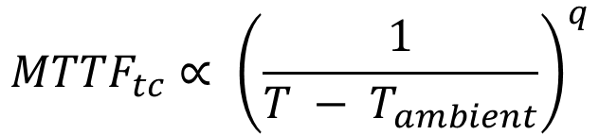
Thermal Cycling
Coffin-Manson equation
$${MTTF}_{tc}∝ {\left(\frac{1}{T − T_{ambient}}\right)}^{q}$$
Term | Meaning
T_{ambient} | Ambient temperature
q | Assumed to be 2.35
The solder joints in the packaging expand and contract
Ultimately, they crack due to metal fatigue and fail

Slide 68
Processor Failures
Infant
End of life
mortality
(wear-out)
7-10 year life
Failure rate
Normal life
Time
Bath tub curve of failure
Failure rate models: exponential and log-normal
A processor is assumed to be a series-failure system

Slide 69
Methods to Tolerate Hard Errors
Reducing temperature drastically reduces all kinds of aging and the probability of developing hard errors
Coat copper wires with TaN (Tantalum nitride). This stops the diffusion of copper items to nearby structures (limits the effects of electromigration)
Keep spare rows in memory structures. If a row develops a fault, map the row addresses to another spare row.
Work in a degraded mode: with less cores and functional units

Slide 70
Conclusion
Particle strikes due to neutrons or alpha particles can
produce current pulses in circuits, which can flip bits.
There is a need to reduce supply voltage noises that can arise due to a non-ideal power grid. It needs to be off resonance.
We can have design faults in processors (errors in the HW design).
We can apply SW patches to avoid conditions that lead to the bugs.
In nanoscale processes, process variation is a very significant issue along with variations in voltage and temperature.
Transistors can age over time due to HCI and NBTI.
Hard errors are a function of the temperature.

Slide 71
The End

