Slide 1

Chapter 13:
Secure Processors

Slide 2

Background Required to Understand this Chapter
Issue, Execute, and Commit
Caches
Simple data structures
Chapters 4 and 7

Slide 3

Outline
1.
Data Encryption
2.
Hashing and Data Integrity
3.
Secure Architectures
4.
Side-Channel Attacks

Slide 4



How to keep a secret?
Encrypted
Confidentiality
Data is encrypted, and the original data cannot be inferred from the encrypted data.
Integrity
The data has not been tampered with
Encryption
Plaintext
Ciphertext

Slide 5

Data Encryption
The two key concepts in data encryption.
Confusion
If we change a single bit of the key, most or all of the ciphertext bits will be affected. This ensures that the key and ciphertext are not correlated (in a statistical sense), and thus given the ciphertext, it is hard to guess the key.
Diffusion
This property states that if we change a single bit in the plaintext, then statistically half the bits in the ciphertext should change, and likewise if we change one bit in the ciphertext then statistically half the bits in the plain text should change. This reduces the correlation
between the plaintext and the ciphertext.

Slide 6

Two Kinds of Ciphers
Block ciphers → Divide data into blocks of 128-256 bits. Encrypt the data block by block.
Stream ciphers → Generate an infinite sequence of pseudorandom numbers. The ciphertext is the XOR of the n^{th} plaintext byte and n^{th} random number.
Key sizes: 128, 192, or 256 bits
Divide plaintext into sizes equal to the <key size>
The algorithm runs in rounds
Key size | Rounds
128 | 10
192 | 12
256 | 14
Block cipher

Slide 7
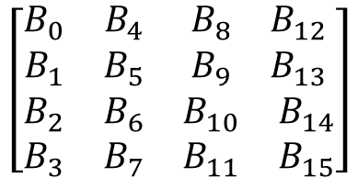
Steps in AES
Running example: Key with 128 bits
Consider a piece of text with the same length
Divide it into 16 blocks: 1 byte each
$$\left[\begin{matrix}\begin{matrix}B_{0} & B_{4} \\ B_{1} & B_{5}\end{matrix} & \begin{matrix}B_{8} & B_{12} \\ B_{9} & B_{13}\end{matrix} \\ \begin{matrix}B_{2} & B_{6} \\ B_{3} & B_{7}\end{matrix} & \begin{matrix}B_{10} & B_{14} \\ B_{11} & B_{15}\end{matrix}\end{matrix}\right]$$
State of the algorithm
In each round
Operation 1: SubBytes
Each byte B_{i} is replaced by a byte C_{i}
Use a lookup table: S-box
Left-rotate the i^{th} row by i positions →
Left-shift and then move the byte that was shifted out to the rightmost position
Operation 2: ShiftRows

Slide 8

AES Operations – II
Operation 3: MixColumns
Take the four bytes in each column and (modular) multiply it with a matrix. Last two operations diffuse bits.
Operation 4: AddRoundKey
Compute a bitwise XOR with the round key (128-bit block)

Slide 9
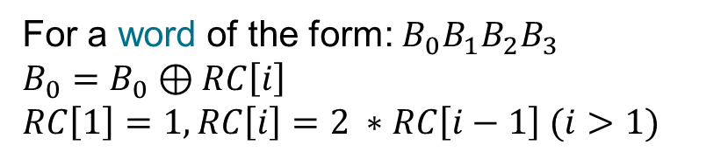

Generating Round Keys
Basic Operations
Operation 1: RotWord (R)
$$B_{0}B_{1}B_{2}B_{3}→B_{1}B_{2}B_{3}B_{0}$$
Operation 2: SubWord (S)
Substitute each byte in a word using the SubBytes function.
Operation 3: XORWord (X)
For a word of the form: $B_{0}B_{1}B_{2}B_{3}$
$$B_{0}=B_{0}⊕RC\left[i\right]$$
$$RC\left[1\right]=1, RC\left[i\right]=2 ∗RC\left[i−1\right] (i>1)$$
RC → array of round constants (1 per round)

Slide 10
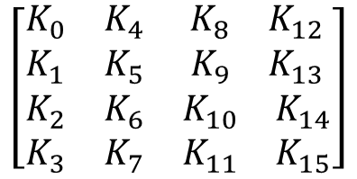
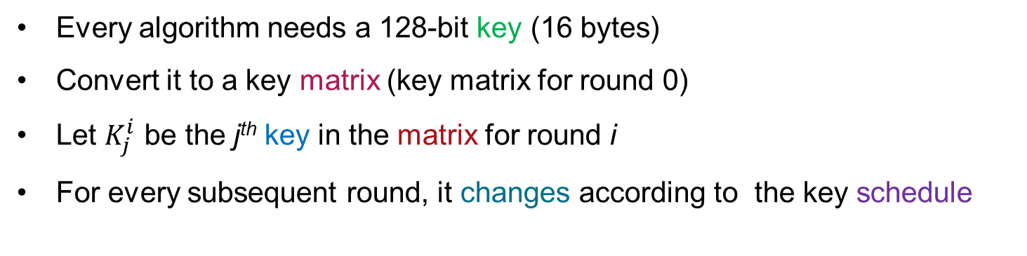
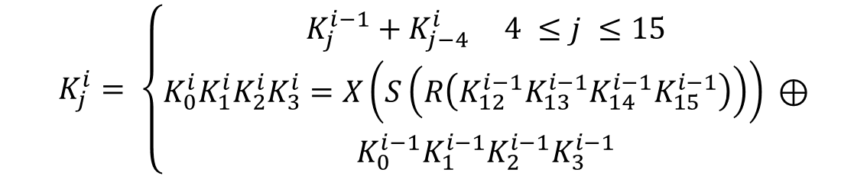
Generating Round Keys – II
$$\left[\begin{matrix}\begin{matrix}K_{0} & K_{4} \\ K_{1} & K_{5}\end{matrix} & \begin{matrix}K_{8} & K_{12} \\ K_{9} & K_{13}\end{matrix} \\ \begin{matrix}K_{2} & K_{6} \\ K_{3} & K_{7}\end{matrix} & \begin{matrix}K_{10} & K_{14} \\ K_{11} & K_{15}\end{matrix}\end{matrix}\right]$$
Key matrix
Every algorithm needs a 128-bit key (16 bytes)
Convert it to a key matrix (key matrix for round 0)
Let $K_{j}^{i}$ be the j^{th} key in the matrix for round i
For every subsequent round, it changes according to the key schedule
$$K_{j}^{i}= \left\{\begin{aligned}K_{j}^{i−1}+K_{j−4}^{i} 4 ≤j ≤15 \\ K_{0}^{i}K_{1}^{i}K_{2}^{i}K_{3}^{i}=X\left(S\left(R\left(K_{12}^{i−1}K_{13}^{i−1}K_{14}^{i−1}K_{15}^{i−1}\right)\right)\right) ⊕ \\ K_{0}^{i−1}K_{1}^{i−1}K_{2}^{i−1}K_{3}^{i−1}\end{aligned}\right.$$

Slide 11


Full AES Algorithm (Assume N rounds)
0th round
Only the AddRoundKey operation is performed
N-1 rounds
All 4 operations are performed
N^{th} rounds
The MixColumns operation is skipped
The state of the algorithm is the final ciphertext
Encrypt a large piece of text

Slide 12


Encryption Modes
Electronic Codebook
Break text into 128-bit sized blocks and encode each one separately. High confusion, low diffusion.
Increase diffusion
Link the encryption of one block to the next one. This will ensure that a large part of the ciphertext will change.

Slide 13


Cipher Block Chaining
Chain the blocks. This increases the diffusion.
Encryption is sequential, decryption is parallel.
If there is a single 1-bit error in the plaintext, the entire ciphertext is damaged.

Slide 14
Output Feedback Mode
Errors don’t propagate
Error checking of the plaintext and encryption can happen in parallel
Both encryption and decryption are sequential

Slide 15
Counter Mode Encryption
Major counter: Specific to an encryption task
Minor counter: Increases by one for every block
The AES block generates the OTP (one-time pad)
This is XORed with the plaintext
Parallel encryption/decryption and error tolerance
Good confusion properties and error tolerance

Slide 16
RC4 Stream Cipher
Generate an infinite sequence of pseudorandom numbers based on the input seed (similar to the OTP)
Encryption: XOR an input byte with the randomly generated number
Decryption: Same as encryption (use the ciphertext byte instead)
Initialization
Pseudo-Random Number Generation
The S array is the key data structure
It is initialized with a known IV (initialization vector)
The length of the key is between 5 and 16 bytes

Slide 17
The Phases of the RC4 Algorithm
S array
Initialization
j=0;
for (i=0; i <=255; i++) {
j = (j + S[i] + key [i% key_length ]) %256;
swap (S[i],S[j]);
}
Pseudo-random number generation
i=0; j=0;
while (1) {
i = (i+1) % 256;
j = (j+S[i]) % 256;
swap (S[i],S[j]);
output (S[(S[i] + S[j]) % 256]) ;
}

Slide 18
Illustration
RC4 stream cipher
i
j
S
1. Swap
2. S[i] + S[j]
3. Output
Swap
Add
Access and output
Steps

Slide 19
Hardware Implementation
It is easy to pipeline AES.
Ist stage – Initialization
3 iterations in one stage
The final stage is the last round
The RC4 algorithm has limited benefits with pipelining
AES pipelined implementation
Initialization
SubBytes
MixColumns
3
ShiftRows
AddRoundKey
SubBytes
MixColumns
3
ShiftRows
AddRoundKey
SubBytes
MixColumns
3
ShiftRows
AddRoundKey
Last round

Slide 20
Asymmetric Encryption: RSA
Encrypt with the encryption key (public key)
Decrypt with the decryption key (private key)
Convert the message to a number: m
Example
p = 59, q = 67. n = pq = 3953
λ(n) = lcm (p-1, q-1) = lcm (58,66) = 1914
Choose e such that e and λ(n) are coprime. Say, e = 31.
Compute d such that (d*e – 1) % 1914 = 0. d = 247
Public key = (n=3953, e=31), private key = (n=3953, d=247)
Key = (n,e,d)
Encryption
Decryption
E(m) = m^{e} mod n
D(m) = m^{d} mod n

Slide 21



Properties of RSA
Encryption and decryption are commutative
$$E\left(D\left(m\right)\right)=m=D(E\left(m\right))$$
Encrypt and then decrypt same as decrypt and then encrypt
Digital signatures
Alice encrypts a message with her private key. Bob can use Alice’s
public key to verify that the message has indeed come from Alice if he already knows the contents of the message.
This message is Alice’s digital signature. Nobody else could have sent it.

Slide 22

Digital Signatures
What is the aim of a signature?
To prove to the world that the signer was aware of the contents of the document, and wholeheartedly endorses it.
What are the properties of a digital signature?
It should be verifiable. If Bob has signed it, the same can be verified.
The signature should be able to cover/protect arbitrarily large pieces of text. It should be clear that Bob has read (processed) the entire text (whatever is to be signed).

Slide 23


Digital Signatures – II
Message
Encrypt with Bob’s private key
Digital signature
Decrypt with Bob’s public key
Original message
Digital signature
The fact that nobody other than Bob can have his private key establishes the authenticity and the validity of the signature.
Note that the contents of the message that is being signed have to be publicly known.

Slide 24

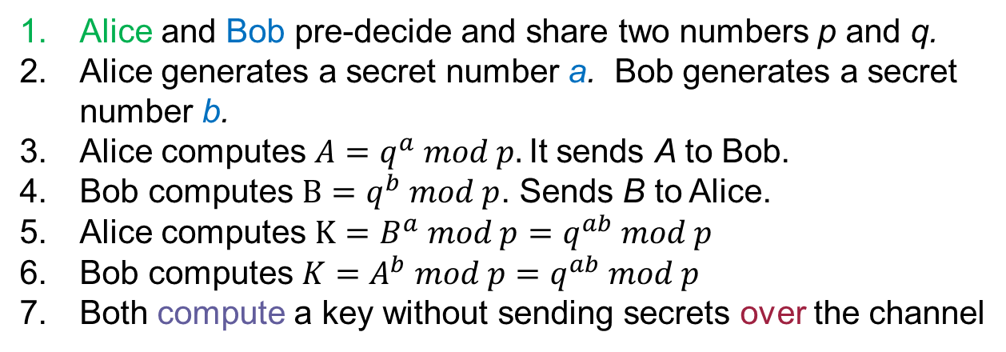
Session Keys
Use the slow RSA-based algorithm to decide on a session key. Then we use the faster AES algorithm (using the session key) for encryption/ decryption.
Diffie-Hellman Key Exchange
Alice and Bob pre-decide and share two numbers p and q.
Alice generates a secret number a. Bob generates a secret number b.
Alice computes $A=q^{a} mod p.$It sends A to Bob.
Bob computes $B=q^{b} mod p$. Sends B to Alice.
Alice computes $K=B^{a} mod p=q^{ab} mod p$
Bob computes $K=A^{b} mod p=q^{ab} mod p$
Both compute a key without sending secrets over the channel

Slide 25
Outline
1.
Data Encryption
2.
Hashing and Data Integrity
3.
Secure Architectures
4.
Side-Channel Attacks

Slide 26
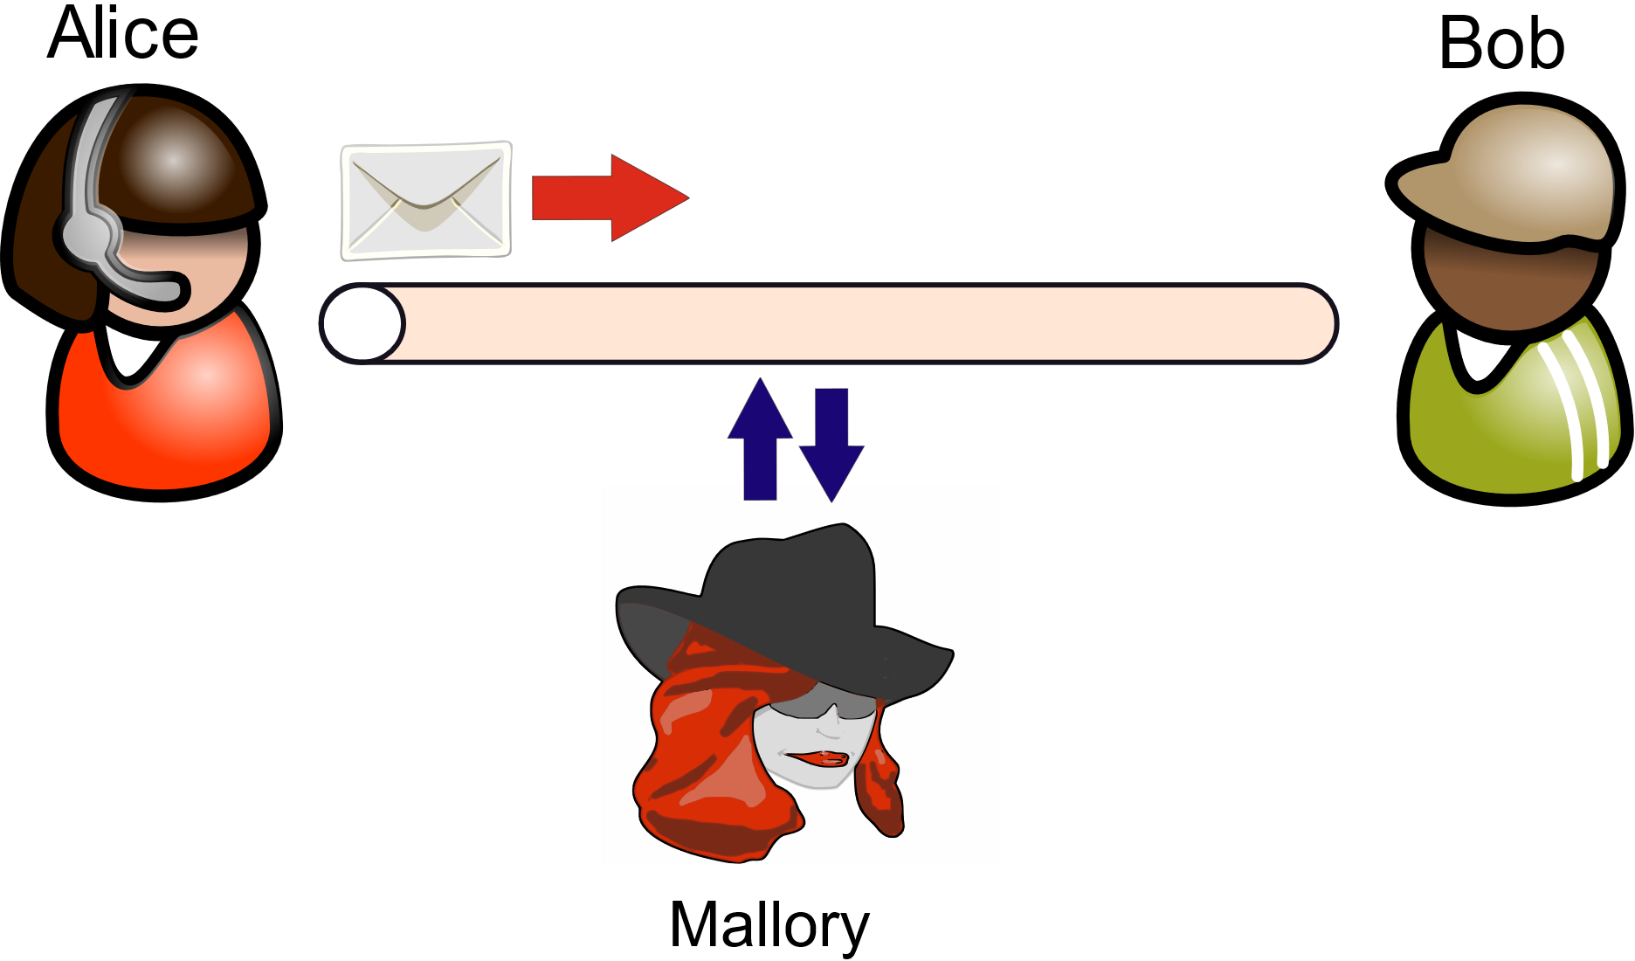
Common Cryptographic Attacks
Alice sends a message to Bob
Mallory, the hacker, can mount several kinds of attacks
If the message is not encrypted, it can simply eavesdrop on the channel and read the message.
Solution: Use encryption

Slide 27
Common Cryptographic Attacks – II
Man-in-the-middle attack: Mallory pretends to be Bob to Alice and pretends to be Alice to Bob. Example of a spoofing attack.
Solution: Use digital signatures. They guarantee authenticity.
Mallory can take some part of a legitimate message sent from Alice to Carlos and use that in a message sent to Bob.
Solution: Use separate keys for separate recipients
Mallory can capture and tamper with the message (integrity violation)
Use hashes (discussed next)

Slide 28
SHA-based Hashing
Arbitrarily large message
Hash
Unique 512-bit number
SHA (Secure Hash Algorithms): SHA1, SHA2, and SHA3
Break the message into 512-bit chunks
Divide into 16 32-bit chunks
64 rounds: permute, rotate, and shift bits
Final one-way hash: 224 to 512 bits
Definition
A MAC (message authentication code) is an encrypted hash.
Solves the problem of integrity and authenticity.

Slide 29
Replay Attacks are still Possible
Mallory simply records a <message,MAC> pair sent from Alice to Bob and replays it later.
Bob will not be able to make out the difference.
Methods to avoid such replay attacks
One-time session keys: Use a separate key for every single communication. Counter-mode encryption is ideally suited for this. Keep incrementing the minor counter.
Timestamps: Use timestamps. The sender includes its local time. Reject old messages.
Nonces: Embed an integer (nonce) in every message. Treat it as a monotonic counter. This can be used to identify old messages.

Slide 30
ACIF Properties
Authenticity
Establish that the message has come from the sender → Use digital signatures
Confidentiality
Do not allow any intermediary to read the message → Encrypt the message
Integrity
Freshness
Do not allow message tampering → Use a MAC
Do not allow replay attacks → Use a nonce or counter-mode encryption

Slide 31
Outline
1.
Data Encryption
2.
Hashing and Data Integrity
3.
Secure Architectures
4.
Side-Channel Attacks

Slide 32
Traditional Attacks in Software
Arguments
Arguments
Ret. address
Ret. address
1. Overwrite
Variables
Variables
return address
Activation
block of a
2. Jumps to a
function
Buffer
Buffer
location in the
Increasing
buffer.
Downward
growing
memory
stack
addresses
Correct state
Overwrite return address
The return address is typically stored on the stack
It is possible to access an array beyond its bounds and overwrite the return address
Code injection attack
int buffer[10];
...
buffer[20] = <address to be returned to>

Slide 33
Code Reuse Attack
Arguments
Ret. address
1. Overwrite
Variables
return
address
Program
2. Jumps to a
code
location in the
program's code
Code reuse attack
We can make the control jump to an arbitrary point in the program.
We can reuse existing code.
To implement malicious logic.

Slide 34

Buffer Overflow Attacks
They are, by far, the most common kind of software-based attacks
Most sophisticated attacks build on this. This is a very effective method of diverting the control flow to specific points within the program’s code and data segments
Code reuse attacks are quite powerful
They can be stopped by randomizing the address space ASLR (address space layout randomization)
Accesses to the code, data, DLLs, memory-mapped files, shared memory, etc., are relative to a region-specific offset
This is specified at the time of program loading
Makes it harder for the attacker to guess the exact addresses

Slide 35

Hardware Security: Key Concepts
Trusted Computing Base (TCB) → Set of hardware/software components that are assumed to be secure.
Kerckhoff’s
Principle
The design of a TCB should be open. It is not possible to hide design-time secrets. The only real secret should be the key
Chain-Link Principle
Any chain is only as strong as the weakest link. If there is one weakness in the TCB, then the entire TCB is compromised.
Attack Surface → Set of all the attacks that can be mounted on a TCB.
Threat Model → Subset of the attack surface. This is the set of all the attacks that the designer expects to be mounted.

Slide 36
Some More Definitions
Trusted Execution Environment (TEE) → It is a hardware environment (primarily) that allows the user to create and run a secure process known as an enclave.
Root of Trust (RoT) → This is some module that is completely trusted (cannot be compromised). It typically provides the following services:
A dedicated piece of hardware known as the Trusted Platform Manager (TPM) verifies the BIOS and initiates a secure boot process.
Provides cryptographic services → encryption, digital signatures, attestation

Slide 37


Notion of Measurements
BIOS
OS loader
OS
Compute a hash of the BIOS code, OS loader, and the OS code. This is done by the RoT and is known as a measurement.
The measurement can be digitally signed and sent to a remote server. It can verify the signature and assess the validity of the measurement. This is known as attestation.
Sealing → Tie the code with the data. Encrypt the data with a key derived from the measurement.
Use all these concepts to create a secure processor
that provides the ACIF guarantees.

Slide 38
Design of a Secure Processor (inspired by Intel SGX)
Assume that the chip is secure – cache banks and cores
However, the main memory is vulnerable – all of its contents can be read and modified at will. The memory can simply be physically removed and its contents can be accessed/modified.

Slide 39

Outline of a Solution
Confidentiality → Encrypt all the data
Integrity → Compute a hash of a cache line and store it somewhere
Authenticity → Encrypt the hash with a secret key
Freshness → Encrypt the same block with a different key every time.
One more reason for encrypting the same data with a different key every time is → an attacker can guess that the same data is being sent if the key is the same. This reveals some important information. We have to stop this.
The main focus is on LLC (last level cache) misses. These cross the secure – nonsecure boundary.

Slide 40


Use Counter-Mode Encryption
64 bits
6 bits
Major counter
64 minor counters
Consider a 4 KB page. It has 64 cache blocks (each block is 64 bytes)
We associate a 64-bit major counter with a page
Each of the blocks is associated with a 6-bit minor counter
Size of each cache line: 64 bytes (512 bits)
64 bits
64 * 6 bits
448 bits
64 bits left

Slide 41

Process of Encryption/Decryption
64 bits
58 bits
6 bits
Major counter
Minor
Block address
ctr
Processor specific unique number
Generate MAC
PUF
Simultaneously compute the 128-bit (16 byte) MAC
Rnd. number
AES block
Enclave id
Generated at boot time
OTP
16 bytes
Increment the minor counter after every encryption The encryption is unique to the processor, boot time, enclave id, block address and values of the counters (no chance of repeats)

Slide 42
Read Operation
If we find a block in the caches, we simply read it. If there is a cache miss in the LLC (last level cache), the following needs to be done.
Send read requests to main memory Block and its MAC
Verify the hash
Compute OTP
Decrypt the data
Send to the CPU
Computing the OTP is not on the critical path (shadow of a miss)
Verifying the hash is off the critical path. If the hash does not match, it is a catastrophic failure – the security has been breached.

Slide 43

Writes and Evicts
Whenever we evict a modified line from the LLC, we write it to secure memory.
Increment the minor counter, compute the OTP, encrypt the block.
Also, compute a MAC (hash + encryption). Use the same OTP.
Write the encrypted data and the MAC to secure memory.
If a minor counter overflows …
Increment the major counter.
Reset all the minor counters for the page
Re-encrypt all the blocks in the page that are in main memory. (The counters have changed)

Slide 44


ACIF Properties
Counters
hash
Secret Key [PUF, num]
Data
We cannot change all four. The <PUF, rnd num> combination is not known and cannot be changed.
We cannot change just the data and the hash → we will not be able to correctly encrypt them
We can of course replace the <counter,data,MAC> triplet with a valid triplet. The system should somehow prohibit this

Slide 45

Integrity of Data
MAC
Data
Hash
C
Encryption ensures confidentiality
It is not possible to tamper with the data or MAC and remain undetected. This guarantees integrity. Can we tamper both?
Can we replace the encrypted <data,hash> pair with another valid pair? The question is from the modified data can we figure out the new MAC. We need to correctly encrypt them, which is not possible. We don’t know the PUF and random number (even if we can guess the counters).
I

Slide 46

Authenticity and Freshness
F
How can we prevent replay attacks? Replacing <counter,data,hash> with a valid triplet (seen in the past)
Answer:
Protect the counters. Do not allow them to be maliciously modified. Just the <encrypted data, MAC> cannot be replayed. The counters would have changed, and integrity check will fail. We cannot fetch data for another address either.
A
How does the processor know whether it is reading back the same data that it wrote?
Answer:
The values of the counters for the block are the same. It just decrypts the block contents and MAC with the same counters. If the hash matches, we are sure that the processor is reading back what it had written earlier. Implicitly: the PUF, enclave id, and rnd num are the same.

Slide 47

Moral of the Story
Just protect the counters. The data is secure.
All ACIF guarantees are provided.
The counters are much smaller as compared to the data. They are easy to store and protect.

Slide 48
Where do we store the counters?
There is a dedicated counter cache that is stored in the regular caches (software managed) or we have special hardware for it on chip
If a counter is found, we take it from the counter cache.
However, there may be evictions. Counters may need to be written to main memory.
A mechanism is required to protect them in main memory. In this case, counters need to be themselves encrypted.
We need counters for encrypting counters !!!
What about those counters, we need another set of counters ....
We need a recursive data structure to store counters and provide ACIF guarantees.

Slide 49
Simple Tree-based Method for Storing Counters
Parent
hash
hash
hash
hash
Child
1
Child
2
Child
7
Child
8
Solution: Use a Merkle tree → Parent stores the hashes of its children.
The leaf is the set of all the counters for a page (448 bits)
An internal node contains the hashes of its children.
For a read (check the hash) at the parent; for a write, cascade updates towards the root
The root of the Merkle tree represents the state of the entire tree
If a counter can be maliciously modified, we can always check its hash
One optimization: The process stops at a cached internal node. No need to cascade updates till the root all the time.

Slide 50

Criticism of this Approach
Why does the process stop at a cached internal node?
Answer:
All cached data (within the processor) is deemed to be correct (it is within the TCB).
What are the problems with this approach?
Answer:
An internal node can have only 8 children. Assume it has a size of 64 bytes, and each hash is 64 bits (8 bytes). There will be too many levels.
Increase the arity of the tree
Reduce the number of levels
Improve performance

Slide 51
Efficient Scheme: 64-ary Tree
MAC (64 bits)
Major counter
Hash
Encryption
block
Major counter
64 bits
64 minor counters
MAC (64 bits)
Every node has 64 children.
Contains one major counter and 64 minor counters
The MAC is a part of the node (encrypted hash of its 448-bit contents)
The node is conceptually connected to its parent → the counters to create the MAC come from the parent.
Every eviction increments the minor counter at its parent.

Slide 52

Continued ...
All the nodes have a similar structure
64-bit major counter + 64 * 6-bit minor counters + 64-bit MAC
The parent and child are connected via the MAC
This means that every leaf (counters used to encrypt data) is connected to the root of the tree
The root is always stored in the TCB (assumed to be correct)
A 64-ary tree reduces the number of cascaded levels, amount of data that needs to be stored on-chip, and read/write times
We can have a dedicated counter cache within the chip or just use the regular caches
512 bits

Slide 53

Creating and Managing Enclaves
Boot time
Processor Reserved Memory (PRM)
Partition the physical memory space.
Reserved memory
Secure region
We can further partition the reserved memory: metadata and secure data.
Intel SGX v1: Total size of the PRM (128 MB), usable space (92 MB)
New instructions added to the ISA

Slide 54

Setting up an Enclave
ECREATE instruction:
Create the data structures for an enclave
Partition the physical and virtual address space between the secure and nonsecure regions
The OS manages the page tables and TLBs, even though it is not trusted.
EADD instruction:
Adds code and data to the secure enclave
Copies data into secure pages (within the enclave)
EINIT instruction:
Compute a measurement and digitally sign it
May use an additional quoting enclave to sign the enclave and send it for remote verification
Launch the enclave

Slide 55


Memory Management
The OS manages the page tables and TLB entry
It can deliberately induce TLB misses and page faults.
This can provide the page address sequence
The hardware zeros out the bits within the page offset (address that caused the TLB miss or page fault)
Nonetheless, some information leaks
How do we stop the OS from redirecting writes to the nonsecure region? Can be easily achieved by creating a malicious TLB mapping.
Answer:
In secure memory (metadata region), we maintain an inverted page table (IPT). Physical frame num → virtual page num

Slide 56


Managing Memory – II
After an EADD instruction an entry in the IPT is created
Before the enclave is launched, check whether all the mappings in the IPT are valid
A secure page should never be pointing to a nonsecure memory region or vice-versa
All the updates to the TLB are monitored
No illegal mapping should be created
The IPT is always deemed to be correct
The OS maintains the page table
This is fine because all TLB updates are monitored
It can swap out pages to the nonsecure memory or the disk
Provide ACIF
Zero out page offset bits for secure pages

Slide 57

Interrupts and Enclave Entry/Exit
Asynchronous Enclave Exit
An interrupt maybe delivered to a core that is running an enclave
The secure context needs to be stored in the secure memory region
Flush the TLB → the secure area should henceforth not be accessible
Enclave Enter (EENTER)
An application must call a secure function (ECALL)
The OS treats this as a regular context switch
The secure mode gets turned on
Enclave Exit (EEXIT)
The secure code calls a nonsecure function (OCALL)
All arguments are copied. The TLB is flushed.

Slide 58

Enclave Removal and System Calls
The EREMOVE instruction is invoked to tear down an enclave.
Clear all the state and pages in the memory and disk
We cannot invoke system calls from secure mode. The OS will be able to see the state of the secure program, which is not allowed.
OCALL
Execute a system call
ECALL
Secure thread
Proxy thread

Slide 59




Oblivious RAM
CPU
Main memory
We can see the stream of addresses. This can leak secrets.
The attacker should not be able to see the sequence of addresses.
Two strategies
Keep migrating memory words to new locations. Make it
harder to guess by such random permutations.
Access more locations than needed. Give the attacker redundant information.

Slide 60

Oblivious RAM – II
Naive solution: For every memory access, just access all the main memory locations. Choose the correct value (for a read within the CPU).
Oblivious RAM: Use some degree of permutation and redundancy.
Path ORAM: Much more efficient version of it.
Local cache
Stash
N memory blocks
Block
address
posMap
Mapped address
[0 ... N-1]

Slide 61

Tree Stored in Main Memory
Tree with 2^{L} leaves and L+1 levels
L = log₂(N)
P(k)
l^{th} level
P(k)[l]
k^{th} leaf
readPath(k)
Returns the contents of all the blocks from the root to the k^{th} leaf
The data for address a can be present in any block in the path P(posMap[a]).
Bucket with B blocks

Slide 62

Few More Definitions
Tree with 2^{L} leaves and L+1 levels
L = log₂(N)
P(k)
P(k)[l]
k^{th} leaf
posMap[a’]
Nodes share a common node and present in the stash
getCousins (k,l)
a’
$$∀ a^{′}∈W, P\left(k\right)\left[l\right]=P(posMap\left[a^{′}\right])[l]$$
$$S\left[a^{′}\right]≠φ$$
W

Slide 63
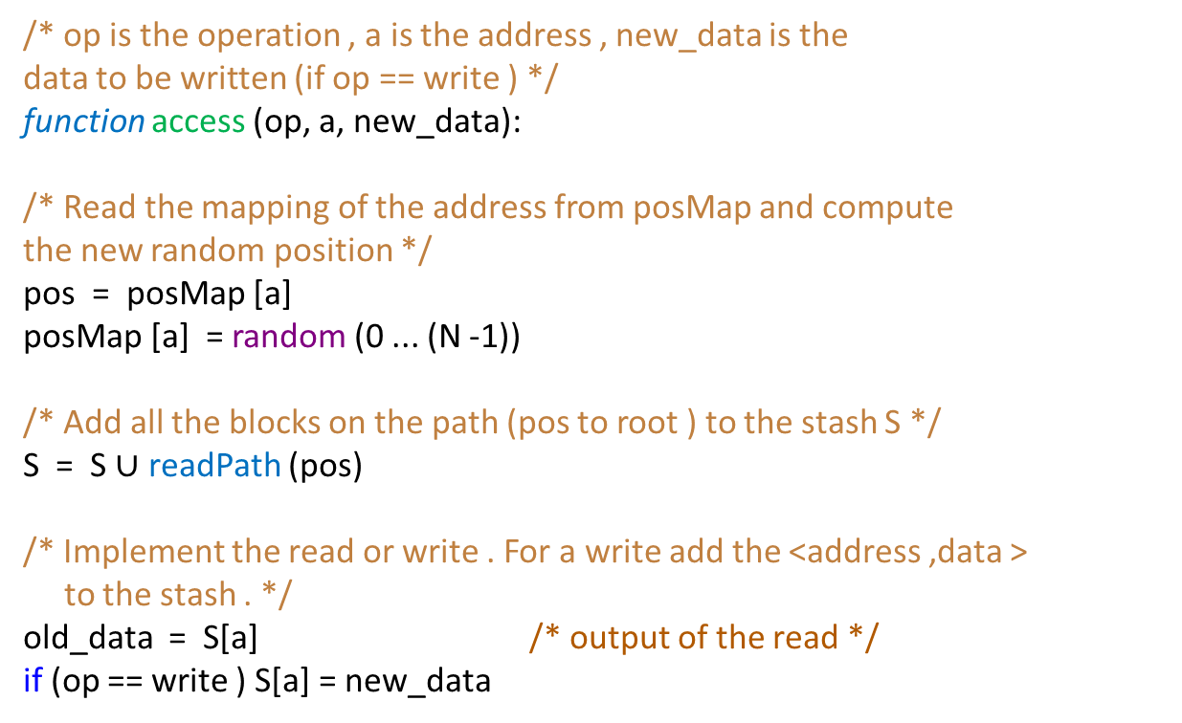
Path ORAM Algorithm
/* op is the operation , a is the address , new_data is the
data to be written (if op == write ) */
function access (op, a, new_data):
/* Read the mapping of the address from posMap and compute
the new random position */
pos = posMap [a]
posMap [a] = random (0 ... (N -1))
/* Add all the blocks on the path (pos to root ) to the stash S */
S = S $∪$ readPath (pos)
/* Implement the read or write . For a write add the <address ,data > to the stash . */
old_data = S[a] /* output of the read */
if (op == write ) S[a] = new_data

Slide 64

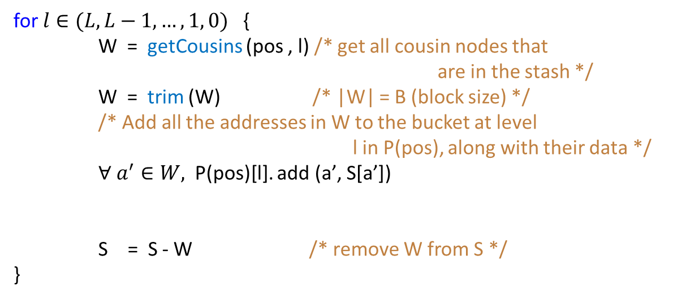
Path ORAM Algorithm – II
Permute Operation
for $l∈(L, L−1, …, 1, 0)$ { W = getCousins (pos , l) /* get all cousin nodes that
are in the stash */
W = trim (W) /* |W| = B (block size) */
/* Add all the addresses in W to the bucket at level
l in P(pos), along with their data */
$∀ a^{′}∈W,$ P(pos)[l]. add (a’, S[a’])
S = S - W /* remove W from S */
}
Add all cousins to the bucket at P(pos)[l]
Read the path → Add them to the tree at possibly a new location → Remove the cousins from the stash

Slide 65
Outline
1.
Data Encryption
2.
Hashing and Data Integrity
3.
Secure Architectures
4.
Side-Channel Attacks

Slide 66


Side Channel Attack
Modern processors have a nanosecond-level high-resolution timer.
An L2 miss makes the processor stall for hundreds of cycles.
An L1 or i-cache miss induces a smaller penalty, which may be detectable.
Is it possible for a process to look at its cache hit/miss behaviour and figure out the memory address sequence of another processor?
Answer:
Yes, by measuring the nature of destructive interference.
There is information leakage through a side channel

Slide 67

Space of Side-Channel Attacks
Logical
Physical
RSA
(internal software entity)
(external agent)
C: ciphertext
C = P^{e} mod n
P: plaintext
P = C^{d} mod n
Self
Contention in
(Attacker observes
/* computes z = x^{e} mod n */ compute_mod_n(x, e, n):
1. Functional units
its own execution)
2. Memory system
z = 1;
while (e ≠ 0)
multiply
Other
1. Execution timing
2. Performance counters and sensors
3. Memory access patterns
1. Power 2. EM radiation
3. Temperature 4. Memory addresses and values
if (e % 2 == 1)
(Attacker observes + possibly modifies the
victim’s execution)
z = (z * x) % n;
e = e >> 1;
x = (x * x) % n;
square
return z;
Whenever some artefact of program execution is measurable, we have a side channel. Some information can leak out.
See the case of RSA, where we have a data-dependent i-cache access.

Slide 68
Prime+Probe Attack
The attacker thread accesses all the lines in the cache (Prime phase)
Yield the processor to the victim process
The victim thread executes. If it needs access to a cache block (code or data), it will have a miss and fetch it from the lower level
The attacker resumes control. It measures the time required to access every cache line. Based on the measured times, it gets an idea of the memory access behavior of the victim process.
Example
RSA has a data-dependent i-cache access (modular multiply function). We can track if this instruction was fetched or not. This will tell us about the i^{th} bit in the key !!!

Slide 69

Flush+Reload Attack
Assume code pages are shared between the attacker and victim threads/processes
The attacker first flushes a given set of cache lines.
Allow the victim to run for some time.
The attacker accesses the same set of lines again.
Check if they are back.
Same idea as the Prime+Probe attack. Get an idea of the memory addresses accessed by the victim in critical code regions.

Slide 70

Other Side Channels
Basically, whenever there is contention and the same is measurable, we have a side channel
Functional units
Architectural structures
Even DRAM rows
Read disturbance → Reading a row repeatedly can disturb the contents of the adjoining rows
The attacker can deliberately perturb a nearby row.
After the victim accesses its row a sufficient number of times, the attacker’s row will have a bit flip
This can be detected with an HRT
The address accessed by the attacker can be detected

Slide 71


Evict + Time Attack
The attacker deliberately evicts some cache lines (carefully crafted accesses)
It runs the victim
It carefully measures the time the victim task took
If there have been cache misses, the victim will take more time.
The address sequence will thus be visible.
The attacker can also take a look at performance counter and page fault data (in the case of an OS).
Many other sources of information leakage are possible: power consumption, EM radiation, temperature, etc.

Slide 72


Transient Execution Attacks
Spectre
Consider this piece of code
Meltdown
if ( val < threshold ) v = array1 [array2 [x]];
Foreshadow
Consider an OOO processor with branch prediction
It speculatively accesses the address: array1_base + array2[x] * 4;
Later on, the pipeline is flushed.
This address can be detected using a Prime+Probe attack
We will get to know array2[x] if we know array1_base
If we can control x, we have access to the entire memory !!!

Slide 73
Countermeasures
Strictly partition the resources such as cache sets between threads. This will eliminate interference.
Can lead to a suboptimal use of resources
Deliberately add noise
Again, can cause slowdowns
Turn off or decrease the resolution of the timer
Some network and gaming applications may cease to work

Slide 74
Conclusion
We can encrypt data using either block ciphers or stream ciphers. AES is the most common block cipher.
For encrypting a block of data, counter mode encryption is a very useful method.
Any secure architecture has to provide the ACIF guarantees. ACIF → Authenticity, Confidentiality, Integrity, and Freshness
A secure architecture just needs to store the counters securely. A Merkle tree of counters is typically used.
Modern processors are prone to side-channel attacks. Whenever there is contention, some information leaks.

Slide 75
The End

