Slide 1

Chapter 2:
Out-of-Order Pipelines

Slide 2


Background Required to Understand this Chapter
Assembly Languages
Basic Processor Design
Basic Pipeline Design
http://www.cse.iitd.ac.in/~srsarangi/archbooksoft.html

Slide 3

Outline
1.
In-Order Pipelines
2.
Performance Considerations
3.
Out-of-Order Pipelines

Slide 4
A Simplified Diagram of a Processor with 5 Stages
Interconnection
element
Control
unit
Branch
Memory
unit
unit
Fetch
Immediate
Register
unit
and branch
flags
write unit
unit
Data
ALU
unit
memory
Instruction
Register
op2
memory
file
op1
Instruction
Operand fetch and
Execute stage
Memory access
Register write-back
fetch stage
decode stage
stage
stage
[IF] Instruction fetch
[OF] Operand fetch and decode
[EX] Execute
[MA] Memory access
[RW] Register write-back

Slide 5

Pipelines
For more efficiency, we can pipeline the design. This will eliminate idleness in the processor.
In-order Pipelines
Instructions enter the pipeline in program order
Inst. Fetch
Operand Fetch
Execute
Memory
Access
Register
Write-back
5-Stage Pipeline

Slide 6
Pipelined Version of the Processor
IF-OF
OF-EX
EX-MA
MA-RW
Control
unit
Branch
Memory
unit
unit
Fetch
Immediate
Register
unit
and branch
flags
write unit
unit
ALU
Data
op2
Unit
memory
Instruction
Register
memory
file
op1
Note the positions of the pipeline latches.

Slide 7
Problems with In-order Pipelines
Inst. Fetch
Operand Fetch
Execute
Memory
Access
Register
Write-back
Hazards
Structural Hazards → Two instructions vie for the same resource (NOT possible in simple 5-stage pipelines)
Data Hazards → An instruction stands to read or write the wrong data.
Control Hazards → Instructions are fetched from the wrong path of the branch

Slide 8
Pipeline Diagrams
1
add r1, r2, r3
add r4, r1, r3
2
1
2
3
4
5
6
IF
1
2
Reads wrong
values
OF
1
2
EX
1
2
MA
1
2
RW
1
2

Slide 9
Pipeline Interlocks
1
2
3
4
5
6
7
IF
1
2
3
3
3
3
OF
1
2
2
2
2
3
Pipeline
EX
1
2
bubble
MA
1
RW
1
An interlock inserts a nop instruction (bubble) in the pipeline

Slide 10
Forwarding from the MA to the EX stage → No stalls
1
2
3
4
5
6
IF
1
2
1: add r1, r2, r3
OF
1
2
2: add r5, r1, r4
EX
1
2
(a)
MA
1
2
RW
1
2
(b)

Slide 11
Forwarding Multiplexers
Latch
EX stage
MA stage
Input 1
ALU
Memory
Input 2
access unit
Forwarded input

Slide 12
We need 4 Forwarding Paths
Forwarding Paths | Example
RW → MA | ld r1, 8[r2] st r1, 8[r3]
RW → EX | ld r1, 8[r2] sub r5, r6, r7 add r3, r2, r1
RW → OF | ld r1, 8[r2] sub r5, r6, r7 sub r8, r9, r10 add r3, r2, r1
MA → EX | add r1, r2, r3 sub r5, r1, r4
Forward as late as possible

Slide 13
Final View of the Pipelined Processor with Forwarding Multiplexers
IF-OF
OF-EX
EX-MA
MA-RW
Control
Branch
Memory
unit
unit
unit
Register
Fetch
Immediate
flags
write unit
unit
and branch
unit
Data
ALU
memory
Instruction
Register
op2
unit
memory
file
op1
op2
We add 6 forwarding multiplexers

Slide 14
Data Hazards in In-order Pipelines with Forwarding
Inst. Fetch
Operand Fetch
Execute
Memory
Access
Register
Write-back
add r5, r4, 1
ld r4, 4[r0]
Need the value in r4 now
Earliest it can be generated
Load-use Hazard
clock

Slide 15
Solution: Stall the Pipeline
Inst. Fetch
Operand Fetch
Execute
Memory
Access
Register
Write-back
add r5, r4, 1
ld r4, 4[r0]
ld r4, 4[r0]
Need the value of r4 now
Cycle N+2
Here is the data
Cycle N
Cycle N+1
clock

Slide 16
Control Hazards
Inst. Fetch
Operand Fetch
Execute
Memory
Access
Register
Write-back
sub r5, r6, r7
add r1, r2, r3
beq .label
beq .label
Cancel these instructions
We know the status of the branch now. Assume it is taken.
Two instruction slots are wasted

Slide 17
Outline
1.
In-Order Pipelines
2.
Performance Considerations
3.
Out-of-Order Pipelines

Slide 18

Performance Equation - I
Is Computer A faster that Computer B
Wrong Answers:
More is the clock speed, faster is the computer
More is the RAM, faster is the computer
What does it mean for computer A to be faster than computer B
Short Answer: NOTHING
Performance is always with respect to a program. You can say that a certain program runs faster on computer A as compared to computer B.

Slide 19
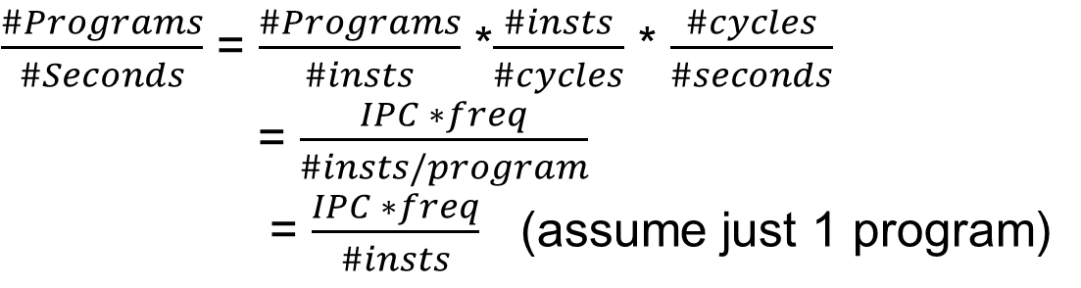
Performance Equation - II
$\frac{\#Programs}{\#Seconds}$ = $\frac{\#Programs}{\#insts}$ *$\frac{\#insts}{\#cycles}$ * $\frac{\#cycles}{\#seconds}$
= $\frac{IPC ∗freq}{\#insts/program}$
= $\frac{IPC ∗freq}{\#insts}$ (assume just 1 program)
IPC is the number of instructions per cycle
Let us loosely refer to the reciprocal of the time per program as the performance

Slide 20

So, what does performance depend on …
#instructions in the program
Depends on the compiler
Frequency
Depends on the transistor technology and the architecture
If we have more pipeline stages, then the time to traverse each stage reduces roughly proportionally
Given that each stage needs to be processed in one clock cycle, smaller the stage, higher the frequency
To increase the frequency, we simply need to increase the number of pipeline stages
IPC
Depends on the architecture and the compiler
A large part of this book is devoted to this aspect.

Slide 21
How to improve performance?
There are 3 factors:
IPC, #instructions, and frequency
#instructions is dependent on the compiler → not on the architecture
Let us look at IPC and frequency
IPC
What is the IPC of an in-order pipeline?
1 if there are no stalls, otherwise < 1
Forwarding
Having more not-taken branches in the code
Faster instruction and data memories
Methods to increase IPC

Slide 22
What about frequency?
What is frequency dependent on …
Frequency = 1 / clock period
Clock Period:
1 pipeline stage is expected to take 1 clock cycle
Clock period = maximum latency of the pipeline stages
How to reduce the clock period?
Make each stage of the pipeline smaller by increasing the number of pipeline stages
Use faster transistors

Slide 23

Limits to Increasing Frequency
Assume that we have the fastest possible transistors
Can we increase the frequency to 100 GHz?
Reasons

Slide 24


Limits to increasing frequency - II
What does it mean to have a very high frequency?
Before answering, keep these facts in mind:
Thumb Rule
$$P ∝f^{3}$$
P → power
f → frequency
1
Thermo-dynamics
$∆$T $∝P$
T → Temperature
2
3
We need to increase the number of pipeline stages → more hazards, more forwarding paths

Slide 25

How many pipeline stages can we have?
Logic
Latch
Logic
Latch
Latch
Few stages
More stages
Even more stages
We are limited by the latch delay
Even with an infinite number of stages, the minimum clock period will be equal to the latch delay

Slide 26


Pipeline Stages vs IPC
$$CPI= \frac{1}{IPC}$$
CPI = CPI_{ideal} + stall_rate * stall_penalty
The stall rate will remain more or less constant per instruction with the number of pipeline stages
The stall penalty (in terms of cycles) will however increase
This will lead to a net increase in CPI and loss in IPC
As we increase the number of stages, the IPC goes down.

Slide 27
Summary: Why we cannot increase frequency by increasing the number of pipeline stages?
Power
Temperature
Effect of the Latch Delay
Stall penalties will increase

Slide 28

Since we cannot increase frequency …
Increase IPC

Slide 29
Increase IPC
Issue more instructions per cycle
2, 4, or 8 instructions
Make it a superscalar processor → A processor that can execute multiple instructions per cycle

Slide 30
In-order Superscalar Processor
Have multiple in-order pipelines.
Inst. Fetch
Operand Fetch
Execute
Memory
Access
Register
Write-back
Inst. Fetch
Instruction i
Inst. Fetch
Operand Fetch
Execute
Memory
Access
Register
Write-back
Inst. Fetch
Instruction i+1
Inst. Fetch
Operand Fetch
Execute
Memory
Access
Register
Write-back
Inst. Fetch
Instruction i+2

Slide 31
In-order Superscalar Processor - II
There can be dependences between instructions
Have O(n²) forwarding paths for an n-issue processor
Complicated logic for detecting dependences, hazards, and forwarding
Still might not be enough ...
To get the peak IPC (= n) in an n-issue pipeline, we need to ensure that there are no stalls
There will be no stalls if there are no taken branches, and no data dependences between instructions.
Programs typically do not have such long sequences of instructions without dependences

Slide 32
Contents
Outline
1.
In-Order Pipelines
2.
Performance Considerations
3.
Out-of-Order Pipelines

Slide 33

What to do ...
Don’t follow program order
mov r1, 1
add r3, r1, r2
add r4, r3, r2
mov r5, 1
add r6, r5, 1
add r8, r7, r6
Too many dependences

Slide 34
Execute out of order
Execute on a 2-issue OOO processor
mov r1, 1
add r3, r1, r2
add r4, r3, r2
mov r5, 1
add r6, r5, 1
add r8, r7, r6
Execute 2 instructions in parallel

Slide 35
Continuation ...
issue slot 1
issue slot 2
cycle 1
mov r1, 1
add r3, r1, r2
add r4, r3, r2
mov r5, 1
add r6, r5, 1
add r8, r7, r6
cycle 2
cycle 3
In Out-of-order (OOO) processors, the execution is not as per program order. It is as per the data dependence order → the consumer is executed always after the producer.

Slide 36
Basic Principle of OOO Processors
Create a pool of instructions
Find instructions that are mutually independent and have all their operands ready
Execute them out-of-order
Instruction level parallelism
The number of ready and independent instructions
we can simultaneously execute.
ILP

Slide 37
Revisit the Example
Pool of Instructions
mov r1, 1
add r3, r1, r2
add r4, r3, r2
mov r5, 1
add r6, r5, 1
add r8, r7, r6
Issue ready and mutually independent instructions

Slide 38

Pool of Instructions: Instruction Window
Needs to be large enough such that the requisite number of mutually independent instructions can be found.
Typical instruction window sizes: 64 to 128
How do we create a large pool of instructions in a program with branches? We need to be sure that all the instructions are on the correct path
for (i = 1; i < m; i++) {
for (j = 1; j < i; j ++ ) {
if (j %2 == 0) continue;
....
}
}
Example

Slide 39


Problems with creating an Instruction Pool
Typically 1 in 5 instructions is a branch
Predict the directions of the branches, and their targets

Slide 40
Motivation for Branch Prediction
This means that
we need a large
instruction window
1
2
We need to predict
ALL the branches
correctly.
We need
high IPC
3
It will have a
lot of branches.
4

Slide 41
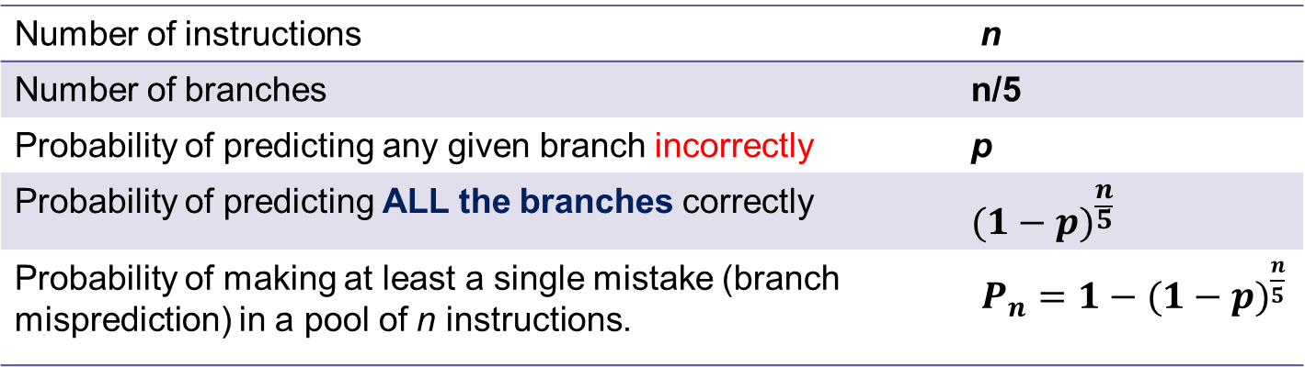
The Maths of Branch Prediction
Number of instructions | n
Number of branches | n/5
Probability of predicting any given branch incorrectly | p
Probability of predicting ALL the branches correctly | $$(1−p)^{\frac{n}{5}}$$
Probability of making at least a single mistake (branch misprediction) in a pool of n instructions. | $P_{n}=1−(1−p)^{\frac{n}{5}}$

Slide 42
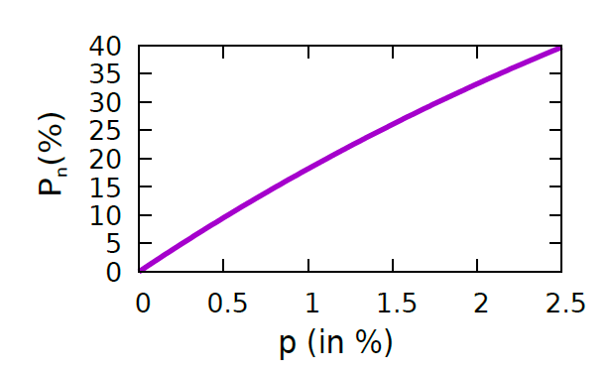

For (n=100) : A plot of P_{n} vs p
If P_{n} = 10%, p has to be as low as 0.5% !!!

Slide 43

If we need a large instruction window, we need a very accurate branch predictor. The accuracy of the branch predictor limits the size of the instruction window.

Slide 44
Nature of Dependences

Slide 45
Dependences between Instructions
Program Order Dependence
mov r1, 1
mov r2, 2
One instruction appears after the other in program order
The program order is the order of instructions that is perceived by a single cycle in-order processor executing the program.

Slide 46
Data Dependences
RAW → Read after Write Dependence (True dependence)
mov r1, 1
add r3, r1, r2
It is a producer-consumer dependence.
The earlier instruction produces a value, and the later instruction reads it.

Slide 47
Data Dependences - II
WAW → Write after Write Dependence (Output dependence)
mov r1, 1
add r1, r4, r2
Two instructions write to the same location
The later instruction needs to take effect after the former

Slide 48
Data Dependences - III
WAR → Write after Read Dependence (Anti dependence)
add r1, r2, r3
add r2, r5, r6
Earlier instruction reads, later instruction writes
The later instruction needs to execute after the earlier instruction has read its values

Slide 49
Control Dependences
beq .label
.....
.label
add r1, r2, r3
The add instruction is control dependent on the branch(beq) instruction
If the branch is taken then only the add instruction will execute, not otherwise

Slide 50
Basic Results
In-order processors respect all program order dependences. Thus, they automatically respect all data and control dependences.
OOO processors respect only data and control dependences.

Slide 51

Can output and anti dependences be removed?
mov r1, 1
add r5, r6, r7
add r1, r4, r2
add r8, r9, r10
add r1, r2, r3
add r5, r6, r7
add r2, r5, r6
add r8, r9, r10
Don’t you think that these dependences are there because we have a finite number of registers.
What if we had an infinite number of registers?
Set r1
Use r1
Use r1
Set r1
Use r1
Avatar 1
Avatar 2

Slide 52
Solution: Assume infinite number of physical registers
Architectural register
Physical register
Format in this example: rx is mapped to px<avatar number>
mov r1, 1
add r1, r2, r3
add r4, r1, 1
mov r2, 5
add r6, r2, r8
mov r1, 8
add r9, r1, r2
mov p11, 1
add p12, p2, p3
add p41, p12, 1
mov p21, 5
add p61, p21, p8
mov p13, 8
add p91, p13, p21
Code with architectural registers
Code with physical registers

Slide 53

Renaming
Program with real (architectural) registers
Program with physical registers
RAW dependences
RAW dependences
WAR dependences
WAW dependences
Higher instruction level parallelism (ILP)

Slide 54

Where are we now ...
Pool of Instructions
Branch Predictor
Fetch + Decode + Rename
Instruction
Memory
Issue + Reg.
read
Execution Units
Write back results

Slide 55
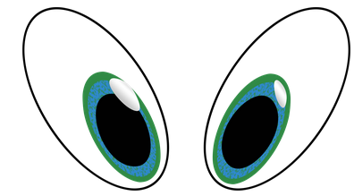

Issue with Write-back
Update State
Register File
Instructions
Processor
Memory
To an outsider should it matter if the processor is in-order or OOO
NO

Slide 56
Assume that there is an exception or interrupt
mov r4, 10
mov r2, 0
div r3, r1, r2
sub r4, r4, 1
Divide by 0
Divide by zero handler
Languages like C or Java have dedicated functions that are called if there is a divide-by-zero in the code.
The question is:
What if the sub instruction has executed when we enter the exception handler?
An in-order processor will never do this.

Slide 57
Precise Exceptions
Flow of actions
Regular Instructions
÷ by 0
Exception
handler
sub
inst.
Assume that the exception handler decides to do nothing and return back
After this the sub instruction should be executed
This is exactly what will happen in an in-order processor
In an OOO processor there is a possibility that the sub inst. can execute out of order
The outsider (exception handler) will see a different view as compared to the view it will see with an in-order processor.

Slide 58
Precise Exceptions - II
Correct
Regular Instructions
÷ by 0
Exception
handler
sub
inst.
Wrong
Regular Instructions
÷ by 0
sub
inst.
Exception
handler
To an external observer
The execution should always be correct and as per program order
Even in the presence of interrupts and exceptions

Slide 59
Precise Exceptions - III
We thus need precise exceptions
Assume that the dynamic instructions in a program (ordered in program order) are: ins₁, ins₂, ins₃ ... ins_{n}
Assume that the processor starts the exception/interrupt handler after it has just finished writing the results of instruction: ins_{k}
Then instructions: ins₁ ... ins_{k} should have executed completely and written their results to the memory/register file
AND, ins_{k+1} and later instructions should not appear to have started their execution at all
Such an exception or interrupt is precise
ins₁
ins₂
ins₃
ins_{k}
Exception
ins_{k+1}

Slide 60
Precise Exceptions in an OOO Processor
In program order
Processor
(Out-of-order execution)
Update State
Register File
Memory

Slide 61
Conclusion
In-order pipelines have a limited IPC because
of hazards and branches
Multi-issue in-order pipelines do not solve the
problem. Reason: dependences and interlocks
Hence, we issue instructions out-of-order (OOO). We need
a large instruction window to find sufficient independent insts.
To sustain a large instruction window, we need a very
accurate branch predictor.
To expose additional ILP, we can remove WAR/WAR
hazards. Finally, we need to have precise exceptions.

Slide 62
The End

