Slide 1








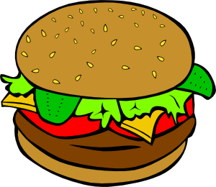









Slide 2





















Answer:

