Slide 1
Advanced Computer Architecture
Prof. Smruti R. Sarangi IIT Delhi

Slide 2

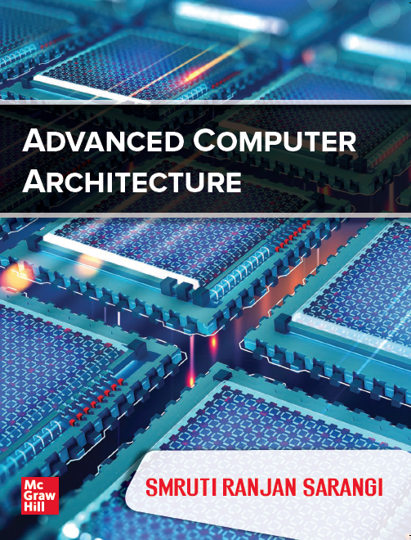
Book
PPTs
Videos
https://www.cse.iitd.ac.in/~srsarangi/advbook/

Slide 3

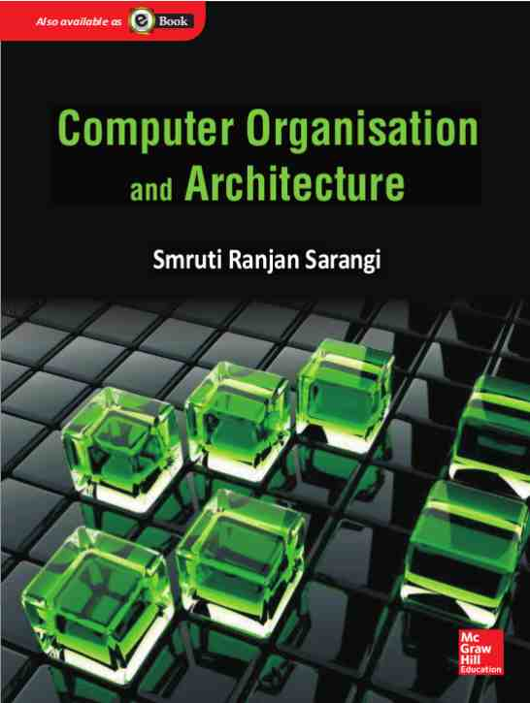
Background Required to Understand this Book
Assembly Languages
Basic Processor Design
Basic Pipeline Design
http://www.cse.iitd.ac.in/~srsarangi/archbooksoft.html

Slide 4
Roadmap of the Course
Multiprocessor Systems
Caches
Graphics
Processors
Out-of-order
Processors

