Slide 1
Introduction Mechanism
Prevention and Recovery
Soft Errors
A curse from the heavens
Smruti R. Sarangi
Department of Computer Science Indian Institute of Technology New Delhi, India

Slide 2


Introduction Mechanism
Prevention and Recovery
Outline
1
Introduction
2
Mechanism
3
Prevention and Recovery Device Level Solutions Circuit Level Techniques
Architecture Level Techniques

Slide 3

Introduction Mechanism
Prevention and Recovery
Curse from the Heavens

Slide 4
Introduction Mechanism
Prevention and Recovery
Soft Error
α
ϐ
current pulse
p
p
n
Figure 1: Current pulse after a particle strike
Definition
Soft Error: A soft error is any measurable or observable change in state or perfor- mance of a microelectronic device, component, subsystem, or system (digital or ana- log) resulting from a single energetic particle strike. The particle includes but is not limited to alpha particles, neutrons, and cosmic rays.

Slide 5
Introduction Mechanism
Prevention and Recovery
History of Research in Particle Strikes
People recorded failures in above ground nuclear sites from 1954 to 1957. (Wallmark and Marcus, 1962)
They started becoming important in space missions in the seven- ties.
The first example of soft errors in circuits was observed in DRAMs. This was observed for the first time at sea level.
In the early 80s most of the soft errors used to happen because of traces of radioactive elements like uranium and thorium in the packaging materials.
Soft Errors gradually started affecting static RAMs. The failure rate is between 100 to 1000 FITs.
By 2012, soft errors will begin affecting logic circuits. (adders, mul- tipliers, and other complex units).

Slide 6
Introduction Mechanism
Prevention and Recovery
Types of Soft Errors
Intrinsic
Power supply noise, cross coupling noise. Temperature variations.
Extrinsic
Cosmic rays.
alpha particles, neutrons, neutrinos, gluons

Slide 7
Introduction Mechanism
Prevention and Recovery
Radiation Mechanisms in Semiconductors
Alpha Particles: In the 70s the were emitted by traces of ura- nium and thorium impurities in packaging materials. Gold used in the pins and lead based isotopes in solder bumps are mainly responsible for alpha particle emissions today. Their energy is between 4-9 MeV.
Neutrons: These are produced by cosmic interactions in far away galaxies. They are able to penetrate the earth’s atmo- sphere and ionize the silicon substrate. Their energy is about 1 MeV.
Secondary radiation: Alpha particles and lithium nuclei are pro- duced by the interaction of neutrons with the unstable isotope of boron, B¹⁰, in boron doped silicon. Their energy is approxi- mately 1 MeV. They were the major source of soft errors in 25 and 18 µ technologies. However, B¹⁰ is nowadays filtered out in the fabrication process.

Slide 8
Introduction Mechanism
Prevention and Recovery
Dynamics of a Strike
In CMOS circuits the transistors in an “off” state are the most sensitive to particle strikes.
Sensitive areas.
Channel region of the nmos transistor. Drain region of the pmos transistor.
The particles typically have an LET greater 20 MeV – cm²/mg.
Definition
Linear Energy Transfer (LET) It is the amount of energy that a particle dissipates per unit distance. It is typically divided by the density of the target material.

Slide 9
Introduction Mechanism
Prevention and Recovery
What Happens on a Strike
The particle displaces electrons and holes, thus ionizing a part of the silicon substrate.

Slide 10
Introduction Mechanism
Prevention and Recovery
What Happens on a Strike
The particle displaces electrons and holes, thus ionizing a part of the silicon substrate.
The displaced electrons and holes begin to recombine. This creates a current pulse.

Slide 11
Introduction Mechanism
Prevention and Recovery
What Happens on a Strike
The particle displaces electrons and holes, thus ionizing a part of the silicon substrate.
The displaced electrons and holes begin to recombine. This creates a current pulse.
The current pulse propagates to other parts of the circuit. When the displaced charge, Q_{coll} , is more than Q_{crit} , the pulse is large enough to create a change in state.

Slide 12
Introduction Mechanism
Prevention and Recovery
What Happens on a Strike
The particle displaces electrons and holes, thus ionizing a part of the silicon substrate.
The displaced electrons and holes begin to recombine. This creates a current pulse.
The current pulse propagates to other parts of the circuit. When the displaced charge, Q_{coll} , is more than Q_{crit} , the pulse is large enough to create a change in state.
Q_{coll} is a function of the ionizing particle’s energy, trajectory, point of impact, and the local electric field.

Slide 13
Introduction Mechanism
Prevention and Recovery
What Happens on a Strike
The particle displaces electrons and holes, thus ionizing a part of the silicon substrate.
The displaced electrons and holes begin to recombine. This creates a current pulse.
The current pulse propagates to other parts of the circuit. When the displaced charge, Q_{coll} , is more than Q_{crit} , the pulse is large enough to create a change in state.
Q_{coll} is a function of the ionizing particle’s energy, trajectory, point of impact, and the local electric field.
The current transient lasts for around 200 picoseconds. (NOTE: A clock cycle is 500 ps on a 2 GHz processor). Most of the impact is within 2-3 microns of the impact site.

Slide 14
Introduction Mechanism
Prevention and Recovery
Shape of the Pulse
The current pulse typically has a sharp rise, and a very gradual fall.
(
Q
coll
t
−
t
−_{τβ}
I(t ) =
e ^{τ}α − e
τ_{α} − τ_{β}
τ_{α} is the collection time constant, which is process depen- dent.
τ_{β} is the ion-track establishment time constant. This is in- dependent of technology.
Typical values : τ_{α} = 164 ps, τ_{β} = 50 ps The displaced charge is about 0.65 pC.

Slide 15
Introduction Mechanism
Prevention and Recovery
Shape of the Pulse-II
0.002
current pulse
0.0018
0.0016
0.0014
0.0012
0.001
0.0008
0.0006
0.0004
0.0002
Current (A)
0
0
200
400
Time (ps)
600
800
1000
Figure 2: A typical current pulse
Any kind of heavy tailed distribution can be used to model it.
Pareto, Log-Normal, Weibull, Double Exponential, Levy

Slide 16
Introduction Mechanism
Prevention and Recovery
Hazucha-Svensson Model
Let us define the term SER as the number of times a current pulse capable of flipping a bit is generated per second.
The Hazucha-Svensson model defines the SER to be
SER = F ∗ CS
F is the neutron flux. The number of neutrons hitting an unit area per second.
CS : Critical Section. This is the area that is susceptible to particle strikes.
The critical section, CS, is proportional to the drain area and is an inverse exponential function of Q_{crit}
−
Q
crit
CS ∝ A ∗ e
Q_{S}

Slide 17
Introduction Mechanism
Prevention and Recovery
Hazucha-Svensson Model II
Q_{S} is the called the collection slope
It depends on the supply voltage and the doping profile.
The Hazucha-Svensson model proposes a one parameter model for the shape of the pulse.
2 t
_{e}−
t T
I(t ) =
T√π T
T is called the effective parameter.

Slide 18
Introduction Mechanism
Prevention and Recovery
Device Level Solutions Circuit Level Techniques
Architecture Level Techniques
General Approaches
Device Level Solutions Circuit Level Solutions Architecture Level Solutions

Slide 19


Introduction Mechanism
Prevention and Recovery
Device Level Solutions Circuit Level Techniques
Architecture Level Techniques
Outline
1
Introduction
2
Mechanism
3
Prevention and Recovery Device Level Solutions Circuit Level Techniques
Architecture Level Techniques

Slide 20
Introduction Mechanism
Prevention and Recovery
Device Level Solutions Circuit Level Techniques
Architecture Level Techniques
Purification of the Silicon
Use low alpha packaging materials.
Uranium and Thorium impurities are reduced to less than 100 parts per trillion.
Purify the gold connectors. Use low alpha based lead iso- topes for the soldering.

Slide 21
Introduction Mechanism
Prevention and Recovery
Device Level Solutions Circuit Level Techniques
Architecture Level Techniques
Purification of the Silicon
Use low alpha packaging materials.
Uranium and Thorium impurities are reduced to less than 100 parts per trillion.
Purify the gold connectors. Use low alpha based lead iso- topes for the soldering.
Reduced the incidence of B¹⁰.
Check all dopants for the unstable isotope.
Replace Boron Phosphate Silicate Glass (use as an insula- tor between metal layers) with other insulators.

Slide 22
Introduction Mechanism
Prevention and Recovery
Device Level Solutions Circuit Level Techniques
Architecture Level Techniques
Use Radiation Hardened Processes
There are two broad approaches to solving this problem: Reduce Q_{coll} or increase Q_{crit} .
Reduce Q_{coll}
Use a triple well process Silicon on insulator process
Increase Q_{crit}
Increase the supply voltage of the transistor Increase the size of the transistor

Slide 23
Introduction Mechanism
Prevention and Recovery
Device Level Solutions Circuit Level Techniques
Architecture Level Techniques
Triple Well Process
n
n
p
buried n well
Figure 3: Triple-well process for a NMOS transistor
An extra n-layer is added to isolate the substrate from electrical interference.
It is also very effective in reducing the displaced charge.

Slide 24

Introduction Mechanism
Prevention and Recovery
Device Level Solutions Circuit Level Techniques
Architecture Level Techniques
Do you know the name of this stone?

Slide 25
Introduction Mechanism
Prevention and Recovery
Device Level Solutions Circuit Level Techniques
Architecture Level Techniques
Do you know the name of this stone?
Sapphire

Slide 26
Introduction Mechanism
Prevention and Recovery
Device Level Solutions Circuit Level Techniques
Architecture Level Techniques
Silicon on Insulator(SOI)
n
n
p
insulating layer
Figure 4: SOI based NMOS transistor
The insulator is sapphire if we desire a radiation hardened process. The insulator shields the substrate from an external influence.
It also decreases its net volume, thus decreasing Q_{coll} in the pro- cess.

Slide 27
Introduction Mechanism
Prevention and Recovery
Device Level Solutions Circuit Level Techniques
Architecture Level Techniques
All about Q_{crit}
Q_{crit} primarily depends on four factors
Transistor size Supply voltage Output capacitance Doping Density
Q_{crit} decreases almost linearly with an increasing W/L ratio.
Q_{crit} decrease very sharply with an increase in supply voltage.

Slide 28
Introduction Mechanism
Prevention and Recovery
Device Level Solutions Circuit Level Techniques
Architecture Level Techniques
Outline
1
Introduction
2
Mechanism
3
Prevention and Recovery Device Level Solutions Circuit Level Techniques
Architecture Level Techniques

Slide 29
Introduction Mechanism
Prevention and Recovery
Device Level Solutions Circuit Level Techniques
Architecture Level Techniques
Logical Masking
0 1
0
0

Slide 30


Introduction Mechanism
Prevention and Recovery
Device Level Solutions Circuit Level Techniques
Architecture Level Techniques
Electrical Masking
Figure 5: Electrical masking : Pulse attenuation
A pulse gets severely attenuated as it passes through multiple gates.
It gradually loses all of its energy.

Slide 31

Introduction Mechanism
Prevention and Recovery
Device Level Solutions Circuit Level Techniques
Architecture Level Techniques
Timing Window Masking
logic
latch
latch
setup time hold time
critical window

Slide 32
Introduction Mechanism
Prevention and Recovery
Device Level Solutions Circuit Level Techniques
Architecture Level Techniques
Finding Sensitive Latches and Gates
Find the set of latches that are on sensitive paths. A “sensi- tive path” is a path of logic gates that can propagate a soft error with high probability.
Increase the size of the transistors of the latch. Increase the output capacitance of the latch.

Slide 33
Introduction Mechanism
Prevention and Recovery
Device Level Solutions Circuit Level Techniques
Architecture Level Techniques
Finding Sensitive Latches and Gates
Find the set of latches that are on sensitive paths. A “sensi- tive path” is a path of logic gates that can propagate a soft error with high probability.
Increase the size of the transistors of the latch. Increase the output capacitance of the latch.
Find the set of logic gates that are on sensitive paths.
Increase the chances of electrical masking by increasing the size of the transistors in the gate.
Or, connect those to a higher supply voltage line.

Slide 34
Introduction Mechanism
Prevention and Recovery
Device Level Solutions Circuit Level Techniques
Architecture Level Techniques
Outline
1
Introduction
2
Mechanism
3
Prevention and Recovery Device Level Solutions Circuit Level Techniques
Architecture Level Techniques

Slide 35
Introduction Mechanism
Prevention and Recovery
Device Level Solutions Circuit Level Techniques
Architecture Level Techniques
ECC and Redundancy
ECC : Error Correction Code
We typically have a SECDED code (single error correction, double error detection)
Almost all the memory elements are protected
Main Memory (since the 70s) L2 and L1 caches (since 2000)
Register Files (since early 2000)
Pipeline Latches (Fujitsu introduced it about 15 years ago)

Slide 36
Introduction Mechanism
Prevention and Recovery
Device Level Solutions Circuit Level Techniques
Architecture Level Techniques
ECC and Redundancy
ECC : Error Correction Code
We typically have a SECDED code (single error correction, double error detection)
Almost all the memory elements are protected
Main Memory (since the 70s) L2 and L1 caches (since 2000)
Register Files (since early 2000)
Pipeline Latches (Fujitsu introduced it about 15 years ago)
Redundancy
Redundant threads: Use another thread to check the results of the current thread. (IBM G-5)
Checker processors : Use a smaller processor to check the results of a larger processor.
Extra cores : Use an extra core on a multi-core machine to
check the results.

Slide 37
Introduction Mechanism
Prevention and Recovery
Device Level Solutions Circuit Level Techniques
Architecture Level Techniques
Architectural Vulnerability Factor (AVF)
Definition
Architectural Vulnerability Factor (AVF): AVF is the probability that a soft error results in a failure.
The failure rate due to soft errors can be defined as follows:
F = SER ∗ TVF ∗ AVF
SER is the soft error rate. TVF is the timing vulnerability factor i.e, the fraction of time, the unit is used. AVF is the probability that the error results in an erroneous output.

Slide 38








Introduction Mechanism
Prevention and Recovery
Device Level Solutions Circuit Level Techniques
Architecture Level Techniques
Dissecting AVF
Bit Read
yes
no
Protected
No Error
yes yes
no
Error is only detected
Error can be corrected
Does the bit matter?
yes
no
Detected but unrecovarable error (DUE)
No Error
Silent Data Corruption (SDC)
No Error
The error rate is a combination of SDC and DUE SDC is potentially more harmful

Slide 39
Introduction Mechanism
Prevention and Recovery
Device Level Solutions Circuit Level Techniques
Architecture Level Techniques
Examples
Example
Example of SDC: Bit flips in functional units that are not protected, e.g., ALU, decode logic, pipeline latches.
Example
Example of DUE: Multiple SER events in units that are protected like the register file or the caches.
When is there no error?

Slide 40
Introduction Mechanism
Prevention and Recovery
Device Level Solutions Circuit Level Techniques
Architecture Level Techniques
Examples
Example
Example of SDC: Bit flips in functional units that are not protected, e.g., ALU, decode logic, pipeline latches.
Example
Example of DUE: Multiple SER events in units that are protected like the register file or the caches.
When is there no error?
Instructions that don’t affect correctness
Dynamically dead instructions Wrong path instructions Performance instructions Prefetch instructions
No ops

Slide 41
Introduction Mechanism
Prevention and Recovery
Device Level Solutions Circuit Level Techniques
Architecture Level Techniques
Examples
Example
Example of SDC: Bit flips in functional units that are not protected, e.g., ALU, decode logic, pipeline latches.
Example
Example of DUE: Multiple SER events in units that are protected like the register file or the caches.
When is there no error?
Instructions that don’t affect correctness
Dynamically dead instructions Wrong path instructions Performance instructions Prefetch instructions
No ops
Functional units that don’t affect correctness
Branch predictor Performance counters

Slide 42
Introduction Mechanism
Prevention and Recovery
Device Level Solutions Circuit Level Techniques
Architecture Level Techniques
AVF for Functional Units
AVF is typically calculated on a per functional unit basis
It takes into cognizance the effect of redundant instructions, and characteristics of the functional unit.
The AVF for the branch predictor is zero. For the latches is about 50%.
It varies widely from 10% to 70% for all other units.
How is AVF calculated?
For units like the branch predictor, it can be calculated theoretically Otherwise, it is estimated with profiling runs for a set of benchmarks.
Inject a fault
Observe if the fault causes a failure in the program

Slide 43
Introduction Mechanism
Prevention and Recovery
Device Level Solutions Circuit Level Techniques
Architecture Level Techniques
Some More Definitions
Definition
ACE : Architecturally Correct Execution. These are instructions that determine the program output. Their erroneous exeuction will lead to a failure.

Slide 44
Introduction Mechanism
Prevention and Recovery
Device Level Solutions Circuit Level Techniques
Architecture Level Techniques
Some More Definitions
Definition
ACE : Architecturally Correct Execution. These are instructions that determine the program output. Their erroneous exeuction will lead to a failure.
Definition
Dynamically Dead Instruction : These are instructions whose values don’t propagate to the final output of the program.

Slide 45
Introduction Mechanism
Prevention and Recovery
Device Level Solutions Circuit Level Techniques
Architecture Level Techniques
Some More Definitions
Definition
ACE : Architecturally Correct Execution. These are instructions that determine the program output. Their erroneous exeuction will lead to a failure.
Definition
Dynamically Dead Instruction : These are instructions whose values don’t propagate to the final output of the program.
Definition
Ex-ACE instruction : Let us consider an ACE instruction in the instruc- tion queue. After it is issued, it is still in the queue till it gets evicted by a newer instruction. After an ACE instruction leaves a functional unit, and is not required anymore by the unit, it becomes an Ex-ACE instruction.

Slide 46
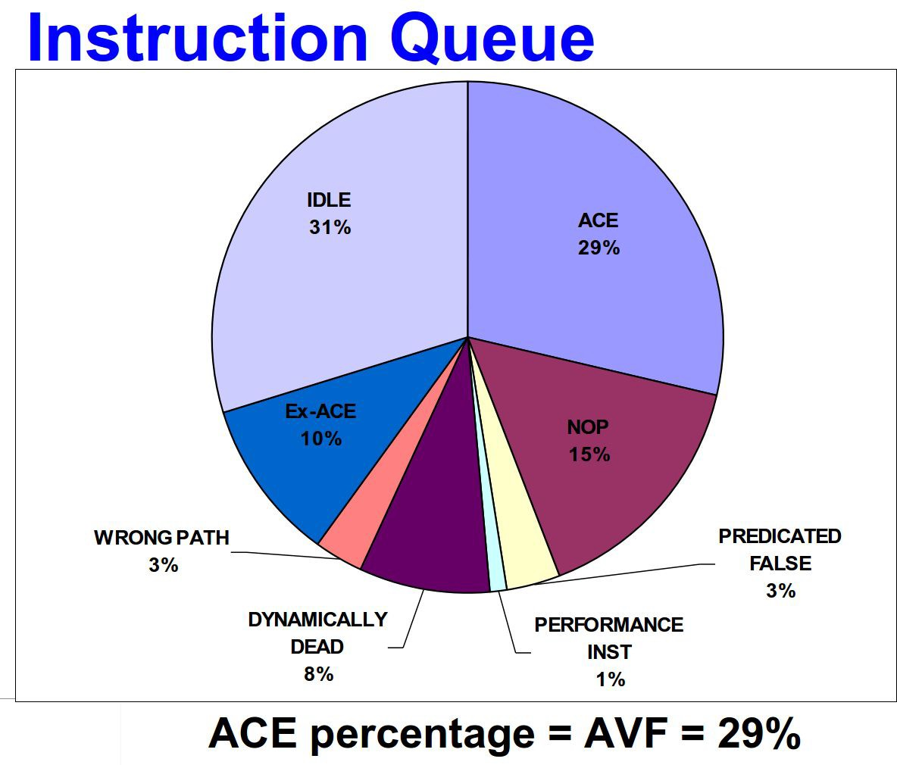
Introduction Mechanism
Prevention and Recovery
Device Level Solutions Circuit Level Techniques
Architecture Level Techniques
AVF for the Instruction Queue
Figure 6: AVF for the instruction queue (courtesy Shubu Mukherjee Intel)

Slide 47
Introduction Mechanism
Prevention and Recovery
Device Level Solutions Circuit Level Techniques
Architecture Level Techniques
Shubhendu S. Mukherjee, Christopher T. Weaver, Joel S. Emer, Steven
K. Reinhardt, Todd M. Austin: A Systematic Methodology to Compute the Architectural Vulnerability Factors for a High-Performance Microproces- sor. MICRO 2003 http://portal.acm.org/citation.cfm?doid=956417.956570
Fan Wang, Agrawal, V.D. : Single Event Upset: An Embedded Tutorial, VLSI Design 2008 http://ieeexplore.ieee.org/xpls/abs_all.jsp?arnumber= 4450538

Slide 48
Can a Processor have a Design Defect ?
No Way !!!
Yes, it is a major challenge.

Slide 49
A Major Challenge ???
50-70% effort spent on debugging
1-2 year verification times
Massive computational resources
Some defects still slip through
to production silicon

Slide 50
Defects slip through ???
1994
Pentium defect costs Intel $475 million
1999
Defect leads to stoppage in shipping Pentium III servers
2004
AMD Opteron defect leads to data loss
2005
A version of Itanium 2 recalled
Increasing features on chip
Conventional approaches are ineffective
Micro-code patching
Compiler workarounds
OS hacks
Firmware
Does not look like it will stop

Slide 51
Vision
Processors include programmable
HW for patching design defects
Vendor discovers a new defect
Vendor characterizes the conditions
that exercise the defect
Vendor sends a defect signature
to processors in the field
Customers patch the HW defect

Slide 52
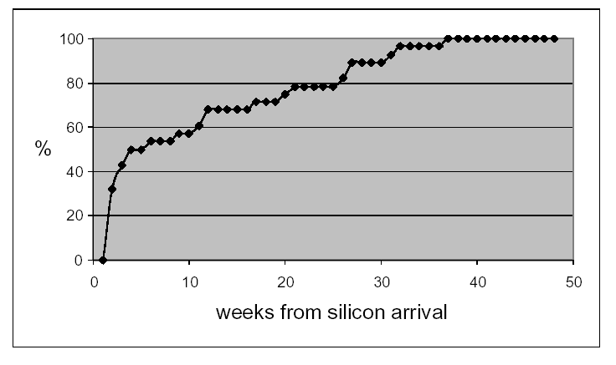
Additional Advantage: Reduced Time to Market
Pentium-M, Silas et al., 2003
% of defects detected
8 weeks
Reduced time to market → Vital ingredient of profitability

Slide 53
Outline
Analysis and Characterization
Architecture for Hardware Patching
Evaluation

Slide 54
Defects in Deployed Systems
100%
50
% of defects detected
We studied public domain errata documents for 10 current processors
  Intel Pentium III, IV, M, and Itanium I and II
  AMD K6, Athlon, Athlon 64
  IBM G3 (PPC 750 FX), MOT G4 (MPC 7457)

Slide 55
Dissecting a Defect – from Errata doc.
Module
L1, ALU, Memory, etc.
Defect
Type of Error
Hang, data corruption
IO failure, wrong data
Condition
A ∪ (B∩C∩D)
Snoop
L1 hit
IO request
Low power mode
Signal

Slide 56
Types of Defects
Design Defect
Non-Critical
Critical
Performance counters
Error reporting registers
Breakpoint support
Defects in memory, IO, etc.
Concurrent
Complex
All signals – same time
Different times

Slide 57
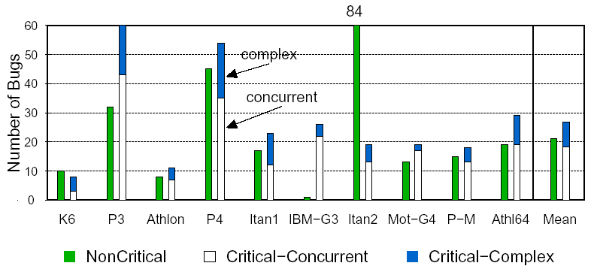
Characterization
31%
69%

Slide 58
When can the defects be detected ?
Post Defect (37%)
Condition
Detector
Local
Pipeline
Other
Signals
Defect
Pre Defect (63%)
ALU
time
Memory, IO

Slide 59
Outline
Analysis and Characterization
Architecture for Hardware Patching
Evaluation

Slide 60
Phoenix Conceptual Design
Store defect signatures
obtained from vendor
Program the on-chip
reconfigurable logic
Signature Buffer
Signal Selection Unit
(SSU)
Tap signals from units
Select a subset
Reconfigurable
Logic
Bug Detection Unit
(BDU)
Collect signals from SSUs
Compute defect conditions
Initiate recovery if a
defect condition is true
Global Recovery Unit

Slide 61
Distributed Design of Phoenix
Neighborhood
Subsystem
Subsystem
To Recovery
Unit
To Recovery
Unit
BDU
SSU
HUB
SSU
BDU
Examples of Subsystems
Inst. Cache | FP ALU | Virtual Mem.
Fetch Unit | L1 Cache | IO Cntrl.

Slide 62
Overall Design
Chip Boundary
Global Recovery
Unit
Neighborhood
Neighborhood
HUB
HUB
HUB
HUB
Neighborhood
Neighborhood

Slide 63
Software Recovery Handler
Flush Pipeline
Rest of Post
Checkpointing
Support
Local Post
Type of
Defect
Yes
No
Reset Module
Pipeline Post
+
Rollback
Interrupt to
OS
Pre
Turn condition off
continue

Slide 64
Designing Phoenix for a New Processor
New Processor
List of Signals
Sizes of Structures
Training
Data
Generic
Specific
Learn from other
processors
Processor
data sheets
Scatter plot of sizes
vs. # of signals in unit
Derive rules of thumb
Training
Data

Slide 65
Designing Phoenix for a New Proc. – II
Generate list of signals to tap
Decide on breakdown of
subsystems and neighborhoods
Place BDUs, SSUs, and HUBs
Size structures using the
rules of thumb
Route all signals and realize
the logic function of defects

Slide 66
Outline
Analysis and Characterization
Architecture for Hardware Patching
Evaluation

Slide 67
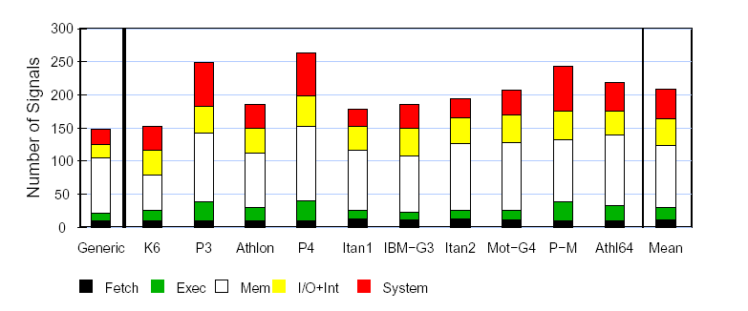
Signals Tapped
Generic+Specific
150-270
Generic Signals
Specific Signals
L2 hit, low power mode
ALU access, etc.
A20 pin set in Pentium 4
BAT mode in IBM 750FX
Notes:
annotate 150-270 , last thing

Slide 68
Defect Coverage Results
Training Set:
Intel P3, P4, P-M
Itanium I & II
AMD K6, K7
AMD Opteron
IBM G3
Motorola G4
All Defects
Recover
Concurrent
Complex
63%
Pre
Post
Detect
37%
69%
31%
Test Set:
UltraSparc II
Intel IXP 1200
Intel PXA 270
PPC 970
Pentium D
Detection Coverage
65%
Test Processors
Recovery Coverage
60%

Slide 69
Overheads
Overheads
Area
Wiring
Timing
Programmable logic
(PLA & interconnect)
Estimated using PLA
layouts (Khatri et al.)
Wires to route signals
Estimated using Rent’s rule
None
0.05%
0.48%

Slide 70
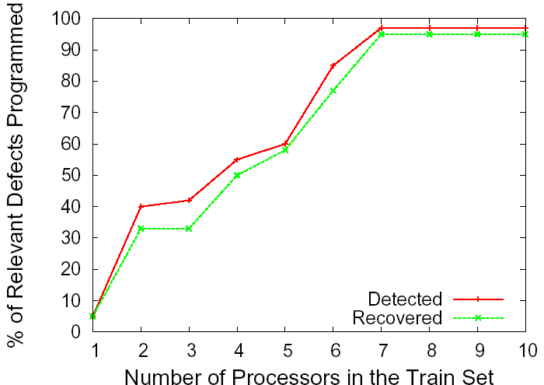
Impact of Training Set Size
Train set only needs to have 7 processors
Coverage in new processors is very high

Slide 71
Conclusion
We analyzed the defects in 10 processors
Phoenix novel on-chip programmable HW
Evaluated impact:
  150 – 270 signals tapped
  Negligible area, wiring, and performance overhead
  Defect coverage: 69% detected, 63% recovered
  Algorithm to automatically size Phoenix for new procs
We can now live with defects !!!

Slide 72
Phoenix: Detecting and Recovering from Permanent Processor Design Bugs with Programmable Hardware
Smruti R. Sarangi
Abhishek Tiwari
Josep Torrellas
University of Illinois at Urbana-Champaign
http://iacoma.cs.uiuc.edu

Slide 73
Backup

Slide 74
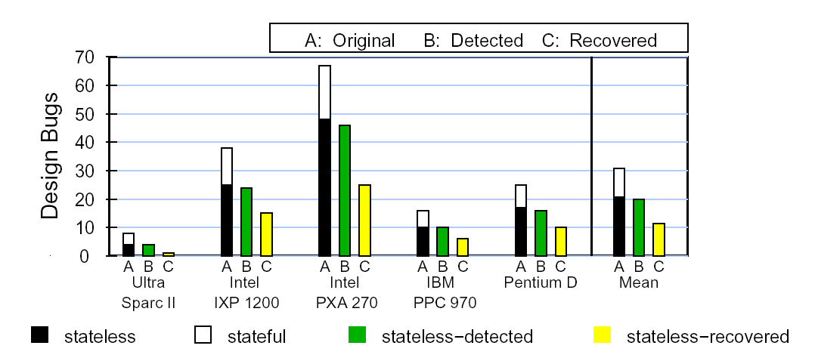
Phoenix Algorithm for New Processors
Generate Signal List
Defect Coverage for New Processors
Place a SSU-BDU pair
in each subsystem
Use k-means clustering to
group subsystems in nbrhoods
Size hardware using the
thumb-rules
Similar results obtained for 9 Sun processors – UltraSparc III, III+, III++, IIIi, IIIe, IV, IV+, Niagara I and II
Map signals in errata to
signals in the list
Route all signals and realize
the logic function

Slide 75
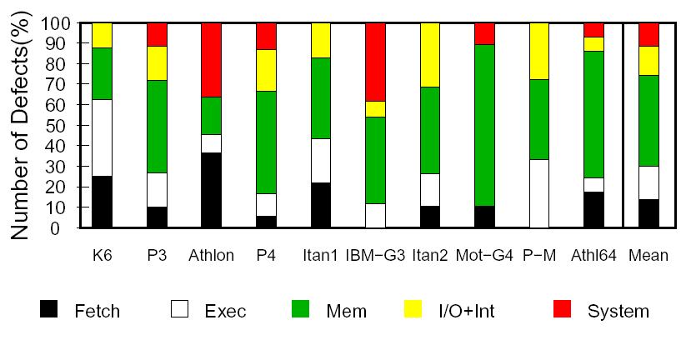
Where are the Critical defects ?
The core is well debugged
Most of the defects are in the mem. system

Slide 76
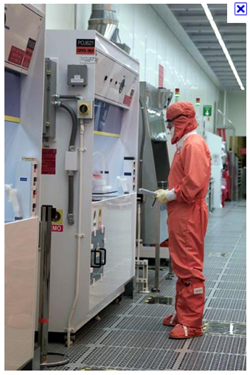
Semiconductor
Fabrication facility
(courtesy tabalcoaching.com)

Slide 77
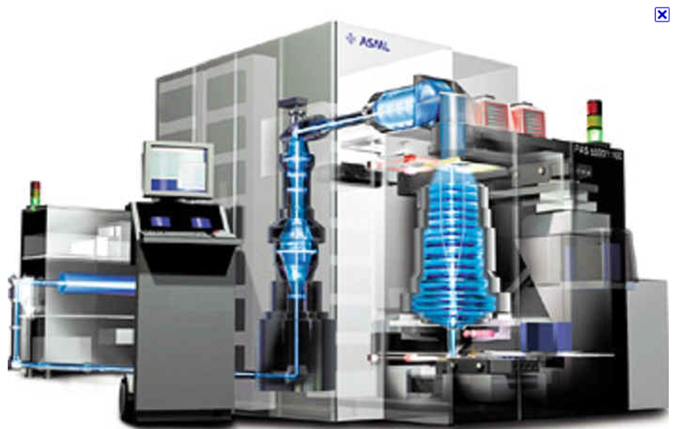
Photolithography Unit
(Courtesy Upenn)

Slide 78
Basic Lithographic Process
The source of light is typically a argon-flouride laser
The light passes through an array of lenses to reach the silicon substrate
The resolution limit is given by:
To decrease the resolution we need to :
  Decrease the wavelength
  Increase the refractive index
R = k₁λ / NA
NA = n sin θ

Slide 79
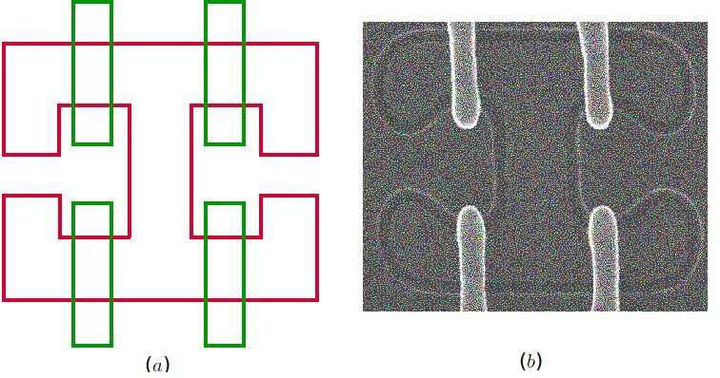
Resolution
We currently use 193 nm light to make 14nm structures
This is what we get

Slide 80
Methods to Compensate for Process Variation – Optical Proximity Correction
Pre-distort the shape such that it prints better

Slide 81
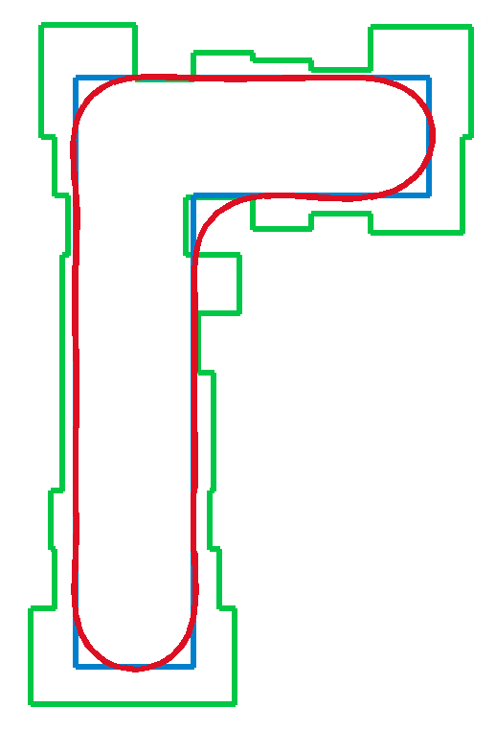

Slide 82
Assist Features
Add small sub-resolution features to increase the exposure at areas, which print sub-optimally

Slide 83
Phase-shift Masking
Insert features, which have a long optical path length (this inverts the phase)
Due to destructive interference the lines will not fuse

Slide 84
Parameter Variation
Parameter Variation
P
V
T
Process
Supply Voltage
Temperature
Threshold Voltage – V_{t}
Transistor Length – L_{eff}

Slide 85
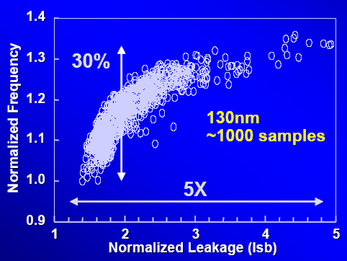
Why is Variation a Problem ?
Unpredictability of V_{t} , L_{eff} and T implies :
→ Lower chip frequency and higher leakage
courtesy Shekhar Borkar, Intel

Slide 86
Implications on Design Decisions
Static timing analysis not possible
Overly conservative designs
  Chips too slow
  Performance of a generation lost
Possible solution
  Clock the chip at an unsafe frequency
  Tolerate resulting timing errors
  Reduce timing errors
    Architectural techniques
    Circuit techniques

Slide 87
Overview
Model for Process Variation
Model for Timing Errors due to
Process Variation
Techniques to
Tolerate Timing Errors
Techniques to
Reduce Timing Errors
Dynamic Optimization

Slide 88
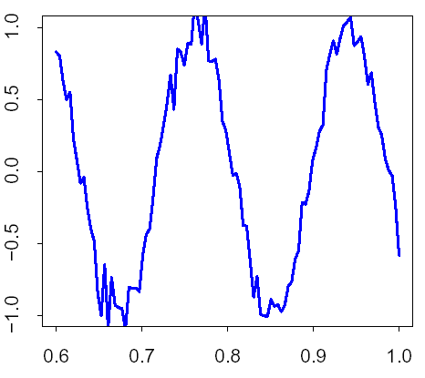
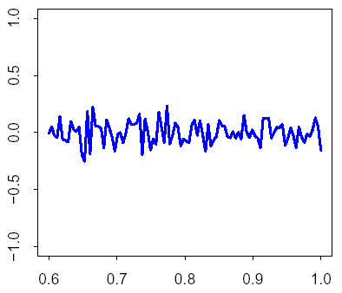
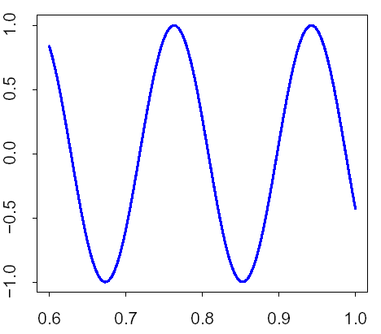
Process Variation
Process Variation
Systematic Variation
Random Variation
Lens aberrations
Mask deformities
Thickness variation in CMP
Photo-lithographic effects
Variable dopant density
Line edge roughness

Slide 89
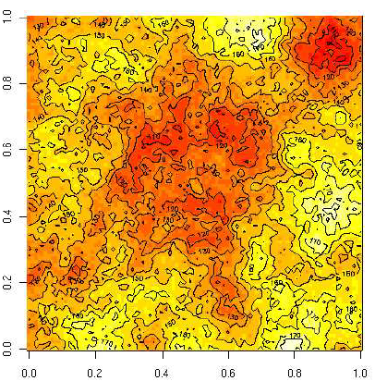
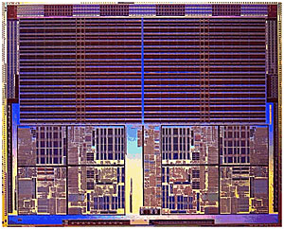
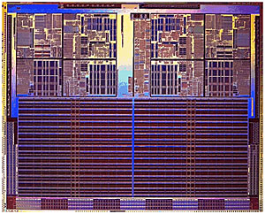
Modeling Systematic Variation
Variation Map
Break into a million cells
1000
1000

Slide 90
Systematic and Random Variation
Distribution of systematic components
  Normal distribution
Normal Distribution
Spatial Correlation
Multi-variate
Normal Distribution
Superimpose random variation on top of systematic

Slide 91
Overview
Model for Process Variation
Model for Timing Errors due to
Process Variation
ISQED ‘07
Techniques to
Tolerate Timing Errors
Techniques to
Reduce Timing Errors
Dynamic Optimization

Slide 92
Timing Errors
P(E) = 1 – cdf(t_{clk})
Timing errors
Distribution of path delays
in pipe stage: No variation
Distribution of path delays
in pipe stage: With variation

Slide 93
Model for Timing Errors
Basic assumptions
  A structure consists of many critical paths
    The critical path depends on the input
    critical path delay > clock period → timing error
  clock period = delay of the longest critical path at
    maximum temperature
    no variation
  All pipeline stages are tightly designed → 0 slack

Slide 94
Paths in a Pipeline Stage
t
Timing errors
1
f
pdf(t)  cdf (t)
Error rate: P_{E} (t) = 1 – cdf(t)

Slide 95
Basic Kinds of Structures
Logic
Memory
Heterogeneous critical paths
ALUs, comparators, sense-amps
Homogenous critical paths
SRAMs, CAMs
Mixed
x% memory and (100-x)% logic
Used to model renamer, wakeup/select

Slide 96
Logic
Critical Path
35% Wiring
65% Gates
Elmore Delay Model
Alpha Power Law

Slide 97
Logic Delay
Distribution of path delays – no variation
d_{wire} + d_{gate} = 1
(d_{wire}+
D_{varlogic} =
D_{logic}
η*
d_{gate})*
D_{logic}
+d_{gate}*D_{extra}
Distribution of
path delays
with variation
Relative gate delay
due to systematic
variation in P,V, T
Delay due to variation
in the random and syst.
component within a stage
Obtain D_{logic} using a timing analysis tool

Slide 98
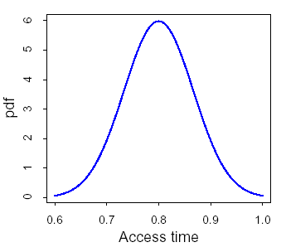
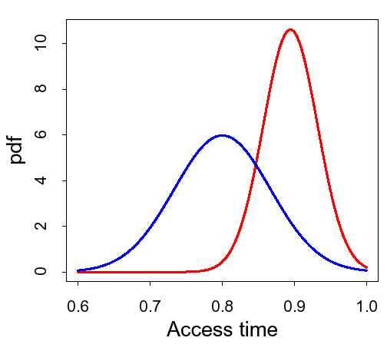
Memory Delay
Memory Cell
Memory Line
extend analysis
done by Roy et. al.
IEEE TCAD ‘05
Use Kirchoff’s equations
Long channel trans. equations
Multi-variable Taylor expansion
Delay dist.
max. distribution
Delay_{line} = max(Delay_{cell})

Slide 99
Combined Error Model
We have the delay distributions – cdf(t) – for memory and logic with variation
For each structure
  per access, P(E) = 1 – cdf(t)
  P(E) per inst. = αP(E) , α=accesses/inst.
Combined error rate per instruction
P(E)_{total} = Σ αP(E)

Slide 100
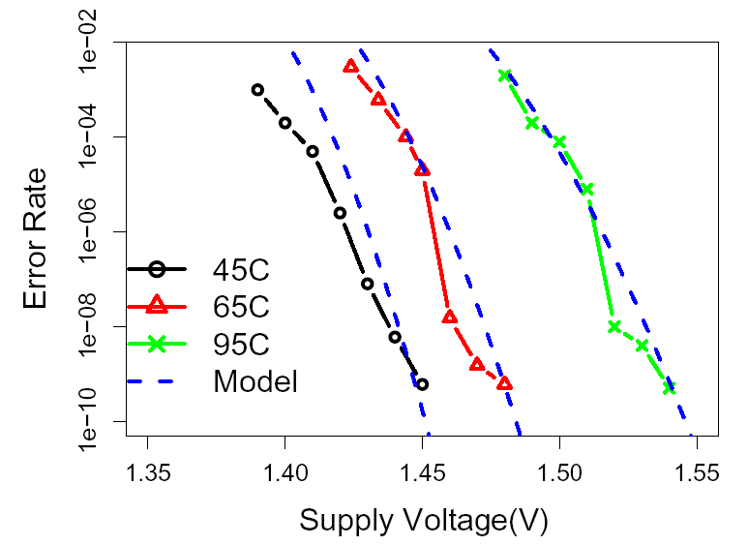
Validation – Logic
S. Das et. al. ‘05

Slide 101
Overview
Model for Process Variation
Model for Timing Errors due to
Process Variation
Techniques to
Tolerate Timing Errors
Techniques to
Reduce Timing Errors
Dynamic Optimization

Slide 102
Variation Aware Timing
Speculation (VATS)
Multicore
Chip
Unsafe
frequency
Error free:
- Lower freq
- Safe design
Checker
Processor
Core
Diva
Checker
L0 Cache
Razor Latches
L1 Cache

Slide 103
Other VATS Checkers
TIMERRTOL – Uht et. al.
Razor – Dan Ernst et. al., MICRO 2003
X-Checker – X. Vera et. al, SELSE 2006
X-Pipe – X. Vera et. al., ASGI 2006
Sato and Arita, COSLP 2003

Slide 104
Overview
Model for Process Variation
Model for Timing Errors due to
Process Variation
Submitted to
ISCA ‘07
Techniques to
Tolerate Timing Errors
Techniques to
Reduce Timing Errors
Dynamic Optimization

Slide 105
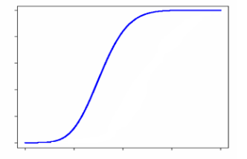
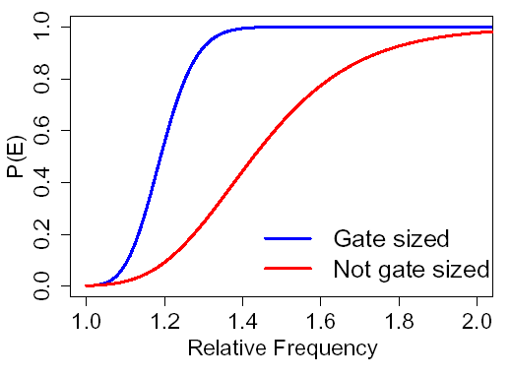
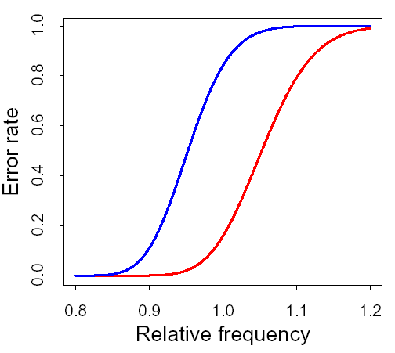
Basic Mechanisms – Shift and Tilt
Error Rate(P_{E})
f
Tilt
frequency
Shift
Errror Rate(P_{E})
Before
Errror Rate(P_{E})
f
f
After
Before
After
frequency
frequency

Slide 106
Architectural Mechanisms
SRAM/CAM array
Resizable issue queue
(Albonesi et. al.)
  switch pass trans. off
  smaller queue
  shifts the error rate curve
Pass Transistors
SRAM/CAM array
Pass Transistors
Original
New error
rate
SRAM/CAM array
Sense Amps

Slide 107
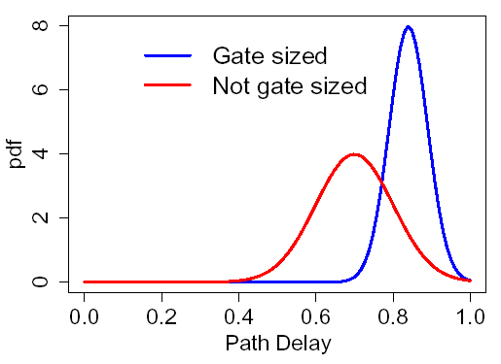
Gate Sizing
Transistor Width – W
Delay ∝ A + B/W
Power ∝ W
Make faster paths
slower to save power
Original path
delay dist.
Gate Sizing

Slide 108
Optimization: Replicate ALUs
Difference in Error Rate
Tradeoff is power vs errors
IDEA : Switch between the two ALUs
  Use gate sized ALU if it is not timing critical and vice versa

Slide 109
Fine Grain ABB and ASV
Error Rate(P_{E})
Adaptive Body Bias (ABB) – V_{bb}
  V_{bb} → Delay Leakage
  V_{bb} → Delay Leakage
Adaptive Supply Voltage (ASV) -- V_{dd}
  V_{dd} → Delay Leakage Dynamic
f
frequency
Multicore
Chip
Vary:
Supply Voltage(ASV)
Body Voltage (ABB)
Core

Slide 110
Overview
Model for Process Variation
Model for Timing Errors due to
Process Variation
Techniques to
Tolerate Timing Errors
Techniques to
Reduce Timing Errors
Dynamic Optimization

Slide 111
Dynamic Behavior
Temperature
Activity Factors

Slide 112
Formulate an Optimization Problem
Optimization
Input
Output
Constraints
Goals
Constraints
  Temperature – At all points T < T_{MAX}
  Power – Total core power < P_{MAX}
  Error – Total errors < Err_{MAX}
Goal – Maximize performance

Slide 113
Outputs
Outputs:
1
15 ABB/ASV regions
  30 values of (V_{dd}, V_{bb})
33 outputs
f, V_{dd}, V_{bb} can take many values
Very large state space
+ 30
+ 1
+ 1
= 33
ALU
V_{dd}
V_{bb}
f
Issue queue
size

Slide 114
Dimensionality Reduction
Find the max. frequency that each stage can support
Find the slowest stage
This is the core frequency
Minimize power in the rest of the units
Minimum Frequency
Max. Frequency
core frequency
1
2
3
4
5
6
7
Stages

Slide 115
Inputs
Phase
Heat sink cycle
Forever
Inputs :
α, T_{H}, V_{t0}, R_{th}, K_{leak}
activity factor
accesses/cycle
Heat sink
temperature
Thermal
resistance
Constant in
Leakage eqn.

Slide 116
Optimization Overview
f_{core}
min
f_{core}
Inputs
Inputs
f⁽¹⁾
f⁽¹⁵⁾
Freq. Algorithm
Freq. Algorithm
Power Algorithm
Power
Algorithm
Inputs
Inputs
V_{dd}
V_{bb}
V_{dd}
V_{bb}

Slide 117
Fuzzy Logic Based Algorithm
Exhaustive Search
(Freq/Power)
Fuzzy Logic
based Algorithm
Inputs
+ Very fast computation times
+ Incorporates detailed models
- Slight inaccuracy
- Computationally expensive
- Requires detailed models
+ Accurate Results

Slide 118
Final Picture
f_{core}
min
f_{core}
Inputs
Inputs
f⁽¹⁾
f⁽¹⁵⁾
Fuzzy
SubController₁
Fuzzy
SubController₁₅
Fuzzy
SubController₁
Fuzzy
SubController₁₅
Inputs
Inputs
V_{dd}
V_{bb}
V_{dd}
V_{bb}

Slide 119
Timeline
Heat Sink Cycle ≈ 2-3 secs
Phase ≈ 120 ms
Phase
t
Retuning Cycles
STOP
1 step
Test configuration
≈
≈
20 μs
6 μs
10 μs
2 ms
0.5 μs
2 ms
New Phase
Detected
Bring to chosen working point
Run Fuzzy Controller Algorithm
Measure IPC and α^{i}

Slide 120
Results

Slide 121
Evaluation Framework
Processor Modeled
Core
Core
C
C
Athlon 64 floorplan
3-wide processor
12 stage pipeline
45 nm, V_{dd} = 1 V, 6 GHz
Core
Core
C
C
4-core private L2 cache
Sherwood phase detector (ISCA ’03)
Variation Modeling
  PVT maps for 100 dies
Fuzzy controller
  10,000 training examples
  25 rules
10 SpecInt and 10 SpecFp
benchmarks, 1 billion insts.

Slide 122
Terminology
Baseline | Proc. with variation effects
TS | Baseline+DIVA checker
TS+FU | TS + FU replication
TS+Queue | TS + issue-queue resizing
TS+ABB+ASV | Both circuit level techniques
TS+Dyn | TS + dynamic optimization
TS+All | TS+FU+Queue+ABB+ASV+dyn
NoVar | Without any variation effects

Slide 123
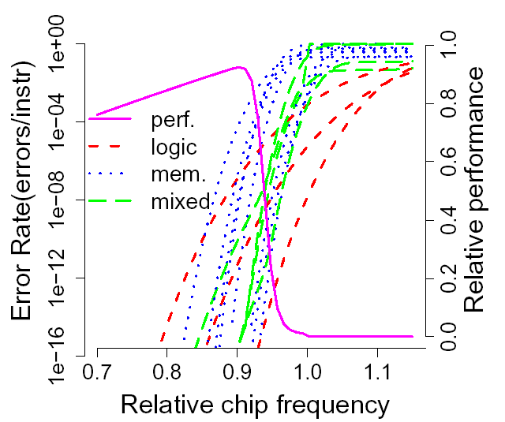
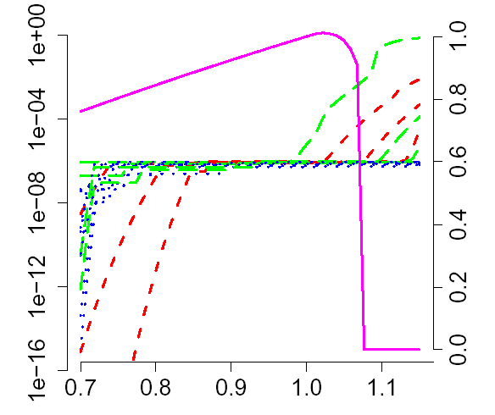
Error Plots
Maximum Perf.
point
Maximum Perf.
point
Err_{MAX}
TS only
ALL = TS + ABB + ASV

Slide 124
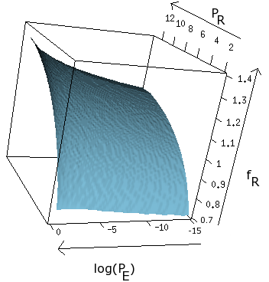
Execution Point
constant
error
constant
power
Power
frequency
power
power
errors
constant
freq.
frequency
errors
Frequency
Log (Timing Error Rate)

Slide 125
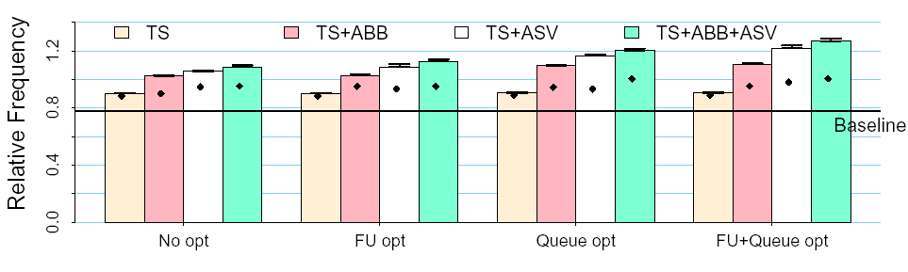
Frequency
Oracle
Fuzzy
49%
23%
Static
Frequency increase: 10 – 49 %
≈50% of the gains are due to dynamic opts.

Slide 126
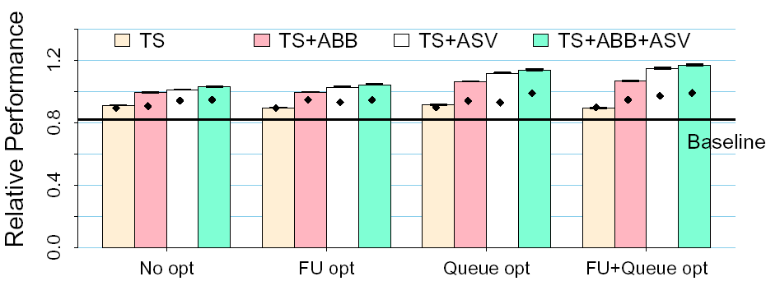
Performance
34%
19%
Static
We can nullify effects of variation and even speedup
The performance loss due to fuzzy logic is minimal

Slide 127
Conclusion
Do not design processors for worst case
  → Need to tolerate variation induced errors
Contributions
  Model for timing errors
  New framework for tradeoffs in P, f and P(E)
  High dimensional dynamic adaptation
  Eval. of μarch. techniques to tolerate/mitigate P(E)
10-49% increase in frequency
7-34% increase in performance

Slide 128
Conclusion II
CADRE (DSN’06)
  Arch. support to make a board level computer cycle-accurate deterministic
Phoenix (MICRO’06 & Top Picks’07)
  μarch. support to detect and patch processor design bugs

Slide 129
BACKUP

Slide 130
Algorithm
Inputs :
∀ f, V_{dd}, V_{bb}
α
P_{dyn}
α
, R_{th}, T_{H}
Verify T < T_{MAX}
T
R_{th}, T_{H}
P_{leak}
, P_{leak0}, V_{t}
P_{leak0}, V_{t}
Verify Err < Err_{MAX}
Delay
V_{t}
Error Model
Find f_{max}

Slide 131
Memory Delay
WL
V_{DD}
Y
Solve for I_{cell} using long channel eqns.
I_{cell} = f(Vt_{X},Vt_{Y},L_{X},L_{Y})
Vt_{X},Vt_{Y},L_{X} and L_{Y} are gaussian variables
I_{cell}
X
BL
BR
μ_{vtx}, μ_{vty}, μ_{lx}, μ_{ly} are the systematic components
σ_{vtx}, σ_{vty}, σ_{lx}, σ_{ly} are the random components

Slide 132
Memory Delay - II
Find a distribution for T_{mem}
  T_{mem} is a function of four gaussian variables
  Model T_{mem} as a normal distribution
  Find the μ and σ for T_{mem} using multi-variable Taylor expansion
  This is the access time dist. for 1 bit
A typical entry has 32-128 bits
  Find the max distribution of 32-128 normal variables
Error probability = 1 – cdf(t_{mem})

Slide 133
Fuzzy Low Level
X
X_{j}
X_{j}
W
y
μ
σ
y
μ_{ij}
μ_{ij}
σ_{ij}
σ_{ij}
y_{i}
i
y_{i}
j
W_{ij} = exp[ -(( - )/ )²]
Final Output
W_{i}

Slide 134
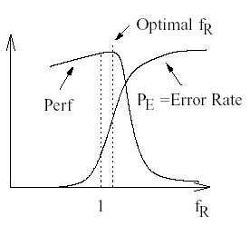
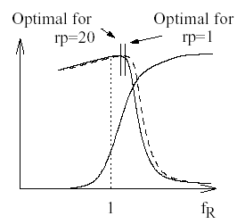
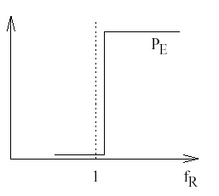
Recovery Penalty

Slide 135
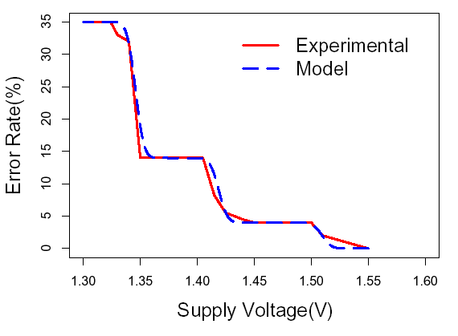
Validation – Memory

Slide 136
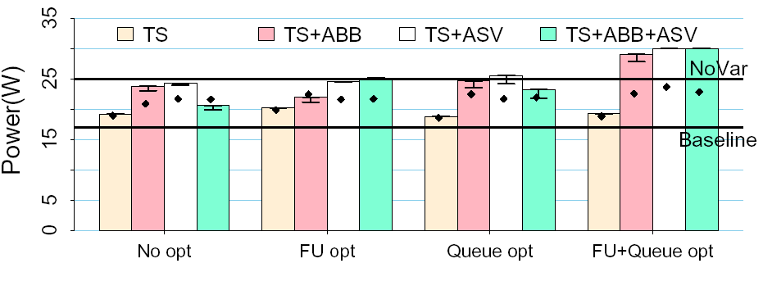
Power
Max Power Limit
Proc. with no variation – 25 W, P_{MAX} = 30 W

Slide 137
Introduction Checker Processors
Advanced Checker Processors Design and Implementation
Checker Processors
Smruti R. Sarangi
Department of Computer Science Indian Institute of Technology New Delhi, India

Slide 138


Introduction Checker Processors
Advanced Checker Processors Design and Implementation
Outline
1
Introduction
Checker Processors Checker Pipeline Checking Mechanism
Advanced Checker Processors Issues with DIVA
Reducing the Loss of Performance in DIVA
Core Checker L1 Failure
Design and Implementation
2
3
4

Slide 139

Introduction Checker Processors
Advanced Checker Processors Design and Implementation
The Pentium Bug
Example
Story of the pentium bug: There was an error in the 9th digit for floating point division. The bug typically showed up in large financial and scientific calculations. Intel recalled all the Pentium chips and replaced them. It had lost about 500 million dollars, 20 years ago.

Slide 140
Introduction Checker Processors
Advanced Checker Processors Design and Implementation
Stories of Some More Bugs
A bug in AMD Opteron forced the designers to turn off prefetch- ing. This had a massive performance impact.
Bugs in IBM’s G3 processor forced the designers to turn off power management.
Due to soft errors, IBM stopped shipping its servers. Cus- tomers turned to Sun servers.
Many more such bugs have been reported, resulting in mas- sive losses to companies.
Is there a way to stop faults from becoming failures?

Slide 141
Introduction Checker Processors
Advanced Checker Processors Design and Implementation
Sources of Faults
Hard Errors: Permanent defects in wires or transistors that typically manifest over time.
Soft Errors: Transient faults caused by current pulses gen- erated by alpha particles and neutrons.
Design Bugs: Errors in cpu design.
Process Variation related Faults: Faults due to problems introduced by the fabrication process.

Slide 142
Introduction Checker Processors
Advanced Checker Processors Design and Implementation
Checker Pipeline Checking Mechanism
Idea of a Checker Processor
Have a checker processor that can check the results of the main processor.
Has significantly simpler logic. The checker is very extensi- bly verified. Hence, it has a low chance of having a design fault.
The transistors are bigger in size. This reduces the chances of soft errors.
The frequency is lower. This along with the fact that the
design is simpler, ensure that the temperature is significantly lower. Low temperature ⇒ less hard errors

Slide 143

Introduction Checker Processors
Advanced Checker Processors Design and Implementation
Checker Pipeline Checking Mechanism
Outline
1
Introduction
Checker Processors Checker Pipeline Checking Mechanism
Advanced Checker Processors Issues with DIVA
Reducing the Loss of Performance in DIVA
Core Checker L1 Failure
Design and Implementation
2
3
4

Slide 144


Introduction Checker Processors
Advanced Checker Processors Design and Implementation
Checker Pipeline Checking Mechanism
Processor Pipeline
EX
IF ID REN
ROB
CT
Instruction Queue
in order retirement
commit
Figure 1: Regular processor pipeline
Instructions are executed out of order.
The reorder buffer(ROB) aggregates them, and commits their state in order. (Why ???)

Slide 145

Introduction Checker Processors
Advanced Checker Processors Design and Implementation
Checker Pipeline Checking Mechanism
DIVA Pipeline
Processor
Diva core
EX
watchdog
timer
IF
ID
REN
ROB
checker
CT
core
Instruction in order
Queue ^{retirement}
commit
Figure 2: DIVA pipeline
The DIVA pipeline adds a few extra stages.
The output from the reorder buffer is sent to the checker core. The checker core commits the instruction after execution.

Slide 146
Introduction Checker Processors
Advanced Checker Processors Design and Implementation
Checker Pipeline Checking Mechanism
Outline
1
Introduction
Checker Processors Checker Pipeline Checking Mechanism
Advanced Checker Processors Issues with DIVA
Reducing the Loss of Performance in DIVA
Core Checker L1 Failure
Design and Implementation
2
3
4

Slide 147
Introduction Checker Processors
Advanced Checker Processors Design and Implementation
Checker Pipeline Checking Mechanism
Passing Instructions to the Checker
Every cycle the core pipeline sends an instruction packet to the checker pipeline.
instruction packet =⇒ <program counter, opcode, operands, operand values, result, memory address accessed >
Example
Inst 20: add r3,r1,r2 (r3 = r1 + r2) r3 = 5, r1 = 2, r2 = 3
The instruction packet will have the following elements
Program Counter → 20 opcode → add
operands → r3, r1, and r2
operand values → 2,3 result → 5
mem. address → none

Slide 148
Introduction Checker Processors
Advanced Checker Processors Design and Implementation
Checker Pipeline Checking Mechanism
The Process of Checking
Computation : We need to check if the computation is correct Communication : We need to check if the correct operand values have been read and the correct result has been written.
ChkComp Pipeline
Re-execute the instructions Verify that the result is cor- rect

Slide 149
Introduction Checker Processors
Advanced Checker Processors Design and Implementation
Checker Pipeline Checking Mechanism
The Process of Checking
Computation : We need to check if the computation is correct Communication : We need to check if the correct operand values have been read and the correct result has been written.
ChkComm Pipeline
ChkComp Pipeline
Read the operands from the register file
Re-execute loads from memory
Verify that the register and memory values are correct
Re-execute the instructions Verify that the result is cor- rect

Slide 150


Introduction Checker Processors
Advanced Checker Processors Design and Implementation
Checker Pipeline Checking Mechanism
The Checker Core Pipeline
Commit
success
success
ChkComp
success
ChkComm
check
check
check
exec.
re-execute ld
read operand
registers
compute address
instruction
packet
Figure 3: Checker core pipelines

Slide 151
Introduction Checker Processors
Advanced Checker Processors Design and Implementation
Checker Pipeline Checking Mechanism
What Happens when an Error is Detected
The checker sends a “flush pipeline” message to the core The core flushes its pipeline
The checker commits the correct results to the architectural state
Core’s register file Checker’s register file Caches
The core resumes execution from the next instruction (one instruction after the erroneous instruction in program order)
1
2
3
4

Slide 152

Introduction Checker Processors
Advanced Checker Processors Design and Implementation
Issues with DIVA
Reducing the Loss of Performance in DIVA
Outline
1
Introduction
Checker Processors Checker Pipeline Checking Mechanism
Advanced Checker Processors Issues with DIVA
Reducing the Loss of Performance in DIVA
Core Checker L1 Failure
Design and Implementation
2
3
4

Slide 153
Introduction Checker Processors
Advanced Checker Processors Design and Implementation
Issues with DIVA
Reducing the Loss of Performance in DIVA
Problems with DIVA
What can be the problems with DIVA?
Performance = Frequency ∗ IPC
The checker is typically running at a slower frequency. Hence, its IPC needs to be higher.
Why should the checker’s IPC be higher
There are fewer dependencies between instructions in the checker (why not zero ???)
The core prefetches memory values for the checker
To summarize: A checker has higher ILP (Instruction Level Parallelism)

Slide 154
Introduction Checker Processors
Advanced Checker Processors Design and Implementation
Issues with DIVA
Reducing the Loss of Performance in DIVA
Problems with DIVA-II
Why should the checker’s IPC be lower
The core typically has a higher peak issue rate than the checker.
Example
For a core that can issue upto four instructions per cycle, it might reach a peak IPC of 1.5. It is sufficient for the checker to have an IPC of 2 in this case.
In this case, we can have a checker with a smaller area.
What if the core has an IPC that is greater than the checker?
While designing the checker, we need to ensure that this case does not arise very frequently
However, there might be some benchmarks or instances within a benchmark that exhibit this behaviour

Slide 155


Introduction Checker Processors
Advanced Checker Processors Design and Implementation
Issues with DIVA
Reducing the Loss of Performance in DIVA
Problems with DIVA-III
queue
Core
Checker
Definition
ILP Instruction Level Parallelism : The average number of in- structions that can be executed in parallel in one cycle
For codes with high ILP, the core will outrun the checker In this case the checker pipeline will stall.
This will lead to core stalls, and the overall performance will reduce.

Slide 156
Introduction Checker Processors
Advanced Checker Processors Design and Implementation
Issues with DIVA
Reducing the Loss of Performance in DIVA
Outline
1
Introduction
Checker Processors Checker Pipeline Checking Mechanism
Advanced Checker Processors Issues with DIVA
Reducing the Loss of Performance in DIVA
Core Checker L1 Failure
Design and Implementation
2
3
4

Slide 157
Introduction Checker Processors
Advanced Checker Processors Design and Implementation
Issues with DIVA
Reducing the Loss of Performance in DIVA
Argument from an IPC Perspective
The overall of IPC in the system can decrease because of the:
core
Resource contention
checker
Very high ILP
Register File Ld/St Queue L1 Cache
Lack of entries in Reorder Buffer Ld/St Queue
Data dependences Cache misses

Slide 158
Introduction Checker Processors
Advanced Checker Processors Design and Implementation
Issues with DIVA
Reducing the Loss of Performance in DIVA
Register File Contention
Every cycle the core accesses its register file for read and write accesses.
The checker needs to access the register file to ensure that the correct values are read, and the correct values are writ- ten.

Slide 159
Introduction Checker Processors
Advanced Checker Processors Design and Implementation
Issues with DIVA
Reducing the Loss of Performance in DIVA
Register File Contention
Every cycle the core accesses its register file for read and write accesses.
The checker needs to access the register file to ensure that the correct values are read, and the correct values are writ- ten.
Replicate the register file. Have a dedicated checker RF

Slide 160
Introduction Checker Processors
Advanced Checker Processors Design and Implementation
Issues with DIVA
Reducing the Loss of Performance in DIVA
Register File Contention
Every cycle the core accesses its register file for read and write accesses.
The checker needs to access the register file to ensure that the correct values are read, and the correct values are writ- ten.
Replicate the register file. Have a dedicated checker RF The checker needs only architectural registers.
The checker populates the register file of the core after a fault is detected.

Slide 161


Introduction Checker Processors
Advanced Checker Processors Design and Implementation
Issues with DIVA
Reducing the Loss of Performance in DIVA
Register File Contention - II
Checker
Core
Checker Core
RF
L1 Cache
Figure 4: DIVA with a dedicated checker register file

Slide 162

Introduction Checker Processors
Advanced Checker Processors Design and Implementation
Issues with DIVA
Reducing the Loss of Performance in DIVA
Load-Store Queue Contention
Definition
Load-Store Queue: It is a FIFO queue of load and store entries. Each entry stores the ld/st address and in the case of a store, the value.
Ld St Ld Ld Ld St St
Rules for using the LSQ
For any load find the first matching store (if any) and forward the value.
All stores happen after the instruction commits.
A LSQ entry is allotted at the time of instruction decode. The entry is populated with the ld/st address after it is gen- erated.

Slide 163
Introduction Checker Processors
Advanced Checker Processors Design and Implementation
Issues with DIVA
Reducing the Loss of Performance in DIVA
Load-Store Queue Contention-II
When loads in the checker execute, they need to check the ld/st queue of the core for any pending stores.
They will collide with loads from the core, and this will result in contention.
Solution:
Replicate just the store queue in the checker.
This will eliminate some of the accesses to the ld/st queue in the core. Not all.
When a store instruction commits in the checker, the corre- sponding entries in the core and checker store queues are removed

Slide 164
Introduction Checker Processors
Advanced Checker Processors Design and Implementation
Issues with DIVA
Reducing the Loss of Performance in DIVA
Load-Store Queue Contention-II
Checker
Core
lsq
Checker Core
RF StQ
L1 Cache
Figure 5: Addition of a store queue to the checker

Slide 165
Introduction Checker Processors
Advanced Checker Processors Design and Implementation
Issues with DIVA
Reducing the Loss of Performance in DIVA
Eliminating Cache Conention
The core accesses the L1 cache for loads and stores. The checker also needs to do the same.
Hence, the bandwidth requirement of the L1 cache will dou- ble.

Slide 166
Introduction Checker Processors
Advanced Checker Processors Design and Implementation
Issues with DIVA
Reducing the Loss of Performance in DIVA
Eliminating Cache Conention
The core accesses the L1 cache for loads and stores. The checker also needs to do the same.
Hence, the bandwidth requirement of the L1 cache will dou- ble.
Idea: Create a small L0 cache for the checker. Any data that is touched by the core will automatically be forwarded to the L0 cache.

Slide 167



Introduction Checker Processors
Advanced Checker Processors Design and Implementation
Issues with DIVA
Reducing the Loss of Performance in DIVA
Checker
Core
lsq
Checker Core
L0
RF StQ
L1 Cache
Figure 6: Checker with L0 cache

Slide 168
Introduction Checker Processors
Advanced Checker Processors Design and Implementation
Issues with DIVA
Reducing the Loss of Performance in DIVA
Lack of Entries
With a checker in place, speculative entries remain within the pipeline for a longer time. This puts pressure on resources.
Lack of entries in the reorder buffer(ROB)
Increase the size of the ROB.
Lack of entries in the Ld/St queue
Once a ld/st instruction moves to the checker, which has a store queue, remove the entry.

Slide 169
Introduction Checker Processors
Advanced Checker Processors Design and Implementation
Issues with DIVA
Reducing the Loss of Performance in DIVA
Very High ILP
Example
Consider a program that is adding two arrays:
c[1. . . n] = a[1. . .n] + b[1. . .n] There are potentially n parallel op- erations.
With properly written code, we potentially have an IPC of n
The core will clearly outperform the checker

Slide 170
Introduction Checker Processors
Advanced Checker Processors Design and Implementation
Issues with DIVA
Reducing the Loss of Performance in DIVA
Very High ILP
Example
Consider a program that is adding two arrays:
c[1. . . n] = a[1. . .n] + b[1. . .n] There are potentially n parallel op- erations.
With properly written code, we potentially have an IPC of n
The core will clearly outperform the checker
Solutions
Only Divine intervention can help you !!!

Slide 171
Introduction Checker Processors
Advanced Checker Processors Design and Implementation
Issues with DIVA
Reducing the Loss of Performance in DIVA
Data Dependences
Example
Dependent Instructions Inst1: r1 = ld r2
Inst2: r3 = r1 + r4
Inst1 and Inst2 are dependent through register, r1
The ChkComm pipeline for Inst2 will stall. It will not be able to check that r1 is read correctly, because of Inst1.
Inst1 and Inst2 cannot be checked parallely.
If Inst2 can be checked just one cycle after Inst1, then we are fine. (Can be achieved through bypass paths)
If there is a longer latency, between these dependent in- struction, then we are limiting the IPC

Slide 172
Introduction Checker Processors
Advanced Checker Processors Design and Implementation
Issues with DIVA
Reducing the Loss of Performance in DIVA
Cache Misses in the Checker
Solutions
The store queue will reduce write misses.
The L0 cache will reduce cache misses to almost zero.

Slide 173
Introduction Checker Processors
Advanced Checker Processors Design and Implementation
Issues with DIVA
Reducing the Loss of Performance in DIVA
Example
Nowadays, the L1 cache, and even sometimes the L2 cache is part of the core. What if there is a problem in the caches that ECC cannot fix?
Bugs in the cache access logic
Bugs in the cache coherence protocol
The clock cycle is too fast, and there are timing errors.
Idea: Have a separate L1 cache for the checker.
The core’s L1 cache only holds speculative state. The checker’s L1 cache is the real L1.
Once a fault is detected : flush the pipeline and clean up the core’s L1

Slide 174
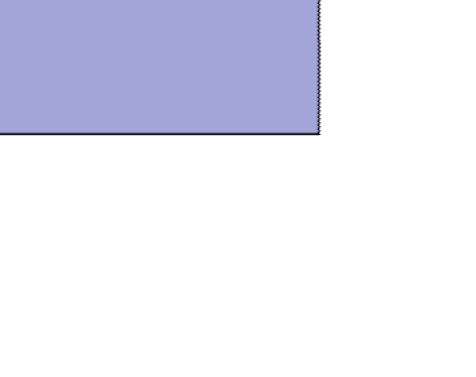

Introduction Checker Processors
Advanced Checker Processors Design and Implementation
Issues with DIVA
Reducing the Loss of Performance in DIVA
Diva with Split L1
Checker
Core
Checker Core
L1 RF
L1 RF
L1 Cache
Figure 7: DIVA with a split L1 cache

Slide 175
Introduction Checker Processors
Advanced Checker Processors Design and Implementation
DIVA was designed and fabricated by Todd Austin and group in 2001.
Experiment configuration
Base Processor : Alpha 21264, four issue, seven stage pipeline Four wide, three stage checker
Synthesized with Synopsys 250 nm library
Conclusions
1.5% power overhead
6% area overhead
Timing overhead limited to 3%

Slide 176
Introduction Checker Processors
Advanced Checker Processors Design and Implementation
DIVA: a reliable substrate for deep submicron microarchitecture de- sign, Todd Austin, Micro, 2000 http://citeseerx.ist.psu.edu/ viewdoc/download?doi=10.1.1.17.5782&rep=rep1&type=pdf
Efficient Checker Processor Design, Saugata Chatterjee, Chris Weaver, Todd Austin, MICRO-33, 2000 http://www.eecs.umich.edu/~taustin/papers/
MICRO33-divadesign.pdf
Fault Tolerant Approach to MicroProcessor Design, Chris Weaver, Todd Austin, DSN 2001.

Slide 177
Hard Errors
Mechanisms and Mitigation
Introduction Different Types of Hard Errors Prevention and Recovery
Smruti R. Sarangi
Department of Computer Science Indian Institute of Technology New Delhi, India

Slide 178
Outline
Introduction Different Types of Hard Errors Prevention and Recovery
1
Introduction
2
Different Types of Hard Errors Failure Modes
Combining Failure Rates RAMP-II
3
Prevention and Recovery

Slide 179
Motivation
Introduction Different Types of Hard Errors Prevention and Recovery
Example
Let us assume that we want to run a 1024 node server for a bank. The server needs to run 24x7. Moreover, we have the following requirements for financial applications
Preferably zero down time Absolutely no data corruption Data security
Maintainability, Serviceability
Let us focus on zero down time, and no data corruption in this talk.

Slide 180
Motivation-II
Introduction Different Types of Hard Errors Prevention and Recovery
Zero Down Time
We would ideally want a computer for any kind of a critical appli- cation :banking, insurance, military, aerospace, to be on most of the time. Failures can be catastrophic if computers start fail- ing on planes and space crafts. For critical applications like aerospace, we desire a failure rate as close to 0% as possi- ble. However, for most financial applications, we are fine with 99.999% (5 9s reliability). This translates to about 5 mins per year. If there are 1000 nodes on a server, then the failure rate per node needs to be pretty small.
No Data Corruption
It is possible that because of computer faults, a bit can get in- verted. This is a very serious failure mechanism in financial ap- plications. Imagine 10,000Rs becoming 2 crore 10,000 Rs, or the reverse !!!

Slide 181
Definition of Hard Errors
Introduction Different Types of Hard Errors Prevention and Recovery
We will discuss Hard Errors in this chapter.
Definition (Hard Error)
These errors are caused by defects in the silicon, or in the metalization, in the processor package. They are permanent in nature.

Slide 182
Definition of Hard Errors
Introduction Different Types of Hard Errors Prevention and Recovery
We will discuss Hard Errors in this chapter.
Definition (Hard Error)
These errors are caused by defects in the silicon, or in the metalization, in the processor package. They are permanent in nature.
There are two kinds of hard errors
Extrinsic
Contaminants on the silicon surface Open and short circuits
Most of them are detected in the Burn-In process
They are like birth defects. Most of them are detected in the Burn-In process.

Slide 183
Definition of Hard Errors
Introduction Different Types of Hard Errors Prevention and Recovery
We will discuss Hard Errors in this chapter.
Definition (Hard Error)
These errors are caused by defects in the silicon, or in the metalization, in the processor package. They are permanent in nature.
There are two kinds of hard errors
Extrinsic
Contaminants on the silicon surface Open and short circuits
Most of them are detected in the Burn-In process
They are like birth defects. Most of them are detected in the Burn-In process.
Intrinsic
Caused by wear and tear
These are age related defects that increase over time

Slide 184
Introduction Different Types of Hard Errors Prevention and Recovery
Failure Modes Combining Failure Rates RAMP-II
Reliability Challenges
Common failure modes Electomigration
Over time the structure of a wire changes. Metal atoms tend to amass at one end at one end of the wire.

Slide 185
Introduction Different Types of Hard Errors Prevention and Recovery
Failure Modes Combining Failure Rates RAMP-II
Reliability Challenges
Common failure modes Electomigration
Over time the structure of a wire changes. Metal atoms tend to amass at one end at one end of the wire.
Stress Migration
Because of varying amounts of thermal expansion along a wire, electrons migrate to different parts of the wire.

Slide 186
Introduction Different Types of Hard Errors Prevention and Recovery
Failure Modes Combining Failure Rates RAMP-II
Reliability Challenges
Common failure modes Electomigration
Over time the structure of a wire changes. Metal atoms tend to amass at one end at one end of the wire.
Stress Migration
Because of varying amounts of thermal expansion along a wire, electrons migrate to different parts of the wire.
Time Dependent Dielectric Breakdown
The gate dielectric in a transistor gradually breaks down over time. It ultimately becomes a short circuit.

Slide 187
Introduction Different Types of Hard Errors Prevention and Recovery
Failure Modes Combining Failure Rates RAMP-II
Reliability Challenges
Common failure modes Electomigration
Over time the structure of a wire changes. Metal atoms tend to amass at one end at one end of the wire.
Stress Migration
Because of varying amounts of thermal expansion along a wire, electrons migrate to different parts of the wire.
Time Dependent Dielectric Breakdown
The gate dielectric in a transistor gradually breaks down over time. It ultimately becomes a short circuit.
Thermal Cycling
The solder joints between the package and die interface experience constant changes in temperature. This causes metal fatigue, and ultimate breakage.

Slide 188
Introduction Different Types of Hard Errors Prevention and Recovery
Failure Modes Combining Failure Rates RAMP-II
Outline
1
Introduction
2
Different Types of Hard Errors Failure Modes
Combining Failure Rates RAMP-II
3
Prevention and Recovery

Slide 189
Introduction Different Types of Hard Errors Prevention and Recovery
Failure Modes Combining Failure Rates RAMP-II
Electromigration
Conducting electors in aluminum or copper interconnects trans- fer some of their momentum to surrounding metal atoms. These metal atoms slowly drift along with the electrons. Over time, atoms from one end drift and accumulate at the other end. The depletion sites exhibit increased resistance. Finally, the wire ceases to conduct.
MTTF
−n
E
aEM kT
em
∝ (J − J ) e
crit
n and E_{aEM} are constants that depend on the metal type. They are close to 1.
J is the current density. J_{crit} is typically 2 orders of magni- tude smaller than J.

Slide 190
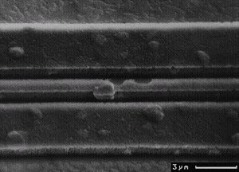
Introduction Different Types of Hard Errors Prevention and Recovery
Failure Modes Combining Failure Rates RAMP-II
Electromigration II
CV
dd
J =
∗ f ∗ p
WH
C: capacitance, V_{dd} : supply voltage, W : width
H: height, f : frequency, p: switching probability
Figure 1: Electromigration (courtesy: Philip Koopman, CMU)

Slide 191
Introduction Different Types of Hard Errors Prevention and Recovery
Failure Modes Combining Failure Rates RAMP-II
Stress Migration
This is a phenomenon similar to electromigration. Atoms migrate because of a variable amount of thermal expansion. This ther- momechanical stress gives wires and contacts irregular shapes. Much of the reasons behind stress migration are not well under- stood.
MTTF ∝ |
−n
E
aSM kT
sm 0
T − T | e
T₀: Temperature at which the metal was originally deposited (500K)
T : Operating temperature, E_{aSM} and n are material depen- dent constants
E_{aSM} = 2.5 and n = 0.9 for copper interconnects

Slide 192
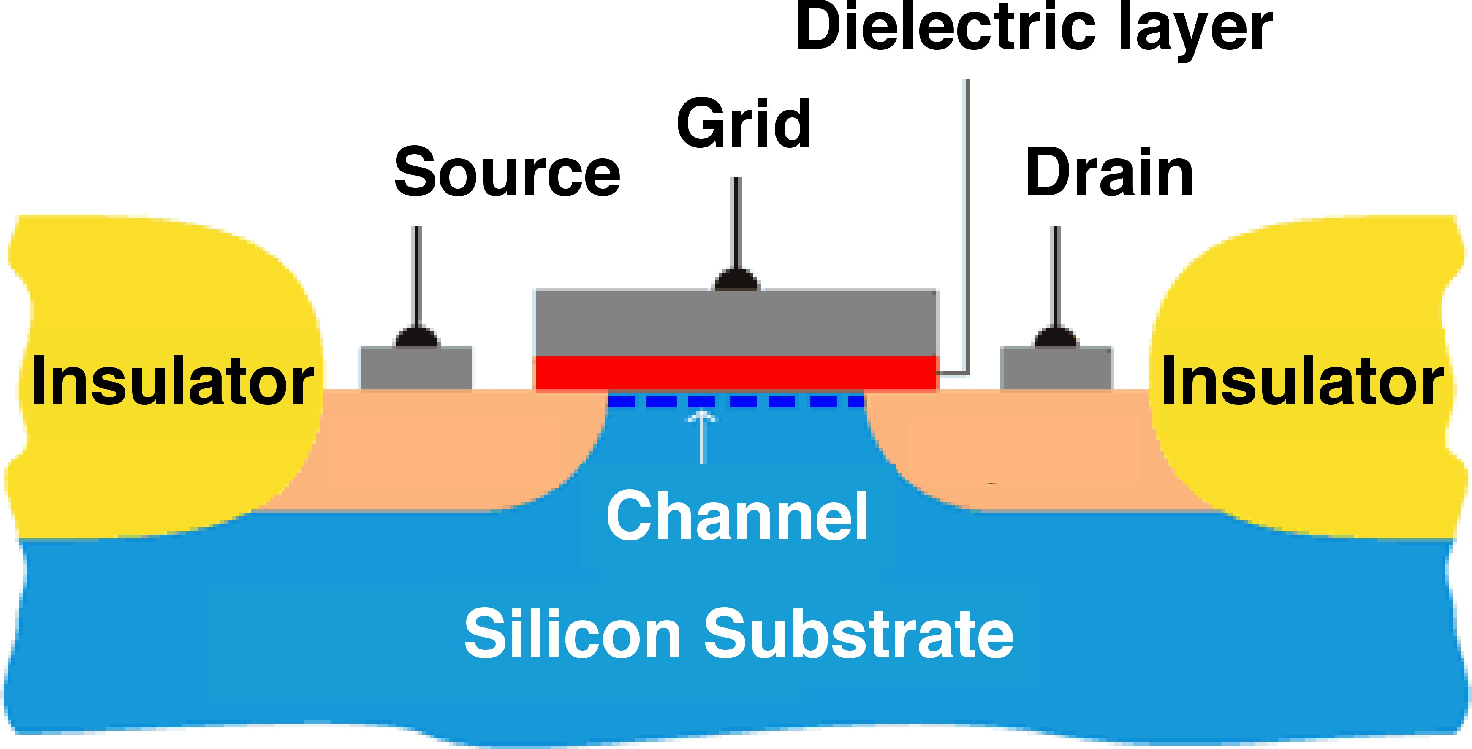
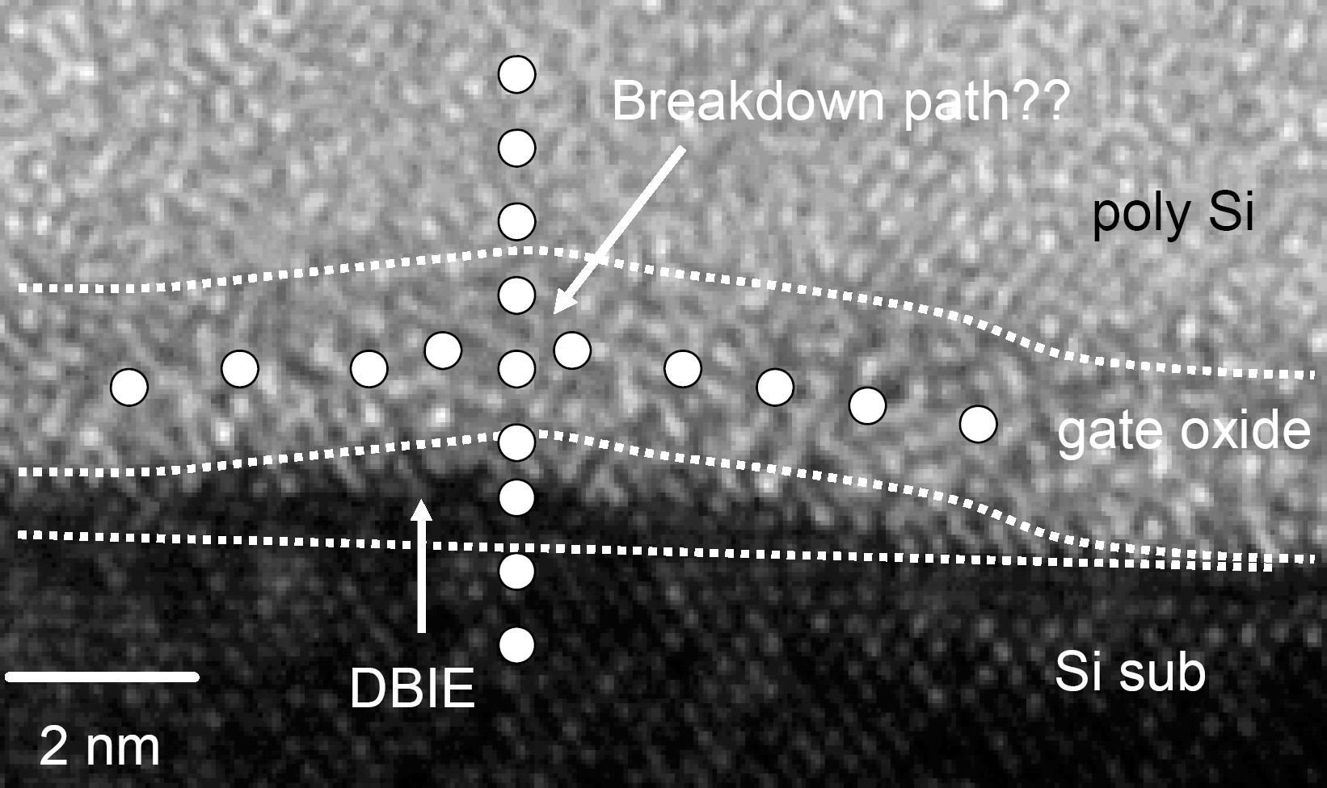
Introduction Different Types of Hard Errors Prevention and Recovery
Failure Modes Combining Failure Rates RAMP-II
Time Dependent Dielectric Breakdown
Figure 2: MOS Transistor (courtesy Gian-Marco Rignanese)
Figure 3: Dielectric Breakdown (courtesy Kin-Leong Pey)

Slide 193
Introduction Different Types of Hard Errors Prevention and Recovery
Failure Modes Combining Failure Rates RAMP-II
Time Dependent Dielectric Breakdown - II
The gate dielectric is typically very thin (about 2 nm). Over time it wears down and current passes through it. It forms a conducting path. It is hyper-exponentially dependent on temperature.
₁ (a−bT )
X + ^{Y} +ZT
MTTF_{tddb} ∝ _{V}
e
T kT

Slide 194
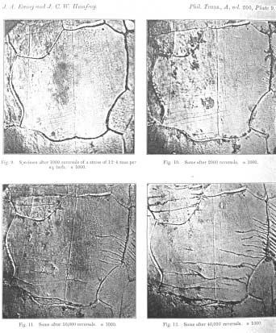
Introduction Different Types of Hard Errors Prevention and Recovery
Failure Modes Combining Failure Rates RAMP-II
Thermal Cycling - Metal Fatigue
Figure 4: Metal Fatigue (wikipedia)

Slide 195
Introduction Different Types of Hard Errors Prevention and Recovery
Failure Modes Combining Failure Rates RAMP-II
Thermal Cycling-II
Cycles of expansion and contraction give rise to metal fa- tigue especially at the I/O contacts.
Over time, cracks begin to form There are two kinds of thermal cycles
Large cycles : Powering up/down the processor
Small cycles: Periods of activity/inactivity while executing a workload.
Coffin Manson Equation
1
^{T − T}ambient
q
MTTF_{tc} ∝
q = 2.35 in the reference.

Slide 196
Introduction Different Types of Hard Errors Prevention and Recovery
Failure Modes Combining Failure Rates RAMP-II
Outline
1
Introduction
2
Different Types of Hard Errors Failure Modes
Combining Failure Rates RAMP-II
3
Prevention and Recovery

Slide 197
Introduction Different Types of Hard Errors Prevention and Recovery
Failure Modes Combining Failure Rates RAMP-II
Sum of Failure Rates Model
Assumptions
The processor is a series failure system. One failure makes the entire processor fail.
Every failure mechanism has an exponential distribution.
Definition
Failure Rate h(t ): It is the conditional probability that a com- ponent will fail between t and (t + δt ), given the fact that it has survived till t . h(t ) = λ, means that the application has a con- stant failure rate.
Example
The exponential distribution f (x ) = λe^{−λx} , has a constant failure rate, λ.

Slide 198
Introduction Different Types of Hard Errors Prevention and Recovery
Failure Modes Combining Failure Rates RAMP-II
Sum of Failure Rates Model - II
Definition
FIT: Failure-in-time. The number of failures in a billion hours.
1 10⁹ 1
MTTF = =
=
p
λ FIT
λ
p
i j
ij
λ_{ij} is the failure rate of i_{th} structure due to the j_{th} failure mechanism.

Slide 199
Introduction Different Types of Hard Errors Prevention and Recovery
Failure Modes Combining Failure Rates RAMP-II
Mathematical Trivia
Theorem
The failure rate for the exponential distribution is λ.
Proof.
Let the time of failure be t_{f} . Let the failure rate be h(t ). The exponential equation for the pdf of the failure is f (t ) = λe^{−λt} . We have:
h(t ) = P(t ≤ t_{f} ≤ t + δt|t_{f} < t )
P((t ≤ t_{f} ≤ t + δt) ∧ (t_{f} < t ))
=
P(t_{f} < t )
f (t )
=
(1)
t
1 − f (
x )
0
_{λe}−λt
_{e}−λt
=
= λ

Slide 200
Introduction Different Types of Hard Errors Prevention and Recovery
Failure Modes Combining Failure Rates RAMP-II
Mathematical Trivia - II
Theorem
The MTTF for the exponential distribution is ¹ .
λ
Proof.
The exponential equation for the pdf of the failure is f (t ) = λe^{−λt} . We have:
∞
MTTF = tf (
t )dt
0
∞
_{e}−λt
= tλ dt
0
1
∞
x
=
xe⁻ dx
(x = λt )
(2)
λ ₀
1
x ∞
∞
_{e}−x
= (−xe⁻ ) |
+
dx
λ
0
0
1
λ
=

Slide 201
Introduction Different Types of Hard Errors Prevention and Recovery
Failure Modes Combining Failure Rates RAMP-II
RAMP Model
Assumptions
Processors are designed to have an MTTF of 30 years. The FIT value is therefore 4000.
Worst case operating conditions will lead to a failure rate of 30 years.
The total failure rate is distributed evenly across the four failure modes.
Let us now try to find the constants in the equations.
There are four parameters considered : T , V , f , and p(activity fac- tor)
Let there values for the worst case be : T_{qual} , V_{qual} , f_{qual} , and p_{qual} . V_{qual} is the highest supply voltage (about 1.2 V), f_{qual} is the highest frequency
p_{qual} is 1. T_{qual} is dependent on the manufacturing specs. Typically 393K (120 ◦C).

Slide 202
Introduction Different Types of Hard Errors Prevention and Recovery
Failure Modes Combining Failure Rates RAMP-II
Ramp Model Contd...
T_{qual} is typically provided by the manufacturer. Most references assume a value of 120 ◦C.
The RAMP model computes the values of the proportional- ity constants for the four failure modes
The RAMP paper evaluates the hard error FIT rates for dif- ferent configurations.

Slide 203
Introduction Different Types of Hard Errors Prevention and Recovery
Failure Modes Combining Failure Rates RAMP-II
Outline
1
Introduction
2
Different Types of Hard Errors Failure Modes
Combining Failure Rates RAMP-II
3
Prevention and Recovery

Slide 204
Introduction Different Types of Hard Errors Prevention and Recovery
Failure Modes Combining Failure Rates RAMP-II
Normal Distribution
Central Limit Theorem
Let (x₁, . . . , x_{n}) be a sequence of numbers that are identically and independently distributed(i.i.d). The sum of the sequence for large values of n, is normally distributed.
Normal distribution:
1
−
(x−µ)
2
f (x ) = √ e
2σ²
σ 2π
µ is the mean, σ is its variance
The normal distribution is thus a very fundamental distribution. Most natural phenomena are modeled by this distribution, or by variants of it.

Slide 205
Introduction Different Types of Hard Errors Prevention and Recovery
Failure Modes Combining Failure Rates RAMP-II
Log-Normal Distribution
The exponential distribution has a constant failure rate.
Most failure rates increase over time This is not an accurate assumption
Such kind of failures are typically model by log-normal distri- butions
x has a log-normal distribution, if ln(x ) has a normal distribu- tion
Log-Normal distribution:
1
−
(ln(x )−µ)
2
f (x ) = √ e xσ 2π
2σ²
, x > 0

Slide 206

Introduction Different Types of Hard Errors Prevention and Recovery
Failure Modes Combining Failure Rates RAMP-II
Food for Thought
Question
Let us consider a failure process, in which the amount of degra- dation between the time instants, t_{n} and t_{n−1} is proportional to the degradation at t_{n−1}. If the degradation at t_{n} is x_{n}, we have: x_{n} − x_{n−1} = α_{n}x_{n−1}. Let us further assume that α_{n} has an i.i.d distribution. Prove that x_{n} has a log-normal distribution.

Slide 207
Introduction Different Types of Hard Errors Prevention and Recovery
Failure Modes Combining Failure Rates RAMP-II
NBTI (Not in course ...)
RAMP-II adds a fifth failure mode called NBTI
NBTI : Negative bias temperature instability
Definition
NBTI: When the p-FET gate is biased negative w.r.t to the drain and source, then positive charge tends to accumulate on the gate oxide. This accumulation causes the threshold voltage of the transistor to increase, ultimately leading to its failure.
A
B
A
B
T
D
1
β
MTTF ∝ ln
− ln
− C ∗
1 + 2e
1 + 2e
_{e}−
kT
kT
kT

Slide 208
Duplication
Introduction Different Types of Hard Errors Prevention and Recovery
Duplication : Maintain multiple copies of a functional unit Example : Two adders, or two versions of the fetch unit Keep one unit permanently powered off
When the first unit fails, switch to the second one
Negative Point: We are increasing the area of the chip in the process
A
B
C
ν = min(A,B,C)
Series Failure System
A
B
C
ν = min(A,(B+B'),C)
B'
B is a duplicated unit

Slide 209
Graceful Degradation
Introduction Different Types of Hard Errors Prevention and Recovery
Degradation : Gradually reduce the functionality of a unit Example : We can gradually decrease the size of buffers like the branch predictor. This will decrease performance but not correctness.
The instruction queue can be segmented. We can gradually decrease the number of segments.
Positive Point: Very little area penalty
A
B
C
ν = min(A,B,C)
Series Failure System
A
B
C
ν = min(A,max(B,B'),C)
B'
B and B' are running parallely

Slide 210
Food for Thought
Introduction Different Types of Hard Errors Prevention and Recovery
Theorem
The distribution of the minimum of n exponential random vari- ables with rates, λ₁, . . . , λ_{n}, is another exponential variable with rate, (λ₁ + . . . + λ_{n}).

Slide 211
Handling Faults in Memories
Introduction Different Types of Hard Errors Prevention and Recovery
memory
spare columns
column remapping
Figure 5: Remapping columns for a memory bank
Perform a BIST (Built-in self test) to find faulty memory cells Change the decoder logic to map the columns with faulty cells to spare columns
Can be done right after manufacturing, or can be done online

Slide 212
Introduction Different Types of Hard Errors Prevention and Recovery
The Case for Lifetime Reliability-Aware Microprocessors, Jayanth Srinivasan, Sarita V. Adve, Pradip Bose, and Jude A. Rivers, Pro- ceedings of 31st International Symposium on Computer Architec- ture (ISCA ’04) June 2004. http://rsim.cs.illinois.edu/~srinivsn/Pubs/ isca04.pdf
Jayanth Srinivasan, Sarita V. Adve, Pradip Bose, Jude A. Rivers: Exploiting Structural Duplication for Lifetime Reliability Enhance- ment. ISCA 2005: 520-531
http://rsim.cs.illinois.edu/~srinivsn/Pubs/ isca05.pdf

