Slide 1
Techniques to Mitigate the Effects of Congenital Faults in Processors
Smruti R. Sarangi

Slide 2
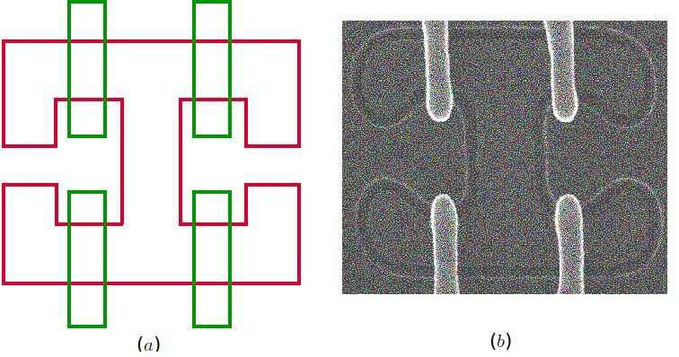
Process Variation
Corner rounding, edge shortening
(courtesy IBM Microelectronics)
Smruti R. Sarangi

Slide 3
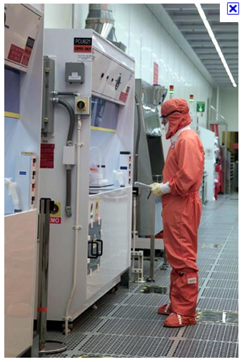
Semiconductor
Fabrication facility
(courtesy tabalcoaching.com)
Smruti R. Sarangi

Slide 4
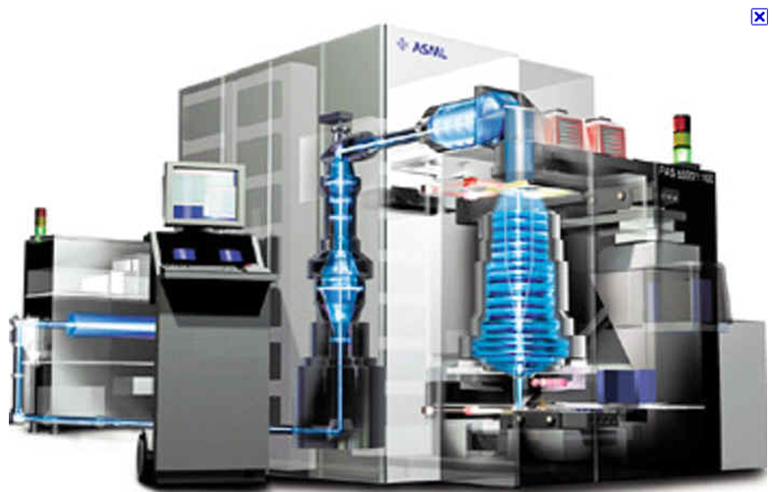
Photolithography Unit
(Courtesy Upenn)
Smruti R. Sarangi

Slide 5
Basic Lithographic Process
The source of light is typically a argon-flouride laser
The light passes through an array of lenses to reach the silicon substrate
The resolution limit is given by:
To decrease the resolution we need to :
  Decrease the wavelength
  Increase the refractive index
R = k₁λ / NA
NA = n sin θ
Smruti R. Sarangi

Slide 6
Parameter Variation
Parameter Variation
P
V
T
Process
Supply Voltage
Temperature
Threshold Voltage – V_{t}
Transistor Length – L_{eff}
Smruti R. Sarangi

Slide 7
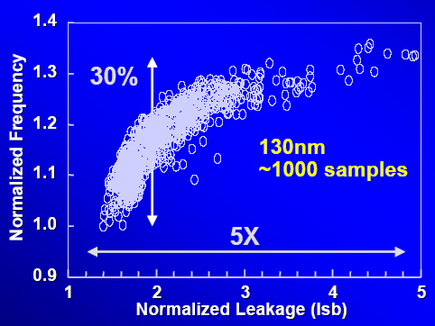
Why is Variation a Problem ?
Unpredictability of V_{t} , L_{eff} and T implies :
→ Lower chip frequency and higher leakage
courtesy Shekhar Borkar, Intel
Smruti R. Sarangi

Slide 8
Implications on Design Decisions
Static timing analysis not possible
Overly conservative designs
  Chips too slow
  Performance of a generation lost
Possible solution
  Clock the chip at an unsafe frequency
  Tolerate resulting timing errors
  Reduce timing errors
    Architectural techniques
    Circuit techniques
Smruti R. Sarangi

Slide 9
Overview
Model for Process Variation
Model for Timing Errors due to
Process Variation
Techniques to
Tolerate Timing Errors
Techniques to
Reduce Timing Errors
Dynamic Optimization
Smruti R. Sarangi

Slide 10
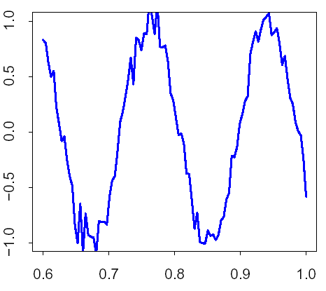
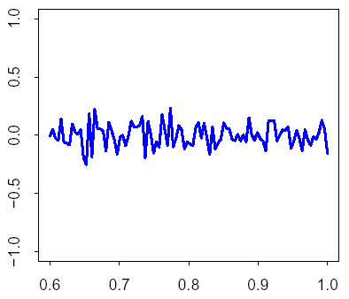
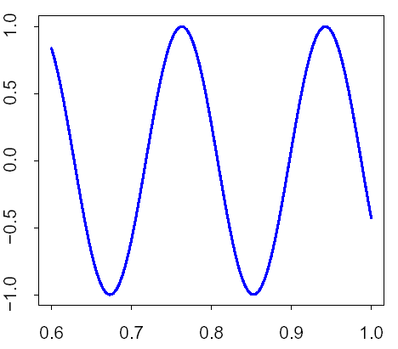
Process Variation
Process Variation
Systematic Variation
Random Variation
Lens aberrations
Mask deformities
Thickness variation in CMP
Photo-lithographic effects
Variable dopant density
Line edge roughness
Smruti R. Sarangi

Slide 11
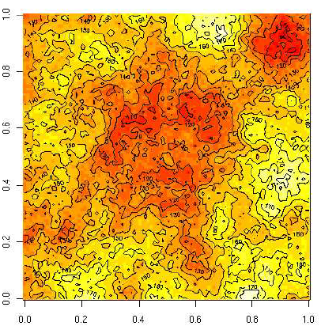
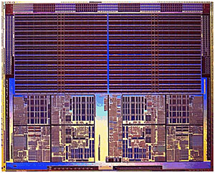
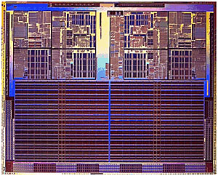
Modeling Systematic Variation
Variation Map
Break into a million cells
1000
1000
Smruti R. Sarangi

Slide 12

Systematic and Random Variation
Distribution of systematic components
  Normal distribution
Normal Distribution
Spatial Correlation
Multi-variate
Normal Distribution
Superimpose random variation on top of systematic
Smruti R. Sarangi

Slide 13
Overview
Model for Process Variation
Model for Timing Errors due to
Process Variation
ISQED ‘07
Techniques to
Tolerate Timing Errors
Techniques to
Reduce Timing Errors
Dynamic Optimization
Smruti R. Sarangi

Slide 14
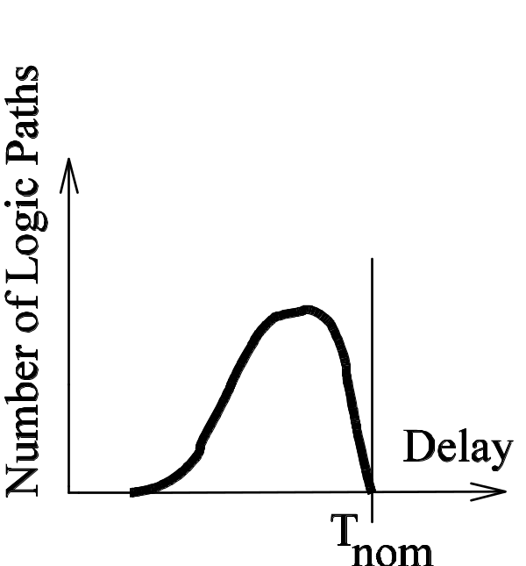
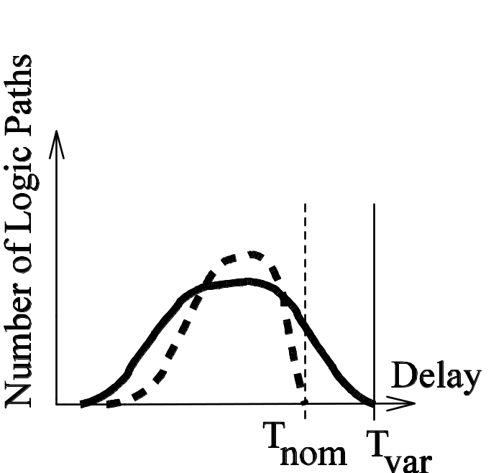
Timing Errors
P(E) = 1 – cdf(t_{clk})
Timing errors
Distribution of path delays
in pipe stage: No variation
Distribution of path delays
in pipe stage: With variation
Smruti R. Sarangi

Slide 15
Model for Timing Errors
Basic assumptions
  A structure consists of many critical paths
    The critical path depends on the input
    critical path delay > clock period → timing error
  clock period = delay of the longest critical path at
    maximum temperature
    no variation
  All pipeline stages are tightly designed → 0 slack
Smruti R. Sarangi

Slide 16
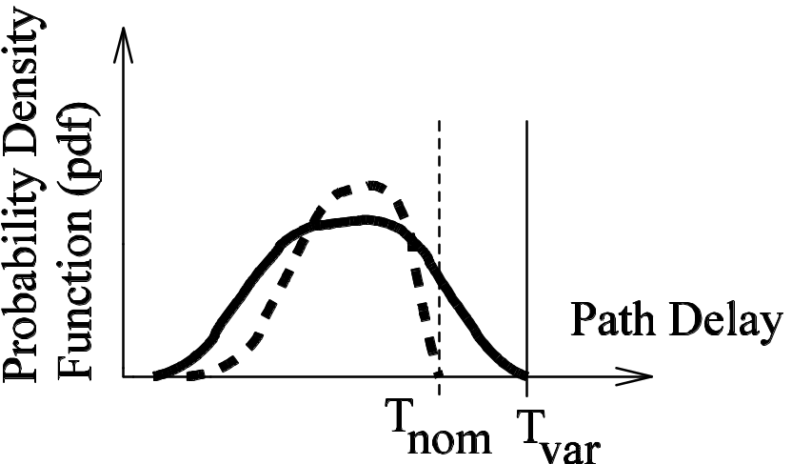
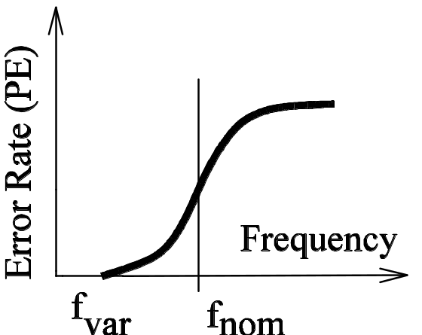
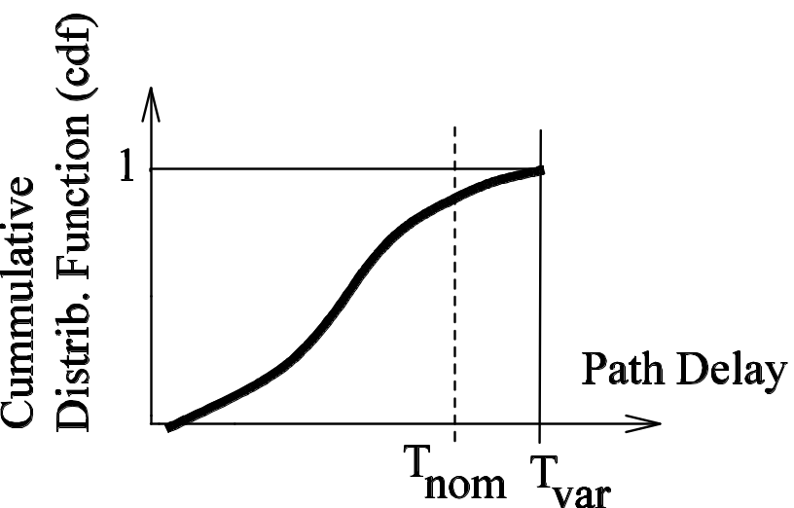
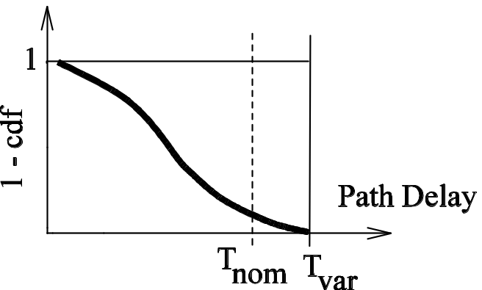
Paths in a Pipeline Stage
t
Timing errors
1
f
pdf(t)  cdf (t)
Error rate: P_{E} (t) = 1 – cdf(t)
Smruti R. Sarangi

Slide 17
Basic Kinds of Structures
Logic
Memory
Heterogeneous critical paths
ALUs, comparators, sense-amps
Homogenous critical paths
SRAMs, CAMs
Mixed
x% memory and (100-x)% logic
Used to model renamer, wakeup/select
Smruti R. Sarangi

Slide 18
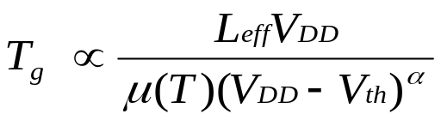
Logic
Critical Path
35% Wiring
65% Gates
Elmore Delay Model
Alpha Power Law
Smruti R. Sarangi

Slide 19
Logic Delay
Distribution of path delays – no variation
d_{wire} + d_{gate} = 1
(d_{wire}+
D_{varlogic} =
D_{logic}
η*
d_{gate})*
D_{logic}
+d_{gate}*D_{extra}
Distribution of
path delays
with variation
Relative gate delay
due to systematic
variation in P,V, T
Delay due to variation
in the random and syst.
component within a stage
Obtain D_{logic} using a timing analysis tool
Smruti R. Sarangi

Slide 20
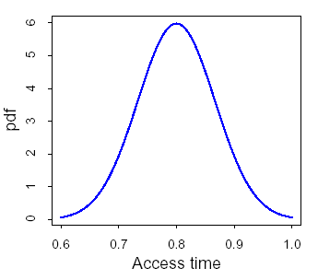
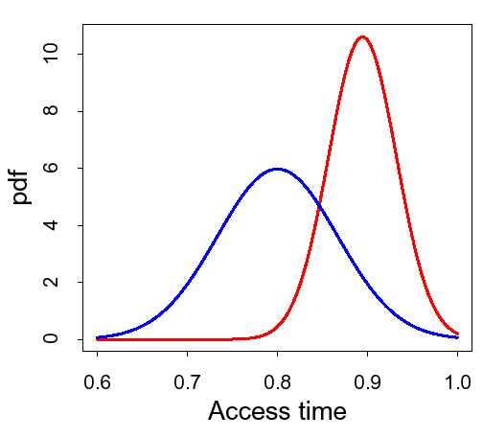
Memory Delay
Memory Cell
Memory Line
extend analysis
done by Roy et. al.
IEEE TCAD ‘05
Use Kirchoff’s equations
Long channel trans. equations
Multi-variable Taylor expansion
Delay dist.
max. distribution
Delay_{line} = max(Delay_{cell})
Smruti R. Sarangi

Slide 21
Combined Error Model
We have the delay distributions – cdf(t) – for memory and logic with variation
For each structure
  per access, P(E) = 1 – cdf(t)
  P(E) per inst. = αP(E) , α=accesses/inst.
Combined error rate per instruction
P(E)_{total} = Σ αP(E)
Smruti R. Sarangi

Slide 22
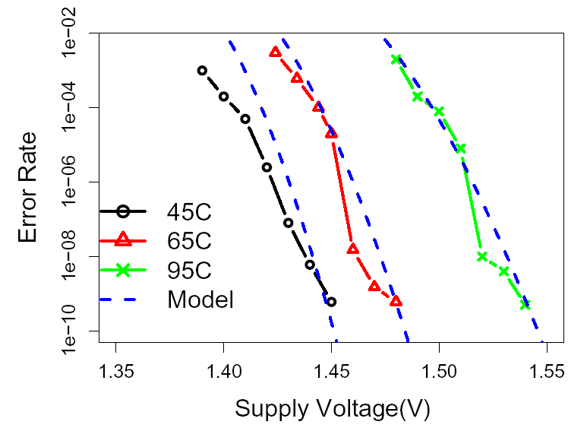
Validation – Logic
S. Das et. al. ‘05
Smruti R. Sarangi

Slide 23
Overview
Model for Process Variation
Model for Timing Errors due to
Process Variation
Techniques to
Tolerate Timing Errors
Techniques to
Reduce Timing Errors
Dynamic Optimization
Smruti R. Sarangi

Slide 24
Variation Aware Timing
Speculation (VATS)
Multicore
Chip
Unsafe
frequency
Error free:
- Lower freq
- Safe design
Checker
Processor
Core
Diva
Checker
L0 Cache
Razor Latches
L1 Cache
Smruti R. Sarangi

Slide 25
Other VATS Checkers
TIMERRTOL – Uht et. al.
Razor – Dan Ernst et. al., MICRO 2003
X-Checker – X. Vera et. al, SELSE 2006
X-Pipe – X. Vera et. al., ASGI 2006
Sato and Arita, COSLP 2003
Smruti R. Sarangi

Slide 26
Overview
Model for Process Variation
Model for Timing Errors due to
Process Variation
Submitted to
ISCA ‘07
Techniques to
Tolerate Timing Errors
Techniques to
Reduce Timing Errors
Dynamic Optimization
Smruti R. Sarangi

Slide 27
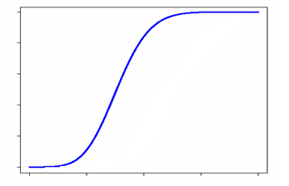
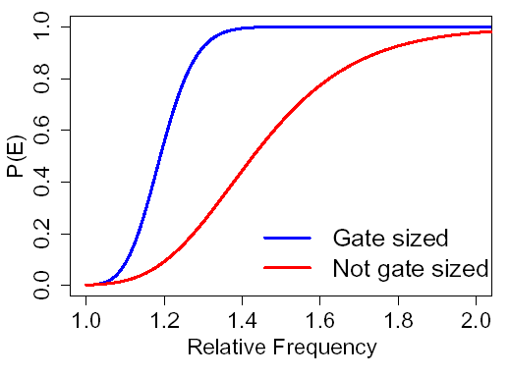
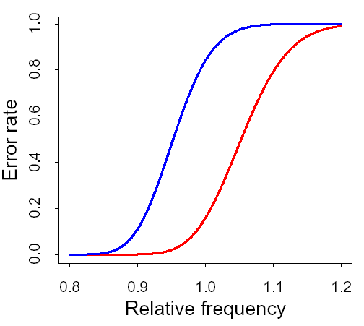
Basic Mechanisms – Shift and Tilt
Error Rate(P_{E})
f
Tilt
frequency
Shift
Errror Rate(P_{E})
Before
Errror Rate(P_{E})
f
f
After
Before
After
frequency
frequency
Smruti R. Sarangi

Slide 28
Architectural Mechanisms
SRAM/CAM array
Resizable issue queue
(Albonesi et. al.)
  switch pass trans. off
  smaller queue
  shifts the error rate curve
Pass Transistors
SRAM/CAM array
Pass Transistors
Original
New error
rate
SRAM/CAM array
Sense Amps
Smruti R. Sarangi

Slide 29
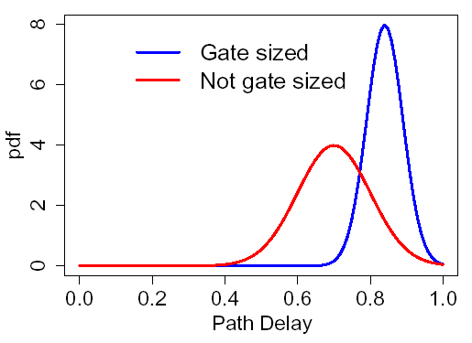
Gate Sizing
Transistor Width – W
Delay ∝ A + B/W
Power ∝ W
Make faster paths
slower to save power
Original path
delay dist.
Gate Sizing
Smruti R. Sarangi

Slide 30
Optimization: Replicate ALUs
Difference in Error Rate
Tradeoff is power vs errors
IDEA : Switch between the two ALUs
  Use gate sized ALU if it is not timing critical and vice versa
Smruti R. Sarangi

Slide 31
Fine Grain ABB and ASV
Adaptive Body Bias (ABB) – V_{bb}
  V_{bb} → Delay Leakage
  V_{bb} → Delay Leakage
Adaptive Supply Voltage (ASV) -- V_{dd}
  V_{dd} → Delay Leakage Dynamic
Error Rate(P_{E})
f
frequency
Multicore
Chip
Vary:
Supply Voltage(ASV)
Body Voltage (ABB)
Core
Smruti R. Sarangi

Slide 32
Overview
Model for Process Variation
Model for Timing Errors due to
Process Variation
Techniques to
Tolerate Timing Errors
Techniques to
Reduce Timing Errors
Dynamic Optimization
Smruti R. Sarangi

Slide 33
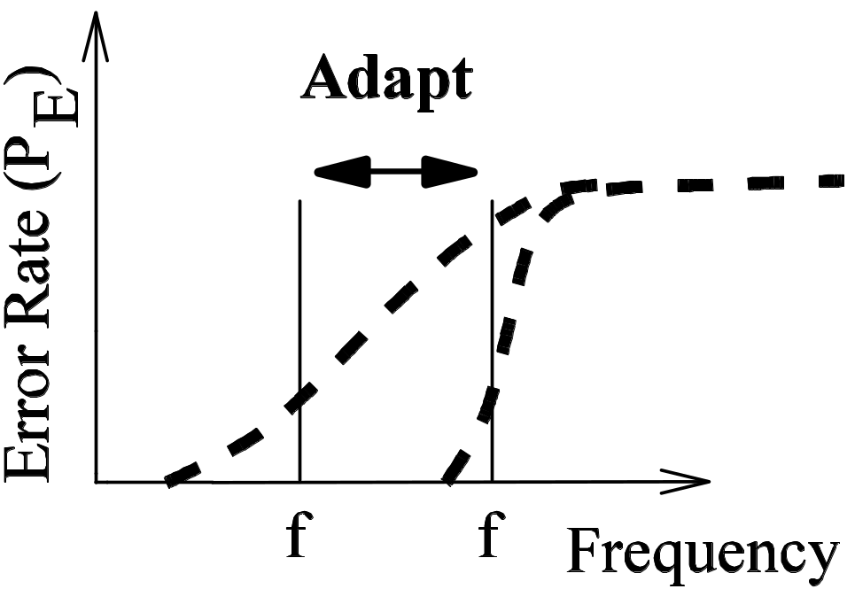
Dynamic Behavior
Temperature
Activity Factors
Smruti R. Sarangi

Slide 34
Formulate an Optimization Problem
Optimization
Input
Output
Constraints
Goals
Constraints
  Temperature – At all points T < T_{MAX}
  Power – Total core power < P_{MAX}
  Error – Total errors < Err_{MAX}
Goal – Maximize performance
Smruti R. Sarangi

Slide 35
Outputs
Outputs:
1
+ 30
+ 1
+ 1
= 33
ALU
15 ABB/ASV regions
  30 values of (V_{dd}, V_{bb})
33 outputs
f, V_{dd}, V_{bb} can take many values
Very large state space
V_{dd}
V_{bb}
f
Issue queue
size
Smruti R. Sarangi

Slide 36
Dimensionality Reduction
Find the max. frequency that each stage can support
Find the slowest stage
This is the core frequency
Minimize power in the rest of the units
Minimum Frequency
Max. Frequency
core frequency
1
2
3
4
5
6
7
Stages
Smruti R. Sarangi

Slide 37
Inputs
Phase
Heat sink cycle
Forever
Inputs :
α, T_{H}, V_{t0}, R_{th}, K_{leak}
activity factor
accesses/cycle
Heat sink
temperature
Thermal
resistance
Constant in
Leakage eqn.
Smruti R. Sarangi

Slide 38
Optimization Overview
f_{core}
min
f_{core}
Inputs
Inputs
f⁽¹⁾
f⁽¹⁵⁾
Freq. Algorithm
Freq. Algorithm
Power Algorithm
Power
Algorithm
Inputs
Inputs
V_{dd}
V_{bb}
V_{dd}
V_{bb}
Smruti R. Sarangi

Slide 39
Fuzzy Logic Based Algorithm
Fuzzy Logic
based Algorithm
Exhaustive Search
(Freq/Power)
Inputs
+ Very fast computation times
+ Incorporates detailed models
- Slight inaccuracy
- Computationally expensive
- Requires detailed models
+ Accurate Results
Smruti R. Sarangi

Slide 40
Final Picture
f_{core}
min
f_{core}
Inputs
Inputs
f⁽¹⁾
f⁽¹⁵⁾
Fuzzy
SubController₁
Fuzzy
SubController₁₅
Fuzzy
SubController₁
Fuzzy
SubController₁₅
Inputs
Inputs
V_{dd}
V_{bb}
V_{dd}
V_{bb}
Smruti R. Sarangi

Slide 41
Timeline
Heat Sink Cycle ≈ 2-3 secs
Phase ≈ 120 ms
Phase
t
Retuning Cycles
STOP
Test configuration
1 step
≈
≈
20 μs
6 μs
10 μs
2 ms
0.5 μs
2 ms
New Phase
Detected
Bring to chosen working point
Run Fuzzy Controller Algorithm
Measure IPC and α^{i}
Smruti R. Sarangi

Slide 42
Results
Smruti R. Sarangi

Slide 43
Evaluation Framework
Processor Modeled
Core
Core
C
C
Athlon 64 floorplan
3-wide processor
12 stage pipeline
45 nm, V_{dd} = 1 V, 6 GHz
Core
Core
C
C
4-core private L2 cache
Sherwood phase detector (ISCA ’03)
Variation Modeling
  PVT maps for 100 dies
Fuzzy controller
  10,000 training examples
  25 rules
10 SpecInt and 10 SpecFp
benchmarks, 1 billion insts.
Smruti R. Sarangi

Slide 44
Terminology
Baseline | Proc. with variation effects
TS | Baseline+DIVA checker
TS+FU | TS + FU replication
TS+Queue | TS + issue-queue resizing
TS+ABB+ASV | Both circuit level techniques
TS+Dyn | TS + dynamic optimization
TS+All | TS+FU+Queue+ABB+ASV+dyn
NoVar | Without any variation effects
Smruti R. Sarangi

Slide 45
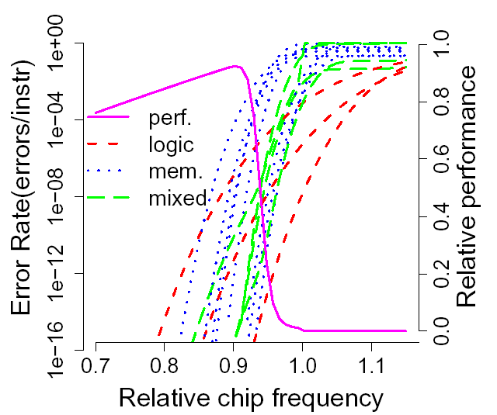
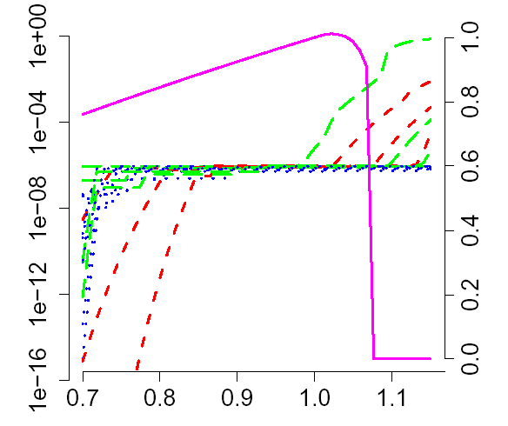
Error Plots
Maximum Perf.
point
Maximum Perf.
point
Err_{MAX}
TS only
ALL = TS + ABB + ASV
Smruti R. Sarangi

Slide 46
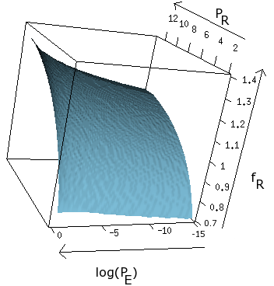
Execution Point
constant
error
constant
power
Power
frequency
power
power
errors
constant
freq.
frequency
errors
Frequency
Log (Timing Error Rate)
Smruti R. Sarangi

Slide 47
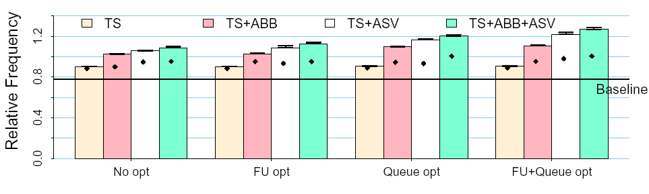
Frequency
Oracle
Fuzzy
49%
23%
Static
Frequency increase: 10 – 49 %
≈50% of the gains are due to dynamic opts.
Smruti R. Sarangi

Slide 48
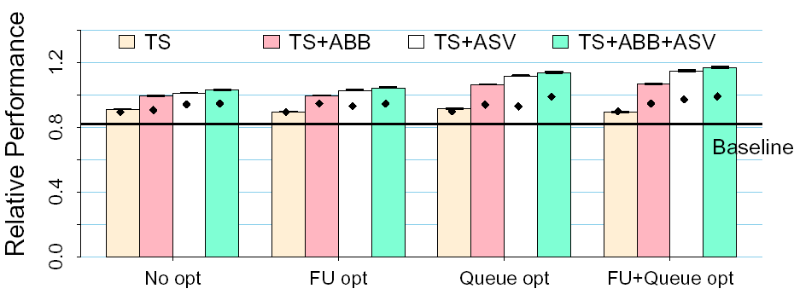
Performance
34%
19%
Static
We can nullify effects of variation and even speedup
The performance loss due to fuzzy logic is minimal
Smruti R. Sarangi

Slide 49
Conclusion
Do not design processors for worst case
  → Need to tolerate variation induced errors
Contributions
  Model for timing errors
  New framework for tradeoffs in P, f and P(E)
  High dimensional dynamic adaptation
  Eval. of μarch. techniques to tolerate/mitigate P(E)
10-49% increase in frequency
7-34% increase in performance
Smruti R. Sarangi

Slide 50
Conclusion II
CADRE (DSN’06)
  Arch. support to make a board level computer cycle-accurate deterministic
Phoenix (MICRO’06 & Top Picks’07)
  μarch. support to detect and patch processor design bugs
Smruti R. Sarangi

Slide 51
BACKUP
Smruti R. Sarangi

Slide 52
Algorithm
Inputs :
∀ f, V_{dd}, V_{bb}
α
P_{dyn}
α
, R_{th}, T_{H}
Verify T < T_{MAX}
T
R_{th}, T_{H}
P_{leak}
, P_{leak0}, V_{t}
P_{leak0}, V_{t}
Verify Err < Err_{MAX}
Delay
V_{t}
Error Model
Find f_{max}
Smruti R. Sarangi

Slide 53
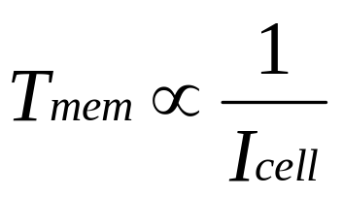
Memory Delay
WL
V_{DD}
Y
Solve for I_{cell} using long channel eqns.
I_{cell} = f(Vt_{X},Vt_{Y},L_{X},L_{Y})
Vt_{X},Vt_{Y},L_{X} and L_{Y} are gaussian variables
I_{cell}
X
BL
BR
μ_{vtx}, μ_{vty}, μ_{lx}, μ_{ly} are the systematic components
σ_{vtx}, σ_{vty}, σ_{lx}, σ_{ly} are the random components
Smruti R. Sarangi

Slide 54
Memory Delay - II
Find a distribution for T_{mem}
  T_{mem} is a function of four gaussian variables
  Model T_{mem} as a normal distribution
  Find the μ and σ for T_{mem} using multi-variable Taylor expansion
  This is the access time dist. for 1 bit
A typical entry has 32-128 bits
  Find the max distribution of 32-128 normal variables
Error probability = 1 – cdf(t_{mem})
Smruti R. Sarangi

Slide 55
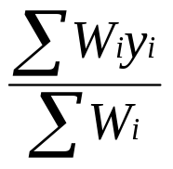
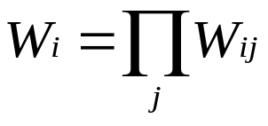
Fuzzy Low Level
X
X_{j}
X_{j}
W
y
μ
σ
y
μ_{ij}
μ_{ij}
σ_{ij}
σ_{ij}
y_{i}
i
y_{i}
j
W_{ij} = exp[ -(( - )/ )²]
Final Output
W_{i}
Smruti R. Sarangi

Slide 56
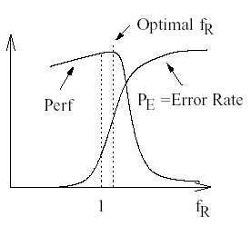
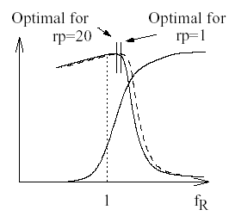
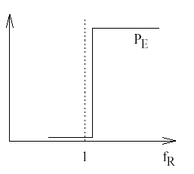
Recovery Penalty
Smruti R. Sarangi

Slide 57
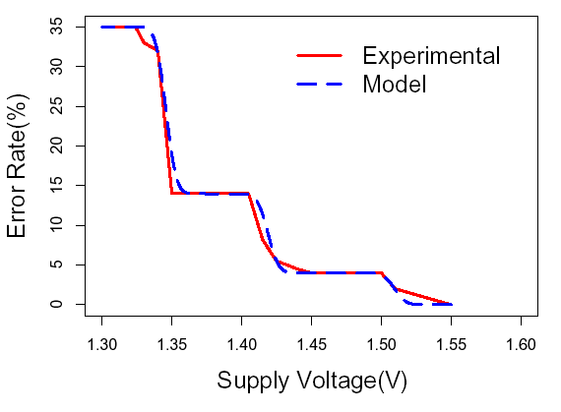
Validation – Memory
Smruti R. Sarangi

Slide 58
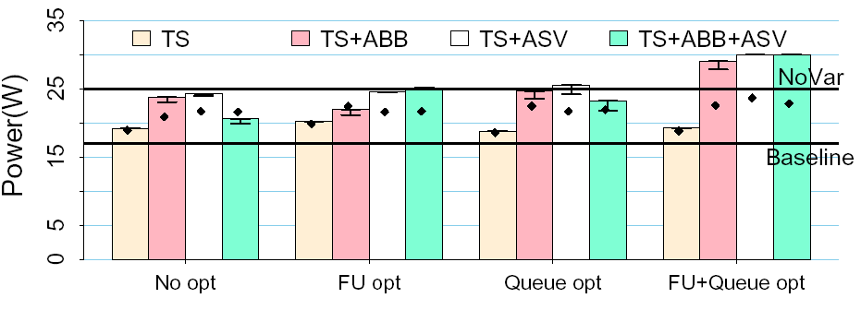
Power
Max Power Limit
Proc. with no variation – 25 W, P_{MAX} = 30 W
Smruti R. Sarangi

