Slide 1
MultiCore Processors
Dr. Smruti Ranjan Sarangi
IIT Delhi

Slide 2
Part I - Multicore Architecture
Part II - Multicore Design
Part III - Multicore Examples

Slide 3
Part I - Multicore Architecture

Slide 4
Outline
Moore's Law and Transistor Scaling
Overview of Multicore Processors
Cache Coherence
Memory Consistency

Slide 5
Moore's Law
Intel's co-founder Gordon Moore predicted in 1965 that the number of transistors on chip will double every year
  Reality Today : Doubles once every 2 years
How many transistors do we have today per chip?
  Approx 1 billion
2014 – 2 billion
2016 – 4 billion

Slide 6
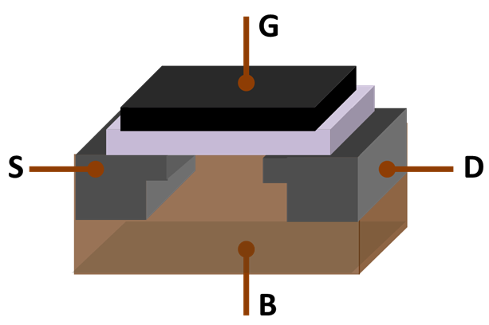
Why do Transistors Double?
Feature Size
source: wikipedia
The feature size keeps shrinking by √2 every 2 years
Currently it is 32 nm
32 nm → 22 nm → 18 nm →

Slide 7
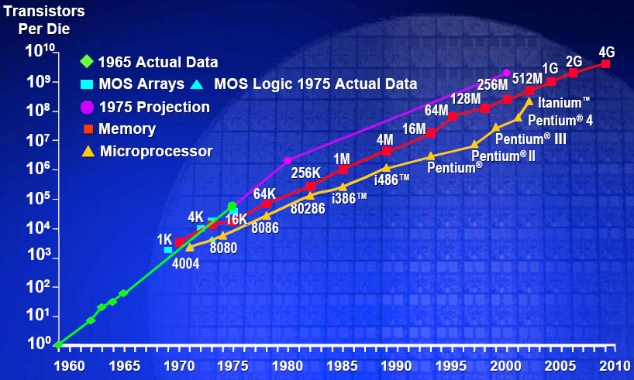
Number of transistors per chip over time
Source: Yaseen et. al.

Slide 8
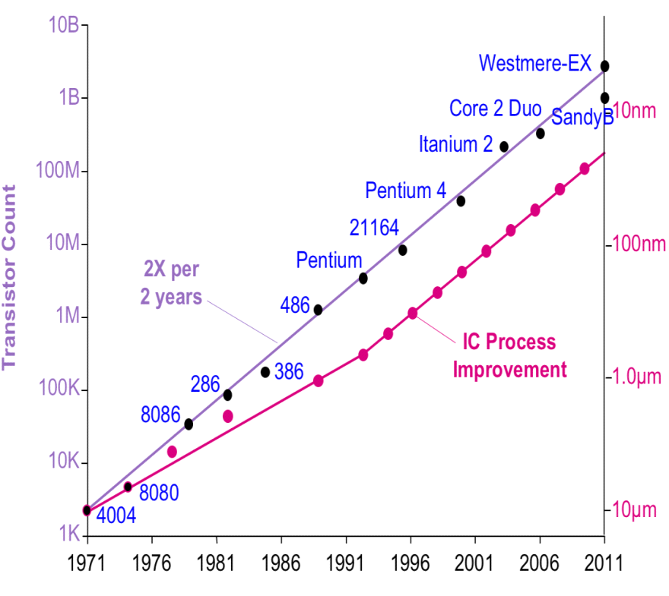
Source: Yaseen et. al.

Slide 9
How to Use the Extra Transistors
Traditional
  Complicate the processor
    Issue width, ROB size, aggressive speculation
  Increase the cache sizes
    L1, L2, L3
Modern (post 2005)
  Increase the number of cores per chip
  Increase the number of threads per core

Slide 10
What was Wrong with the Traditional Approach?
Law of diminishing returns
  Performance does not scale well with the increase in cpu resources
  Delay is proportional to size of a cpu structure
  Sometimes it is proportional to the square of the size
  Hence, there was no significant difference between a 4-issue and a 8-issue processor
  Extra caches had also limited benefit because the working set of a program completely fits in the cache
Wire Delay
  It takes 10s of cycles for a signal to propagate from one end of a chip to the other end. Wire delays decrease the advantage of pipelining.

Slide 11
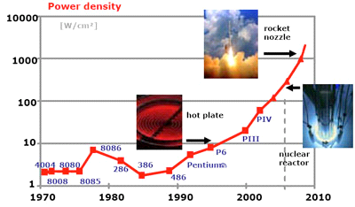
Power & Temperature
Source: Intel Microprocessor Report

Slide 12
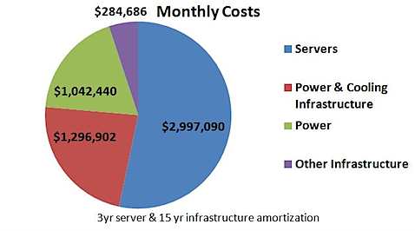
Power &Temperature - II
High power consumption
  Increases cooling costs
  Increases the power bill
Source: O'Reilly Radar

Slide 13
Intel's Solution: Have Many Simple Cores
Some major enhancements to processors
  Pentium – 2 issue inorder pipeline (5 stage)
  Pentium Pro – Out of order pipeline (7 stage)
  Pentium 4 – Aggressive out-of-order pipeline (18 stage) + trace cache
  Pentium Northwood – 27 stage out-of-order pipeline
  Pentium M – 12 stage out of order pipeline
  Intel Core2 Duo – 2 Pentium M cores
  Intel QuadCore – 4 Pentium M cores

Slide 14
Source: chipworks.com

Slide 15
Outline
Moore's Law and Transistor Scaling
Overview of Multicore Processors
Cache Coherence
Memory Consistency

Slide 16
What is a Multicore Processor?
Core
Core
Core
Core
Cache
Cache
Cache
Cache
L2 Cache
Multiple processing cores, with private caches
Large shared L2 or L3 caches
Complex interconnection network
This is also called symmetric multicore processor

Slide 17

Advantages of Multicores
The power consumption per core is limited. It decreases by about 30% per generation.
The design has lesser complexity
  easy to design, debug and verify
The performance per core increases by about 30% per generation
The number of cores double every generation.

Slide 18



Multicores
Power
Complexity
Performance
per Core
Parallelism

Slide 19


Issues in Multicores
We have so many cores ...
How to use them?
ANSWER
1) We need to write effective and efficient parallel programs
2) The hardware has to facilitate this endeavor
Parallel processing is the biggest advantage

Slide 20
Parallel Programs
Sequential
Parallel
for (i=0;i<n;i++)
  c[i] = a[i] * b[i]
parallel_for(i=0;i<n;i++)
  c[i] = a[i] * b[i]
What if ???
parallel_for(i=0;i<n;i++)
  c[d[i]] = a[i] * b[i]
Is the loop still parallel?

Slide 21
1st Challenge: Finding Parallelism
To run parallel programs efficiently on multi-cores we need to:
  discover parallelism in programs
  re-organize code to expose more parallelism
Discovering parallelism : automatic approaches
  Automatic compiler analysis
  Profiling
  Hardware based methods

Slide 22
Finding Parallelism- II
Discovering parallelism: manually
  Write explicitly parallel algorithms
  Restructure loops to make them parallel
Example
Sequential
Parallel
for (i=0;i<n-1;i++)
  a[i] = a[i] * a[i+1]
a_copy = copy(a)
parallel_for(i=0;i<n-1;i++)
  a[i] = a_copy[i] * a_copy[i+1]

Slide 23
Tradeoffs
Compiler Approach
  Not very extensive
  Slow
  Limited utility
Manual approach
  Very difficult
  Much better results
  Broad utility
Given good software level approaches, how can hardware help ?

Slide 24


Models of Parallel Programs
Shared memory
  All the threads see the same view of memory (same address space)
  Hard to implement but easy to program
  Default (used by almost all multicores)
Message passing
  Each thread has its private address space
  Simpler to program
  Research prototypes

Slide 25
Shared Memory Multicores
What is shared memory?
Core
Core
read x
x=19
Cache
Cache

Slide 26
How does it help?
Programmers need not bother about low level details.
The model is immune to process/thread migration
The same data can be accessed/ modified from any core
Programs can be ported across architectures very easily, often without any modification

Slide 27
Outline
Moore's Law and Transistor Scaling
Overview of Multicore Processors
Cache Coherence
Memory Consistency

Slide 28
What are the Pitfalls?
Example 1
x = 0
Thread 1
Thread 2
Thread 3
x = 1
x = 2
r1 = x
r2 = x
r3 = x
r4 = x
Is the outcome (r1=1, r2=2) (r3=2, r4=1) feasible?
Does it make sense?

Slide 29
Example 1 contd...
Thread 1
Thread 2
Thread 3
x=2
x=2
x=1
x=1
Intercore-network
Order gets reversed

Slide 30
Example 2
x = 0
Thread 1
Thread 2
Thread 3
x = 1
r1 = x
r3 = x
Is the outcome (r1 = 0, r3 = 0) feasible?
Does it make sense?
When should a write from one processor be visible to other processors?

Slide 31
Point to Note
Memory accesses can be reordered by the memory system.
The memory system is like a real world network.
It suffers from bottlenecks, delays, hot spots, and sometimes can drop a packet

Slide 32
How should Applications behave?
It should be possible for programmers to write programs that make sense
Programs should behave the same way across different architectures
Cache Coherence
Axiom 1
A write is ultimately visible.
Axiom 2
Writes to the same location are seen in the same
order

Slide 33
Example Protocol
Claim
The following set of conditions satisfy Axiom 1 and 2
Axiom 1
A write is ultimately visible.
Condition 1
Every write completes in a finite amount of time
Axiom 2
Writes to the same location are seen in the same
order
Writes to the same location are seen in the same
order
Condition 2
At any point of time: a given cache block is either being
read by multiple readers, or being written by just one writer

Slide 34
Practical Implementations
Snoopy Coherence
  Maintain some state per every cache block
  Elaborate protocol for state transition
  Suitable for CMPs with cores less than 16
  Requires a shared bus
Directory Coherence
  Elaborate state transition logic
  Distributed protocol relying on messages
  Suitable for CMPs with more than 16 cores

Slide 35
Implications of Cache Coherence
It is not possible to drop packets. All the threads/cores should perceive 100% reliability
Memory system cannot reorder requests or responses to the same address
How to enforce cache coherence
  Use Snoopy or Directory protocols
  Reference: Henessey Patterson Part 2

Slide 36
Outline
Moore's Law and Transistor Scaling
Overview of Multicore Processors
Cache Coherence
Memory Consistency

Slide 37
Reordering Memory Requests in General
x = 0 , y = 0
Thread 1
Thread 2
x = 1
r1 = y
y = 1
r2 = x
Is the outcome (r1=0, r2=0) feasible?
Does it make sense?
Answer : Depends ….

Slide 38
Reordering Memory Requests
Sources
1
Network on Chip
2
Write Buffer
3
Out-of-order Pipeline

Slide 39
Write Buffer
x=1
y=1
Processor 1
r1=y
r2=x
Processor 2
0
0
WB
WB
Write Buffers
Cache Subsystem
Write buffers can break W → R ordering

Slide 40
Out of Order Pipeline
Processor 1
Processor 2
r1=y
x=1
y=1
r2=x
Cache Subsystem
r1=0
r2=0
A typical out-of-order pipeline can cause abnormal thread behavior

Slide 41
What is allowed and What is Not?
Same Address
Different Address
Cannot reorder memory
Requests
Reordering may be possible
Cache Coherence
Memory Consistency

Slide 42

Memory Consistency Models
 | W → R | W → W | R → W | R → R
Sequential Consistency (SC) E.g, MIPS R1000
Total Store Order (TSO) E.g., Intel procs, Sun Sparc V9
Partial Store Order (PSO) E.g., Sparc V8
Weak Consistency IBM Power
Relaxed Consistency E.g., Research prototypes

Slide 43
Sequential Consistency is Intuitive
Definition of sequential consistency
  If we run a parallel program on a sequentially consistent machine, then the output is equal to that produced by some sequential execution.

Slide 44
Example
x = 0 , y = 0
Thread 1
Thread 2
x = 1
r1 = y
y = 1
r2 = x
Is the outcome (r1=0, r2=0) feasible?
Answer
  Sequential Consistency (NO)
  All other models (YES)

Slide 45
Comparison
Sequential consistency is intuitive
  Very low performance
  Hard to implement and verify
  Easy to write programs
Relaxed memory models
  Good performance
  Easier to verify
  Difficult to write correct programs

Slide 46
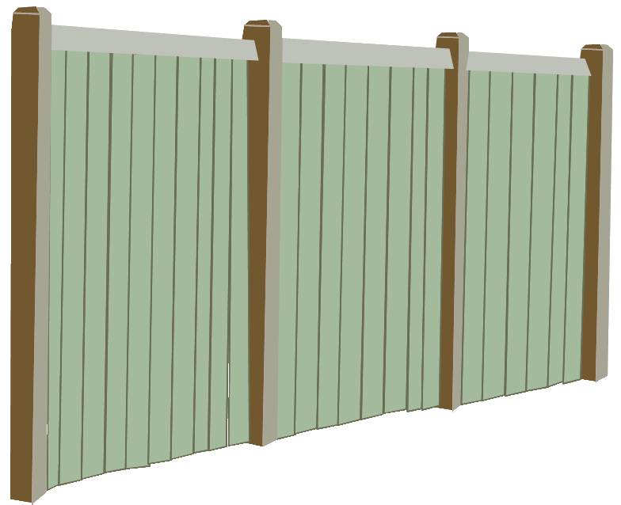
Solution
Program
Instructions
Fence
Complete all out-standing
Memory requests
Program
Instructions

Slide 47
Make our Example
Run Correctly
x = 0 , y = 0
Thread 1
Thread 2
x = 1
Fence
r1 = y
y = 1
Fence
r2 = x
Gives the correct result irrespective of the memory consistency model

Slide 48
Basic Theorem
It is possible to guarantee sequentially consistent execution of a program by inserting fences at the correct places.
Implications:
  Programmers need to be multi-core aware and write programs properly
  Smart compiler infrastructure

Slide 49
Shared Memory:
A Perspective
Implementing a memory system for multicore processors is a non-trivial task
  Cache coherence (fast, scalable)
  Memory consistency
    Library and compiler support
    Tradeoff: Performance vs simplicity

Slide 50
Part II - Multiprocessor Design

Slide 51
Multicore Organization
Processor 1
Processor 2
Processor 3
Processor 4
Caches
Memory Cntrlr 1
I/O Cntrlr
Memory Cntrlr 2
Memory Bank
Memory Bank
I/O
Devices

Slide 52
Architecture vs Organization
Architecture
  Shared memory
  Cache coherence
  Memory consistency
Organization
  Caches
  Network on chip (NOC)
  Memory and I/O controllers

Slide 53
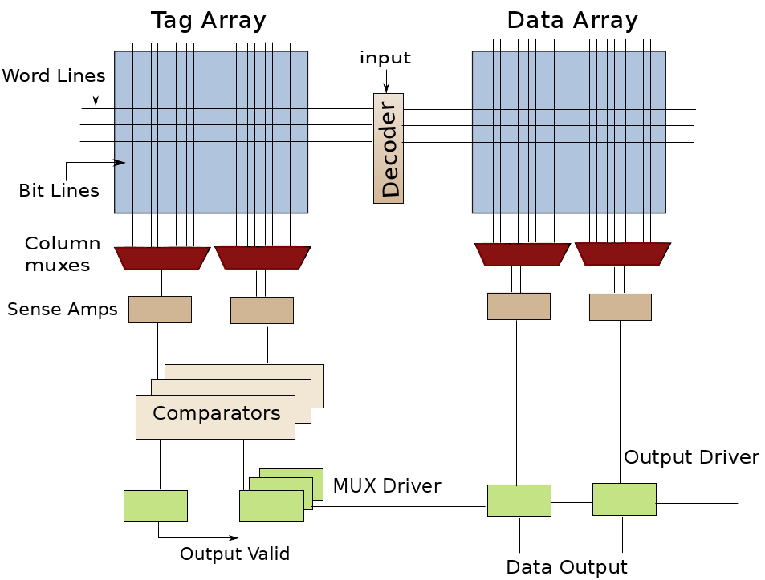
Basics of Multicore Caches - Cache Bank

Slide 54
Large Caches
Multicores typically have large caches (2- 8 MB)
Several cores need to simultaneously access the cache
We need a cache that is fast and power efficient
DUMB SOLUTION : Have one large cache
Why is the solution dumb?
  Violates the basic rules of cache design

Slide 55
ABCs of Caches
Delay is proportional to size
Power is proportional to size
  Can be proportional to size² for very large caches
Delay is proportional to (#ports)²
Wire delay is a major factor
18
10
10
2
# cycles

Slide 56
Smart Solution
Create a network of small caches
Each cache is indexed by unique bits of the address
Connect the caches using an on-chip network
Link
Buffer
Router
Cache

Slide 57
Network Topology
(a) chain
(b) ring
(c) mesh

Slide 58
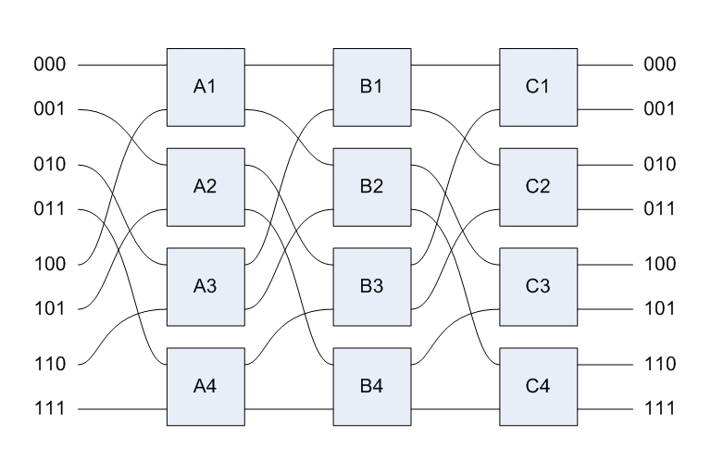
(d) 2D Torus
(e) Omega Network

Slide 59
Network Routing
Aims
  Avoid deadlock
  Minimize latency
  Avoid hot-spots
Major types
  Oblivious -- fixed policy
  Adaptive -- takes into account hot-spots and congestion

Slide 60
Oblivious Routing
X-Y routing
  First move along the X-axis, and then the Y-axis
Y-X routing
  Reverse of X-Y routing

Slide 61
Adaptive Routing
Route from X_S, Y_S to X_T, Y_T
source
target
West-first
  If X_T ≤ X_S use X-Y routing
  Else, route adaptively
North-last
  If Y_T ≤ Y_S use X-Y routing
  Else, route adaptively
Negative-first
  If (X_T ≤ X_S || Y_T ≤ Y_S) use X-Y routing
  Else, route adaptively

Slide 62
Flow Control
Store and forward
  A router stores the entire packet
  Once it receives all the flits, sends it onward
Wormhole routing
  Flits continue to proceed along outbound links
  They are not necessarily buffered

Slide 63
Flow Control - II
Circuit switched
  Resources such as buffers and slots are pre-allocated
  Low latency, at the cost of high starvation
Virtual channel
  Allows multiple flows to share a single channel
  Implemented by having multiple queues at the routers

Slide 64
Part III -- Examples

Slide 65
AMD Opteron

Slide 66
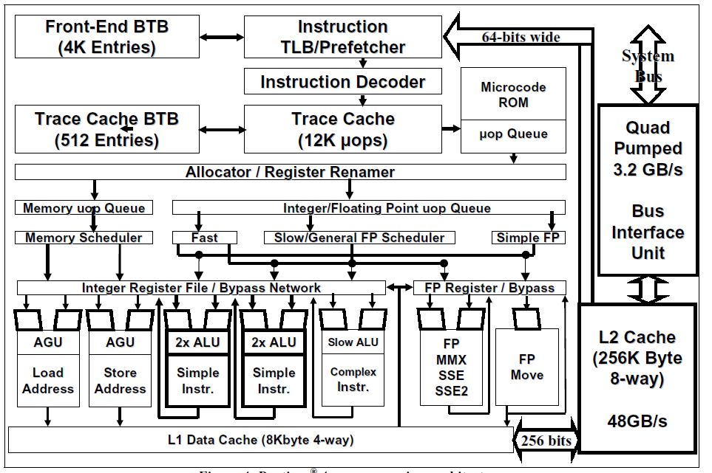
Intel - Pentium 4
source: Intel Techology Docs

Slide 67
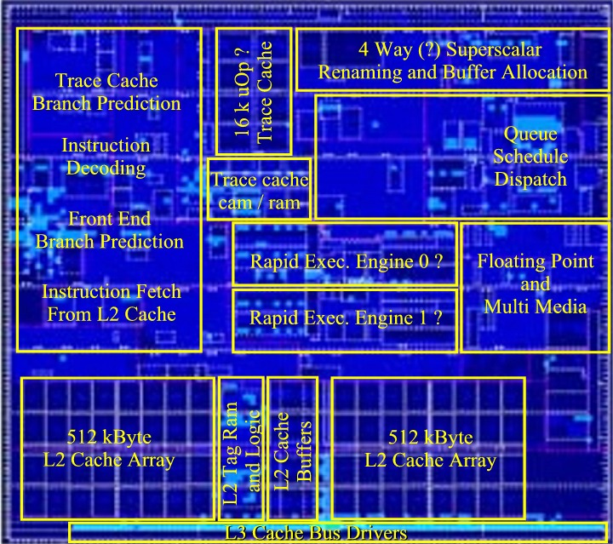
Intel Prescott
source: chip-architect.com

Slide 68
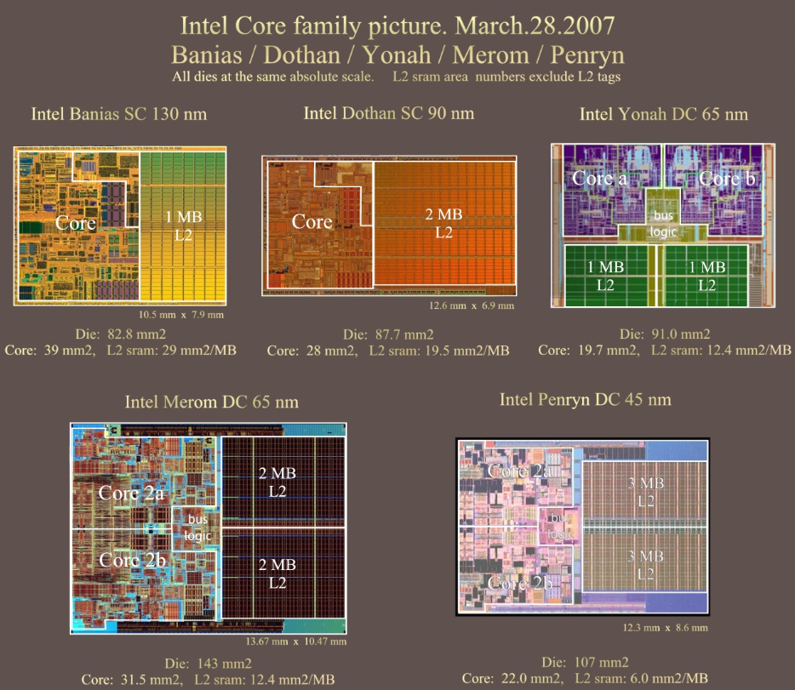
source: chip-architect.com

Slide 69
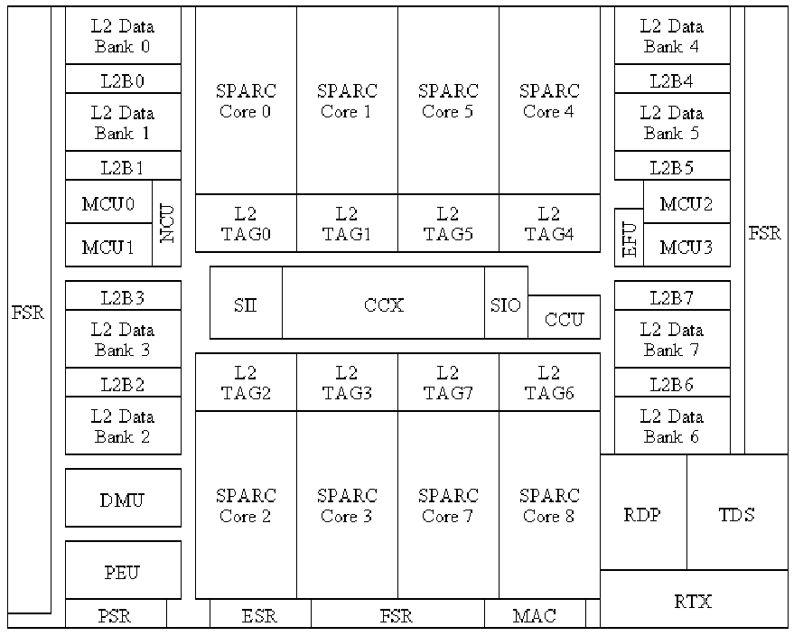
UltraSparc T2
source: wikipedia

Slide 70
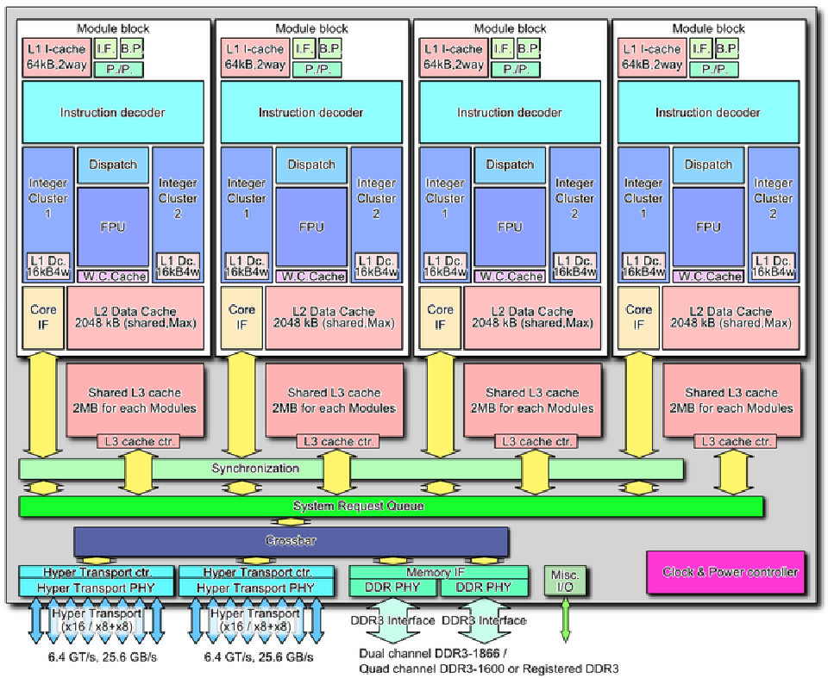
AMD: Bulldozer
source: wikipedia

Slide 71
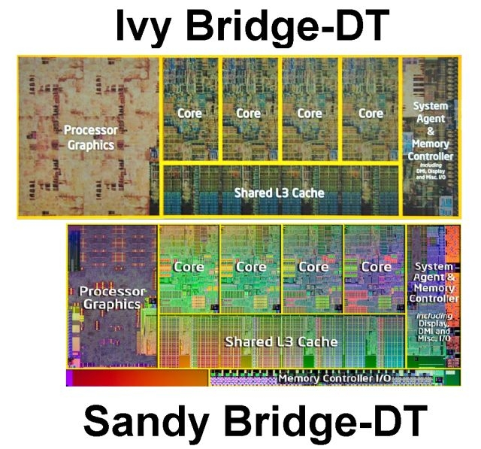
Intel Sandybridge & Ivybridge
source: itportal.com

Slide 72
Intel Ivybridge
Micro-architecture
  32KB L1 data cache + 32 KB L1 instruction cache
  256 KB coherent L2 cache per core
  Shared L3 cache (2 - 20 MB)
  256 bit ring interconnect
  Upto 8 cores
  Roughly 1.1 billion transistors
  Turbo mode - Can run at an elevated temperature for upto 20s.
  Built-in graphics processor

Slide 73
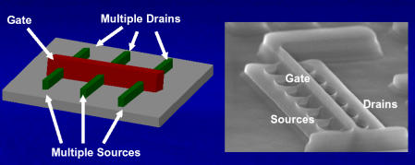
Revolutionary Features
3D Tri-gate Transistors based on FinFets
source: wikipedia
Faster operation
Lower threshold voltage and leakage power
Higher drive strength

Slide 74
Enhanced I/O Support
PCI Express 3.0
RAM: 2800 MT/s
Intel HD Graphics, DirectX 11, OpenGL 3.1, OpenCL 1.1
DDR3L
Configurable thermal limits
Multiple video playbacks possible

Slide 75
Security
RdRand instruction
  Generates pseudo random numbers based on truly random seeds
  Uses an on-chip source of randomness for getting the seed
Intel vPRO
  Possible to remotely disable processors or erase hard disks by sending signals over the internet or 3G
  Can verify identity of users/ environments for trusted execution

Slide 76

Thank You
Slides can be downloaded at:
source: http://www.cse.iitd.ac.in/~srsarangi/files/drdo-pres-july18-2012.odp
pdf : http://www.cse.iitd.ac.in/~srsarangi/files/drdo-pres-july18-2012.pdf

