Slide 1

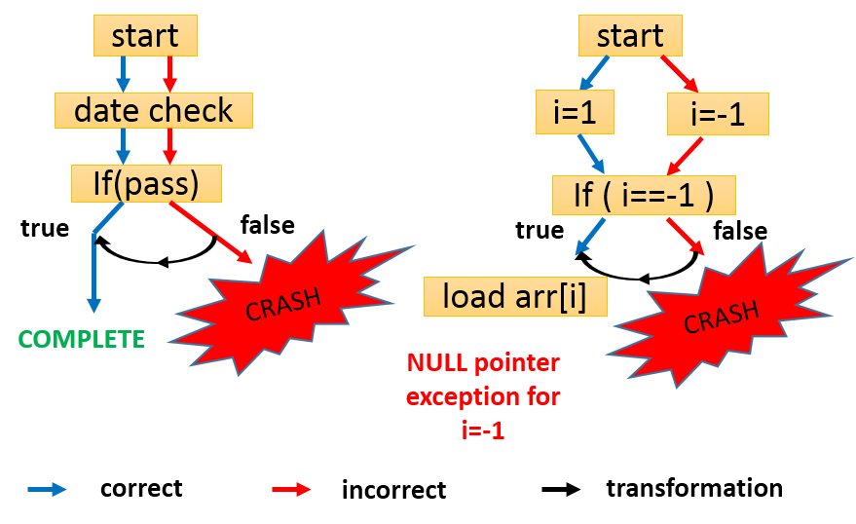
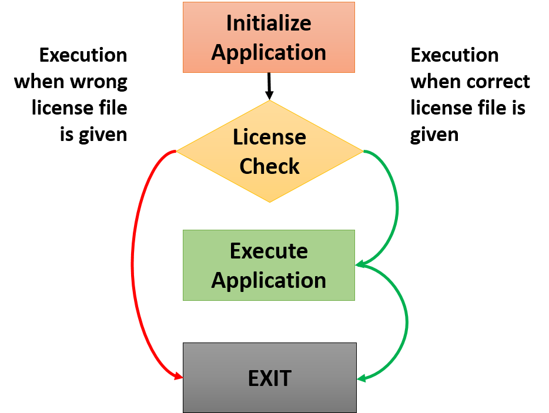
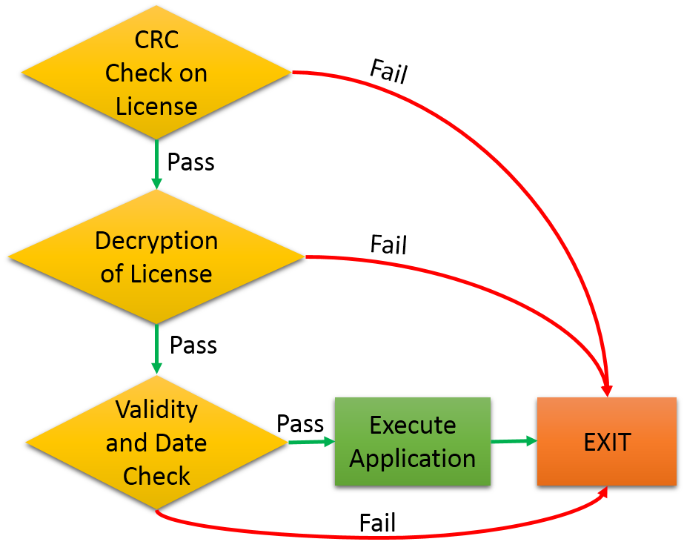
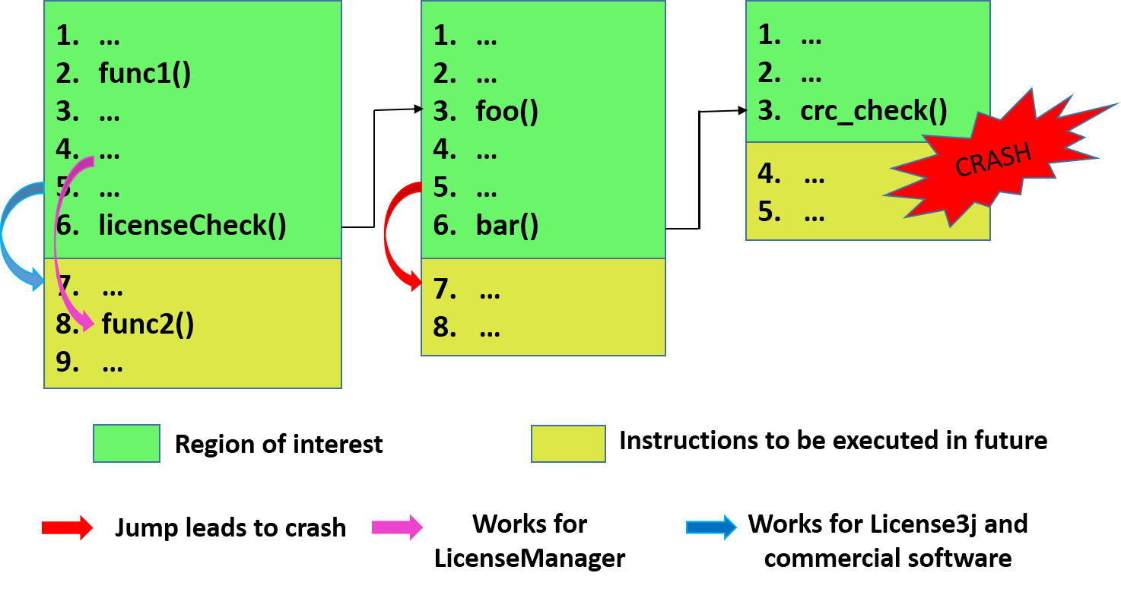
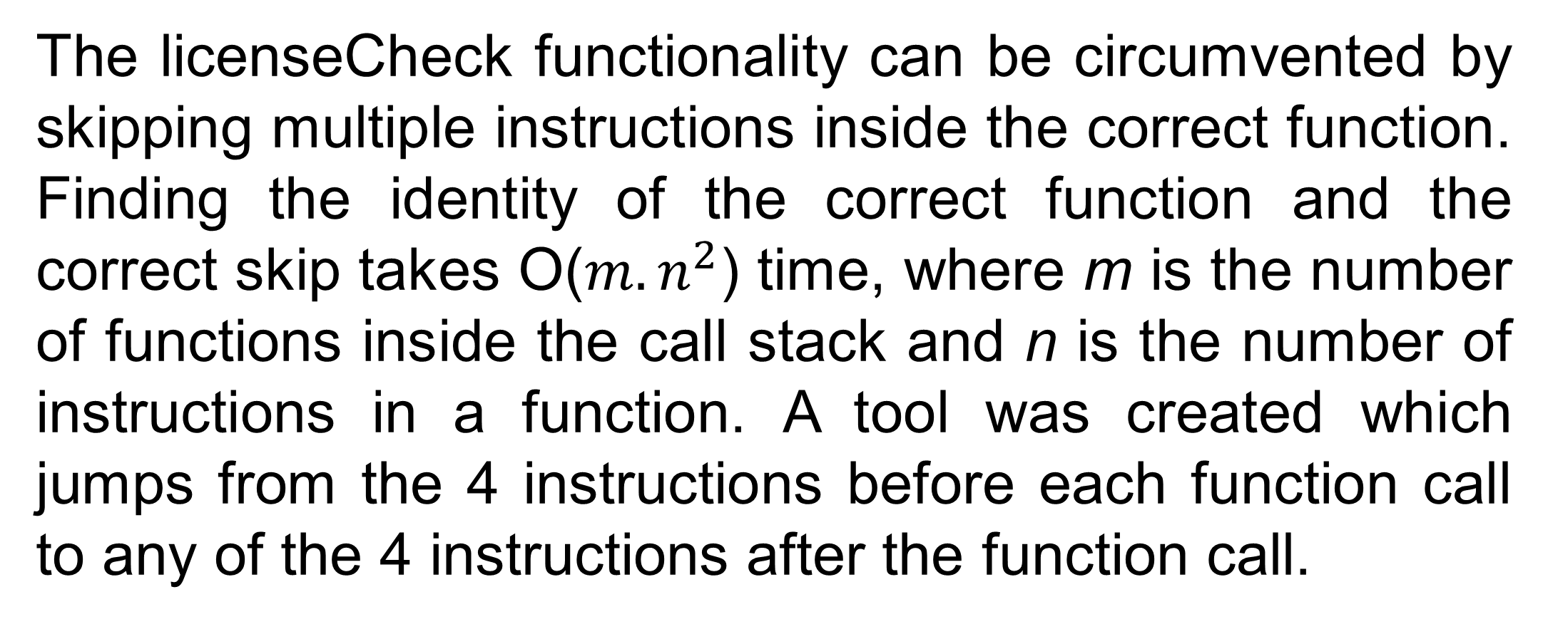
Ethical Hacking of License Managers
Karishma Agarwal, Prathmesh Kallurkar, Siva Krishna Aleti , Smruti R. Sarangi ,IIT Delhi
Problem
Control Flow Deviation Analysis(CFDA)
The licenseCheck functionality can be circumvented by skipping multiple instructions inside the correct function. Finding the identity of the correct function and the correct skip takes O($m.n^{2}$) time, where m is the number of functions inside the call stack and n is the number of instructions in a function. A tool was created which jumps from the 4 instructions before each function call to any of the 4 instructions after the function call.
This paper proposes a novel strategy to circumvent the license validation of proprietary software. We use an emulator, Intel PIN, to collect the control flow information of the program. This information is used to create an automated tool, which determines the potential regions of code that could be checking the validity of the license file and tries to skip them.
The basic strategy is to ascertain the difference in the dynamic control flow of the application with a valid license key
Results of CGA
Working of a License Manager
and an invalid one. This difference is then leveraged to spoof a valid run. The Longest Common Subsequence (LCS) algorithm is applied to find the divergence in the two execution traces.
We were able to break the applications created using License3j and the commercial software by skipping a single instruction (function call). However, we could break LicenseManager by using small skips of 4 instructions.
Results of CFDA
We were able to subvert the date check for all the three software using this approach. However, the CRC check and decryption of the license file is performed using multiple functions, each causing a side-effect by changing a global variable, hence rendering this approach impractical for our purpose.
Conclusion
Related Work
Our approach uses an emulator to analyze the control flow of the software using an incorrect license file. We prove the correctness of the CGA approach on all the three applications. This approach uses a lot of combinations to break the license validation phase. We are currently working on pruning the combinations by a substantial amount.
Traditional techniques use a lot of manual intervention to reverse engineer a proprietary software. Commonly used tools are :
Decompilers
Disassemblers
Debuggers
Microring Resonators
Call Graph Alteration (CGA)
Software used for our Experimentations
References
We use three applications for our purpose :
Two of them are open source license managers: License3j and LicenseManager
The third application is a proprietary software whose source code is not available with us.
LicenseManager: http://java.nicholaswilliams.net/licensemanager/.
License3j : http://verhas.github.io/license3j/home.html.
Luk, Chi-Keung, et. al. “Pin : building customized program analysis tools with dynamic instrumentation”, ACM SIGPLAN Notices. Vol. 40 No. 6, 2005.
When we provide an incorrect license file to the software, the execution follows a series of functions before crashing. If we skip a correct function in this call stack, we may reach a valid state without passing through the license check.

