Slide 1
DUST: A Generalized Notion of Similarity between Uncertain Time Series
Smruti R. Sarangi and Karin Murthy
IBM Research Labs, Bangalore, India

Slide 2


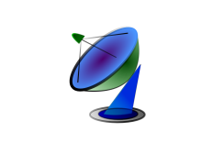

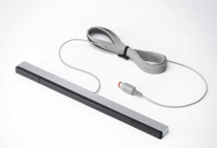


Uncertainty in Data
Uncertainty introduced due to massive amount of sensor data
Analytics
Millions of Sensors
Server
Business Decisions
Privacy preserving techniques
  A certain degree of uncertainty is sometimes intentionally introduced

Slide 3
Outline
Motivation
Generalized Distance Measure
  Properties of a Distance Measure
  Algebraic Derivation
DUST Distance
  Computation
  Properties
  Examples
Results
  Setup
  Classification, Motif Detection, 1-NN search
Conclusion

Slide 4
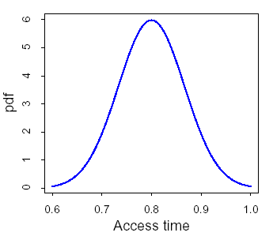
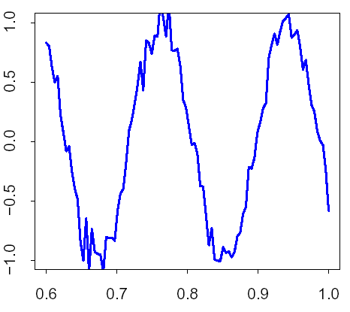
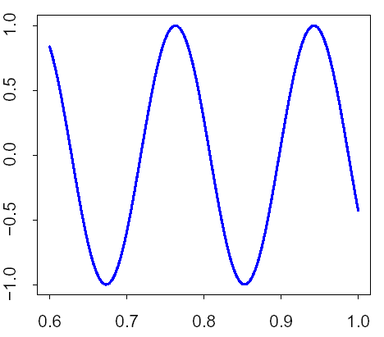
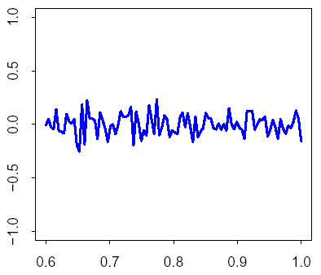
What does Uncertain Data Look Like?
x = r(x) + ε(x)
observed value
error
real value
error distribution
Uncertain Time Series
observed
original
error

Slide 5



Data Mining on Uncertain Time Series
Clustering
Classification
Pattern Discovery
…
Require at least a partial order on the
distances between time series elements
Are x and x’ closer than y and y’ ?
However, a total order between the distances is better
Ensures that all pairs are comparable
Easy to store the distance and manage it later
We need a distance function to measure the distance between uncertain time series elements

Slide 6
Distance between Uncertain Time Series
Clearly T₃
Doesn’t Matter
value
T₂
value
T₂
T₁
T₁
T₃
T₃
time
time
T₂ or T₃ ???
Is T₂ closer to T₁, or is T₃ closer to T₁ ?
T₃
value
T₂
T₁
time

Slide 7

How to Measure the Distance between two Time Series Elements?
Consider two values
x = r(x) + ε(x)
x’ = r(x’) + ε(x’)
Axiom: The distance between x and x’, should say something about the distance between normal Euclidean distance between r(x) and r(x’)
Prior Approaches
1
Compute the apriori probability distribution of the random variable X = (r(x) – r(x’))
2
Work with only the mean and standard deviation of X
X is not a distance measure.
It is hard to work with probabilities.

Slide 8


Resolving the Question
T₂ or T₃ ???
Euclidean distance (EUCL) and Dynamic Time Warping (DTW)
T₃
T₃
value
T₂
T₁
DUST
T₂
time
T₂ should be closer to T₁ than T₃
  This is because it is possible that T₂ and T₁ are the same time series. T₂ just has some additional error.
  T₃ and T₁ can never be the same time series because the last value has a very large divergence

Slide 9
Outline
Motivation
Generalized Distance Measure
  Properties of a Distance Measure
  Algebraic Derivation
DUST Distance
  Computation
  Properties
  Examples
Results
  Setup
  Classification, Motif Detection, 1-NN search
Conclusion

Slide 10
Arriving at a Distance Measure
Properties of a Distance Measure
Non-negativity: d(A,B) ≥ 0
2. Identity of Indiscernibles: d(A,B) = 0 iff A= B
Symmetry: d(A,B) = d(B,A)
Triangle Inequality: d(A,B) + d(A,C) ≥ d(B,C)
5. The distance should be similar to EUCL or DTW
if the magnitude of the error is small.
(Extra Condition for an uncertain distance measure)

Slide 11

Extending Prior Work
Prior Work
Two time series are considered similar if :
P(DIST(T₁,T₂) ≤ ε) ≥ τ
DIST(T₁, T₂) = sqrt(Σ_{i} dist(T₁[i], T₂[i])²)
dist(x,y) = |x-y|
Assumption
P(DIST(T₁,T₂) ≤ ε) = p(DIST(T₁,T₂) = 0) ε
(irrespective of the size of ε)

Slide 12
Some Algebra
P(DIST(T₁,T₂) ≤ ε) > P(DIST(T₁,T₃) ≤ ε)
≈
p(DIST(T₁,T₂) = 0) > p(DIST(T₁,T₃) = 0)
Π_{i} p(dist(T₁[i], T₂[i]) = 0) > Π_{i} p(dist(T₁[i], T₃[i]) = 0)
Σ_{i} –log(p(dist(T₁[i], T₂[i]) = 0)) ≤ Σ_{i} –log(p(dist(T₁[i], T₃[i]) = 0))
-log (φ(|T₁[i] – T₂[i]|)
dist(x,y) is only dependent on |x-y|
φ(x) = p(dist(0,x) = 0)
proved in the paper
Definition
dust(x,y) = -log(φ(|x-y|)) + log(φ(0)

Slide 13
Some Algebra - II
P(DIST(T₁,T₂) ≤ ε) > P(DIST(T₁,T₃) ≤ ε)
≈
Σ_{i} –log(p(dist(T₁[i], T₂[i]) = 0)) ≤ Σ_{i} –log(p(dist(T₁[i], T₃[i]) = 0))
Definition
dust(x,y) = -log(φ(|x-y|)) + log(φ(0)
T₃
value
T₁
Σ_{i} dust(T₁[i], T₂[i])² ≤ Σ_{i} dust(T₁[i], T₃[i])²
T₂
Definition
DUST(T₁, T₂) =
Σ_{i} dust(T₁[i], T₂[i])²
time
DUST(T₁, T₂) ≤ DUST(T₁, T₃)
DUST behaves like a standard distance measure

Slide 14
Outline
Motivation
Generalized Distance Measure
  Properties of a Distance Measure
  Algebraic Derivation
DUST Distance
  Computation
  Properties
  Examples
Results
  Setup
  Classification, Motif Detection, 1-NN search
Conclusion

Slide 15
Computing the DUST Distance
Offline Computation
Δ x
Compute dust(0,Δx)
Original distribution
of data
1. Assume values are independent
2. Use Bayes’ Theorem
3. Arrive at final solution through
numerical integration
dust(0,Δx)
error distribution
Save the values in a lookup table
Compress it using a piece-wise
linear representation
dust(0,Δx)
|x-y|
Online Computation
dust(0,Δx)
Δ x
Check the
last segment in the lookup table
No
Perform a binary
search to find
the right segment
calculate
value
Yes

Slide 16
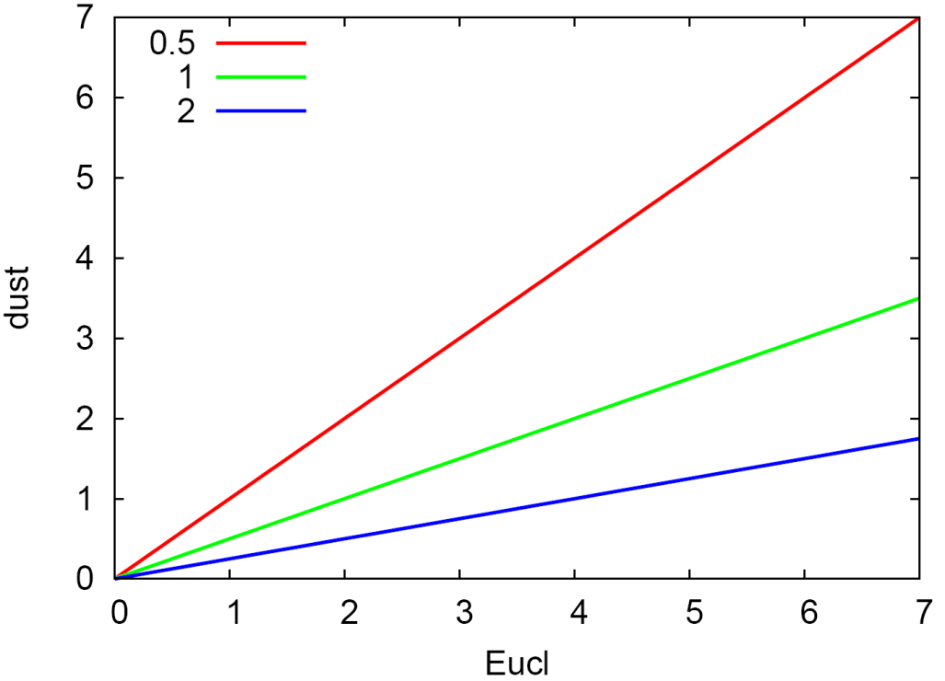
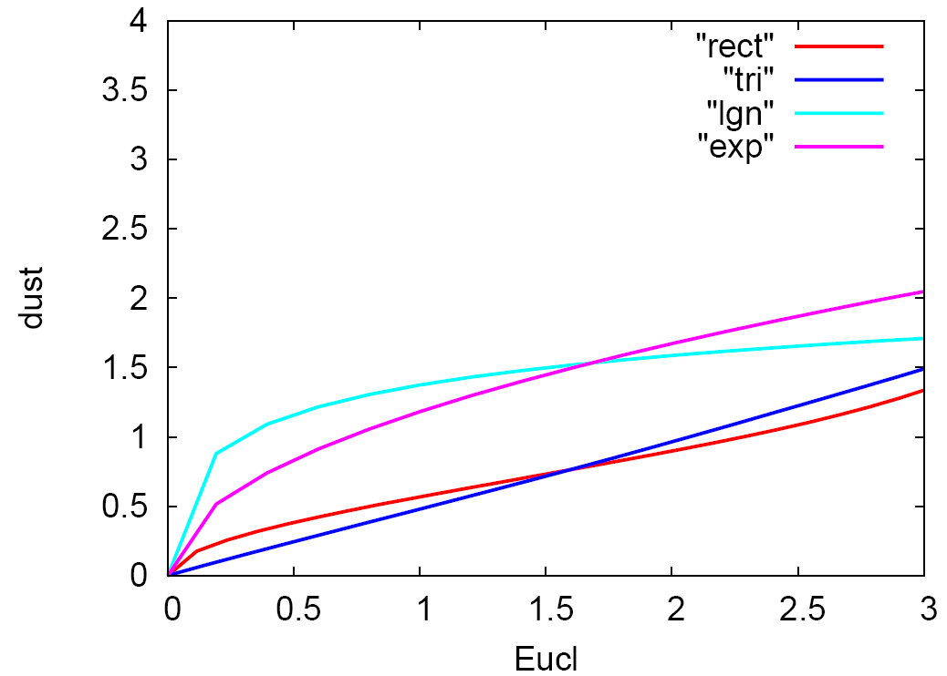

The dust Distance
Normal Distribution
Other Distributions
The dust distance is exactly the same as Euclidean distance
for the Normal distribution
dust ultimately converges with Euclidean distance

Slide 17
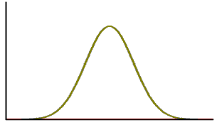
Combining Multiple Distributions
T₁
T₂
Normal
Uniform
Exponential
Let the values in a time series have different
error distributions f₁ … f_{n}. Let their standard
deviations be σ₁ … σ_{n}.
Let us choose σ_{e} = min (σ₁, …, σ_{n})/5
Not interested
Interested
Adjusted
η₁ ≤ x ≤ η₂
f(x)
f’(x)
x < η₁
N(0, σ_{e})
η₁
η₂
x > η₂
N(0, σ_{e})

Slide 18
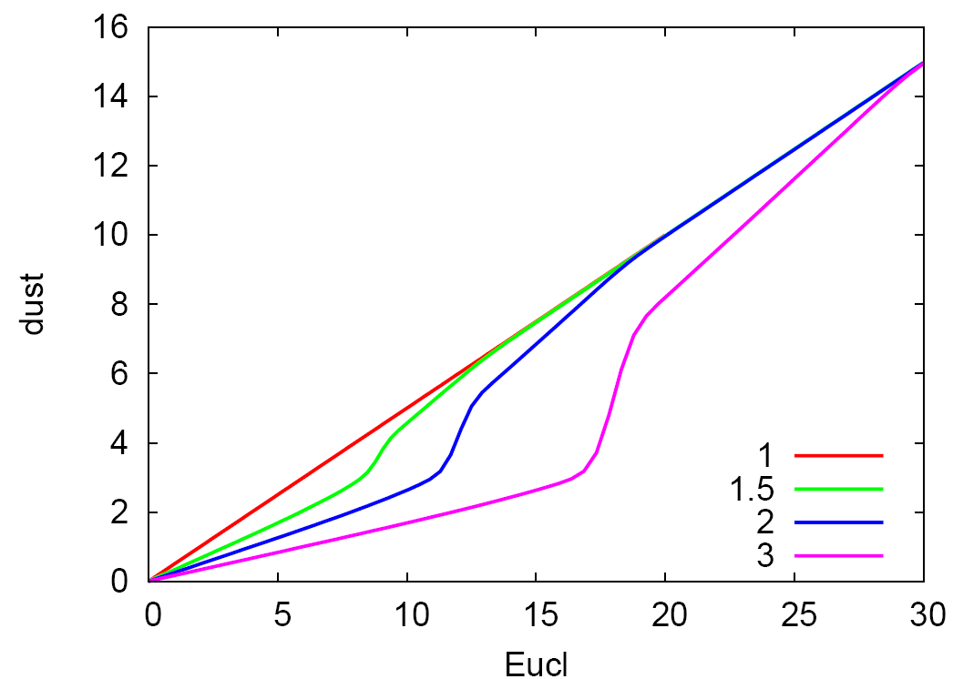
Combining Multiple Normal Distributions
Converge to the same distance func.
Combining multiple normal distributions with different
Standard deviations

Slide 19
Results

Slide 20
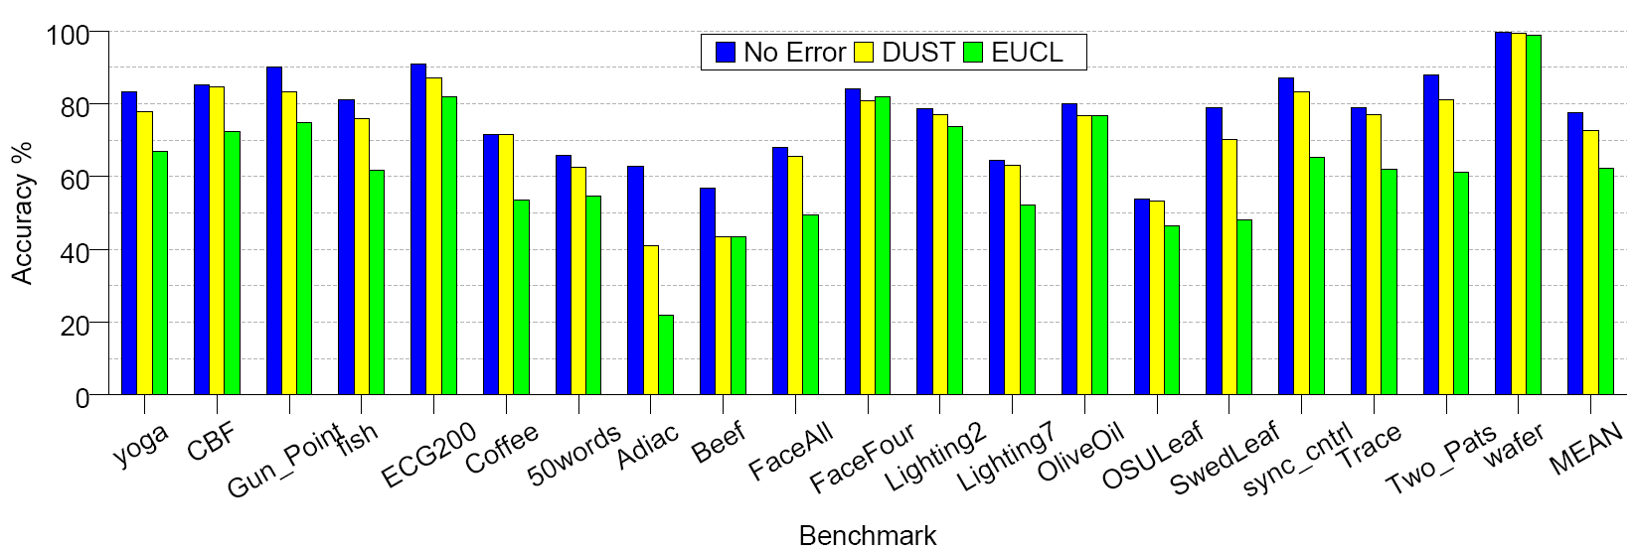
Classification Accuracy
No Error : 77%, DUST: 72%, Euclidean Distance: 62%

Slide 21
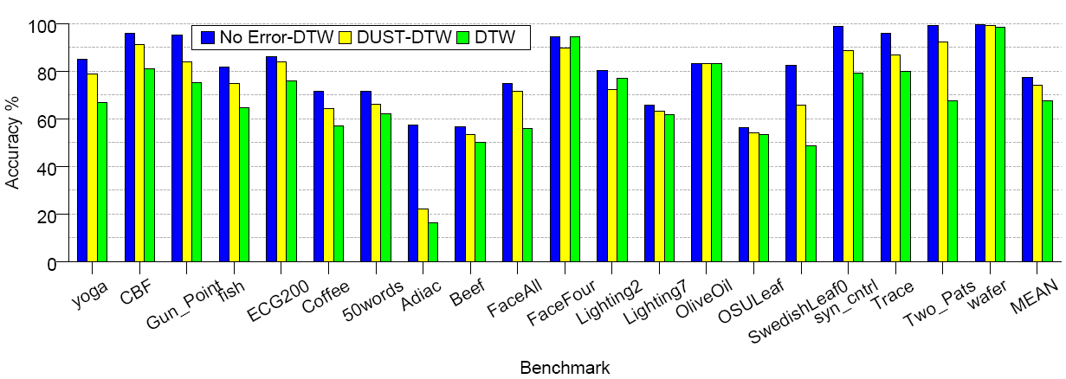
Classification Accuracy: Dynamic Time Warping
No Error : 78%, DUST: 74%, Euclidean Distance: 67%

Slide 22
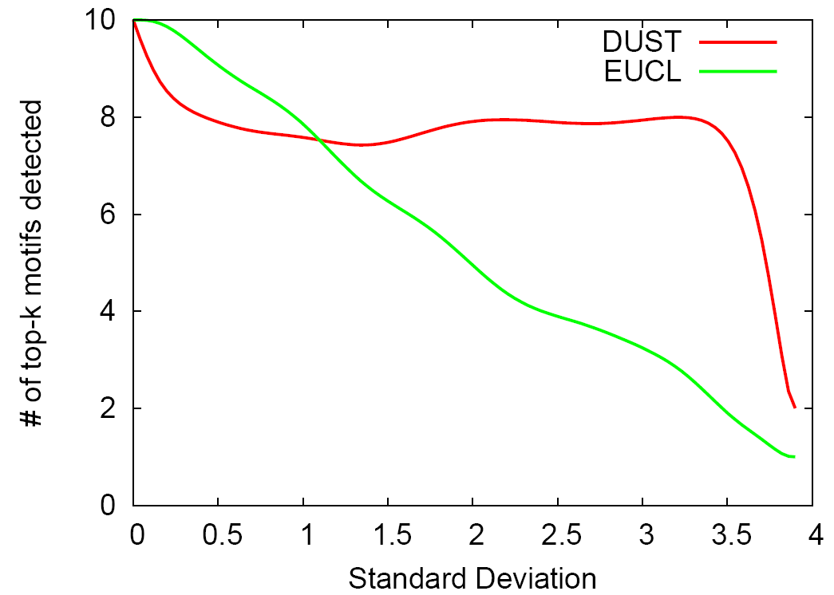
Top-k Motifs : EEG Dataset
Superior performance
of DUST
Anomalous Behavior

Slide 23
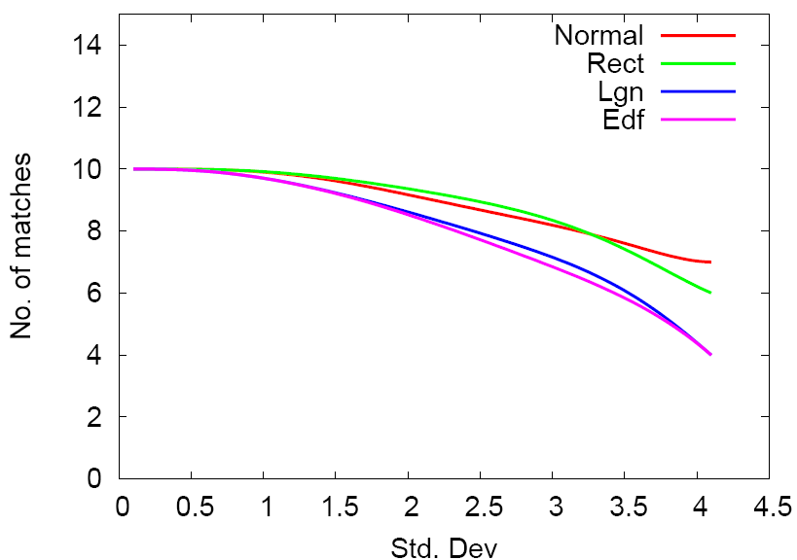
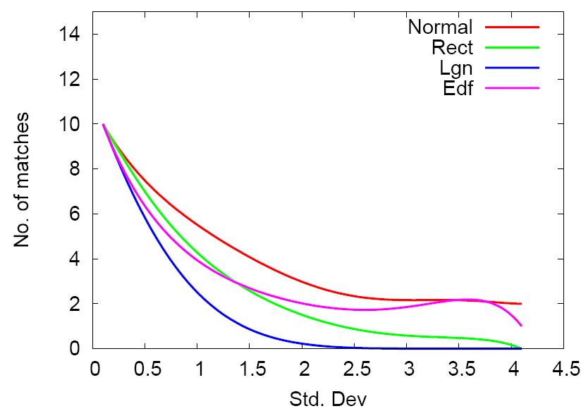
#of Matches vs Standard Deviation for k-NN classification – wafer dataset
DUST
Euclidean Dist.

Slide 24
Conclusions
Uncertainty in data is increasingly prevalent in
  Sensor data
  Privacy preserving techniques
Conventional approaches
  Don’t produce good results with mining uncertain data
Propose novel metric DUST
  Incorporates theoretical measures of similarity
  Easy to compute
DUST makes up for half the accuracy lost due to uncertainty

Slide 25


DUST: A Generalized Notion of Similarity between Uncertain Time Series
Smruti R. Sarangi and Karin Murthy
IBM Research Labs, Bangalore, India

