Slide 1

The R Language
Dr. Smruti R. Sarangi and Ms. Hameedah Sultan
Computer Science and Engineering
IIT Delhi

Slide 2
Overview of R
Language for statistical computing and data analysis
Freely available under GPL v2
Extensive library support
Programming paradigms
procedural
functional
object-oriented
General matrix computation (similar to Matlab)

Slide 3
Running R
Command Line
Just type R
The R command prompt comes up > .....
With a GUI
R Studio
R Commander

Slide 4
Outline
Variables and Vectors
Factors
Arrays and Matrices
Data Frames
Functions and Conditionals
Graphical Procedures

Slide 5
Normal Variables
We can use <- as the assignment operator in R
> x <- 4 (set x to 4)
For printing the value of x
> x [1] 4
OR, > print(x) [1] 4

Slide 6
A Numeric Vector
Simplest data structure
Numeric vector
> v <- c(1,2,3)
<- is the assignment operator
c is the list concatenation operator
To print the value, v
Type : > v
Output: [1] 1 2 3

Slide 7
A vector is a full fledged variable
Let us do the following:
> 1/v [1] 1.0000000 0.5000000 0.3333333
> v + 2 [1] 3 4 5
We can treat a vector as a regular variable
For example, we can have:
> v1 <- v / 2 > v1 [1] 0.5 1.0 1.5

Slide 8
Creating a vector with vectors
> v <- c (1,2,3) > v
[1] 1 2 3 > vnew <- c (v,0,v)
> vnew
[1] 1 2 3 0 1 2 3
The c operator concatenates all the vectors

Slide 9
Functions on Vectors and Complex Numbers
If v is a vector
Here, are a few of the functions that take vectors as inputs: mean(v), max(v), sqrt(v), length(v), sum(v), prod(v), sort (v) (in ascending order)
> x <- 1 + 1i
> y <- 1i
> x * y
[1] -1+1i

Slide 10
Generating Vectors
Suppose we want a vector of the form: (1,2,3,... 100)
We do not have to generate it manually.
We can use the following commands: > v <- 1:100 OR > v <- seq(1,100)
seq takes an additional argument, which is the difference between consecutive numbers:
seq (1,100,10) gives (1,11,21,31 ... , 91)
rep (2,5) generates a vector (2, 2, 2, 2, 2)

Slide 11
Boolean Variables and Vectors
R recognizes the constants: TRUE, FALSE
TRUE corresponds to 1
FALSE corresponds to 0
We can define a vector of the form:
v <- c (TRUE, FALSE, TRUE)
We can also define a logical vector
Can be created with logical operators: <, <=, >=, ==, !=, & and I
> v <- 1:9 > 5
> v
[1] FALSE FALSE FALSE FALSE FALSE TRUE TRUE TRUE TRUE

Slide 12
String Vectors
Similarly, we can have a vector of strings
> vec <- c (“f1”, “f2”, “f3”)
> vec
[1] "f1" "f2" "f3“
The paste function can be used to create a vector of strings
paste(1:3, 3:5,sep="*")
[1] "1*3" "2*4" "3*5"
It takes two vectors of the same length, and an optional argument, sep. The i^{th} element of the result string, contains the i^{th} elements of both the arguments, separated by the string specified by sep.

Slide 13
Outline
Variables and Vectors
Factors
Arrays and Matrices
Data Frames
Functions and Conditionals
Graphical Procedures

Slide 14
Factors
Definition: A vector used to specify
a grouping (classification) of objects
in other vectors.
Factor
Consider the following problem:
We have a vector of the type of the Nationality of students, and a vector of their marks in a given subject.
AIM: Find the average scores per nationality.

Slide 15
Graphical View of the Problem
Indian
6
Chinese
8
Indian
Indian
7
Chinese
Chinese
9
Russian
Indian
8
Factor
Russian
10
Nationality
Marks

Slide 16
Code
# character starts a comment
> nationalities <- c ("Indian", "Chinese", "Indian", "Chinese",
"Indian", "Russian") # create a factor > marks <- c (6, 8, 7, 9, 8, 10)
> fac <- factor(nationalities)
> fac
[1] Indian Chinese Indian Chinese Indian Russian
Levels: Chinese Indian Russian
The levels of a factor indicate the categories

Slide 17
Code - II
Now let us apply the factor to the marks vector
> results <- tapply (marks, fac, mean)
Works on each element of the list
factor
compute the mean in each category
List of marks

Slide 18
Time for the results
> results
Chinese Indian Russian
8.5 7.0 10.0
Let us now apply the sum function > tapply (marks, fac, sum) Chinese Indian Russian
17 21 10

Slide 19
levels and table
> levels (fac)
[1] "Chinese" "Indian" "Russian"
> table (fac)
fac
Chinese Indian Russian
2 3 1
Let us assume that the factor is fac.
fac is
[1] Indian Chinese Indian Chinese Indian Russian
Levels: Chinese Indian Russian
levels returns a vector containing all the unique labels
table returns a special kind of array that contains the counts of entries for each label

Slide 20
Outline
Variables and Vectors
Factors
Arrays and Matrices
Data Frames
Functions and Conditionals
Graphical Procedures

Slide 21

Arrays and Matrices
Generic array function
Creates an array. Takes two arguments:
data_vector → vector of values
dimension_vector
Example: > array (1:10, c(2,5))
[,1 [,2] [,3] [,4] [,5]
[1,] 1 3 5 7 9
[2,] 2 4 6 8 10
The numbers are laid out in column major order.
Count from 1, Not 0

Slide 22
Other ways to make arrays
Take a vector, and assign it dimensions
> v <- c (1,2,3,4)
> dim(v) <- c(2,2)
> v
[,1] [,2]
[1,] 1 3
[2,] 2 4

Slide 23
Arrays are Created in Column Major Order
> v <- 1:8
> dim(v) <- c(2,2,2)
> v
, , 1
[,1] [,2]
[1,] 1 3
[2,] 2 4
, , 2
[,1] [,2]
[1,] 5 7
[2,] 6 8
> v[2,1,2]
[1] 6
Start from the last index
Array elements are accessed by specifying their index (within square brackets)

Slide 24
The matrix command
A matrix is a 2-D array
There is a fast method of creating a matrix
Use the matrix (data, dim1, dim2) command
Example:
> matrix(1:4, 2, 2)
[,1] [,2]
[1,] 1 3
[2,] 2 4

Slide 25
cbind and rbind
mat1
mat2
mat1
mat2
cbind
mat1
mat1
mat2
mat2
rbind

Slide 26
Problem: set the diagonal elements of a matrix to 0
> mat <- matrix(1:16,4,4)
> mat
[,1] [,2] [,3] [,4]
[1,] 1 5 9 13
[2,] 2 6 10 14
[3,] 3 7 11 15
[4,] 4 8 12 16
> indices <- cbind (1:4, 1:4)
> mat[indices] <- 0
> mat
[,1] [,2] [,3] [,4]
[1,] 0 5 9 13
[2,] 2 0 10 14
[3,] 3 7 0 15
[4,] 4 8 12 0

Slide 27

Recycling Rule
> cbind (1:4, 1:8)
[,1] [,2]
[1,] 1 1
[2,] 2 2
[3,] 3 3
[4,] 4 4
[5,] 1 5
[6,] 2 6
[7,] 3 7
[8,] 4 8
The smaller structure is replicated to match the length of the longer structure
Note that the size of the longer structure has to be a multiple of the size of the smaller structure.

Slide 28
Matrix Operations
A * B is a normal element-by-element product
A %*% B is a matrix product
Equation solution:
solve (A, b) (for equations of the form Ax = b)
solve (A) returns the inverse of the matrix
> A <- matrix (1:4, 2, 2)
> b <- 5:6
> solve (A,b)
[1] -1 2
Solve an equation of the form: Ax = b
> solve(A) %*% b
[,1]
[1,] -1
[2,] 2
A⁻¹ * b = x

Slide 29
Additional Features
nrow (mat) → Number of rows in the matrix
ncol (mat) → Number of columns in the matrix
Feature | Function
Eigen Values | eigen
Singular Value Decomposition | svd
Least Squares Fitting | lsfit
QR decomposition | qr

Slide 30
Outline
Variables and Vectors
Factors
Arrays and Matrices
Data Frames
Functions and Conditionals
Graphical Procedures

Slide 31
Lists and Data Frames
A list is a heterogeneous data structure
It can contain data belonging to all kinds of types
Example:
> lst <- list (“one”, 1, TRUE)
Elements can be lists, arrays, factors, and normal variables
The components are always numbered
They are accessed as follows: lst[[1]], lst[[2]], lst[[3]]
[[ ... ]] is the operator for accessing an element in a list

Slide 32
Named Components
Lists can also have named components
lst <- list(name=“Sofia”, age=29, marks=33.7)
The three components are: lst$name, lst$age, lst$marks
We can also use
lst [[“name”]], lst[[“age”]], lst [[“marks”]]

Slide 33
Data Frames
columns
Data Frame
rows
It is a table in R
> entries <- c(“cars”, “trucks”, “bikes”)
> price <- c (8, 10, 5)
> num <- c (1, 2, 3) > df <- data.frame(entries, price, num)
> df
entries price num
1 cars 8 1
2 trucks 10 2
3 bikes 5 3

Slide 34
Accessing an Element
Can be accessed as a regular array, or as a list
> df[1,2]
[1] 8
> df[2,]
entries price num
2 trucks 10 2
> df$price
[1] 8 10 5
Summary shows a summary of each variable in the data frame
> summary(df)
entries price num
bikes :1 Min. : 5.000 Min. :1.0
cars :1 1st Qu.: 6.500 1st Qu.:1.5
trucks:1 Median : 8.000 Median :2.0
Mean : 7.667 Mean :2.0
3rd Qu.: 9.000 3rd Qu.:2.5
Max. :10.000 Max. :3.0
Row names, i.e. character values
Feature | Function
Show first 6 rows of df | head(df)
List objects | ls()
Remove variables x & y from data frame | rm(x,y)
Sort df on variable x | [order(df$x),]

Slide 35
Operations on Data Frames
A data frame can be sorted on the values of a variable, filtered using values of a variable, and grouped by a variable.
Eg. Filter rows where entries = “cars”
> df[df$entries == "cars",]
entries price num
1 cars 8 1
Group by entries
> aggregate(df,by = list(entries), mean)
Group.1 entries price num
1 bikes NA 5 3
2 cars NA 8 1
3 trucks NA 10 2

Slide 36
Reading Data from Files
Reads in a data frame from a file
Steps:
Store the data frame in a file
Read it in
> df <- read.table (“<filename>”)
Access the data frame

Slide 37
Outline
Variables and Vectors
Factors
Arrays and Matrices
Data Frames
Functions and Conditionals
Graphical Procedures

Slide 38
Grouping, Loops, Conditional Execution
R does have support for regular if statements, while loops, and other conditionals
if statement
if (condition) statement 1 else statement 2. Use {} for creating grouped statements
The condition should evaluate to a single variable (not a vector)
Example:
> x <- 3
> if (x > 0) x <- x+ 3 else x <- x + 6
> x
[1] 6

Slide 39
For loop
for (var in expr1) {
....
....
}
Example:
> for (v in 1:10) print (v)
[1] 1
[1] 2
[1] 3
[1] 4
[1] 5
[1] 6
[1] 7
[1] 8
[1] 9
[1] 10

Slide 40
While loop
> while (x[i] < 10) {
+ print (x[i])
+ i <- i + 1
+ }
[1] 1
[1] 2
[1] 3
[1] 4
[1] 5
[1] 6
[1] 7
[1] 8
[1] 9
Use the break statement to exit a loop

Slide 41
Writing one’s own functions
> cube <- function (x) {
+ x * x * x
+ }
> cube(4)
[1] 64
A function takes a list of arguments within ( ... )
To return a value, just print the expression (without assignment statements)
Function calling convention → similar to C

Slide 42
Applying a Function
> lapply (1:2,cube)
[[1]]
[1] 1
[[2]]
[1] 8
Apply the cube function to a vector
Applies the function to each and every argument
sapply returns a list
> sapply (1:3, cube)
[1] 1 8 27

Slide 43
Named arguments
> fun <- function (x=4, y=3) { x - y }
> fun()
[1] 1
> fun (4,3)
[1] 1
> fun (y=4, x=3)
[1] -1
Possible to specify default values in the function declaration
If a variable is not specified, the default value is used
We can also specify the values of the variables by the name of the argument (last line)

Slide 44
Scoping in R
> deposit <- function (amt) balance + amt
> withdraw <- function (amt) balance - amt
> balance <- withdraw(10)
> balance <- deposit (20)
> balance
[1] 110
Scope of variables in R
Function arguments (valid only inside the function)
Local variables (valid only inside the function)
Global variables (balance)

Slide 45
Functional Programming: Closures
> exponent <- function (n) {
+ power <- function (x) {
+ x ** n
+ }
+ }
> square <- exponent(2)
> square(4)
[1] 16
A function with pre-specified data is called a closure
exponent returns a function power (with n = 2)

Slide 46

Example: Numerical Integration
source
http://adv-r.had.co.nz/Functional-programming.html
> composite <- function(f, a, b, n = 10, rule) {
area <- 0
+ points <- seq(a, b, length = n + 1)
+
+ area <- 0
+ for (i in seq_len(n)) {
+ area <- area + rule(f, points[i], points[i + 1])
+ }
+
+ area
+ }
> midpoint <- function(f, a, b) {
+ (b - a) * f((a + b) / 2)
+ }
> composite(sin, 0, pi, n = 1000, rule = midpoint)
[1] 2.00000
Function for numerical integration
Midpoint rule
function passed as an argument
$$\int_{0}^{π}{\sin\left(x\right)dx}$$

Slide 47
Outline
Variables and Vectors
Factors
Arrays and Matrices
Data Frames
Functions and Conditionals
Graphical Procedures

Slide 48
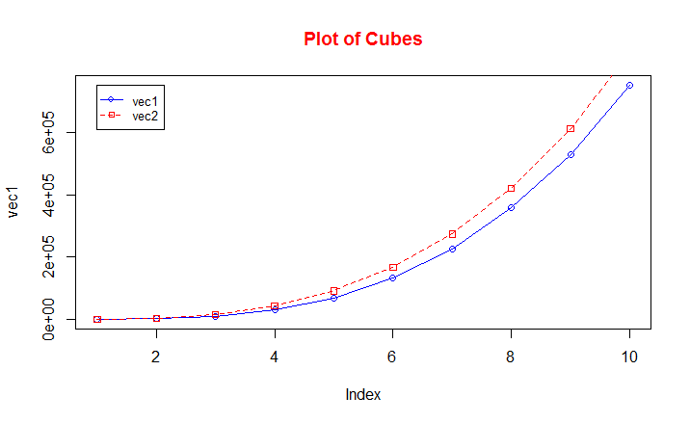
Plotting a Function
A basic 2D plot:
vec1 <-cube(seq(1,100,10))
vec2 <-cube(seq(5,100,10))
plot(vec1, type="o", col="blue“, ylim=c(0,3e5))
title(main=“Plot of Cubes", col.main="red")
To add a line to the same plot:
lines(vec2, type=“o", lty = 2, pch = 22, col=“red“)
To add a legend:
legend(1, max(vec1), c(“vec1",“vec2"), cex=0.8, col=c("blue","red"), pch=21:22, lty=1:2)
Plot type (overplotted)
Line type: dashed
Marker type: square

Slide 49
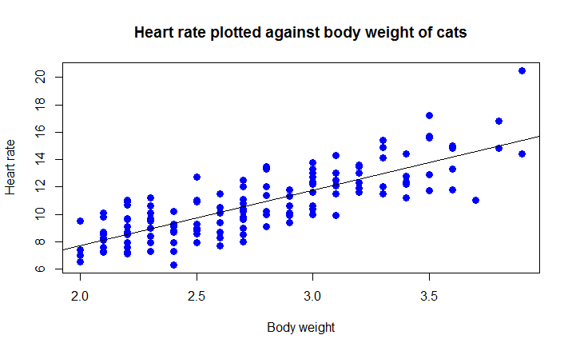
Plotting: Linear Regression
library("MASS")
data(cats) # load data
plot(cats$Bwt, cats$Hwt) # scatter plot of cats body weight vs heart rate
M <- lm(formula = cats$Hwt ~ cats$Bwt, data=cats) # fit a linear model
regmodel <- predict(M) # predict values using this model
plot(cats$Bwt, cats$Hwt, pch = 16, cex = 1.3, col = "blue", main = "Heart rate plotted against body weight of cats", xlab = "Body weight", ylab = "Heart rate") # scatter plot
abline(M) # plot the regression line

Slide 50
Creating 3-D plots
Packages plot3D, ggplot2 contain useful 3D plotting options
plot3d, scatter3d, surf3d, persp3d are some of the commonly used plots.
plot3d is from package rgl.
It allows creating interactive 3D plots that can be rotated using the mouse.
plot3d(x, y, z, col="red", size=3)

Slide 51
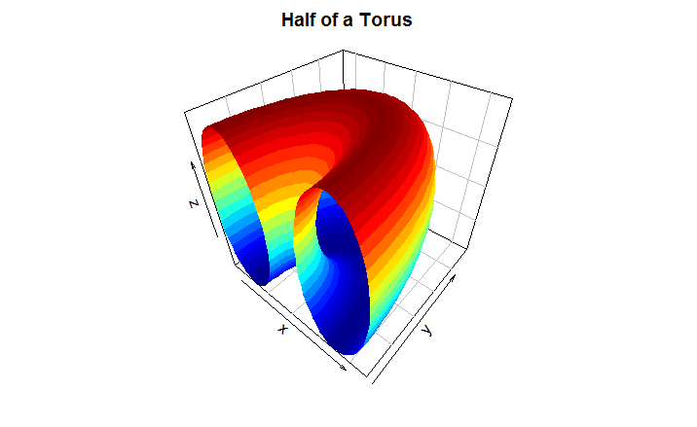
Creating 3-D plots: surf3D
Surf3d (package: plot3D) allows us to create surface plots like the one shown below:
#source: http://blog.revolutionanalytics.com/2014/02/3d-
plots-in-r.html
library ('ggplot2')
library(plot3D)
par(mar = c(2, 2, 2, 2))
par(mfrow = c(1, 1))
R <- 3; r <- 2
x <- seq(0, 2*pi,length.out=50)
y <- seq(0, pi,length.out=50)
M <- mesh(x, y)
alpha <- M$x; beta <- M$y
surf3D(x = (R + r*cos(alpha)) * cos(beta),
y = (R + r*cos(alpha)) * sin(beta),
z = r * sin(alpha),
colkey=FALSE,
bty="b2",
main="Half of a Torus")

Slide 52
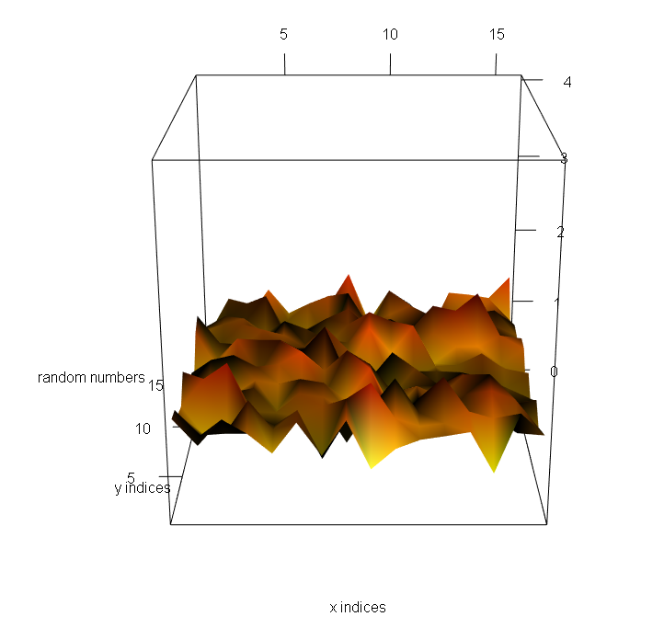
Creating 3-D plots: persp3d
persp3d(package: plot3D) allows us to create surface plots like the one shown below:
xdim <- 16
newmap <- array(0,dim=c(xdim,xdim))
newmap <- rnorm(256,1,.2)
jet.colors <- colorRampPalette( c("yellow", "red") )
pal <- jet.colors(100)
col.ind <- cut(newmap,100) # colour indices of each point
persp3d(seq(1:xdim),seq(1:xdim),newmap,shade=TRUE,
type="wire", col=pal[col.ind],xlab="",ylab="",zlab="",
cex.axis=1.5,xtics="",aspect=2,zlim=c(0,5))

Slide 53


