Slide 1
SchedTask: A Hardware-Assisted Task Scheduler
Prathmesh Kallurkar* Smruti R. Sarangi
Microarchitecture Research Lab Department of Computer Science & Engg.
Intel India Indian Institute of Technology Delhi
*Contributed to this work while I was a student at IIT Delhi

Slide 2
Outline
Introduction
SuperFunction
Scheduler
Problem of instruction cache pollution for OS intensive applications
Results
Overview of the proposed technique
Characterization

Slide 3
Model of Execution
Non-privileged: User Applications
Privileged: Operating System

Slide 4
OS Intensive (Web server)
Non-privileged: User Applications
Privileged: Operating System
Observations:
Different tasks execute different code.
Combined size of instruction footprints of all tasks is larger than the instruction cache.
App1
App2
Syscall
handler
Interrupt
handler
Time

Slide 5
Linux
SchedTask (proposed)
A
B
C
D
A
B
C
D
B
C
D
A
A
B
C
D
Time
Time
C
D
A
B
A
B
C
D
D
A
B
C
A
B
C
D
Core 0
Core 1
Core 2
Core 3
Core 0
Core 1
Core 2
Core 3
Agnostic to instruction footprint of tasks
May execute dissimilar tasks on same core
Core specialization
Execute similar tasks on the same core

Slide 6
Outline
Introduction
SuperFunction
Scheduler
Characterization
Results
Notes:
Here is a brief outline of the talk. I have divided it in four sections. First I shall introduce you to the problem of instruction cache pollution for OS-intensive applications, and then I will discuss the three techniques that we have proposed to mitigate the problem of instruction cache pollution.

Slide 7
Decomposing System Execution into SuperFunctions
System Execution
Applications
(Entire User Process)
OS
Apache
MySQL
Distinguished by the code that the application executes at run time
System call
Interrupt
Bottom Half
Read
Write
Disk
Network
SCSI
Distinguished by the handler’s routine
Distinguished by the system call identifier
Distinguished by the interrupt signal ID

Slide 8
Insights regarding the SuperFunctions
Apache webserver
Mail server
Thread 0
Thread 1
Thread 0
Thread 1
…
…
…
Read()
…
Write()
…
…
Read()
…
…
Write()
…
…
…
…
…
Read()
…
Write()
…
…
Read()
…
…
Write()
…
…
Take advantage of locality effects by executing common execution blocks on the same core
High similarity between the instruction and data footprints of the system call handler on both threads
Footprint of system call handlers does not differ much across different applications

Slide 9
Determining instruction overlap between different types of SuperFunctions
System call handlers
Read syscall
Pread syscall
Write syscall
Pwrite syscall
High insn. overlap
High insn. overlap
Constraint: SchedTask is forced to execute two SuperFunctionTypes on the same core
Desirable: Execute SuperFunctions with higher instruction overlap on the same core
How: Quantify the overlap between SuperFunctions as the number of common code pages that they access
Notes:
While ideally SchedTask would like to allocate at least one core to execute each type of SuperFunction, there can be cases when it is forced to execute different types of SuperFunctions on the same core. In such cases, it is preferable to execute SuperFunctions that have a higher instruction overlap on the same core. In order to achieve this, we have proposed a technique to find the instruction overlap between different types of SuperFunctions by calculating the number of common physical code pages that they access.

Slide 10
Page-heatmap (Bloom Filter)
Captures the set of physical code pages accessed by the SuperFunction
512 bits
Page-heatmap register
1 | 0 | 0 | 0 | 0 | 0 | 0
1 | 0 | 0 | 0 | 0 | 1 | 0
0 | 0 | 0 | 0 | 0 | 0 | 0
Set bit number 5
Set bit number 0
All bits are set to ‘0’ at the start of an epoch
Insn sequence:
hash (pf(x))
hash (pf(y))
insn x
insn y
hash(x) = (( (x) + (x>>9) + (x>>18) + (x>>27) + (x>>36) + (x>>45) ) mod 512
Hash function uses all bits of the physical address in calculating the index of bit to be modified
Notes:
We capture the physical code pages that are accessed by a SuperFunction in a 512-bit hardware register named Page-heatmap register. At the start of an epoch’s execution, we set all bits of the Page-heatmap register to 0. When an instruction with page-frame-number x is executed, we set the hash(x)th bit in the Page-heatmap register to 1. Similarly, when an instruction with … As we see, at the end of an invocation, bits for all accessed physical code pages is set to true.

Slide 11
Calculating Page Overlap
A’s Page heatmap:
1 | 0 | 0 | 1 | 0 | 0 | 1
0 | 0 | 0 | 0 | 0 | 0 | 0
B’s Page heatmap:
1 | 0 | 0 | 0 | 0 | 1 | 1
Overlap between A and B = #common pages accessed = 2
Hamming weight of the bit vectors representing their Page-heatmaps
Notes:
We then calculate the amount of overlap between different types of SuperFunctions as the number of common 1’s that their Page-heatmap registers have. This is also known as the hamming weight of two bit vectors.

Slide 12
Outline
Introduction
SuperFunction
Scheduler
Characterization
Results

Slide 13
Benchmarks
Network:
1) Apache: Web server (Apache)
2) ISCP: Secure copy file from remote machine to local machine (SCP)
3) OSCP: Secure copy file from local machine to remote machine (SCP)
Database:
4) DSS: Decision Support System (TPCH: Query 2)
5) OLTP: Online Transaction Processing (Sysbench benchmark suite)
File system
6) Find: Filesystem browsing (Linux utility application Find)
7) FileSrv: Random reads and writes to file (Sysbench benchmark suite)
8) MailSrvIO: Imitate file operations of a mail server (Filebench benchmark suite)

Slide 14
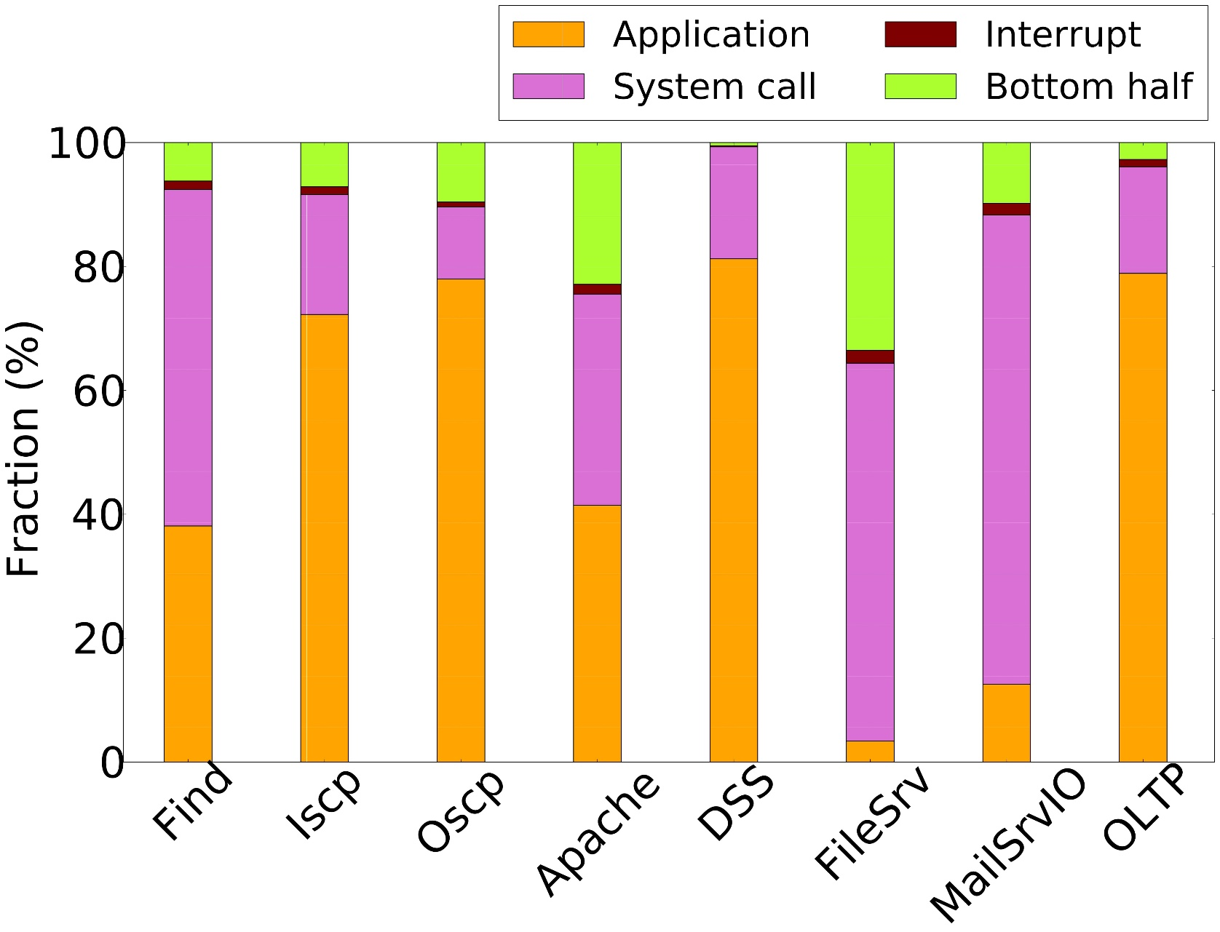
Instruction Breakup
20% for Iscp and DSS
90% for FileSrv
Execn block: 1 billion insn per core

Slide 15

Instruction Breakup: Similarity Across Epochs
Epoch n
(3ms)
Epoch n+1
(3ms)
Type of SuperFunction | Fraction (%)
AppX | 50
Read syscall | 25
Write syscall | 25
Type of SuperFunction | Fraction (%)
AppX | 50 ± δ1
Read syscall | 25 ± δ2
Write syscall | 25 ± δ3
Collect execn profile of SuperFunctions in one epoch
Use it to decide a schedule for the next epoch
Time
Instruction breakup remains mostly similar
Notes:
We performed a detailed characterization of a suite of OS intensive workloads. Our studies indicated that the OS-intensive workloads have a highly cyclical execution pattern ...… meaning that the fraction of time spent in executing different SuperFunctions remains mostly same across two consecutive epochs of execution. We propose a hierarchical scheduler that leverages the cyclical execution pattern of OS-intensive workloads.

Slide 16
Outline
Introduction
SuperFunction
Scheduler
Characterization
Results

Slide 17

Hierarchical Scheduler
Execution statistics of the last epoch
Allocation Table for the current epoch
SuperFunction Type | Time
ApplicationX | 1.5 ms
ReadSys | 1.5 ms
SuperFunctionType | Core
ApplicationX | 0
ReadSys | 1
Executed at the start of the epoch
Performs resource allocation for the current epoch
Steering Logic
TMigrate
ApplicationX
ApplicationX
TMigrate
TMigrate
TAlloc
TMigrate
Core 0
Core 1
TMigrate
ReadSys
TMigrate
Start of an epoch
Time
Notes:
We explain the high level design of the scheduler using the timeline of a single thread’s execution on a 2-core system. Assume that we have the execution statistics of the last epoch’s execution in some global table, and we are now starting the execution of a new epoch. At the start of an epoch, an OS routine named TAlloc is executed. TAlloc reads the execution statistics of the last epoch, and assigns cores to different types of SuperFunctions for the current epoch. Here, we notice that two SuperFunctions, ApplicationX and Read system calls executed for 50% in the last epoch. Hence, Talloc assigns 50% of the computation resources to each type of SuperFunction; in this case, it comes to 1 core for each type of SuperFunction. For the rest of the epoch’s execution, we execute an OS routine named Tmigrate before the execution of each epoch. TMigrate maps the type of the SuperFunction to the core on which it should be executed on. If that core is different from the current core, the thread is migrated there.

Slide 18
TAlloc
Allocation Table
SuperFuncType | Cores
A | 0,1
B | 2
C | 3
Last Epoch’s Execn Profile
SuperFuncType | Time | Freq. | Page-heatmap
A | 2 ms | 10 | PH_{A}
B | 1 ms | 5 | PH_{B}
C | 1 ms | 5 | PH_{C}
Overlap Table
SuperFuncType | Overlap Value
A | (B, 3) (C, 1)
B | (A, 3) (C, 2)
C | (B, 2) (A, 1)
Based on the execution of last epoch
Notes:
As discussed before, Talloc is the OS routine that is executed at the start of each epoch’s execution. This routine summates the per-core execution statistics of the last epoch, and uses this to create a schedule for the current epoch. It creates two tables. First is the allocation table which stores the information regarding which SuperFunction should be executed on which core, and the other table is Overlap table that stores the amount of overlap between different types of SuperFunctions.

Slide 19
TMigrate: Work Stealing
Cores
Core 1
A
Core 2
A
Core 3
B
Core 4
C
?
A₁
B₁
C₁
List of pending SuperFunctions
A₂
B₂
C₂
A₃
B₃
C₃
A₄
B₄
C₄
What to do when core has no SuperFunction to execute
Steal same type of work from other cores
19
Notes:
While the TAlloc routine ensures that each SuperFunction is allocated an appropriate amount of computing resources, there can be circumstances when a particular core does not get requests to execute SuperFunctions that it is supposed to execute. We have shown an example scenario where a core that is expected to execute SuperFunctions of type A has nothing to execute. Letting the core remain idle may lead to lower performance; hence, we chose to steal SuperFunctions from other cores such that we do not pollute the instruction cache.
The first strategy that Tmigrate attemps is called steal same work only. Here, while core 1 can execute SuperFunctions of type A, such SuperFunctions are already waiting to be executed on Core 2. We steal one SuperFunction from Core 2 and transfer it to core 1.

Slide 20
TMigrate: Work Stealing
Core 1
A
Core 2
B
Core 3
B
Core 4
C
Cores
?
B₁
B₅
C₁
List of pending SuperFunctions
B₂
B₆
C₂
B₃
B₇
C₃
B₄
B₈
C₄
Refer the Page overlap table
A and B have a higher overlap than A and C
While A and B are similar, A≠ B
B may access some cache lines that are not accessed by A
Amortize effort by stealing multiple SuperFunctions of type B
Steal similar work from other cores
20
Notes:
While steal same work only strategy works if same type of work is available on other cores, there may be circumstances when such a strategy does not work. In such case, Tmigrate consults the Overlap table to find which SuperFunctions on other cores have a higher overlap with the SuperFunctions that it executes. In the given example, A and B have a higher overlap than A and C. Hence, Core 1 decides to steal SuperFunctions of type B from other cores.
Notice that while B is similar to A, it may access lines that have never been accessed by A. Hence, to amortize the effort of reading such lines, we steal multiple such SuperFunctions.

Slide 21
Outline
Introduction
SuperFunction
Scheduler
Characterization
Results

Slide 22
Evaluated Techniques
Technique | High level approach
SelectiveOffload [Tech Report ‘09] | Proposes a system with 2n cores; n reserved for application and n reserved for the OS
FlexSC [OSDI ‘10] | Segregate execution of application and system call handlers
RegionSched [ASPLOS ‘12] | Segregate execution of application and system call handlers
SLICC [MICRO’13] | Hardware scheduler
SchedTask [proposed technique] | Segregate execution of SuperFunctions. Also reduce core idleness using work stealing

Slide 23
Baseline System
Parameter | Value
Cores | 32
Pipeline | Out Of Order Pipeline
Private caches | i-cache and d-cache (4-way 32 KB) L2 cache: (4-way 256 KB)
Shared cache | L3 cache (8-way 4 MB)
OS | Linux 2.6.32 (Debian 6.0)

Slide 24
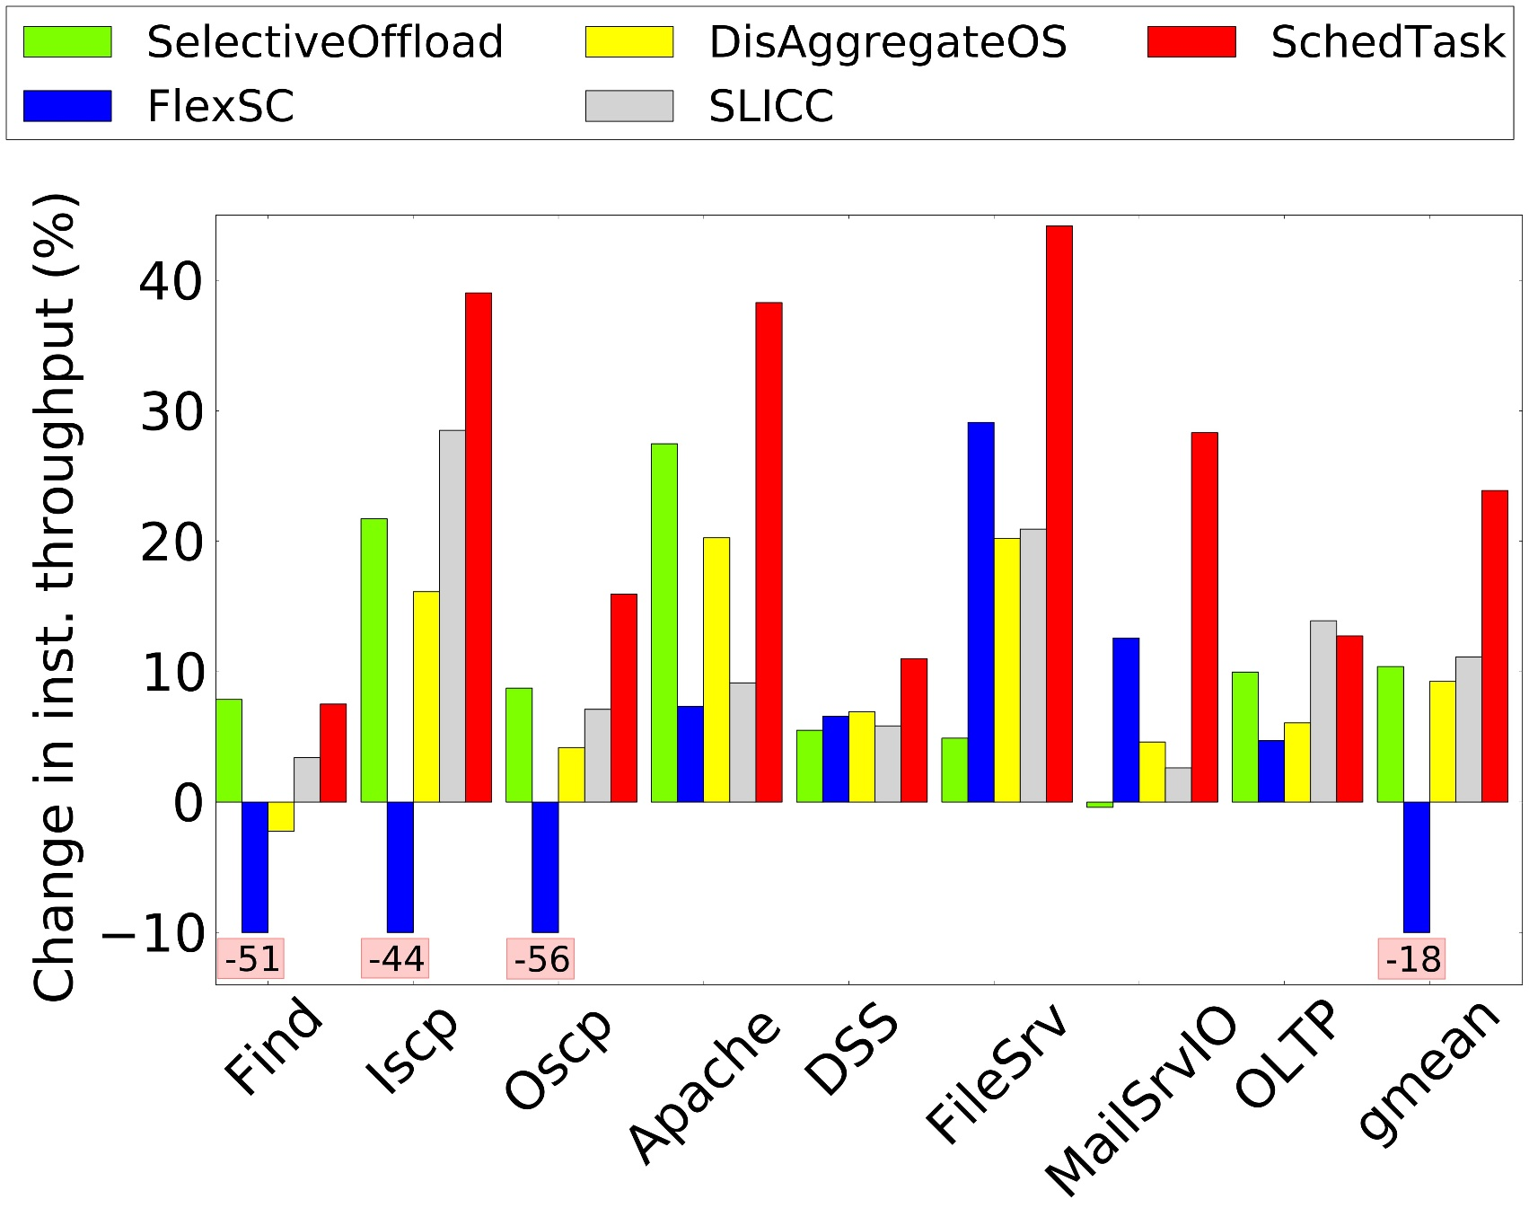
Performance
SchedTask outperforms state of the art schedulers by around 11.4 %
Reasons:
High i-cache hit rates due to fine-grained scheduling
Low core idleness due to work stealing

Slide 25
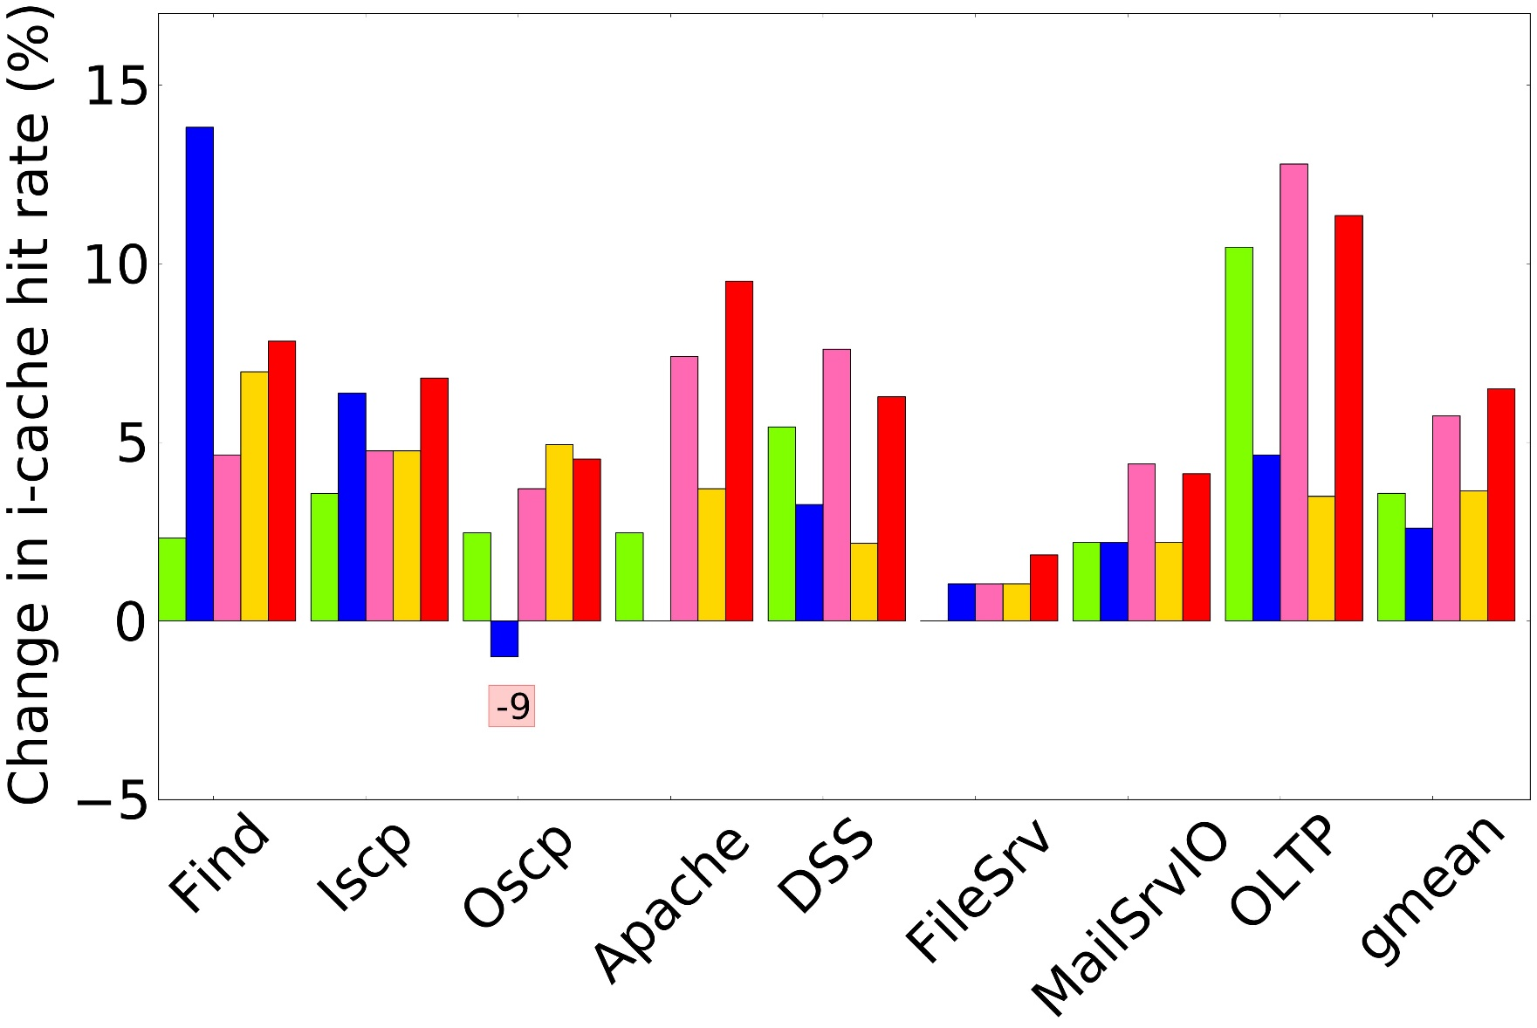
I-Cache Hit-Rate
Reason:
High i-cache hit rates due to fine-grained scheduling

Slide 26
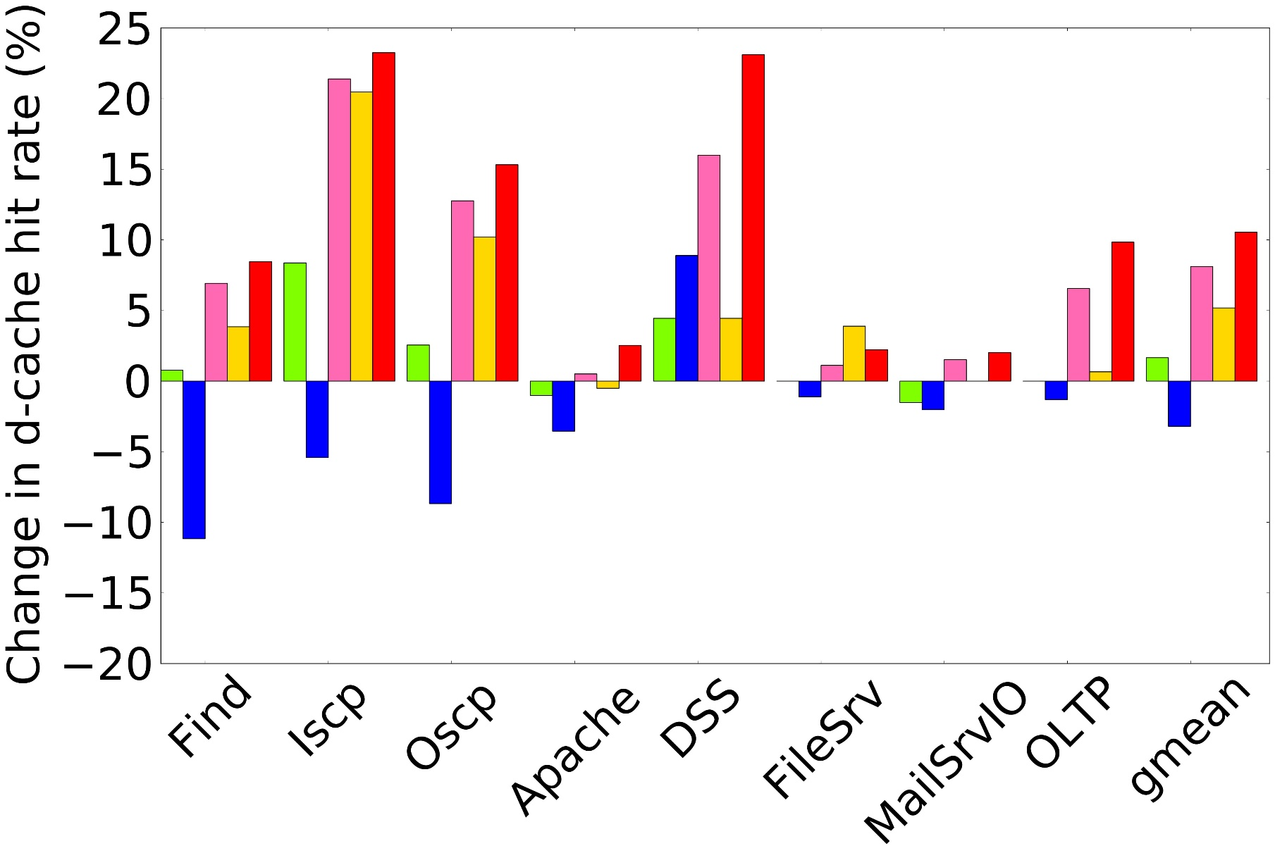
D-Cache Hit-Rate
Core specialization increases d-cache hit rate.
Intuition: SuperFunctions that execute the same code typically access common data structures.
Fewer cache line bounces.

Slide 27
Threads ->
t1: read()
t2: read()
t3: read()
t4: read()
Baseline:
Core 1
Core 2
Core 3
Core 4
file sys.lock
file sys.lock
Cache line bouncing ☹
read()
SchedTask:
Core 1
Core 2
Core 3
Core 4
file sys.lock
By reducing cache line bounces, we improve the data locality

Slide 28
Summary
Decomposed the execution of OS intensive applications in to sequences of instructions called SuperFunctions
Proposed a hierarchical scheduler that executes SuperFunctions with higher instruction overlap on the same core
Demonstrated an average increase in instruction throughput of 11.4% over state of the art OS schedulers for a suite of 8 OS intensive applications

