Slide 1

VisSched: An Auction based Scheduler for Vision Workloads on Heterogeneous Processors
Diksha Moolchandani*, Anshul Kumar*,
José F. Martínez¥, and Smruti R. Sarangi*
*Indian Institute of Technology Delhi, India
¥Cornell University, Ithaca, NY, USA
Contact: diksha.moolchandani@cse.iitd.ac.in

Slide 2
Outline
Problem Motivation
Background and Related Work
Characterization of Workloads
Our Approach
Results
Conclusion

Slide 3

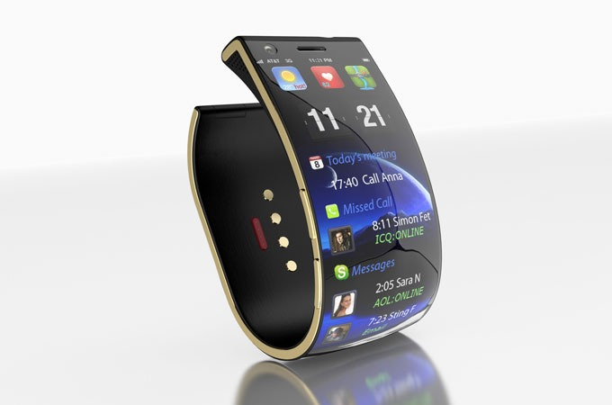
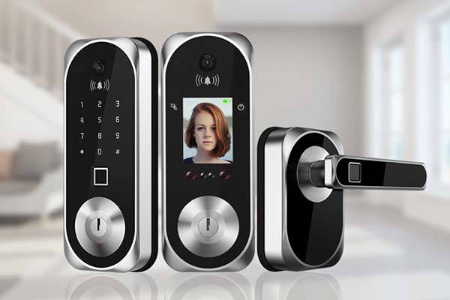
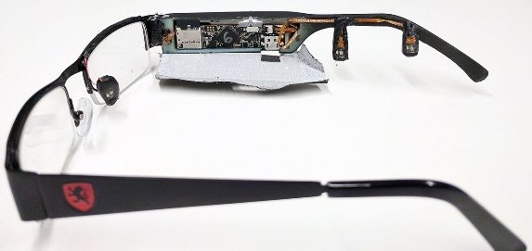
Problem Motivation
AR/VR headset
Smart glasses
Smart door lock with
face recognition
Smart watch with camera
Emergence of mobile/IoT/edge computing
Emergence of new types of benchmark suites

Slide 4

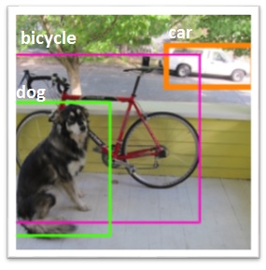
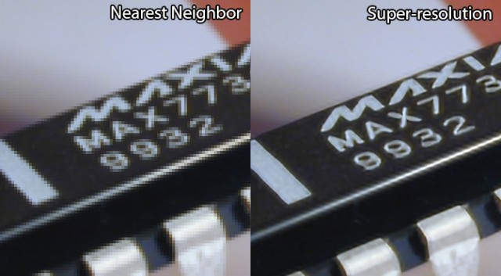
Problem Motivation
Super resolution
Face Recognition
Object Detection
Similar workloads share a lot of common code kernels, eg: convolution

Slide 5

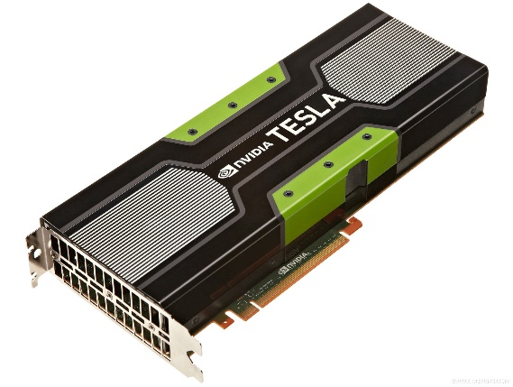
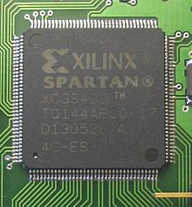
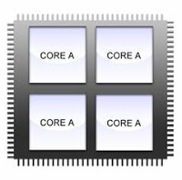
Problem Motivation
Conventional way to accelerate vision workloads
FPGA
GPU
No efficient techniques for handling multi-application concurrency
Multicore
Limited compute capability of IoT Offload to cloud

Slide 6
Overall Design
Auction Theory is the choice
W1
W2
W4
W6
W7
W8
W10
W11
W13
W3
W5
W12
?
?
?
N Workloads
N>K
K Resources
S
S
B
B
S
S
B
Big core
S
Small core

Slide 7
Our Approach
Memory
Pattern Table
Specialized scheduling algorithms
Exploit the correlation among the phases of the workloads
Store precomputed bidding strategies for each phase and the current state of the workload – pattern table
Multicore
Auction Controller
L2 Cache
B
B
B
B
B
B
S
S
HW Structures
S
S
S
S
S
S
S
S
HW Scheduler
B
Big core
S
Small core

Slide 8
Outline
Problem Motivation
Background and Related Work
Characterization of Workloads
Our Approach
Results
Conclusion

Slide 9
Nash Equilibrium
Stable operating point
No player can unilaterally change its strategy without getting worse off
Multiple such points can exist
Choose the one that maximizes the aggregate utility (sum of individual utilities of all the players)

Slide 10
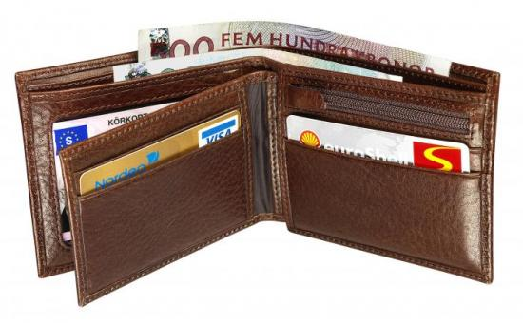







Auction Theoretic Formulation
wallet1
wallet2
If bid2 > bid1 and bid2 = wallet2,
Alice will have an ice cream and zero money
bid1
bid2
If bid2 > bid1 and bid2 > wallet2,
Alice will have an icecream and a debt
If bid2 > bid1 and bid2 < wallet2,
Alice will have an icecream and some money
If bid2 < bid1,
Alice will not get the ice cream
Thus bid proportionally,
Bid = μ * Wallet (W), 0 < μ < 1
Bob
Alice
$$Utility=\left\{\begin{aligned}\left(1−\text{μ}\right)∗W, winner \\ &0, loser\end{aligned}\right.$$
Complicate the scenario. Deduct a fee from their wallet
Bid = μ * (W-F), F is the auctioneer’s fee
Some children get more happy with the ice cream, some need it more, some just throw it half

Slide 11
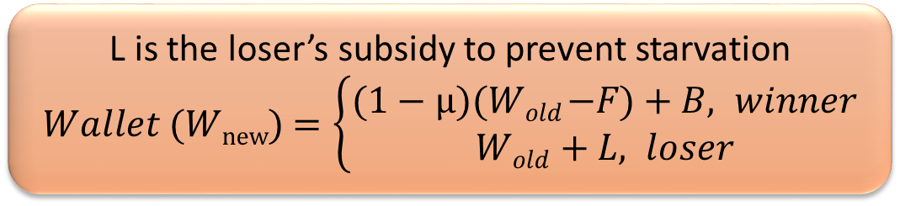
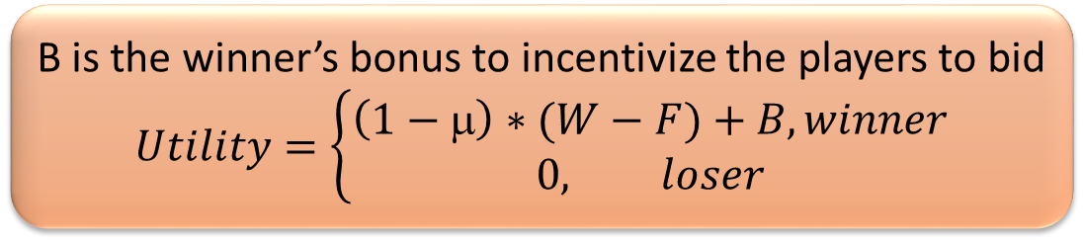
Auction Theoretic Formulation
A1
wallet2
A2
Unlike Bob-Alice’s one time ice-cream purchasing competition, scheduling has multiple such competitions at every scheduling quantum
wallet1
bid1
bid2
B is the winner’s bonus to incentivize the players to bid
$$Utility=\left\{\begin{aligned}\left(1−\text{μ}\right)∗(W−F)+B, winner \\ &0, loser\end{aligned}\right.$$
Auction
Need to incentivize the players to bid in the current round, else they will keep saving the wallet money for future
L is the loser’s subsidy to prevent starvation
$Wallet$ ($Wnew$) $=\left\{\begin{aligned}\text{(1 − µ)(}Wold \text{−}F\text{) + }B, winner \\ &Wold \text{+} L, loser\end{aligned}\right.$
Winner

Slide 12
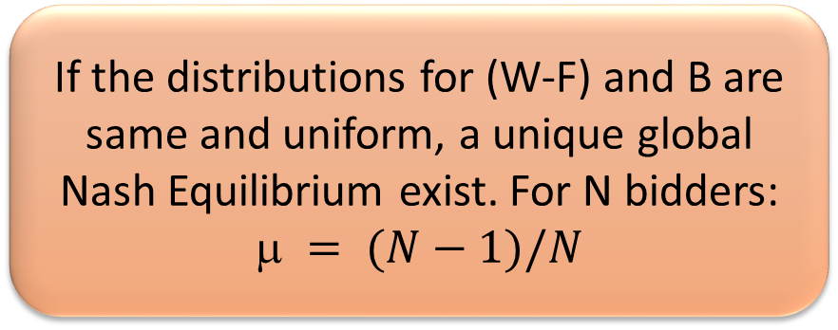
Strategy Calculation
If the distributions for (W-F) and B are same and uniform, a unique global Nash Equilibrium exist. For N bidders:
$$ = (N−1)/N$$
wallet1
A1
wallet2
A2
bid1
bid2
Auction
For different distributions, the strategies are calculated using Monte Carlo simulations accelerated with AI techniques
Winner

Slide 13
Related Work
Technique | Functionality
SLICC [Atta et al. 2012] | Exploits the similarity of code based on i-cache footprints
CAMP [Saez et al. 2010] | Accelerates the applications that get maximum speedup for fast cores
BIS [Joao et al. 2012] | Accelerates the bottlenecks (leading to maximum number of wait cycles) on big cores
UBA [Joao et al. 2013] | Accelerates bottlenecks and lagging threads such that reduction in total execution time is maximized
AdaMD [Basireddy et al. 2019] | Accelerates the underperforming applications determined using an ML model
COLAB [Yu et al. 2020] | Finds core affinity of application and schedules on the basis of bottlenecks ensuring fairness by adjusting scheduling time slice

Slide 14
Outline
Problem Motivation
Background and Related Work
Characterization of Workloads
Our Approach
Results
Conclusion

Slide 15
Experimental Setup
Memory
Parameter | Value
Cores | 10 small + 6 big
Frequency | 1.55 GHz & 3.1 GHz
L1 I/D Cache | 32 KB, 64 bytes block size, associativity 4
Shared L2 | 256 KB per bank, 16 banks, 64 bytes block size, associativity 8
Multicore
L2 Cache
B
B
B
B
B
B
S
S
S
S
S
S
S
S
S
S
B
Big core
S
Small core

Slide 16
Benchmarks
MEVbench Suite
CortexSuite
SD-VBS
7 multi-threaded (Sift, Surf, KNN, SVM, HoG, ORB, FAST), 4 single-threaded (Boost, ObjRec, FaceDet, AugRel)
Motion Estimation, PCA, RBM, Image Segmentation, Speech Recognition
Image Stitching, Texture Synthesis, Disparity, Localization, MSER, Feature Tracking

Slide 17
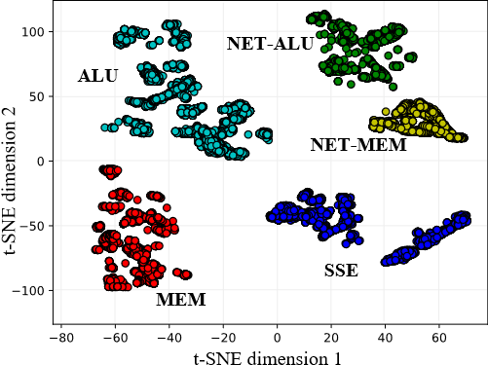
Characterization of Workloads
Use the instruction mix in an execution interval as a feature vector
Perform clustering
Any interval belongs to one of the five clusters
The clusters are named on the basis of the dominant instructions in the intervals

Slide 18
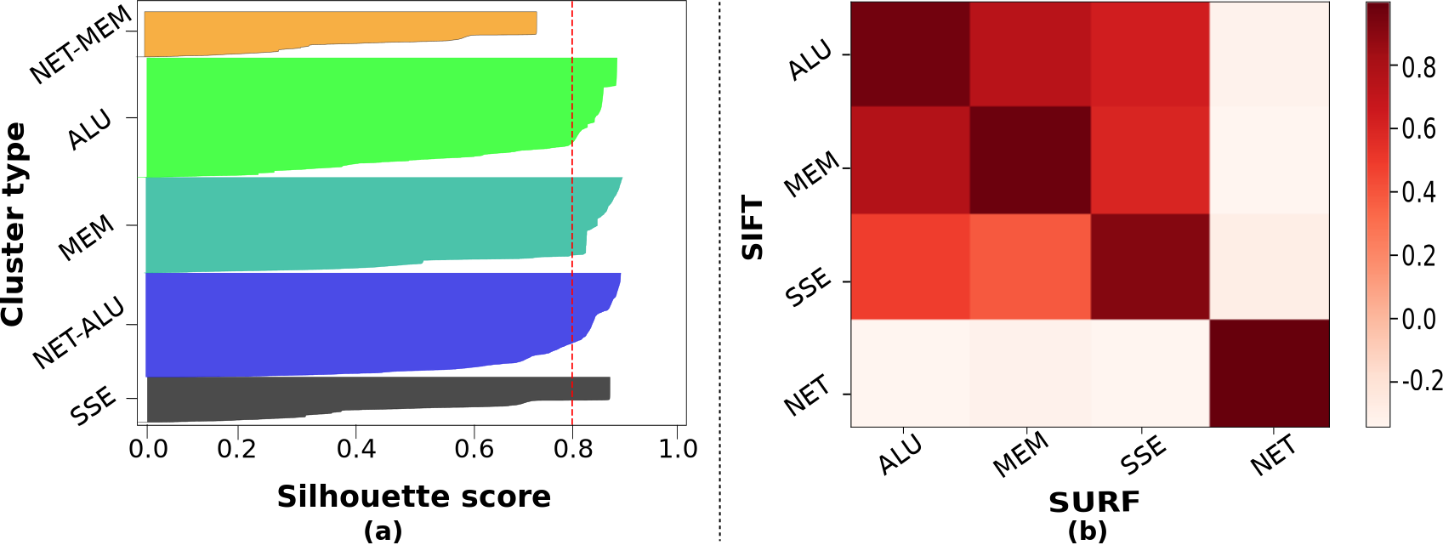
Characterization of Workloads
Average Silhouette score=0.8 implies the samples are correctly classified
Strong positive correlation between the same phases across different applications

Slide 19
Outline
Problem Motivation
Background and Related Work
Characterization of Workloads
Our Approach
Results
Conclusion

Slide 20
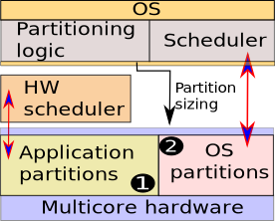
Overall Design
Cores are partitioned between OS scheduler and HW scheduler
Scheduling Granularity: 31.25-62.5 μs
Context Sw. overheads in OS: 44.1-1496 μs
Context Sw. in HW: 67 ns
HW Scheduler:
2 queues, running and ready queue
PC and register state
Invokes the auction controller for scheduling
Scope of this work

Slide 21
Overall Design
ALU
MEM
ALU
SSE
SSE
ALU
MEM
SSE
MEM
SSE
ALU
ALU
W1
W2
W4
W6
W7
W8
W10
W11
W13
W3
W5
W12
?
?
?
N Workloads
N>K
K Resources
S
S
B
B
S
S
B
Big core
S
Small core

Slide 22
VisSched: Flow Chart
Is scheduling
quantum of thread t on core c exhausted?
Create phase table: phase-to-core mapping
Schedule thread t to core c
Winner thread t
Yes
Predict the next phase for thread t & enqueue it in the appropriate waiting queue
Auction core c among the threads in its waiting queue

Slide 23
Phase-to-Core Mapping
Phase Table
Provide an initial phase to core mapping for all the phases
Phase | Core
SSE | C1 C2 C5 C7
ALU | C8 C9 C11 C12
MEM | C13 C3 C4 C6
NET | C10 C14 C15 C16
Recomputed at every 100 M cycle interval. Smaller intervals lead to frequent cache misses
Heuristic: relative proportion of the executed phases (ϕ_{s} : ϕ_{n} : ϕ_{m} : ϕ_{c}), where ϕ_{s} , ϕ_{n} , ϕ_{m} , ϕ_{c} are the mapping counters
Stored as 16 bits per row, one bit corres. to each core

Slide 24
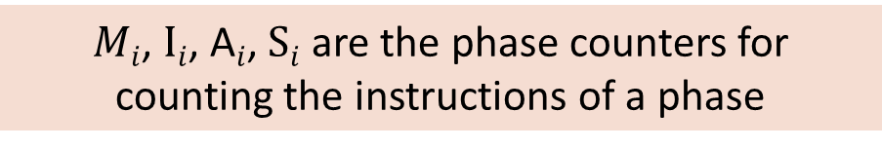
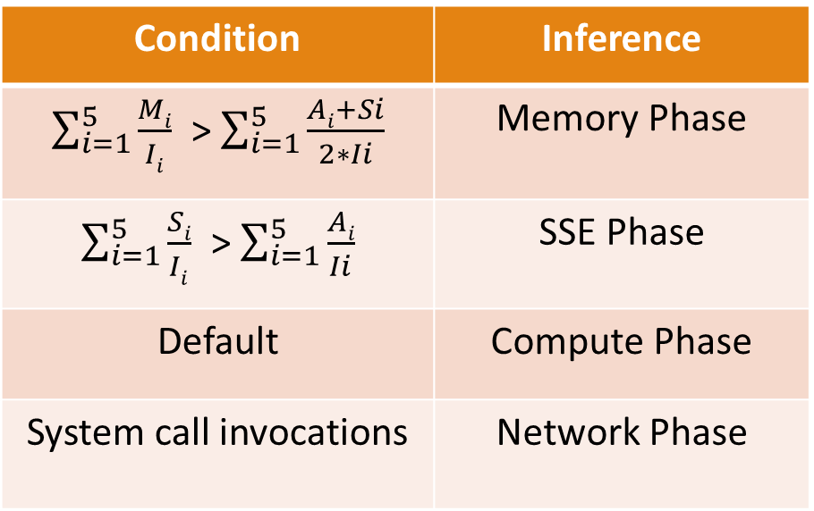
Predicting the Next Phase
Condition | Inference
$\sum_{i=1}^{5}{\frac{Mi}{Ii}}$ > $\sum_{i=1}^{5}{\frac{Ai+Si}{2∗Ii}}$ | Memory Phase
$\sum_{i=1}^{5}{\frac{Si}{Ii}}$ > $\sum_{i=1}^{5}{\frac{Ai}{Ii}}$ | SSE Phase
Default | Compute Phase
System call invocations | Network Phase
Additional priority to memory instructions because they involve multiple operations (addition+memory)
$Mi$, $Ii$, A$i$, $Si$ are the phase counters for counting the instructions of a phase

Slide 25
Auction Process
Terms | Symbols | VisSched
Wallet | W | W
Auctioneer's fee | F | κ * C
Bid | µ * (W - F) | µ * (W - κ * C)
Bonus | B | λ * IPC/Energy + W_{base}
Loser's subsidy | L | L = γ * W_{base}
Symbol | Meaning
W_{base} | Base Wallet balance
C | Migration cost calculated as a function of cache misses
IPC | Instructions per cycle
Energy | Energy consumed by the system
κ, γ, λ | Normalization constant
µ | Bidding Strategy
W_{new} | Wallet balance in next auction round
W_{old} | Wallet balance in prev. auction round
Updating the metrics | Winner | Loser
Utility | (1 - µ)(W_{old} - F) + B | 0
Wallet (W_{new}) | (1 - µ)(W_{old} - F) + B | W_{old} + L

Slide 26
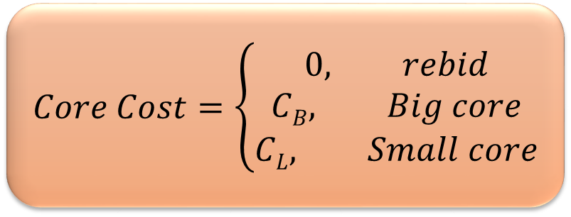
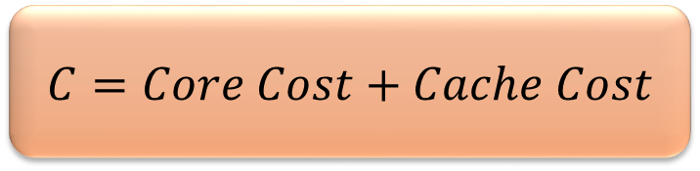

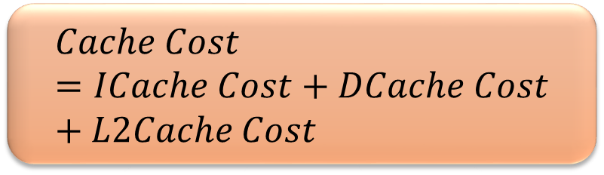
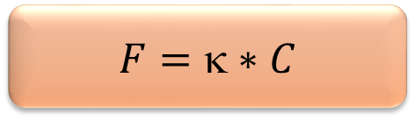
Auctioneer’s Fee (F)
$$F=\text{κ}∗C$$
$$C=Core Cost+Cache Cost$$
$$Core Cost=\left\{\begin{aligned}0, rebid \\ CB, Big core \\ CL, Small core\end{aligned}\right.$$
$$Cache Cost=ICache Cost+DCache Cost+L2Cache Cost$$
$$ICache Cost= \frac{1}{5}\sum_{i=1}^{5}{IMiss Rate}$$

Slide 27
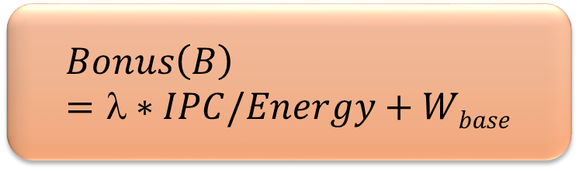
Winner’s Bonus (B)
Good metric for homogeneous system, but biased for heterogeneous system, favors big cores
Intuitively it should be IPC, it is the derived advantage that a thread gets if it gets access to the core
Average energy usage in small cores is 60-70% lower than big cores
Use IPC/Energy: unbiased, positively correlated with IPC (0.8-0.99)
$$Bonus\left(B\right)=λ∗IPC/Energy+Wbase$$

Slide 28
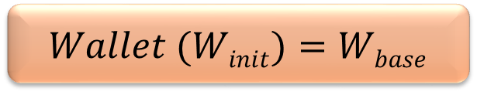
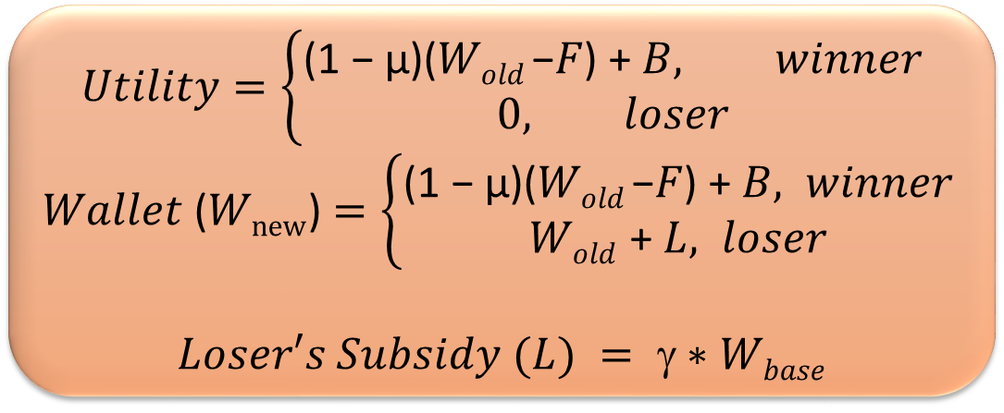
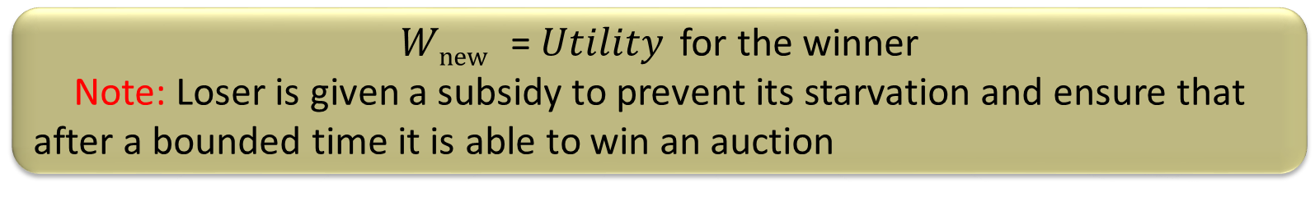
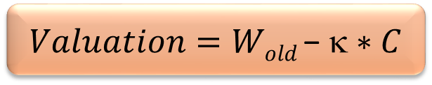
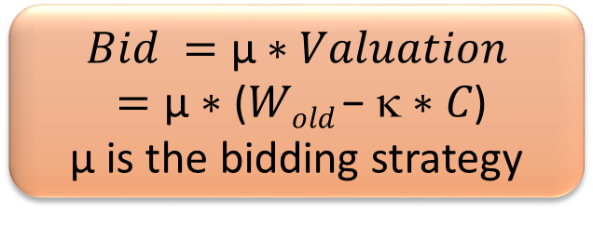
Bid, Wallet Balance & Loser’s Subsidy
$$Wallet (Winit)=Wbase$$
$$Utility=\left\{\begin{aligned}\text{(1 − µ)(}Wold \text{−}F\text{) + }B, winner \\ &0, loser\end{aligned}\right.$$
$Wallet$ ($Wnew$) $=\left\{\begin{aligned}\text{(1 − µ)(}Wold \text{−}F\text{)}\text{ + }B, winner \\ &Wold \text{+} L, loser\end{aligned}\right.$
$$Loser′s Subsidy (L) = ∗Wbase$$
$$Valuation=Wold \text{−} κ∗C$$
$$Bid =\text{µ} \text{∗} Valuation$$
$=\text{µ}\text{ ∗ }\text{(}Wold \text{−} κ∗C\text{)}$
$\text{µ}$ is the bidding strategy
$Wnew$ = $Utility$ for the winner
Note: Loser is given a subsidy to prevent its starvation and ensure that after a bounded time it is able to win an auction

Slide 29
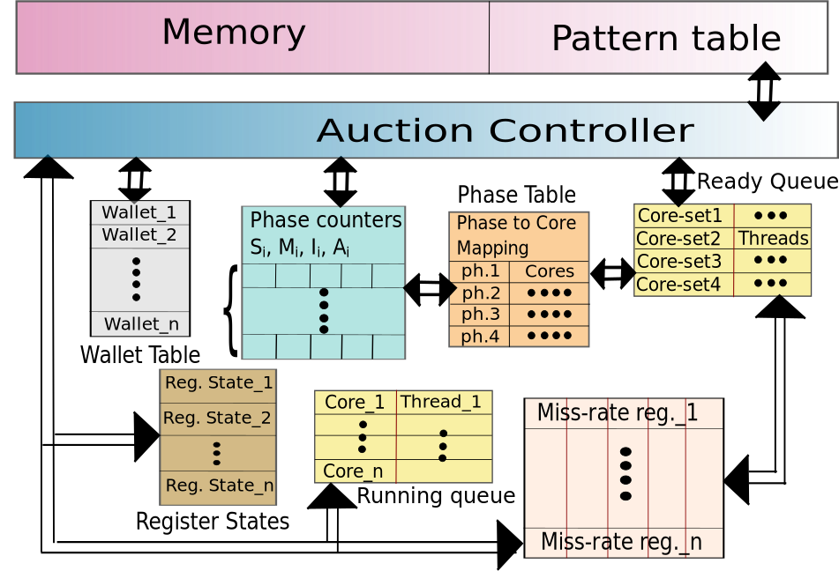
Auction Controller
Get the threads in the ready queue of the freed core, calculate their miss costs, calculate the new wallet balance and get the bidding strategy from the pattern table
Upon phase change, the wallet of the thread in the wallet table is updated with the bonus
New phase of the thread is calculated using the phase counters, and enqueued in the ready queue of the mapped core obtained from the phase table
Hardware Scheduler

Slide 30
Pattern Table (PT)
Core-type
Phase ids of n bidders
Bidding strategy
R
C
#n
Ph_id₁..................Ph_id_{n}
μ_{1 ......................} μ_{n}
rebid
No of bidders
Store pre-computed bidding strategies (μ₁... μ_{n}) in a lookup table
Requires to store the bidding strategy for every possible combination of bidders (W-F and B) rows of PT
Exploit the direct correlation of phases with the distributions of W-F and B
Note: 2- bit phase id (for 4 phases) can be used to identify the valuation of a bidder

Slide 31
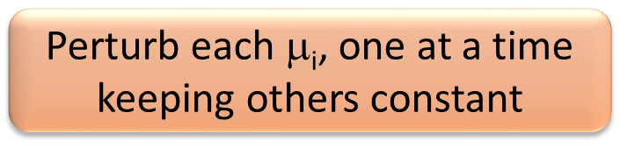
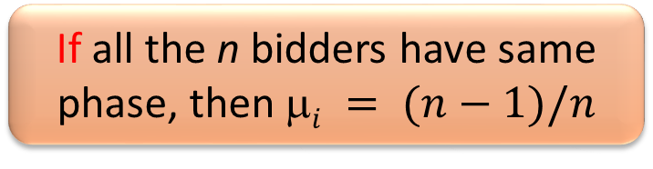
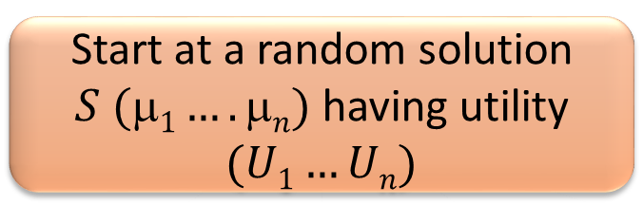
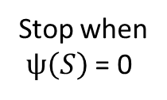
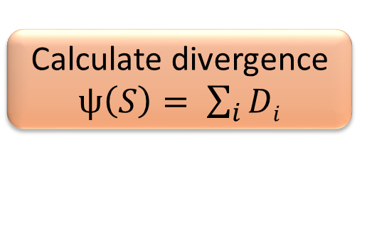
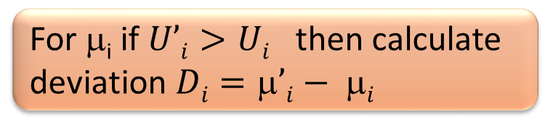
Filling the Pattern Table (PT)
If all the n bidders have same phase, then $i = (n−1)/n$
Default PT
Collect samples
of B and W-F
New B and W-F distributions
PT generation
algorithm
New PT
else
Dist. converged?
No
Start at a random solution $S (1….n)$having utility $(U1…Un)$
Perturb each $$_{i}, one at a time keeping others constant
Yes
Stop
Calculate divergence $ψ\left(S\right)= \sum_{i}{Di}$
For μ_{i} if $U’i>Ui$ then calculate deviation $Di=’i− i$
Default PT stores μ=0.5 for all the combination of bidders
Collect 1000 samples of valuations and bonus
Stop when
$ψ\left(S\right)$ = 0
Find Nash equilibrium for all possible combinations of distributions in the PT

Slide 32
Outline
Problem Motivation
Background and Related Work
Characterization of Workloads
Our Approach
Results
Conclusion

Slide 33
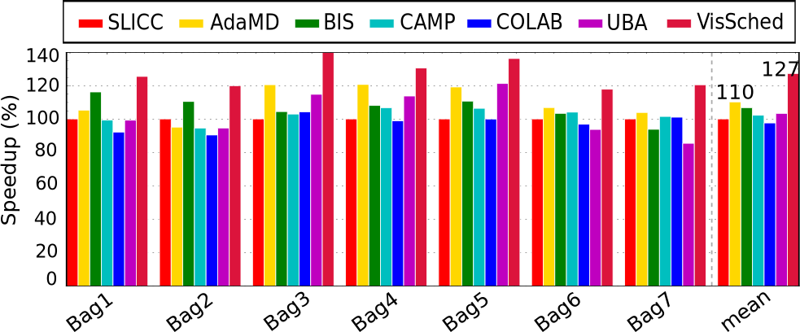
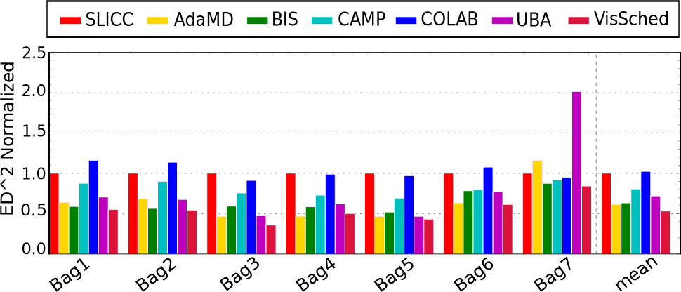
Results: Performance & ED²
Performance improvement 17%
ED² improvement 14%

Slide 34
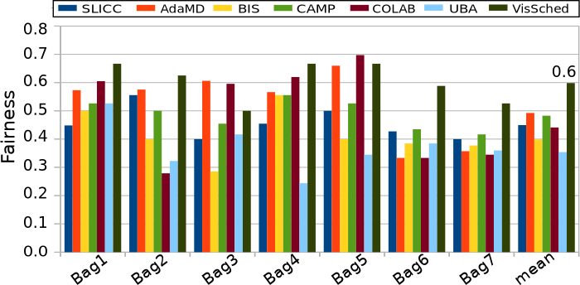
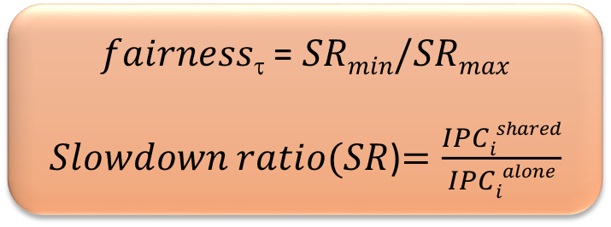
Results: Fairness
0.49
$fairness$ = $SRmin/SRmax$
$Slowdown ratio(SR$)$=\frac{IPCishared}{IPCialone}$
Fairness for VisSched: 0.6
Nearest competing technique: 0.49

Slide 35
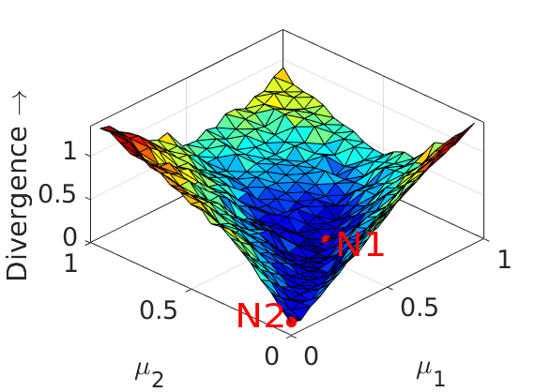
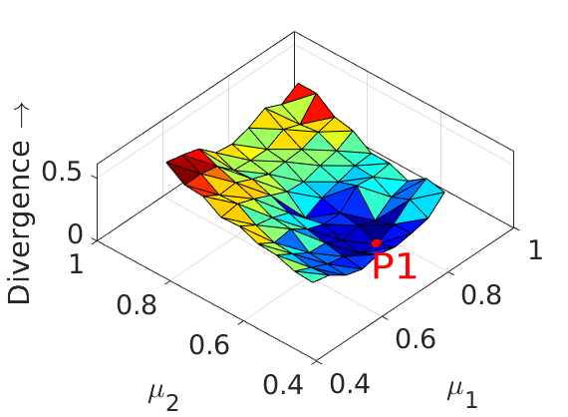
Results: Hill Climbing
Characterize the search space of the strategies of the bidders
For the 2-bidder case, two minima exist: N1(0.52, 0.37) and N2 (0.0.2, 0.02)
Mostly convex with small bumps; non-convexity ratio <= 5.6%
2-bidder case
Need to find the non-trivial minima at N1
For 4-bidder case, each point is the best configuration of (μ₃, μ₄)
Use hill climbing to reach a minima
4-bidder case

Slide 36
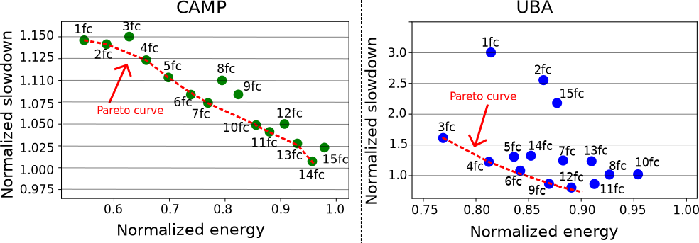
Results
Red line is the Pareto optimal front: no other configuration uses lower energy for the same slowdown
Configurations (6fc, 10sc) and (4fc, 12sc) are the Pareto optimal configurations in both the schemes

Slide 37
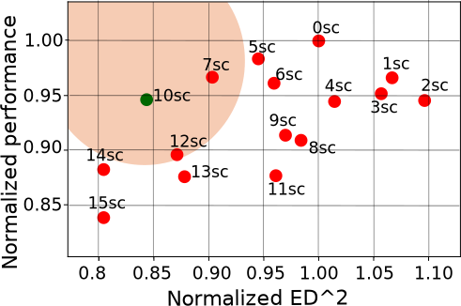
Results: Sensitivity
Sensitivity of VisSched w.r.t. small and big core counts
(10sc, 6fc), and (9fc, 7sc) in the Pareto front
The top leftmost point (10sc, 6fc) is optimal both in terms of ED² and performance

Slide 38
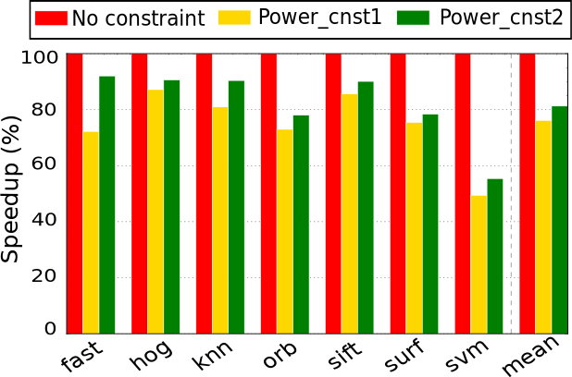
Results: DVFS
2W per thread
4W per thread
Power constraint is defined for each thread
19%
Scheduling granularity of VisSched: 31.25 μs
Time to switch between DVFS levels: 30-40 μs
24%
Switch DVFS level when the thread has executed on the same core for 3 consecutive intervals

Slide 39
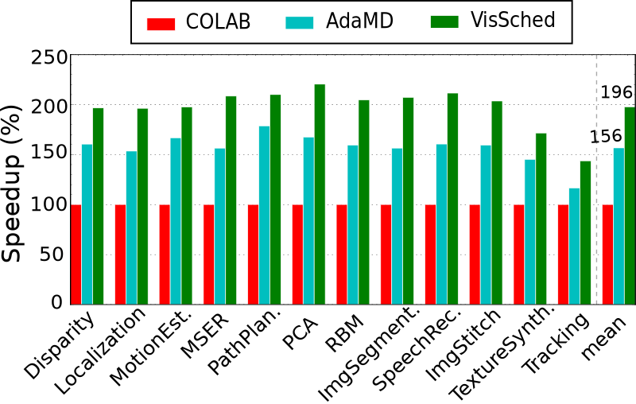
Results: Generality
40-60% same phase auctions in CortexSuite: 40% perf. improvement
20-40% same phase auctions in MEVBench: 17% perf. improvement

Slide 40
Outline
Problem Motivation
Background and Related Work
Characterization of Workloads
Our Approach
Results
Conclusion

Slide 41
Conclusion
Proposed a clustering-based technique to divide the execution intervals of a workload into phases
Demonstrated the correlation of phases across workloads
Proposed an auction-based starvation-free scheduling scheme where each thread has a replenishable virtual wallet to bid for cores
Used hill climbing to reach a Nash solution and store the bidding strategies of the bidders in the pattern table
17% performance improvement & 14% ED² improvement
Proved the generality of the scheme and extended it for DVFS and custom accelerator

Slide 42


