Slide 1
Expander: Lock-free Cache for a Concurrent Data Structure
Pooja Aggarwal (IBM Research, bangalore)
Smruti R. Sarangi (IIT Delhi)

Slide 2
Concurrent Object
Each thread executes a method on the object
Threads
Concurrent Object
method
request
response
method
Thread 1
Thread 2
Linearizability
Thread 3
Timeline

Slide 3




Blocking vs Non-blocking Algorithms
Blocking algorithm with a lock
Non-blocking algorithm
lock
val = acc.balance
acc.balance += 100
unlock
return val
val = acc.balance. fetchAndAdd (100)
return val

Slide 4



Few Definitions
Blocking algorithm with locks
Only one thread is allowed to hold a lock and enter the critical section
Lock-free algorithms
There are no locks
At any point of time at least one thread makes progress and completes the operation
Wait-free algorithms
Every request completes in a finite amount of time.

Slide 5


Comparison Between Locks, Lock-free, and Wait-free
Finite Execution
Time
Disjoint Access Parallelism
Starvation Freedom
With Locks
Lock-free
Wait-free

Slide 6



Why not make all algorithms wait-free?
Locks
Lock-free
Wait-free
Easy to program
Starvation, Blocking,
No disjoint access parallelism
Need a black belt in programming

Slide 7

Example of Temporary Fields
while(true) {
<val, ts> = acc.balance;
newval = val + 100;
newts = ts + 1;
if (CAS (acc.balance, <val,ts>,
<newval,newts>)) break;
}
while(true) {
val = acc.balance;
newval = val + 100;
if (CAS (acc.balance, val,
newval)) break;
}
CAS → CompareAndSet
CAS (val, old, new) →
if (val == old)
val = new;
Temporary Field
balance
value
timestamp

Slide 8
Packing
Temporary Fields
Value
Field1
Field2
Field3
Memory Word
Size of a field is restricted by
the size of the memory word

Slide 9
Redirection
Object
Value
Pointer
Field1
Field2
Field3
Lot of memory wastage.

Slide 10
Examples of Packing and Redirection
Packing
Paper | Authors | Temporary Fields
Wait-free multiword CAS | Sundell | index, thread id, descriptor
Universal construction | Anderson et al. | thread id, valid bit, count
Wait-free slot scheduler | Aggarwal et al. | request id, thread id, round, timestamp, slot number, state
Redirection
Paper | Authors | Temporary Fields
Wait-free queue | Kogan et al. | enqueue id, dequeue id
Wait-free priority queue | Israeli et al. | value, type, freeze bit
Wait-free linked list | Timnat et al. | mark bit and success bit

Slide 11
Idea of the Expander
Program
Memory Space
Expander
The Expander works as a cache
It caches the value of a memory word and the temporary fields
If the word is not required, its value is flushed to memory, and the temporary fields are removed
Advantages: Any number of temporary fields with arbitrary sizes
Makes packing feasible, and eliminates the memory overhead of redirection

Slide 12
Design of the Expander
Node of type MemCell
Memory Word
value
Hash
memIndex
dataState
tmpFields
Hash Table (listHead)
next
version
state
reference
timestamp
mark bit

Slide 13
Basic Operations
kGet → Get the value of a memory word along with temporary fields
kSet → Set the value of a memory word and its fields
kCAS → Compare the value and all the fields, and if all of the match, then do a kSet
free → Remove the entry of the Expander

Slide 14
FSM of an Expander’s Node
CLEAN
kSet/kCAS
DIRTY
kGet
kSet/kCAS/kGet
free
free
kGet
FLUSH
WRITEBACK
kSet/kCAS/kGet

Slide 15
kGet
Is the word there in the Expander?
Yes
No
Return the value and the temporary fields
Read the value from memory
Use default values for the temporary fields

Slide 16
kCAS
node ← lookUpOrAllocate()
do all the values/fields match?
Yes
node.state == FLUSH
No
help delete
No
Yes
set a new dataState
create a new version
set state to DIRTY
return false
if not successful return false else return true

Slide 17
free
if state == WRITEBACK or FLUSH
Yes
No
return false
state = WRITEBACK
write to memory
state = FLUSH
help delete

Slide 18
Proofs and Example
All methods are linearizable and lock-free
If we consider a special set of wait-free algorithms where a request is guaranteed to complete if at least one thread handling it has completed N steps → the algorithm remains wait-free with the Expander
The paper shows a wait-free queue with the Expander – code changes in only 8 lines

Slide 19
Evaluation Setup
Details of the Machine
Dell PowerEdge R820 Server
Four socket, each socket has an 16-thread 2.2 GHz Xeon Chip
16 MB L2 cache, and 64 GB main memory
Software
Ubuntu 12.10 and Java 1.7
Use Java’s built-in totalMemory and freeMemory calls
1-6 temporary fields
Additional: 1-62 bits
Packing
Redirection
Wait-free multi-word compare-and-set
Wait-free slot scheduler
Slot scheduler for SSD devices (RADIR)
Wait-free queue
Lock-free linked list and binary search tree
Lock-free skiplist

Slide 20
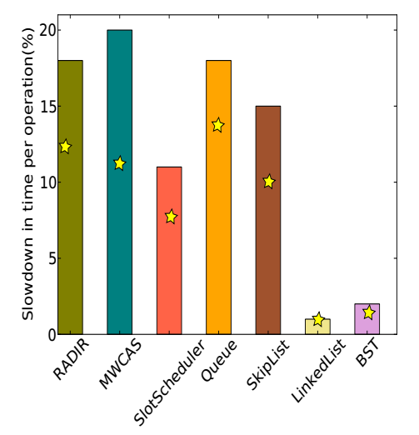
Slowdown (with 64 threads)
32 threads
2-20% Slowdown

Slide 21
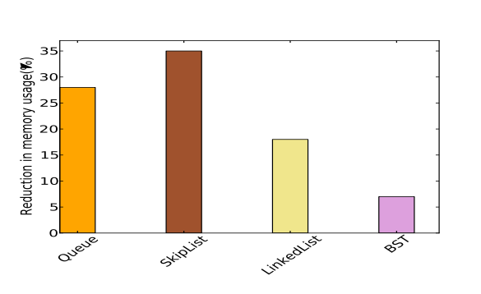
Reduction in Memory Usage (Redirection)
5-35% reduction in the
memory footprint

Slide 22
Conclusions
The Expander has many advantages
Makes algorithms with packing feasible
Reduces the memory footprint of algorithms with redirection by up to 35%
Minimal modifications in the code
Most wait-free algorithms remain wait-free with the Expander

Slide 23


