Slide 1
Energy Efficient Scheduling in IoT Networks
Smruti R. Sarangi, Sakshi Goel, Bhumika Singh
Indian Institute of Technology Delhi

Slide 2

Projections regarding IoT Networks
Forbes Forecasts [1]
50-100 billion devices
450 billion $ market
Smart cities, Industrial IoT, Connected health

Slide 3




Major Challenge in IoT Networks: Energy Efficiency
Most IoT nodes run on batteries
Many use intermittent sources of power
Many applications need real time data analytics support

Slide 4
More about Energy Dissipation
Communication
Energy
Processor
Computation
Energy
We only focus on computation energy (up to 99% of energy consumption)
Existing methods: DVFS, throttling, low power states

Slide 5


Problems with Current Approaches
They make local choices
The choice is independent of
State of the environment
Actions of other nodes
Can we coordinate energy reduction mechanisms between IoT nodes?
Will it lead to benefits?

Slide 6
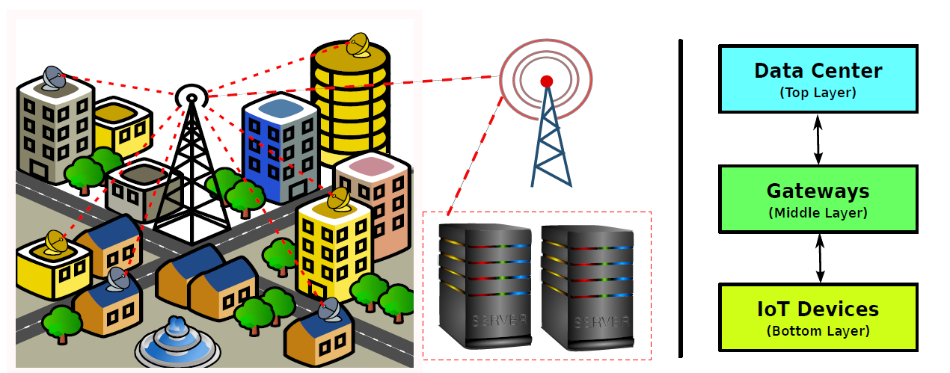
Typical IoT Stack
Region of Interest

Slide 7
Relevant Background
A → Activity factor
P → power
C → capacitance
V → voltage
f → frequency
Reduce the activity
Reduce the voltage and frequency (DVFS)
Reduce both

Slide 8
Reducing Energy Consumption in Sensor Networks
Duty Cycling
Data Driven Approaches
Mobility Driven Approaches
Power the nodes off when they do not need to sense a signal or they do not need to transmit
Move the motes closer to the
source of the signal
Change the sampling rate,
data quantization, and
eliminate redundancy

Slide 9
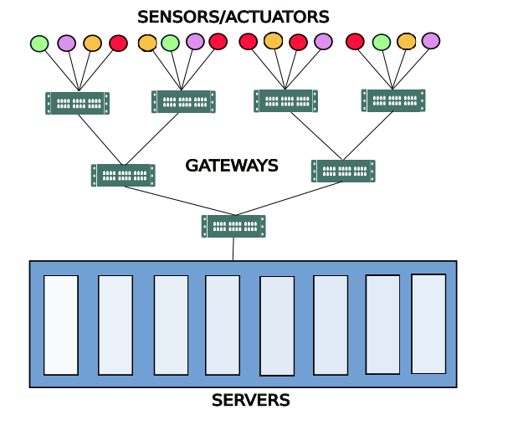
Model of the System
From the sensors
to the cloud
From the cloud to
the actuators
Sensors → Smart Gateways → Cloud

Slide 10
Problem Statement
Task
Start time
Deadline
Network Traffic (bytes)
Worst case exec. cycles at each node
AIM: For a task minimize the energy without missing the deadline.
Approach:
At each node keep a dynamic estimate of the time required to finish the task
Perform DVFS at each node accordingly
Assume each node is a multicore processor, where we can set different frequencies per core

Slide 11
Algorithm for Applying DVFS at each Node
freq_{max} ← maximum frequency
C ← Total exec. cycles
w_{i} ← average waiting time
t_{rem} ← max_time_to_execute_task()
if (t_{rem} ≤ 0) run any core at freq_{max} ; return
if (there is an idle core)
run on idle core with frequency = C/ t_{rem}
else
run on a core with min. frequency f_{i} such that w_{i} + c_{i}/f_{i} ≤ t_{rem}
if no such core found →
increase frequency of core with maximum frequency to freq_{max}
`
Periodically reduce the frequency of high frequency cores

Slide 12
Main Problem
Gateways
sensor
actuator
Task
t_{est}
We need to have a good estimate of t_{est}
Then only we can compute t_{rem} = deadline – current_time - t_{est}

Slide 13
Global Algorithm
Gateways
sensor
actuator
Central Server (CS)
Each node computes a t_{avg} → average time between job arrival and departure
It periodically sends it to the CS
Separate t_{avg} computed for each predecessor
Node
Pred
t_{avg}
t_{avg} for each predecessor
CS

Slide 14


Global Algorithm - II
The server computes t_{est}
Sum of the t_{avg} values for all the nodes in the chain till the actuator
Plus the worst case network latency across all hops
Enhancements
Maintain a moving average of t_{avg} values
Use a distribution instead of a single value.

Slide 15
Local Algorithm
Task
t_{est}
t_{est}
Every node maintains a table of t_{est} values for its neighbors
The t_{est} is piggybacked with every message
Additionally, nodes often share this value with their neighbors (1 or 2 hop distance)
Nodes add or subtract t_{avg}, to update t_{est} depending on the direction
They maintain a weighted moving average of t_{est}

Slide 16

Stability Properties
Assume we initialize the system with the correct values of t_{avg} and t_{est}
It will remain stable
If there are perturbations in the compute time or network delay
They will get conveyed from the source of the perturbation to its neighbors.
The information will gradually propagate
Nodes near the actuator will always have accurate values.
They will send this downstream

Slide 17
Evaluation

Slide 18
Simulation Setup
Validated with NS3
and CloudSim
IoT Simulator
1. 64 bit Ubuntu Linux System
Intel Core i7 CPU, 3.10 Ghz, 4 GB RAM
2. Energy values taken from the Tejas architectural simulator
Sinaeepourfard et al.
Data for Barcelona City
Real World IoT Data
Configurations
Gateway
0.5-1 GHz
Server
1.5-2 GHz
No-DVFS
Deadline-Share
DVFS Step
100 MHz

Slide 19
Deadlines
Number of Sensors | Tight Deadlines | Loose Deadlines
16 | 3-4% | 9-12%
32 | 4-6% | 14-18%
64 | 7-10% | 23-28%
128 | 13-15% | 40-45%
256 | 22-26% | 69-76%
512 | 40-44% | 80-90%
1024 | 72-78% | 95-100%

Slide 20
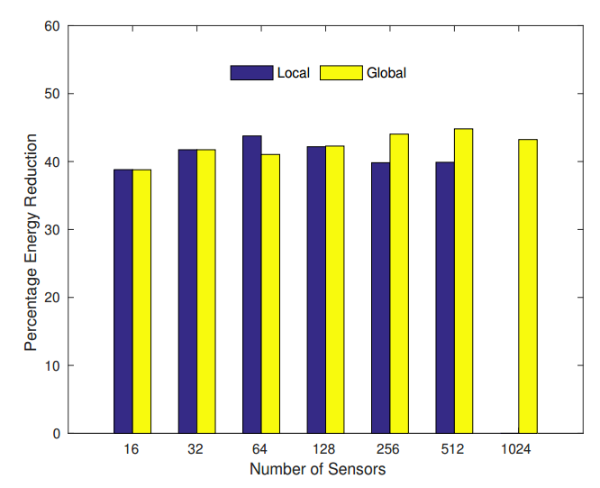
Energy Minimization with Tight Deadlines
Baseline:
No-DVFS
Local does not scale
Mostly as good as global

Slide 21
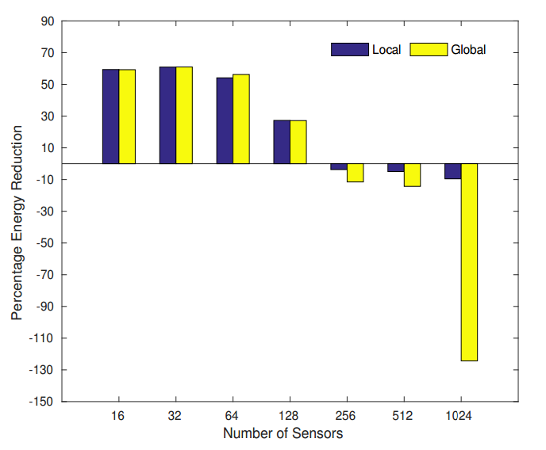
Energy Minimization with Tight Deadlines
Baseline:
Deadline-Share
Energy Minimization with Tight Deadlines
30-50% task
drops for deadline-share

Slide 22
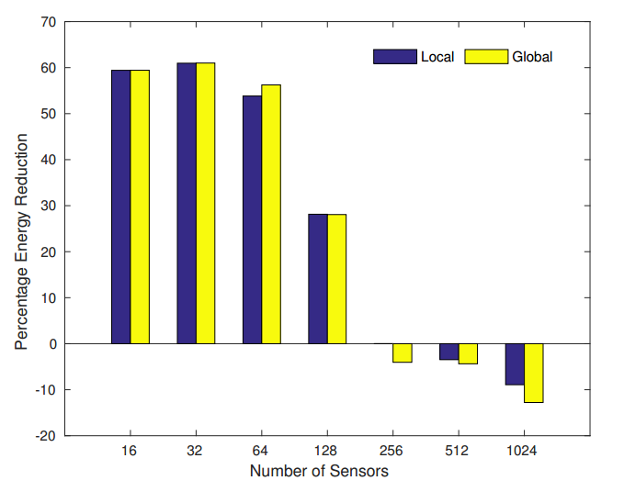
Energy Minimization with Loose Deadlines
Baseline:
Deadline-Share
30-50% task drops
with Deadline-Share

Slide 23
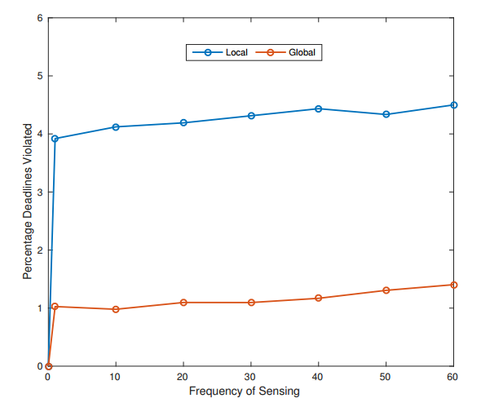
Frequency of Sensing
% Deadlines Violated
Sensing Interval (s)

Slide 24
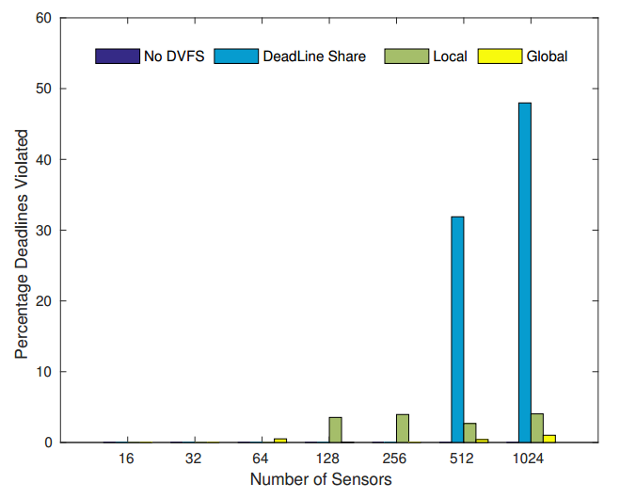
Task Drop Rates

Slide 25
Conclusions
Co-operative protocols can yield significant energy savings in IoT networks
The global algorithm is the best in terms of scalability and task drop rates
It is hard to implement
The gossip based local algorithm performs very well for small and medium loads
It has scalability issues.
The search is on for a good hybrid approach ....

Slide 26
References
https://www.forbes.com/sites/louiscolumbus/2017/12/10/2017-roundup-of-internet-of-things-forecasts

Slide 27


