Slide 1
Lock-free and Wait-free Slot Scheduling Algorithms
Pooja Aggarwal Smruti R. Sarangi
Computer Science, IIT Delhi, India

Slide 2
Outline
Motivation
Related Work
Parallel Slot Scheduler Design
Performance Results
Summary

Slide 3
Real-Time System
How to schedule the requests
Thread _{i}
Thread _{j}
t_{i}
t₁
t₂
time
Notes:
A Real-Time system is any information processing system which has to respond to externally generated request within a finite and specified period, and the correctness depends not only on the logical result but also the time it was delivered

Slide 4
Slot Scheduling
Treats time as a discrete quantity
Globally-visible reservation system
Requires advance algorithm for parallel scheduling

Slide 5
T₁
Reservation System
T1
T2
T₀ T₁ T₂ T_{n-2} T_{n-1} T_{n}
T₁
T₂
Shared Resource
time
Notes:
Tell about the uses

Slide 6
Related Work
In 1982 Ousterhout proposed the matrix representation of time-slices and processors to facilitate running jobs simultaneously
The real-time scheduler for the Rialto operating system, based on CPU reservations, bears a great deal of similarity to slot scheduling.
Generic scheduling using locks
In 2009 Mhamdi et. al. gave online variants of scheduling problem for a message passing based system
In 2011 Keller et. al. propose an offline version of the algorithm that has a known task dependence graph.
We propose a novel, parallel, and Linearizable non-blocking slot scheduling algorithms
Notes:
Instead of matrix representation they use directed graph which is somewhat less flexible

Slide 7
Nx1 Problem
BUSY
N
FREE
M

Slide 8
Nx1 Problem
N
NxM
M

Slide 9
1xM Problem
Resource can process one request per slot
P3
P2 P2 P2
P3 P3 P3
T₀ T₁ T₂ T₃ T₄ T_{i} T_{i+1} T_{i+2}
Time Slots

Slide 10
NxM Problem
Empty slot
2
2
2
busy Free
2
4
4
time

Slide 11
Problems with Locking
Deadlock – no progress
Priority Inversion – lower-priority process preempted while holding lock
Convoying – lockholder de-scheduled
Starvation – a process never completes

Slide 12
Lock-free Algorithm
Optimistic approach
a lock-free algorithm can run in four phases:
complete one's own operation
assist an obstructing operation (internal helping)
abort an obstructing operation
and wait
Fast execution when low contention
Avoids blocking and priority inversion
Avoids deadlock

Slide 13
Wait-free Algorithm
Per-operation progress guarantees
Every operation is guaranteed to complete in a finite number of steps
Faster thread helps the slower thread
Wait-free = Lock-free + Starvation free

Slide 14

Basic Helping Mechanism
Each thread is assigned a priority based on the initial timestamp of its request
Shared Data Structure is used to store the requests
Each thread requesting for slots
First chooses a monotonically increasing request ID (reqid)
Announce the request
helps all threads with a non-larger reqid
NEED TO HELP
Announcing the request
requestId
9
10
11
state
SOFT
NEW
NEW
path
null
null
null
threadId
1
2
3
timeSlot
3
10
7
numSlots
4
4
4
REQUEST entry
per thread

Slide 15
Optimized Helping Criteria
Drawback of basic scheme:
Helping even if no starvation
even when there is no contention
many threads help same operations
large redundant work
Optimization:
REQUEST_THRESHOLD
HELP_THRESHOLD
INTERNAL HELPING

Slide 16
Parallel Slot Scheduler Design
Schedule operation is accomplished in 3 three atomic steps
Announce the request
concurrent processes realize that there is an operation-in-progress
Temporary Reservation
Try to reserve the earliest possible available slots
Permanent Reservation
finalizing the reserve slots

Slide 17
FSM of a Request
POINT of LINEARIZABILITY
NEW
Make temporary reservation
FAIL
SOFT
Finished reserving the required slots
POINT of LINEARIZABILITY
CANCEL
FORCEHARD
Make permanent reservation
Cancelled by other thread or cancelled itself
Could not find empty slot
DONE

Slide 18
Schedule Operation
EMPTY
1
6 6
1
1
1
1
1
SOFT
HARD
6 6 6
1
6 6 6
1
POINT of LINEARIZABILITY
requestId
9
10
state
DONE
NEW
SOFT
NEW
FORCEHARD
SOFT
SOFT
CANCEL
FORCEHARD
NEW
DONE
path
(3,1)
(7,5),(8,5),(9,5)
(3,1),(4,2),(5,2),(6,5)
null
(3,1),(4,2),(5,2)
null
null
(4,1),(5,1)
threadId
1
6
timeSlot
3
4
numSlots
4
3

Slide 19
State Transitions’ of a Slot
EMPTY
Temporary Reservation
SOFT
Permanent Reservation
HARD
Tstamp reqId tid state slotno round
threadId

Slide 20
Role of Saving Slot
Already booked
Reserved 2 slots
2
Reserved 4 slots
Temporary Reservation
4 4 4 4
1 1
2

Slide 21
Role of Round
NEW
SOFT
NEW
NEW
SOFT
SOFT
CANCEL
CANCEL
With every cancellation, round is increment
round is 2
Round is 3
round is 1
CAS
2 2
2
2 2
1 1 1

Slide 22
Selecting a Slot
BOOKED
6 6
FREE
SOFT,2
1
1 1
5
1
1 1
SOFT, 2
2 2
SOFT, 4
4 4 4 4
Another helper reserved slot
Another helper Booked the slot
1
1
7

Slide 23
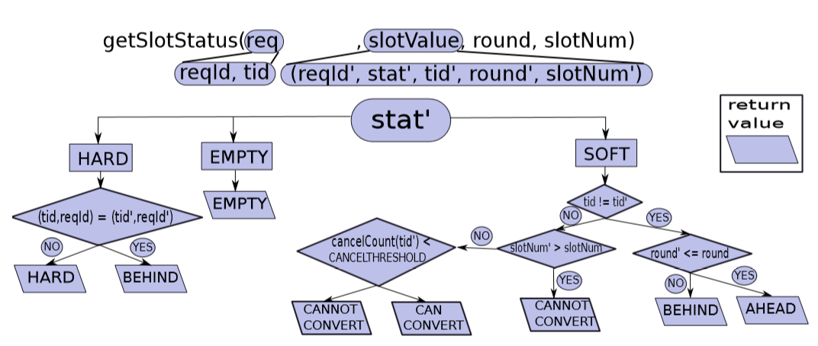

Slide 24
Issues and Resolutions
ABA issue
Time-Stamp
Multiple rollbacks
CANCEL-THRESHOLD
Multiple reservations
PATH array
SHADOW array
Notes:
- The ABA problem represents a situation where a thread, t_{i}, may incorrectly succeed in a CAS operation, even though the content of the memory location has changed between the instant it read the old value and actually performed the CAS

Slide 25
Setup
Architecture
Two six core 2.66 Ghz Intel Xeon GHz processors
OS
Ubuntu Linux 12.10
RAM
64 GB
Threads
Platform
Sun’s Java SE Runtime 1.6.0
24

Slide 26
Workload
The inter-request distances are truncated normal distributions
Box-Muller transform is used to generate the normal variants
Experiment is executed till one of the thread completes all its iterations
Each thread performs 1000 iterations
Each experiment is performed 10 times, and mean values are reported

Slide 27
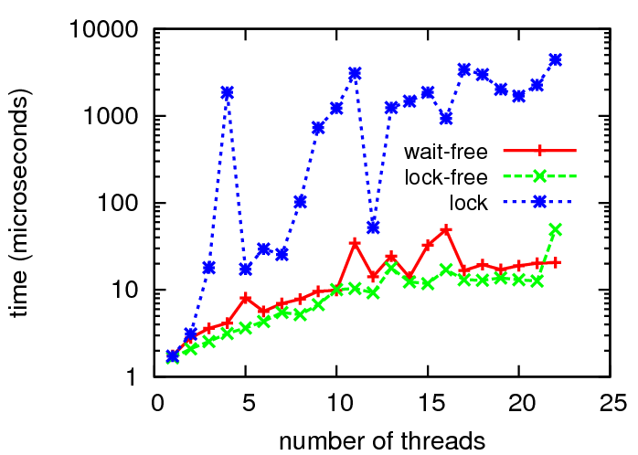
Mean time per request (t_{req})
Lock is 100 times slower

Slide 28
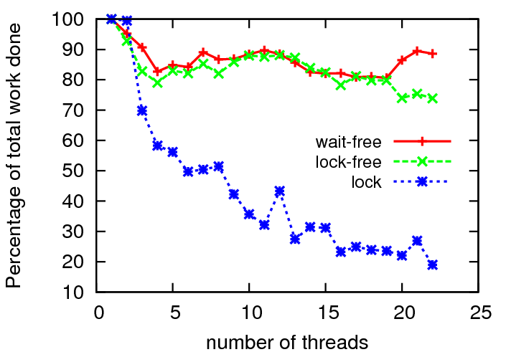
Work Done
We run the system till the fastest thread completes κ requests.
wk = tot requests/(κ ×NUMTHREADS).
Wait-free Work done is around 10 % more

Slide 29
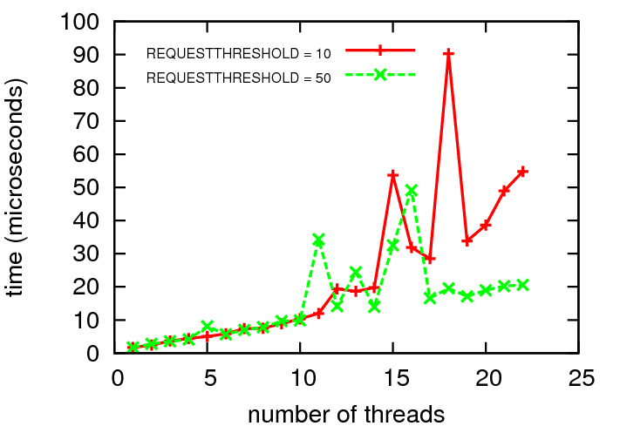
Sensitivity: Request-threshold

Slide 30
Summary
First lock-free and wait-free algorithm for four variants of the generic slot scheduling problem
Lock-free is fastest of the three approaches
Wait-freedom incurs an inherent trade-off
bounds the completion time of a single operation
Total Work done is more
All our algorithms are linearizable
Proposed design scheme might be applicable for other wait-free data structures

Slide 31
Thank you!
Questions?

