Slide 1
JASS: A Tunable Checkpointing System for NVM-based Systems
Akshin Singh
Smruti R. Sarangi
IIT Delhi

Slide 2
Introduction

Slide 3


Overview of Checkpointing
There are failures in systems. We need periodic checkpointing.
Regular operation
Checkpoint
Regular operation
Checkpoint
Checkpoint
Restore

Slide 4


How long does it take to checkpoint?
CL
Checkpoint latency
3-5 ms
CL
300-500 ms
Hardware
Tsoper, NvOverlay
Software
CRIU, ULFM, ReInit++
Use NVMs

Slide 5

Why do we need millisecond-level latencies?
Record-replay debugging
High-throughput Tx systems
Job migration in exascale systems
Banks, stock exchanges

Slide 6


Why NVMs?
Horizontal integration
CPU
Reads: 2-4X slower than DRAM
Writes: 8-50X slower
DRAM
NVM
Flash
Limited endurance
MRAM
PCM
Hard disk

Slide 7
Some Key Definitions
CL_{down}
Regular operation
Regular operation
Checkpoint
Checkpoint
ES
CL
Term | Definition
CL | Checkpoint latency
CL_{down} | Downtime during checkpointing
ES | Epoch Size
MTBF | Mean time between failures

Slide 8


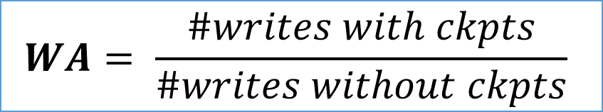
Key Definitions – II
Transfer the checkpoint data
Transfer the checkpoint data
CPU
Checkpointing induces more writes
Periodically transfer the state to the NVM
DRAM
NVM
$$WA= \frac{\#writes with ckpts}{\#writes without ckpts}$$
Hard disk
Write amplification

Slide 9




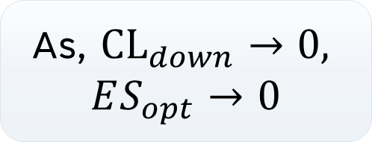
A Little Bit of Theory
Young, 1974
$$ES_{opt}= \sqrt{2∗CL_{down}∗MTBF}$$
As, ${CL}_{down}→0,$
$$ES_{opt}→0$$
Optimal epoch size
Down time
Minimize the overall execution time
Does not take WA into account.

Slide 10
Our Objective Function
Objective function
Fix the ES
Given a CL, minimize WA
Given a WA, minimize CL

Slide 11


Where do we stand vis-a-vis related work?
ES and CL values continuously reduced increasing WA significantly.
ThyNVM
JASS
Our Novelty
ES or CL
PiCL
Tradeoff the ES and CL with WA in a controlled manner.
NVoverlay
2015
2018
2021
2023
Year of Publication

Slide 12





The Checkpointing Process
Move some DRAM data to the NVM
Run a locality predictor
Move pre-snapshot data to DRAM
Flush pre-snapshot lines in the caches
Flush all in-flight messages from the NoC and L1 caches

Slide 13
Basic Concepts + Related Work

Slide 14


Flushing the NoC is difficult ...
How do we guarantee that all the pre-snapshot messages are recorded in a checkpoint?
Answer:
Build a protocol using the classical Chandy-Lamport algorithm
Assume FIFO channels
3. Record all
pre-snapshot messages
1. Take local
snapshot
2a. Propagate token 2b. Send an ack

Slide 15

Simplifications
Maintain only two versions – current and previous
Single page table in NVM (ckpt version)
Do not use a coherence-based epoch scheme

Slide 16



How do you ensure a guaranteed CL and minimize WA?
How do I minimize my study time before the exam, yet still pass with a B?
Answer:
Study a little bit during the semester.
Keep persisting some DRAM data to the NVM regularly. Ensure that CL is bounded.

Slide 17
Design

Slide 18

Overview of the Scheme
Start the checkpoint
Flush the NoC
Scrub the caches and send data to the lower level
Scrub the DRAM and send data to the NVM
Scrub the LLC (send data to NVM and the DRAM)
Coalesce data on chip
Finish the scrubbing

Slide 19
Cores/Caches: Tracking snapshot data requires a single bit!
Epoch 0
Epoch 1
SB =0
SB =1
SB =1
SB =0
Post-Snapshot
Post-Snapshot
Pre-Snapshot
Pre-Snapshot

Slide 20


Step 2: FLUSH
Cache
Write
WAR
Can a core read data from a newer version?
Scrubber
Persist long lived lines
Non-Trivial

Slide 21

Lemmae
Lemma 1: A post-snapshot message never reaches a router in state NTR.
Lemma 2: A pre-snapshot marked message is counted by only a single router.

Slide 22

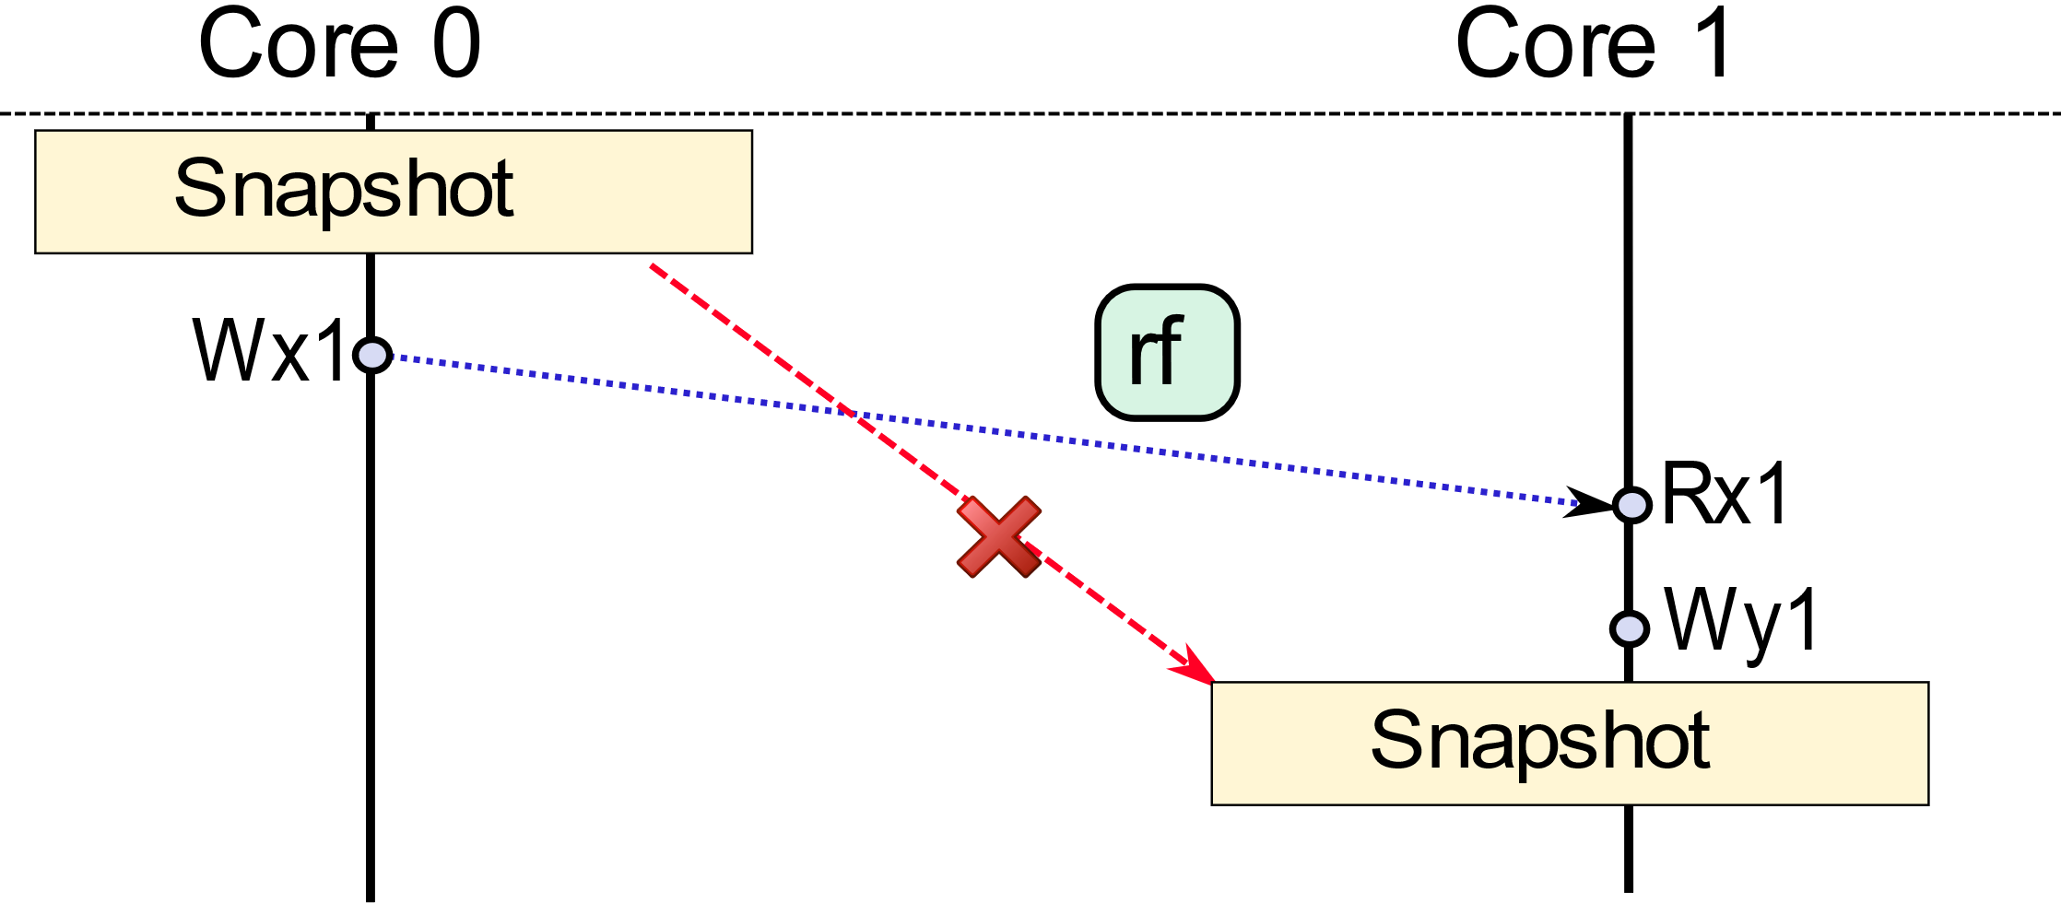
Not possible

Slide 23

Step 3: Cache Operations on Modified Pre-snapshot Lines
READ
Seamless read
GETS
EVICT
Evict pre-snapshotted lines
GETX
WRITE

Slide 24




Step 4
How to scrub the DRAM?
How to ensure an optimal CL?
How to coalesce DRAM and LLC accesses?

Slide 25
Incrementally walk the page table to find pages to persist to NVM
overflow and increment
overflow and increment
overflow and increment
Level 3 Counter
Level 2 Counter
Level 1 Counter
Level 0 Counter
Walk complete
Increment in every walk

Slide 26




Ensure an optimal CL
$$If working set>n?$$
Keep n modified pages in DRAM and rest in NVM
$$Which pages to keep in DRAM and which pages to persist?$$
Locality Predictor

Slide 27




Locality Predictor
DRAM page (256 Bytes)
2 bits
Increment when a pre-snapshot line is sent to the DRAM
DRAM page
(256 Bytes)
Clear bits in these counters during period page walks
3 bits
)
DRAM page (256 B
When the counters are zero, persist the page to the NVM

Slide 28
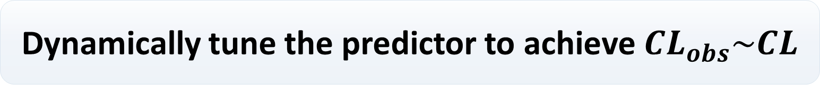
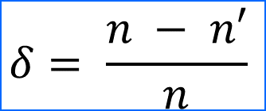
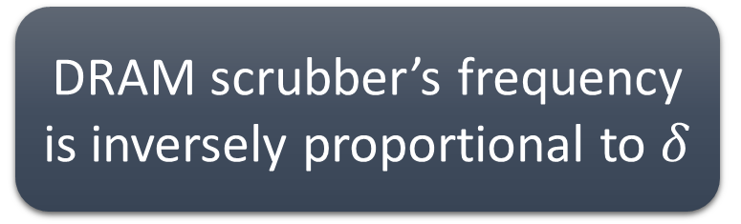
PD controller
Dynamically tune the predictor to achieve ${CL}_{obs}\sim CL$
Sub epoch 1
Sub epoch 2
Sub epoch 50
…………………………………
Epoch
modified lines
DRAM scrubber’s frequency is inversely proportional to $δ$
$$δ= \frac{n − n′}{n}$$

Slide 29
Evaluation

Slide 30
Configuration
8 OOO cores
Parsec benchmarks
L1: 32 KB
L2: 256 KB
L3: 2 MB
256 B (basic page size)
2 ranks, 8 banks (DRAM and NVM)
Tejas simulator
http://www.cse.iitd.ac.in/tejas

Slide 31

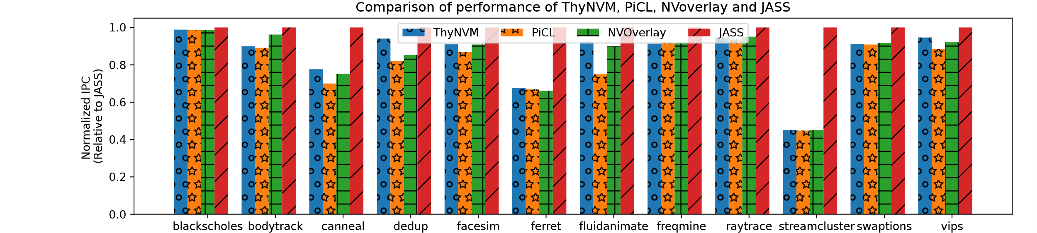
Performance Comparison
19.4%
WA reduction by 35-96%

Slide 32
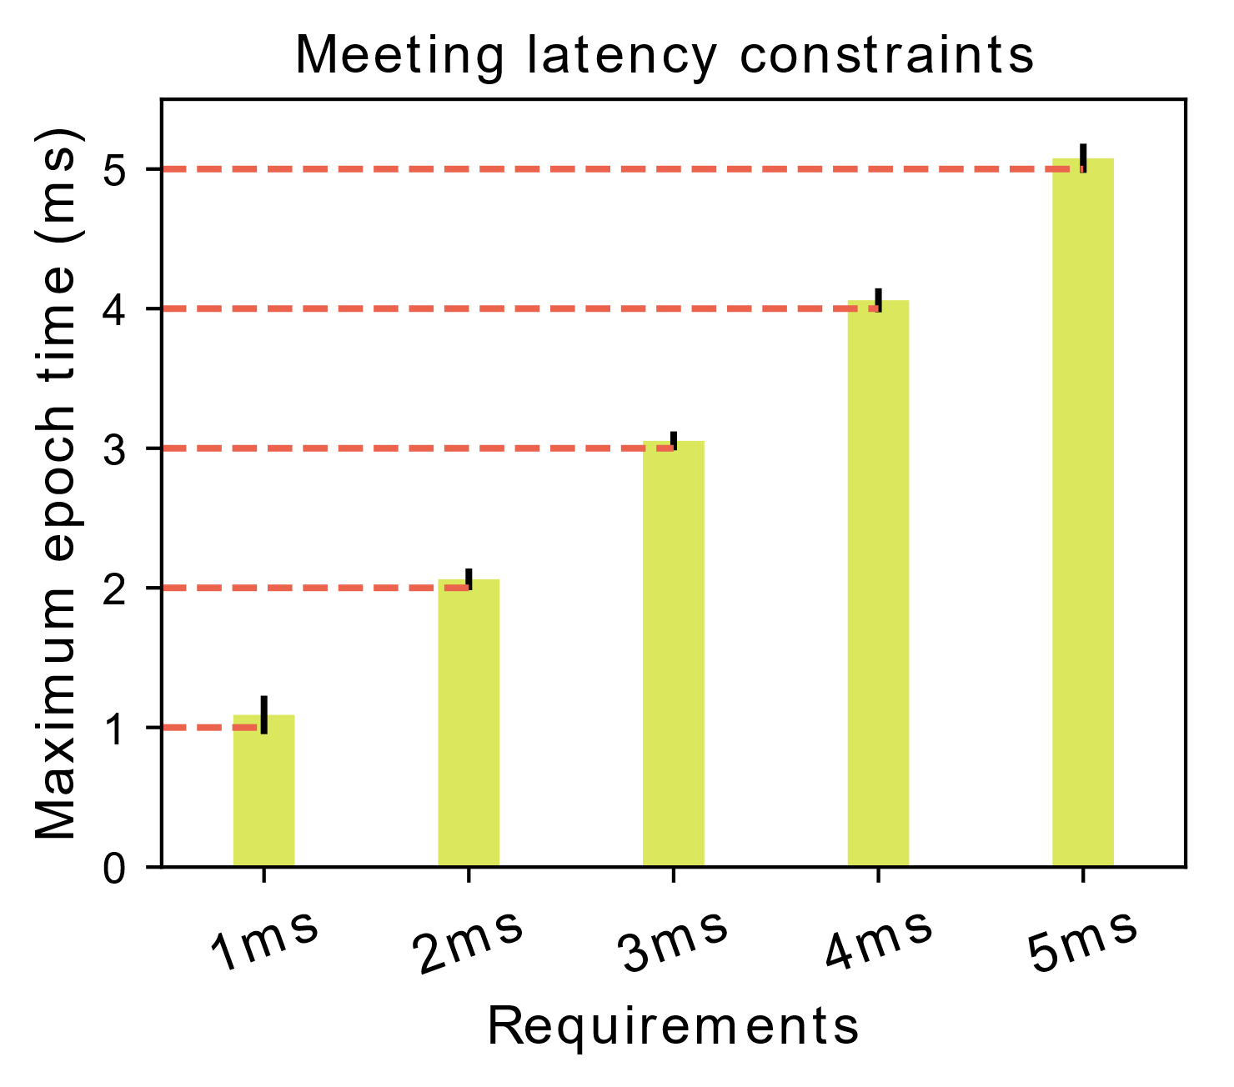
We meet the CL constraints

Slide 33
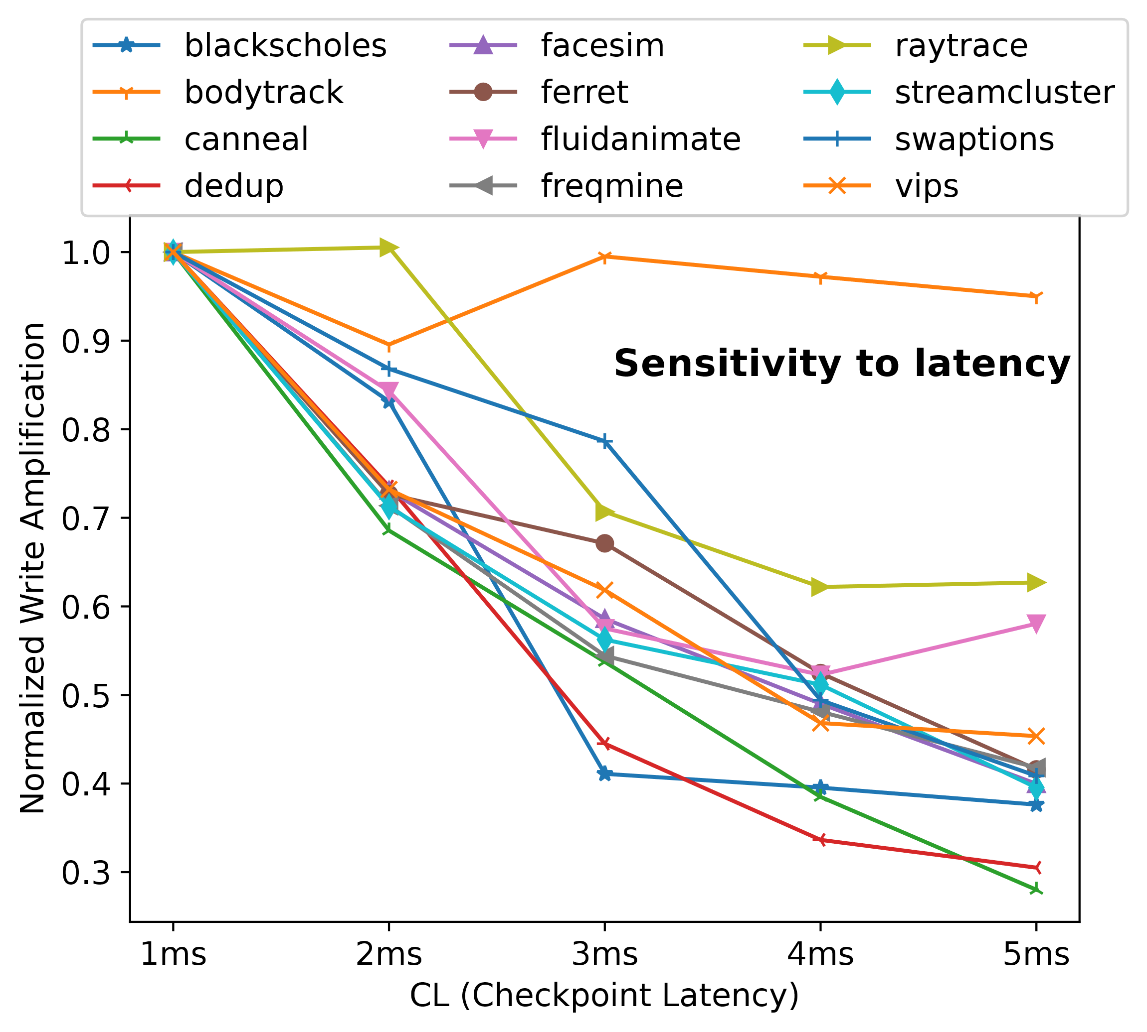
WA
vs
CL

Slide 34
Conclusion
Flushing the NoC is challenging.
Simple binary checkpointing that is epoch based.
Limit the CL (minimize WA). Use a PD controller

Slide 35

Smruti R. Sarangi
srsarangi@cse.iitd.ac.in

Slide 36

Proof
Lemma 1: A post-snapshot message never reaches a router in state NTR.
Lemma 2: A pre-snapshot marked message is counted by only a single router.
In-flight messages
NTR to TR
Ri
Rj
TOK
Transit timer elapsed
Lemma 3: Use timers to take care of messages in transit.

Slide 37
New messages
Message
Request
Message
Directory
Modify the directory’s router
Message
Update xcount if outgoing > incoming
Update pcount if outgoing=0
Theorem: No pre-snapshot message remains in the NoC after termination detection.

Slide 38
State = TR; pcount = 0
Send xcount to checkpoint controller
Send token to neighbors (highest priority)
Message M arrived at a router R
Record the number of messages in flight (xcount)
yes
M is a snapshot token?
no
NTR
Check state
Normal operation
M is a snapshot token?
TR
no
no
yes
M has reached its destination?
pcount++

Slide 39
Workload | Completion Time | %Cache | %DRAM | %Coalescing | LLC MPKI | %DRAM WA
Blackscholes | 5.25 | 88 | 12 | 13 | 0.20 | 50.16
Bodytrack | 5.0 | 78 | 22 | 2 | 0.14 | 25.6
Canneal | 5.0 | 40 | 60 | 23 | 0.48 | 49.1
Dedup | 5.0 | 81 | 19 | 4 | 17.6 | 23.1
Facesim | 5.0 | 84 | 16 | 0.4 | 0.91 | 8.7
Ferret | 5.05 | 78 | 22 | 9.5 | 0.33 | 50.7
Fluidanimate | 5.0 | 47 | 53 | 1.6 | 0.51 | 10.7
Freqmine | 5.0 | 68 | 32 | 1.6 | 0.51 | 10.7
Raytrace | 5.0 | 84 | 16 | 1.5 | 0.78 | 15.2
Streamcluster | 5.1 | 84 | 16 | 0.9 | 0.55 | 18.7
Swaptions | 5.23 | 86 | 14 | 5.5 | 0.09 | 25.3
Vips | 5.01 | 84 | 16 | 2.6 | 0.17 | 49.9

Slide 40
Workload | Completion Time | %Cache | %DRAM | %Coalescing | LLC MPKI | %DRAM WA
Blackscholes | 5.25 | 88 | 12 | 13 | 0.20 | 50.16
Bodytrack | 5.0 | 78 | 22 | 2 | 0.14 | 25.6
Canneal | 5.0 | 40 | 60 | 23 | 0.48 | 49.1
Dedup | 5.0 | 81 | 19 | 4 | 17.6 | 23.1
Facesim | 5.0 | 84 | 16 | 0.4 | 0.91 | 8.7
Ferret | 5.05 | 78 | 22 | 9.5 | 0.33 | 50.7
Fluidanimate | 5.0 | 47 | 53 | 1.6 | 0.51 | 10.7
Freqmine | 5.0 | 68 | 32 | 1.6 | 0.51 | 10.7
Raytrace | 5.0 | 84 | 16 | 1.5 | 0.78 | 15.2
Streamcluster | 5.1 | 84 | 16 | 0.9 | 0.55 | 18.7
Swaptions | 5.23 | 86 | 14 | 5.5 | 0.09 | 25.3
Vips | 5.01 | 84 | 16 | 2.6 | 0.17 | 49.9

Slide 41
Workload | Completion Time | %Cache | %DRAM | %Coalescing | LLC MPKI | %DRAM WA
Blackscholes | 5.25 | 88 | 12 | 13 | 0.20 | 50.16
Bodytrack | 5.0 | 78 | 22 | 2 | 0.14 | 25.6
Canneal | 5.0 | 40 | 60 | 23 | 0.48 | 49.1
Dedup | 5.0 | 81 | 19 | 4 | 17.6 | 23.1
Facesim | 5.0 | 84 | 16 | 0.4 | 0.91 | 8.7
Ferret | 5.05 | 78 | 22 | 9.5 | 0.33 | 50.7
Fluidanimate | 5.0 | 47 | 53 | 1.6 | 0.51 | 10.7
Freqmine | 5.0 | 68 | 32 | 1.6 | 0.51 | 10.7
Raytrace | 5.0 | 84 | 16 | 1.5 | 0.78 | 15.2
Streamcluster | 5.1 | 84 | 16 | 0.9 | 0.55 | 18.7
Swaptions | 5.23 | 86 | 14 | 5.5 | 0.09 | 25.3
Vips | 5.01 | 84 | 16 | 2.6 | 0.17 | 49.9

