Slide 1

Snapstore: a snapshot storage system for serverless systems
Abhisek Panda, Smruti R. Sarangi
Computer Science and Engineering
IIT Delhi, India
24th ACM/IFIP International Middleware Conference
Notes:
Hello everyone,
I will be presenting our paper titled “SnapStore: A snapshot storage system for serverless systems”.

Slide 2
OUTLINE
Problem Statement
Motivation and Prior Work
Design of SnapStore
Results
Conclusion
Problem Statement
Notes:
This is the outline for this presentation.
Let us start with introducing the problem statement.

Slide 3



COLD START MITIGATION
F₂
F₃
Cost of spawning a sanbox environment.
F₂
F₃
F₁
F₂
F₁
F₁
F₃
Remote Storage Service
DRAM
Function Snapshot
Disk
F₂
F₃
F₁
Sandbox
Environment
Minimizes the initialization cost.
Notes:
Upon receiving a request from a user, the serverless platform spawns a container with the function F1 to serve the request. Compared to conventional cloud computing paradigms, the cost of creating a sandbox is on the critical path. To resolve this overhead, platforms widely use snapshot and restore based mechanisms, in which we take a snapshot of a function prior to function execution. This minimizes the overhead of initializing the OS, runtime and respective libraries for the subsequent executions of F1. Similarly we execute the request F2. Upon the completion of both the requests. We receive a request F3, following the snapshot and restore based mechanisms, we save the snapshot of F3. Sadly, the local disk is full. Therefore, we transfer a snapshot to a remote storage and make space for the snapshot.

Slide 4
PROBLEM STATEMENT
F₁
Goal: Design an efficient snapshot storage system capable of storing an ample amount of function snapshots.
F₁
Remote Storage Service
F₁
DRAM
The benefits of snapshot and restore techniques are limited by the cost of fetching the snapshot.
Disk
F₂
F₃
Notes:
If in future we encounter a request from function F1, we need to fetch the snapshot of F1 from a remote storage. This will limit the benefits gained from the snapshot and restore technique. Hence, we formulate our problem statement. Design an efficient snapshot storage system to increase the number of function snapshots stored.

Slide 5
OUTLINE
Problem Statement
Motivation and Prior Work
Design of SnapStore
Results
Conclusion
Motivation and Prior Work
Notes:
Now let us discuss the motivation and prior work.

Slide 6

SNAPSHOT ANALYSIS
F₁
Memory File
55.6%
NRT
51.6%
RX_MAP
26.9%
W_MAP
21.5%
A runtime page without write permission
(RX_MAP)
A runtime page with write permission
(W_MAP)
A dirty memory page
A non-dirty memory page
A non-runtime memory page
(NRT)
Notes:
Now let us analyze the snapshot of a firecracker’s microVM. In a snapshot, the majority disk space occupied by the memory file, which contains the memory pages of a microVM. Now let us represent the microVM in an array of memory pages. We found that about 55.6% of the memory pages are non-dirty memory pages, typically zero pages. Storing these pages will lead to space wastage. Therefore, we store a memory file as a sparse file, i.e. removing the non-dirty memory pages. Now let us take a fine granular view of the dirty memory pages. We split the memory pages into three categories namely non-runtime memory pages, runtime memory pages with write permission, and runtime memory pages with read permissions. The occupancy of each category is shown in the slide.

Slide 7
SCOPE OF DEDUPLICATION
F₁
F₂
Region Type | Data redundancy b/w regions | Impact on redundancy with a decrease in the data chunk’s size
NRT | 56.7% - 77.5% | Increases
RX_MAP | 57.4% - 94.6% | Remains almost the same
W_MAP | Up to 25.2% | Increases
NRT
RX_MAP
W_MAP
Notes:
Now we study the scope of deduplication between two function snapshots F1 and F2. In this analysis, we use fixed-size deduplication mechanism to measure the data redundancy between regions by varying the data chunk’s size. We first study the deduplication between the NRT memory regions of two snapshots. We find that the data redundancy between the regions lie in the range of XX to XX. Also the data redundancy increases with the decrease in the data chunk’s size. Then we move to the RX_MAP region, we found that the redundancy lies between XX to XX. But the decrease in the data chunk’s size does not impact the data redundancy. At last for the W_MAP region we observe that the redundancy is the lowest that is XX %. Therefore, we propose that we must design a deduplication technique that performs a memory region wise deduplication instead of comparing between every chunk of a snapshot file with the other.

Slide 8
PRIOR WORK
VM Deduplication (QuickDedup(JPDC’20))
Does not exploit the deduplication opportunities at a granularity of memory region types.
Data Deduplication [MeGA(ATC’22), (HiDeStore (Middleware’ 20)]
Explicitly designed for backup data.
Does not take adequate measures to improve the restoration process in the context of microVM snapshots.

Slide 9
OUTLINE
Problem Statement
Motivation and Prior Work
Design of SnapStore
Results
Conclusion
Design of SnapStore

Slide 10
SNAPSTORE: DEDUPLICATION
Split into memory regions
F₁
Divide a region into chunks and compute their respective hashes.
#
#
#
#
#
#
#
#
#
#
#
#
#
#
#
#
#
#
#
#
#
#
#
#
Fingerprint Index Table
Fingerprint Index Table
Detect and eliminate duplicate chunks among regions of the same type
Recipe
F₁
NRT
RX_MAP
W_MAP
Data block store
Data block store
Data block store
Notes:
First, let us discuss the design of the deduplication process. First, we take a snapshot of a function, then split the memory pages of a function snapshot into different memory region types. Then we divide memory pages into data chunks and compute its hash; except the W_MAP region. Note that the chunk size is different for each region type as discussed in the motivation slides. As a result the number of hash operations performed reduces significantly reduces. Then we maintain separate fingerprint tables that store the hash of the unique data chunks encountered by the system. In case of a unique data chunk, we store it in the data block store with respect to its type. In case of a duplicate data chunk, we store a pointer to the unique data chunk stored on the data block store. Finally we generate a recipe F1 that stores the information for each data chunk of a snapshot.

Slide 11
SNAPSTORE: RETRIEVAL
Restore chunks as per the memory region type.
Recipe
F₁
Data block store
Data block store
Data block store
Restore Cache
F₁
NRT
RX_MAP
W_MAP
RAM Based Cache

Slide 12
OUTLINE
Problem Statement
Motivation and Prior Work
Design of SnapStore
Results
Conclusion
Results

Slide 13
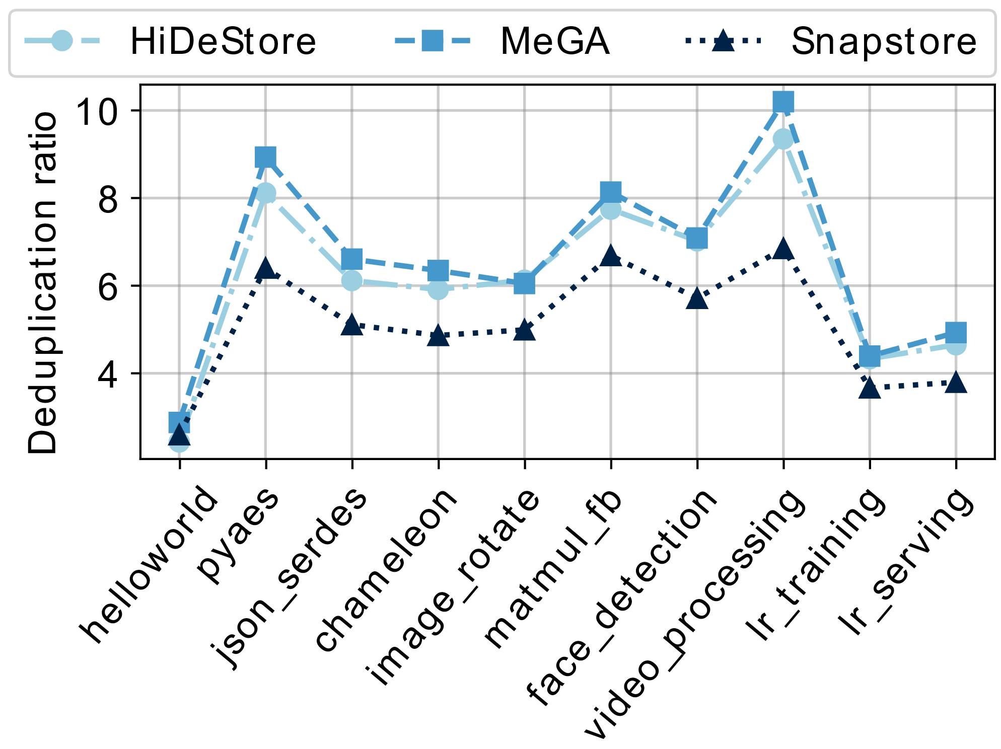
SETUP AND STORAGE COST
Name | Setting
Processor | Intel Xeon 6226R
CPUs | 1 Socket, 16 cores
HDD | Seagate 2TB HDD, 7.2KRPM
SSD | Samsung 860 EVO 500GB
DRAM | 256 GB
GCC version | 7.5
SnapStore reduces the deduplication ratio by 21.6%.
Notes:
What is serverless computing?
Design
Autoscaling
Supported applications: Streaming application like Netfilix, product review analysis, object detector, DNA visualization etc.

Slide 14
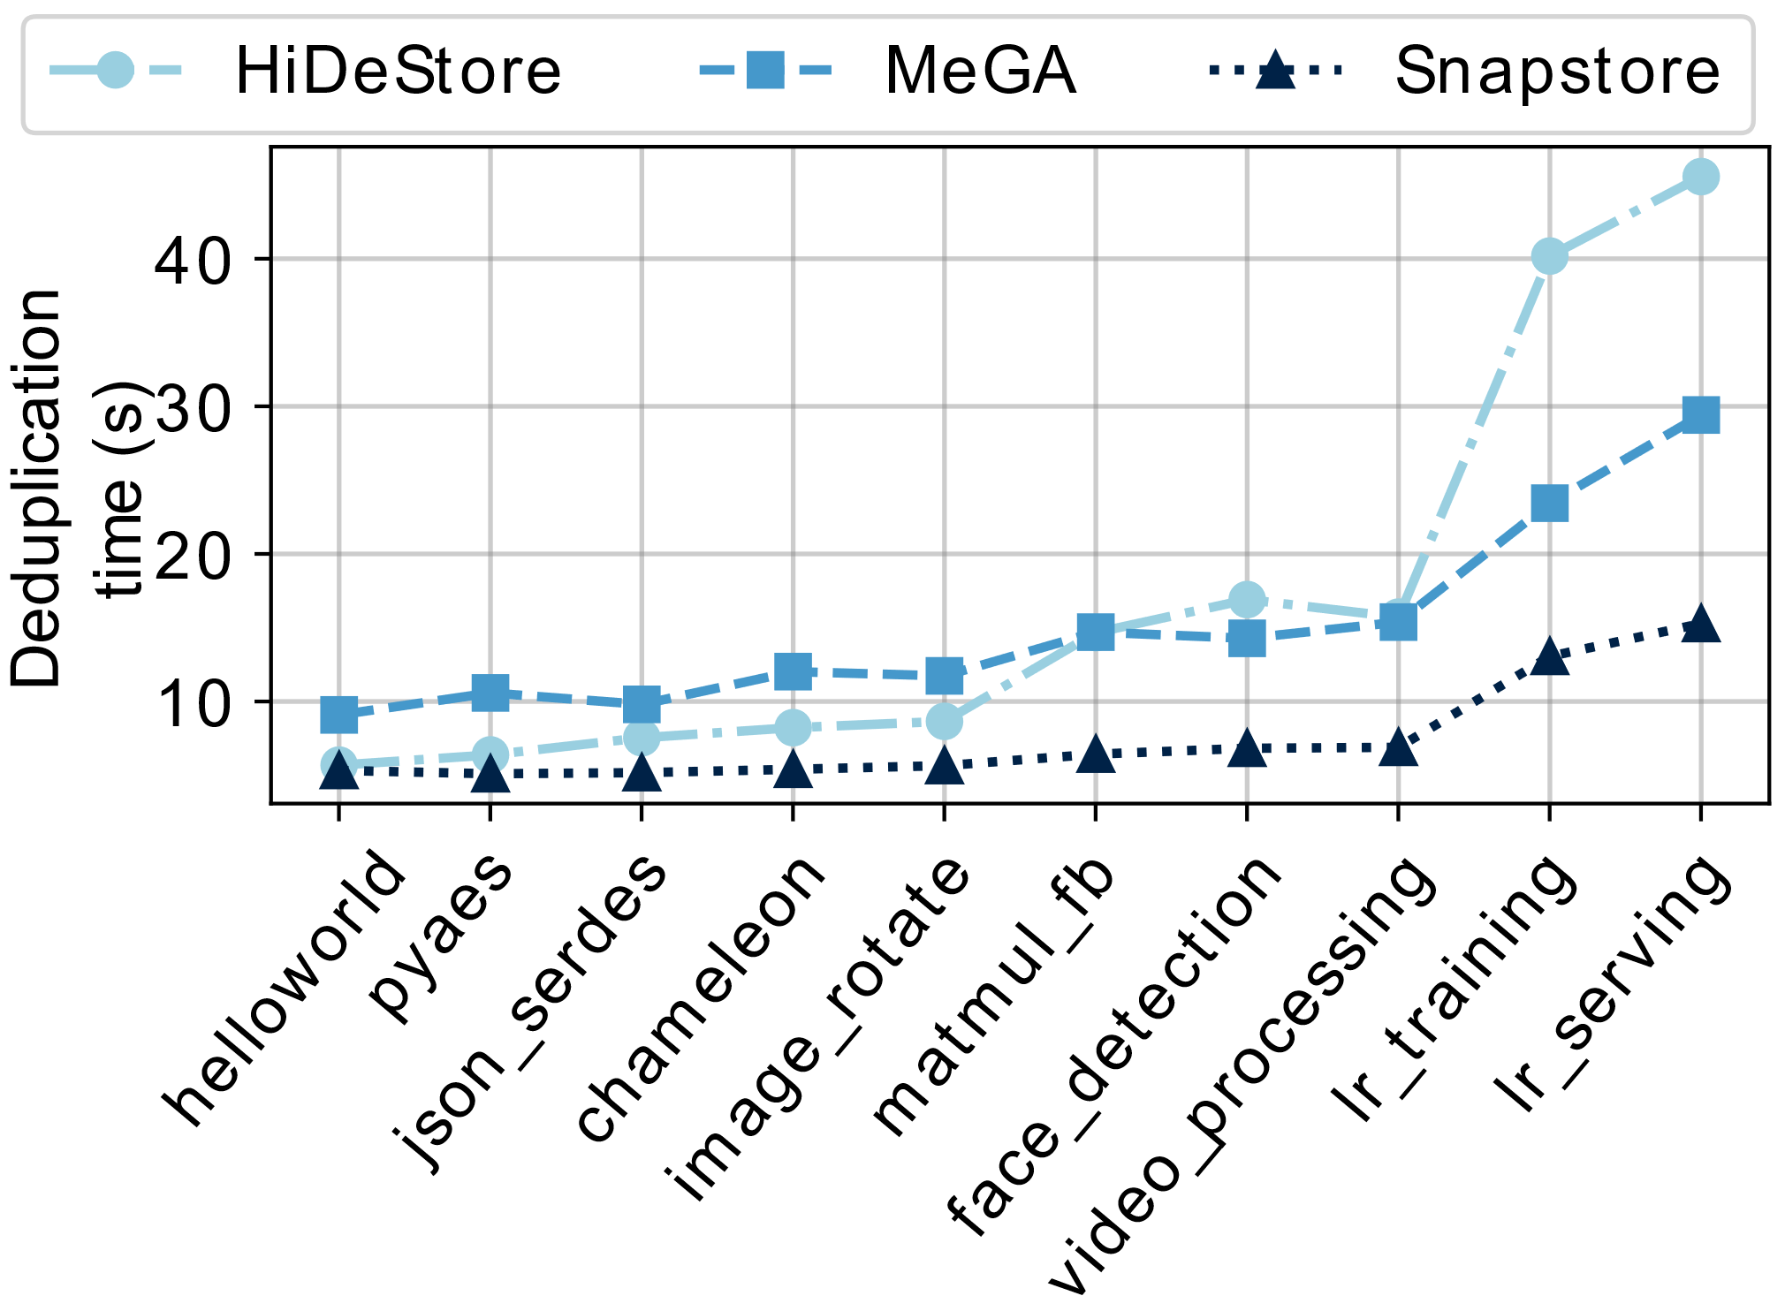
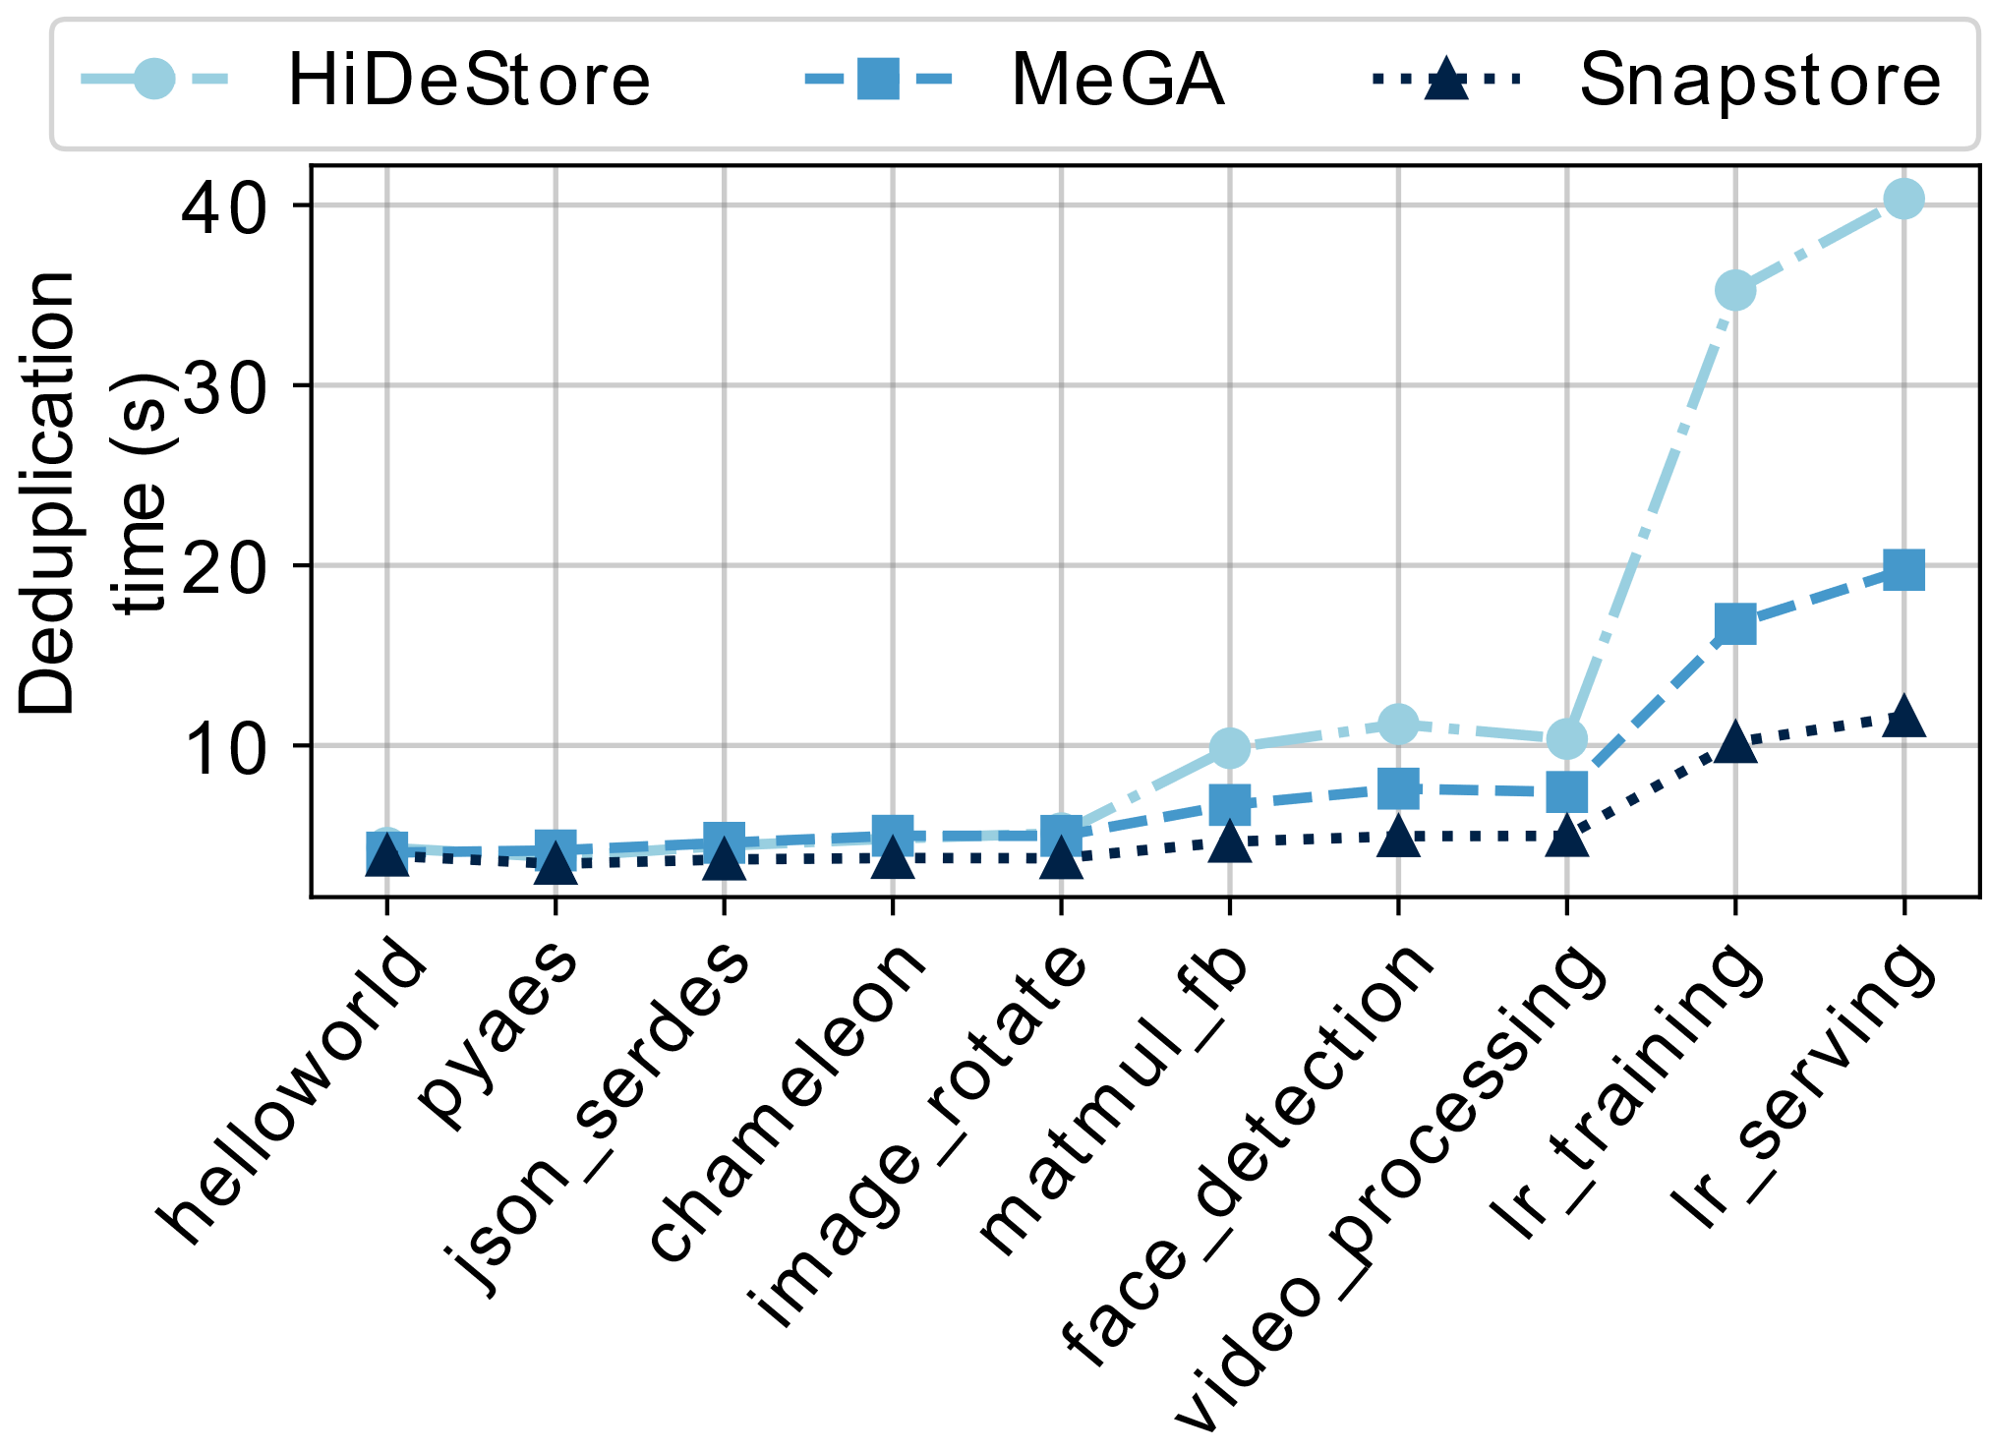
DEDUPLICATION TIME
Deduplication time on HDDs
Deduplication time on SSDs
SnapStore improves the deduplication time by 50% on HDDs and 30.8% on SSDs.
Notes:
What is serverless computing?
Design
Autoscaling
Supported applications: Streaming application like Netfilix, product review analysis, object detector, DNA visualization etc.

Slide 15
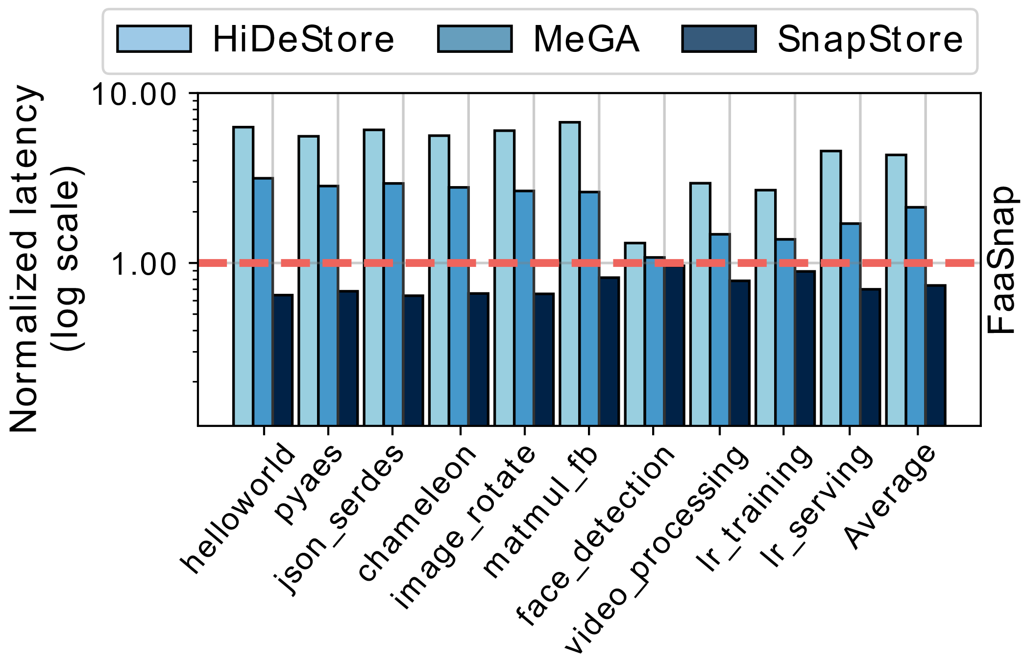
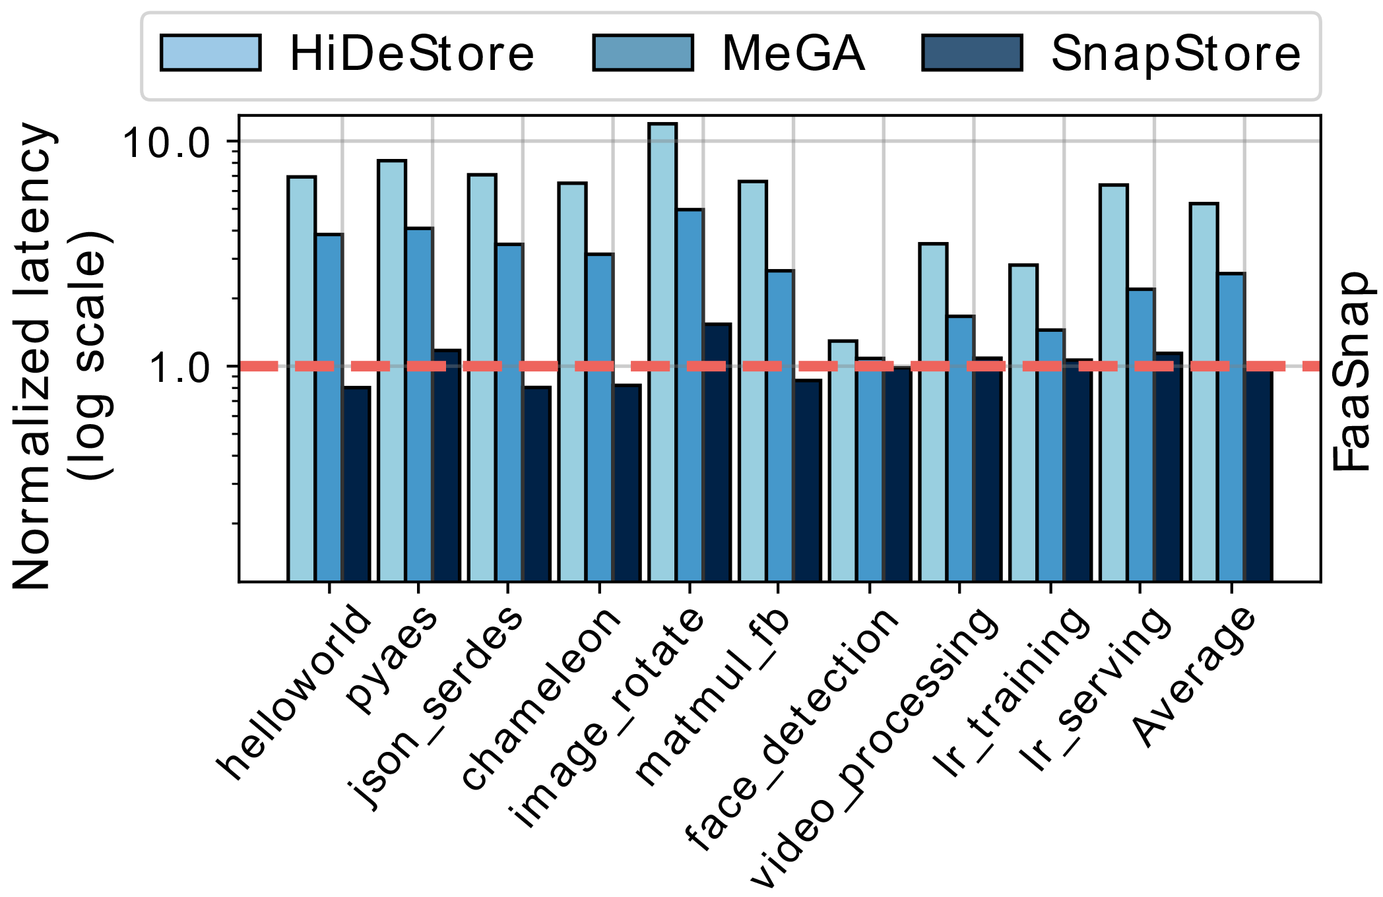
END-TO-END LATENCY
End-to-end latency on HDDs
End-to-end latency on SSDs
With the integration of SnapStore with FaaSnap (a state-of-the-art serverless platform), the end-to-end latency improves by 25.9% over FaaSnap on HDDs, while it degrades by a mere 0.6% on SSDs, on average.
Notes:
What is serverless computing?
Design
Autoscaling
Supported applications: Streaming application like Netfilix, product review analysis, object detector, DNA visualization etc.

Slide 16
OUTLINE
Problem Statement
Motivation and Prior Work
Design of SnapStore
Results
Conclusion
Conclusion

Slide 17
CONCLUSION
The occupancy of non-dirty memory pages of a function snapshot is 55.6% of the memory file.
The degree of overlap between the memory regions of a memory region type (NRT, RX_MAP, W_MAP) varies, while that of W_MAP is the lowest.
SnapStore + FaaSnap improves the end-to-end latency of serverless functions by 25.9% along with 2.4× storage space reduction over vanilla FaaSnap on HDDs.
Notes:
Host overload scenario
Warm containers
81% are highly concurrent
A compute node can host thousands of a container.
3000 is the concurrency request.
Host can accommodate thousands of sandboxes
Idle containers leads to memory underutilization
Multi tenant setup
Load aware serverless scheduler

Slide 18

Thank You
Contact:
Abhisek Panda: abhisek.panda@cse.iitd.ac.in
Smruti R. Sarangi: srsarangi@cse.iitd.ac.in

