Slide 1
Novel Paradigms of Parallel Programming
Prof. Smruti R. Sarangi
IIT Delhi

Slide 2
Outline
Multicore Processors
Parallel Programming Pardigms
Transactional Memory: Basics
Software Transactional Memory(STM)
Hardware Transactional Memory
Slot Scheduler using STM

Slide 3
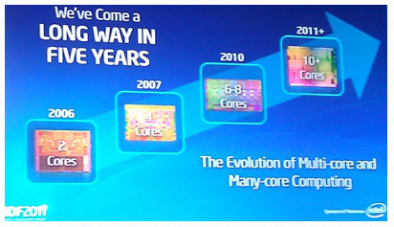
Multicores in the last Five Years
Source : Intel IDF

Slide 4
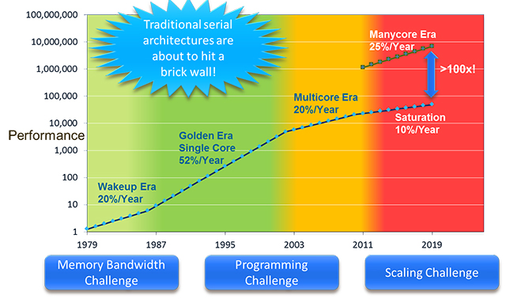
Rise and Rise of Multicore Processors
According to Moore’s Law, the number of cores are doubling each year.
Source: extremetech.com

Slide 5
Future of Multicores
Cores doubling every two years
16 cores by 2014
32 cores by 2016
64 cores by 2018
Increasing number of threads per core
Intel processors – 2 threads (hyperthreading mode)
IBM Power 7 – upto 4 threads per core

Slide 6


Main Challenges
Programming and Scaling
How to design a system that scales to hundreds of cores?
How to program it effectively?
Scaling
Programming
Computer Architects are working on it …
We need to work on it …

Slide 7
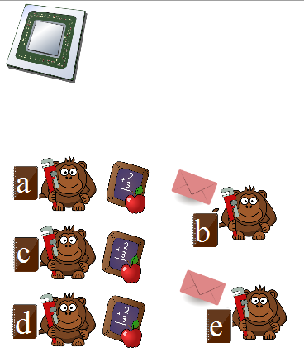
Leveraging Multicore Processors
Suitable for only desktop applications
Each core does a separate job → email, editor, music player, video player

Slide 8
What about Enterprise/ Scientific Applications?
Need support for parallel programming
Traditional Methods
Lock based
Non-traditional methods
Non-blocking methods (lock free/ wait free)
Transactional Memory
Software
Hardware

Slide 9
Outline
Multicore Processors
Parallel Programming Paradigms
Transactional Memory: Basics
Software Transactional Memory(STM)
Hardware Transactional Memory
Slot Scheduler using STM

Slide 10

Conventional Lock-Based Programming
val = account.balance;
newval = val + 100;
account.balance = newval
Can this code be executed in parallel by multiple threads?

Slide 11
What is the problem?
val = account.balance;
newval = val + 100;
account.balance = newval
100
100
val = account.balance;
newval = val + 100;
account.balance = newval
200
200
200
200
We need to clearly order one computation before the other
Otherwise, the result will be incorrect

Slide 12

Solution: Use Locks
lock();
val = account.balance;
newval = val + 100;
account.balance = newval;
unlock();
Problems with Locks
Does not allow disjoint access parallelism

Slide 13

What is disjoint access parallelism?
Allows code from different threads to run in parallel if they do not
access the same data.

Slide 14
Other problems with locks
In a typical UNIX futex based implementation
If a thread cannot get a lock for 100 µs, it invokes the kernel and goes to sleep
System calls have an additional overhead
They lead to OS jitter, which can be as high as tens of milliseconds
[Sarangi and Kallurkar] → OS jitter slows down parallel applications by more than 10%

Slide 15
How to get rid of locks?
Use the HW instruction
CAS (atomic compare and set)
Example:
CAS a, 10, 5
5
a

Slide 16
Lock free Algorithm
while(true) {
<val, ts> = account.balance;
newval = val + 100;
newts = ts + 1;
if (CAS (account.balance, <val,ts>, <newval,newts>) )
break;
}
account.balance
value
timestamp

Slide 17
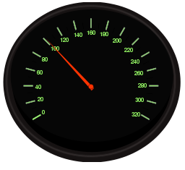


Issues with the Lockfree Algorithm
The loop might never terminate
Can lead to starvation
There are two metrics that we need to optimize
balance
speed

Slide 18

How to increase the balance?
Wait free algorithms
Basic Idea
A request, T, first finds another request, R, that is waiting for a long time
T decides to help R
This strategy ensures that no request is left behind
Also known as an altruistic algorithm

Slide 19
Support Required
dcas (double CAS) instruction
dcas(a, v1, v2, b, v3, v4)
Atomic
if ((a = v1), and (b = v3))
set a = v2
set b = v4

Slide 20
Implementation of a Wait Free Algorithm
repeat until (R = null)
R = needsHelp();
if (R != null) help (R);
help (T)
help(T)
while(true) {
<val, ts> = T.account.balance;
newval = val + 100;
newts = ts + 1;
if (dcas (T.account.balance, <val,ts>, <newval,newts>, T.status, 0, 1) )
break;
if(T.status == 1) break;
}

Slide 21
Issues in implementing a wait free algorithm
The dcas instruction is not available on most machines
Possible to implement it with regular cas instructions
Wait free algorithms are thus very complicated
balance
speed

Slide 22
Implementing a wait free algorithm is the same as …
A black belt in programming

Slide 23
Outline
Multicore Processors
Parallel Programming Paradigms
Transactional Memory: Basics
Software Transactional Memory(STM)
Hardware Transactional Memory
Slot Scheduler using STM

Slide 24

Transactional Memory (TM)
What is the best way to achieve both speed and balance?
Try transactional memory:
begin(atomic) {
val = account.balance;
newval = val + 100;
account.balance = newval;
}

Slide 25
Advantages
Easy to program
Tries to provide the optimal balance and speed
Similar to database transactions
ACID → (atomic, consistent, isolated, durable)
Hardware TM
Software TM

Slide 26
Basics of Transactional Memory
Notion of a conflict
Two transactions conflict, when there is a possibility of an error, if they execute in parallel
Formally:
read set
write set
set of variables that are
read by the transaction
set of variables that are
written by the transaction

Slide 27
When do transactions conflict?
Let R_{i} and W_{i}, be the read and write sets of transaction, i
Similarly, let R_{j} and W_{j} be the read and write sets of transaction, j
There is a conflict iff:
W_{i} ∩ W_{j} ≠ φ
W_{i} ∩ R_{j} ≠ φ
OR
R_{i} ∩ W_{j} ≠ φ

Slide 28


Abort and Commit
Commit
A transaction completed without any conflicts
Finished writing its data to main memory
Abort
A transaction could not complete
due to conflicts
Did not make any of its writes visible

Slide 29
Basics of Concurrency Control
A conflict occurs when the read-write sets overlap
A conflict is detected when the TM system
becomes aware of it
A conflict is resolved when the TM system either
delays a transaction
aborts it
occurrence
detection
resolution

Slide 30
Pessimistic vs Optimistic Concurrency Control
occurrence,
detection,
resolution
pessimistic
concurrency
control
detection
resolution
occurrence
optimistic
concurrency
control

Slide 31
Version Management
Eager version management
Write directly to memory
Maintain an undo log
Lazy version management
Write to a buffer (redo log)
Transfer the buffer to memory on a commit
commit
flush undo log
abort
writeback undo log
commit
writeback
redo log
abort
flush redo log

Slide 32


Conflict Detection
Eager
Check for conflicts as soon as a transaction accesses a memory location
Lazy
Check at the time of
committing a transaction

Slide 33
Semantics of Transactions
Serializable
Transactions can be ordered sequentially
Strictly Serializable
The sequential ordering is consistent with the real time ordering
Linearizable
A transaction appears to execute instantaneously
Opacity
A transaction is strictly serializable with respect to non-transactional accesses also

Slide 34
What happens after an abort?
The transaction restarts and re-executes
Might wait for a random duration of time to minimize future conflicts
do {
…
…
} while (! Tx.commit())

Slide 35
Outline
Multicore Processors
Parallel Programming Pardigms
Transactional Memory: Basics
Software Transactional Memory(STM)
Hardware Transactional Memory
Slot Scheduler using STM

Slide 36
Software Transactional Memory
choices
Concurrency Control
Optimistic or Pessimistic
Version Management
Lazy or Eager
Conflict Detection
Lazy or Eager

Slide 37
Support Required
Augment every transactional object/ variable with meta data
object
Transaction that has locked the object
Read or write
object
metadata

Slide 38
Maintaining Read –Write Sets
Each transaction maintains a list of locations that it has
read in the read-set
written in the write-set
Every memory read or write operation is augmented
readTX (read, and enter in the read set)
writeTX(write, and enter in the write set, make changes to the undo/redo log)

Slide 39

Bartok STM
Every variable has the following fields
version
value
lock
value
version
Transactional Variable

Slide 40
Read Operation
Read Operation
Record the version of the variable
Add the variable to the read set
Read the value

Slide 41
Write Operation
Lock the variable
Abort if it is already locked
Add the old value to the undo log
Write the new value

Slide 42
Commit Operation
For each entry in the read set
Check if the version of the variable is still the same
Yes
No
Abort
For each entry in the write set
Increment the version
Release the lock

Slide 43


Pros and Cons
simple
does not
provide opacity
reads are simple
uses locks
provide a strong
semantics for
transactions

Slide 44
TL2 STM
Uses lazy version management → redo log
Uses a global timestamp
Provides strong guarantees with respect to other transactions, and even operations that are not within the context of a transaction
Locks variables only at commit time
Every transaction tX has a unique version (tx.V) that is assigned to it when it starts

Slide 45
Read Operation
Read Operation
read (tX, obj)
obj in the redo log
No
Yes
Return value in the redo log
v1 = obj.timestamp
result = obj.value
v2 = obj.timestamp
if( (v1 != v2) || (v1 > tX.V) || obj.lock) abort();
addToReadSet(obj);
return result;

Slide 46
Write Operation
Add entry to the redo log if required
Perform the write

Slide 47
Commit Operation
For each entry in the write set
failure
Lock object
abort
version ← globalClock + 1
For each entry e in the read set
failure
if (e.version > tx.V)
abort
writeback redo log
For each entry in the write set
set the version,
undo lock

Slide 48
Pros and Cons
simple
A redo log is slower
provides opacity
uses locks
holds locks for a
lesser amount of time

Slide 49
Outline
Multicore Processors
Parallel Programming Pardigms
Transactional Memory: Basics
Software Transactional Memory(STM)
Hardware Transactional Memory
Slot Scheduler using STM

Slide 50
Hardware Transactional Memory
pessimistic concurrency control
eager conflict detection
lazy version management
Processor
Processor
Processor
L1 Cache
L1 Cache
L1 Cache
L2 Cache

Slide 51
Basics of Hardware Transactions
Start Transaction
Write back all the modified lines in the L1 cache to the lower level
Write Operation
1. Broadcast the write to all the processors
2. If any processor has read the location, then abort
Read Operation
1. Broadcast the read to all the processors
Commit Operation
1. Convert all speculative data to non-speculative
Abort Operation
1. Convert all speculative data to invalid

Slide 52
Outline
Multicore Processors
Parallel Programming Pardigms
Transactional Memory: Basics
Software Transactional Memory(STM)
Hardware Transactional Memory
Slot Scheduler using STM

Slide 53
Slot Scheduling
How to schedule the requests
Thread _{i}
Thread _{j}
t_{i}
t₁
t₂

Slide 54
Slot Scheduling - II
T₁
Reservation System
T1
T2
T₀ T₁ T₂ T_{n-2} T_{n-1} T_{n}
T₁
T₂
Shared Resource
time

Slide 55
Slot Scheduler Design
START
@Atomic
NOT FOUND
@Atomic
MARK_TEMP
Succeed
RESERVE_ALL
@Atomic
Request Cannot be fulfilled
@Atomic
RETURN

Slide 56
Another Approach
START
@Atomic
Merge into one transaction
NOT FOUND
MARK_TEMP
@Atomic
RESERVE_ALL
@Atomic
Succeed
RESERVE_ALL
@Atomic
Request Cannot be fulfilled
@Atomic
RETURN

Slide 57
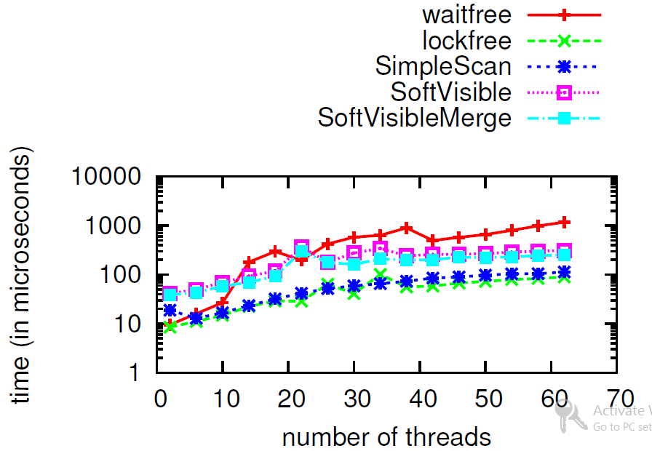
Mean time per request (t_{req})
SoftVisible is 10x faster
SimpleScan is as fast as lock-free

Slide 58
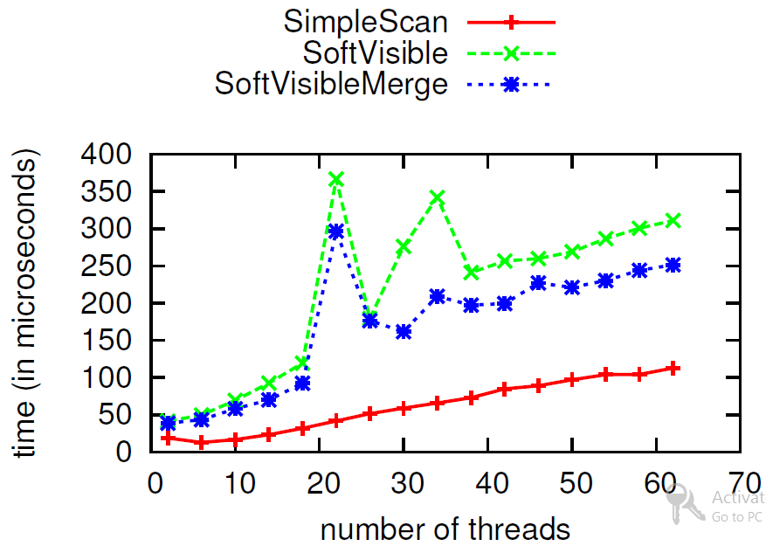
SoftVisibleMerge is 20% faster

Slide 59
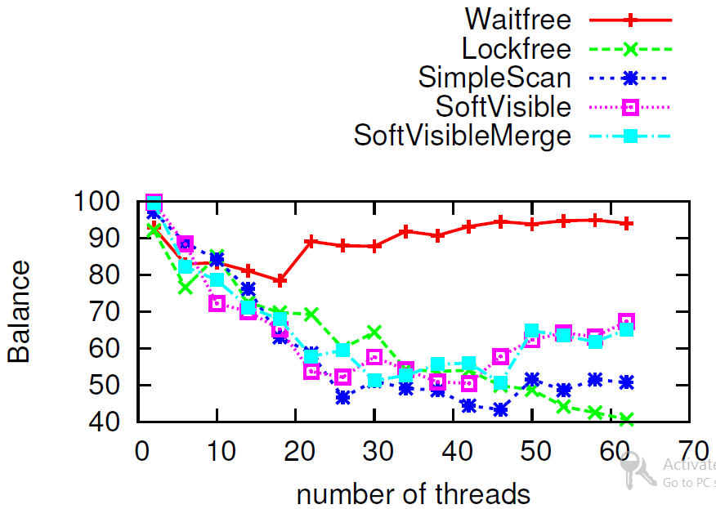
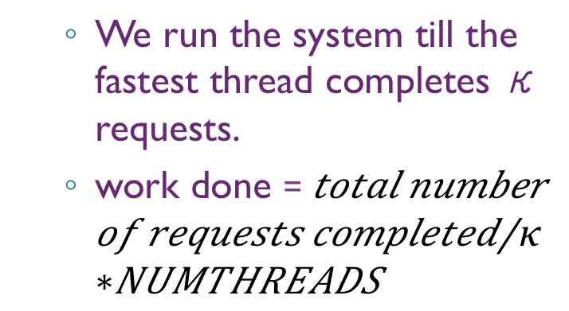
Work Done
We run the system till the fastest thread completes κ requests.
work done =
For 50+ threads SimpleScan is worse

Slide 60
Bibliography
[Bartok STM] David F. Bacon, Ravi Konuru, Chet Murthy, and Mauricio Serrano. 1998. Thin locks: featherweight synchronization for Java. SIGPLAN Not. 33, 5 (May 1998), 258-268
[TL2 STM] Dave Dice, Ori Shalev, and Nir Shavit. 2006. Transactional locking II. In Proceedings of the 20th international conference on Distributed Computing (DISC'06),
[STM] Transactional Memory (2nd Ed) Tim Harris, James Larus, and Ravi Rajwar, Morgan and Claypool, Synthesis Lectures in Computer Science

Slide 61


