Slide 1

HybMT: Hybrid Meta-Predictor based ML Algorithm for Fast Test Vector Generation
Shruti Pandey, Jayadeva and Smruti. R. Sarangi
Department of Electrical Engineering
Indian Institute of Technology Delhi
New Delhi, India
29th Asia and South Pacific Design Automation Conference (ASP-DAC) 2024
Notes:
I am Shruti Pandey from IIT Delhi, India. I am going to present my paper titled HybMT: Hybrid Meta-Predictor based ML Algorithm for Fast Test Vector Generation. This paper is done under the supervision of Prof. Jayadeva and prof. Smruti Ranjan Sarangi from IIT Delhi.

Slide 2
Outline
Introduction and Motivation
Background
Methodology
Results and Conclusion
Notes:
Here is the outline of my presentation. Let us begin with the Introduction and motivation.

Slide 3


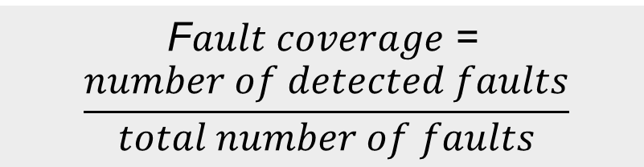
Problem Statement
Automatic Test Pattern Generation (ATPG)
algorithm
Circuit
Test vectors
Fault list
F$ault coverage$ =
$$\frac{number of detected faults}{total number of faults}$$
Fault
coverage
ATPG
runtime
Equivalent to the SAT problem
NP-complete
Notes:
Here is a quick introduction to the terms used in our work
There are two important points to be noted. ATPG in its simplest form is equivalent to the SAT (circuit-satisfiability) problem where we need to find the primary inputs (PIs) that set the value of a certain net to 0 or 1.and hence is an NP-complete problem.
An automatic test pattern generation algorithm takes the circuit and the fault list as inputs and gives the test vectors as the output
The efficiency of an ATPG algorithm is measured in terms of its fault coverage and its runtime.
Where fault coverage is defined as the ratio of the number of detected faults to that of the total number of faults
There is a trade-off between coverage and the speed of test vector generation.
Our work Minimizes the test vector generation time using machine learning subject to sufficient fault coverage.

Slide 4


Problem Statement
NP-complete
Use traditional heuristics
Faster
Excellent decision-making
More accurate
Machine Learning
Minimize the test vector generation time using ML subject to sufficient fault coverage.
Notes:
Now, Given that ATPG is an NP-complete problem and hence over the years a lot of heuristics have been developed for efficient test generation.
But recently machine learning based algorithms have shown promising results in the field of test generation.
Moreover, ML techniques are faster and more accurate than human experience-based problem solving
and have Proven their efficacy in decision-making and design-space exploration,
hence our work proposes an ML algorithm to minimize the test vector generation time subject to sufficient fault coverage.

Slide 5

Pitfalls of Prior Work
Have not moved beyond the 4-decade old ISCAS ’85 benchmarks.
No comparisons with the commercial tools.
No work demonstrated consistent improvement across all the benchmark circuits.
Notes:
Now let us see the pitfalls of the prior work.
We have focused on ML-based ATPG algorithms that target stuck-at faults in combinational circuits.
None of the prior work have moved beyond the 4-decade old ISCAS ’85 and the ITC’99 benchmarks for test generation.
There are no comparisons with the commercial tools.
And further No work demonstrates consistent improvement across all the benchmark circuits.

Slide 6



HybMT Overcomes these Pitfalls
Generates test inputs for recently released benchmark circuits that are up to 70× larger than the ISCAS’85 circuits.
Outperforms a popular commercial ATPG tool
Shows a consistent speedup across all the benchmark circuits.
Notes:
Our proposed HybMT algorithm overcomes these pitfalls in the following ways:
HybMT Generates test inputs for recently released benchmark circuits that are up to 70× larger than the ISCAS’85 circuits.
It shows a consistent speedup across all the benchmark circuits.

Slide 7
Outline
Introduction and Motivation
Background
Methodology
Results and Conclusion
Notes:
Now, Let us go through the background.

Slide 8
Fundamentals of Generating a Test
Fault-oriented ATPG for single stuck-at-faults (SSFs)
Generating a test for a fault s-a-v at net ‘l’,
1. Fault Activation:
To activate (excite) the fault.
2. Fault Propagation:
To propagate the fault to a primary output (PO).
Activating the fault means setting primary input (PI) values that cause net ‘l’ to have value $\overline{v}.$
Activating the fault means setting primary input (PI) values that cause net ‘l’ to have value ¯𝒗.
Notes:
First, we will see the Fundamentals of Generating a Test. We are focusing on Fault-oriented ATPG for single stuck-at-faults (SSFs).
Generating a test for a fault s-a-v at line ‘l’, where v can be 1/0, involves two fundamental steps
First is
Activating the fault means setting primary input (PI) values that cause net ‘l’
to have a value opposite to that of the fault.
And second is

Slide 9
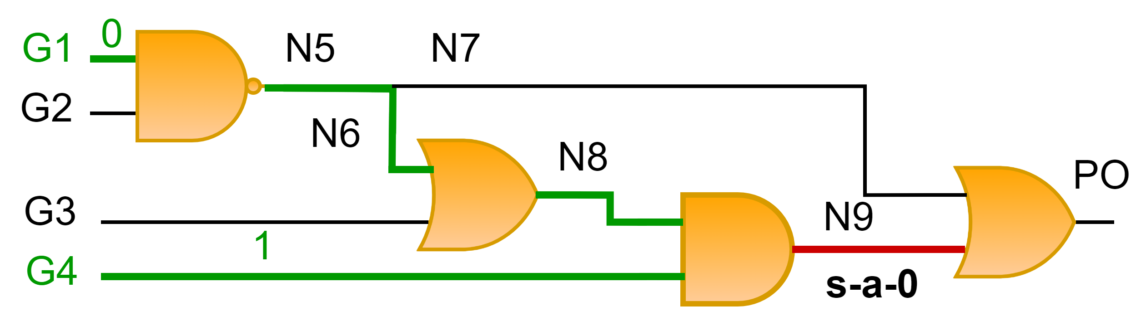
PODEM: Path Oriented Decision Making
1. Backtrace path: G4
2. Backtrace path: N8,N6,N5,G1
Objective to set 1 at N9
Notes:
Here, I will discuss the ATPG algorithm used in our work: PODEM. PODEM stands for Path Oriented Decision Making.
Let us understand the key procedures of PODEM through an example
We have a small circuit with the net N9 being stuck-at-0.
PODEM’s first objective will be to set 1 at N9 to activate the fault
To achieve this objective, it will trace backwards till the PI and make an assignment at the PI. This is termed as backtrace.
We backtrace from N9 to G4 and assign a 1.
Next we backtrace from N9, N8,N6,N5 to G1 and assign a 0.

Slide 10
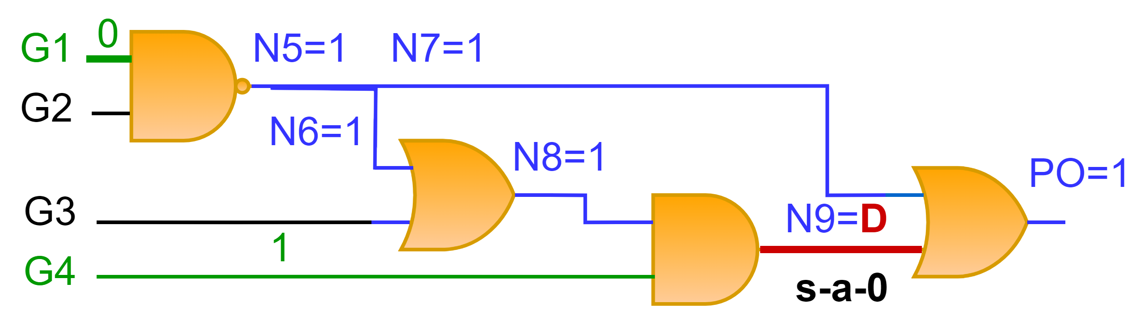

PODEM: Path Oriented Decision Making
A value of 0 at G1 implies 1 at N5,N6,N7,N8,PO and a D at N9
Fault cannot be
propagated to the PO
The symbol D denotes a composite value of 1/0 for the same net in good/faulty circuits.
Objective (N9,1) met
Notes:
Next we perform the implication procedure. Implication refers to computing values at all the nets due to a PI assignment
For example, A value of 0 at G1 implies 1 at N5,N6,N7,N8,PO and a D at N9, where the symbol D denotes a composite value of 1/0 for the same net in the good and the faulty circuit respectively.
Our objective of setting 1 at N9 is met but the Fault cannot be propagated to the PO.

Slide 11
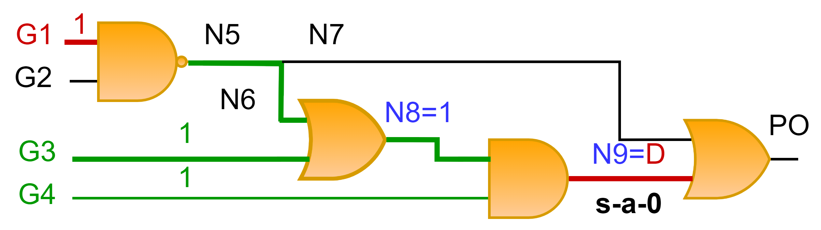
PODEM: Path Oriented Decision Making
We need to reverse our previous decision of setting 0 at G1.
Backtrack
Next, we backtrace till G3 through N8 and
assign it to 1. Implication N8=1 and N9=D.
New objective (N7,0)
Make decisions such that number of backtracks is minimized.
Notes:
Thus from this example it is clear that bad decisions while backtrace may lead to wasted work. Hence we Make decisions such that number of backtracks is minimized.
Hence we need to reverse our previous decision of setting 0 at G1.
This process of reversing previous decisions due to conflicts is termed as backtrack. Note that backtrace and backtrack are two different procedures.
PODEM keeps performing these key procedures until the activated fault is observed at the PO.
For example, setting G1 to 1 does not imply anything at NAND gate’s output, so we will backtrace through a new path from N9 to N8 till G3, and assign a 1, which implies a 1 at N8 and a D at N9.
Now the fault at N9 can be propagated to the PO only if the other input of the OR gate is not 1. PODEM will move to a new objective of setting N7 to 0.

Slide 12
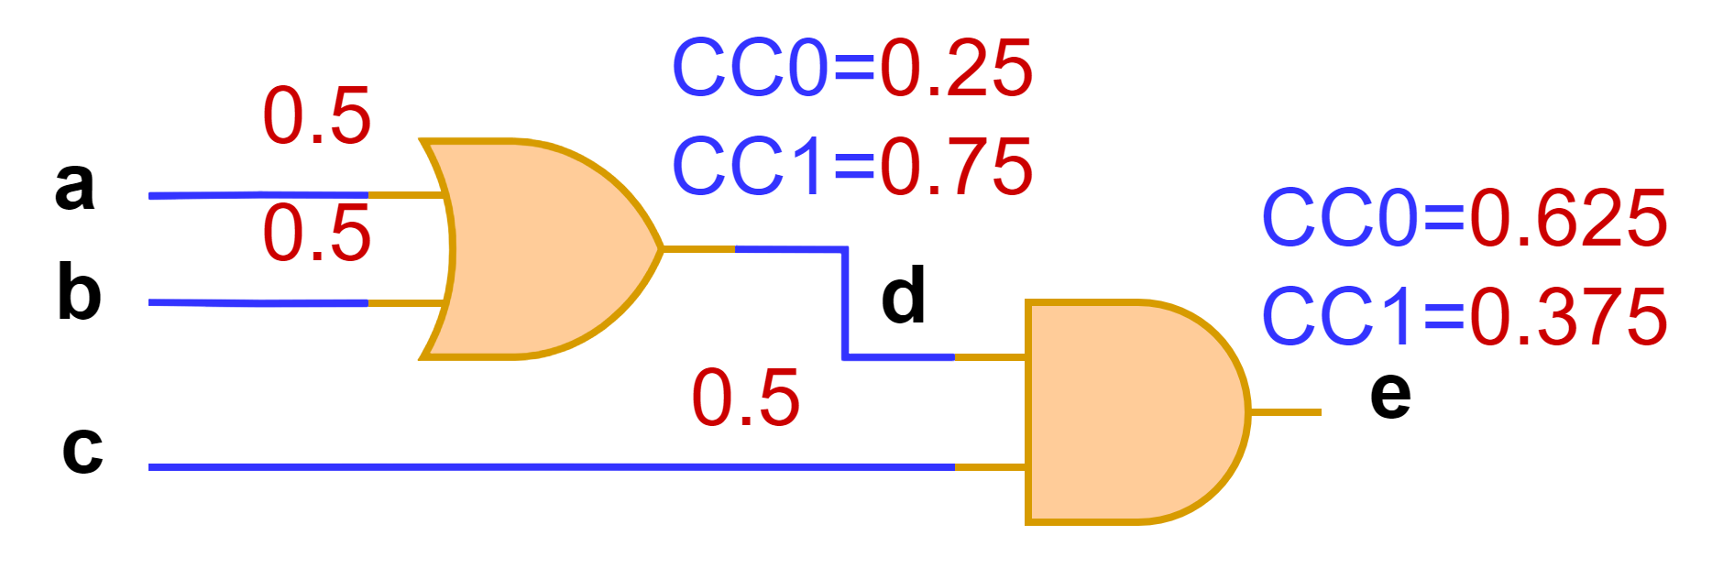

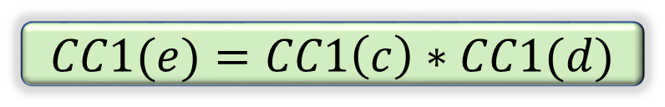
Controllability
The probability of setting a net to 0 or 1 by making random PI assignments
$$CC\left(x\right)$$
$$CC1(e)=CC1\left(c\right)∗CC1(d)$$
Notes:
Let us now discuss two important measures of testability. First one is controllability. Controllability is defined as The probability of setting a net to 0 or 1 by making random PI assignments.
We denote the combinational controllability of a net as CC(x).
We assign CC values of all the Pis to 0.5. And then compute the CC values of other nets using the truth tables of the gates.
Suppose we want to set a 1 at the output net ‘e’ of the circuit, we have to set c and d as 1. Hence CC1 of e is equal to the product of the CC1 at c and CC1 at d. we compute the CC0 in a similar manner using the gate’s truth table.

Slide 13
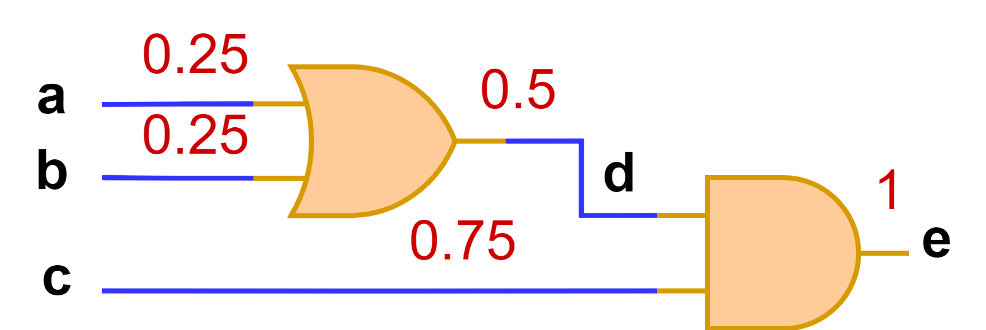
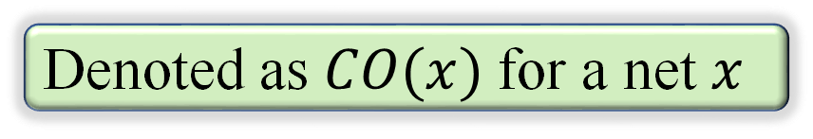
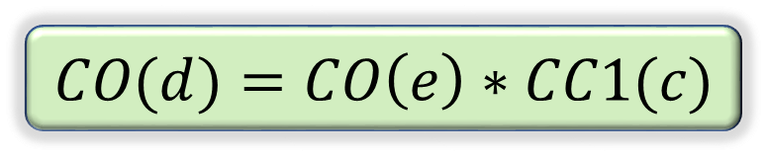
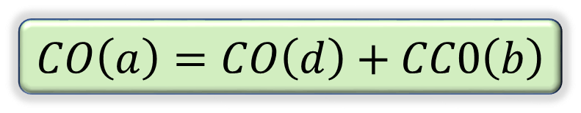
Observability
The probability of propagating the value at a net to a primary output (PO).
Denoted as $CO(x)$ for a net $x$
$$CO(d)=CO\left(e\right)∗CC1(c)$$
$$CO\left(a\right)=CO\left(d\right)+CC0\left(b\right)$$
Notes:
Observability is defined as the probability of propagating the value at a net to a primary output (PO). It is denoted as $CO(x)$ for a net $x$.
The figure shows the observability of all the nets of the circuit.
We assign CO value of 1 at the PO as it is always observable. Then we traverse backwards to compute the CO values of other nets.
For example a value at net d is observable at the PO only if the other input of the AND gate is 1.
To compute the CO value of a net. To propagate the value at line a to the PO y, we should apply a non-controlling value at the input line b.
The CO value of line a is the product of the CO value of line y and the CC value of line b.

Slide 14
Outline
Introduction and Motivation
Background
Methodology
Results and Conclusion

Slide 15

Data Generation: Labels of a Net
Conflict: Fault cannot be propagated
If PI assignment leads to a conflict ground truth label for the nets in the backtrace path is 0 else 1
Notes:
First we generated the dataset for training ML models. The figure shows a scenario of a conflict in a circuit with a s-a-0 fault at net N9. When we set G1 to 0, it implies a value of 1 at the PO and hence we cannot propagate the fault to the PO.

Slide 16


Data Generation: No-backtrack Probability
A circuit net occurs several times while running PODEM.
Its input features remain the same,
But the ground truth label keeps changing.
Probability of no-backtrack
$$\frac{\text{(}\text{\#} \text{ground} \text{truth} \text{label} \text{for} \text{circuit} \text{net}\text{ ′}\text{l}\text{′ }\text{is}\text{ 1}\text{)}}{\text{(}\text{frequency} \text{of} \text{occurrence} \text{of} \text{circuit} \text{net}\text{ ′}\text{l}\text{′}\text{)}}$$
Notes:
Next I will talk about the no-backtrack probability that we use as a backtrace heuristic in PODEM.

Slide 17
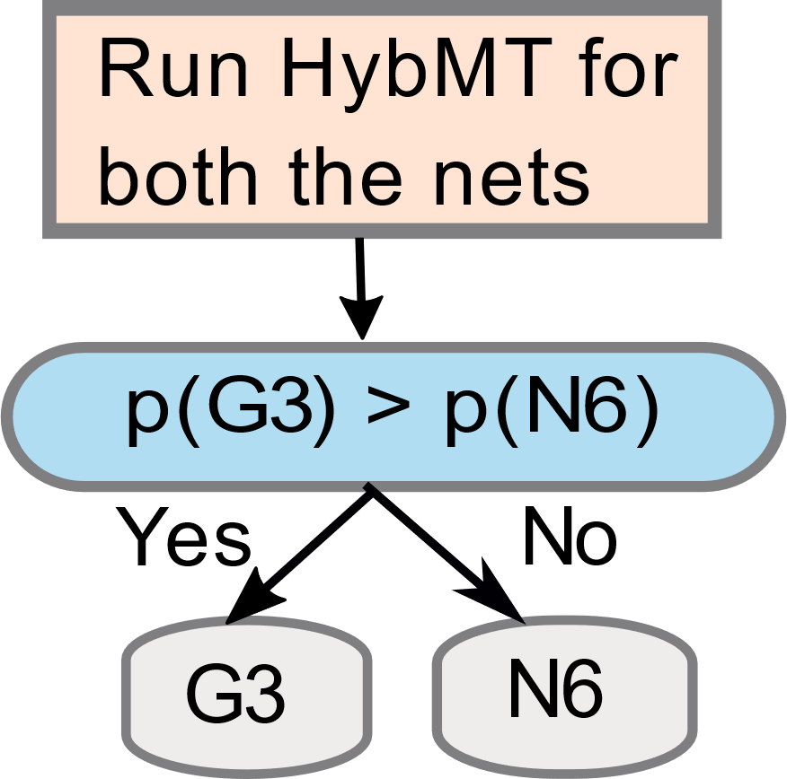
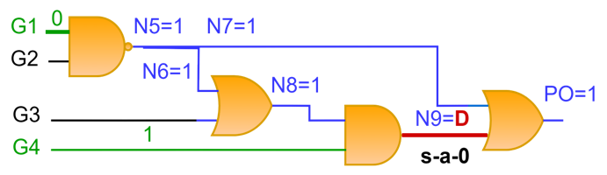
HybMT based PODEM
Choose the net with a higher probability of no-backtrack
Notes:
Let us first discuss the basic idea behind HybMT based PODEM. Our example circuit shows that we need to choose from N6 and G3 while backtracing in PODEM.
WE run hybmt for both G3 and N6 to get the probability of no-backtrack. HybMT will choose G3 (having a greater probability of no-backtrack), saving all the wasted work due to choosing N6.

Slide 18
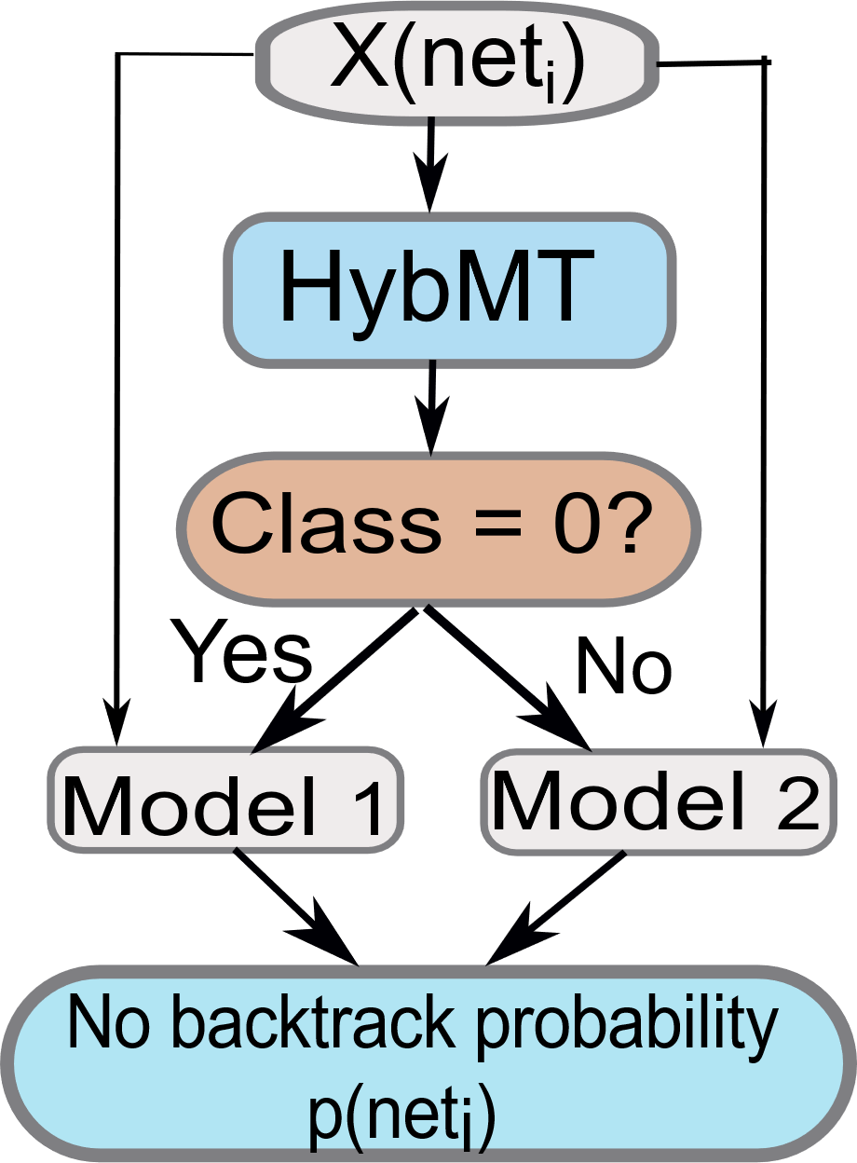
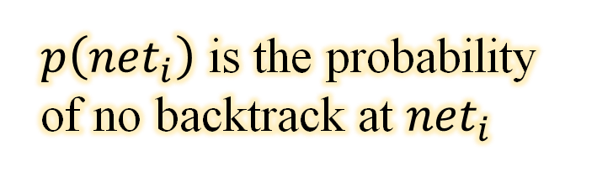
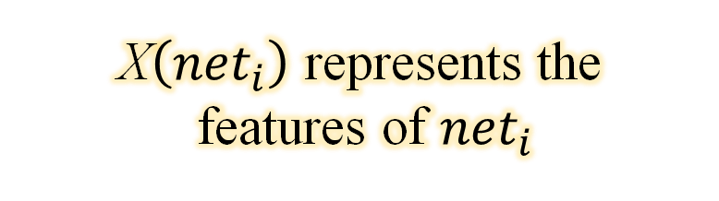
Working of HybMT
X$\left({net}_{i}\right)$ represents the
features of ${net}_{i}$
Level 1
Ensemble learning based meta predictor
$p\left({net}_{i}\right)$ is the probability
of no backtrack at ${net}_{i}$
Level 2
Predicts the no-backtrack probability
Notes:
Here I will present the working of HybMT
Our proposed HybMT algorithm consists of 2 levels of predictors
The first level is a meta predictor that predicts the lower-level predictor to use for a given circuit net.
Then this lower-level predictor gives the no-backtrack probability value for a given circuit net
We use a random forest classifier (RFC) model as the meta predictor
An RFC model uses Ensemble learning as it combines the predictions of different decision tree classifiers to give a more accurate prediction than its constituent models
Extra: Two classes based on the results (HybNN and SVR)

Slide 19
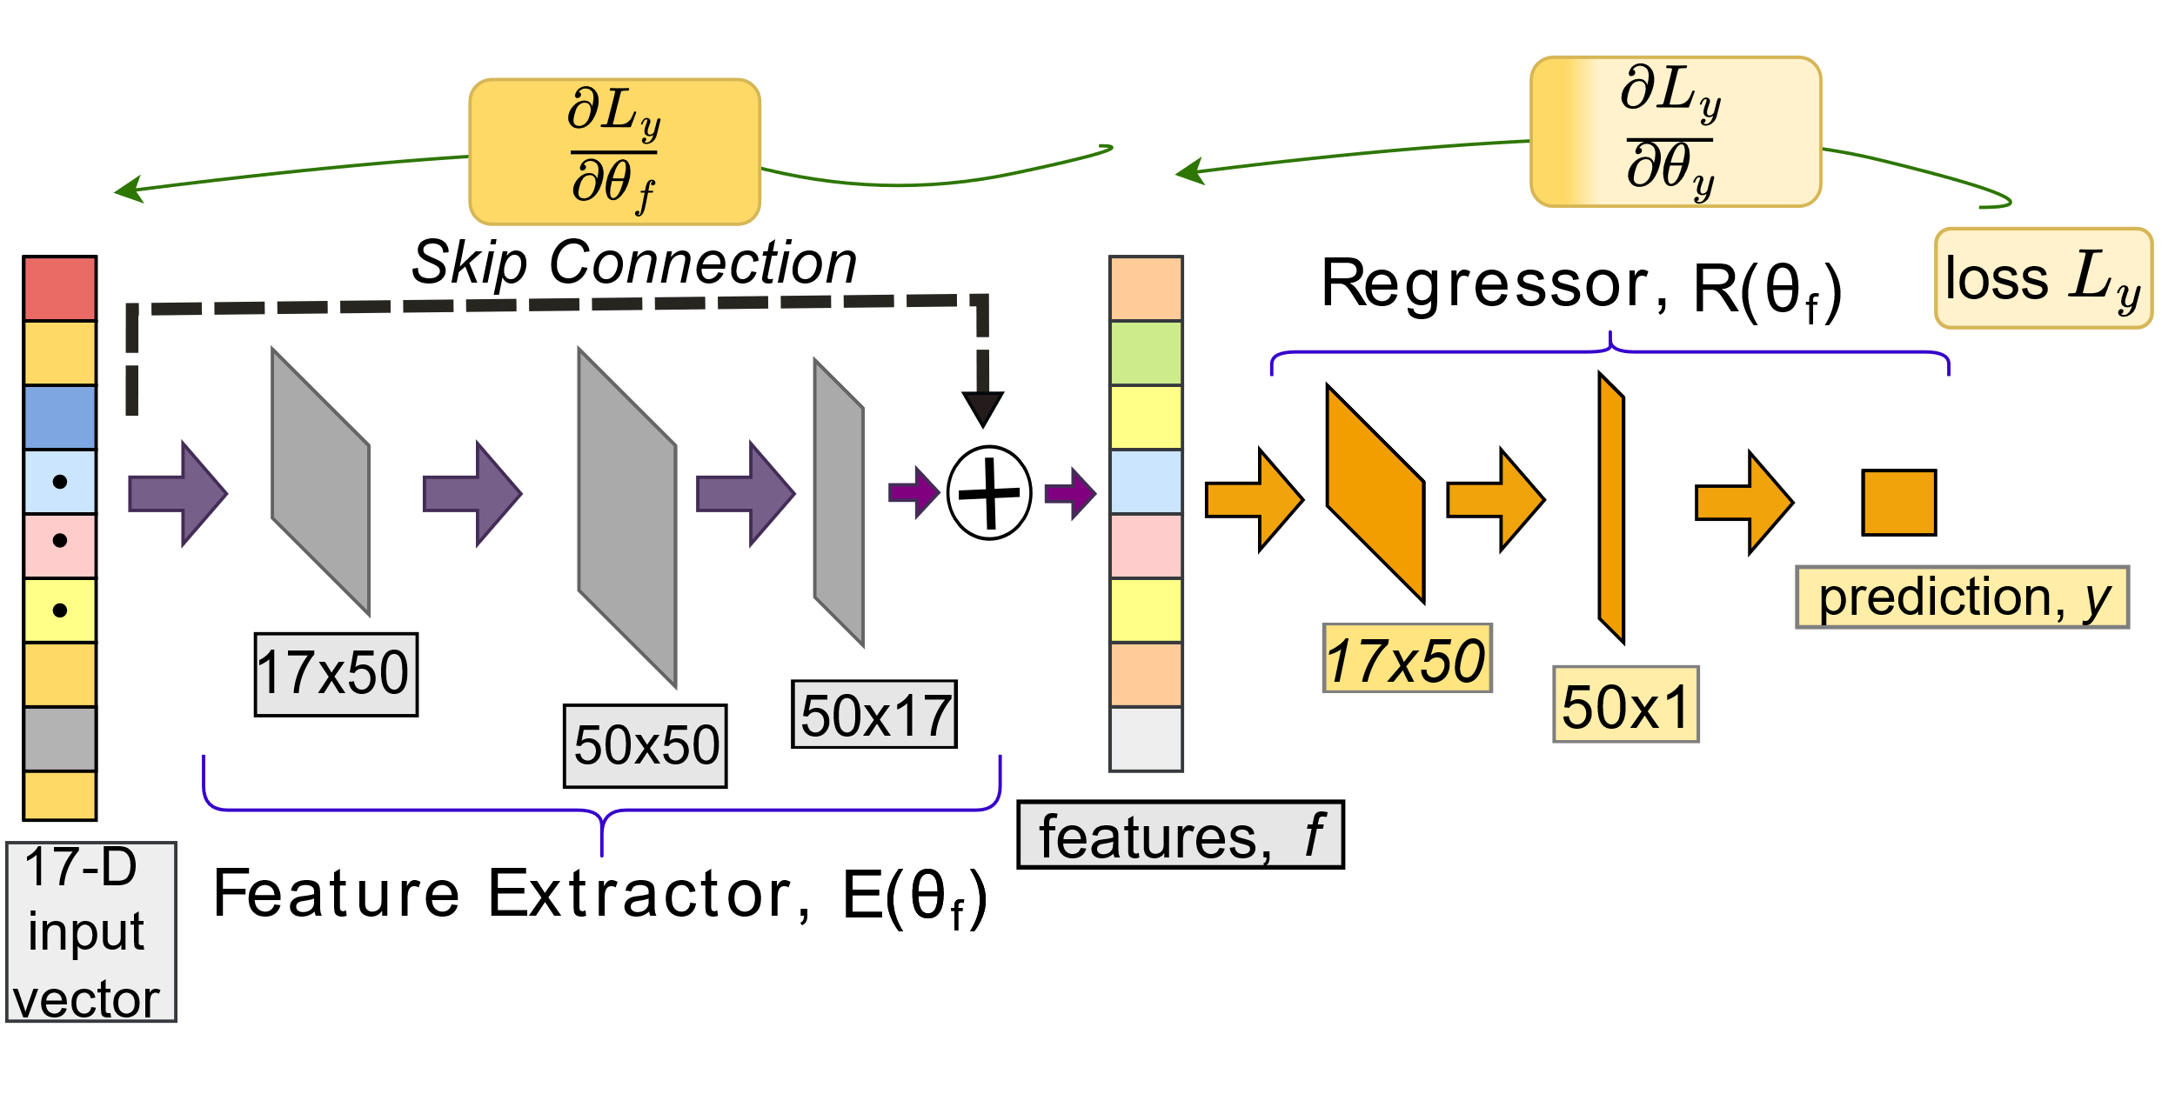
Working of HybMT: Lower-level Predictors
Architecture of HybNN
HybNN: fully connected
feed-forward neural network
Notes:
Next, I will describe our novel hybrid neural network model HybNN
HybNN: fully connected feed-forward neural network with a skip connection
It has two sub-networks: a feature extractor and a regressor.
We define a linear layer followed by rectified linear unit (ReLU, a nonlinear activation function) as a hidden layer.
The feature extractor takes the circuit net features as input and gives the most significant features at the output.
These features are given as input to the regressor to obtain the no-backtrack probability as the output.
A skip connection is used to solve
the vanishing gradient problem as it provides an alternate path
for the gradient to flow [9]. We see a significant improvement
in performance by adding a skip connection to our neural
network.

Slide 20



Features of the ML Models
SCOAP controllability*
SCOAP observability**
Fanout of the gate
HybMT
Second-level Predictor
*minimum number of PIs required to set the value of a net to a given value
COP controllability
COP observability
Shortest distance from the primary input (PI) (normalized)
Type of the gate (AND, OR etc.)
**minimum number of PI assignments that need to be
made to propagate the fault to a PO

Slide 21
Outline
Introduction and Motivation
Background
Methodology
Results and Conclusion

Slide 22
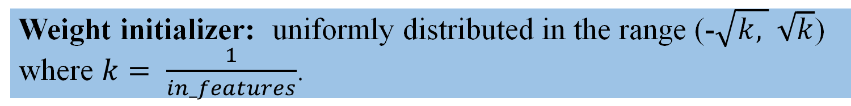
Setup
Modified the open-source ATPG framework for PODEM
obtained from Fault, a part of Google’s OpenLane project.
Loss function: Mean squared error.​
Optimizer: Adam with a learning rate of 0.01.​
Weight initializer: uniformly distributed in the range (-$\sqrt{k, }$ $\sqrt{k}$) where $k= \frac{1}{in_features}$.

Slide 23


Results: EPFL Benchmark Circuits
ATPG CPU time reduction of 126.4% over the best ML-based ATPG algorithm
Fault Coverage
ATPG CPU time reduction of 56.6% over a popular commercial tool

Slide 24
First to beat a commercial tool !!
Results: CPU Time and Fault Coverage
EPFL Benchmark Circuits | CPU Time (in ms) |  |  | Fault Coverage (in %)
 | Commercial ATPG Tool | Baseline | HybMT | Commercial ATPG Tool | Baseline | HybMT
Adder | 190 | 2,891 | 180 | 100 | 100 | 100
Barrel-shifter | 340 | 50 | 56 | 100 | 100 | 100
Max | 950 | 44 | 780 | 100 | 100 | 100
Multiplier | 2,510 | 2,545 | 2,200 | 100 | 100 | 100
Sine | 790 | 3,25,340 | 708 | 97 | 74 | 97
Square | 1,870 | 647 | 800 | 98 | 98 | 98
Notes:
The table shows The CPU time and fault coverage for the EPFL benchmark.
The EPFL benchmark is the most recent benchmark and has circuits 100 times larger than the ISCAS’85 circuits.
We compare our proposed HybMT algorithm with a popular commercial tool and the baseline (state-of-the-art ML based approach).
We observe that HYbMT gives better or comparable fault coverage and is faster for most of the circuits

Slide 25
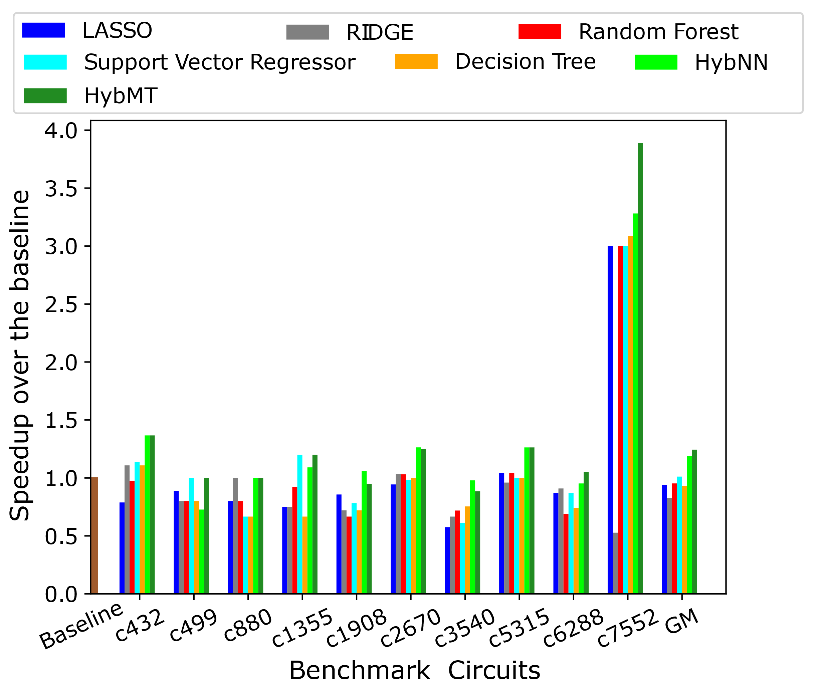
Results
Speedup for
ISCAS’85 circuits
High fault coverage (> 90%)
HybMT shows a speedup of 24.4%
HybNN shows a speedup of 18.8%
Notes:
Let us discuss the results now
we show the speedup obtained by our proposed algorithm over the baseline for the 100 hard-to-detect faults of the ISCAS’85 circuits
Baseline is the recent state of the art work that uses ML to obtain speedup in test generation
The x axis of the graph represents the Benchmark circuits.
The y axis represents the Speedup obtained that is the ratio of the CPU time taken by the baseline to that taken by HybMT
We obtained a high fault coverage (>90%) for all the circuits
The results show that HybMT obtains a speedup of 24.4% over the baseline
Among the 2nd-level predictors our proposed HybNN performs the best. It shows a speedup of 18.8% over the baseline

Slide 26
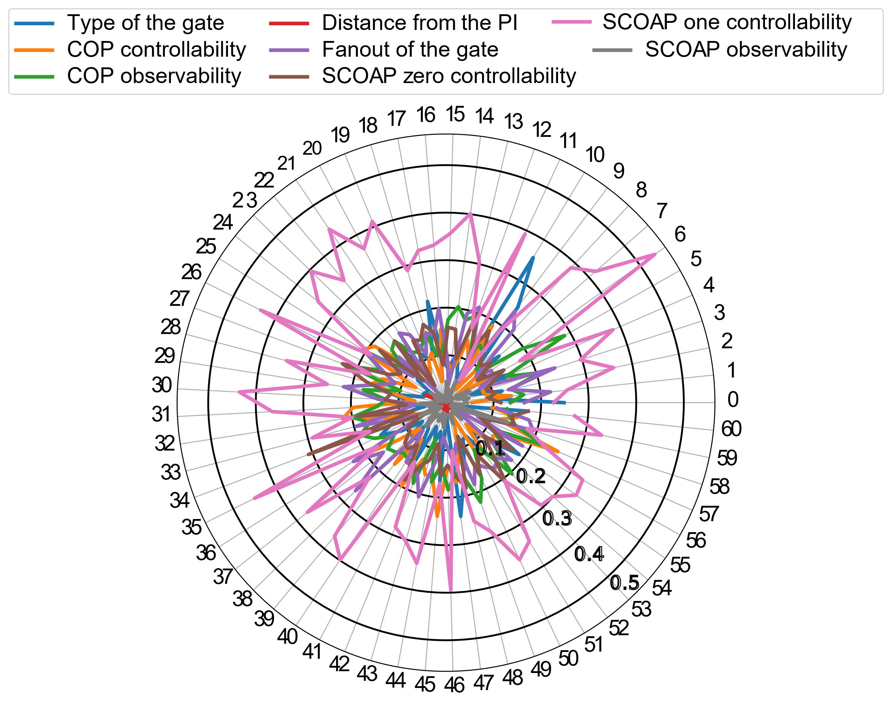

Results
SCOAP one controlability is the most important feature of all.
The character of a net is primarily determined by the minimum number of PIs that can control it.
Notes:
The radar plot shows the importance of each feature in the decision making process of the ensemble-based meta predictor
The angular-axis represents the decision trees of the meta predictor model, and the radial-axis represents the number of times a feature is used to split a decision tree node, weighted by the number of samples it split
s.

Slide 27



Conclusion
A two-level predictor HybMT for key decision making in PODEM.
Reduces PODEM’s CPU time without sacrificing on fault coverage.
Obtains a speedup of 56.6% and 126.4% over the commercial tool and the state-of–the–art approach respectively.
Properly designed neural networks like HybNN are better candidates for guiding backtracing.

Slide 28


THANK YOU
Contact:
shruti.pandey@ee.iitd.ac.in
Questions
This work was funded in part by the Semiconductor Research Corporation (SRC).

