Slide 1

SecureLease: Maintaining Execution Control In The Wild Using Intel SGX
Sandeep Kumar#, Abhisek Panda*, Smruti R. Sarangi*
# School of Information Technology, IIT Delhi, India
* Computer Science and Engineering, IIT Delhi, India
23rd ACM/IFIP International Middleware Conference
Presented by: Sandeep Kumar
Notes:
Hello. I am Sandeep Kumar, a Ph.D. student at IIT Delhi. Today I will be talking about our work SecueLease, which is about maintaining control over the executions of an application on remote machines.

Slide 2
Outline
Problem Statement
Prior work & Motivation
Design of SecureLease
Results
Conclusion
Notes:
Here is an outline of the talk. We will start with the problem statement, followed by a discussion on the prior work and motivation for the current work. We will then discuss the design of the SecureLeaseAfter that, we will discuss some results, followed by a conclusion.

Slide 3
Outline
Problem Statement
Prior work & Motivation
Design of SecureLease
Results
Conclusion

Slide 4





Setup
Access controlled functionalities.
Plugins developed by different developers
License Managers
Plugins
Do not trust each other.
Protected by a license manager.
Access after purchase or on Trial-basis
Developer
Software
Notes:
Modern softwares follow a trend where most applications are given as freeware to users with certain premium features. Users have to pay an additional amount to unlock those features.
Apart from these so-called premium features, a new model is also emerging where third-party developers can release plugins for applications that provide an additional feature for the software. These plugins can be released completely free, with a paid feature, or a more popular way is to allow trial phases - either limited by the number of times users can use the plugin or by the time duration.
The key point here is that the plugins are developed by different developers that may not trust each other or even the main application. Hence, they employ a license manager to control access to their plugin.

Slide 5
Protecting Intellectual property (IP)
Pre-Authentication
Valid license
Initialization
phase
1
Authentication
Dependency
module
Execution flow
2
Protected region
Normal execution flow
Notes:
Here is a typical working of a license manager. If a user holds a valid license for an application, a license check module which we refer to as an authentication module in the paper, allows the execution to flow into the protected region of the application.

Slide 6
Breaking License Checks
Pre-Authentication
Valid license
Invalid license
Initialization
Initialization
phase
phase
1
1
Authentication
Authentication
Dependency
module
module
Execution flow
2
2
Protected region
3
ABORT
Protected region
Normal execution flow
Control flow bending attack or CFB
Notes:
In case the license is not valid, the execution is aborted. However, there is a class of attacks called control flow bending attacks that hijacks this control flow and diverts the control to the correct path. Intuitively, the decision as to whether abort or continue the execution is decided by a conditional branch statement. If the attacker can force a particular branch to be taken, irrespective of the condition, then she can potentially divert the control flow in any direction.
Please note that the method to find the correct branch statement is not a trivial problem and requires some intelligent method to find it.We were able to bypass the security of MySQL using this method. Due to time constraints, we will not be discussing it here. The details are in the paper.

Slide 7


Problem Statement:
Untrusted User
10 Trial executions
Developer
Software
User
Executing
Need more executions
After 10 executions
Please buy
Control-Flow Bending Attack
Notes:
Here is a typical scenario where a CFB attack can be used to break the licensing guarantees in an application and gain unrestricted use of an access-controlled feature to a paid plugin.
The developer releases an access-controlled feature in a trial mode where the users are allowed to access the feature ten times before it gets locked, and the user has to pay for it.
However, as the user has access to the complete code, only its execution is denied; she can mount a CFB attack and break the security of the license manager, and use the feature without any restriction, causing the developer to lose revenue.

Slide 8
Attacks on License Checks/PlUGINS
CVE-ID: CVE-2017-12822
The vulnerability allows a remote attacker to bypass security restrictions on the target system.
CVE-ID: CVE-2022-40684
An authentication bypass vulnerability that allows an unauthenticated atttacker to perform operations on the administrative interface via specially crafted HTTP or HTTPS requests
Visual Studio Code Extensions
Vulnerabilities in extensions could be exploited to steal valuable information from developers and even compromise organizations, researchers with open-source software security. https://www.securityweek.com/vulnerabilities-visual-studio-code-extensions-expose-developers-attacks
Notes:
There are many instances where the license manager present in an application is bypassed using an attack or due to some bug in the implementation to gain access to a piece of code or vulnerabilities in the plugins, causing the leaking of sensitive data.

Slide 9
Outline
Problem Statement
Design of SecureLease
Results
Conclusion
Prior work & Motivation

Slide 10
Prior Work
S. Kumar, D. Moolchandani, T. Ono and S. R. Sarangi, “F-LaaS: A Control-flow-attack Immune License-as-a-service Model," 2019 IEEE international conference on services computing (SCC), 2019

Slide 11

Intel SGX + Remote Attestation
Intel SGX
Allows secure execution of an application on an untrusted machine.
Security guaranteed by the hardware.
Remote Attestation
Validate if an executing application has the correct code and data and has not been modified.
SGX prevents CFB attacks on the code executing within the secure region
Notes:
In our prior work, we leverage SGX to prevent CFB attacks on softwares. Intel SGX, or secure guard extension, is a trusted execution environment where the security of the application is guaranteed by the hardware.
Any tampering with the code, data, or execution flow will be detected by the hardware, and the execution will halt.
Intel SGX also has a remote attestation process where an application executing on a remote machine but on SGX can be validated, whether it has been tampered with or not. Once validated, secret keys can be sent securely to the hardware.
SGX keeps all data and code encrypted all the time - even when it is in the DRAM. In the interest of time, we will not go into the details.

Slide 12
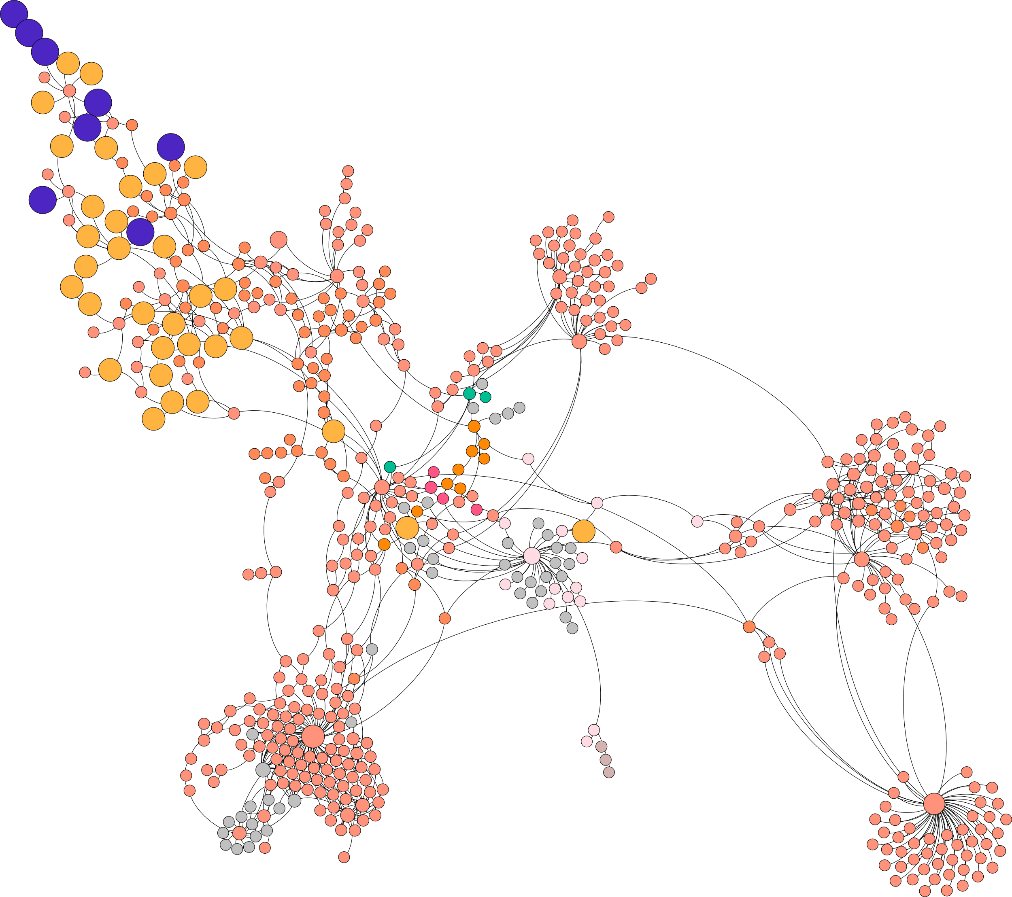
Prior Work
Protected region
Split the application into secure and unsecure regions.
Remove a small but critical piece of code.
Modern binaries contain many functions - not all need security.
Run the secure parts on Intel SGX.
Deliver the code in encrypted format after validation.
A Control Flow Graph
Notes:
In our prior work, we partitioned the access-controlled region and removed a piece of small but critical code from the application. We then deliver a handicapped version of the software to the user.
If the user attempts to bypass the license manager, she won't have access to execute a portion of it within the SGX.
The application will be patched with the removed code after a secure server validates the license using the remote attestation feature (within SGX).
The code will be delivered in an encrypted state and the user never sees the code patch in plain text. This feature is supported by SGX.

Slide 13



Prior Work
Untrusted User
10 Trial Executions
Developer
Software
User
Contact the server every time
Can I?
Yes
Can I?
Yes
Execution in SGX
Can I?
Yes
Too Slow !!!
Notes:
This setup ensures that the access-controlled region cannot be accessed without a valid key. Note that it does not prevent a CFB attack on the code that is NOT executing in SGX. It just ensures that in case of an attack, the software will not be usable.
However, there are cetains issues.
This model requires the user to contact the remote server every time using the remote attestation process.This is a very slow process and may not be suitable where an application requires very frequent access to the protected region, such as in some plugins or microservices.
Furthermore, this setup cannot work if the remote system is unreachable.

Slide 14
OuR AIM: Missing from Prior Work
High Speed
Offline Execution
Scalable
Notes:
So, in this work, our aim is to build a high-speed, secure licensing system that can also work in case of an unstable network.

Slide 15
Outline
Problem statement
Design of SecureLease
Results
Conclusion
Prior work & Motivation

Slide 16
Secure-Lease Design
S
e
c
u
r
Maintain security of the local cache?
Challenges:
How to renew leases if concurrent requests for the same license arrives?
What happens if the local machine crashes?
e
C
h
a
n
n
e
l
S
L
-
M
a
n
a
g
e
Secure remote
server
r
Secure
local
Lease
cache
S
L
A
p
p
M
5
O
S
I
N
T
E
L
S
G
X
Leasing-based solution
A single lease allows for a single execution of the protected region
Notes:
We will now discuss a high-level design of SecureLease.
We keep the base design the same but introduce a new entity that acts as a cache of the leases. A lease is a token that allows for single access.
On the first execution, the user provides the key to the SLM, which in turn sends it to the cache, the cache checks that this is the first execution. It contacts the remote server, along with the key. The remote server checks the keys and allocates some leases corresponding to the key to the contacting cache.
We discuss the distribution algorithm in the next slides.
Once the local cache is populated, it can serve the request for the same key till the leases are valid. Once the leases run out, it needs to go and contact the server again.
There are some additional challenges that must be kept in mind:
Maintain security of the cache when the machine is running and how handle graceful shutdowns and init.
How to handle current accesses for the same key from different machines.
What happens to the leases stored in the cache if the machine crashes?

Slide 17
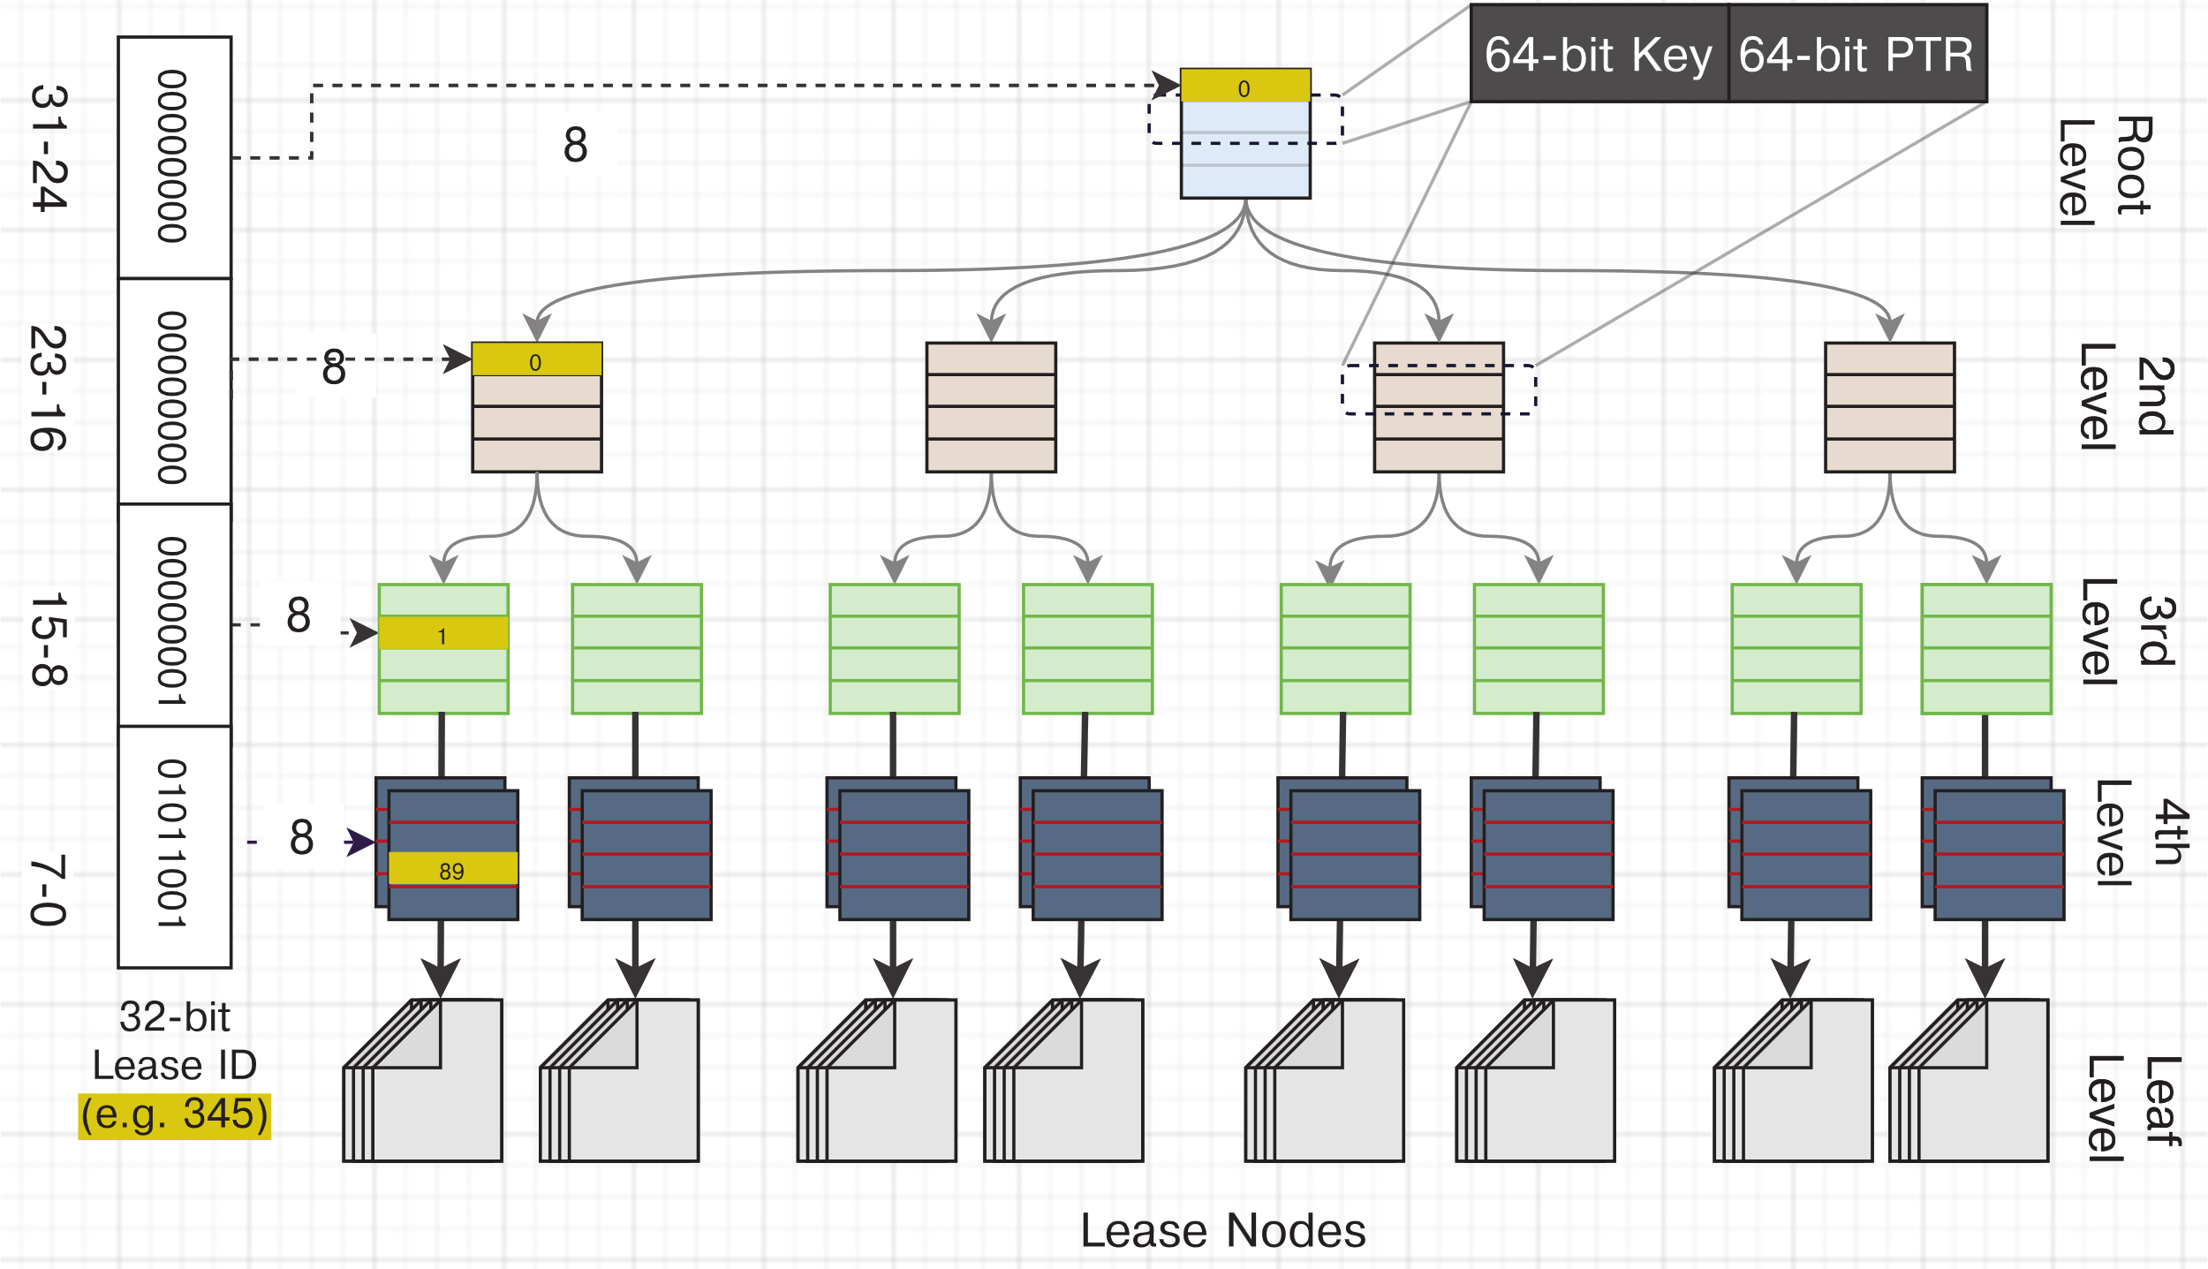
SL-Local Organization
A page-table inspired structure to store leases on a remote machine.
Efficient look up performance compared to other data structures.
Memory efficient storage.
Locality of lease use can be leveraged.
Notes:
The organization of the local cache is inspired by the structure of a page table. This allows us to give each key a unique id and then use those bits to uniquely place it in the leaves of the page table, and later on, efficient lookup of a key.Due to time constraints, we will not go into the details. At a high level, this structure allows us to perform efficient lookups. Also, in case of memory pressure, a part of the tree can be offloaded from the main memory.

Slide 18
SL-REMOTE Lease DISTRIBUTION
Unreliable network
A remote server distributes leases
Allows for parallel authenticated execution of applications
Node network connection stability: If poor, assign more leases so that it can server more requests locally.
Node health: If poor, assign fewer leases, as a crash will causes all the leases to be lost.
SL-Client 1
SL-Client 3
Trusted remote server
(SL-REMOTE)
SL-Client 2
SL-Client 4
Unreliable node
Notes:
Distributing leases also needs to be done carefully. The design allows for the concurrent use of the same key.However, how the leases corresponding to a key are to be distributed is non-trivial.Due to security reasons, if a machine crashes, all the leases on the machine are lost. This is required to prevent a rollback attack; details are in the paper.Hence, the distribution logic checks the node's health before allocating leases. If the node is unstable, it reduces the number of leases to be allocated.On the other hand, if the network is unstable, a high number of leases are allocated so that the local cache can service much more requests if the network goes down.The distribution algorithm is highly customizable and can be tweaked as per the requirement.

Slide 19
Outline
Problem statement
Design of SecureLease
Results
Conclusion
Prior work & Motivation

Slide 20
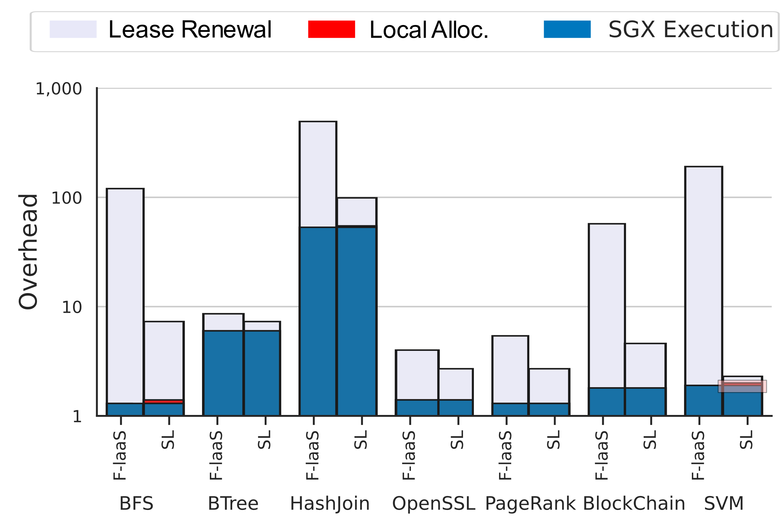

Results
Name | Setting
CPU | Core i7-10700 2.9 GHz
DRAM | 16 GB
Kernel | 5.9
SGX PRM | 128 MB
SGX SDK | 2.13
Local validation takes < 1% of the lease renewal time
S. Kumar, A. Panda and S. R. Sarangi, "SGXGauge: A Comprehensive Benchmark Suite for Intel SGX," 2022 IEEE ISPASS
Notes:
Now we will discuss some results.We evaluate SecureLease over a suite of SGX applications.We see that the total local allocation time takes less than 1% when during each lease renewal, 25% of leases are allocated.

Slide 21
Outline
Problem statement
Design of SecureLease
Results
Conclusion
Prior work & Motivation

Slide 22
Conclusion
We highlight the requirement of a secure, fast, and reliable license manager.
Our design mitigates several costly SGX operations, such as the costly remote attestation step.
We also solved issues related to the distribution and crash-consistency of license managers.
Future work:
Intel recently released TME. It eliminates several restrictions that were present in SGX. However, at the same time, it lowers the security guarantees provided by the hardware.
Notes:
To conclude:We show the requirement for a secure, fast, reliable, and scalable license manager.We propose a design that mitigates the cost of using SGX.We also propose lease distribution algorithms and how to store them efficiently on a local cache.Intel has announced TME, where the entire DRAM can be encrypted, which eliminates some restrictions of the SGX. However, it also reduces the security guarantees. It will be interesting future work to make SecureSLease compatible with the TME.Thank you.

Slide 23
Thank You!
Contact:
Sandeep Kumar: sandeep.kumar@cse.iitd.ac.in
Smruti R. Sarangi: srsarangi@cse.iitd.ac.in

