Slide 1
NanoLeak: A Fast Analytical Green’s Function-based Leakage-aware Thermal Simulator
Anjali Agrawal
Smruti R. Sarangi
IIT Delhi

Slide 2
CONTENTS
INTRODUCTION
BACKGROUND
FOURIER ANALYSIS
BTE ANALYSIS
VALIDATION RESULTS
CONCLUSION
REFERENCES

Slide 3
INTRODUCTION
Effect of leakage in today's systems
Contributes to 30-40% of total power dissipation
Exists in a positive feedback loop with temperature
Important to incorporate its effects for an accurate temperature profile
Issues with existing thermal simulators
Uses slow FEM/FDM based methods to the Green's function
To incorporate leakage, need to re-iterate several times till feedback loop convergence

Slide 4
INTRODUCTION
Fourier's heat equation fails to hold beyond 30nm
Need to solve the Boltzmann Transport Equation(BTE)
We incorporate the effects of leakage in the gray-BTE model
Nanometer scale effects in devices

Slide 5
COMPARISON OF THERMAL SIMULATORS
Simulator | Fourier | Leakage aware Fourier | BTE | Leakage aware BTE
COMSOL | ✓ | ✘ | ✘ | ✘
ThermalScope | ✓ | ✘ | ✓ | ✘
HotSpot[1] | ✓ | ✘ | ✘ | ✘
3DICE[2] | ✓ | ✘ | ✘ | ✘
NanoTherm[3] | ✓ | ✘ | ✓ | ✘
NanoLeak | ✓ | ✓ | ✓ | ✓
W. Huang, “Hotspot: a compact thermal modeling methodology for early-stage vlsi design,” IEEE TVLSI, 2006.
A. Sridhar, “3d-ice: Fast compact transient thermal modeling for 3d ics with inter-tier liquid cooling,” IEEE/ACM ICCAD, 2010.
S. Varshney, "NanoTherm: An Analytical Fourier-Boltzmann Framework for Full Chip Thermal Simulations," IEEE/ACM ICCAD, USA, 2019

Slide 6

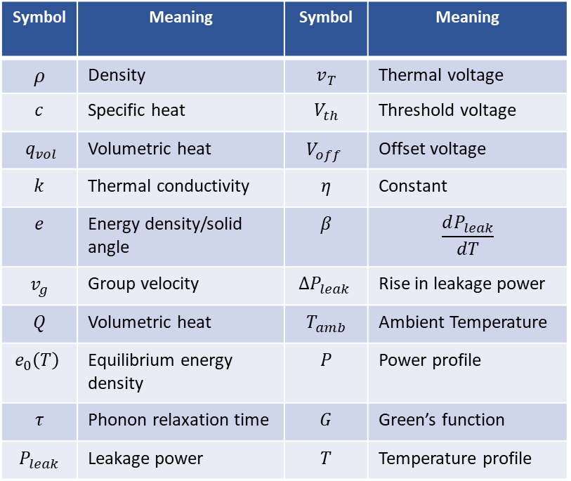

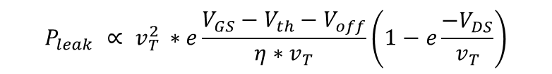

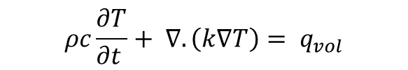
BACKGROUND
Fourier's Heat equation
Gray-BTE model
Leakage power simplified BSIM4 model
Approximated linear leakage power model
Green's function
$$ρc\frac{∂T}{∂t }+ ∇.\left(k∇T\right)= q_{vol}$$
Symbol | Meaning | Symbol | Meaning
$$ρ$$ | Density | $$v_{T}$$ | Thermal voltage
$$c$$ | Specific heat | $$V_{th}$$ | Threshold voltage
$$q_{vol}$$ | Volumetric heat | $$V_{off}$$ | Offset voltage
$$k$$ | Thermal conductivity | $$η$$ | Constant
$$e$$ | Energy density/solid angle | $$β$$ | $$\frac{dP_{leak}}{dT}$$
$$v_{g}$$ | Group velocity | $$∆P_{leak}$$ | Rise in leakage power
$$Q$$ | Volumetric heat | $$T_{amb}$$ | Ambient Temperature
$$e_{0}\left(T\right)$$ | Equilibrium energy density | $$P$$ | Power profile
$$τ$$ | Phonon relaxation time | $$G$$ | Green’s function
$$P_{leak}$$ | Leakage power | $$T$$ | Temperature profile
$$\frac{∂e}{∂t }+∇.\vec{s}v_{g}e−\frac{Q}{4π}=−\frac{e−e_{0}(T)}{T}$$
$$P_{leak} ∝ v_{T }^{2}∗e\frac{V_{GS}−V_{th}−V_{off}}{η∗v_{T}}\left(1−e\frac{−V_{DS}}{v_{T}}\right)$$
$$ΔP_{leak}= β(T−T_{amb})$$
$$T=P∗G$$

Slide 7

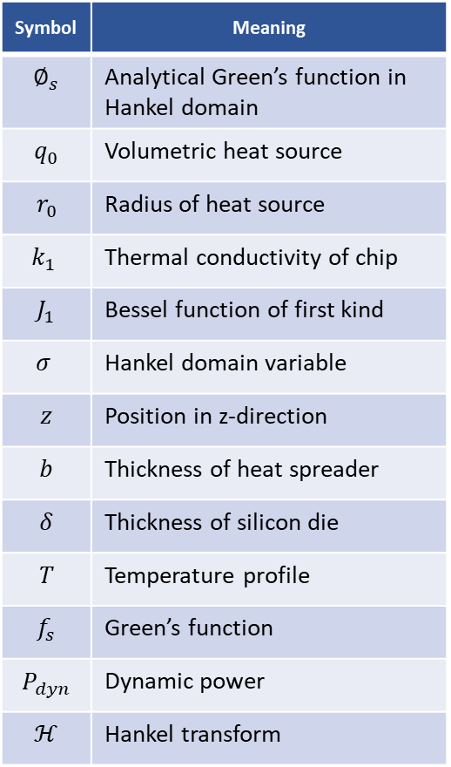



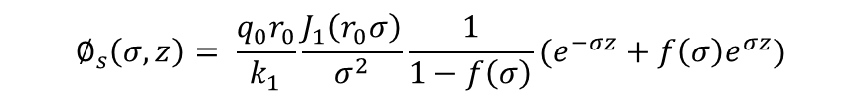
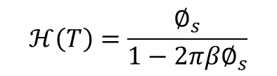
FOURIER GREEN'S FUNCTION
Symbol | Meaning
$$∅_{s}$$ | Analytical Green’s function in Hankel domain
$$q_{0}$$ | Volumetric heat source
$$r_{0}$$ | Radius of heat source
$$k_{1}$$ | Thermal conductivity of chip
$$J_{1}$$ | Bessel function of first kind
$$σ$$ | Hankel domain variable
$$z$$ | Position in z-direction
$$b$$ | Thickness of heat spreader
$$δ$$ | Thickness of silicon die
$$T$$ | Temperature profile
$$f_{s}$$ | Green’s function
$$P_{dyn}$$ | Dynamic power
$$ℋ$$ | Hankel transform
STEADY STATE
Calculated Green's function without leakage[3] is given by
Temperature profile of the chip considering leakage
Considering linear model for leakage
Hence, the equation becomes
Taking Hankel transform on both sides
Leakage aware steady state Green's function in Hankel domain
$$∅_{s}\left(σ,z\right)= \frac{q_{0}r_{0}}{k_{1}}\frac{J_{1}\left(r_{0}σ\right)}{σ^{2}}\frac{1}{1−f\left(σ\right)}(e^{−σz}+f\left(σ\right)e^{σz})$$
$$T=f_{s}∗(P_{dyn}+∆P_{leak})$$
$$∆P_{leak}= βT$$
$$T=f_{s}∗P_{dyn}+ β(f_{s}∗T)$$
$$ℋ\left(T\right)=ℋ\left(f_{s}\right)+2πβℋ(f_{s})ℋ(T)$$
$$ℋ\left(T\right)=\frac{∅_{s}}{1−2πβ∅_{s}}$$
3. S. Varshney, "NanoTherm: An Analytical Fourier-Boltzmann Framework for Full Chip Thermal Simulations," IEEE/ACM ICCAD, USA, 2019

Slide 8

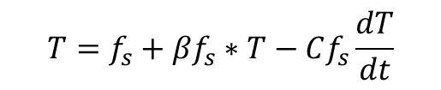

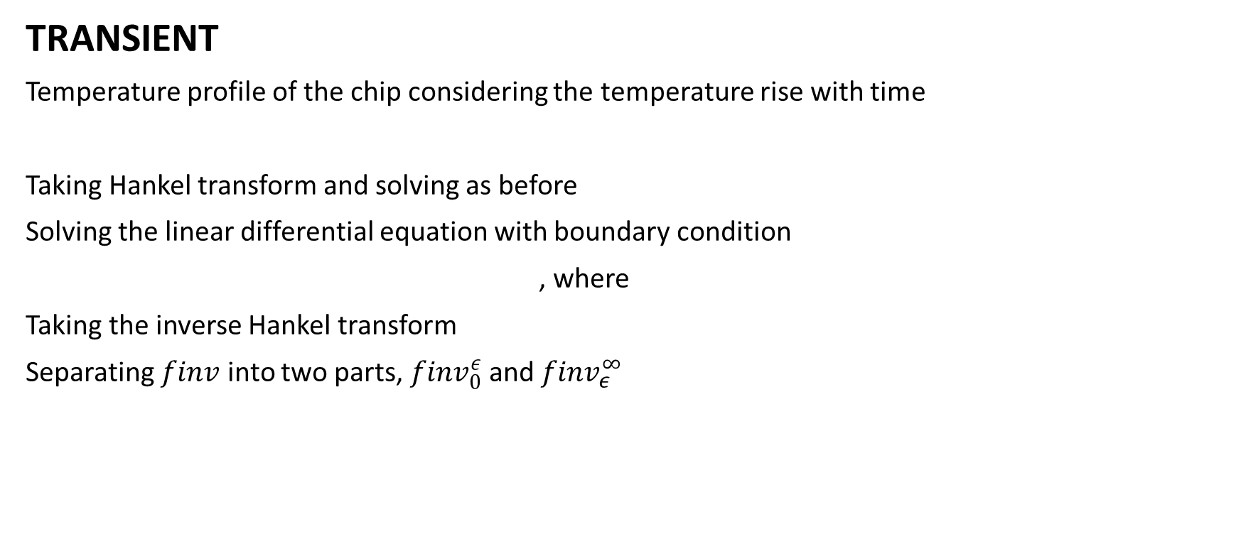


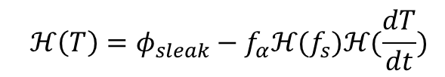
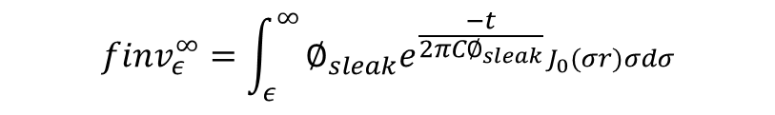
FOURIER GREEN'S FUNCTION
TRANSIENT
Temperature profile of the chip considering the temperature rise with time
Taking Hankel transform and solving as before
Solving the linear differential equation with boundary condition
, where
Taking the inverse Hankel transform
Separating $finv$ into two parts, ${finv}_{0}^{ε}$ and${ finv}_{ε}^{∞}$
$$T=f_{s}+βf_{s}∗T−Cf_{s}\frac{dT}{dt}$$
$$ℋ\left(T\right)=φ_{sleak}−f_{α}ℋ(f_{s})ℋ(\frac{dT}{dt})$$
$$ℋ\left(T\right)|_{t=0}=0$$
$$ℋ\left(T\right)=∅_{sleak}−∅_{sleak}e^{\frac{−t}{f_{α}ℋ\left(f_{s}\right)}}$$
$$f_{α}=2πC(1+2πβℋ\left(f_{s}\right))$$
$$T=T_{ss}−finv$$
$${finv}_{ε}^{∞}=\int_{ε}^{∞}{∅_{sleak}e^{\frac{−t}{{2πC∅}_{sleak}}}J_{0}(σr)σdσ}$$

Slide 9

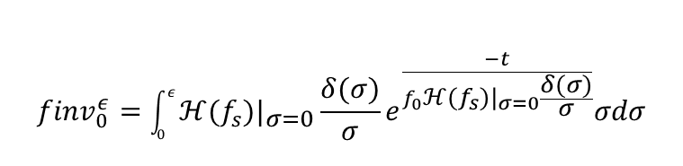




FOURIER GREEN'S FUNCTION
TRANSIENT
When $ε→0, σr=0, J_{0}\left(σr\right)=1.$When $σ→ε,$
Also, since $\frac{δ(σ)}{σ}≫βT$, we can ignore the leakage terms in $∅_{sleak}$
Hence, the steady state leakage term becomes
Thus, we get
Solving the integration, we get
The transient leakage aware Green's function is given by
$$f_{α}=f_{0}=2πC(1+2πβℋ(f_{s})|σ=0$$
$$ℋ\left(T_{ss}\right)=ℋ\left(f_{s}\right)=ℋ(f_{s})|_{σ=0}\frac{δ(σ)}{σ}$$
$${finv}_{0}^{ε}=\int_{0}^{ε}{ℋ(f_{s})|_{σ=0}\frac{δ(σ)}{σ}e^{\frac{−t}{f_{0}ℋ(f_{s})|_{σ=0}\frac{δ(σ)}{σ}}}σdσ}$$
$${finv}_{0}^{ε}=\frac{{\left(ℋ\left(f_{s}\right)|_{σ=0}\right)}^{2}f_{0}}{ε^{2}t}\left(1−\frac{{−tε}^{2}}{e^{f_{0}{ℋ(f_{s})|}_{σ=0}}}\right)$$
$$T=T_{ss}−{finv}_{0}^{ε}−{finv}_{ε}^{∞}$$

Slide 10
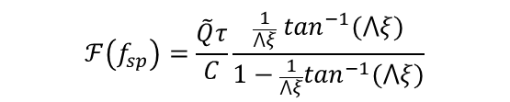
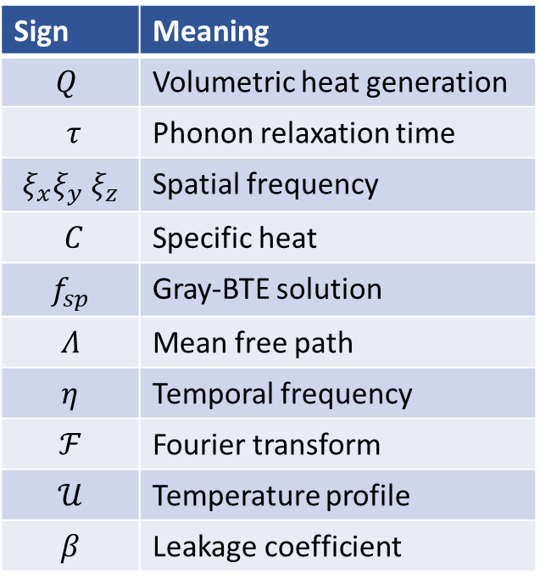
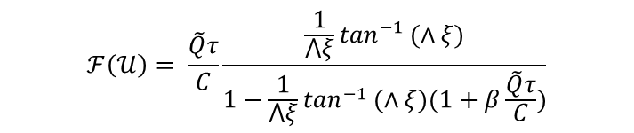

Gray-BTE Green's Function
Sign | Meaning
$$Q$$ | Volumetric heat generation
$$τ$$ | Phonon relaxation time
$$ξ_{x}ξ_{y} ξ_{z}$$ | Spatial frequency
$$C$$ | Specific heat
$$f_{sp}$$ | Gray-BTE solution
$$Λ$$ | Mean free path
$$η$$ | Temporal frequency
$$ℱ$$ | Fourier transform
$$𝒰$$ | Temperature profile
$$β$$ | Leakage coefficient
STEADY STATE
Green's function for steady state gray-BTE without leakage[3]
Temperature field considering linear leakage model
Taking the 2D Fourier transform and solving as before
Leakage aware steady state Green's function for gray-BTE
$$ℱ\left(f_{sp}\right)=\frac{\tilde{Q}τ}{C}\frac{\frac{1}{⋀ξ} \tan^{−1}(⋀ξ)}{1−\frac{1}{⋀ξ}\tan^{−1}(⋀ξ)}$$
$$ℱ\left(𝒰\right)=\frac{\frac{\tilde{Q}τ}{C}\frac{\frac{1}{⋀ξ}\tan^{−1} (⋀ξ)}{1− \frac{1}{∧ξ}\tan^{−1} (⋀ξ)}}{1−β(\frac{\tilde{Q}τ}{C}\frac{\frac{1}{⋀ξ} \tan^{−1}\left(∧ξ\right)}{1−\frac{1}{∧ξ }\tan^{−1}\left(∧ξ\right)})}$$
$$ℱ\left(𝒰\right)= \frac{\tilde{Q}τ}{C}\frac{\frac{1}{⋀ξ}\tan^{−1 }(∧ξ)}{1−\frac{1}{⋀ξ}\tan^{−1 }(∧ξ)(1+β\frac{\tilde{Q}τ}{C})}$$
3. S. Varshney, "NanoTherm: An Analytical Fourier-Boltzmann Framework for Full Chip Thermal Simulations," IEEE/ACM ICCAD, USA, 2019

Slide 11
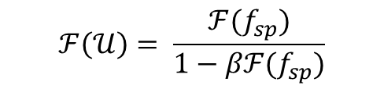
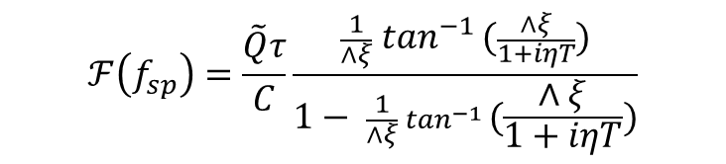
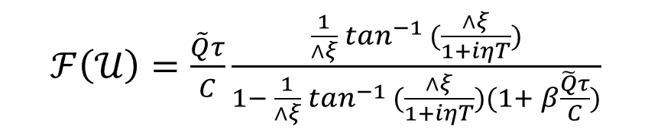
Gray-BTE Green's Function
TRANSIENT
Transient Green's function without leakage[3],
Considering linear model for leakage and taking 2D Fourier transform
Substituting the value and solving as before, we get the Transient leakage aware Green's function for gray-BTE
$$ℱ\left(f_{sp}\right)=\frac{\tilde{Q}τ}{C}\frac{\frac{1}{∧ξ} \tan^{−1 }(\frac{∧ξ}{1+iηT})}{1− \frac{1}{∧ξ} \tan^{−1 }(\frac{∧ξ}{1+iηT})}$$
$$ℱ\left(𝒰\right)= \frac{ℱ(f_{sp})}{1−βℱ(f_{sp})}$$
$ℱ\left(𝒰\right)=\frac{\tilde{Q}τ}{C}\frac{\frac{1}{∧ξ} \tan^{−1 }(\frac{∧ξ}{1+iηT})}{1− \frac{1}{∧ξ} \tan^{−1 }(\frac{∧ξ}{1+iηT})(1+ β\frac{\tilde{Q}τ}{C})}$
3. S. Varshney, "NanoTherm: An Analytical Fourier-Boltzmann Framework for Full Chip Thermal Simulations," IEEE/ACM ICCAD, USA, 2019

Slide 12
VALIDATION RESULTS

Slide 13
FOURIER ANALYSIS
Model of the chip
Heat spreader placed on top of the chip with a 0.2mm × 0.2mm source at the center
Chip dimensions: 11.2mm × 11.2mm × 0.15mm
Thermal conductivity of chip: 150W/mK
Heat spreader dimensions: 11.2mm × 11.2mm × 3.52mm
Thermal conductivity: 256W/mK

Slide 14
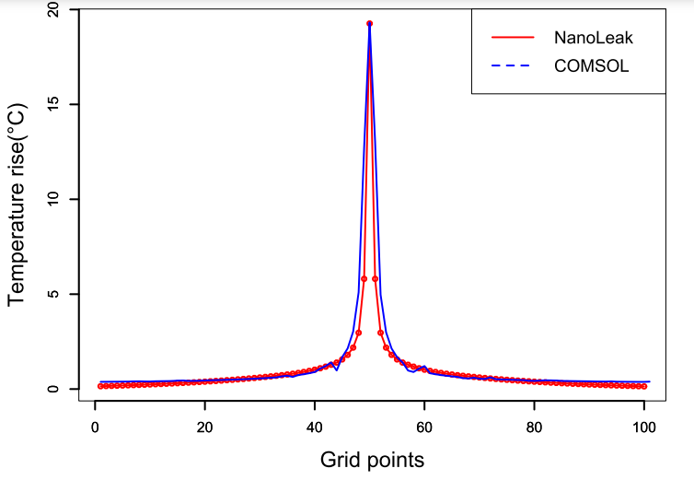
STEADY STATE SIMULATIONS
Green’s function calculation
Total time taken:
NanoLeak: 1.22s
COMSOL: 25min
Error: 2.4%
Speedup: 1250X

Slide 15
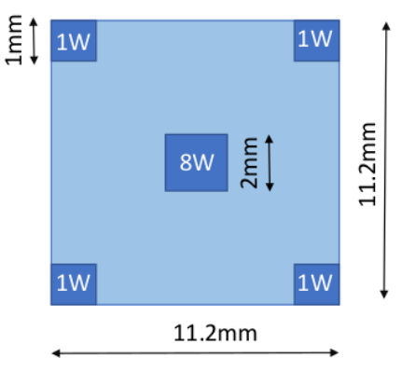
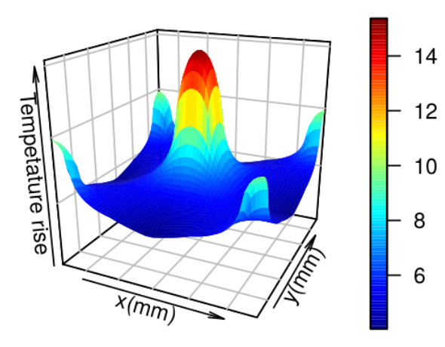
STEADY STATE SIMULATIONS
Power distribution
Full chip thermal profile

Slide 16
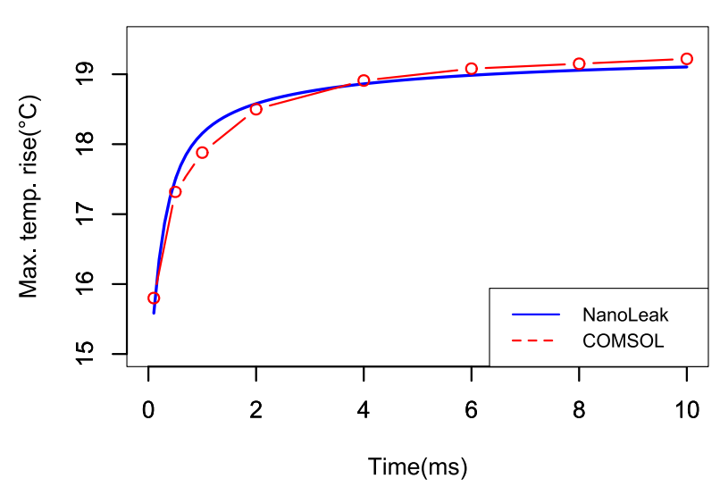
TRANSIENT SIMULATIONS
Green’s function calculation
Total time taken:
NanoLeak: 1.62s
COMSOL: 45min
Error: <2%
Speedup: 1670X
Comparison of variation of transient Green’s function with time

Slide 17
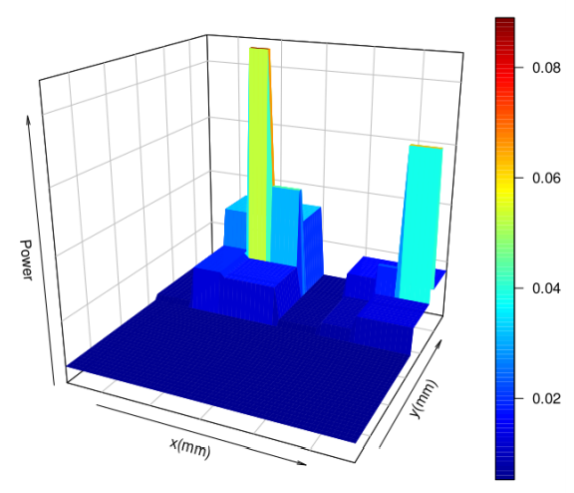
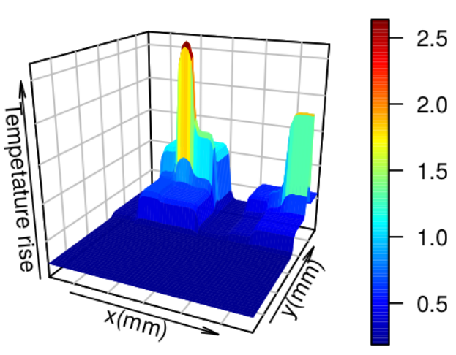
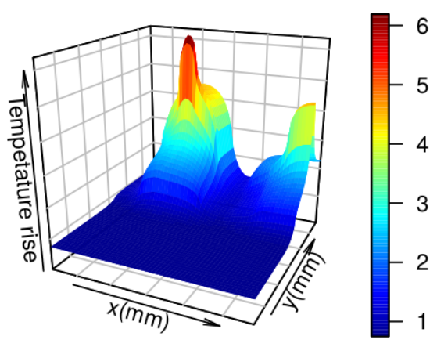
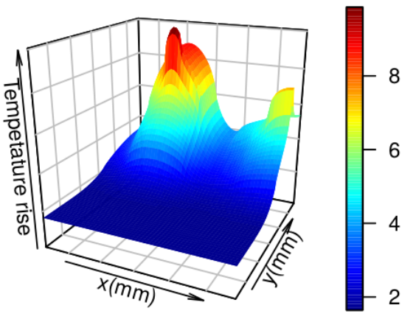
TRANSIENT SIMULATIONS
(a) Power distribution
(b) ∆T at 1ms
(c) ∆T at 5ms
(d) ∆T at 10ms
Transient full-chip thermal profile at different time steps

Slide 18
BTE ANALYSIS
Device: 60nm×45nm×20nm
Nanoleak: 400×400×200 grid points
Thermalscope: 60×60×48 grid points

Slide 19
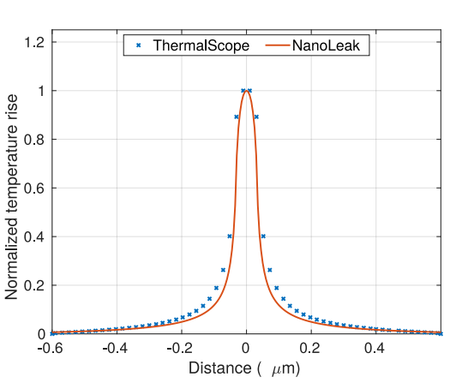
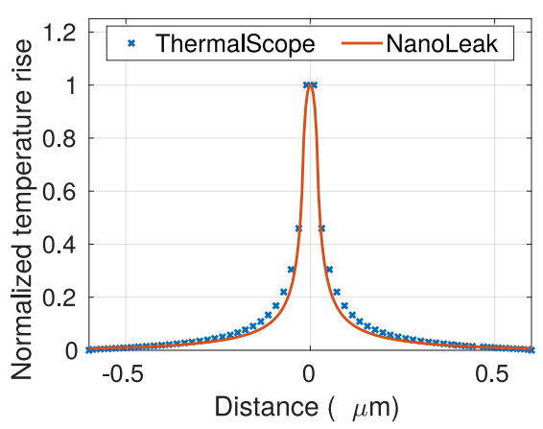
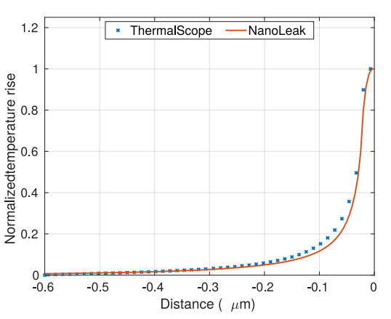
STEADY STATE SIMULATIONS
Along the x axis
Along the y axis
Along the z axis
Simulation time
NanoLeak: 4.3 s
ThermalScope: 185 min
Comparison of steady state BTE solution
Speedup: 1670X
RMS Error: 0.05°C

Slide 20
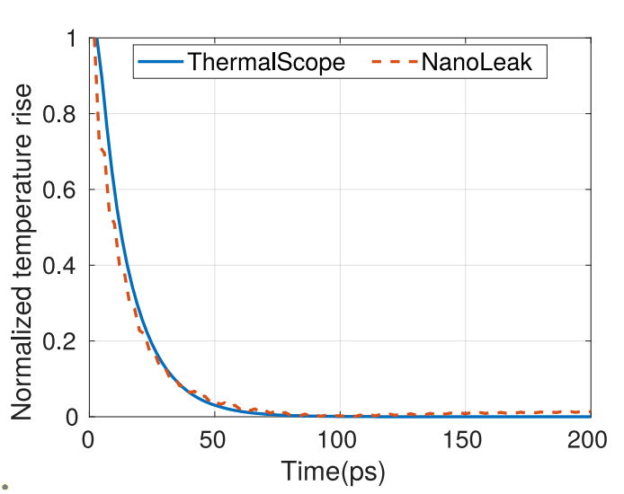
TRANSIENT SIMULATIONS
Simulation time:
NanoLeak: 68 s
ThermalScope: 244 min
RMS error: 0.0527 °C
Speedup: 211X
Comparison of transient BTE solution

Slide 21
Speed of Thermal Simulators
Simulator | Fourier heat equation |  | BTE
 | Steady | Transient | Steady | Transient
COMSOL | 1500s | 2880s | - | -
ThermalScope | - | - | 185min | 240min
NanoTherm | 0.415s | 16.8s | 16.5s | 168s
NanoLeak | 1.22s | 1.62s | 4.3s | 68s

Slide 22
CONCLUSION
We have developed an analytical model to compute the Fourier heat solution of the chip while taking leakage into account
We have incorporated the nano-scale effects by analytically solving the gray-BTE equation considering leakage
NanoLeak is considerably faster than the commercial simulators COMSOL and ThermalScope

Slide 23
REFERENCES
S. Varshney, H. Sultan, P. Jain and S. R. Sarangi, "NanoTherm: An Analytical Fourier-Boltzmann Framework for Full Chip Thermal Simulations," IEEE/ACM ICCAD, USA, 2019.
S. R. Sarangi, G. Ananthanarayanan and M. Balakrishnan, "LightSim: A leakage aware ultrafast temperature simulator,“ ASP-DAC, Singapore, 2014.
H. Sultan and S. R. Sarangi, "A fast leakage aware thermal simulator for 3D chips,"DATE, 2017, Lausanne, Switzerland, 2017.
S. Borkar, Low power design challenges for the decade (invited talk), in ASPDAC, 2001.
W. Liu, K. Cao, X. Jin, and C. Hu, BSIM 4.0.0 technical notes, Tech. Rep. UCB/ERL M00/39, EECS Department, University of California, Berkeley, 2000.
A. Ziabari, E. K. Ardestani, J. Renau, and A. Shakouri, Fast thermal simulators for architecture level integrated circuit design, in 2011 27th Annual IEEE Semiconductor Thermal Measurement and Management Symposium, 2011.
Y. Zhan and S. Sapatnekar, A high effciency full-chip thermal simulation algorithm, in ICCAD-2005. IEEE/ACM International Conference on Computer-Aided Design, 2005.
Z. Hassan, N. Allec, F. Yang, L. Shang, R. P. Dick, and X. Zeng, Full-spectrum spatial temporal dynamic thermal analysis for nanometer-scale integrated circuits, IEEE Transactions on Very Large Scale Integration (VLSI) Systems,2011.
W. Huang, S. Ghosh, S. Velusamy, K. Sankaranarayanan, K. Skadron, and M. Stan, “Hotspot: a compact thermal modeling methodology for early-stage vlsi design,” IEEE Transactions on Very Large Scale Integration (VLSI) Systems, 2006.
A. Sridhar, A. Vincenzi, M. Ruggiero, T. Brunschwiler, and D. Atienza, “3d-ice: Fast compact transient thermal modeling for 3d ics with inter-tier liquid cooling,” in 2010 IEEE/ACM ICCAD, 2010.

Slide 24
Thank you

