Slide 1


PanoptiChrome: A Modern In-Browser Taint Analysis Framework
WWW 2024
INDIAN INSTITUTE OF TECHNOLOGY, DELHI
THE WEB CONFERENCE 2024
Rahul Kanyal and Prof. Smruti R. Sarangi
Notes:
Hello, everyone. I am Rahul Kanyal and I am very excited to present the work done with Prof. Smruti R. Sarangi on PanoptiChrome which is an in-browser dynamic taint analysis framework for the chromium browser

Slide 2

























Websites are a mixed bag of scripts : anyone could be exploited
/shipping.js
/player.js
Payment Gateway
/payment-processor.js
Credit Card
/detect-bot.js
4567 XXXX 1234 YYYY
CVV
***
/fraud-detection.js
Name on Card
/form-validator.js
Rahul Kanyal
/translate.js
Expiry Date
7/27
/ad-tracker.js
/marketing-news.js
Pay
/recaptcha.js
/twitter.js
/facebook.js
I’m not a robot
/linkedin.js
/monitoring.js
/chat.js
We use cookies to improve experience. Read privacy policy.
/analytics.js
OK
/cookie-consent.js
Notes:
Now websites are a mixed bag of scripts from a lot of third-party domains
Any bug or unpatched vulnerability in any one of the scripts might lead to a problem like this:

Slide 3




https://benign-site.com?search=<script>sendAttacker(cookies)</script>
<script>
let a = document.URL
b = …
c = …
eval(c)
document.write(x)
document.location.href = x
</script>
Cryptojacking
Cryptojacking
Sends user’s cookies to attacker
Intrusive
advertisements
index.html
Service workers
DOM-XSS
Open Redirect
Trust model
Injection based
Fingerprinting
Malicious JavaScript
Man in the machine
XSS
Website
CSRF
Extensions
SQL Injection
3
Notes:
Where the users’s sensitive data might get leaked to a remote attacker
Or the site might get vulnerable to DOM-XSS or open redirect
Similarly problems like fingerprinting, Cryptojacking and others might also arise due to these scripts

Slide 4
Taint analysis
var cok = document.cookie;
var obj = { cookie: cok, length: cok.length };
var length = obj.length;
var output = " ";
for (var i = 0; i < length; i ++) {
var c = obj.cookie[ i ];
if ( c == " a ")
output += " a ";
else if ( c == " b ")
output += " b ";
/* repeated for all valid URL characters */
}
var result = xhr.send( output ) ;
source
Taint analysis
Models an attack as an information flow graph
explicit flow
Sources
Any attacker-controlled data
URL parameters
User’s private data
Cookies, file contents
implicit flow
Sinks
Functions that can execute arbitrary code
Functions that can make network request
Propagation rules
sink
Explicit flows (direct flows)
Implicit flows (indirect flows)
Notes:
These problems can be modelled as a information flow graph where,
the information flows from user’s sensitive data or an attacker controlled parameter in the URL to a sink like eval that executes string as code or a network request with the user’s data
The flow of information could be direct, also called explicit flow or indirect via control flow statements known as implicit flow

Slide 5




The need for In-browser dynamic analysis
Dynamic nature
Eval, monkey-patching, prototypal inheritance
Dynamic typing
Source transformations
Minification
Obfuscation
Encryption
Dependency on Web APIs
WebGPU, WebRTC, WebSockets
WebXR, WebHID
In-browser dynamic analysis is the most feasible approach
Notes:
Statically performing an information flow analysis is difficult in case of javascript since it has functions like eval and features that allow the code to monkey-patch itself at runtime
Furthermore properties like prototypal inheritance and dynamic typing when paired with encryption and obfuscation make the analysis even harder
Hence dynamic analysis and especially in-browser dynamic analysis is most feasible for javascript since it also provides access to comple web api environments like webgpu, webrtc, websockets and so on

Slide 6


Limitations of prior approaches
Fixed set of sensitive endpoints: non-extensible
Heavy weight patches : non-maintainable
Do not cover all data types : incomplete
Do not cover all flow paths : incomplete
Coarse grained
Platform dependent
Notes:
The problem with prior in-browser dynamic analysis approaches is that they all have a fixed set of source and sink endpoints, this makes the framework non-extensible for further use-cases.
Also they need to patch all the possible information flows in the javascript engine which renders the framework non-maintaianable
Other problems like the inability to track information flows through all data types also limits the completenes

Slide 7
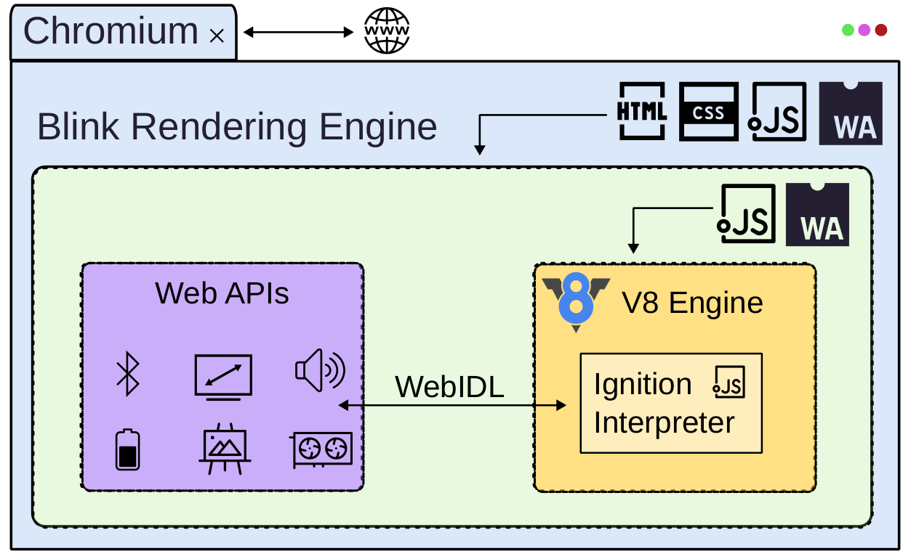
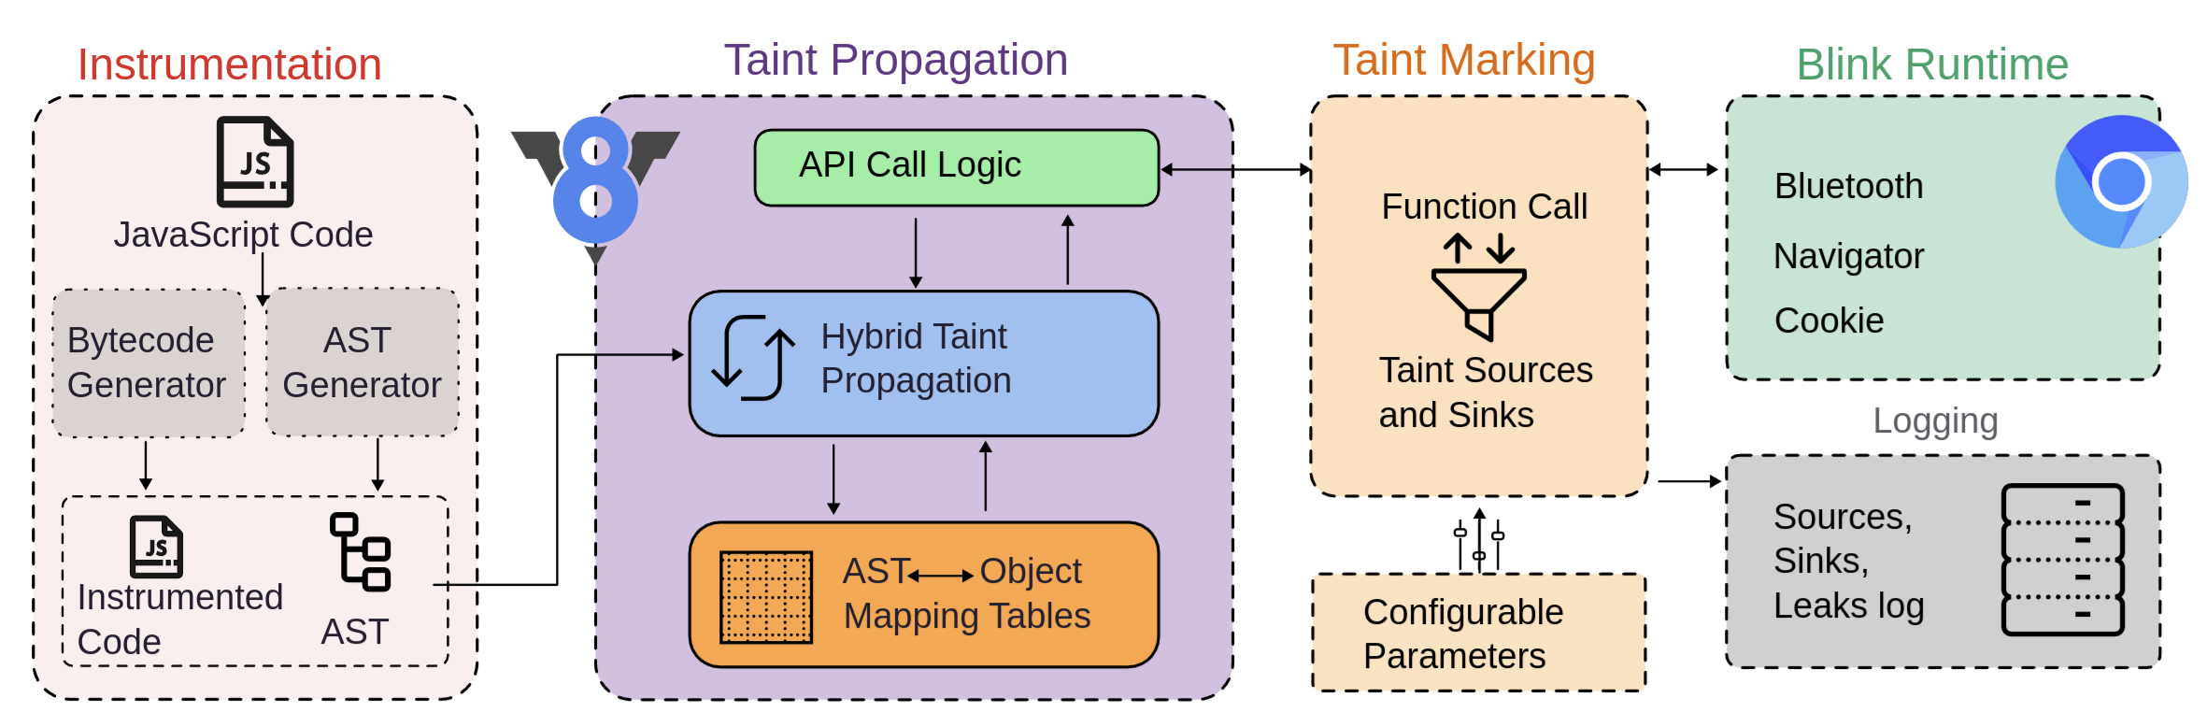

Enter PanoptiChrome
Patches limited to the V8 engine only
Novel Taint marking and generation
~7000 lines of changes
Does not touch the Blink rendering engine
Can be embedded in Node JS and Electron
Features
Handles all data types (complete)
Fine-grained taint tracking (variable level)
Platform agnostic (Linux, Android)
User configurable sources and sinks (JSON)
Open source
https:/github.com/therahulkanyal/panoptichrome
Notes:
Hence we created an open source framework called panoptichrome that solves a lot of existing problems
The patches in panoptichrome are limited to the V8 javascript engine of the Chrome browser and hence can be embedded in other v8 based frameworks like nodejs and electron
At the heart of panoptichrome is a novel taint tracking and generation engine that can mark any object property pair as a taint source or sink at runtime
based on simple configuration parameters set by the developer without recompiling the browser
Furthermore it is platform agnostic and handles both implicit and explicit flows in all data types.

Slide 8
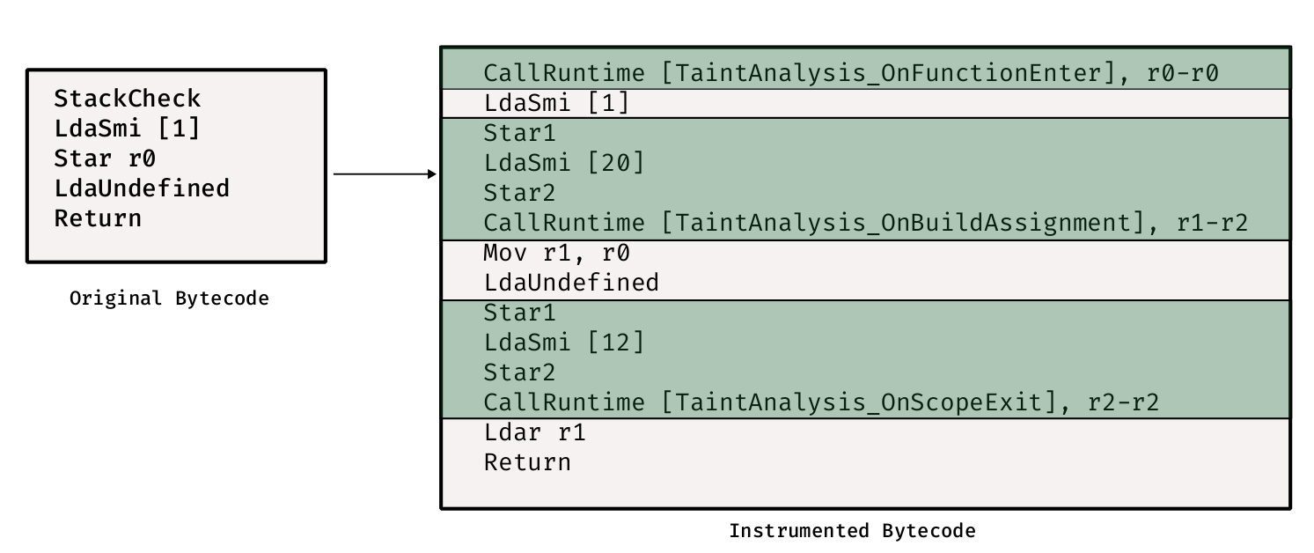

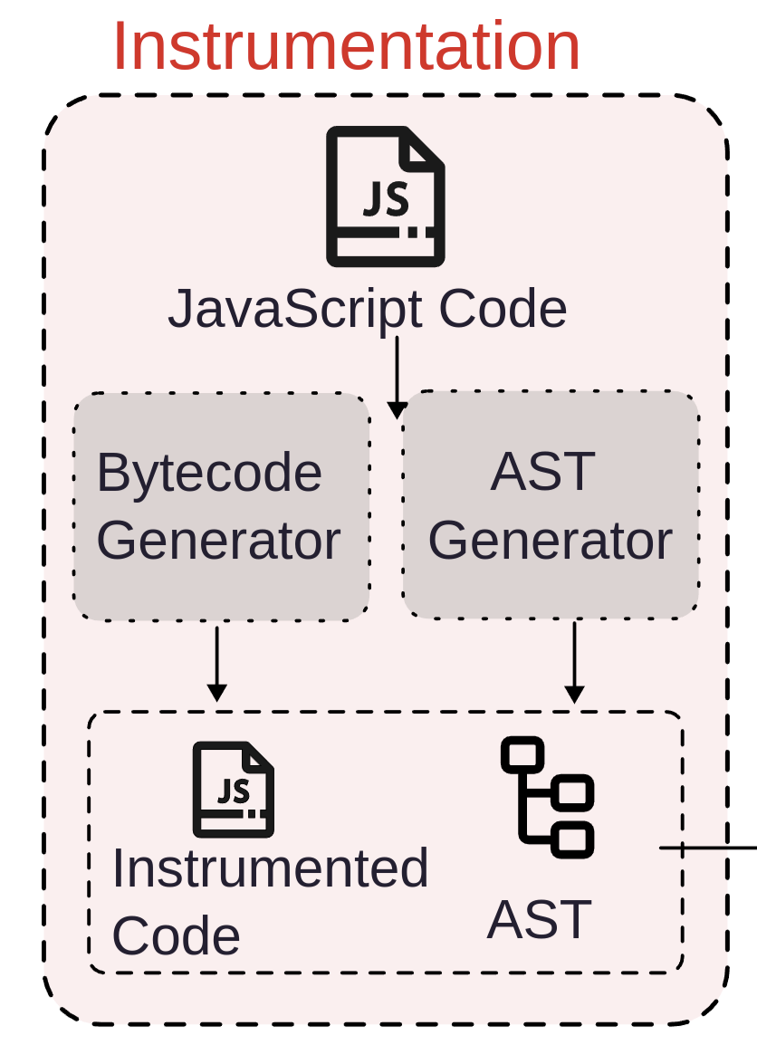



PanoptiChrome's instrumentation system
Bytecode generator patches
Emits instrumented code that traps into runtime functions
Modifies 3 / 60 bytecode builders and 8 / 85 AST visitors
Hooks
End of each basic block
Function call and return
Assignment expressions and object/array access
Data Structures
emits this instead
Object Taint Table, AST Taint Table
AST to Object Map Table
Handles persistence in the face of garbage collection
Notes:
Panoptichrome modifies the bytecode generator of the V8 javascript engine to emit instrumented code that traps into runtime functions responsible for taint marking and propagation
Panoptichrome needs to modify only 3 bytecode builders and 8 AST visitors for the full taint tracking functionality
The hooks in the instrumented code are inserted at the end of each basic block, start and end of each function and the assignment and access to an object property
Panoptichrome maintains multiple tables that store the taint status of runtime objects

Slide 9
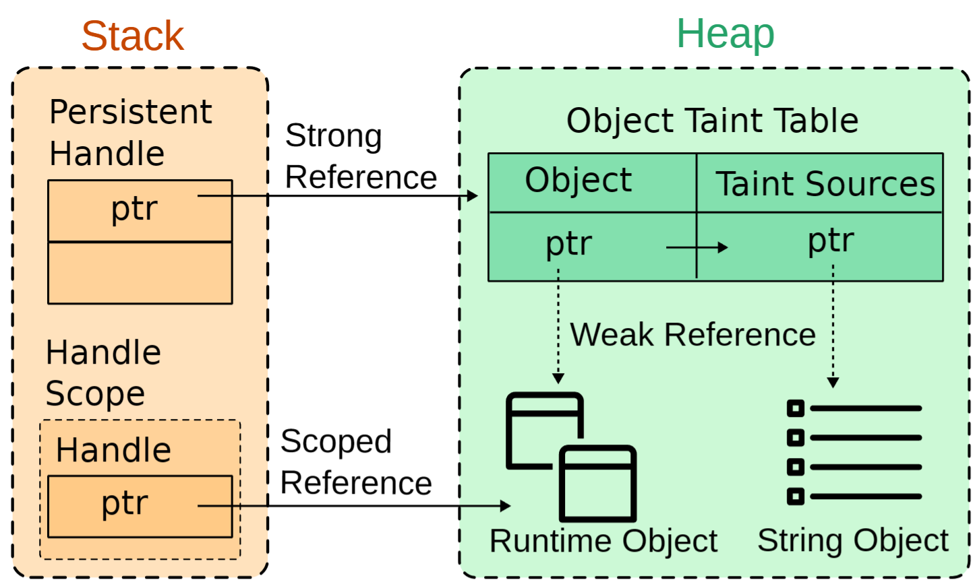
Taint State Management
Object Taint Table
Maps the tagged heap pointer (of the runtime object) to the list of string-encoded taint sources
The garbage collector (GC) relocates and removes runtime objects, taint sources, and taint tables in memory.
Implemented as a custom persistent ephemeron hash table
Interlinks the lifetime of string-encoded taint sources to the runtime object
AST, Object Mapping Table
AST Taint Table
Multi-level Hash Table
Frame pointer -> unique location in AST
Maps the location of the AST node to the corresponding runtime object
Stores the taint status of AST nodes
Implemented as a multi-level simple number dictionary
Notes:
The primary table is the object taint table that maps the tagged heap pointer or the location of each javascript runtime object in memory to the encoded list of corresponding taint sources
Since the garbage collector relocates and removes objects which are not reachable from the javascript source code and since all the taint tables are not present in the javascript source code hence we need to treat them in a special manner
For which we implemented a custom persistent ephemeron hash table that interlinks the lifetime of encoded taint sources with the lifetime of corresponding runtime javascript object and also makes sure that the taint tables are not garbage collected
Since the same abstract syntax tree can correspond to multiple invocations of the same function
AST taint table and the AST to object mapping tables that will be explained soon are implemented as GC-safe multi level hash tables that are indexed by the frame pointer of the currently executing function and then the actual unique location of the node in the AST

Slide 10

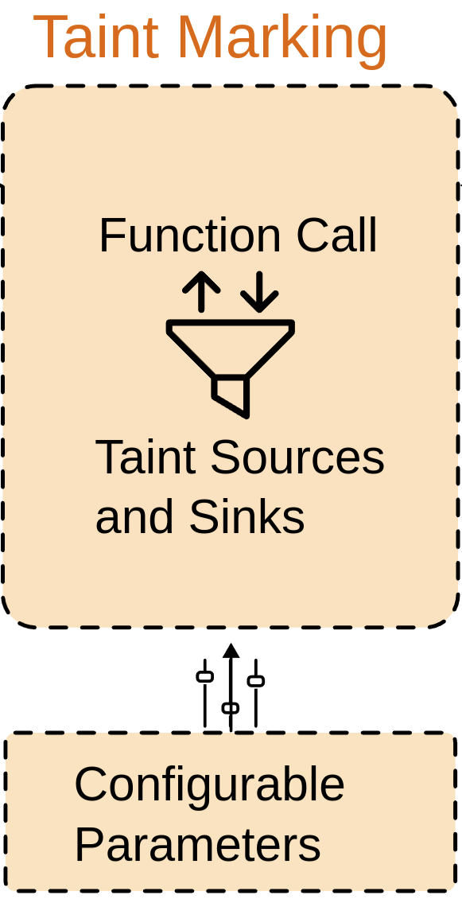


Taint Marking
Information collected at runtime
Execution context
Object, property data
Call arguments and return value
Filtered Contexts
Browser extensions
Settings, browser pages
Configurable parameters
[Object_Name : IncludedProperties, ExcludedProperties]
Sources and Sinks in JSON format
Format :
< Object Name : Included Properties : Excluded Properties >
Handles prototypal inheritance, object reassignment/renaming and global objects
Notes:
Taint marking engine uses the data collected by the instrumented functions like execution context, object and property data along with the call arguments and the return value to identify the current environment and mark the object property pair as sensitive if the configuration parameters list the name as sensitive and the current environment is not internal to the browser like new tab page, settings page or browser devtools
The configuration parameters are listed in a simple JSON file in the format of object name, included properties and the excluded properties
Taint marking engine can handle object reassignment, prototypal inheritance and global objects where the name mentioned in the configuration file does not match the name of the object.

Slide 11
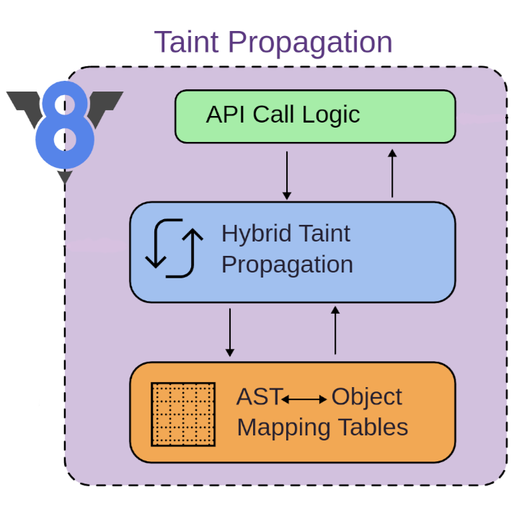
Taint Propagation System
Approach
Order-independent intra-procedural analysis
Builds upon Mystique (CCS, 2018)
More expressive taint propagation routine
Larger contexts
Can generate taint along with propagation
Notes:
For taint propagation, panoptichrome follows an order-independent intra-procedural analysis similar to that of mystique but with more expressive contexts that can also generate taint along with propagation

Slide 12
Taint Propagation System
let a = document.cookie
if(a == “secret”) {
xhr.send(“secret”)
}
Propagation routine
Generates flow graph based on AST that combines
Implicit and explicit flows
Propagates taint information to the in-memory runtime values based on reachability analysis of the flow graph
AST | Object
1’s node | 1’s heap
2’s node | 2’s heap
3’s node | 3’s heap
1
d.cookie
d.cookie
flow graph
Hybrid mapping mechanism
Object Taint
AST Taint
Utilizes mapping tables (AST to Object taint and Object to AST taint) to manage link between AST and in-memory values
explicit
flow
2
Taint marking
1’s heap address
1’s node
a
a
3
xhr.send
xhr.send
3’s heap address
reachability
analysis
implicit
flow
Notes:
Initially a flow graph is generated along with the instrumented code,
Now during the execution whenever the document.cookie is accessed, the taint marking engine marks the runtime object corresponding to the document.cookie as tainted in the object taint table with the string encoding of document.cookie as the taint source and the corresponding AST node is marked sensitive in the AST taint table
Now during the invocation of xhr.send that generates a network request, a taint propagation routine is invoked that performs the reachability analysis from the tainted source in AST marked 1, this marks the node numbered 2 and 3 as tainted in the AST.
Now all the runtime objects corresponding to the tainted AST nodes are looked up in the AST to object mapping table and the corresponding runtime objects are marked tainted in the object taint table with the corresponding taint sources as the flow originator

Slide 13
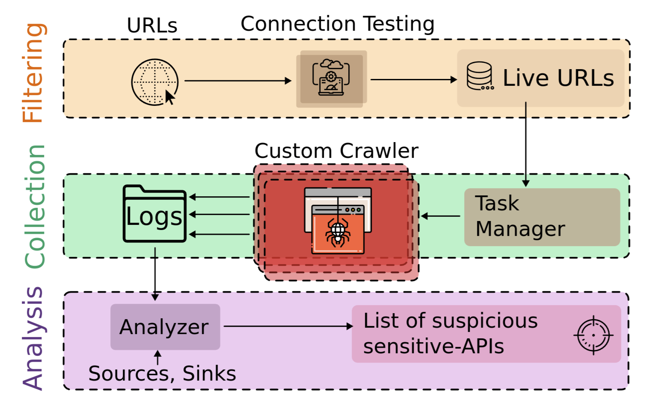
Evaluation
Web APIs
Provides functionality to JavaScript
WebGPU, WebRTC, WebSockets, WebXR, WebHID
~7000 APIs: categorized into 106 bins
Sensitive sources
All APIs (except sinks were marked sensitive : taint sources)
Sensitive sinks
All network and storage related APIs : XHR, SendBeacon
PostMessage, RTCDataChannel, IDBObjectStore
Crawling infrastructure
Tranco top 20K
Chromium version 117
30 parallel instances
Notes:
To evaluate panoptichrome, we focused on the web APIs that are used to provide functionalities like gpu, RTC and HID capabilities to the javascript.
We categorized all the 7000 apis into 106 bins and marked all the network and storage apis as taint sinks and the remaining APIs as taint sources
we then parallely crawled the top 20 thousand websites with panoptichrome built over chromium version 117

Slide 14
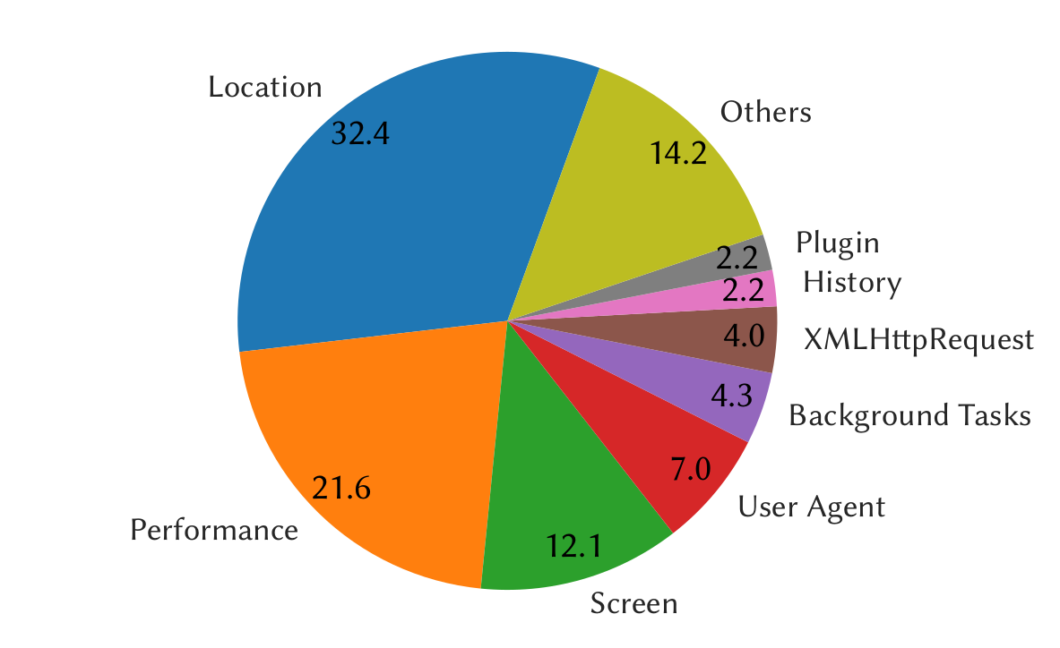




Results
Location APIs ~32.4%
Document.URL / referrer / domain
Window.origin / location / name
Performance APIs ~21.6%
Window.performance
MemoryInfo
PerformanceObserver
Screen APIs ~12.1 %
Average API leak distribution per site
Window.screen
Window.outerHeight / outerWidth
Window.innerHeight / innerWidth
API leakage trends
User Agent APIs ~7.0 %
5,673 unique APIs accessed
Maximum single-origin leakage: 144 APIs
Window.navigator
Window.clientInformation
Notes:
We observed that 5673 unique APIs were accessed cumulatively
with a maximum of 144 APIs that were leaked simultaneously from a single origin, that is, the data from all those APIs flowed to a taint sink.
On average, location APIs account for the highest leakage from a website with 32.4% of the total leaked apis being from the location category
Performance and screen apis follow closely with 21.6 and 12.1 percent respectively.

Slide 15
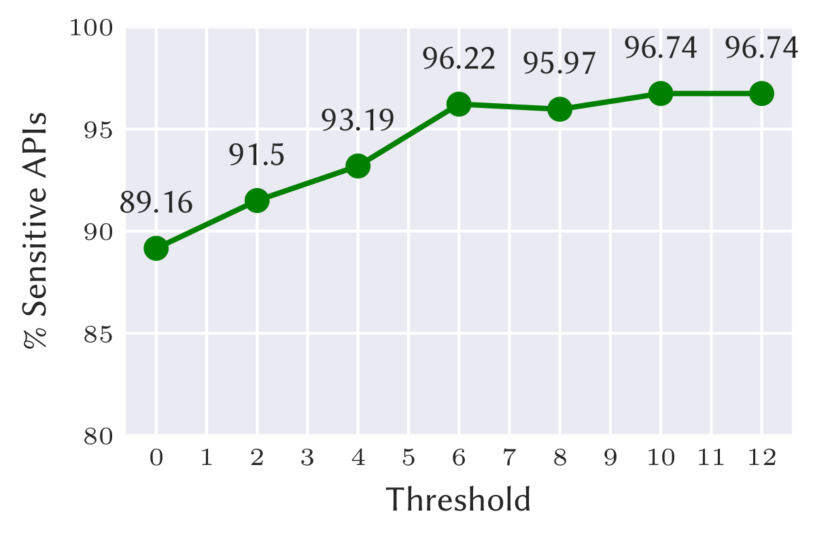
Results
Discovery by association
Fingerprinting techniques club API data together
Do not span multiple files
Results
With threshold = 0, 406 APIs are marked sensitive, 89.16 % correct (-DOM)
With threshold = 12, 92 APIs are marked sensitive, 96.74 % correct
Potential APIs for fingerprinting
Variation of the #sensitive APIs with the threshold
Navigator.deviceMemory
Plugin.description
FeaturePolicy.allowedFeatures
… 208 APIs
Locality
All APIs sent to the common sink are analysed
Packet is logged if it contains more than a threshold known APIs
Notes:
We further analyzed the collected data to identify all the APIs that are sent together in a single packet through a single taint sink.
Prior researchers have observed that fingerprinting techniques that aim to uniquely identify the user and the browser often club the data obtained from various web APIs together and then form a unique identifier with that data which is then exfiltrated to the remote server
If the number of APIs that are sent through a single taint sink exceed a predefined number of KNOWN fingerprinting APIs we mark all the remaining APIs as sensitive as well
We observe that with a threshold of zero 406 APIs are marked suspicious, with 89.16% being actually sensitive
With a threshold of 12 known fingerprinting APIs, only 92 APIs are marked suspicious out of which 96.74 are then determined to be of potentially fingerprinting nature
With this method we discover a total of 362 APIs that have the potential of being used for browser fingerprinting out of which 208 APIs were never reported by prior workss

Slide 16
Conclusion
Developed an embeddable, customizable, dynamic, complete and platform-agnostic taint analysis framework for Chromium
Introduced a novel taint marking engine
Characterized API data transfer for the top 20K websites
Discovered 208 potential fingerprinting APIs
Notes:
So in conclusion we developed an embeddable, customizable, dynamic, complete and platform-agnostic taint analysis framework for chromium with a novel taint marking engine
We then characterized the API leak data for the top 20 thousand websites
And discovered 208 APIs that have the potential to be used for fingerprinting

Slide 17
Thank You
Thank You
Notes:
Please have a look at our paper for more details

