Slide 1
pTask: A Smart Prefetching Scheme for OS Intensive Applications
Prathmesh Kallurkar, Smruti R. Sarangi
Indian Institute of Technology Delhi

Slide 2
Outline of the talk
Introduction
Characterization of OS intensive applications
Results
Design of our prefetching technique ‘pTask’

Slide 3
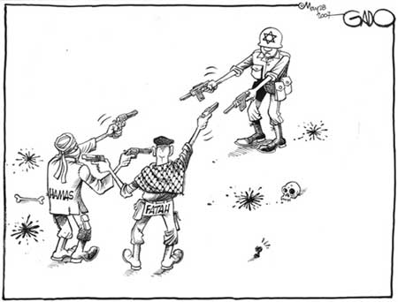
Why Instruction Prefetching for OS Intensive Applications
Non-privileged: Application
Privileged: OS
Each task has a different instruction footprint.
Parse web
request
Create
page
Combined size of instruction footprints of all tasks is larger than the instruction cache
Interrupt
Read
System call
Write
System call
System call
Time
Application

Slide 4
Why another instruction prefetcher
 | Proactive Instruction Fetch (MICRO’11) | Return Address Directed Prefetching (MICRO ‘13)
Prefetch operation | All the time | All the time
Hardware overhead | 200 KB per core | 64 KB per core
Software overhead | None | None
Performance Improvement | 20.51 % | 19.78 %
Storage overhead of additional structures would make it difficult for the deployment of such sophisticated prefetchers in real systems

Slide 5
What are we proposing
 | Proactive Instruction Fetch (MICRO’11) | Return Address Directed Prefetching (MICRO ‘13) | pTask (MICRO ‘16)
Prefetch operation | All the time | All the time | Certain points in the code
Hardware overhead | 200 KB per core | 64 KB per core | 72 B per core
Software overhead | None | None | OS routines
Performance Improvement | 20.51 % | 19.78 % | 27.38 %
pTask uses in-memory data structures to store the prefetch information

Slide 6
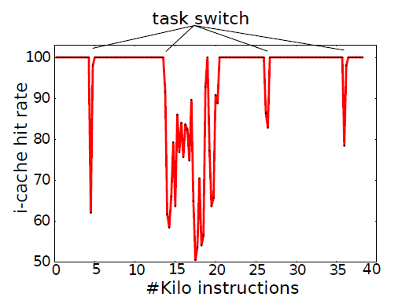
Apache: Variation in i-cache hit rate
Tasks: system call handlers, interrupt (top half and bottom half) handlers, scheduler, applications
i-cache hit rate drops mostly when we switch from one task to another
Crux of our technique:
Do not run prefetching all the time
Prefetch only when transitioning from one task to another

Slide 7
Identify prefetchable execution blocks
Non-privileged: Application
Privileged: OS
libC functions that perform system call
Core functionality of OS tasks
Execution block of 125 functions
OS Events
HyperTask
1) System call
2) Interrupt (top-half)
3) Interrupt (bottom-half)
4) Schedule routine
Time

Slide 8
HyperTasks
System Execution
Application
(Execution between two system calls)
OS
Parse query
Create reply
System call
Interrupt
Bottom Half
Scheduler
Read file
Page fault
SCSI
schedule()

Slide 9
Leverage repetitive execution pattern for prefetching
Time
Overview of the scheme:
Profile
Normal
Record the execution pattern of the HyperTask and find the list of frequently accessed functions.
Prefetch the HyperTask’s frequently accessed functions into the i-cache before executing it
Slower than baseline ☹
Faster than baseline ☺

Slide 10
Outline of the talk
Introduction
Characterization of OS intensive applications
Results
Design of our prefetching technique ‘pTask’

Slide 11
Benchmarks
Network:
1) Apache: Web server (Apache)
2) ISCP: Secure copy file from remote machine to local machine (SCP)
3) OSCP: Secure copy file from local machine to remote machine (SCP)
Database:
4) DSS: Decision Support System (TPCH: Query 2)
5) OLTP: Online Transaction Processing (Sysbench benchmark suite)
File system
6) Find: Filesystem browsing (Linux utility application Find)
7) FileSrv: Random reads and writes to file (Sysbench benchmark suite)
8) MailSrvIO: Imitate file operations of a mail server (Filebench benchmark suite)

Slide 12
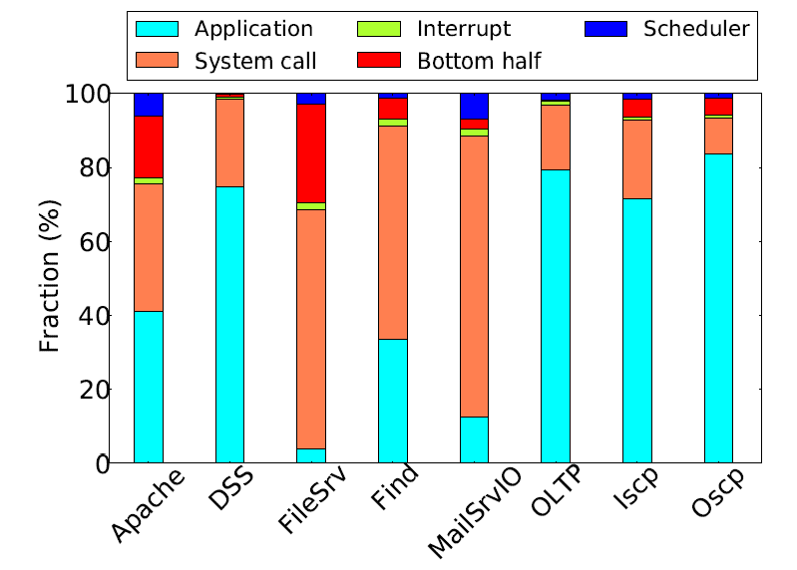
Instruction break up
Interrupt handlers
(top-half and bottom-half)
should also be considered for
Instruction prefetching
20% for Oscp
90% for FileSrv

Slide 13
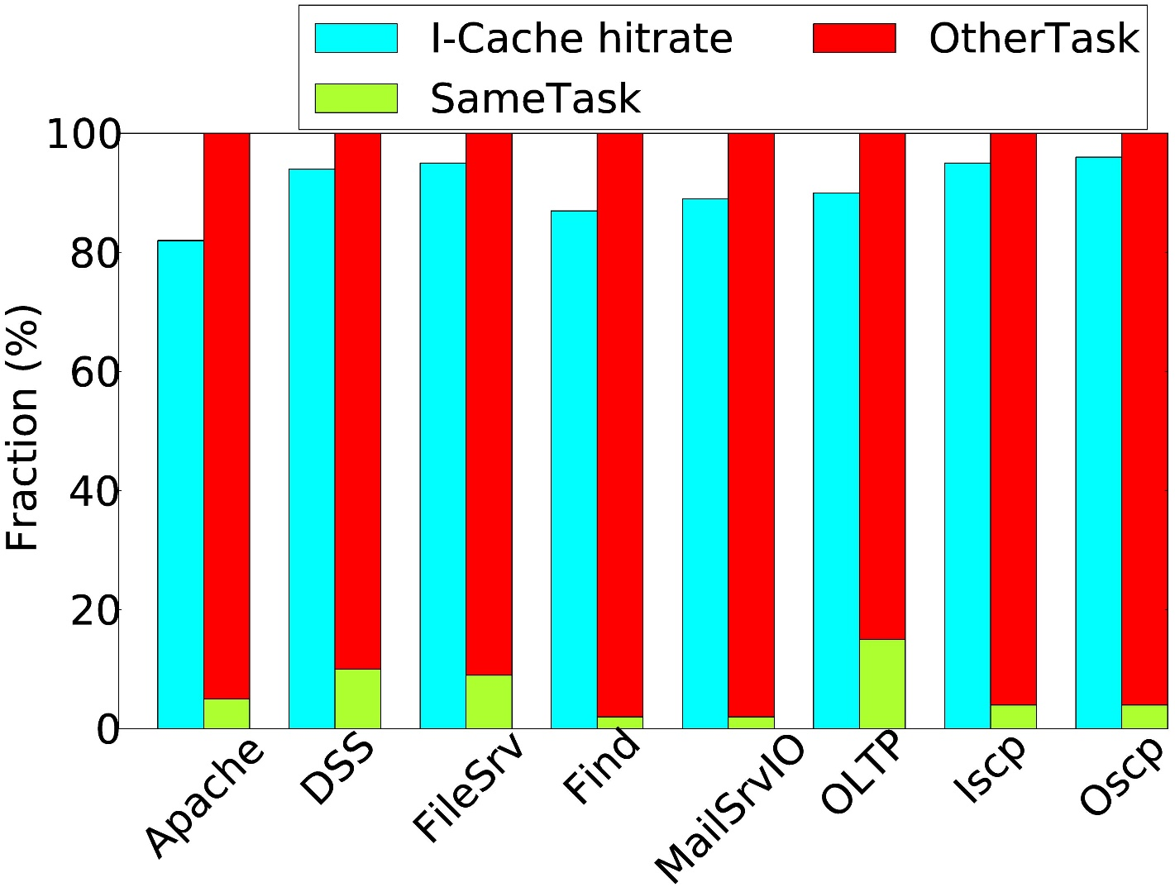
13/40
Break-up of i-cache’s hit rate and evictions
breakup of evictions
hit rate
i-cache hit rate: OS intensive applications (80-90%) SPEC/PARSEC (>99%)
Most i-cache evictions occur because of inter-HyperTask competition

Slide 14
Challenge 1: Which functions should be prefetched?
9/10 profile runs
10 profile runs
d
f
d
e
f
e
b
j
b
c
a
c
j
Start:
a
: End
1/10 profile run
g
g
i
h
i
h
Classes of functions based on their frequency in profile runs:
100 % (10/10)
90 % (9/10)
10 % (1/10)

Slide 15


Challenge 1: Which functions should be prefetched?
Prefetch functions that were
called in all profile runs (100%)
Prefetch all functions (>0%)
Advantage: Will be able to prefetch most functions
Disadvantage: Many prefetch operations may remain unused
Disadvantage: Will be able to prefetch limited number of functions only
Advantage: Most of the prefetch will be used
Classes of functions based on their frequency in profile runs:
b
e
h
a
c
j
d
f
g
i
100 % (10/10)
90 % (9/10)
10 % (1/10)

Slide 16
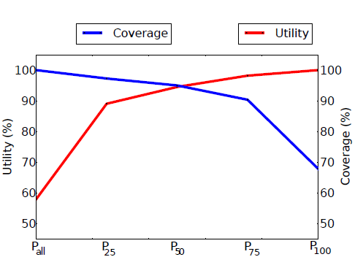
16/40
Challenge 1: Which functions should be prefetched?
P_{X}=prefetch functions that were accessed in x% of the invocations
Coverage =
#accessed lines found in prefetch list
#lines accessed by the HyperTask
Utility =
#lines in prefetch list that were accessed
#total lines in the HyperTask
Choose P₅₀
What we want -> High Coverage and High Utility

Slide 17
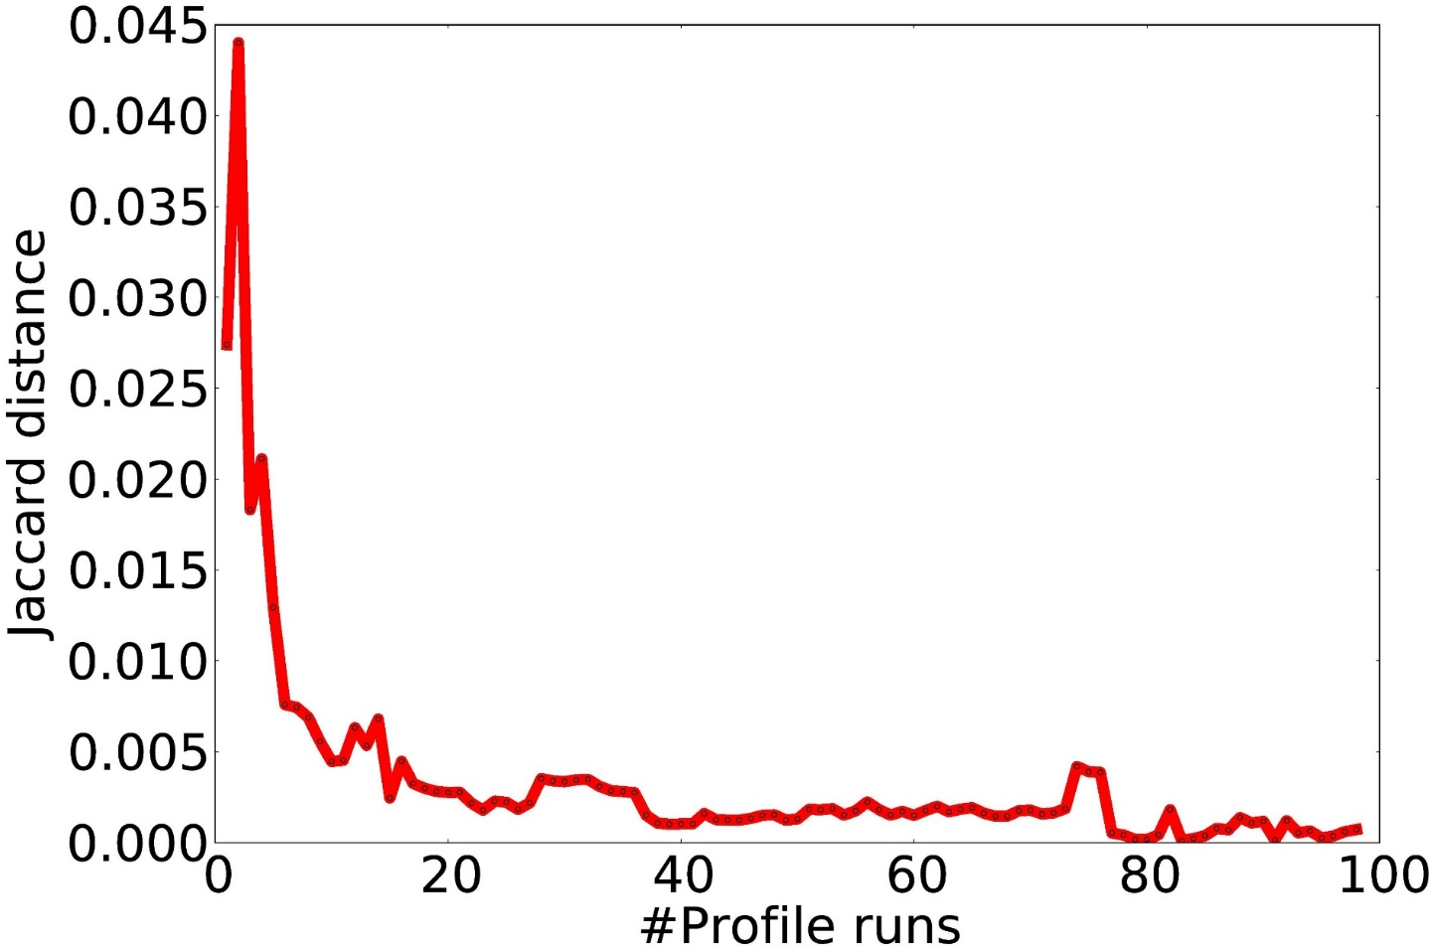
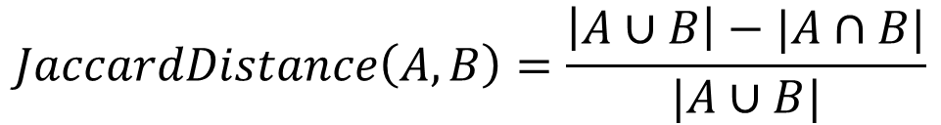
Challenge 2: How many times should we profile?
Create a Prefetch list at the end of each profile run
After 10 profile runs, JaccardDistance < 0.005
Plot the JaccardDistance between the Prefetch lists created at the each of consecutive profile runs
$$JaccardDistance\left(A,B\right)=\frac{\left|A∪B\right|−|A∩B|}{|A∪B|}$$

Slide 18
Outline of the talk
Introduction
Characterization of OS intensive applications
Results
Design of our prefetching technique ‘pTask’

Slide 19
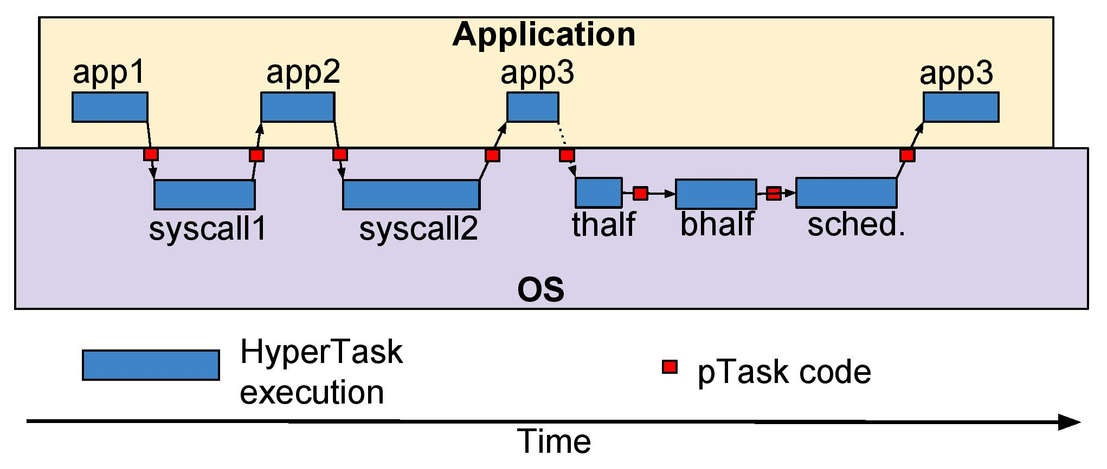
Execution Model With pTask routines
pTask routines are called before starting each HyperTask

Slide 20
Outline of the design section
Profiling
Prefetch list
HyperTask annotation
Normal mode
Recording functions in a single execution
Function annotation in OS and application executables

Slide 21
Function annotation in OS and Application executables
Add marker instruction to each function
Add header to each executable
(Function Map)
Function foo () {
….
}
Function bar() {
…
}
Function foo () {
recordFunc 0
….
}
Function bar() {
recordFunc 1
…
}
Function IDx | Start address | #Lines
0 | 0x345 | 4
1 | 0x349 | 5

Slide 22
Profiling: Recording Function Execution
No. of functions in the executable
Function Vector
(stored in memory)
1 | 0 | 0 | 0 | 0 | 0 | 0
1 | 0 | 0 | 0 | 0 | 1 | 0
0 | 0 | 0 | 0 | 0 | 0 | 0
Set bit number 5
Set bit number 0
All bits are set to ‘0’ at the start of a profile run
Function call sequence:
foo(): recordFunc 0
func(): recordFunc 5
Bit of each executed function should be set to ‘1’ at the end of profile run

Slide 23
Outline of the design section
Profiling
Prefetch list
HyperTask annotation
Normal mode
Identifying application HyperTasks
Identifying OS HyperTasks

Slide 24
Identifying Application HyperTasks
Application HyperTask: user process’ execution between two system calls
Encode the sequence of functions called by the user process between two system calls
Captured using two 256-bit registers: pathSum and pathVector
i = n % 256
pathVec[i]
== 0
recordFunc n
pathVec[i] = 1
Y
pathSum += i
pathSum (left-shift) i

Slide 25
Identifying OS HyperTasks
System calls:
Naïve approach: Use system call ID (as defined by the OS developer)
Read system call
Write system call
Network socket
Disk file
Both versions have different instruction sequences
How to differentiate at run-time:
Use ID of the application HyperTask that executed just before the system call

Slide 26
Identifying OS HyperTasks
OS HyperTasks
System call handler
Interrupt handler
Bottom half handler
Scheduler
ID of the previous application HyperTask
Interrupt ID
Program counter of the bottom half handler’s routine
Add special instruction at the beginning of schedule()

Slide 27
Outline of the design section
Profiling
Prefetch list
HyperTask annotation
Normal mode
Profile store
Prefetch store

Slide 28
Profile Store
Function Vector
(End of profile run)
0 | 0 | 0 | 1 | 0 | 0 | 1 | 0 | 0 | 1
Increment frequencies of functions 3,6,9
Profile Store
(in-memory)
HyperTask ID | #Profile runs | Function frequency list
H₁ | 1 | (3→1) (6→1) (9→1)

Slide 29
Prefetch Store
Profile Store
(in-memory)
HyperTask ID | #Profile runs | Function frequency list
H₁ | 10 | (3→10) (6→2) (8→7) (9→9)
Choose functions that satisfy P₅₀ criteria
Functions deemed to be frequent
for HyperTask H₁:
3, 6, 9
HyperTask ID | Prefetch list (run-length encoding)
H₁ | (0x695, 3) (0x734, 2) (0x789→4)
Prefetch Store
(in-memory)

Slide 30
Outline of the design section
Profiling
Prefetch list
HyperTask annotation
Normal mode
Issue prefetch operations
Re-profiling

Slide 31
Normal mode
HyperTask boundary
Execute HyperTask
Step 1: Locate prefetch list and issue prefetch operations
Step 2: Execute HyperTask
recordFunc instruction:
Treat as NOP for OS HyperTasks
Update application taskID

Slide 32
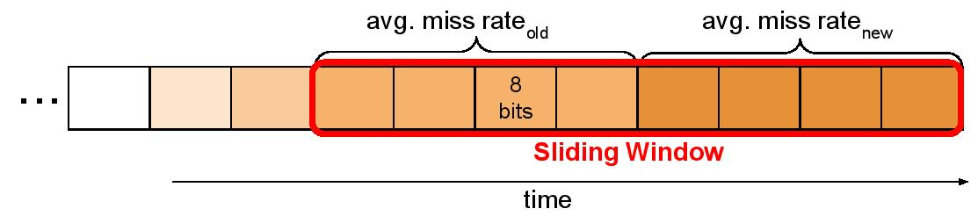
Re-profiling
(Avg. miss rate_{old} – Avg. miss rate_{new}) > 8%
Re-profile HyperTask if:

Slide 33
Outline of the talk
Introduction
Characterization of OS intensive applications
Results
Design of our prefetching technique ‘pTask’

Slide 34
Evaluation Setup
Benchmark
Execution
Traces
Guest OS
(Linux 2.6.32)
QemuTrace
Tejas
Native OS

Slide 35
Hardware Details
Parameter | Value
Cores | 16
Pipeline | Out Of Order Pipeline
Private cache | i-cache (4-way 32 KB), and d-cache (4-way 32 KB)
Shared cache | L2 cache (8-way 4 MB)
OS | Linux 2.6.32 (Debian 6.0)

Slide 36
Evaluated Techniques
Technique | Granularity | Hardware overhead
Markov [MICRO’05] | i-cache line | 4 KB per core
Call Graph Prefetching [TOCS’03] | Functions | 32 KB per core
Proactive Instruction Fetch [MICRO’11] | Stream of instructions | 200 KB per core
Return Address Directed Prefetching [MICRO’13] | Functions | 64 KB per core
pTask [proposed] | Next HyperTask | 72 B per core

Slide 37
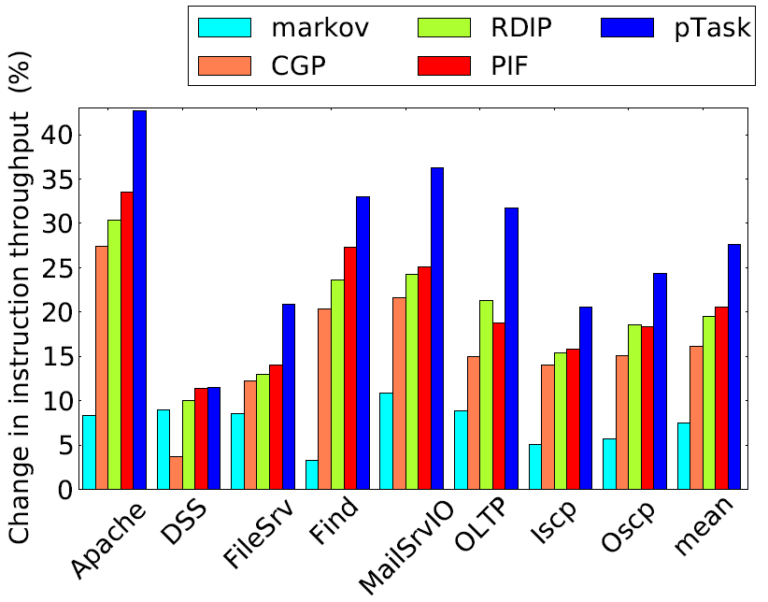
37/40
Performance Comparison
pTask outperforms
state of the art
prefetchers
by 6-7%

Slide 38
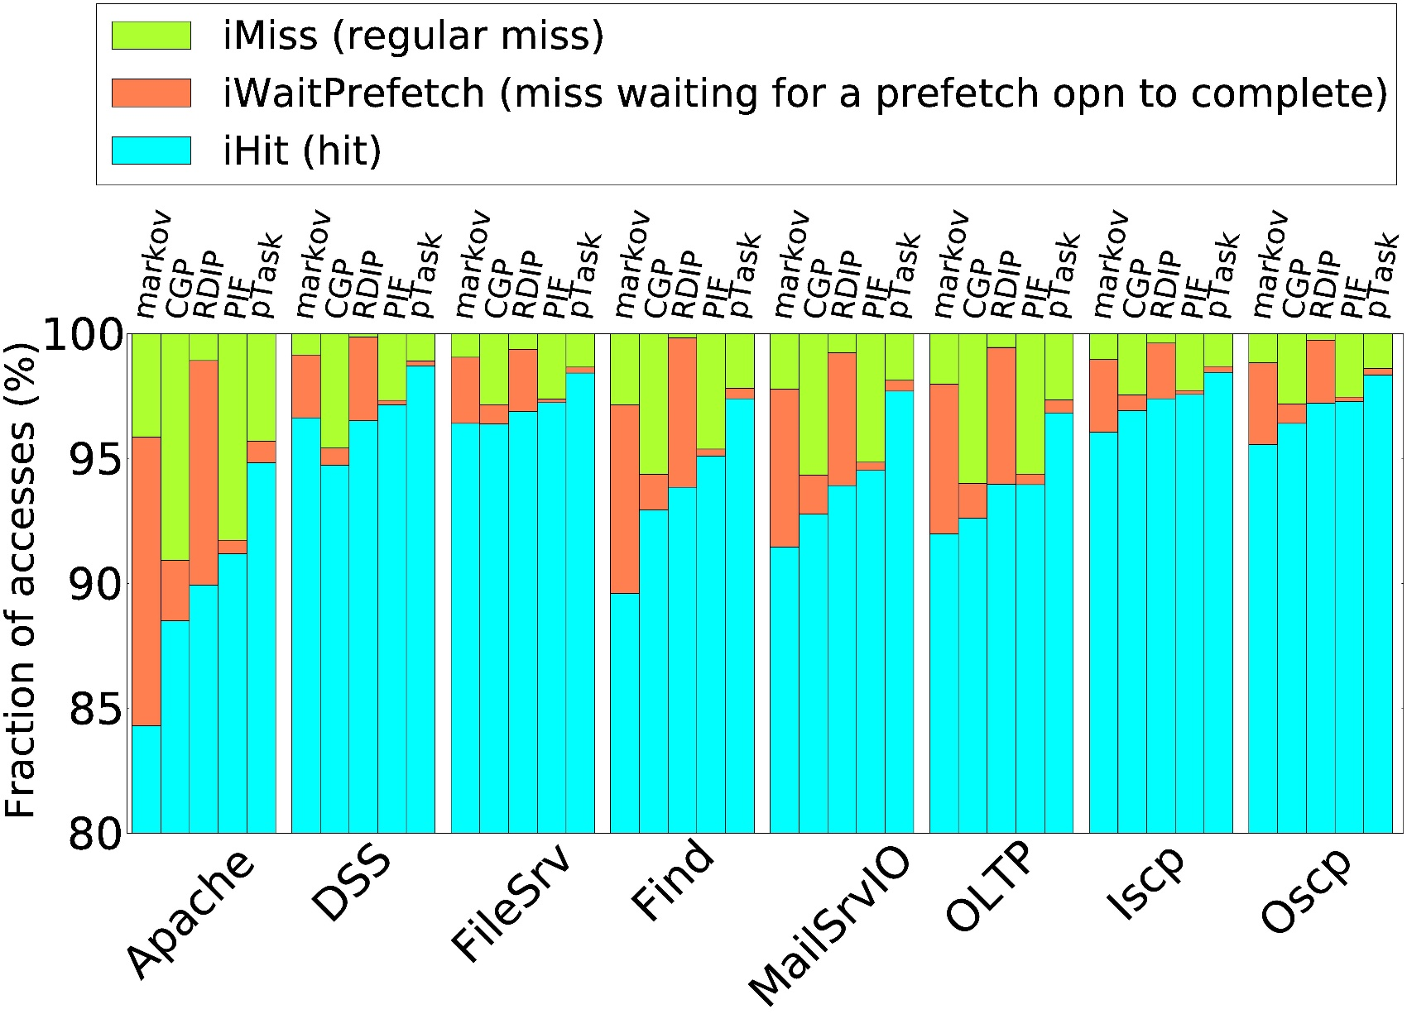
38/40
Breakup of
i-cache accesses:
Low iWaitPrefetch
Prefetch opns complete before the line is accessed
High iHit
Able to predict the execution patterns better

Slide 39
Conclusion
Proposed pTask, an instruction prefetcher that is optimized for OS intensive workloads
Basic insights:
Prefetch only when transitioning from one task to another
Turn off prefetching for steady phase of execution when i-cache hit rates are high
Demonstrated an average increase in instruction throughput of 7% over highly optimized instruction prefetching proposals for a suite of 8 OS intensive applications

Slide 40

Questions

