Slide 1



HAJPAQUE: Hardware ACCELERATOR FOR JSON PARSING, QUERY PROCESSING AND SCHEMA VALIDATION
SAMIKSHA AGARWAL AND SMRUTI R. SARANGI
SCHOOL OF INFORMATION TECHNOLOGY
INDIAN INSTITUTE OF TECHNOLOGY DELHI, INDIA

Slide 2
Outline
Motivation
Background
Design Proposal
Evaluation
Comparison with Existing work
Conclusion

Slide 3
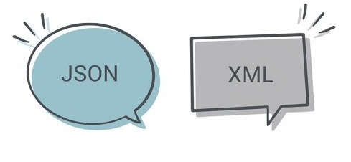

MOTIVATION: WHY JSON PARSING IN H/W
2.
1.
Increasing popularity of JSON over XML (more readable and memory - efficient)
Heavily used in real time analytics supporting throughputs > 50Gbps
SW parsers offer best case throughput of 20 Gbps → performance bottleneck
SW parsers’ throughput is highly sensitive to the nature of JSON data and queries
1. Image Source: http://realpython.com/python-json/
2. Image Source: http://blog.axway.com/apis/why-json-won-over-xml
Notes:
Big data : Volume and velocity(streaming new data)
Real time analytics is the discipline that applies logic and mathematics to data to provide insights for making better decisions quickly. Source of real-time data can be sensors, IoT devices or web requests(twitter).

Slide 4

1.
SCALABLE
ROBUST
FAST
1. Image Source: http://www.sumuforex.com/p/forex-sinhala-advantages-of-forex.html

Slide 5
Outline
Motivation
Background
Proposal
Evaluation
Comparison with Existing work
Conclusion

Slide 6

BACKGROUND: JSON (JavaScript Object Notation)
Format for representing semi-structured data
Collection of objects, where every object is an un-ordered set of key-value pairs.
KEY
VALUE
TOKENS
{
:
,
}
[
]
{“Name”: “John”, “AGE”: 50, “Car”: NULL}
{“Name”: “Ray”, “AGE”: 45, “Car”: {“attributes”: {“color”: Black, “electric”: Yes}}
{“Name”: “Mike”, “AGE”: 30, “Car”: {“Sedan”: [BMW, Mercedes], “SUV”: False}}
RECORD
(TOP-LEVEL OBJECT)
NESTED OBJECT
Sample JSON document
VALUE ARRAY

Slide 7
Background: JSON Query/SCHEMA
JSON Schema
Query1
{
“type”: “object”,
“required”: [“NAME”, “AGE”, “Car”],
“properties”: {
“Name”: {
“type”: “string”
},
“AGE”: {
“type”: “number”,
“minimum”:0 ,
“maximum”:70
},
}
}
{“Name”: “John”, “AGE”: 50, “Car”: NULL}
{“Name”: “Ray”, “AGE”: 45, “Car”: {“attributes”: {“color”: Black, “electric”: Yes}}
Name
John, Ray
Query2
Car.attributes.color
Black

Slide 8
Outline
Motivation
Background
Proposal
Evaluation
Comparison with Existing work
Conclusion

Slide 9

PROPOSAL: DESIGN CONSIDERATIONS
$$THROUGHPUT=\frac{f}{CPB}$$
f = operating design frequency
CPB = clock cycles per byte
Reduce CPB
Process 16 bytes in parallel : theoretically reducing CPB by 16 times.
Penalty: More complexity, area and power
JSON
HAJPAQUE
16 bytes
Increase f
Pipelined design
Use of novel design techniques to reduce critical path length

Slide 10
PROPOSAL: HAJPAQUE
Stream Parser
Stream Parser
DOM
JSON
Constructor
Depth-processing & Key-Value Pair creation
UTF-8 validation
Memory
Offline
Online
Online
Query
Query
Schema
Processor
Check-map construction & compaction
Key/Value address location, filtering & extraction
Processor
Validator
Application
Block Diagram : HAJPAQUE

Slide 11

STEP1: UTF-8 VALIDATION
There are two types of bytes used in the UTF-8 encoding technique: leading byte and continuation byte.
The leading byte has the information about the length of the character.
Byte No.
B0
B1
B2
B3
B4
B5
Byte Type
Leading
Continuation
Continuation
Leading
Leading
Continuation
Character
3
1
1
1
2
1
Length
Byte No.
B0
B1
B2
B3
B4
B5
Byte Type
Leading
Continuation
Continuation
Leading
Leading
Continuation
Character
3
1
1
2
2
1
Length
Error Recovery: The erroneous leading byte and the corresponding continuation bytes (if any) are excluded from further processing.

Slide 12
Step2: KEY-VALUE LOCATOR
QUOTE
QCOLON
QUOTE
QCOLON
Byte No.
0 | 1 | 2 | 3 | 4 | 5 | 6 | 7 | 8 | 9 | 10 | 11 | 12 | 13 | 14 | 15
“ | K | 1 | ” | : | V | A | L | 1 | , | “ | K | 2 | ” | : | V
JSON Set
Check-Map builder
Check-Map
1 | 0 | 0 | 2 | 0 | 0 | 0 | 0 | 0 | 0 | 1 | 0 | 0 | 2 | 0 | 0
Compaction engine
Type CCM
1 | 2 | 1 | 2 | 0 | 0 | 0 | 0 | 0 | 0 | 0 | 0 | 0 | 0 | 0 | 0
0 | 3 | 10 | 13 | 0 | 0 | 0 | 0 | 0 | 0 | 0 | 0 | 0 | 0 | 0 | 0
Position CCM
Key-Value locator
Type CCM
1 | 2 | 1 | 2 | 0 | 0 | 0 | 0 | 0 | 0 | 0 | 0 | 0 | 0 | 0 | 0
0 | 3 | 10 | 13 | 0 | 0 | 0 | 0 | 0 | 0 | 0 | 0 | 0 | 0 | 0 | 0
Position CCM
Parallel sliding Window based approach
Type of field
Key
Value
Key
Notes:
Each pair of consecutive CCM entries are examined to determine the type of JSON field.
The position CCM is used to determine the start and end address of the identified JSON field.
The compaction of the check-map allows us to apply the sliding window in parallel; hence shortening the critical timing path.

Slide 13
STEP3: KEY-VALUE FILTERING AND EXTRACTION
The value might contain a few structural tokens like the comma or curly braces; they need to be filtered out.
Token i | Token i+1 | Type of enclosed field
QCOLON | QUOTE | VALUE
QUOTE | QUOTE | VALUE
QUOTE | QCOLON | KEY
0 | 1 | 2 | 3 | 4 | 5 | 6 | 7 | 8 | 9 | 10 | 11 | 12 | 13 | 14 | 15
“ | K | 1 | ” | : | V | A | L | 1 | , | “ | K | 2 | ” | : | V
“ | K | 1 | ” | : | V | A | L | 1 | } | { | “ | K | 2 | “ | :
“ | K | 1 | ” | : | { | “ | K | 2 | “ | : | V | A | L | 2 | ,
The incomplete keys/values in a set are buffered and are read out when the key/value completes in the next cycle.
Error Recovery in case of buffer overflow: The key or the value that caused the buffer to overflow, is excluded in its entirety from further processing

Slide 14
Step4: KEY-VALUE PAIR CREATION/relationship builder
Pair Array
KEY | 0 | 0 | KEY | 0 | 0 | 0 | 0 | 0 | 0 | VALUE | 0 | 0 | 0 | 0 | 0
Parallel Sliding Window based approach
Compaction engine
Compacted Pair Array
KEY | KEY | VALUE | 0 | 0 | 0 | 0 | 0 | 0 | 0 | 0 | 0 | 0 | 0 | 0 | 0
Key-Value Pair
Parent child relationship among 2 keys, if and only if depth(parent key) depth(child key) -1
Key-Value pair if and only if depth(key) = depth(value)
Field relationship
1st key is the parent of 2nd key ; 2nd key is child of 1st key
1ST key is “Non-Terminal” key
2nd key is “Terminal” Key

Slide 15
DEPTH CALCULATION
Byte No.
0 | 1 | 2 | 3 | 4 | 5 | 6 | 7 | 8 | 9 | 10 | 11 | 12 | 13 | 14 | 15
{ | “ | K | 1 | “ | : | { | “ | K | 2 | “ | : | V | 1 | } | }
JSON Set
Check-Map
1 | 0 | 0 | 0 | 0 | 0 | 1 | 0 | 0 | 0 | 0 | 0 | 0 | 0 | 2 | 2
Type CCM
1 | 1 | 2 | 2 | 0 | 0 | 0 | 0 | 0 | 0 | 0 | 0 | 0 | 0 | 0 | 0
0 | 6 | 14 | 15 | 0 | 0 | 0 | 0 | 0 | 0 | 0 | 0 | 0 | 0 | 0 | 0
Position CCM
Depth=D
D+1
D+2
D+1
D
Increment depth whenever a ‘{‘ is encountered, decrement depth whenever a ‘}’ is encountered.

Slide 16
Online QUERY PROCESSOR
Online Query Processor
Stream Parser
DOM
Query Tables
Query Matching engine
JSON
Constructor
Memory
Offline
Query
VALID | KEY
1 | Car
1 | attributes
1 | electric
0
0
0
0
Online
Online
Query
Schema
Processor
Processor
Validator
Car.attributes..electric??
Query Table 1
Application
Query tables must be pre-programmed with the application queries.

Slide 17
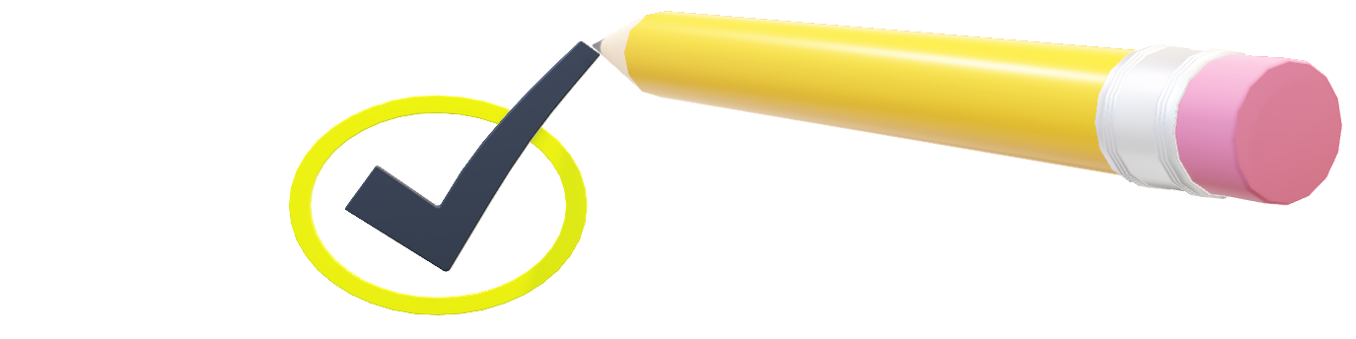
QUERY MATCHING ENGINE
Necessary checks:
If the match is due to a non-terminal key, the Valid bit of the succeeding entry of the Query Table must be ‘1’.
If the match is due to a terminal key, the Valid bit of the succeeding entry in the query table must be ‘0’, except if the match is for the last table entry.
Car.attributes. electric??
Car.attributes.mileage??
VALID | KEY | Match
1 | Car | 1
1 | attributes | 1
1 | electric | 1
0
0
0
0
VALID | KEY | Match
1 | Car | 1
1 | attributes | 1
1 | mileage | 0
0
0
0
0
Error Recovery: The query-match bits of all the entries of the query table are reset.

Slide 18


SOLUTION
What if the matching keys are not in the correct order??
Use DEPTH information of the keys extracted from JSON data
Car. color. attributes??
VALID | KEY | Match | Depth
1 | Car | 1 | 1
1 | color | 1 | 3
1 | attributes | 1 | 2
0
0
0
0
If the Query Table has k valid entries,
Depth[i] = (Depth[i-1] + 1) where (i=0,1,...k-1)

Slide 19
RESETTING MATCH BITS
Byte No.
0 | 1 | 2 | 3 | 4 | 5 | 6 | 7 | 8 | 9 | 10 | 11 | 12 | 13 | 14 | 15
C | a | r | “ | : | N | U | L | L | } | { | “ | N | A | : | V
JSON Set
Check-Map
0 | 0 | 0 | 0 | 0 | 0 | 0 | 0 | 0 | 1 | 2 | 0 | 0 | 0 | 0 | 0
Sliding Window
CCM
1 | 2 | 0 | 0 | 0 | 0 | 0 | 0 | 0 | 0 | 0 | 0 | 0 | 0 | 0 | 0
9 | 10 | 0 | 0 | 0 | 0 | 0 | 0 | 0 | 0 | 0 | 0 | 0 | 0 | 0 | 0
Start of New Record
Reset Match bits whenever the starting point of a new record is detected

Slide 20

1.
NOVEL CONTRIBUTIONS
Creation and Compaction of check-maps using lookup tables
Parallel application of sliding-windows for following tasks is responsible for achieved parallelism:
Key-value location
Key-value relationship building
Depth calculation
We propose the HPQME (Highly Parallel Query Matching Engine) to achieve a high degree of parallelism:
Every incoming key is matched with all entries of query table in parallel.
The depth of the matching keys are analyzed using parallel application of 2-entry sliding window.
Parallel application of sliding window to detect start of a new record: useful for both resetting query tables as well as schema table.
These techniques are generic in nature and can be utilized in any hardware design dealing with semi-structured data
1. Image Source: https://nuts-about-needlepoint.com/october-new-needlepoint-products/

Slide 21
Outline
Motivation
Background
Proposal
Evaluation
Comparison with Existing work
Conclusion

Slide 22
EVALUATION: SETUP
Datasets
iris.json
Covid_features.json (YELP)
business.json (YELP)
twitter.json
HDL : Verilog
Tools :
HDL editor: Xilinx Vivado
Simulator : Xilinx Vivado
Synthesis: Synopsys DC
Target Device : ASIC
Technology: 28nm FDSOI
Corner: SSLVLT(worst for this technology)
Standard datasets; vary in terms of (for a given size of dataset):
Number of records
Number of parsed fields
Maximum depth of nested object in a record
Standard queries chosen; vary in terms of frequency and depth of valid results

Slide 23
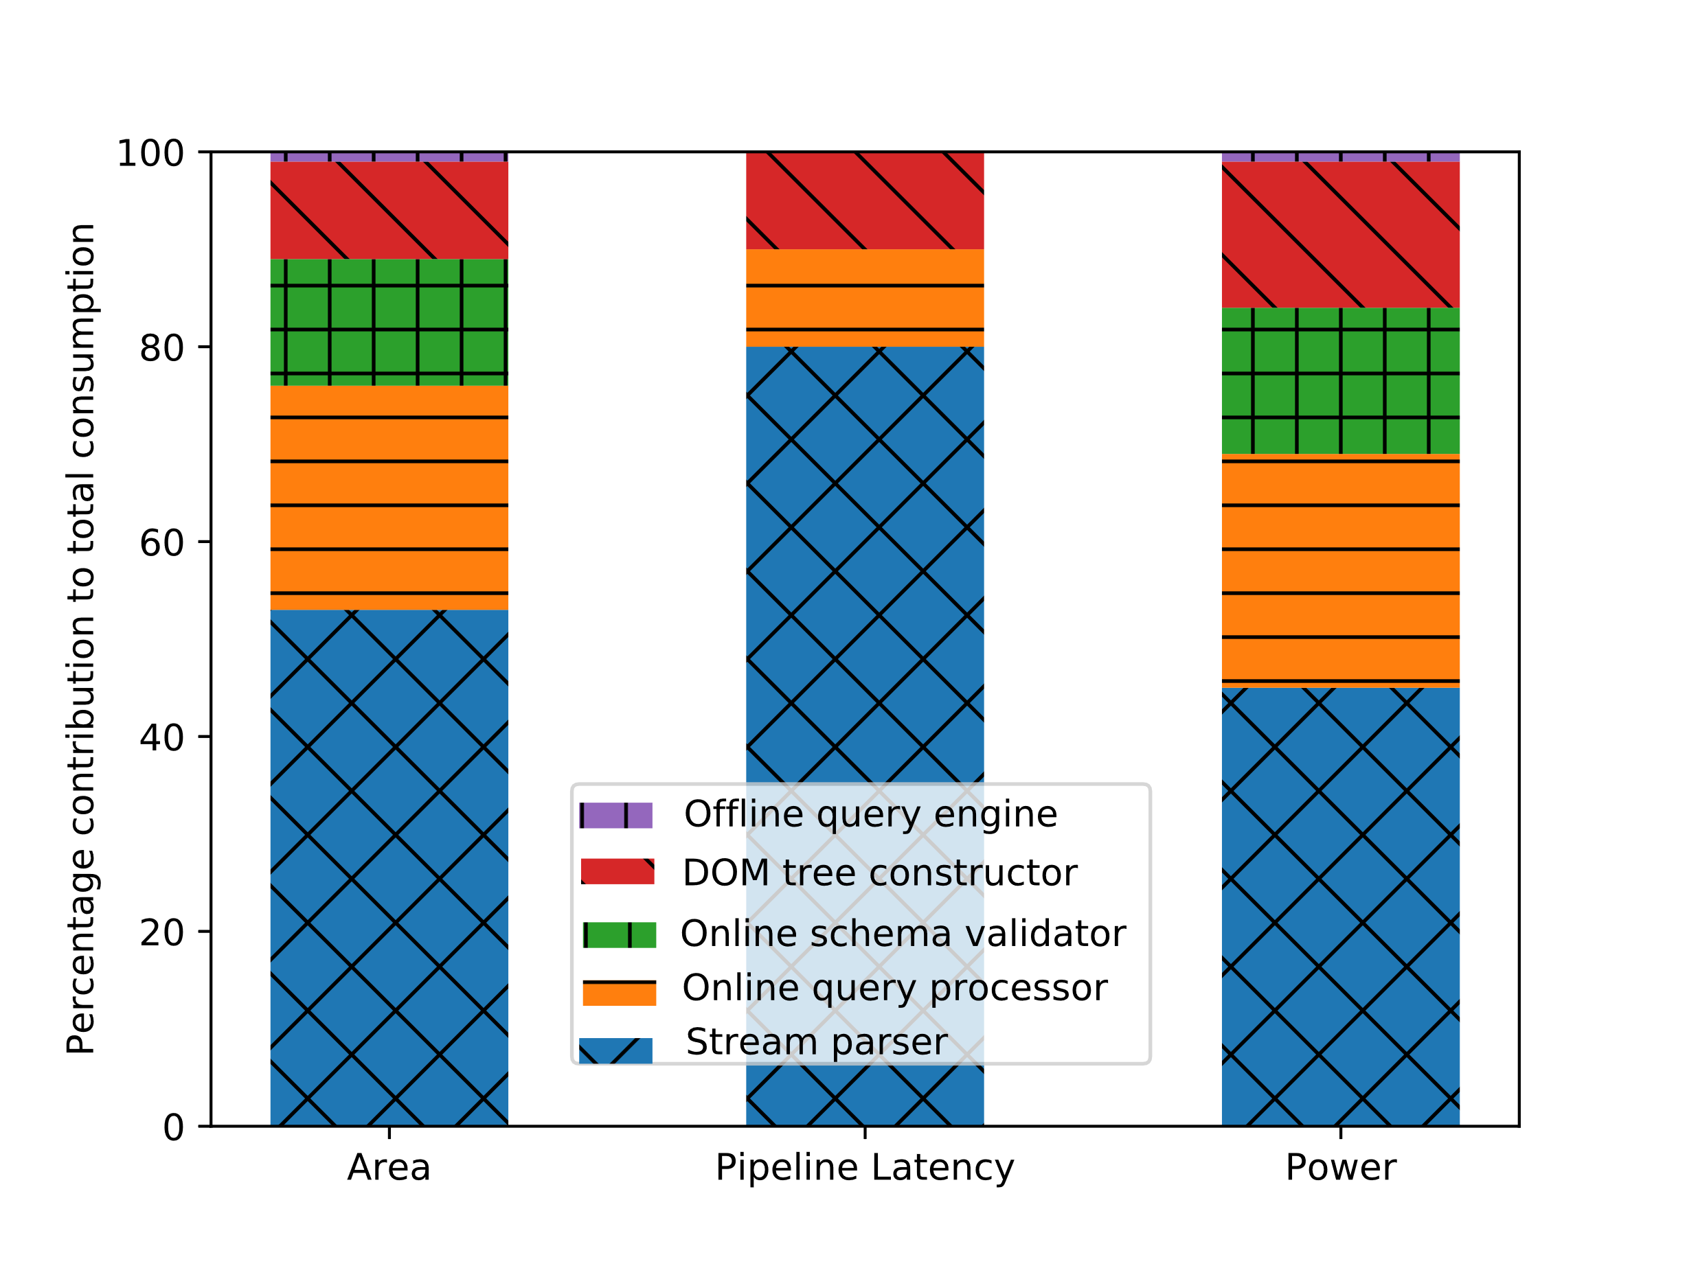
EVALUATION: SYNTHESIS REPORTS
DESIGN PARAMETER | VALUE
Number of query processors/tables | 1
Number of entries in the query table | 7
Width of a query table entry | 32 bytes
Number of entries in the schema table | 4
Width of schema table entry | 32 bytes
AREA (in um²⁾
Total | 292839
Combinational | 184097
Sequential | 108742
POWER ( in mW)
Dynamic | 43.3
Static | 0.008
HAJPAQUE is a 10 stage pipeline
Streaming parser contributes roughly 50% to the total area and power consumption and 80% to the total pipeline latency
Maximum operating frequency = 833 MHz

Slide 24
Evaluation: PERFORMANCE ANALYSIS
STREAM PARSING + ONLINE QUERYING
DOM PARSING
Size of dataset (twitter.json) | Total clock cycles | CPB | Throughput
100 B | 16 | 0.16 | 5.21 GB/s
1 kB | 72 | 0.072 | 11.57 GB/s
10 kB | 634 | 0.0634 | 13.14 GB/s
100 kB | 6250 | 0.0625 | 13.33 GB/s
0.6 MB | 37500 | 0.0625 | 13.33 GB/s
Size of dataset (twitter.json) | Total clock cycles | CPB | Throughput
100 B | 18 | 0.18 | 4.62 GB/s
1 kB | 79 | 0.079 | 10.54 GB/s
10 kB | 685 | 0.0685 | 12.16 GB/s
100 kB | 6789 | 0.0679 | 12.27 GB/s
0.6 MB | 40621 | 0.0677 | 12.30 GB/s
Throughputs saturate for datasets>10kB→ as fixed overheads of pipeline latency becomes insignificant
DOM parsing throughput < Stream-based parsing due to the memory accesses

Slide 25
Outline
Motivation
Background
Proposal
Evaluation
Comparison with Existing work
Conclusion

Slide 26


COMPARISON with state-of-the-art parsers
Feature | Rapidjson | Mison | Simdjson | HAJPAQUE
Stream Parsing
Online Querying
DOM Parsing
Offline Querying
UTF-8 encoding validation
Schema Validation
HAJPAQUE IS A FULLY-FEATURED JSON PARSER

Slide 27
COMPARISON with state-of-the-art parsers
System:
Intel Core i7-8700 CPU @
3.20GHz
Query:
user.id
Dataset:
twitter.json (0.6 MB)
Parser | Parse DOM only | Parse + Scan DOM | Stream Parse + Online Querying
Rapidjson | 0.21 GB/s | 0.1 GB/s | 0.2 GB/s
Simdjson | 0.63 GB/s | 0.32 GB/s | 0.6 GB/s
HAJPAQUE | 12.3 GB/s | 7.5 GB/s | 13.33 GB/s
Roughly ~20X speedup as compared to Simdjson

Slide 28
Outline
Motivation
Background
Proposal
Evaluation
Comparison with Existing work
Conclusion

Slide 29
CONTRIBUTIONS
Proposed integrated hardware solution for parsing; querying and schema validation of JSON
Our design caters to a diverse class of applications; some of which rely on stream parsers and some on DOM parsers.
Achieved a throughput of 13 GB/s, which is 5X-20X faster than existing software parsers.
Processed 16-bytes together; offering significant much higher CPB as opposed to single byte per cycle approach
Proposed novel design techniques like the sliding window-based field locator and the parallel query matching engine to achieve optimum operating frequency
The stream parser’s performance is not affected by the nature of JSON data or JSON queries
If we do not consider DOM-tree construction, then the rest of our online pipeline does not have any stalls

Slide 30


Questions
Email: agarwalsamiksha94@gmail.com
Contact: +44 7435846807
Academic institution: IIT DELHI, India
Current Organization: Indie Semiconductor, Edinburgh, UK

